Slide 1
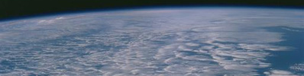

Global to regional manifestation of Earth's energy imbalance
Department of Meteorology
Richard P. Allan r.p.allan@reading.ac.uk @rpallanuk
Chunlei Liu (University of Reading); Pat Hyder, Matt Palmer, (Met Office), Chris Roberts (Met Office/ECMWF), Michael Mayer (Univ. Vienna/ECMWF)

Slide 2
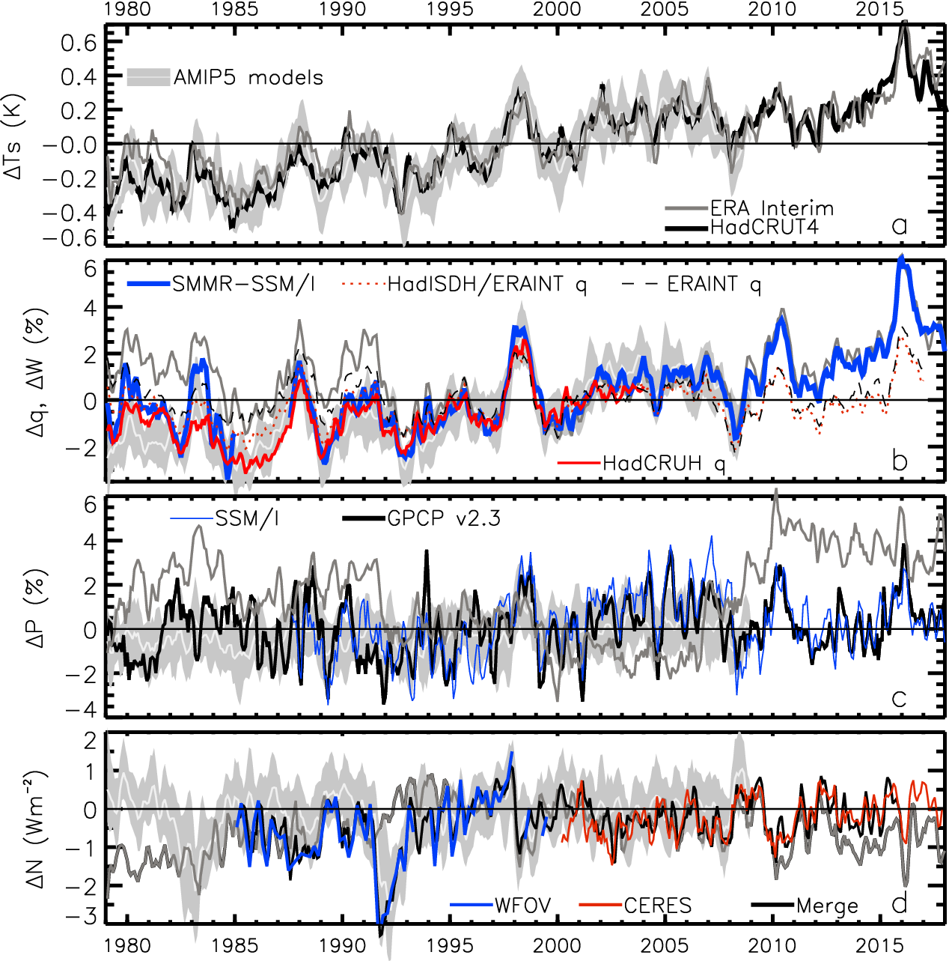
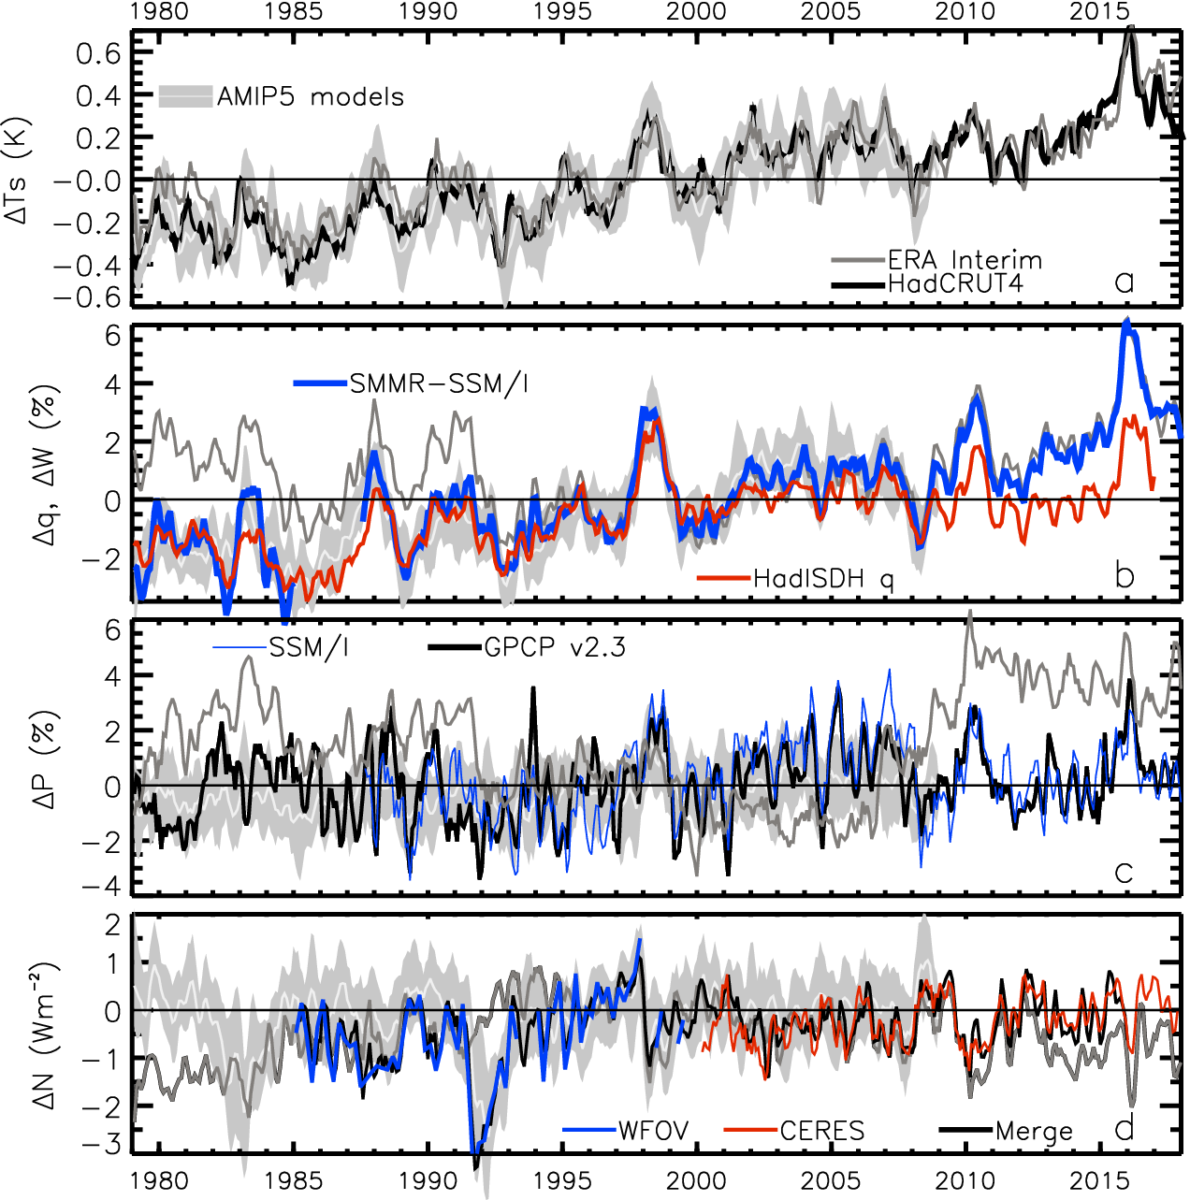
Recent global climate variability
Surface temperature anomaly (degC)
Water Vapour anomaly (%)
?
Update from Allan et al.(2014) Surv. Geophys

Slide 3
Recent global climate variability
Precip anomaly (%)
2.8
1.8
0.8
-0.2
-1.2
-2.2
Energy Imbalance anomaly (Wm⁻²)
Update from Allan et al.(2014) Surv. Geophys.; Allan et al. (2014) GRL

Slide 4
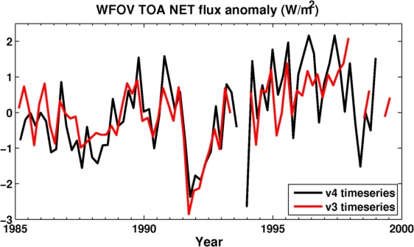
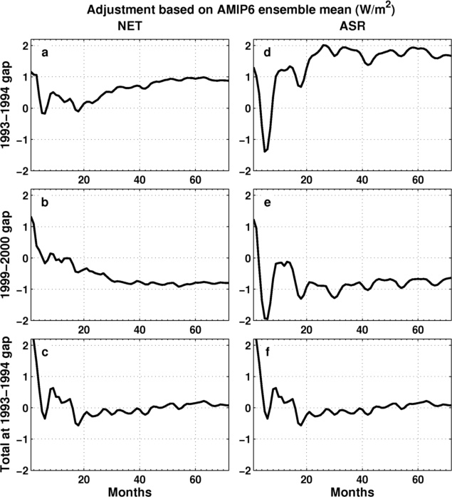
EEI Reconstructions
Longer EEI record → forcing, feedback & links to water cycle
Combine ERBS/CERES/simulations (Allan et al. 2014 GRL)
Methods of Trenberth & Caron (2001) and others to reconstruct surface fluxes (Liu et al. (2017 JGR)
  Mass corrections, land flux adjustment, satellite gap adjustments
  Update with CERES EBAFv4.0 & enthalpy corrections (Mayer et al. 2018 but see Trenberth & Fasullo 2018 J. Clim),
  Use ERBS v3 and ERA interim data for now, poster by Chunlei Liu

Slide 5
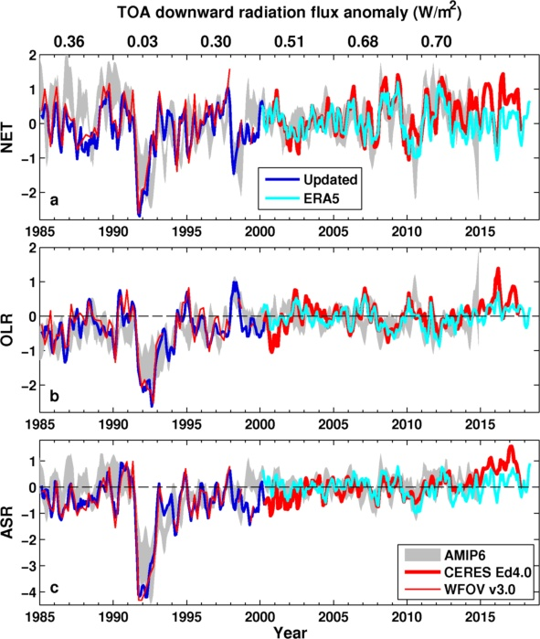
Preliminary comparison with AMIP6 and ERA5
Large uncertainty in pre-CERES EEI remains
ERA5 does not capture observed ASR increase after warming slowdown (e.g. Loeb et al. 2018)
AMIP vs reconstruction:
  NET: r = 0.46
  OLR: r = 0.57
  ASR: r = 0.67
Consistent with ocean heat content (Cheng et al. 2017 Sci. Adv.) lower than new independent estimate by Resplandy et al. (2018) Nature

Slide 6
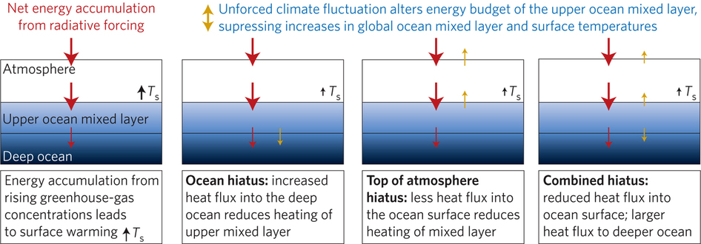
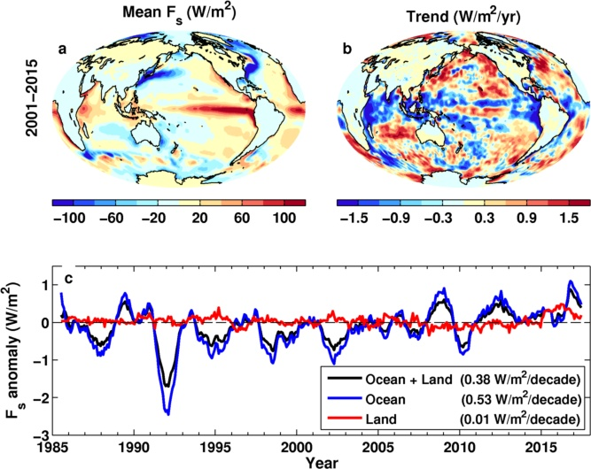
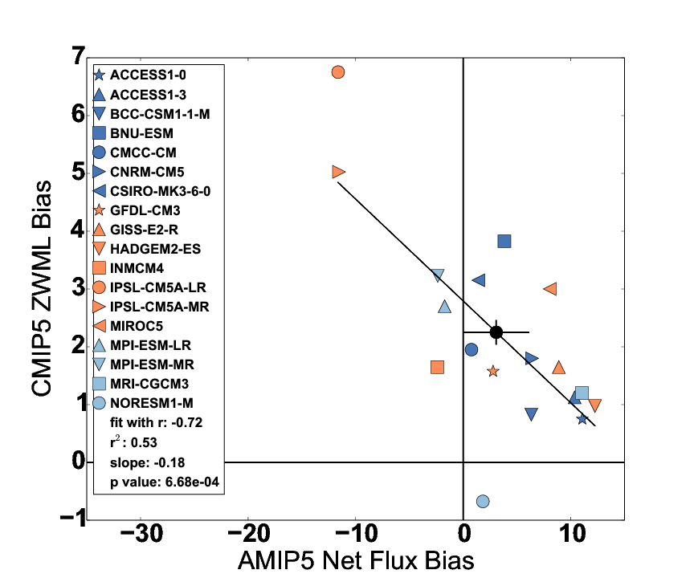
Interpreting Variability & Bias Using
Ocean Mixed Layer Energy Balance
Interpreting warming slowdown: upper ocean mixed layer heat budget (e.g. Hedemann et al. 2017; Roberts et al. 2017 JGR)
Combine with surface radiation estimates (Kato et al., 2018 J. Clim) to investigate Southern Ocean biases (Hyder et al. 2018 Nature Comms)
Zonal wind max latitude bias
Hyder et al. 2018

Slide 7
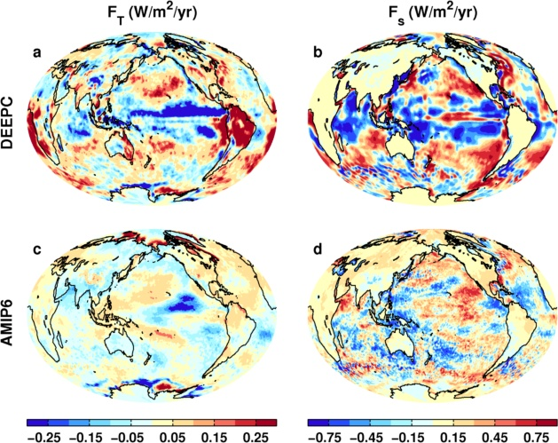
Trends in Net Fluxes 1985-2014
Top of atmosphere Surface
Contrasting changes in AMIP & observed surface fluxes into warming slowdown (Liu et al., 2015 JGR)
← Also for prelim AMIP6
Cloud feedbacks in E Pacific identified as important (Zhou et al., 2016 Nature Geosci)
Surface evaporation increases contribute at surface (Liu & Allan, 2018 J. Clim; Hu et al. 2018 Clim. Dyn.)

Slide 8
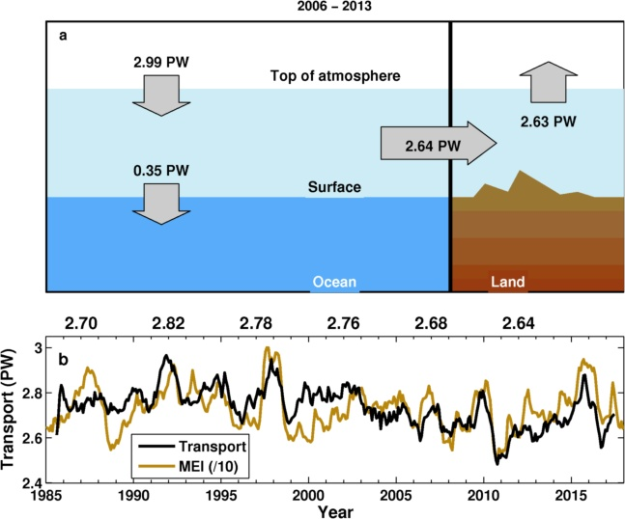
Land/Ocean Energy transport Estimate

Slide 9
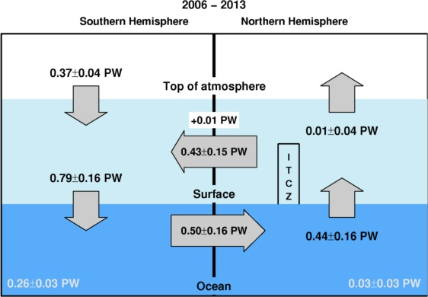
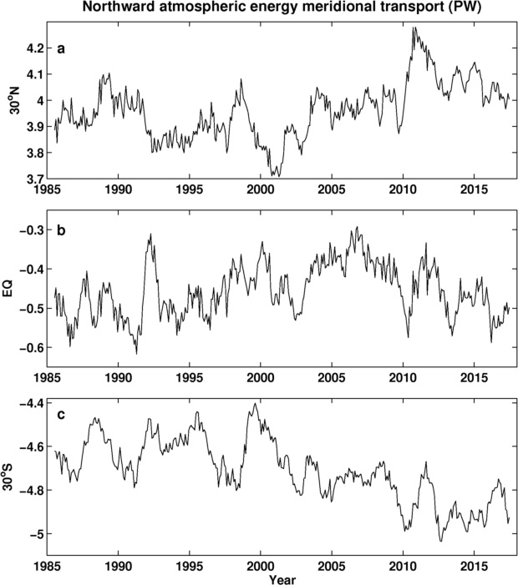
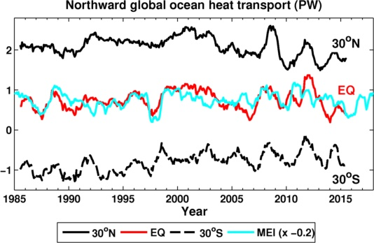
Estimated Variability
In Energy Transports

Slide 10
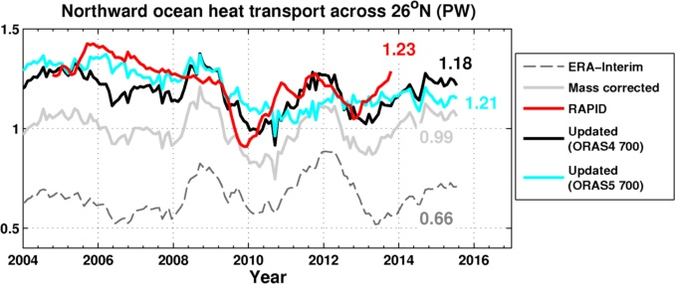
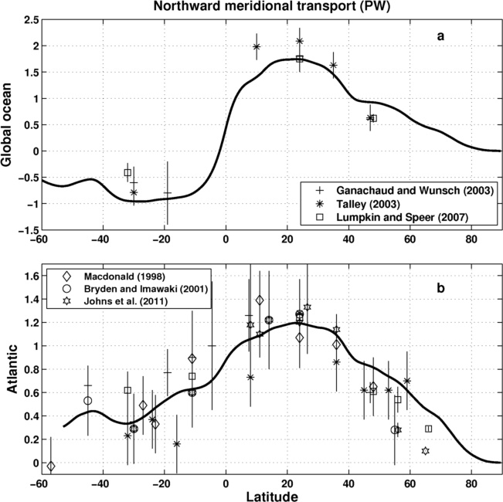
Ocean heat transport 26ºN
Slightly larger than Trenberth & Fasullo (2017) GRL (~1 PW)
Agreement with magnitude of RAPID observations
Variability: some agreement, ORAS5 worse than ORAS4?
26ºN

Slide 11
Summary & Questions
Multi-decadal estimates of Earth’s energy imbalance/sea level broadly consistent (e.g. Cheng et al. 2017 Sci. Adv.; Allan et al. 2014 GRL; Nerem et al. (2018) PNAS)
Advances in observing energy transports (Trenberth & Fasullo, 2017 GRL)
Upper ocean mixed layer energy budget links EEI & surface warming rate (Roberts et al. 2015 JGR; Hedemann et al. 2017 Nature Clim.; Xie & Kosaka 201 CCCR)
What explains discrepancy in AMIP vs observed surface flux change?
Distinct feedbacks on internal variability & forced change e.g. Brown et al. 2016; Xie et al. 2015 ; England et al. (2014)
Do climate models underestimate low cloud amplifying feedbacks, internal variability &climate sensitivity? Marvel et al. 2018; Silvers et al. 2017 ; Yuan et al. 2018
Spatial patterns of warming crucial for feedbacks & climate sensitivity e.g. He & Soden (2016); Richardson et al. (2016); Ceppi & Gregory (2017); Andrews & Webb (2017)
Can radiative forcing spatial pattern drive temperature change?
Are there missing dynamical feedbacks on warming?
How does rebound from volcanic eruptions (e.g. Pinatubo) influence the climate system; is this represented by models?)
Can fast water cycle/energy budget adjustments to forcings be observed?
Combine energy/water(&salinity?/carbon?) budget constraints (Keith Haines)

Slide 13
Notes
15mins ~ 8 slides
Intro on method (+refs)
Eval of models (Hyder); Ocean heating (Roberts); Volcano (Schmidt)
Method, WFOV/Sensitiivity to adjust
Global EEI comparison
Meridional heat transport
N Atlantic
Hemispheric diagram
Land/ocean, tropics/extra tropics
Conclusions/poster

Slide 14
Outstanding questions
Can net zero global radiative forcing but with spatial pattern drive temperature change?
Does the east Pacific control hiatus/surge events? Does the Atlantic drive the Pacific? Do the tropics drive the N Atlantic?
How does rebound from volcanic eruptions (e.g. Pinatubo) influence the climate system; is this represented by models?
Are there a missing ocean dynamical feedbacks on warming?
Is internal variability adequately represented by models?
What is the role of aerosol changes/uncertainty in determining observed/simulated warming rate & difference?
Need clever people with big models to address some of these…

Slide 15
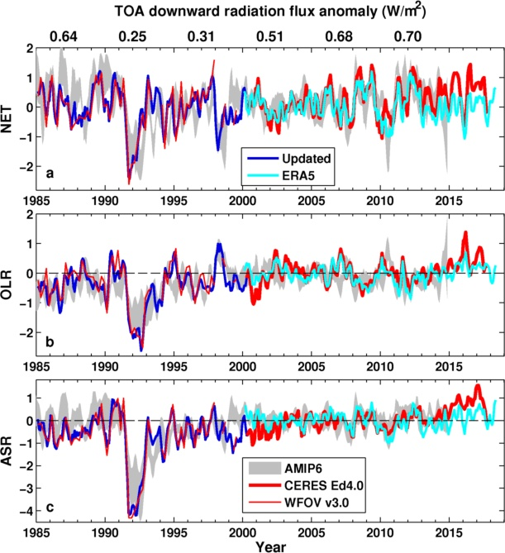
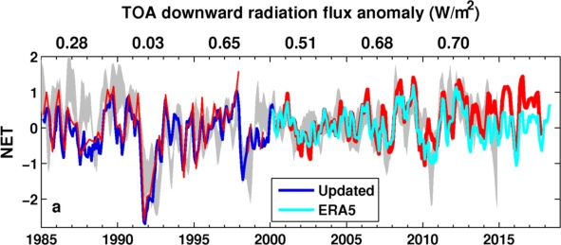
Preliminary comparison with AMIP6 and ERA5

Slide 17
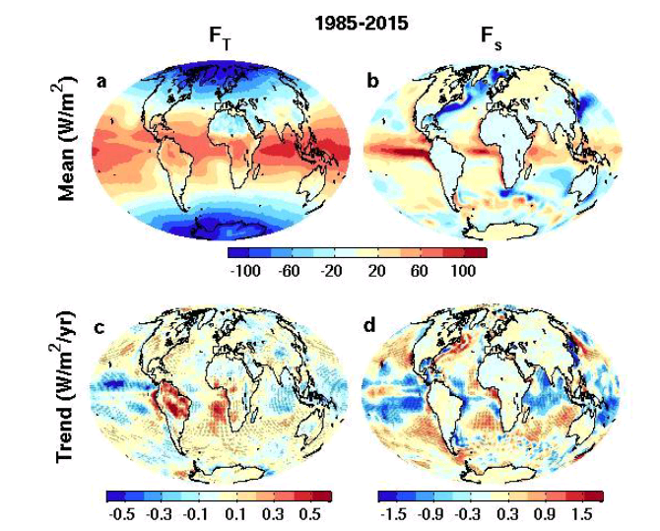
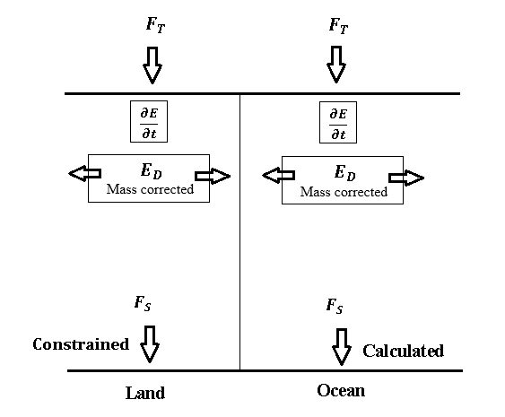

New global surface flux estimates
top of atmosphere surface
ERBS CERES
reanalyses
Surface energy flux dataset combines top of atmosphere satellite reconstruction with reanalysis energy transports: Liu et al. (2015) JGR
Liu et al. (2017) JGR Data: http://dx.doi.org/10.17864/1947.111

Slide 18
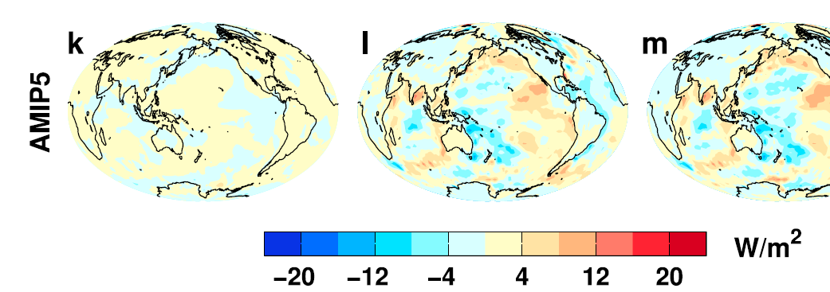
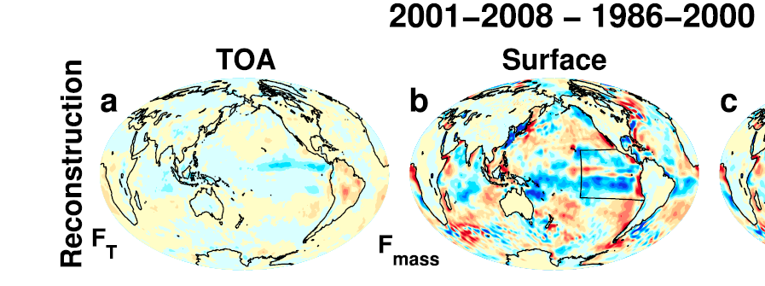
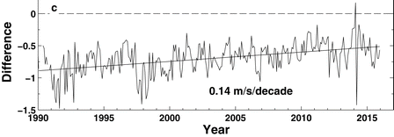
regional Changes & Feedbacks
update to Liu et al. (2015) JGR
Discrepancy between observed/AMIP patterns of surface flux change
Cloud feedbacks in east Pacific e.g. Zhou et al. (2016) Nature Geosci
Latent heat flux changes also important (Liu & Allan (2018) J. Clim)
Distinct feedbacks on internal variability & forced change e.g. Brown et al. 2016; Xie et al. 2015 ; England et al. (2014)
Spatial patterns of warming crucial for feedbacks & climate sensitivity e.g. He & Soden (2016); Richardson et al. (2016); Ceppi & Gregory (2017); Andrews & Webb (2017)
Do climate models underestimate low cloud amplifying feedbacks, internal variability & climate sensitivity? Marvel et al. 2018; Silvers et al. 2017 ; Yuan et al. 2018
Changes in downward surface flux
2001-2008 minus 1986-2000
OBSERVATIONS AMIP MODELS
ERAINT – buoy wind speed
Liu & Allan (2018) J. Clim
Notes:
Combining decadal observations of cloud, radiation and energy transports is leading to advances in understanding regional to global feedbacks
There is emerging evidence of contrasting energy budget responses/feedbacks acting on internal and forced variability
The spatial pattern of warming is crucial in determining global feedback responses; accounting for this may help in determining climate sensitivity from observations

Slide 19
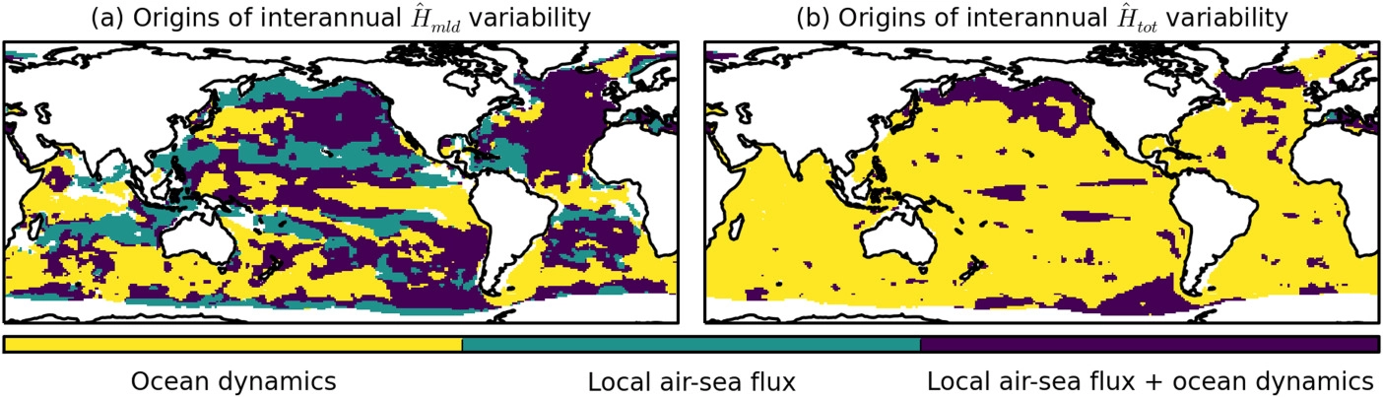
Ocean mixed layer energy budget
Allan (2017) & Hedemann et al. 2017 Nature Climate Change
Slowdown events simulated by climate models
  ↑ocean heat uptake below 300m (Meehl et al. 2011)
Energy imbalance increase since 1990s, steady in 2000s (Cheng et al. 2017 Sci. Adv.; Allan et al. 2014 GRL)
Upper ocean mixed layer heat budget → global surface temperature Hedemann et al. 2017 Nature-CC
  Small perturbations obfuscate attribution
  Useful interpretive framework
Dynamics Heat Flux Both
Origins of ocean mixed layer heat content variability Roberts et al. 2017 JGR
Notes:
Improved and longer records of ocean heating and top of atmosphere radiation measurements have improved estimates of Earth’s energy imbalance and its changes over recent decades.
Simulations with prescribed observed SST and radiative forcing are able to capture variations in energy budget
Greater appreciation for the role of internal variability in influencing global energy budget and the link between energy imbalance and surface temperature via heat budget of upper ocean

Slide 20
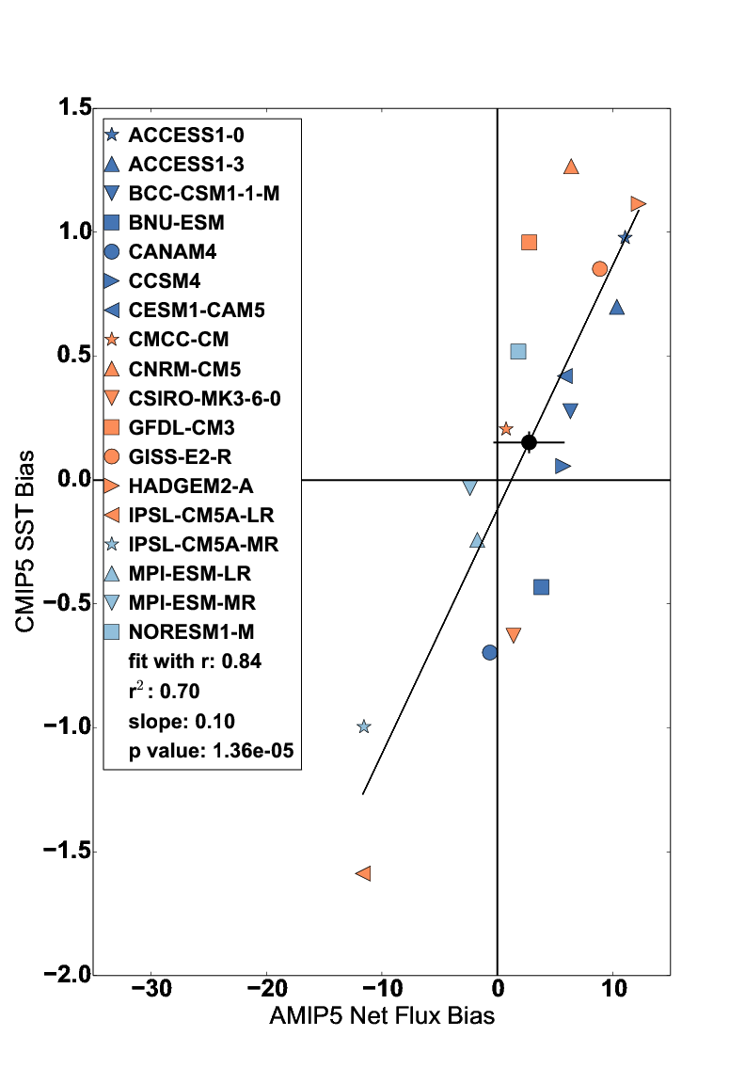
Evaluation of model biases in surface flux
Use surface flux product to trace causes of coupled SST biases to atmospheric model processes
Biases in AMIP5 simulations of cloud linked to SST & zonal wind maximum latitude (ZWML) bias
Hyder et al. in prep

Slide 21
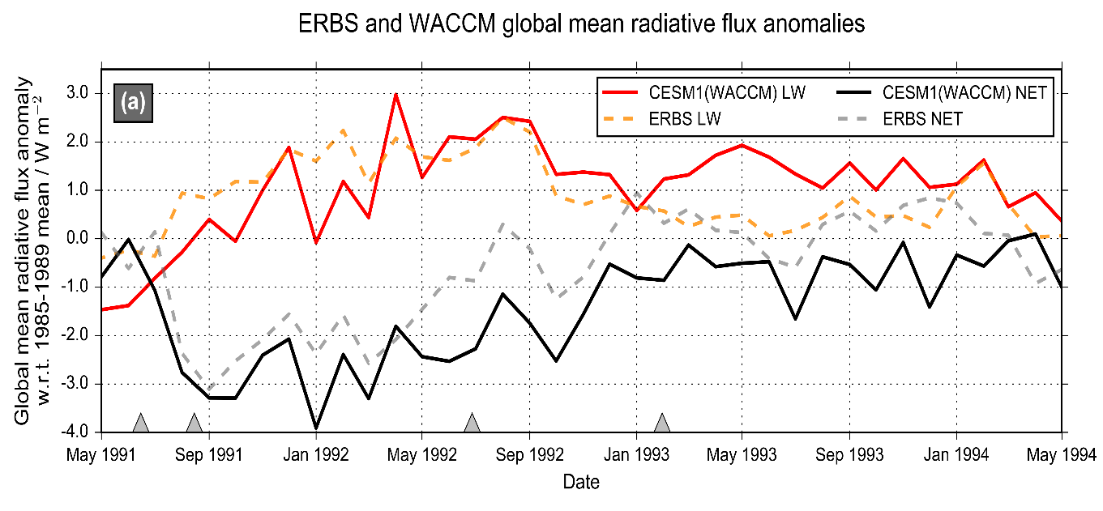
Improved understanding of volcanic aerosol effects on climate
Malavelle et al. (2017) Nature
MODIS-Aqua Observations
Cloud water Droplet size
Volcanic aerosol haze brightens low altitude clouds, cooling climate
Further indirect effects in cloud water found to be negligible (but see McCoy et al. (2018) ACPD)
New assessment of direct volcanic influence on climate combining nudged models & observations
Schmidt et al. (2017) in prep

Slide 22
Did global warming go on holiday?
Global surface warming rate slowed from 1980s/90s to 2000s
  Energy imbalance remains positive/strengthens, sea level rise accelerates
  Ocean heat uptake to deeper levels, distinct Pacific variability pattern
Unusual climate phenomena
  Unprecedented Pacific trades, suppressed El Niño, AMOC & ITF ocean changes, Arctic warming, cold northern winters, NAO/PDV/AMV phase
Warming rate unusually low compared to climate simulations
  Radiative Forcing & sampling explains some of discrepancy
  Internal variability explains much of remaining discrepancy
  SST-pattern suppression of climate sensitivity involving cloud feedbacks?
  Unrepresented forced responses can’t be discounted
  http://www.met.reading.ac.uk/~sgs02rpa/research/DEEP-C.html#PAPERS
Multiple factors explain hiatus/surge events: understanding decadal variability advances climate science Cassou et al. 2018 BAMS

Slide 23
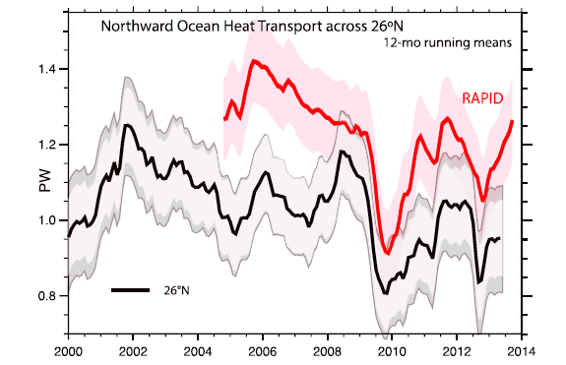
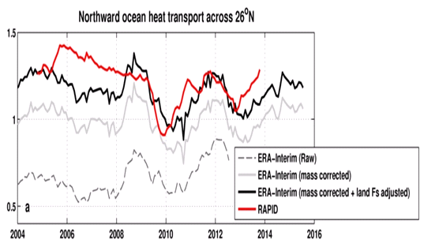
Inferred ocean heat transport@26ºN
Trenberth & Fasullo (2017) GRL
Compare indirect method with RAPID observations
Is TF2017 discrepancy due to lack of land F_{s} adjustment?
Ocean heating from ORAS4 (0-700m).
Better agreement after land Fs adjustment
2004-2013
RAPID 1.23 PW
TF2017 1.00 PW
Liu et al: 1.16 PW
large uncertainty

Slide 24
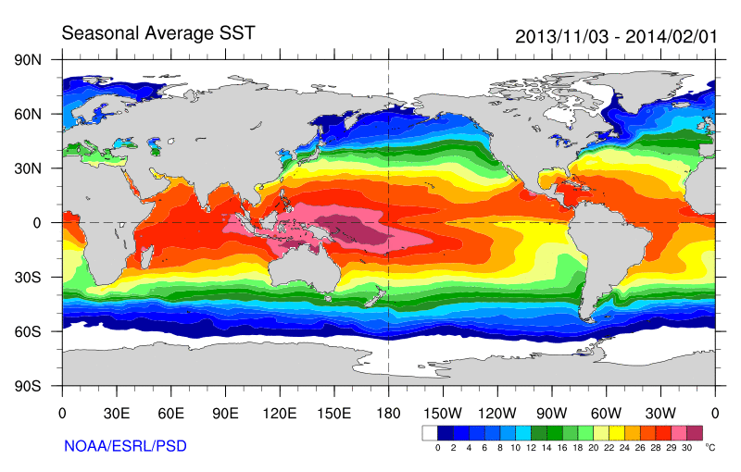
Some earlier strands
Radiative Forcing/Imbalance Johnson et al. (2016) ; Checa-Garcia et al. (2016) ; Huber & Knutti (2014) ;Santer et al. (2015) :
Continued heating from greenhouse gases
Aerosol forcing of circulation (Smith et al. 2016)
Unusual weather patterns (Ding et al. 2014; Trenberth et al. 2014b)
Pacific SST strengthens atmospheric circulation
Enhanced Walker Circulation
? Heat flux to Indian ocean Lee etal 2015
Increased sea height
Warm
Upwelling,
Cool water
Remote forcing from Atlantic:
Li et al. (2016) ;
McGregor et al. (2014)
Increased precipitation
Decreased salinity
Strengthening trade winds
Equatorial Undercurrent
Pacific dominates?
Mann et al. (2016) Kosaka & Xie (2013) England et al. (2014)
Enhanced mixing of heat below 100 metres depth by accelerating shallow overturning cells and equatorial undercurrent
See also: Merrifield (2010).; Sohn et al. (2013) .; L’Heureux et al. (2013) . Change; Watanabe et al. (2014) ; Balmaseda et al. (2013) ; Trenberth et al. (2014) .; Llovel et al. (2014) ;Durack et al. (2014) ; Nieves et al. (2015) ; Brown et al. (2015) JGR ; Somavilla et al. (2016) ; Liu et al. (2016)
Notes:
There is lots of new results focussing on the slower rates of surface warming and associated unusual climatic conditions at the beginning of the 21st century (see DEEP-C website: http://www.met.reading.ac.uk/~sgs02rpa/research/DEEP-C.html#PAPERS).

