Slide 1
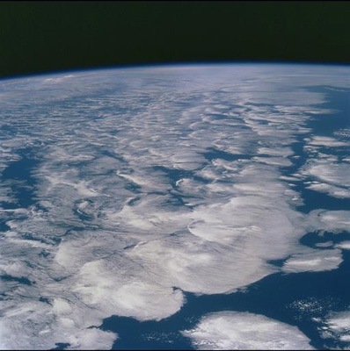





The Science of Climate Change
Professor Richard Allan,
Department of Meteorology, University of Reading
Climate Outreach Day, 17th January 2018
Notes:
CLIMATE OUTREACH – here for Year 9 (age 13-14) ~45 minutes but plenty of extra slides for a longer session.
ACTIVITIES:
Infrared thermometer to demonstrate greenhouse effect
Scratch energy balance demonstration
Students demonstrate feedback loop
INTRODUCTION – see notes on next slide.

Slide 2
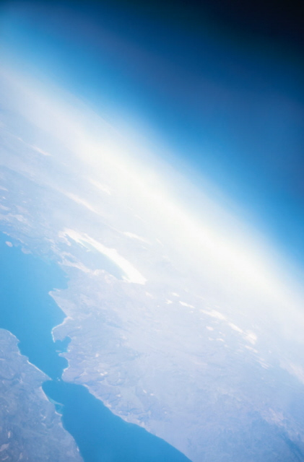
What Causes Climate Change?
Notes:
INTRO:
Why did I get interested in weather and climate, what I needed to study to be climate scientist
I talk about ice ages as getting me interested, you can mention that 20,000 years ago ice sheets crossed northern Britain and sea levels were >100m lower while global temperature was just 4-5oC lower than now.
Glacial cycles operate over tens of thousands of years, very slow compared to human civilisations (modern humans ~200k yr, modern societies last few thousand).
Climate has always changed (e.g. plate tectonics 100s Myr, glacial cycles, 10s kyr, changes in the sun and volcanic eruptions)
Ice cores drilled into Antarctica are like time machines going back nearly 1million years – they show natural swings in temperature, ice and sea level and natural greenhouse gases such as CO2
But now CO2 is nearly 50% higher than at any time over past million years
Human activities are causing the climate to heat up, but how does this work?

Slide 3
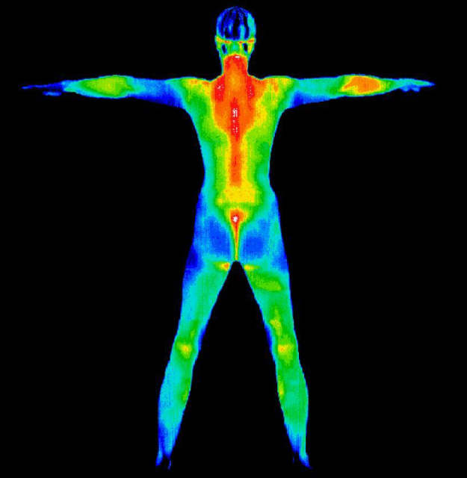
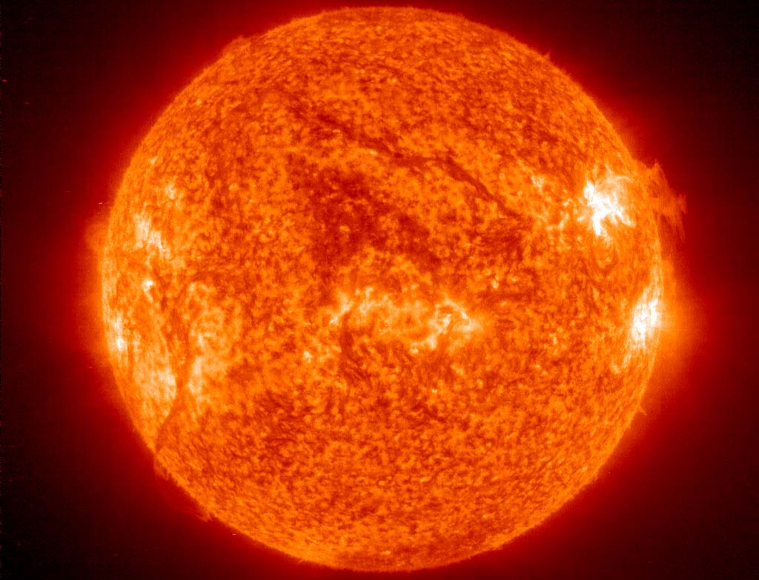
Everything emits radiation energy units: Watts per square metre (Wm⁻²)
Cool things: long wave-length or thermal radiation, e.g. us ~300 K
Hot things: short wave-length radiation, e.g. the sun ~6000 K
Temperature in Kelvin = Temperature in ºC + 273.15
Notes:
Warmer things emit more radiation energy at shorter wavelengths – example of us and sun.
Mention Kelvin temperature scale.
Junk:
The amount of radiation emitted is approximated by: F=σT⁴, where σ is the Stefan Boltzman Constant (5.67x10⁻⁸ Wm⁻²K⁻⁴) and T is the temperature in Kelvin. So a body at around the Earth’s surface temperature (288 K) will emit 390 Wm⁻² of radiation energy. The Earth actually emits more like 240 Wm⁻² of thermal radiation out to space, showing that something is reducing the cooling efficiency. Can you calculate what the Earth’s effective emitting temperature is?
(or F=56.7xTxTxTxT/1 billion) or about a 5 Wm-2 increase for each oC increase at Earth’s temperatures.

Slide 4
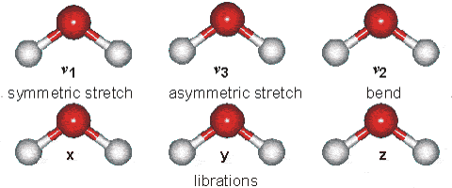
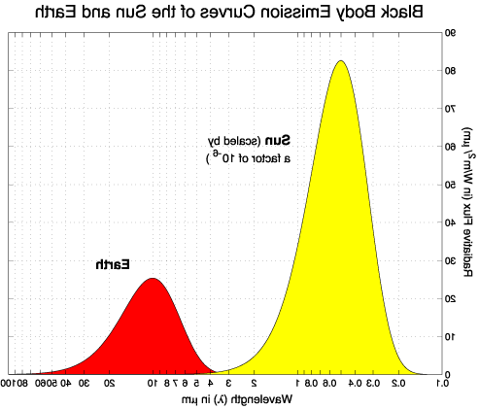
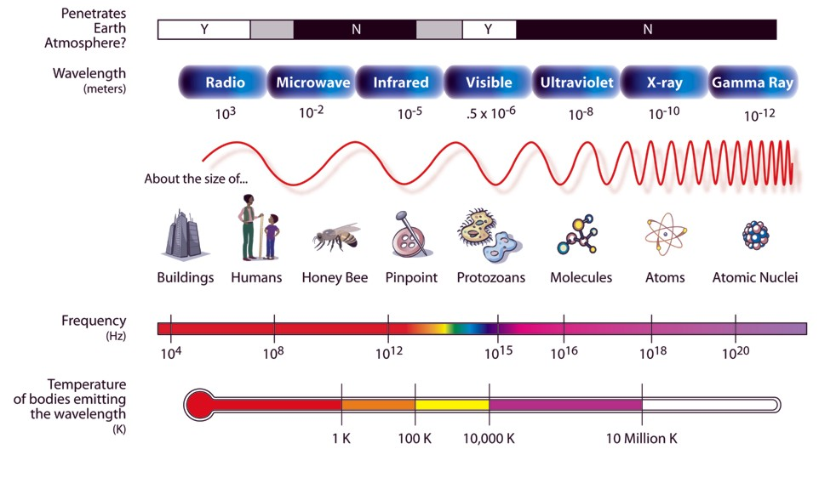
The Electromagnetic Spectrum
Figure from NASA.
IR thermometer activity
Notes:
4
Example of electromagnetic spectrum
point out where Earth and sun are emitting
note that atmosphere lets in lots of sunlight but blocks outgoing energy
Example of water molecule which absorbs both
IR THERMOMETER ACTIVITY:
Get 2 students, one fires gun at other, measures temperature (aim close at head)
2nd student does same and also measures floor, other students (we are warmer than floor, hopefully!)
Q: How does this measure temperature from far away? (IR radiation)
1st or another student then points at sky out of window then at sky through open window
Q: why is it colder? (window blocks IR radiation, like atmosphere)
Can also note that this is in part of IR spectrum where water vapour absorption is small so you can see the temperature of cloud base – used in Met to measure height of cloud base.
Notes:
In the above graph, the first bar is a key to the electromagnetic radiation that either, do or don't penetrate the earth's atmosphere. Y is for yes and N is for no. Although some radiation are marked as N for no in the diagram, some waves do in fact penetrate the atmosphere, although extremely minimally compared to the other radiations. Next the wavelengths are expressed in terms of meters, using scientific notation. Notice the spectrum goes from the longer Radio waves, at 103 meters, all the way to the shorter Gamma Rays, at 10-12 meters. Next the various wavelengths are compared to sizes found in everyday life.
Frequency, wavelength and wavenumber
Atmospheric radiation has been influenced by many different fields, each with its own preferred nomenclature and units. For example, physicists mainly use frequency, others use wavelength and spectroscopists use wavenumber.
Relationship between frequency and wavelength: c = ν λ
where ν (Greek nu) is frequency (cycles per second) and λ is wavelength
c is the speed of light (299,792,458 ms-1 by definition)
Wavenumber is the reciprocal of the wavelength expressed in cm.
Example: the peak of the main infrared absorption band of carbon dioxide is at;
Wavelength: 15 μm (microns: 10-6 metres)
Wavenumber: 667 cm-1 (667 cycles per cm)
Frequency: 2.1013 Hz = 20THz (teraHertz)

Slide 5


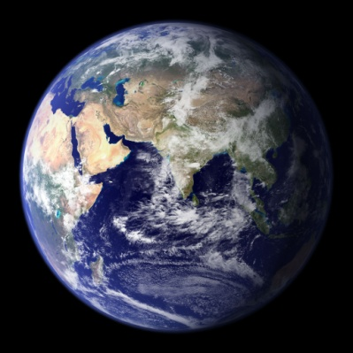
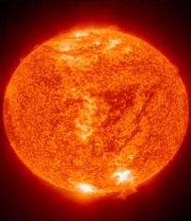



Earth’s Radiation balance in space
4πr²
Thermal/Infra-red or Outgoing Longwave Radiation (OLR)
S
πr²
Absorbed Solar or Shortwave Radiation $\frac{S}{4}$x$\left(1−α\right)$
α is “albedo” – the proportion of incoming solar radiation reflected back
There is a balance between heating from absorbed sunlight and cooling to space through thermal/longwave radiative energy
$\frac{S}{4}$ $\left(1−α\right)=OLR$ S ≈ 1361 Wm⁻², α ≈ 0.3, OLR ≈ 239 Wm⁻²
How does it balance? Why is Earth’s average temperature ~15ºC?
Scratch Energy Balance Activity
Notes:
5
Earth’s climate is determined by the balance between absorbed sunlight and outgoing infrared cooling to space
If more energy is arriving than leaving, Earth heats up until it emits enough energy to space to balance (at a new higher temperature)
NOTE: observations show currently 300 billion kW energy accumulating (every person alive has 20 kettles (2kW) to slowly boil ocean (babies will need supervision) – this is causing climate to heat up (7x10^9 x20 x2 = 280 billion kW)
Use Scratch activity (click link, go full screen, top left button):
Turn on calc temperature, how low will T go if we remove the atmosphere (emissivity to zero)
Click green flag, turn on and then off calc temperature
What happens if we increase emissivity by 2%? (more energy in than out)
Note surface temperature then turn on calc T and show increase
BUT: it’s not that simple (feedback loops)…

Slide 6
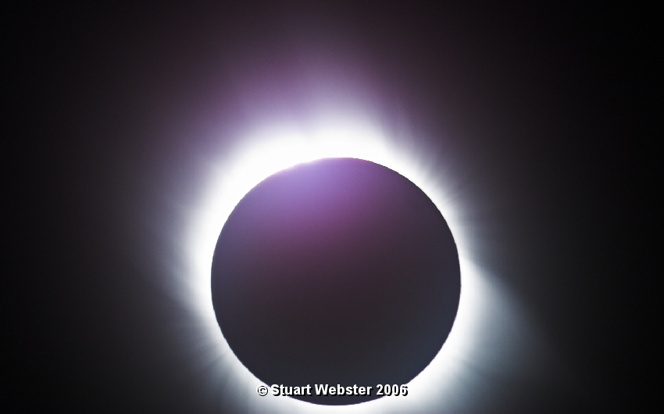
Forcing and response: a natural experiment
Notes:
In this example, my friend took pictures of solar eclipse in Turkey.
Show the sky before, during (still light at horizon) and afterwards.
Q: did anyone spot the difference in the sky? (clouds went)
One hypothesis – they blew away – perfectly possible.
But why are clouds there? (think lava lamp, remove heating source (sun) cloud go)

Slide 7
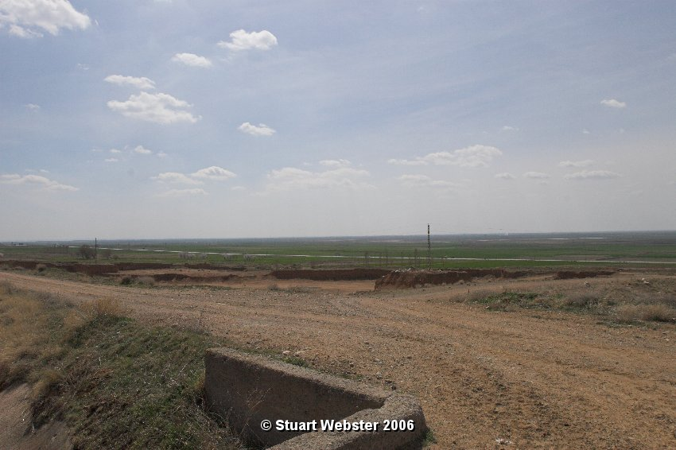
29/3/06 11.05am

Slide 8
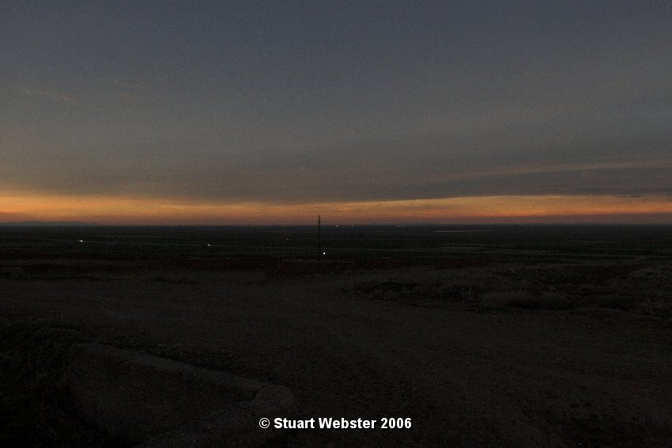

Slide 9
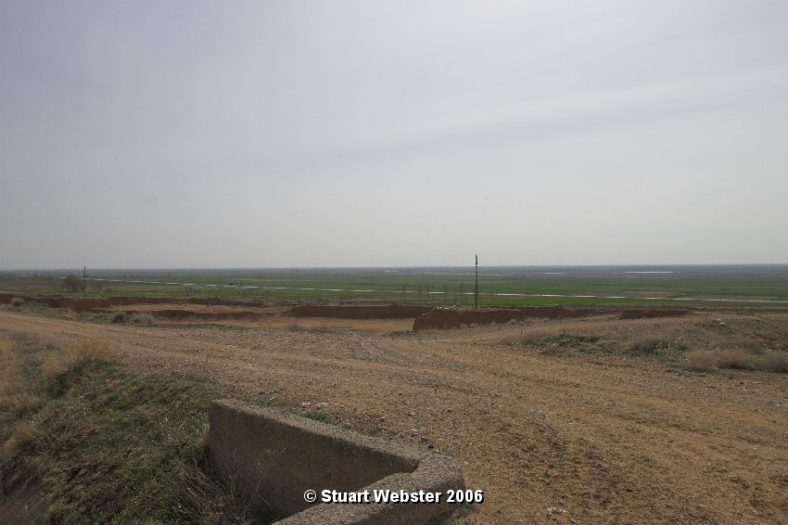
29/3/06 12.26pm

Slide 10
Clouds affect radiation fluxes
Radiation fluxes affect clouds
Feedback/response activity
Notes:
Take away message: Clouds depend on sunlight heating surface, sunlight reaching surface also depends on clouds!
Possibility for feedback loop.
Feedback loop demonstration:
Get back row up to front (~10 students?)
Form a line, one pushes, the other response (impact is at the end, hopefully not severe!)
Now in a loop, one pushes, others respond but feedback to beginning again.
An example is ice albedo feedback (e.g. higher T → ice melts → less sunlight reflected → more heating → even higher T)

Slide 11
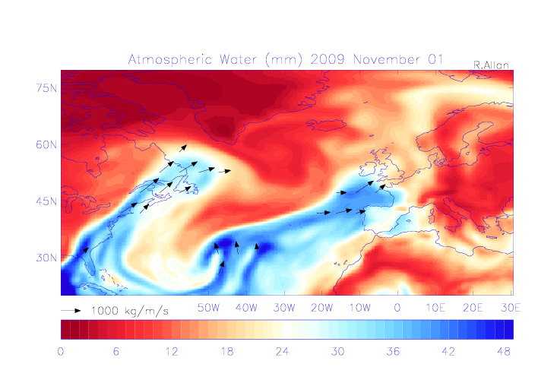
Water vapour and climate
Notes:
Water vapour:
most of water in air is invisble (clouds are just tip of iceberg)
Important for weather as climate as it is fuel for heavy rainfall (see animation above)
Also amplifies climate change with a feedback loop…

Slide 12
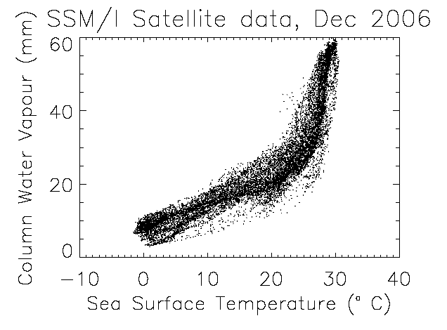
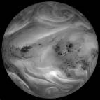
Water Vapour causes an amplifying positive Feedback loop
↑ CO₂
↑ Water vapour
↑ Greenhouse effect and more absorption of sunlight
↑Temperature
↑ Net Heating
Notes:
12
COULD SKIP!!
Higher T → more water vapour → stronger greenhouse effect (+ absorbs more sunlight) → heating → even higher T
(not: also works in reverse, lower T → less water vapour → even colder)
Notes:
For example, as the atmosphere warms it will be able to ‘hold’ more water vapour. Water vapour itself is a very powerful greenhouse gas, so this will act as a positive feedback and roughly double the amount of warming. Similarly, when sea ice begins to melt, some of the solar radiation which would otherwise be reflected from the sea ice is absorbed by the ocean, and heats it further; another positive feedback. On the other hand, when carbon dioxide concentrations increase in the atmosphere then it acts to speed up the growth of plants and trees (the fertilisation effect) which in turn absorb more of the carbon dioxide; this acts as a negative feedback.

Slide 13
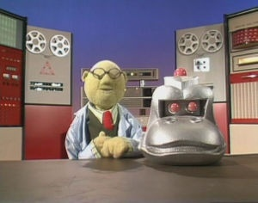
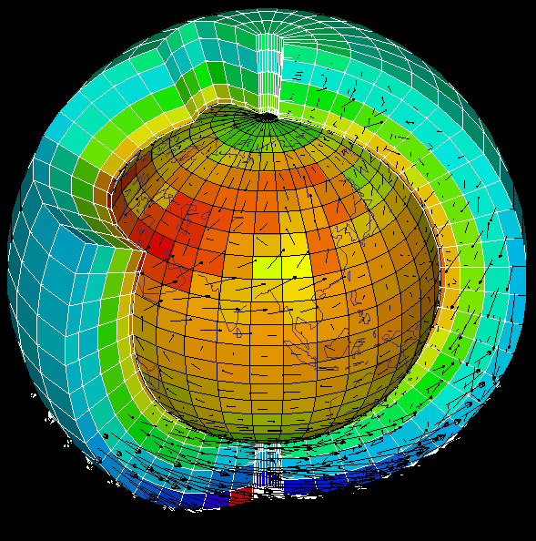
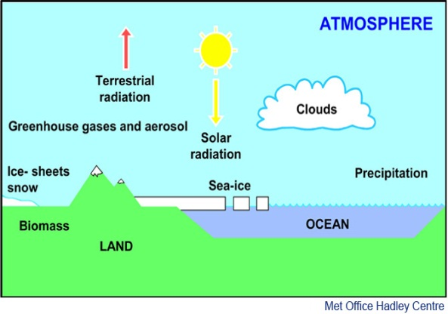
Climate simulations
Scientists put all the physics of the atmosphere, oceans and land into complex computer simulations
Many millions of lines of code are used to calculate the equations and pass information between grid cells
These simulations are used to:
  understand why climate has changed in the past
  project how climate will change over future decades and centuries
climate model animation
Notes:
To understand climate and make predictions of future climate change, scientists need to build complex simulations that are built on observations-based physics equations
These need to represent all the feedback loops
The atmosphere, oceans and surface are slit into millions of blocks, equations calculated for wind, cloud, vegetation, etc and information passed from cell to cell (just like students in classroom)
SHOW ANIMATION as an example
By prescribing scenarios in which atmospheric constituents change in response to human-related emissions and changes in natural forcing agents such as the sun or volcanos, experiments can be made with climate models to see how well they reproduce the past climate and then what they project for future climate.

Slide 14
How will climate change over your lifetimes?
Notes:
This Section can be reduced if required but it is useful to show some of climate projections, discuss these in context of human lifetimes and what we can do about the issue.

Slide 15
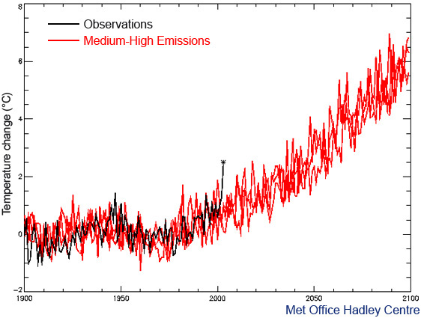

Summer 2003 European heatwave temperatures normal by the 2040s, cool by 2060s
70
70
70
European summer temperature change (ºC) -2 0 2 4 6 8
1900 1950 2000 2050 2100
Notes:
2003 heatwave – students were embryos! Many died in France
My Dad was 70 5yrs ago
When I’m 70 2003 extreme temperature may be normal
When my son and students are 70 such “cold” summer temperatures will be unheard of! (but it’ll be a different sort of heat)
Notes:
The simulation from 1900 to 2000 agrees well with the observations (black), except for the summer of 2003 (black asterisk) which was much warmer than either the model simulation or the climatic norm. In the absence of any human modification of climate, temperatures such as those seen in Europe in 2003 are estimated to be a 1-in-1,000 year event. Despite this, it is seen that, by the 2040s, a 2003- type summer is predicted to be about average, and by the 2060s it would typically be the coldest summer of the decade. Recent work has demonstrated that hot, 2003-type, European summers would already be being experienced much more frequently (more than once per decade on average) were it not for the cooling effect of man-made sulphate aerosols. Once the shielding effect of these aerosols is removed, the warming commitment from past greenhouse gas emissions will mean that such hot summers are likely to become a regular occurrence, even without any further man-made greenhouse warming.

Slide 16
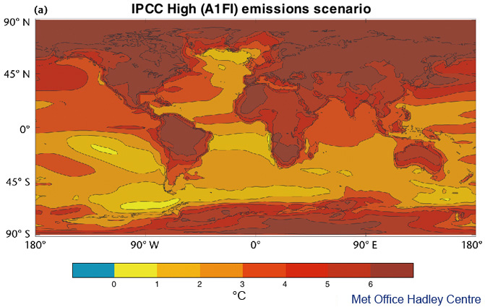
Warming will be greater over the land and greatest in the Arctic
Change in average surface temperature (1986−2005 to 2081−2100) RCP 8.5 Scenario
Notes:
CAN SKIP TO SUMMARY IF SHORT OF TIME, just mention sea level rise and intensification of rainfall to link with impacts.
Land will warm up more than ocean, Artic the most.
Notes:
Models show a stronger warming over land and over polar regions compared to the oceans due to changes in circulation but also due the large heat capacity of the deep oceans.
Temperatures over land are expected to increase about twice as rapidly as temperatures over the ocean. The annual average warming by 2100 over land areas, where of course we live and work, is predicted to be in the range 3 °C to 8 °C for the high emissions scenario. Although the Earth's temperature has varied considerably over the last 1,000 years for natural reasons, the rise over the next 100 years due to human activities is predicted to be very much larger than natural variability, even with the lowest projected man-made emissions scenario.

Slide 17
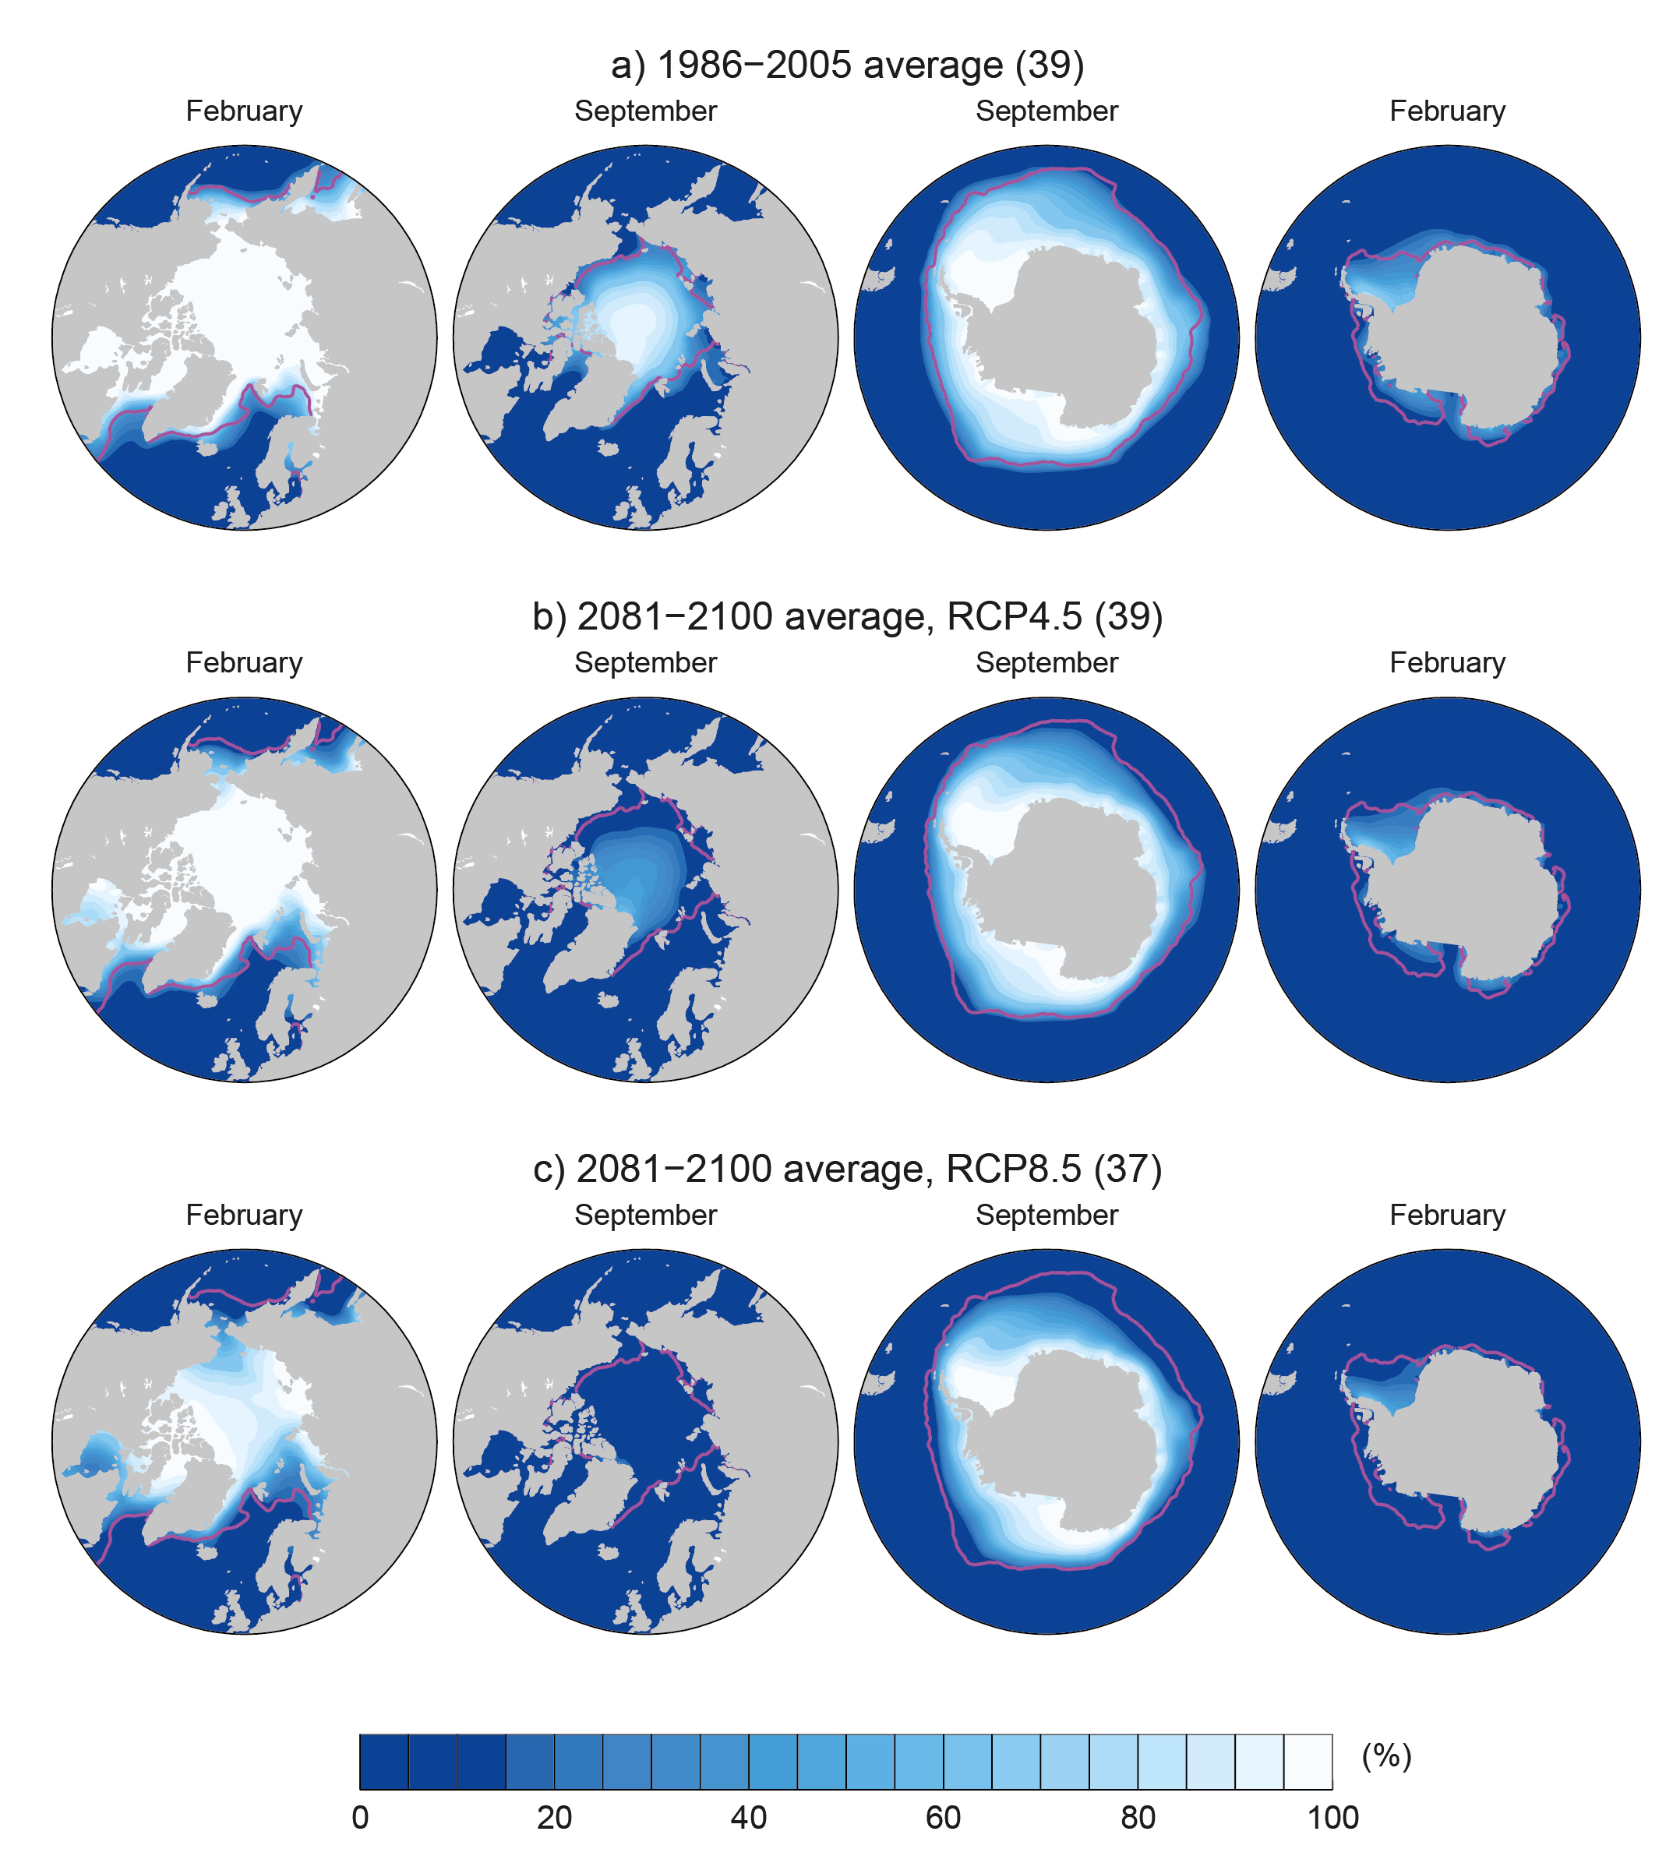
Arctic sea ice extent is projected to diminish over the 21st century
94% decrease in September and
34% decrease in February for the RCP8.5 scenario
2081-2100 (RCP 8.5) 1986-2005
IPCC (2013) WG1 Fig. 12.29
Notes:
Arctic ice is melting at a rate of 3000 cubic km per decade.
Note: O2 Arena is about 4 million m^3 (0.004 km^3) so ¾ million O2 Arenas per decade
Arctic ice will be effectively absent by middle-late century
Notes:
Under the High Emissions scenario many models find that ice in the month of September (when it is at its minimum extent in the annual cycle) will have almost completely disappeared the middle of the 21st century. Other emissions scenarios lead to a slower reduction in Arctic ice. Reductions are also predicted for other seasons and also for the Antarctic although models are at present not able to capture the observed increases in Antarctic sea ice extent which is thought to relate to changes in atmospheric and oceanic circulation changes in response to increases in greenhouse gases and decreased stratospheric ozone.

Slide 18
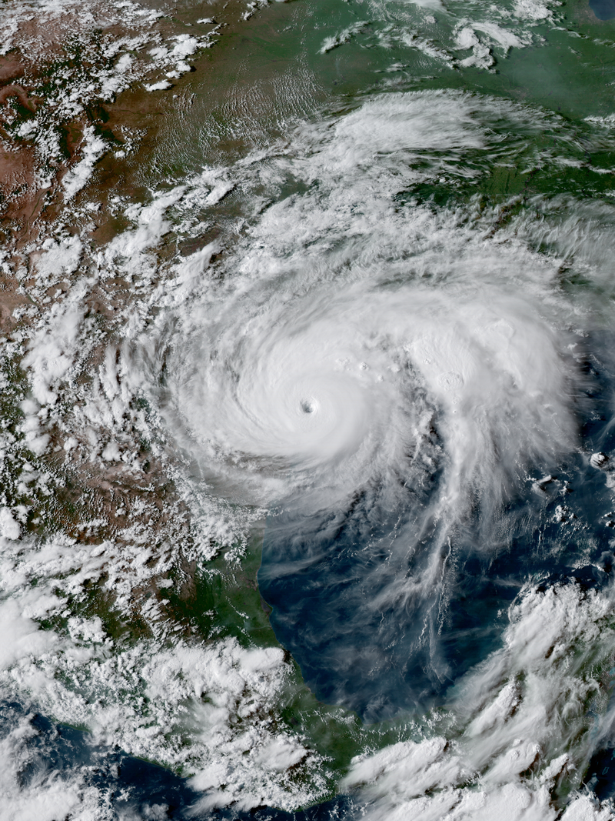
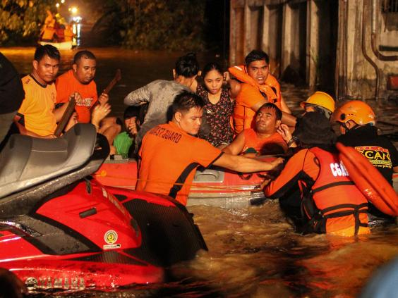
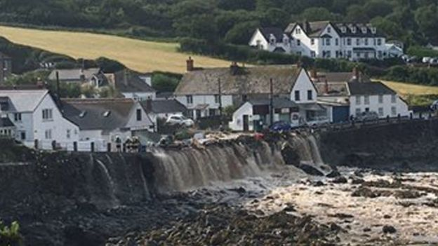
Intensification of heavy rainfall
Hurricane Harvey
Philippines
Coverack, Cornwall
Notes:
Note that water vapour is increasing and this is making heavy rainfall events more intense

Slide 19
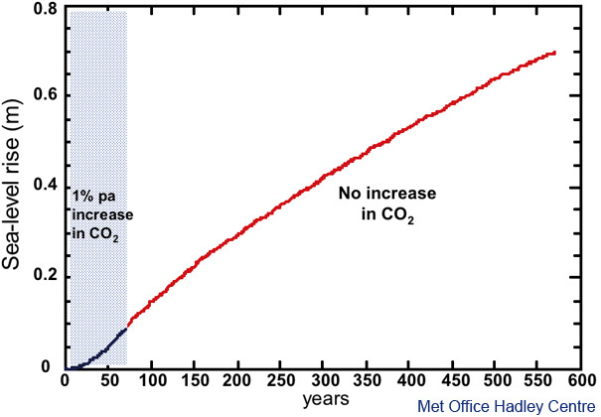
Sea-level rise will continue to rise for centuries
CO₂ increase stops here
Notes:
Sea level is rising at 3.5mm/year because warmer water expands and melting ice sheets add water to the ocean
It takes hundreds to thousands of years for ice sheets and the deep ocean to fully respond to warmer surface temperature
So sea level will continue to rise for many hundreds of years to come (most big cities are near sea level)

Slide 20
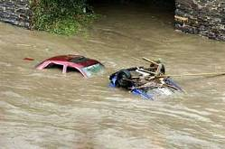
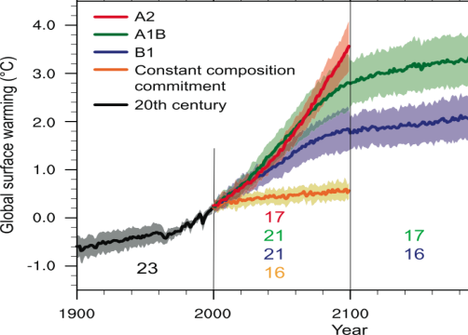
Summary
Climate has always changed
Greenhouse gases such as carbon dioxide are at their highest levels for at least the last 800,000 years
This pollution from human activity is amplifying the natural greenhouse effect
This is heating the planet by impeding outgoing infrared cooling to space
Substantial changes in global temperature and rainfall patterns are projected using computer simulations
Predicting regional climate change is a challenge
What can we do to avoid dangerous climate change?
Notes:
Summary and what can we do?? Questions?
Notes:
Scientists are now even more certain that the current warming since the mid-20th century is primarily due to mans impact on the atmosphere via fossil fuel burning, agriculture and changes in land-use.
Much of this certainty comes from the observations but a large component comes about applying physical laws and theory, refined by the observations, to develop sophisticated computer models of the Earth’s environment that help to understand the reasons for the warming and to enable predictions of future climate change over the next few hundred years…

Slide 21
EXTRA SLIDES

Slide 22
COP21 Paris Climate Deal source: http://www.carbonbrief.org/analysis-the-final-paris-climate-deal
Target: global temperature well below 2ºC; efforts to limit to 1.5ºC
Mitigation: pursue policies aiming to achieve INDC climate pledges; subsequent pledges progressively more ambitious; global stocktake 2018 & then every 5 years; peak global greenhouse gas emissions “as soon as possible”; “balance” between emissions & sinks 2050-2100
Adaptation: $100bn/yr fund for developing countries: new collective quantified goal by 2025; periodic review of adaptive planning of Loss & damage has its own Article in the agreement — now on par with mitigation & adaptation; liability/compensation excluded.
Transparency: "facilitative, non-intrusive, non-punitive” system of review will track countries’ progress; emissions trading allowed; aviation/shipping not included
Treaty: deal enters force once 55+ parties, covering at least 55% of global emissions have signed up

Slide 23
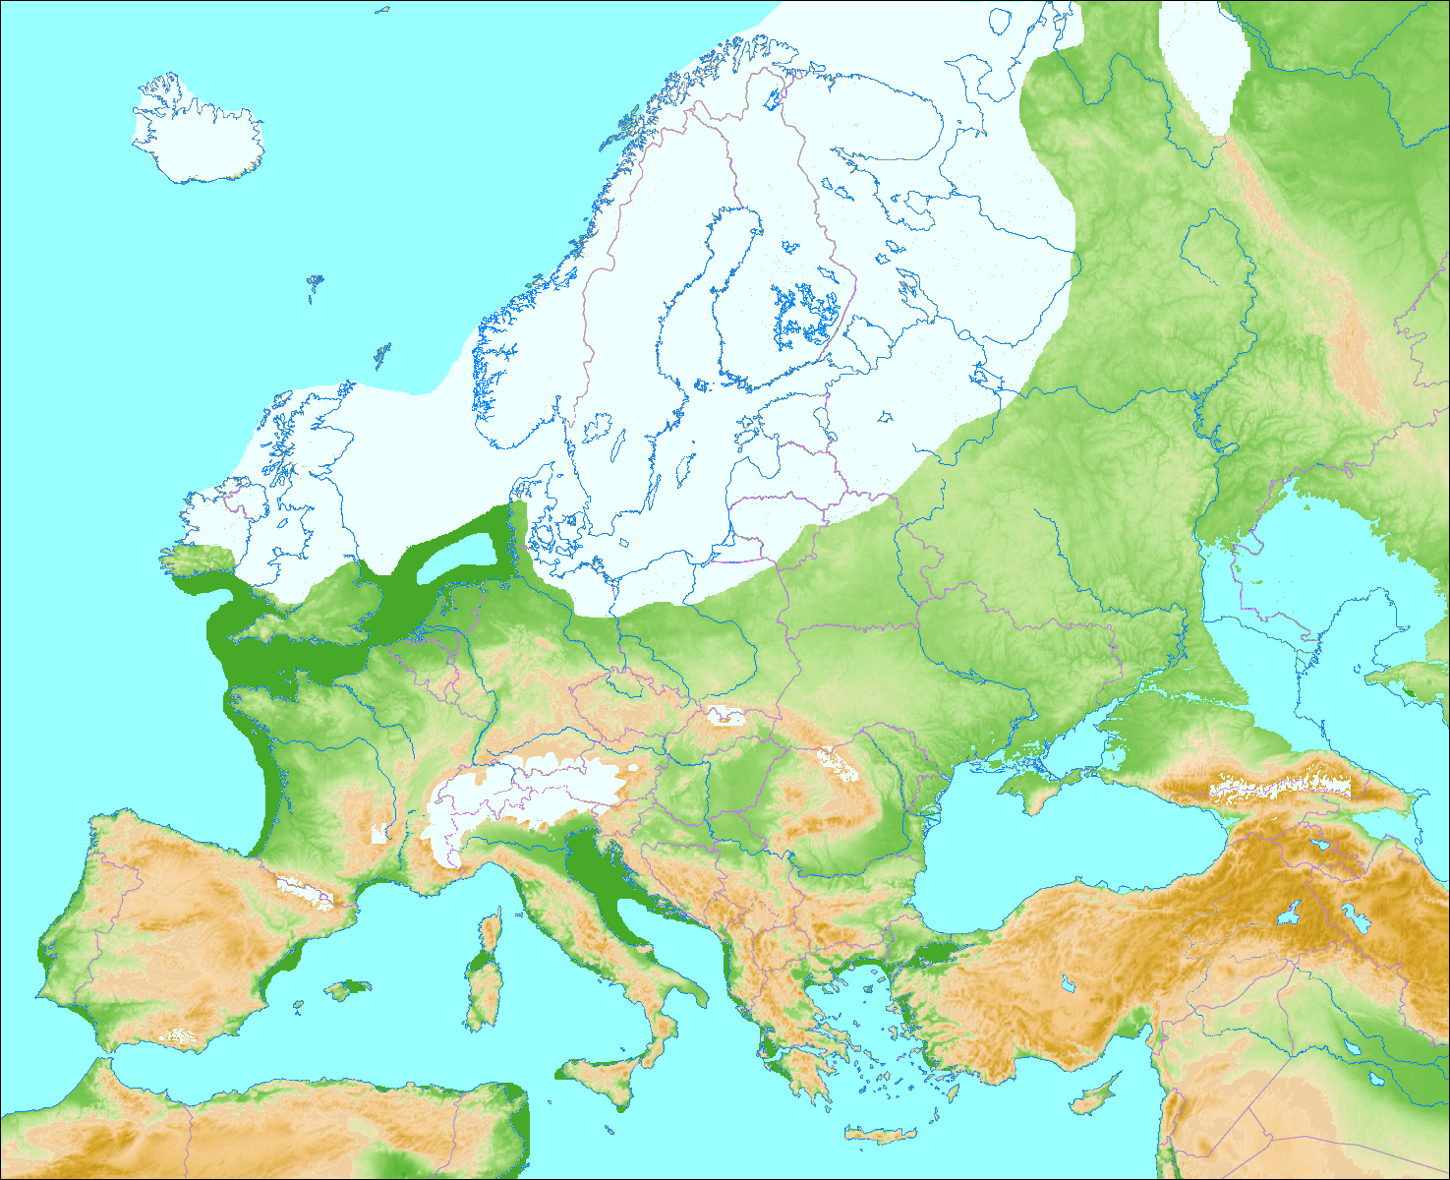
The last glacial maximum
About 20,000 years ago…
Northern Britain was covered by an ice sheet
Sea level was 100 metres lower

Slide 24
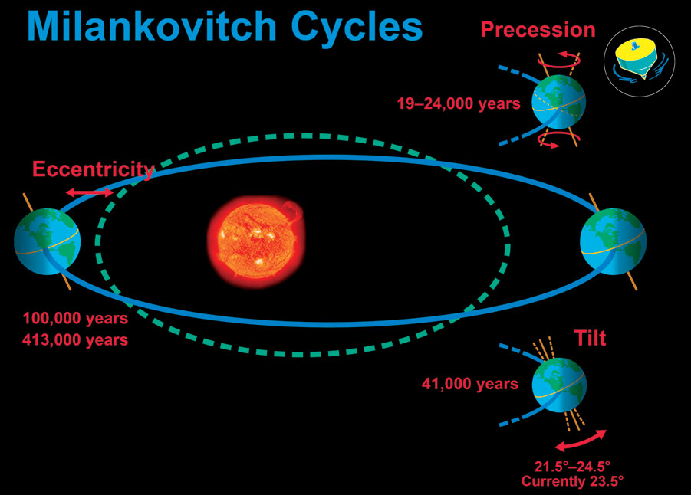
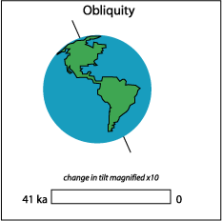
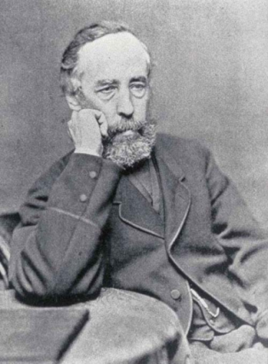
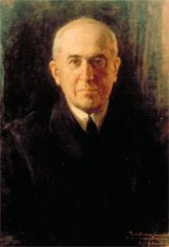
Croll-Milankovitch Cycles

Slide 25

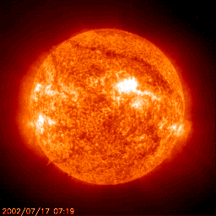
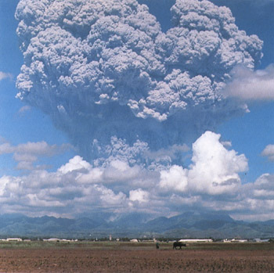
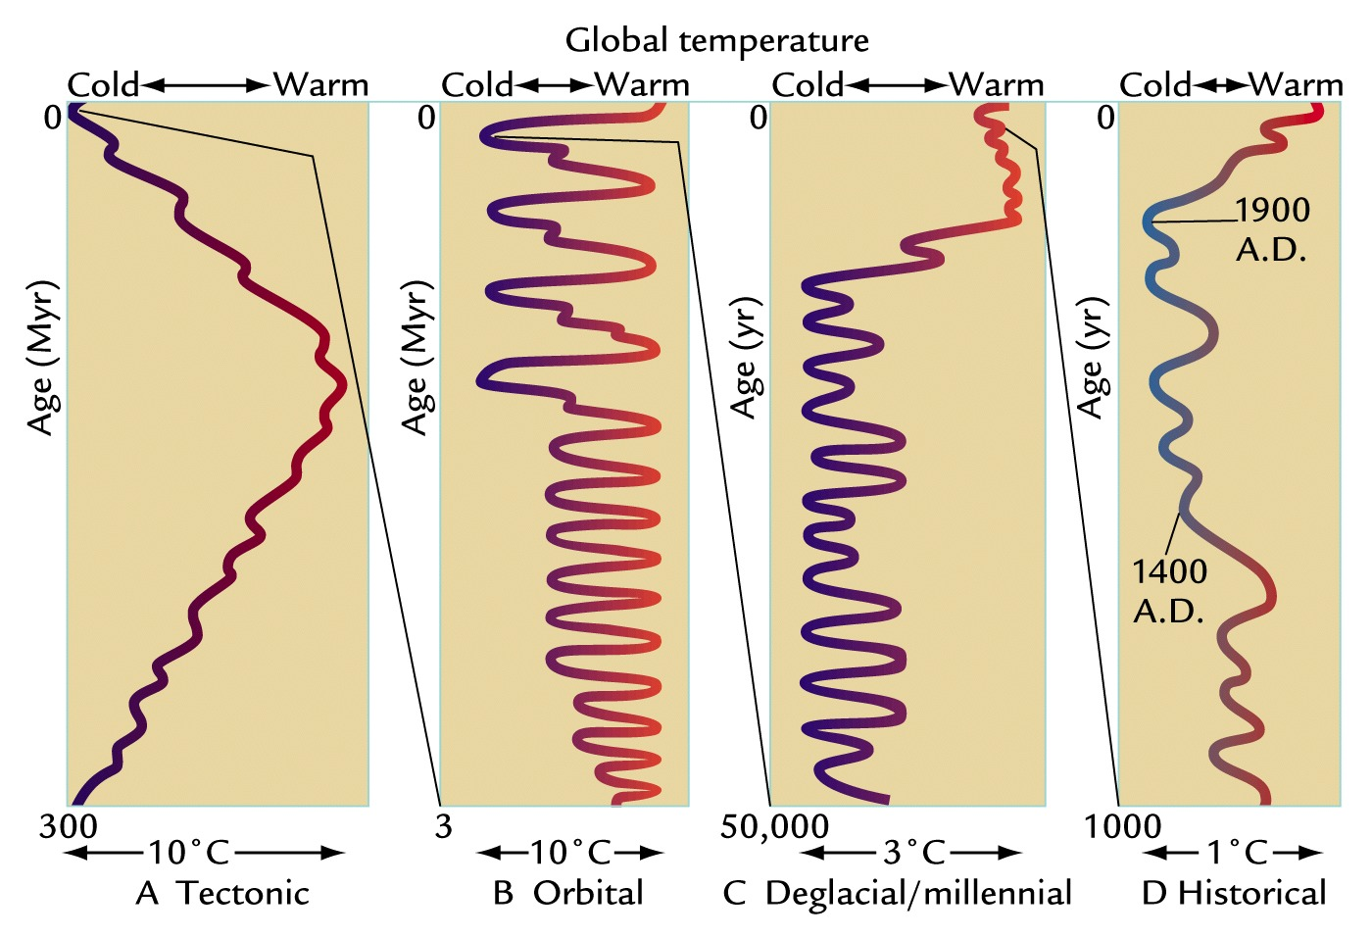
Earth’s Climate has always been changing
Ruddiman WF. 2001
Earth's Climate, Past and Future
Notes:
FIGURE 1-3 Time scales of climate change Changes in Earth’s climate span several time scales, arrayed from longer to shorter: (A) the last 300 million years, (B) the last 3 million years, (C) the last 50,000 years, and (D) the last 1000 years. Here progressively smaller changes in climate at successively shorter time scales are magnified out from the larger changes at longer time scales.
[Ruddiman WF. 2001. Earth's Climate, Past and Future. New York: W. H. Freeman.]
Climate changes on all time-scales. One of the most important determinants of climate is variations in the absorption of solar radiation by the planet.
Over billions of years the solar output has increased with time, as has the evolution of the Earth’s atmosphere and distribution of land and ocean which modifies the efficiency at which the Earth can cool to space via thermal/long wavelength radiation as well as impacting absorption of sunlight.
Over tens and hundreds of thousands of years, changes in the Earth’s orbit around the sun alter the amount of solar radiation reaching different parts of the planet. These cycles are predictable (they depend upon the gravitational pulls of the sun, planets and the moon) and they are widely believed to have caused glacial-interglacial cycles in which global temperatures swing by up to 10ºC. However, crucial to these swings are feedbacks which either amplify or dampen the radiative forcing from these Milankovic cycles. For example, cooler temperatures lead to more ice and greater reflection of solar radiation which amplifies the cooling.

Slide 26
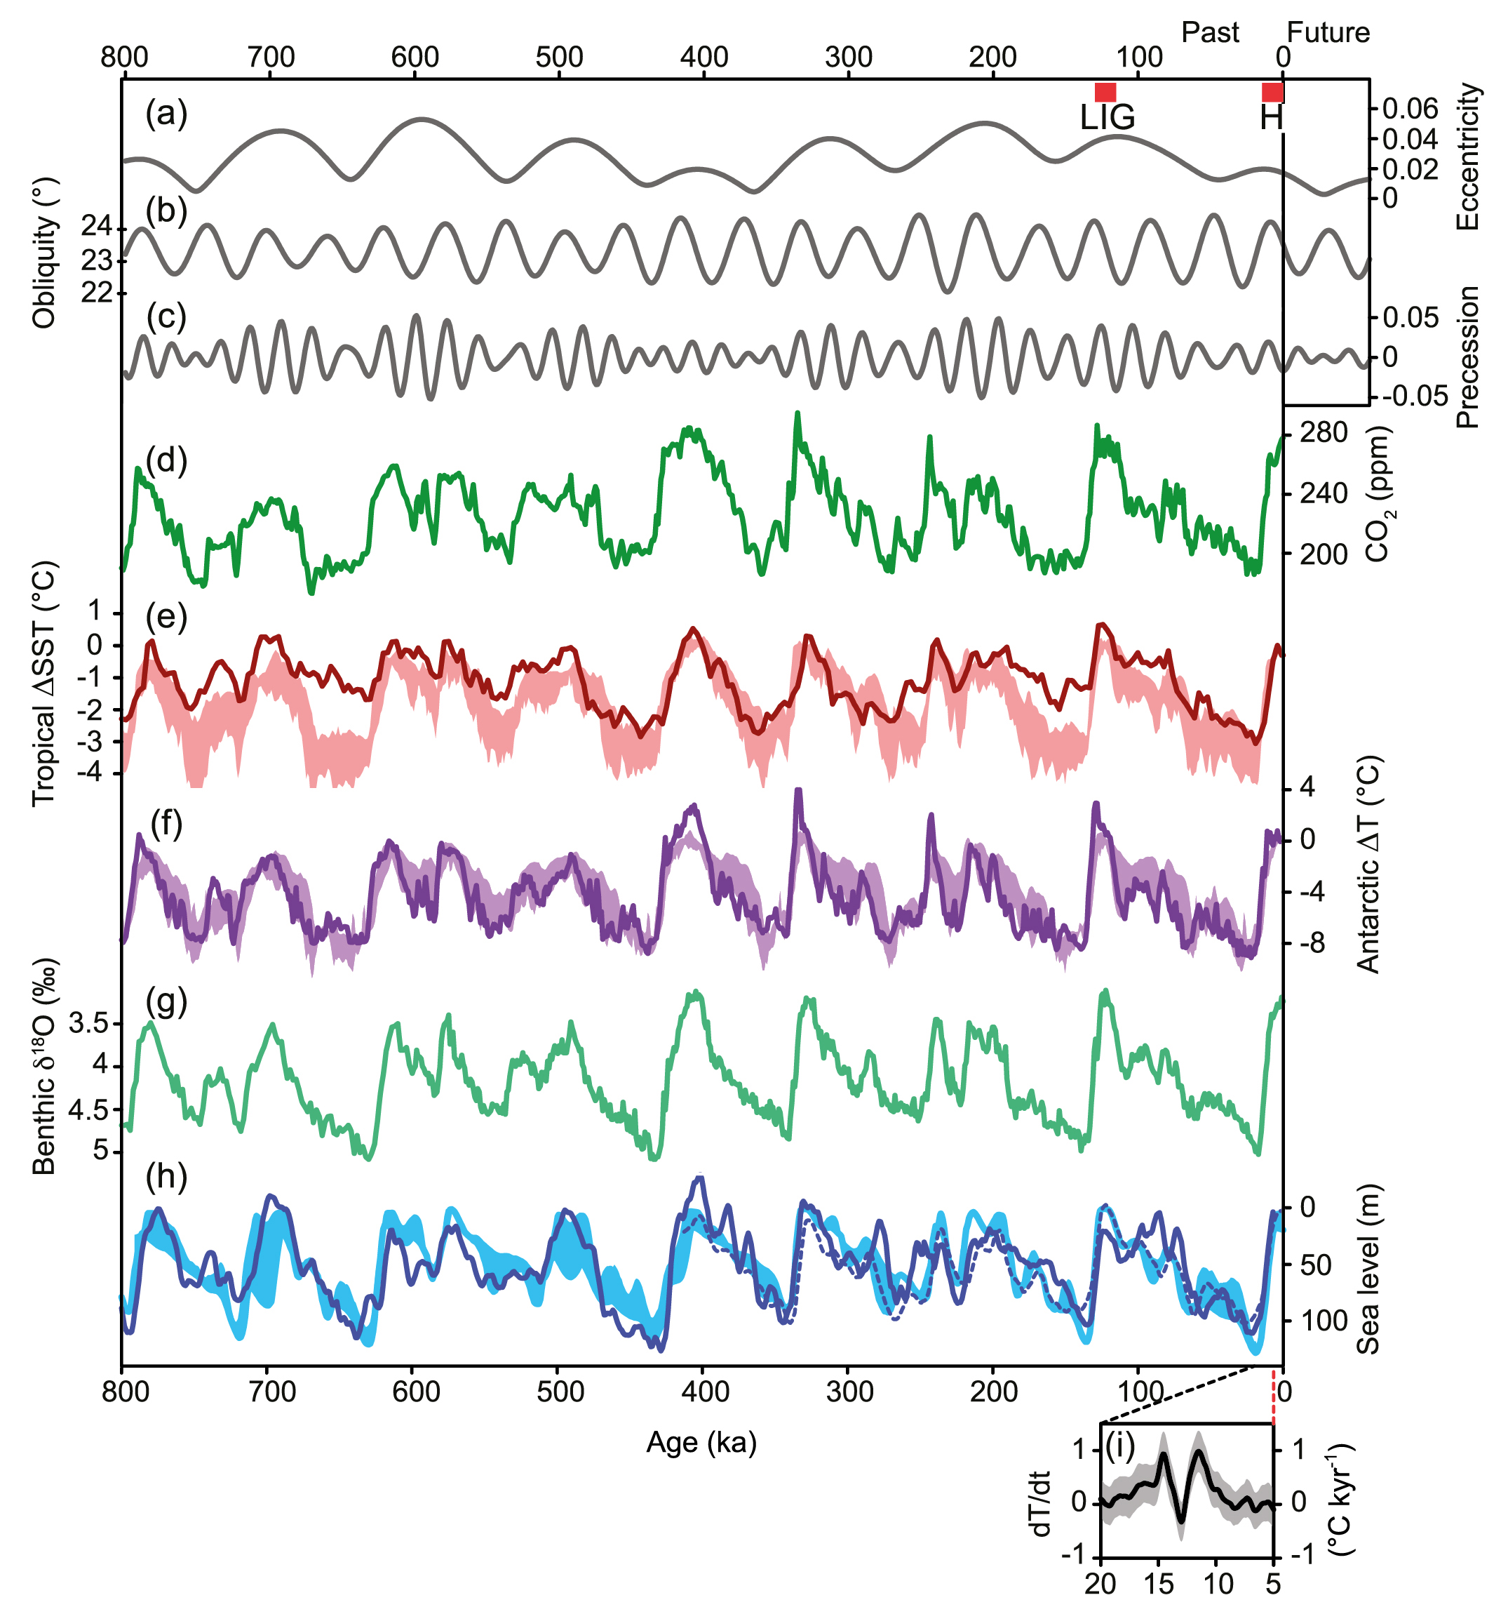
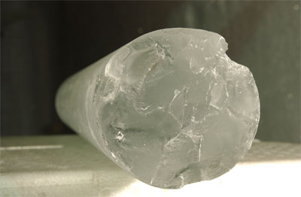


Climate change over last 800,000 years
400 ppm
CO₂
Antarctic Temperature
8ºC
Ice volume proxy
Sea level
Modern humans
100m
IPCC (2013) Chap. 5 Fig 5.3
Africa Exodus
Europe
Agriculture
Notes:
During colder glacial periods:
More ¹⁶O locked away in ice sheets so higher ¹⁸O in oceans & air bubbles in ice cores: ice volume
Larger equator to pole temperature gradient leading to greater depletion of ¹⁸O in snow compacted in ice cores
Ice cores from Antarctica provide abundant evidence of climate change over the past 800,000 years. Trapped air bubbles record past atmospheric composition, including carbon dioxide and methane, and isotopic analysis of oxygen and hydrogen in the air bubbles or of the ice itself can tell us indirectly about changes in Antarctic temperature (or temperature difference between tropics and poles) and ice volume (additional evidence from ocean sediments is also particularly valuable). A series of milder interglacials punctuate the longer glacial periods of low temperature and high ice volume, the timings of which relate to changes in the Croll-Milankovic orbital cycles. Natural changes in carbon dioxide (and methane) in response to the substantial climate changes act to amplify the temperature responses over glacial cycles (more next week).

Slide 27
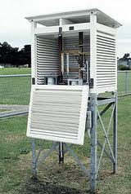
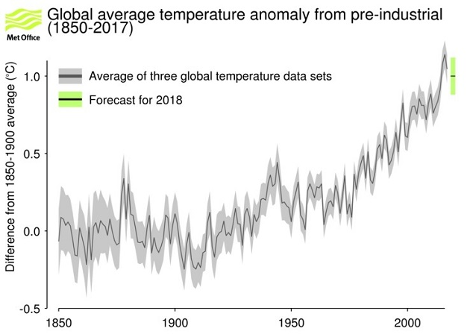
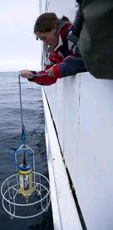

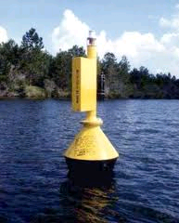
The planet is warming
44 years
www.metoffice.gov.uk/research/monitoring/climate/surface-temperature
Notes:
The instrumental record goes back to about 1850. A few areas of the globe have not warmed in recent decades, mainly over some parts of the Southern Hemisphere oceans and parts of Antarctica. The rate of surface warming is not smooth; there are lumps and bumps in the record and this rate has slowed in the recent decade.

Slide 28
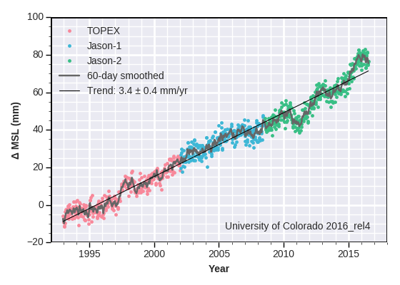
Global average sea level is rising…
http://sealevel.colorado.edu/
Notes:
Are there other indicators of the warming? Global sea level has risen, based on historical proxy data and tidal gauges that have been adjusted to allow for rising and falling of land and other factors. Global sea levels have risen about 20cm over the past 100 years – a rate of about 2mm a year. This is faster than the rise over any of the last 5000 years (less than 1mm a year), but still slower than the average rise of 5mm a year predicted for the next 80 years. Most of this rise occurs because as the oceans get warmer, their water takes up more space (thermal expansion). Melting glaciers in the Andes, Himalayas, the Rockies and the Alps are increasingly contributing to sea level rise and melting of ice sheets at the periphery of Greenland and Antarctica are increasingly contributing.

Slide 29
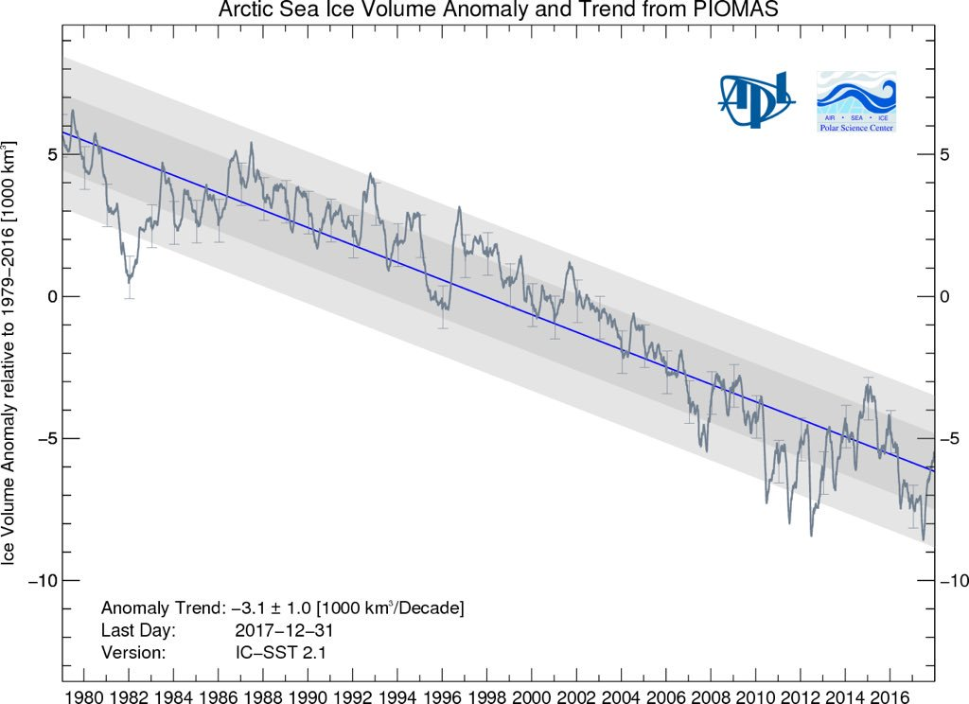
Melting of Greenland ice sheet & Arctic sea Ice
NSIDC :
Notes:
Greenland is losing 300 Gt of ice every year = 3x10^9 t = 3x10^12 kg (3000 billion kg)
Elephant 6000 kg = 6 tonnes → 300 billion tonnes = 50 billion elephants (1 millionx elephant population)
Artic ice losing 300 km^3 ice per year (100 million Olympic Swimming Pools per year).
(3x10^11 m^3 ~ 1x10^8 swimming pools (100 million)
Olympic Swimming Pool: 2500 m^3
Changes in atmospheric and oceanic circulation cause variability in the coverage of Arctic sea ice. However, the declining coverage in the satellite record (passive microwave measurements made since 1979) is robust and further, there has been a drop in “old” ice (older than 2 years for example) since the grand minimum coverage in 2007 with a larger fractional coverage of young <1 year old ice (which is more transient in nature meaning that it can melt and reform more quickly).

Slide 30
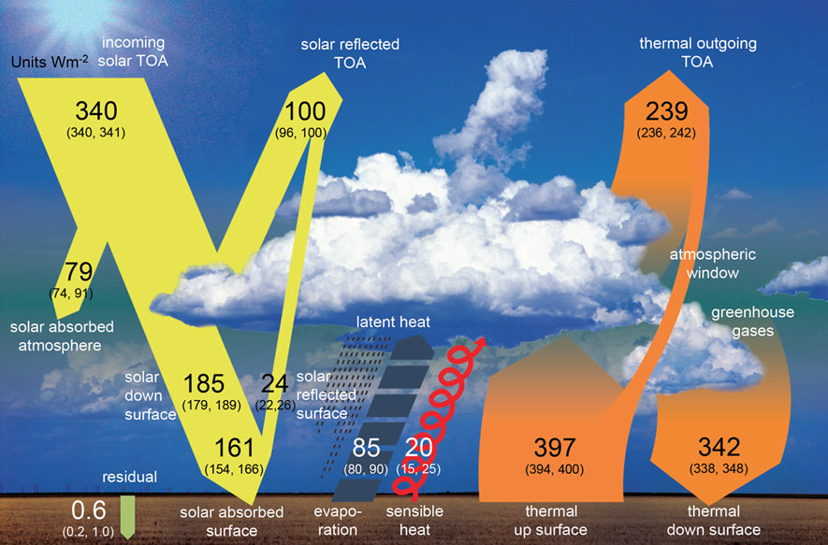
Earth’s Global Annual Average Energy Balance
Wild et al. (2012) Clim. Dynamics. See also: RMetS Climate Science updates

Slide 31
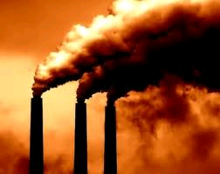
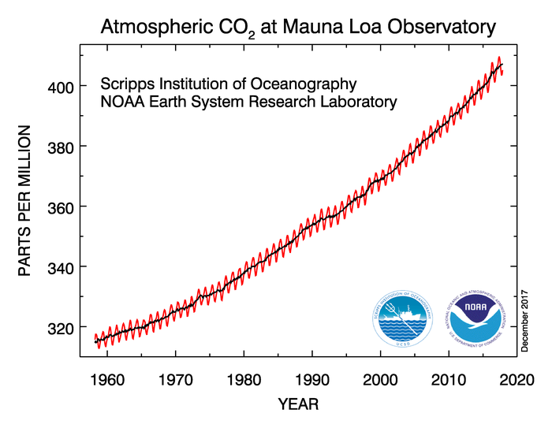
“Radiative forcing” of climate
140 billion 2kW kettles heating up the oceans!
44 years
Notes:
Currently energy is accumulating at a rate equivalent to every person currently alive using 20 kettles (2kW) each to boil oceans (or about 300 trillion watts) Allan et al. (2014)

Slide 32
Future projections to 2100 from climate models
1.0
0.8
0.6
0.4
0.2
0.0
High emissions
Low emissions
(m)
“Continued emissions of greenhouse gases will cause further warming and changes in all components of the climate system. Limiting climate change will require substantial and sustained reductions of greenhouse gas emissions.” [IPCC 2013 SPM]
IPCC (2014) WG1 Summary for Policy Makers
Notes:
Higher emissions (e.g. burning coal/oil) = bigger impact (so reduce emissions)
High emissions: 4oC warming by 2100 (kids will be very old) – note that last ice age, global T only about 4-5oC colder
Notes:
Increase of global mean surface temperatures for 2081–2100 relative to 1986–2005 is projected to likely be in the ranges 0.3°C to 1.7°C for the lowest emissions scenario (RCP2.6) and 2.6°C to 4.8°C for the highest emissions scenario (RCP8.5). The Arctic region will warm more rapidly than the global mean, and mean warming over land will be larger than over the ocean.
Global mean sea level rise is projected to range from 0.52 to 0.98 m by 2100 for RCP8.5, with a rate during 2081 to 2100 of 8 to 16 mm per year. Further uptake of carbon by the ocean will increase ocean acidification.
Heavy rainfall is expected to become more intense with wet regions generally seeing more rainfall and dry sub-tropical regions or seasons less.
For further details, see the IPCC (2014) WG1 Summary For Policy Makers, Section E.

Slide 34
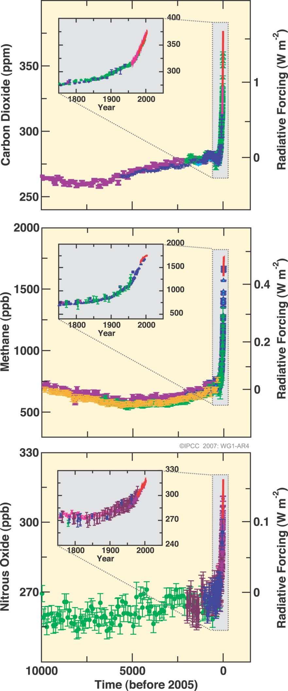
“Radiative forcing” of climate
Human activity is increasing greenhouse gases in the air that heat the planet by reducing how effectively Earth can cool to space through infra-red emission
Also, “aerosol” particle pollution is cooling the planet by reflecting sunlight like a mirror (smaller effect)
If more energy is arriving than leaving, Earth should heat up…
Currently energy is accumulating at a rate equivalent to every person currently alive using 20 kettles (2kW) each to boil oceans (or about 300 trillion watts) Allan et al. (2014)

Slide 35
Water vapour & climate change
Water vapour is a powerful greenhouse gas
Water vapour in the air increases with warming
This increases magnitude of climate change
Also drives intensification of extreme rainfall events
Nov 2009 Cumbria flooding event
weather will always generate extreme rainfall events but warming of climate will increase their severity
Lavers et al. (2013) Environ. Res. Lett.

Slide 36
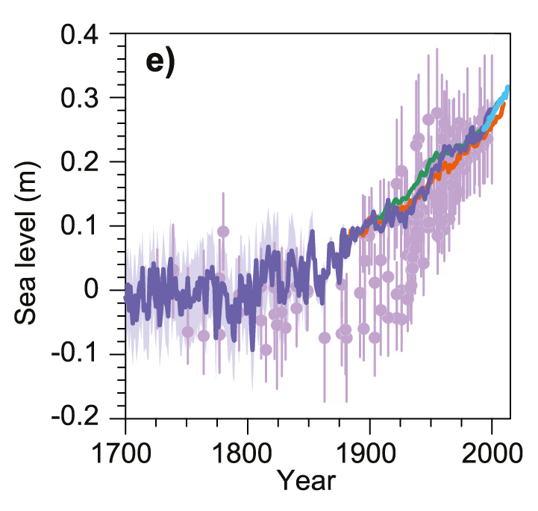
Global average sea level is rising…
Satellite Altimeter data
● paleo data
– tidal gauges – –
http://sealevel.colorado.edu/
IPCC (2013) Figure 13.3
Notes:
Are there other indicators of the warming? Global sea level has risen, based on historical proxy data and tidal gauges that have been adjusted to allow for rising and falling of land and other factors. Global sea levels have risen about 20cm over the past 100 years – a rate of about 2mm a year. This is faster than the rise over any of the last 5000 years (less than 1mm a year), but still slower than the average rise of 5mm a year predicted for the next 80 years. Most of this rise occurs because as the oceans get warmer, their water takes up more space (thermal expansion). Melting glaciers in the Andes, Himalayas, the Rockies and the Alps are increasingly contributing to sea level rise and melting of ice sheets at the periphery of Greenland and Antarctica are increasingly contributing.

Slide 37
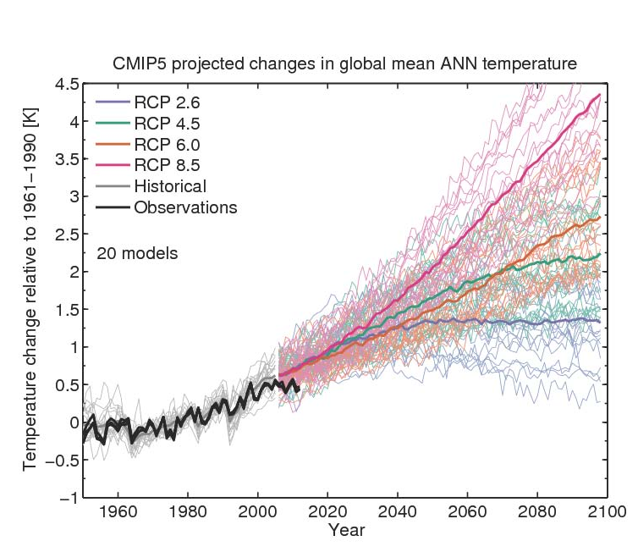

How much will planet warm?
Climate sensitivity and socioeconomic scenario
Climate sensitivity
By Ed Hawkins: see Climate Lab Book

Slide 38












Melting of Greenland ice sheet & Arctic sea Ice
Ice volume anomaly (1000s km³)
Ice extent (Millions of km)
NSIDC :
Notes:
Changes in atmospheric and oceanic circulation cause variability in the coverage of Arctic sea ice. However, the declining coverage in the satellite record (passive microwave measurements made since 1979) is robust and further, there has been a drop in “old” ice (older than 2 years for example) since the grand minimum coverage in 2007 with a larger fractional coverage of young <1 year old ice (which is more transient in nature meaning that it can melt and reform more quickly).

Slide 39




Projections of the water cycle
Precipitation intensity
Increased Precipitation
More Intense Rainfall
More droughts
Intensification of wet and dry seasons?
Regional projections??
IPCC WGI (2013)
Notes:
The above graphs from the IPCC (2014) WG1 report show:
(top left) Increases in 5-day precipitation intensity (%) for 2081-2100 relative to 1981-2000 for RCP8.5 (Fig. 12.26, Chapter 12) where stippling denotes a significant change.
(bottom left) Annual average % changes in soil moisture in the upper 10cm of soil in the RCP8.5 scenario where stippling shows significant changes (Technical Summary, TFE.1, Figure 3)
(bottom right) Annual average changes in precipitation (mm per day) for the RCP8.5 scenario where stippling shows significant changes (Technical Summary, TFE.1, Figure 3).

Slide 40


Long-term commitment to sea-level rise
2.3m sea level rise per ºC warming over long term (e.g. 2000 years) [IPCC Fig. 13.14]
Current melt/ accumulation
RCP 8.5, Year 5000
CO₂ increase stops here
Golledge et al. (2015) Nature

Slide 41
Summary
The planet is warming and this is primarily attributable to rising greenhouse gas concentrations
Greenhouse gases at highest levels for > 800,000 yrs
Physics of greenhouse effect well understood
Substantial changes in global temperature and rainfall patterns are projected using computer simulations
Predicting regional climate change is a challenge…
  Will substantial greenhouse gas emissions continue?
  Are “knock on effects” of warming amplifying or reducing the magnitude of change (e.g. clouds, land surface, …)?
  Changes in atmospheric and oceanic circulations change are crucial for local impacts yet challenging to predict
Notes:
Scientists are now even more certain that the current warming since the mid-20th century is primarily due to mans impact on the atmosphere via fossil fuel burning, agriculture and changes in land-use.
Much of this certainty comes from the observations but a large component comes about applying physical laws and theory, refined by the observations, to develop sophisticated computer models of the Earth’s environment that help to understand the reasons for the warming and to enable predictions of future climate change over the next few hundred years…

Slide 42

Planet Earth continues to heat up…
The planet is gaining heat at the rate of 300 trillion Watts…
Loeb et al. (2012) Nat. Geosci. ; Allan et al. (2014) GRL

Slide 43
Decadal climate fluctuations expected
Heating due to rising greenhouse gas concentrations
also influenced by aerosol pollution and natural factors e.g. volcanoes, the sun
Rapid surface warming
Slower surface warming
heating
Weak heating
heating
1980s-1990s: heating of upper layers of the ocean – rapidly rising surface temperature
2000s: heating of deeper layers of the ocean – slower rises in surface temperature
Large body of research – listed on DEEP-C project website
Notes:
43

Slide 44


A hiatus in global warming?
No: the oceans have continued to warm, sea levels have continued to rise and ice is melting…
But…natural factors have temporarily suppressed the rate of surface warming slightly
  A slight dimming of the sun and small volcanic eruptions offset some of the heating from rising greenhouse gases
  Ocean fluctuations rearranged where heat has accumulated
  Climate models can simulate ocean fluctuations but are not designed to capture timings of lumps and bumps in temperature record.
  2014 -2016 likely to be the warmest in the instrumental record
How much the planet will warm in response to greenhouse gas emissions mostly depends on total emissions…

Slide 46


Slide 47


Slide 48

There is currently more energy arriving than leaving the planet
This is causing Earth to heat up
This is mostly because the atmospheric greenhouse gases carbon dioxide is increasing in concentration because of human activities and reducing how effectively the planet can cool to space
But how much will the planet warm?

Slide 49





Northern Hemisphere, Proxies IPCC (2013) Tech. Summary, Box TS.5
GLOBAL, Instrumental
Northern hemisphere proxies
Indirect (or “proxy”) observations must be used to piece together past climate. These help us to understand how climate has changed in the past and put current direct observations (top right) in context
GLOBAL, proxies, Marcott et al. (2013) Science

Slide 50


Slide 51
Changes in greenhouse gases from ice core and modern data
Carbon dioxide, methane and nitrous oxide
IPCC (2007) Summary for Policy Makers Fig. SPM.1
Notes:
Global atmospheric concentrations of carbon dioxide, methane and nitrous oxide have increased markedly as a result of human activities since 1750 and now far exceed pre-industrial values determined from ice cores spanning many thousands of years (above). The global increases in carbon dioxide concentration are due primarily to fossil fuel use and land-use change, while those of methane and nitrous oxide are primarily due to agriculture.
• Carbon dioxide is the most important anthropogenic (human produced) greenhouse gas. The global atmospheric concentration of carbon dioxide has increased from a pre-industrial value of about 280 ppm to 400 ppm in 2014, which exceeds by far the natural range over the last 800,000 years (180 to 300 ppm) as determined from ice cores.

Slide 52

Man-made CO₂ has diluted natural CO₂
Theoretical
Tree Ring Observations
Notes:
How do we know that the rise in carbon dioxide concentrations since the Industrial Revolution is due to emissions from man's activities? The carbon in CO₂ has several different forms; the most common (about 99%) is called ¹²C, but there is a very small fraction of ¹⁴C, which is radioactive, with a half life of about 5,700 years. Because fossil fuels are so old, the ¹⁴C in them has decayed, so the CO₂ given off when we burn them has very much less ¹⁴C in it. So the amount of ¹⁴C in the air is being diluted by CO₂ emissions from burning coal, oil and gas, known as the ‘Suess effect’. We can estimate the change in ¹⁴C in the air from 1850 to 1950 by measuring it in tree rings; this estimate is shown above in green. When we calculate what this should be, based on man-made CO₂ emissions, the calculation (red line) agrees well with the measurements. This is proof that the rise in CO₂ concentration is due to fossil fuel burning. The technique fails to work after about 1950, because radioactivity from atomic bombs corrupts the technique. There is other supporting evidence, such as the consistency between the rise in concentration (unprecedented over the last several hundred thousand years) and man-made emissions, and the north-south gradient of CO₂ concentration and stable ¹³C measurements.

Slide 53
Satellite observations detect enhanced greenhouse effect: 1997-1970 Harries et al. 2001, Nature
These results showed for the first time experimental confirmation of the significant increase in the greenhouse effect from trace gases such as carbon dioxide and methane
← Long-wavelength portion of electromagnetic spectrum →
Notes:
It is undoubtedly true that greenhouse gases act to warm the planet via the natural greenhouse effect.
Increases in these greenhouse gases have been shown, using satellite data, to have reduced the planets cooling from 1970 to 1997, in line with their predicted effects on the radiation budget.
Only by including the forcing of these greenhouse gas increases on the Earth’s radiative energy balance in sophisticated climate models, can the current warming trend be simulated…

Slide 54

“Radiative forcing” of climate
Increases in greenhouse gases heat the planet by reducing how easily Earth can cool to space through infra-red emission
More small pollutant “aerosol” particles cool the planet by reflecting sunlight
If more energy is arriving than leaving, Earth should heat up…
Currently energy is accumulating at rate equivalent to every person currently alive using 20 kettles (2kW) each to boil oceans (or about 300 trillion watts) Allan et al. (2014)

Slide 55
Attributing causes of climate change
How much of recent warming is explained by natural effects?
To answer such questions, experiments can be performed with climate simulations
  including just natural factors (ocean circulation, volcanic eruptions, changes in the sun, …)
  including natural and anthropogenic factors (e.g. greenhouse gas emissions which cause heating + sulphate aerosol pollutant particles which cause cooling)
Notes:
By prescribing scenarios in which atmospheric constituents change in response to human-related emissions and changes in natural forcing agents such as the sun or volcanos, experiments can be made with climate models to see how well they reproduce the past climate and then what they project for future climate.

Slide 56


Natural factors cannot explain recent warming
See IPCC FAQ 10.1
and SPM Fig. 6
Notes:
As we have already outlined, natural factors include a chaotic variability of climate due largely to interactions between atmosphere and ocean, changes in the output of the Sun and changes in the optical depth of the atmosphere from volcanic emissions. Climate models have been driven by changes in all these natural factors, and it simulates changes in global temperature shown by the blue band in the slide above. This clearly does not agree with observations, particularly in the period since about 1970 when observed temperatures have risen by about 0.5 °C, but those simulated from natural factors have hardly changed at all.

Slide 57
Recent warming can be simulated when man-made factors are included
See IPCC FAQ 10.1
and SPM Fig. 6
Notes:
If the climate model is now driven by changes in human-made factors — changes in greenhouse gas concentrations and sulphate particles — in addition to natural factors, observations (black) and model simulation (red/orange) are in much better agreement. In particular, the warming since about 1970 is captured. Of course, this agreement may, to some extent, be fortuitous, for example, if the heating effect of man-made greenhouse gases and the cooling effect of man-made aerosols have been overestimated. Nevertheless, the ability to simulate recent warming only when human activities are taken into account is a powerful argument for the influence of man on climate. In addition to simulating the global mean temperature, the model also simulates the pattern of changes in temperature, across the surface of the Earth and through the depth of the atmosphere. These ‘fingerprints of man-made warming’ have been compared to observations, providing even stronger evidence for the majority of the long-term trend over the last 50 years having been due to human activity.

Slide 58
4) What are the predictions?

