Slide 1
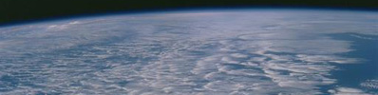

Changes in Earth’s energy & water cycles
Department of Meteorology
Richard P. Allan r.p.allan@reading.ac.uk @rpallanuk
Chunlei Liu (Guangdong Ocean University, Zhanjiang, China)

Slide 2
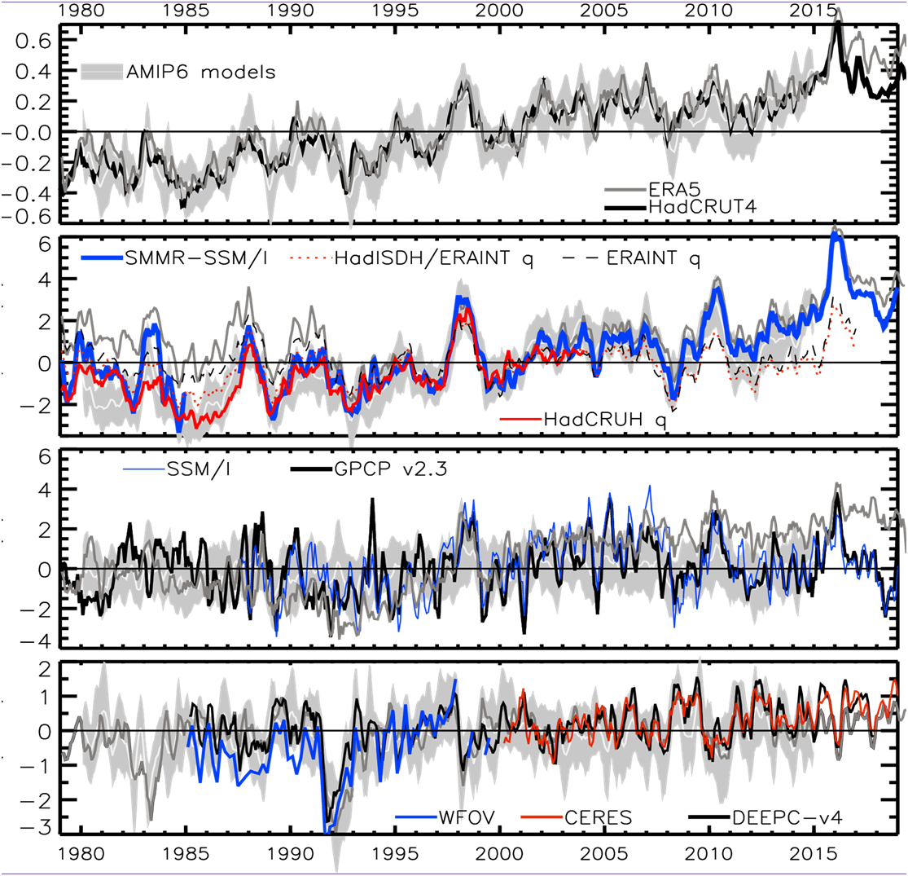
Current global climate change
+0.15 K/decade
Moisture (%) Temperature (degC)
+1 %/decade
?
Update from Allan et al. (2014) Surv. Geophys.
Declining RH over land since ~2000 linked to land/sea warming contrast (O’Gorman & Byrne 2018 PNAS) but under-estimated by models? (Dunn et al. 2017 ESD)

Slide 3
Current global climate change
+0.3 %/decade
Heating (Wm⁻²) Precipitation (%)
2.8
1.8
0.8
-0.2
-1.2
-2.2
+0.34 Wm⁻²/decade
Update from Allan et al. (2014) Surv. Geophys.; Allan et al. (2014) GRL

Slide 4
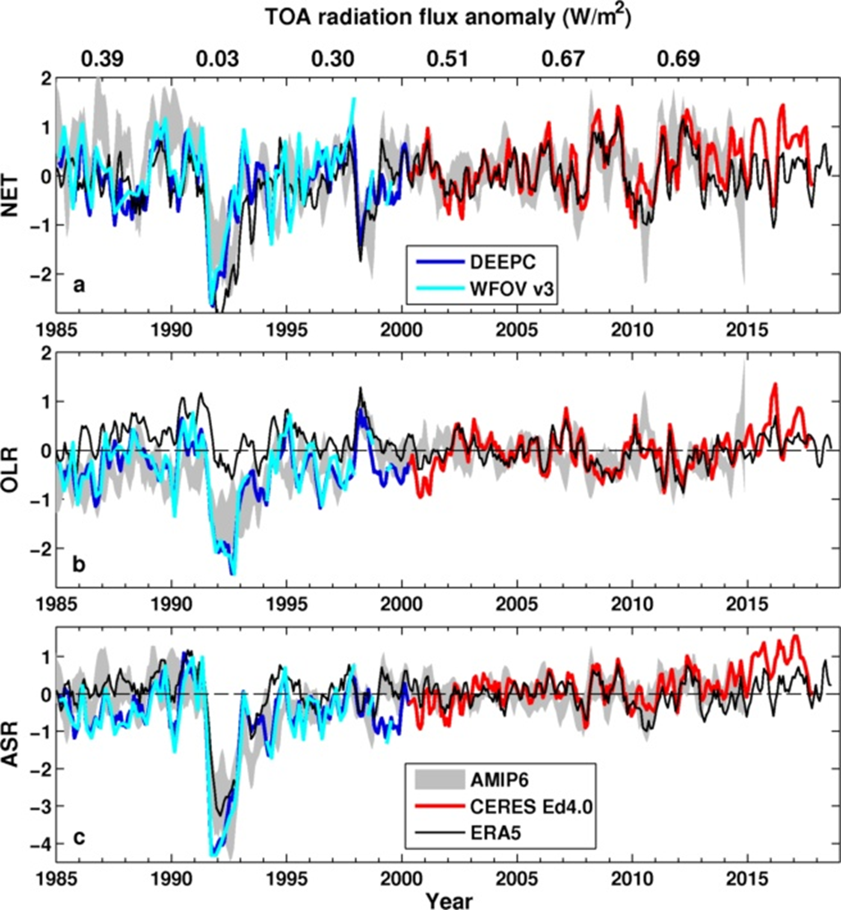
CURRENT Energy Budget Changes
Preliminary comparison with AMIP6 and ERA5
Large uncertainty in pre-CERES EEI remains
Consistent with ocean heat content changes (Cheng et al. 2017 Sci. Adv.), lower than Resplandy et al. (2019) Sci. Rep. which now has larger range following correction (0.3-1.3 Wm⁻²)
ERA5 does not capture observed ASR increase after warming slowdown (e.g. Loeb et al. 2018)
  ↑Heating 2015/16
  Cloud plus aerosol?
  r = 0.46
?
  r = 0.57
  r = 0.7

Slide 5
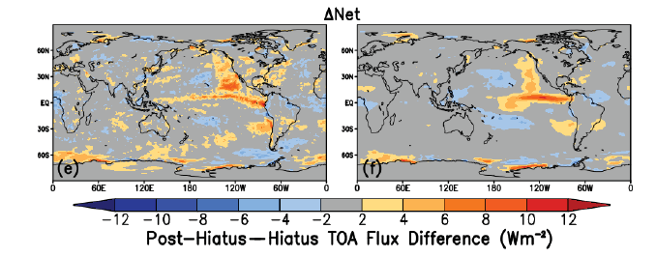
Cloud Feedbacks
CERES EBAF v4.1
CMIP6 model ensemble
July 2014–June 2017 minus July 2000–June 2014
Use 2015/16 El Nino as laboratory to test cloud feedbacks (Loeb et al. 2020 GRL)
  CMIP6 AMIP simulations generally able to capture net flux responses
  Depends on model ability to represent SW radiation changes in low cloud regions
Cloud errors and wind-feedbacks also determine systematic model biases in Southern Ocean (Hyder et al. 2018 Nature Comms) and globally (Hyder et al. in prep)

Slide 6
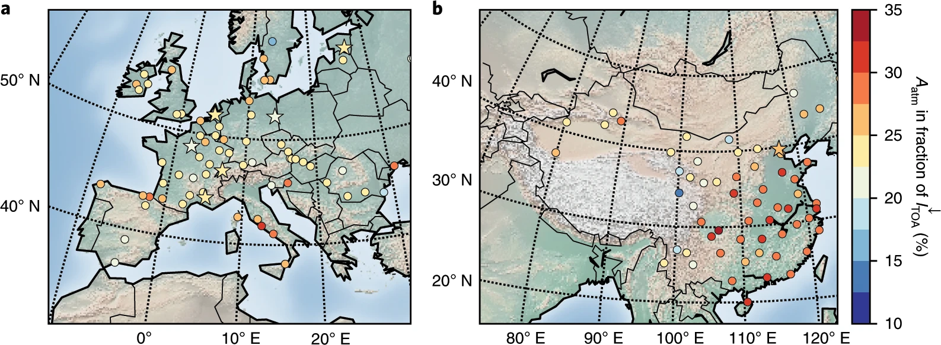
Observed
Changes in shortwave absorption
- Combine TOA & surface obs
- Surface dimming then brightening after air pollution control
- Atmospheric absorption more important than previously thought
- Implications for water cycle e.g. Wilcox et al. (2020) ACPD
Schwarz et al. (2020) Nature Geosci.

Slide 7
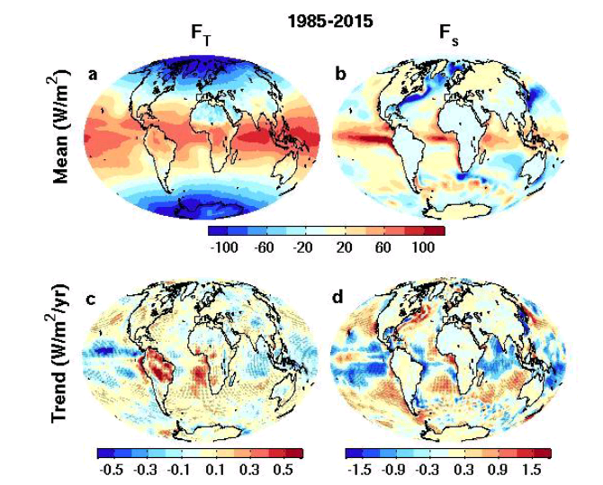
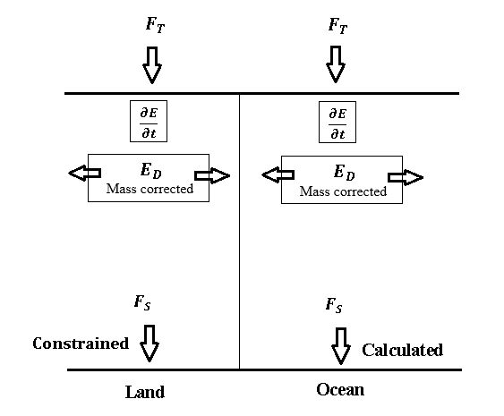

global surface flux estimates
top of atmosphere surface
ERBS CERES
reanalyses
Liu et al. (2017) JGR Data: http://dx.doi.org/10.17864/1947.111
Evaluation of models, reanalyses, satellite products e.g. Williams et al. (2018) JAMES; Wittenberg et al. (2018) JAMES ; Roberts et al. (2018) GMD; Sus et al. (2018) AMT, etc
Southern Ocean biases: Hyder et al. (2018) Nature Comms
Volcanic radiative responses: Schmidt et al. (2018) JGR
North Atlantic Heat transports: Brydon et al. (2020) J. Clim
Aerosol effects on energy budget: Schwarz et al. 2020 Nature Geosci.

Slide 8
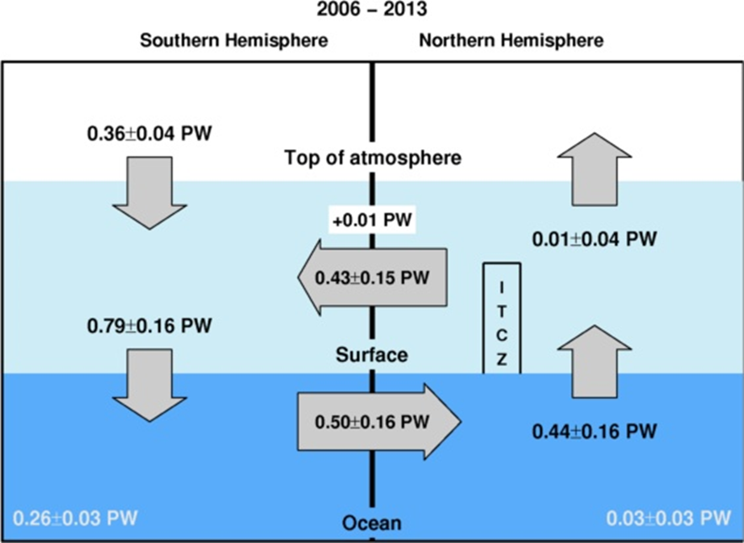
Hemispheric Asymmetry
In EARTH’S Energy Budget
Mean position of the tropical rainy belt in northern hemisphere determined by northward energy transport by ocean e.g. Frierson et al. (2013) Nature Geosci
Important to quantify hemispheric energy budget:
← Inferred 2006-2013 cross equatorial energy flux (updated from Liu et al. 2017 & Loeb et al. (2015) Clim. Dyn using ocean heating from Roemmich et al. (2015) Nature Clim, Desbruyeres et al. (2016) GRL or ORAS4 reanalysis)
Liu et al. in prep

Slide 9
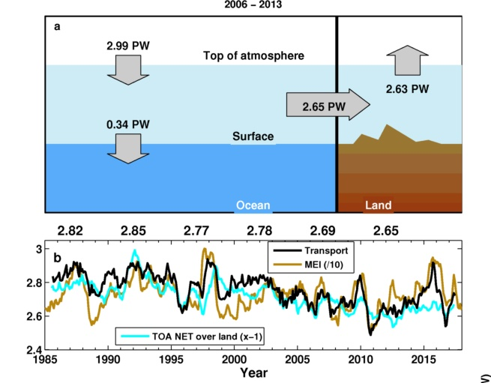
Ocean and land energy budget
Liu et al. in prep
Notes:
(a) Updated observations of energy flows between ocean and land regions in the climate system in petawatts (PW) over 2006–2013. TOA radiative flux is from CERES EBAF 4.0 anchored to 0.71 Wm-2 (0.36 PW) over 2006–2013. (b) Time series of the transport from ocean to land, together with the MEI index which is divided by 10 and shifted up to match the transport. The five year mean transports are displayed at the top.

Slide 10
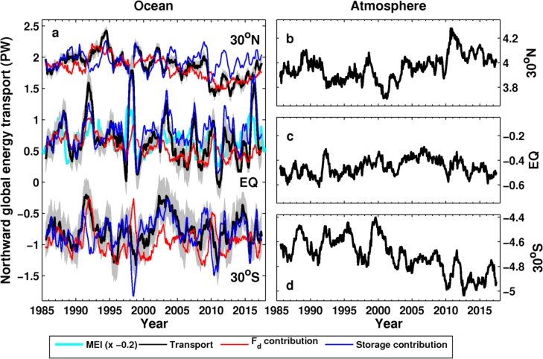
Computed global meridional energy transports (30ºN, equator, 30ºS)
Liu et al. in prep
Notes:
Time series of global meridional transports at 30◦N, equator and 30◦S in ocean (left column) and atmosphere (right column). Contributions of net surface energy flux and heat storage integrated from the north pole to oceanic transport are also plotted. Heat storage contribution and MEI index are all adjusted up and down for clarity.

Slide 11
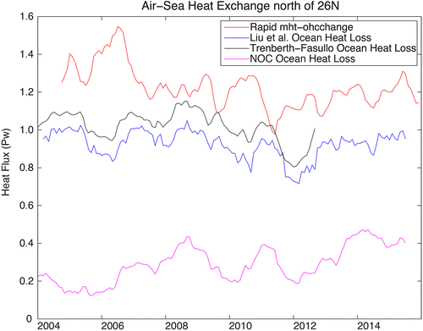
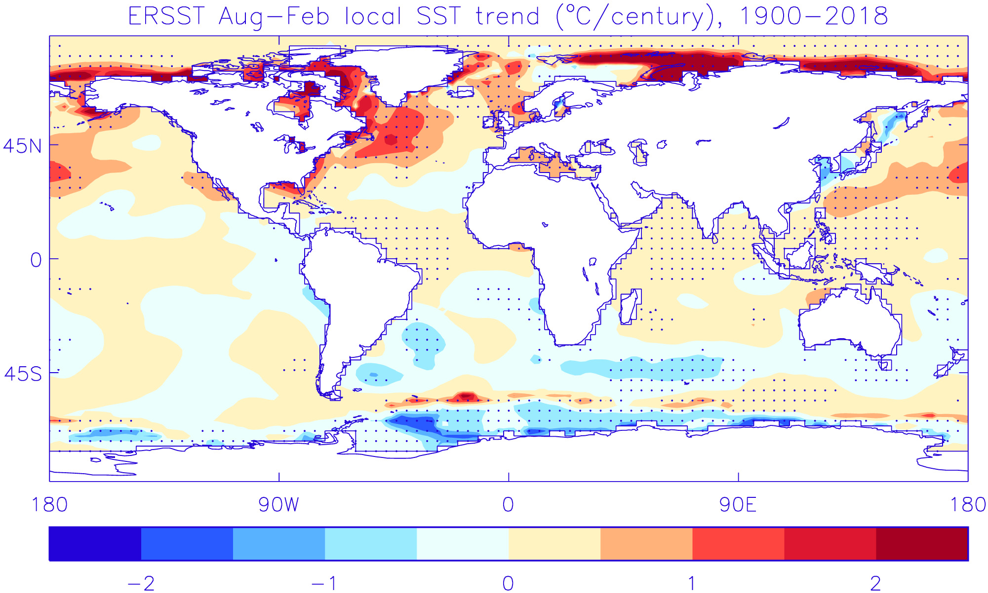
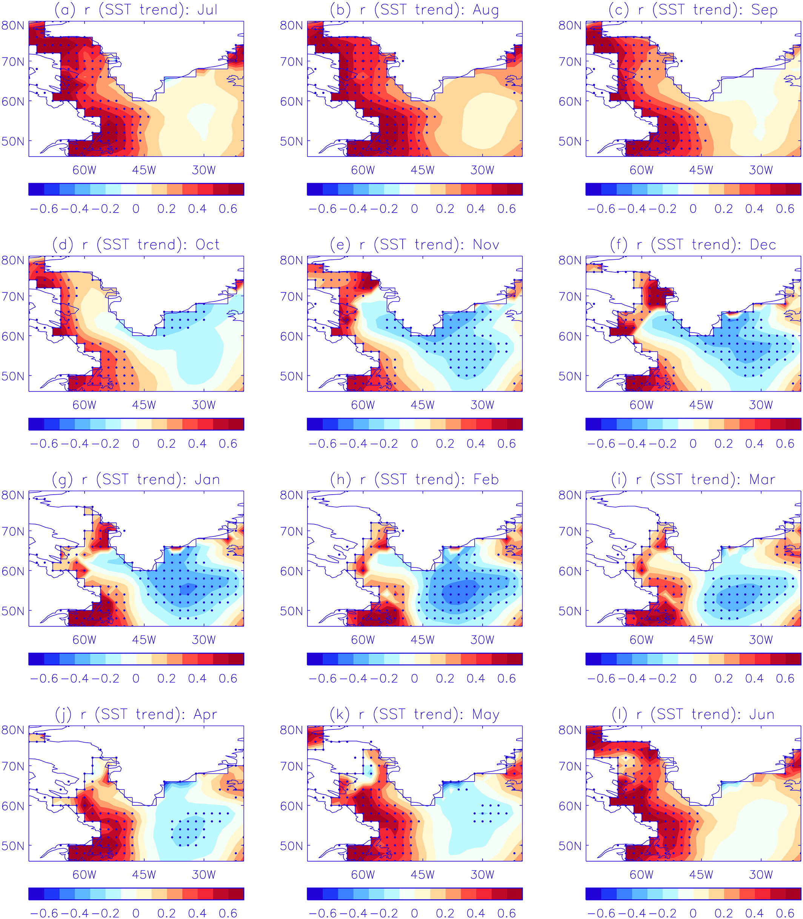
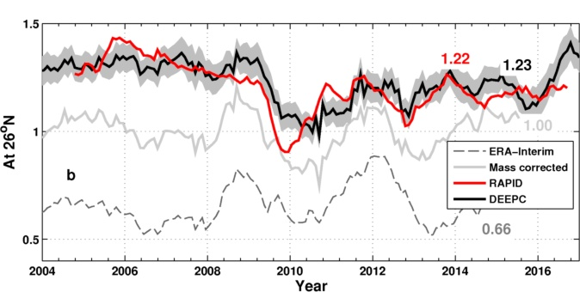
Atlantic heat transport
AND the cold blob
Brydon et al. (2020) J. Clim
Allan & son Ltd (2019) JGR
Liu et al. in prep

Slide 12
Summary
Multi-decadal estimates of Earth’s energy imbalance/sea level broadly consistent (e.g. Cheng et al. 2017 Sci. Adv.; Allan et al. 2014 GRL; Nerem et al. (2018) PNAS)
Advances in observing energy transports (Trenberth & Fasullo, 2017 GRL)
Upper ocean mixed layer energy budget links EEI & surface warming rate (Roberts et al. 2015 JGR; Hedemann et al. 2017 Nature Clim.; Xie & Kosaka 201 CCCR)
Distinct feedbacks on internal variability & forced change e.g. Brown et al. 2016; Xie et al. 2015 ; England et al. (2014)
Do climate models underestimate low cloud amplifying feedbacks, internal variability & climate sensitivity? Marvel et al. 2018; Silvers et al. 2017 ; Yuan et al. 2018 ; Loeb et al. 2020 GRL
Spatial patterns of warming crucial for feedbacks & climate sensitivity e.g. He & Soden (2016); Richardson et al. (2016); Ceppi & Gregory (2017); Andrews & Webb (2017)
Can radiative forcing spatial pattern drive temperature change? Are there missing dynamical feedbacks on warming?
What are the mechanisms that determine N Atlantic variability and links with Pacific and ocean heat uptake? How are inter-hemispheric, land/ocean and low to high latitude heat transports changing?
What is the aerosol impact on atmospheric absorption and hydrological cycle?

Slide 14
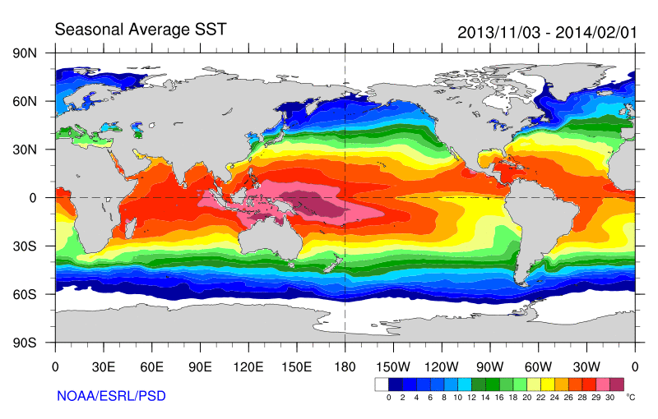
Some earlier strands
Radiative Forcing/Imbalance Johnson et al. (2016) ; Checa-Garcia et al. (2016) ; Huber & Knutti (2014) ;Santer et al. (2015)
Continued heating from greenhouse gases
Aerosol forcing of circulation (Smith et al. 2016)
Unusual weather patterns (Ding et al. 2014; Trenberth et al. 2014b)
Pacific SST strengthens atmospheric circulation
Enhanced Walker Circulation
? Heat flux to Indian ocean Lee etal 2015
Increased sea height
Warm
Upwelling,
Cool water
Remote forcing from Atlantic:
Li et al. (2016) ;
McGregor et al. (2014)
Increased precipitation
Decreased salinity
Strengthening trade winds
Equatorial Undercurrent
Pacific dominates?
Mann et al. (2016) Kosaka & Xie (2013) England et al. (2014)
Enhanced mixing of heat below 100 metres depth by accelerating shallow overturning cells and equatorial undercurrent
See also: Merrifield (2010).; Sohn et al. (2013) .; L’Heureux et al. (2013) . Change; Watanabe et al. (2014) ; Balmaseda et al. (2013) ; Trenberth et al. (2014) .; Llovel et al. (2014) ;Durack et al. (2014) ; Nieves et al. (2015) ; Brown et al. (2015) JGR ; Somavilla et al. (2016) ; Liu et al. (2016)
Notes:
There is lots of new results focussing on the slower rates of surface warming and associated unusual climatic conditions at the beginning of the 21st century (see DEEP-C website: http://www.met.reading.ac.uk/~sgs02rpa/research/DEEP-C.html#PAPERS).

Slide 15
Declining RH over land since ~2000 linked to land/sea warming contrast (O’Gorman & Byrne 2018 PNAS) but under-estimated by models? (Dunn et al. 2017 ESD)
+0.15 K/decade
+1 %/decade
?
Heating (Wm⁻²) Precip (%) Moisture (%) Temperature (degC)
+0.3 %/decade
Update from Allan et al. (2014) Surv. Geophys.; Allan et al. (2014) GRL
2.8
1.8
0.8
-0.2
-1.2
-2.2
+0.34 Wm⁻²/decade

Slide 16
New global surface flux estimates
top of atmosphere surface
ERBS CERES
reanalyses
Surface energy flux dataset combines top of atmosphere satellite reconstruction with reanalysis energy transports: Liu et al. (2015) JGR
Liu et al. (2017) JGR Data: http://dx.doi.org/10.17864/1947.111

Slide 17
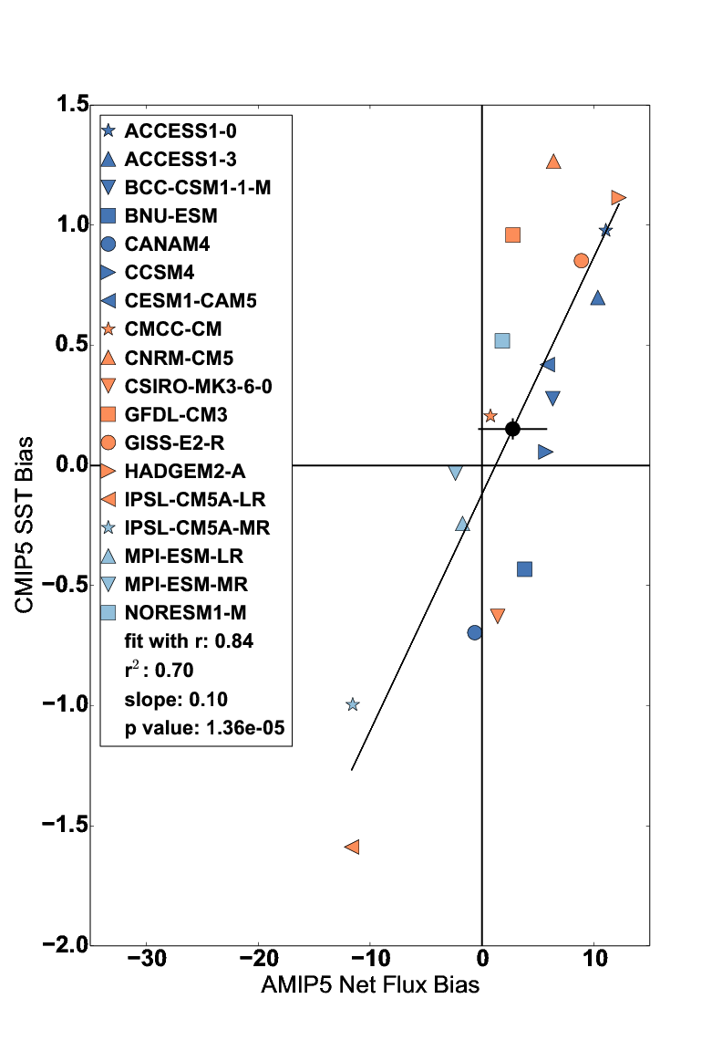
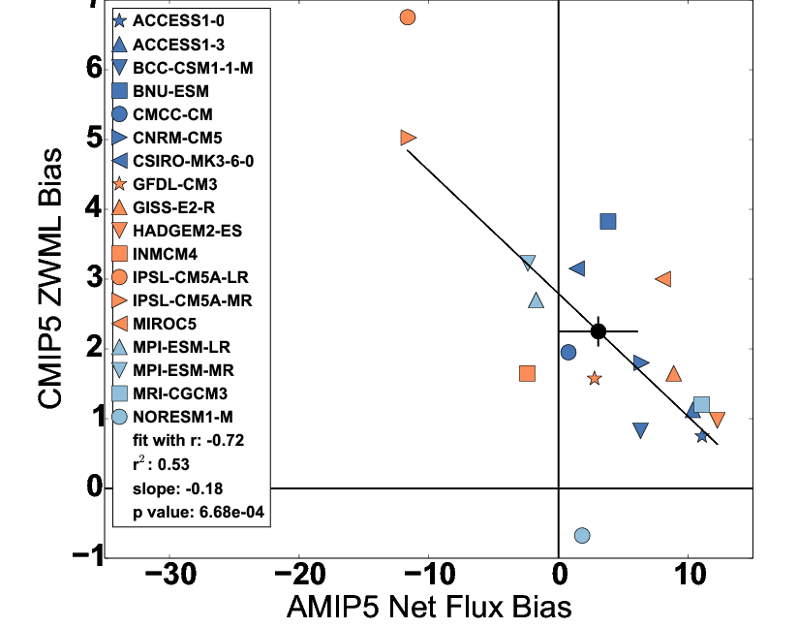
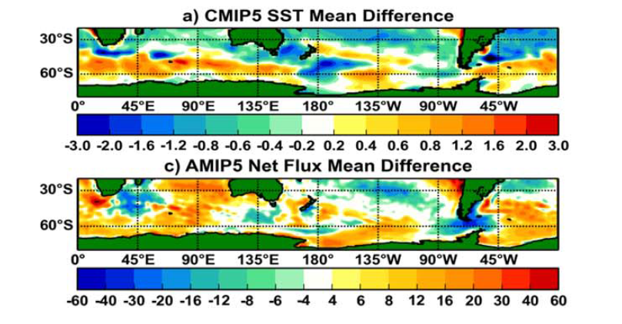
CLIMATE model biases in SOUTHERN OCEAN
Influence Asymmetry
Use surface flux product to trace causes of coupled SST biases to atmospheric model processes
Biases in AMIP5 simulations of cloud linked to SST & zonal wind maximum latitude (ZWML) bias
Hyder et al. (2018) Nature Comms
CMIP5 SST bias

Slide 19
Conclusions
Water vapour increasing with warming climate as expected from thermodynamics
  Abatement of near surface moistening over land since ~2000 remains
Global precipitation barely increasing, expected from energy constraints
  direct atmospheric heating from radiative forcings offsetting much of increase due to atmospheric warming that enhanced radiative cooling rate
Imbalance in Earth’s energy budget driving climate change
  Heating currently dominated by southern hemisphere
  Imbalance in heating between hemispheres affecting precipitation patterns
Systematic model biases related to hemispheric imbalance:
  Aerosol indirect effects on cloud
  Biases in cloud and SST in Southern Ocean & Africa/Atlantic region
  Warming of climate and strengthening Sahara heat low expected to drive increases in rainfall and its intensity and later wet season over north Africa

Slide 20
(a) Multiannual mean (2006–2013) northward total meridional ocean heat transports (unit is PW) in Atlantic derived from the updated net DEEPC surface fluxes and observations (symbols, error bars show one standard deviation). The ocean heat storage derived from observational data of Desbruyeres et al. [2017] is also taken into account. (b) Northward meridional ocean heat transports at 26oN of Atlantic from RAPID observations (red) and updated DEEPC net surface fluxes taking into account the ocean heat storage of ORAS4 0-700m (solid black), together with the transports inferred from ERA-Interim model surface fluxes (dashed grey line) and the one with mass corrected atmospheric energy divergences (but no land surface flux adjustment) (solid light grey line). The multiannual mean (April 2004 – March 2014) transports are also displayed in the plot.

Slide 21
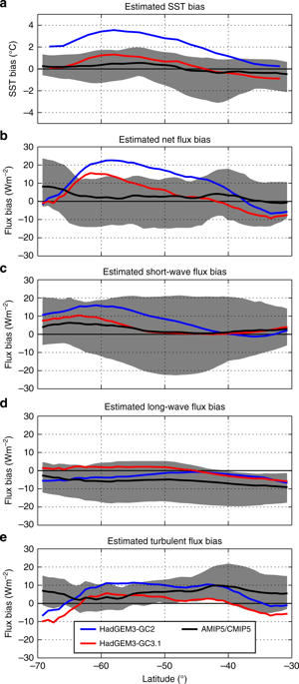
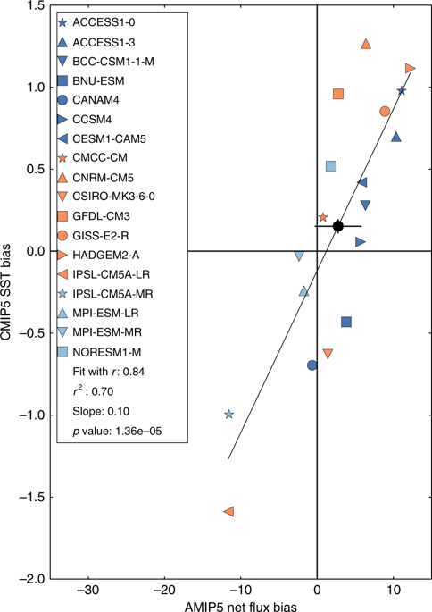
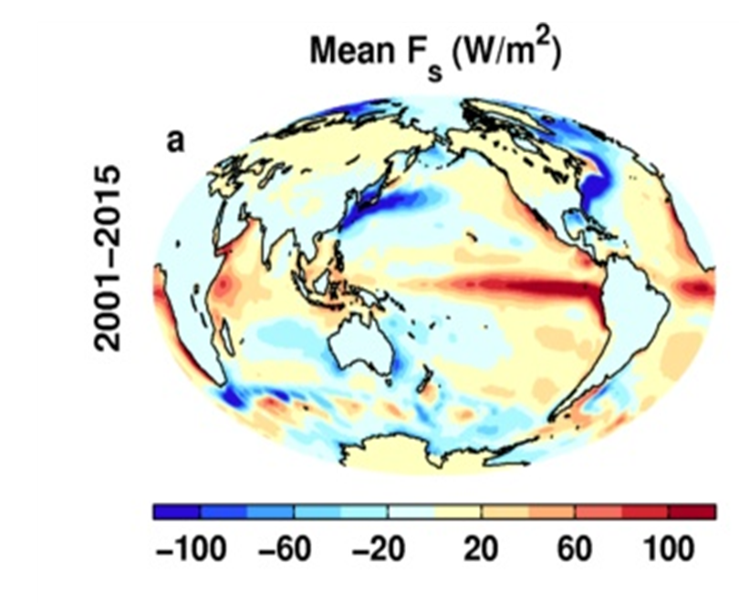
How do cloud errors contribute to evolving systematic model biases?
Combine AMIP/CMIP to understand fast/slow evolution of model biases
External partner: Met Office
Hyder et al. 2018 Nature Comms

Slide 22
Do models simulate realistic interannual cloud feedbacks?
Evaluating cloud feedback using satellite data (CERES EBAF)
CERES
AMIP
Collaboration with Norman Loeb (NASA Langley)
External links with Met Office and NASA Langley.
TOA RSW 2014-2017 El Nino minus 2000-2014 climatology

Slide 23
Anomaly correlation coefficient over 1985-2016 between surface temperature and TOA (a) OLR, (b) ASR, (c) NET and (d) surface net energy flux Fs. The reference period is 2001-2005. The OLR is positive upward here. Also shown are the anomaly scatter plots between surface temperature and (e) TOA ASR and (f) TOA OLR.

Slide 24
NEAR sURFACE Humidity Trends
HadISD specific and relative humidity trends (Dunn et al. 2017 ESD)
Declining RH over land since ~2000.
Not captured by CMIP5 simulations but is when models forced with SST
Explained by land/sea warming contrast: O’Gorman & Byrne (2018) PNAS

