Slide 1
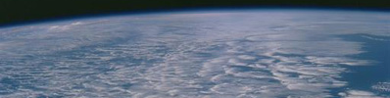

MOAP Water Vapour Meeting, Reading 19/02/20
Department of Meteorology
Richard P. Allan r.p.allan@reading.ac.uk @rpallanuk

Slide 2
Agenda
Attending: Richard Allan, Kate Willett, Rob Chadwick, Tim Trent, Michaela Hegglin, + remotely: Viju John Alan Vance?, Christoforos Tsamalis? 10:30am Coffee
11am Introduction – Richard Allan
Talks from Kate Willett, Viju John Skype, others…
12:30pm Lunch
1pm – Outcomes: prioritise 1 paper, 1 grant proposal
2pm Close
Meeting number (access code): 144 236 781
Meeting password: 8fZYDBWGy33
Join meeting: https://eumetsat.webex.com/eumetsat/j.php?MTID=mb02ece6a6ac2f0b4a1ca0768add213a5

Slide 3
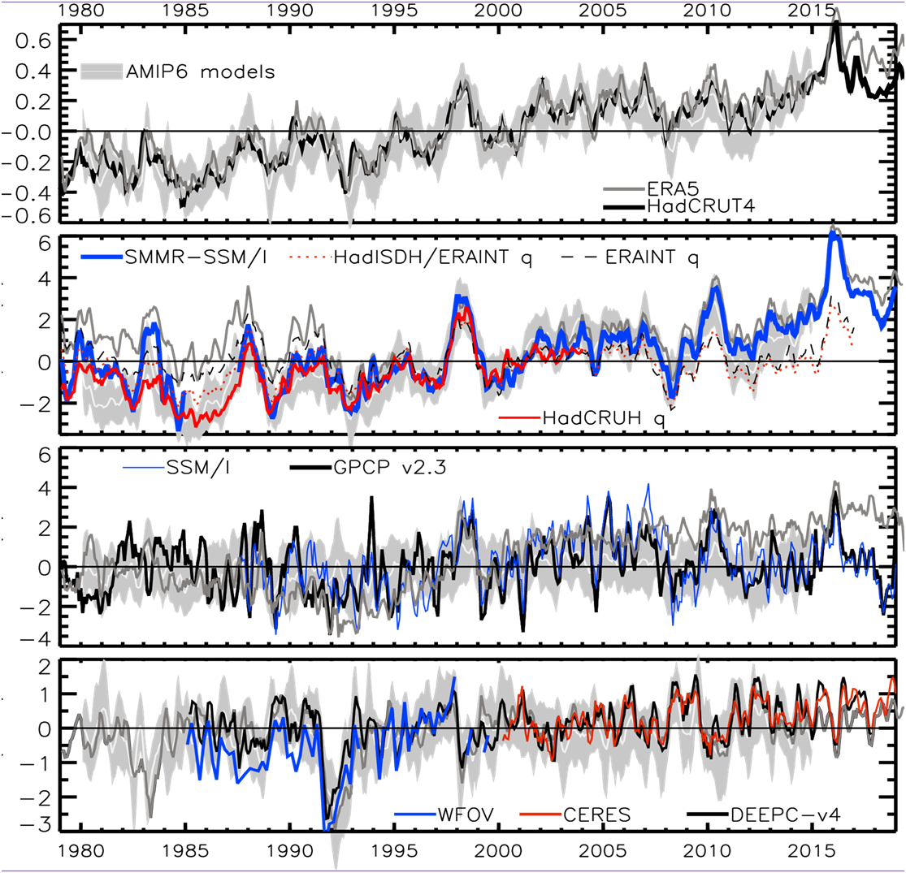
+0.15 K/decade
+1 %/decade
Precip (%) Moisture (%) Temperature (degC)
?
+0.3 %/decade
Update from Allan et al. (2014) Surv. Geophys.
Small precipitation response so far expected on energetic grounds (cooling from sulphate aerosol and fast adjustments to GHGs and absorbing aerosol) Allan et al. 2020
ERA5 captures water vapour changes since mid-1990s but not precipitation since water budget not closed (e.g. Allan et al. 2014 SG)

Slide 4
NEAR sURFACE Humidity Trends
HadISD specific and relative humidity trends (Dunn et al. 2017 ESD)
Declining RH over land since ~2000.
Not captured by CMIP5 simulations but is when models forced with SST
Explained by land/sea warming contrast: O’Gorman & Byrne (2018) PNAS

Slide 5
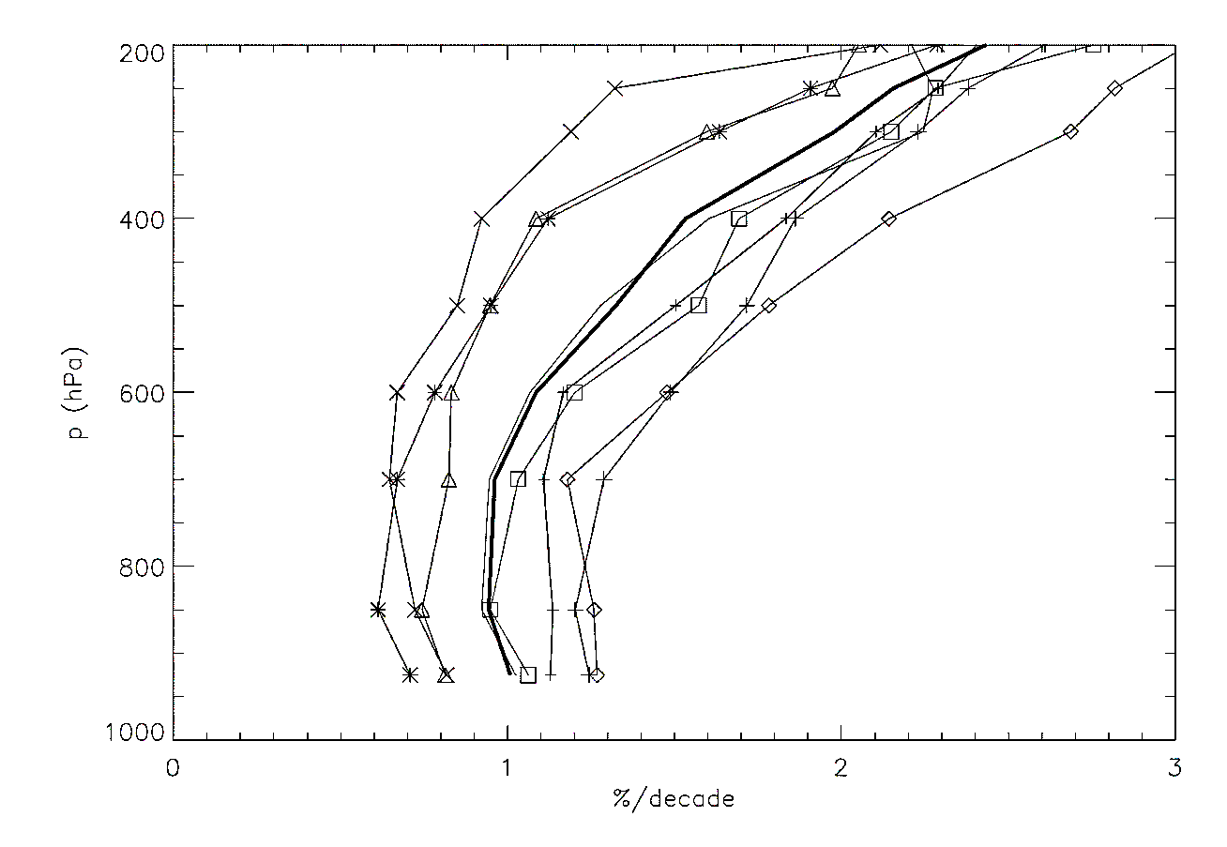
Simulated water vapour changes
Right: water vapour trends (1980-2014) in 8 CMIP6 amip simulations →
Low-level water vapour increases around 1%/decade based on SSM/I-ERA5 record (see also Schroeder et al. 2016)
Mid-upper tropospheric water vapour increases drive powerful amplifying feedback (e.g. John et al. 2019 in BAMS State of Climate)

Slide 6
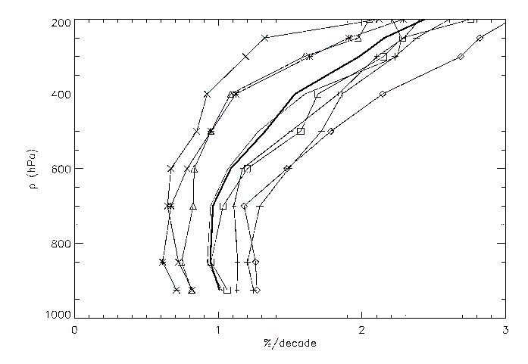
Possible Future analysis?
Synthesis plots (different datasets/metrics e.g. HADISDH q₀, ERA5, AIRS q(p), SSMIS CWV, AMSU-B q(dUTH)?, …)
Global, Tropical vs high lat? Land vs ocean; Trends, sensitivity to Ts. CMIP6 (hist, amip) vs Obs, time series, zonal, maps; 1988-present?
global
oceans
land
dq/dt
dq/dT

Slide 7
Stalled INITIAL Work Plan
CMIP6 data (1979-2014) – have some monthly amip/historical
AIRS (2003-2018) - Viju to get monthly q, (T?)
ERA5 (1979-2018) – have some monthly data, need to calc surface q?
  Get monthly T, q, RH (p-level) and tas
SSM/I TCWV (1988-2019)
  Merge with ERA5 & regrid
  CMSAF data?
HadISDH (+HadCRUH)
  Merge with ERA5?
UTH (1994-2018 microwave; 1979-? HIRS)
  Investigate how to convert to q’ proxy using ERA5
  Calculate on overpasses, make conversion, calc 2.5x2.5 mean
Analysis (?ECV inventory: https://climatemonitoring.info/ecvinventory/)
  Begin with AIRS/CMIP6, add in other data, monthly, deseasonalise at grid point level?
  Merge at high resolution, then regrid to 2.5x2.5 or 1x1 degree
  Convert UTH’ into UTSH’ proxy (investigate uncertainty) ?? Merge hi-lat with ERA5?
  Timeseries (global, ocean, land) TCWV, huss, upper trop q?
  Maps of trends
  Table of trends and detrended regression with Ts, also calc dX/dT=dX/dt*dT/dt
  Height dependent changes (AIRS/reanalyses) possibly adding indicative symbols for in situ and TCWV changes plus upper tropospheric q proxy

Slide 8
Seeking Funding?
Need big issue question, preferably with initial work highlighting this
E.g. Continental RH changes, model processes & regional precipitation
Do models underestimate continental RH decline and if so why?
How is water vapour changing across datasets and throughout the atmosphere (synthesis of surface and satellite data including
  HadISDH, microwave CWV, ?radiosonde, AIRS, microwave UTH, ...)
What are the regional changes in RH and can this help in understanding regional precip changes?
Can we improve on regional precipitation projections by more intelligent consideration of model biases (too dry region can’t get much drier)?
Are there hooks we can initiate a NERC proposal/collaboration such as RH decline discrepancy and/or regional changes in RH/P

