Slide 1
Variational data assimilation and forecast error statistics
“All models are wrong …” (George Box)
“All models are wrong and all observations are inaccurate” (a data assimilator)
Ross Bannister, 11th July 2011
University of Reading, r.n.bannister@reading.ac.uk

Slide 2
Distinction between ‘errors’ and ‘error statistics’
When people say ‘errors’ they sometimes (but not always) mean ‘error statistics’
Error: The difference between some estimated/measured quantity and its true value.
E.g. ε_{est} = x_{est} – x_{true} or ε_{y} = y – y_{true}
Errors are unknown and unknowable quantities
Error Statistics: Some useful measure of the possible values that ε could have.
E.g. a PDF
Error statistics are knowable, although often difficult to determine – even in the Gaussian case.
Here, error statistics = second moment (ie assume PDFs are Gaussian and unbiased, <ε> = 0).
E.g. second moment of ε, <ε²> (called a variance), or <ε²>^{1/2} = σ (standard deviation). If only the variance is known, then the PDF is approximated as a Gaussian.
P(ε) ~ exp – ε²/2<ε²>
PDF(ε)
σ= √<ε²>
ε
ε

Slide 3
Plan
A. Erroneous quantities
B. Error statistics are important
C. ‘Observation’ and ‘state’ vectors
D. ‘Inner’ and ‘outer’ products
E. Error covariances
F. Bayes’ theorem
G. Flavours of variational data assimilation
H. Control variable transforms
I. The ‘BLUE’ formula
J. A single observation example
K. Forecast error covariance statistics
L. Hybrid data assimilation

Slide 4
A. Erroneous quantities in data assimilation
Information available about the system before observations are considered.
Data that are being fitted to
Observations (real-world data)
Prior data for the system’s state
Prior data for any unknown parameters
Imperfections in the assimilation system
Model error within the da system
Representivity
Data that have been fitted
Data assimilation-fitted data (analysis, ie posteriori error statistics)
}

Slide 5
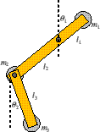
B.1 Error statistics are important
1. Error statistics give a measure of confidence in data (eg here obs error stats)
No assim
Assim with large obs errors Assim with small obs errors

Slide 6
B.2 How are error statistics important?
2. Error statistics of prior data imply relationships between variables
time
x₂
Background forecast (no assim)
Analysis forecast (consistent with prior and ob errors)
x₁
x₁ and x₂ cannot be varied independently by the assimilation here because of the shape of the prior joint PDF.
Known relationships between variables are often exploited to gain knowledge of the complicated nature of the prior error statistics (e.g. changes in pressure are associated with changes in wind in the mid-latitude atmosphere (geostrophic balance)).

Slide 7
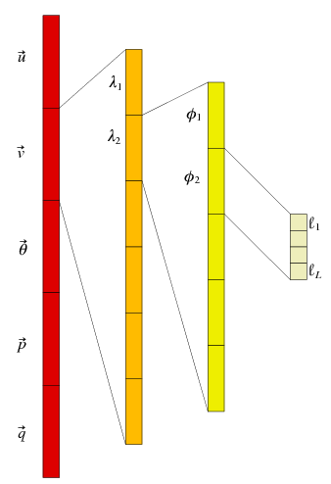
C. ‘Observation’ and ‘state’ vectors
y =
x =
extra parameters
The observation vector – comprising each observation made. There are p observations.
The structure of the state vector (for the example of meteorological fields u, v, θ, p, q are 3-D fields; λ, φ and ℓ are longitude, latitude and vertical level). There are n elements in total.

Slide 8
D. ‘Inner’ and ‘outer’ products
The inner product (‘scalar’ product) between two vectors gives a scalar
The outer product between two vectors gives a matrix
When ε is a vector of errors, <εε^{T}> is a (symmetric) error covariance matrix

Slide 9
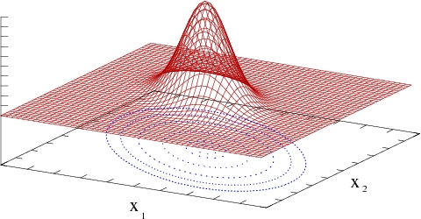
E. Forms of (Gaussian) error covariances
The one-variable case
σ= √<ε²>
<x>
The many variable case
0

Slide 10
F. Bayes’ theorem and the variational cost function
Bayes theorem links the following
PDF of the observations (given the truth)
PDF of the prior information (the background state)
PDF of the state (given the observations – this is the objective of data assimilation)
Lorenc A.C., Analysis methods for numerical weather prediction, Q.J.R.Meteor.Soc. 112 pp.1177-1194 (1986)

Slide 11
G.1 Flavours of variational data assimilation
1. Weak constraint 4D-VAR
General form
Simplified form : assume model errors are uncorrelated in time (white noise)
Q : model error covariance matrix

Slide 12
G.2 Flavours of variational data assimilation
2. Strong constraint 4D-VAR
Assume perfect model:
The ‘strong constraint’ approximation is valid if model error is negligible

Slide 13
G.3 Flavours of variational data assimilation
2. Incremental 4D-VAR (quasi-linear)
Linearisation of m Linearisation of h
Apply to strong constraint cost function
The incremental form is exactly linear and is valid if non-linearity is ‘weak’

Slide 14
H. Control variable transforms
Advantages of the new control variable:
No B -matrix to worry about
Better conditioning of the problem
In practice we design U and B follows (the implied B = U U ^{T})
The design of U is called ‘background error covariance modelling’

Slide 15
I. The cost function and the ‘BLUE’ formula

Slide 16
J. A single observation example
Analysis increment of the assimilation of a direct observation of one variable.
Obs of atmospheric pressure →

Slide 17
K.1 Forecast error covariance statistics
In data assimilation prior information often comes from a forecast.
Forecast error covariance statistics (P_{f}) specify how the forecast might be in error
ε_{f} = x_{f} – x_{true}, P_{f} = <ε_{f} ε_{f}^{T}>.
How could P_{f} be estimated for use in data assimilation?
Analysis of innovations (*).
Differences of varying length forecasts (‘NMC method’).
Monte-Carlo method (*).
Forecast time lags.
Problems with the above methods.
A climatological average forecast error covariance matrix is called ‘B’.

Slide 18
K.2 Analysis of innovations
We don’t know the truth, but we do have observations of the truth with known error statistics.
Definition of observation error : y = y_{true} + ε_{y} = h(x_{true}) + ε_{y}
Definition of forecast error : x_{true} = x_{f} – ε_{f}
Eliminate x_{true} : y = h(x_{f} – ε_{f}) + ε_{y} ≈ h(x_{f} ) - Hε_{f} + ε_{y}
‘Innovation’ : y - h(x_{f} ) ≈ ε_{y} - Hε_{f}
LHS (known), RHS(unknown)
Take pairs of in-situ obs whose errors are uncorrelated (for variable v₁, posn r and v₂, r+Δr)
y(v₁,r) - x_{f} (v₁,r) ≈ ε_{y}(v₁,r) - ε_{f}(v₁,r) y(v₂,r +Δr) - x_{f} (v₂,r +Δr) ≈ ε_{y}(v₂,r +Δr) - ε_{f}(v₂,r +Δr)
Covariances
<[y(v₁,r) - x_{f} (v₁,r)] [y(v₂,r +Δr) - x_{f} (v₂,r +Δr)]> = <[ε_{y}(v₁,r) - ε_{f}(v₁,r)] [ε_{y}(v₂,r +Δr) - ε_{f}(v₂,r +Δr)]>
= <ε_{y}(v₁,r) ε_{y}(v₂,r +Δr)> - <ε_{y}(v₁,r) ε_{f}(v₂,r +Δr)> - <ε_{f}(v₁,r ) ε_{y}(v₂,r +Δr)> + <ε_{f}(v₁,r) ε_{f}(v₂,r +Δr)>
↑ ↑ ↑ ↑
Obs error covariance Zero (obs and forecast errors Forecast error covariance
between (v₁, r) and (v₂, r+Δr) uncorrelated) between (v₁, r) and (v₂, r+Δr)
zero unless v₁=v₂ and Δr=0
(one particular matrix element of P^{f} or B)
<> average over available observations and sample population of forecasts

Slide 19
K.3 Monte-Carlo method (ensembles)
N members of an ensemble of analyses.
Leads to N members of an ensemble of forecasts.
The ensemble must capture the errors contributing to forecast errors.
Initial condition errors (forecast/observation/assimilation errors from previous data assimilation).
Model formulation errors (finite resolution, unknown parameters, …).
Unknown forcing.
Can be used to estimate the forecast error covariance matrix, e.g.
P_{f} ≈ < (x-<x>) (x-<x>) ^{T} > = 1/(N-1) ∑_{i=1,N} (x_{i} - <x>) (x_{i} - <x>)^{T}
Problem: for some applications N << n.
n elements of the state vector (in Meteorology can be 10⁷).
N ensemble members (typically 10²).
Consequence – when P_{f} acts on a vector, the result is forced to lie in the sub-space spanned by the N ensemble members.
Ensembles
x
t

Slide 20
L. Hybrid data assimilation
Variational data assimilation (with B-matrix)
B is full-rank
B is static
Ensemble data assimilation
Sample P_{f} is flow dependent
Sample P_{f} is low rank

Slide 21
Comments and Questions
!
?

