Slide 1


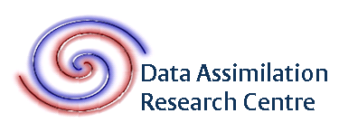

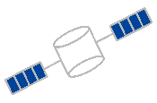
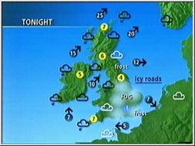
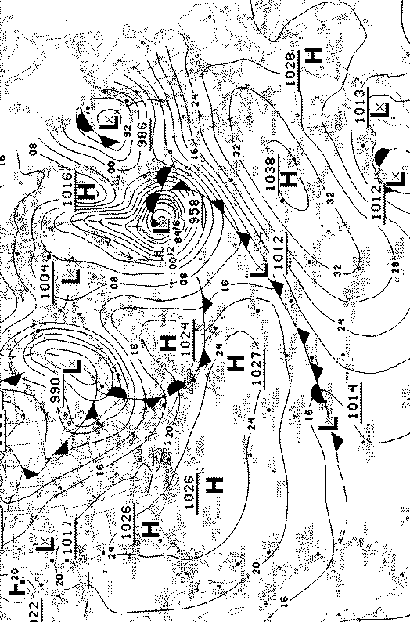
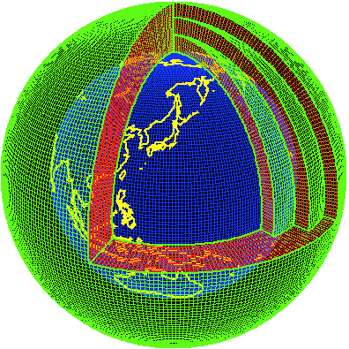


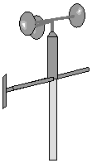


Satellites for Meteorology and Weather Forecasting
Weather forecasts
Meteorological model
Observations
data
assimilation
(‘initial conditions’)
Ross Bannister
High Resolution Atmospheric Assimilation Group,
NERC National Centre for Earth Observation, University of Reading, UK, r.n.bannister@reading.ac.uk

Slide 2


How do satellites help in understanding and forecasting weather events?
There is a huge demand for up-to-date knowledge about the Earth system
Issues with use of satellite data for numerical weather prediction (NWP)
1 | Model forecasts stray from reality over time (chaotic destruction of knowledge). The ‘butterfly effect’.
2 | The world is a very large place! Volume of atmosphere: 5 billion km³.
1 | Satellites don’t measure directly meteorological quantities (winds / temperature / humidity / etc). These have to be inferred for use with models: data assimilation.
2 | Qualitative information from satellites (‘satellite pictures’) help us see the evolving atmosphere, but doesn’t satisfy this demand.
3 | Satellite data need to be treated quantitatively to be useful for numerical weather forecasting.

Slide 3
Types of weather measurements
not comprehensive!
 |  | Coverage |  |  |  | Resolution
Instrument | Quantities | Spatial |  | Temporal |  | Horiz. | Vert.
In-situ instruments
Radiosondes | u, v, T, p, q, (O3) | Cont. N.H., t-sphere | 6 hourly |  |  | point | point
Surface stations | u, v, T, p, q | Continental surface | 6 hourly |  |  | point | n/a
Aircraft | u, v, T, p, q | Flight paths, airports | In flight |  |  | point | point
Drifting buoys | u, v, T, p | Drift paths, sea level | hourly |  |  | point | n/a
Remote sensing instruments
Geostationary satellites | Rad: MW, IR, Vis | Global |  | 15-30 mins | > 10 km |  | many kms
Polar orbit satellites (nadir) | Rad: MW, IR, Vis | Global |  | Continuous | 100s m |  | many kms
Polar orbit satellites (limb) | Rad: MW, IR, Vis | Global |  | Continuous | 100s km |  | 1-2 km
Scatterometer | Radar backscatter | Oceans |  | Continuous | 50 km |  | n/a
Radio occultation | GPS phase shifts | Global |  | ~ hourly | 150–300 km |  | 1 km
Ground-based radar | Radar reflectivity / Dopler shift | N.Am., Eu., Australia. 200km from antenna |  | 10 mins | ~ 1°
'Rad'=radiances, 'MW'=microwave, 'IR'=infrared, 'Vis'=visible
In operational global weather forecasting there are ~10⁸ observations assimilated per cycle

Slide 4
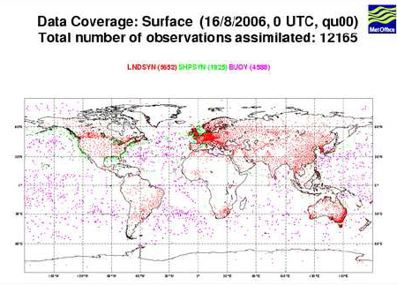
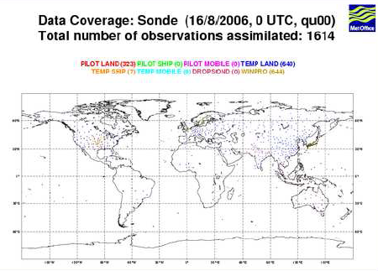
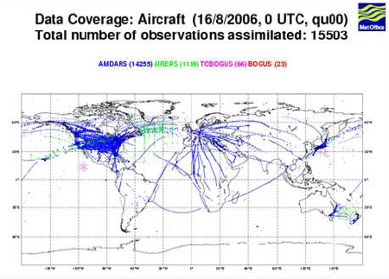
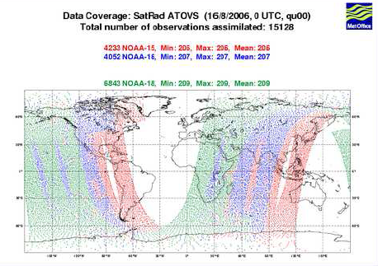
Coverage maps for NWP
Courtesy Met Office

Slide 5
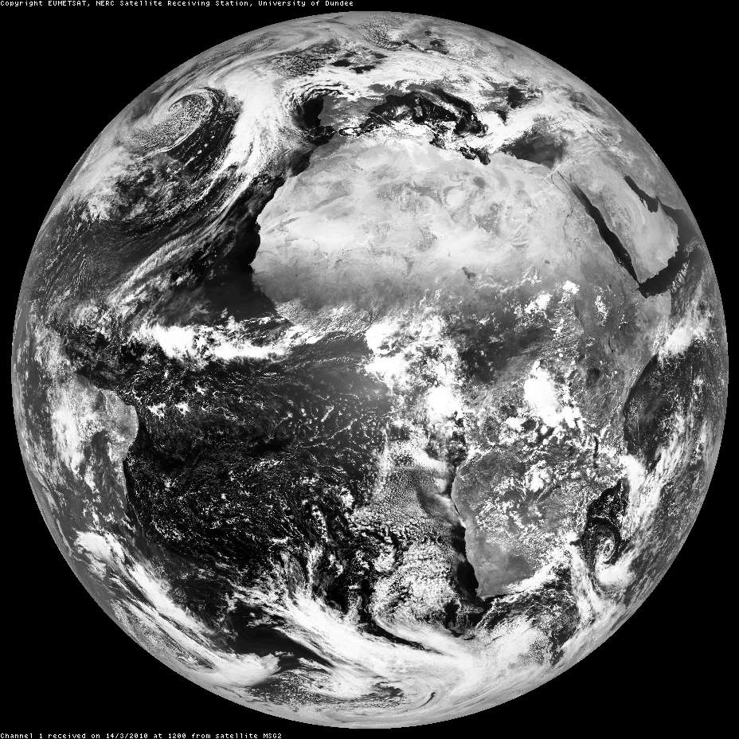
Contents
PART A | A history of satellites for weather forecasting / Earth observation
PART B | What does a satellite ‘see’?
PART C | Types of satellite orbit / viewing geometry / instrument
PART D | Example imagery
PART E | Deriving useful information from satellite measurements

Slide 6
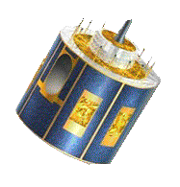
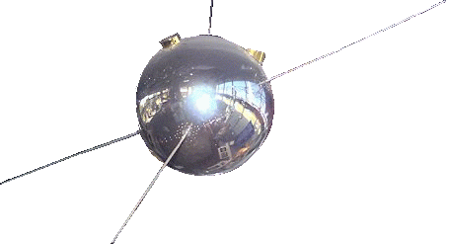
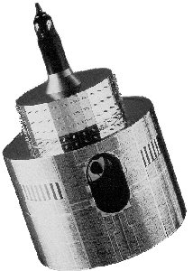
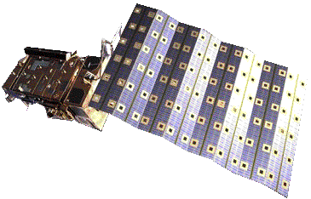
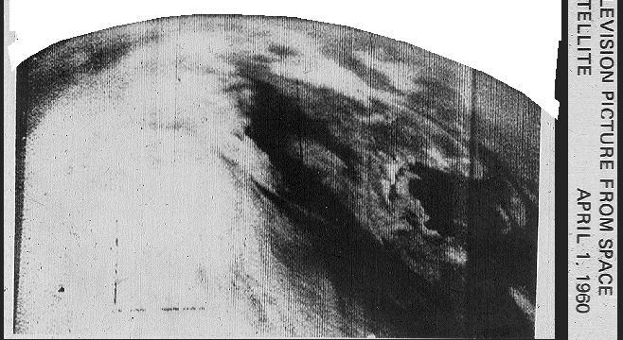
A history of satellites for weather forecasting
not comprehensive!
1978 – MeteoSat (geostationary)
1966 – ATS (geostationary)
2004 – MeteoSat SG (geostationary)
1974 – SMS (geostationary)
Apr 1960 – TIROS 1
Aug 1959 – Explorer 6
Feb 1959 – Vanguard 2
1969 – Nimbus 3
2006 - MetOp
First picture of Earth from TIROS-1

Slide 7

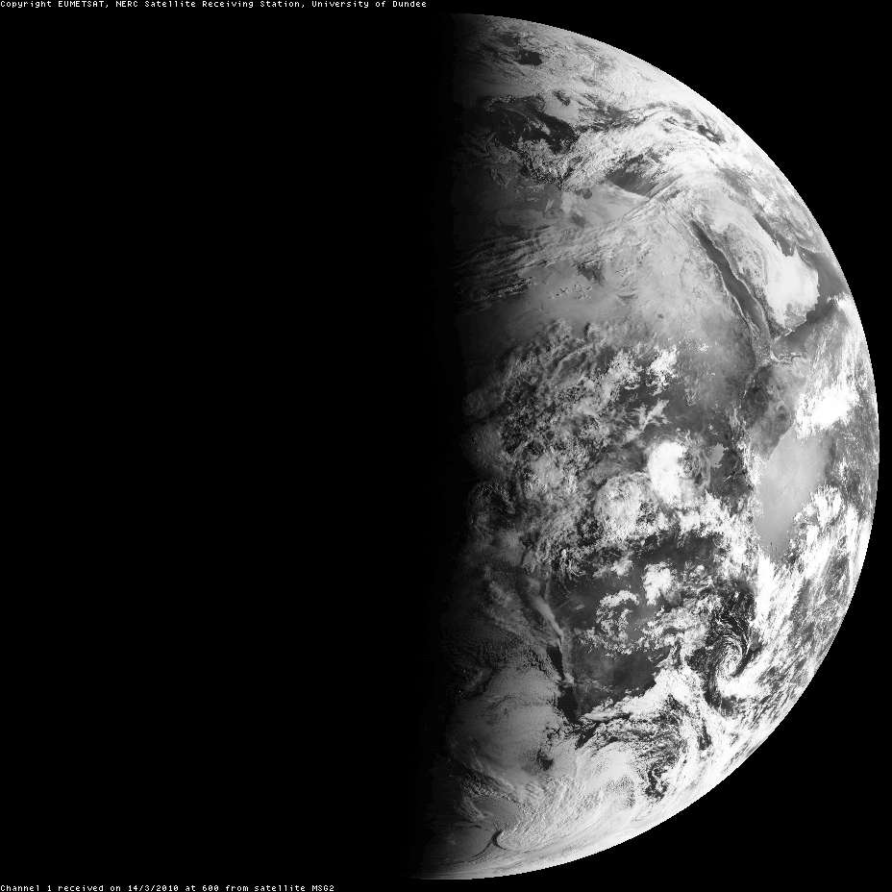
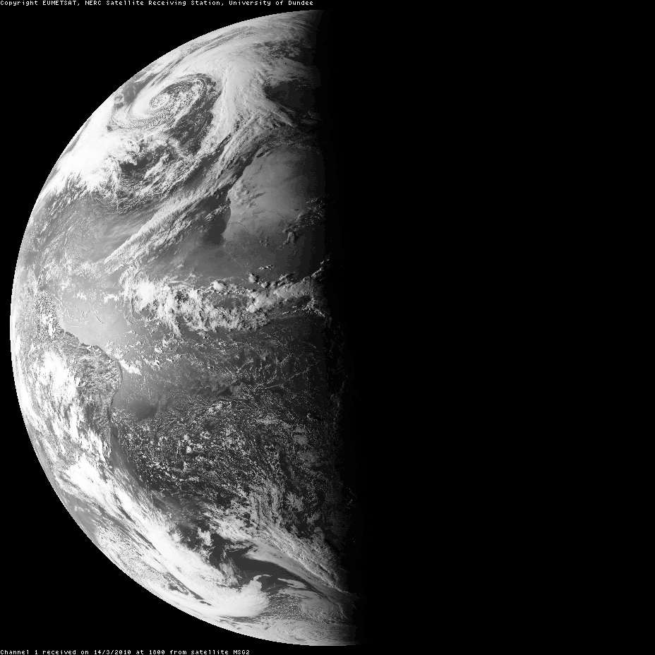

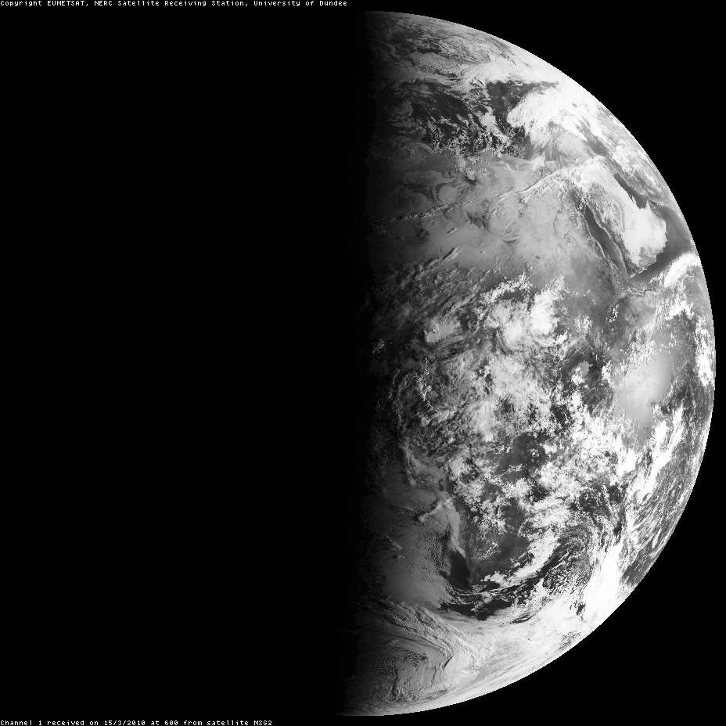
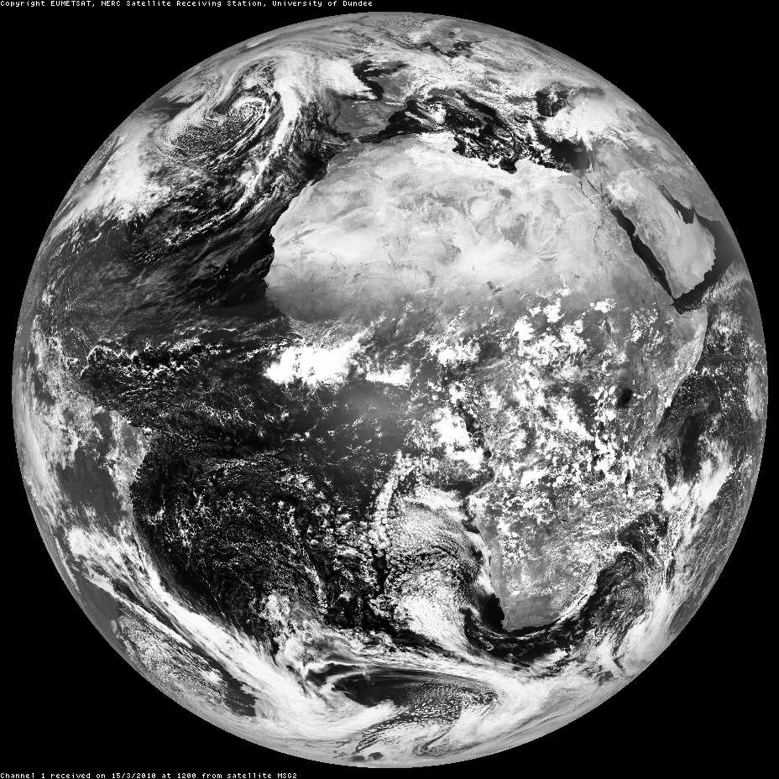
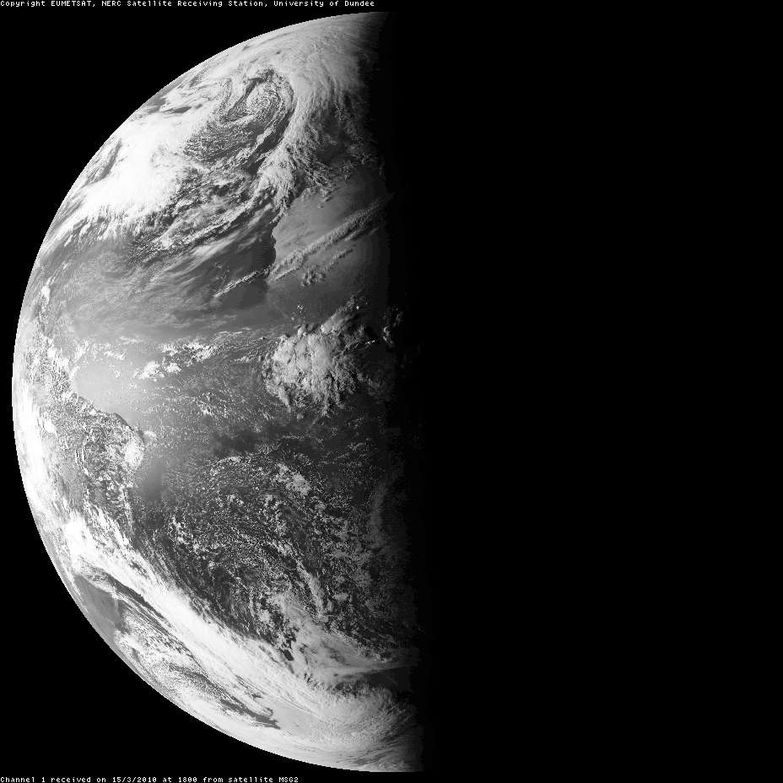

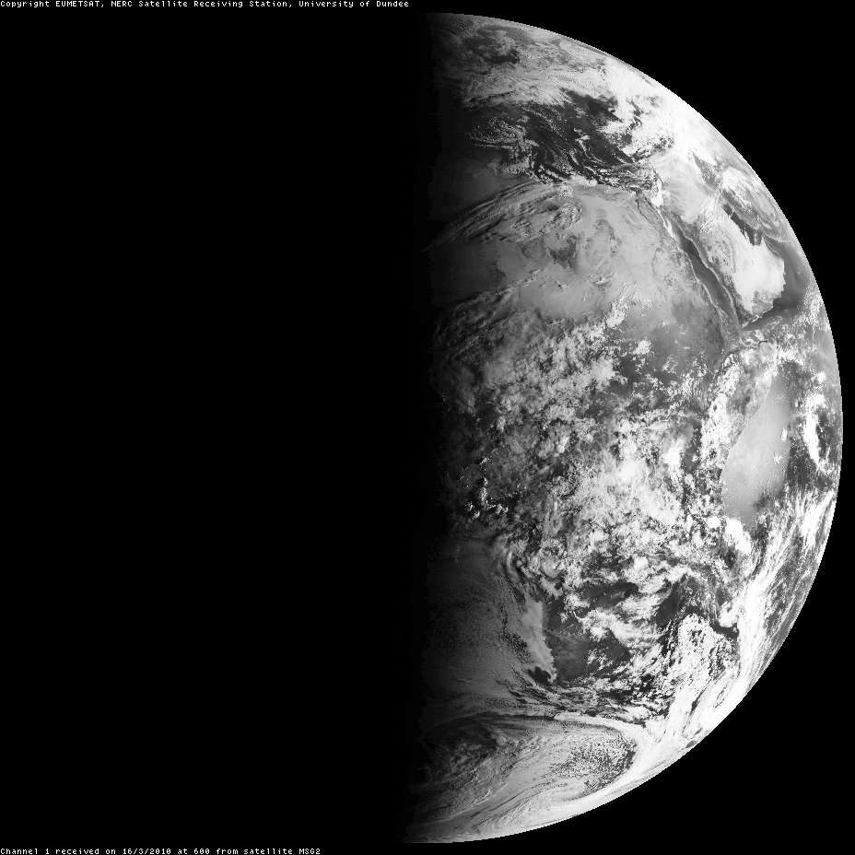
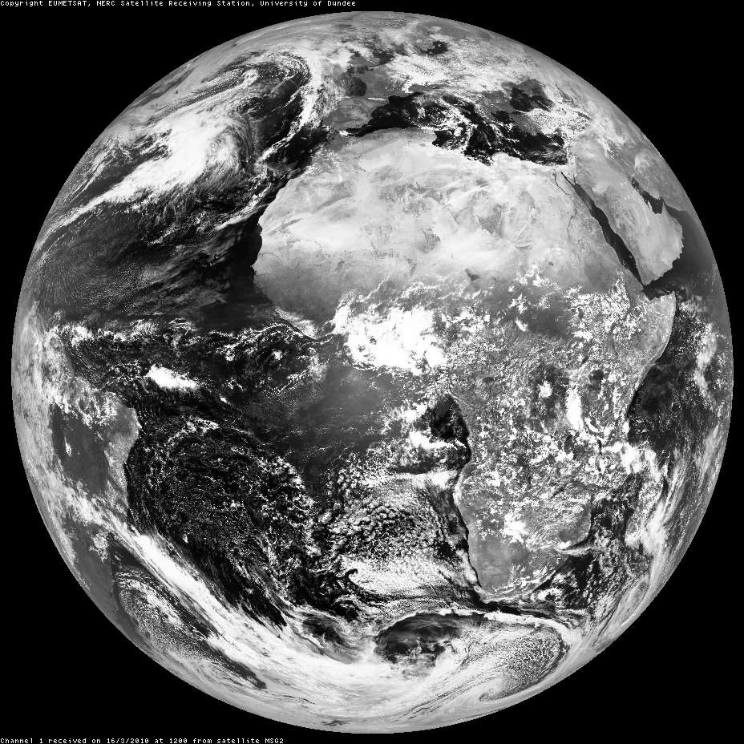
Sequences of satellite pictures (visible)
www.sat.dundee.ac.uk
SEVIRI channel 1, 0.56 – 0.71 μm
Courtesy NERC Satellite Receiving Station, University of Dundee

Slide 8
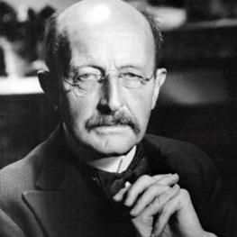
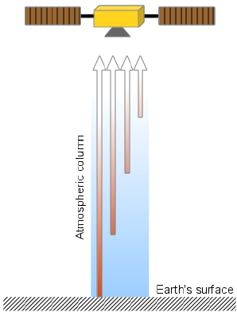
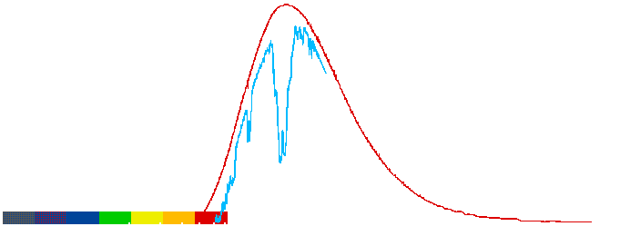
Information from satellite measurements over other parts of the EM spectrum
12.0 µm - information on temperature near the surface to ~3 km
9.7 µm - information on temperature at ~13 km
Max Planck
‘radiance’ measured by satellite
Thermal emission
from body at 300K
7.3 µm - information on temperature at ~3 to ~8 km
Wavelength 10⁻⁶ m (µm)

Slide 9
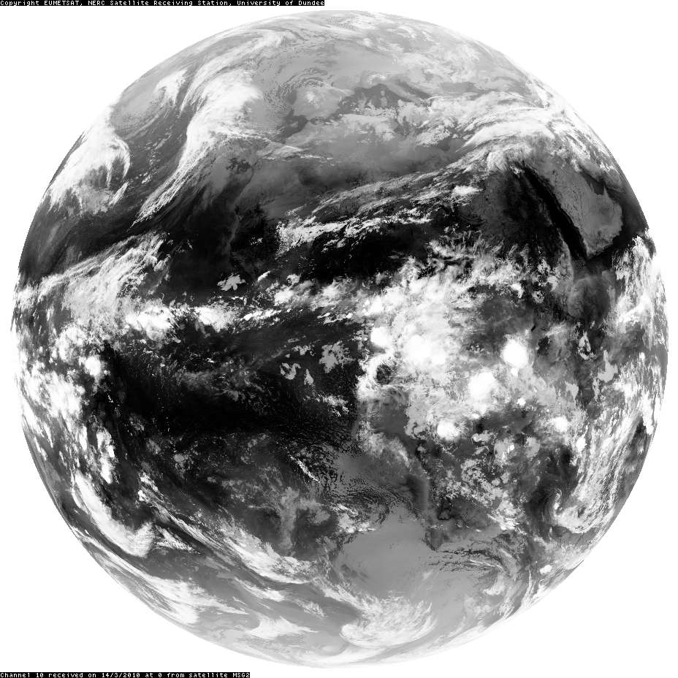
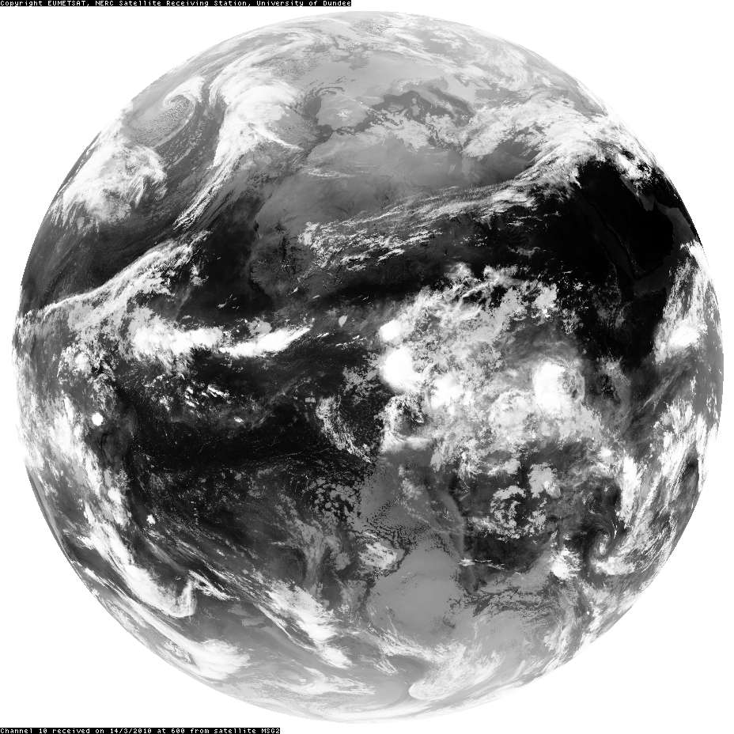
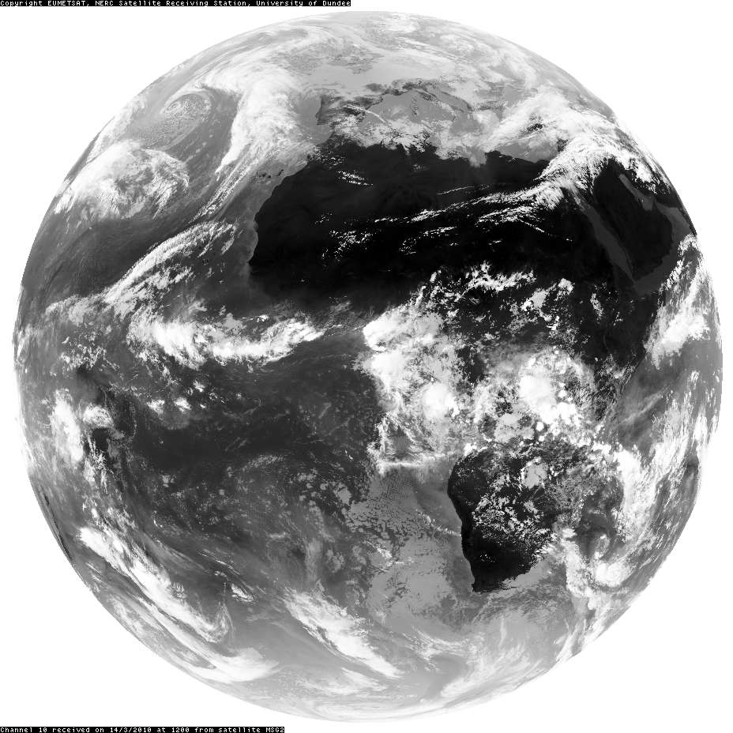
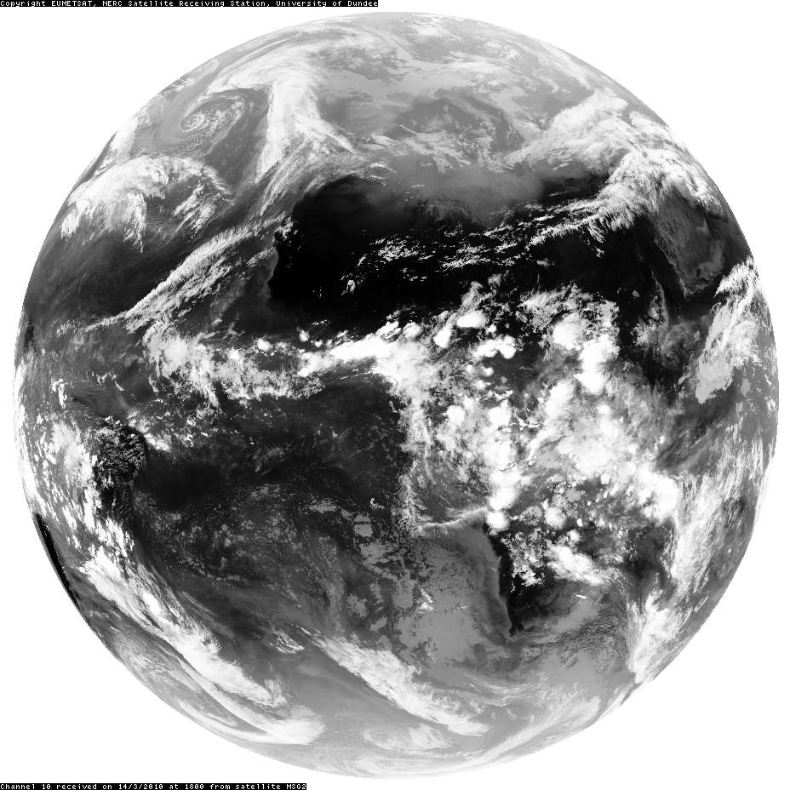
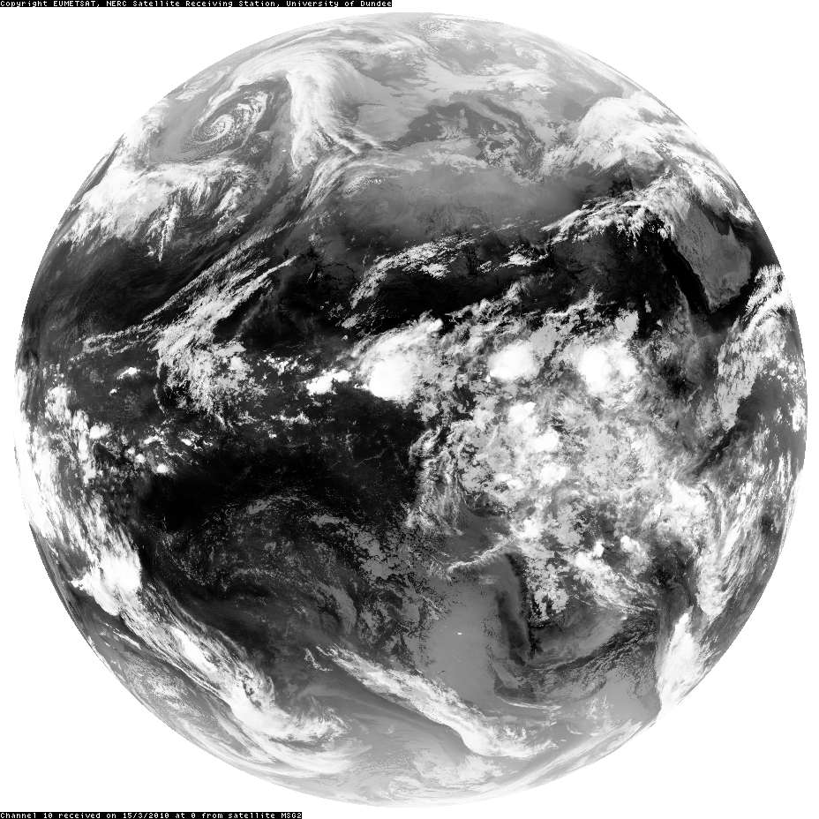
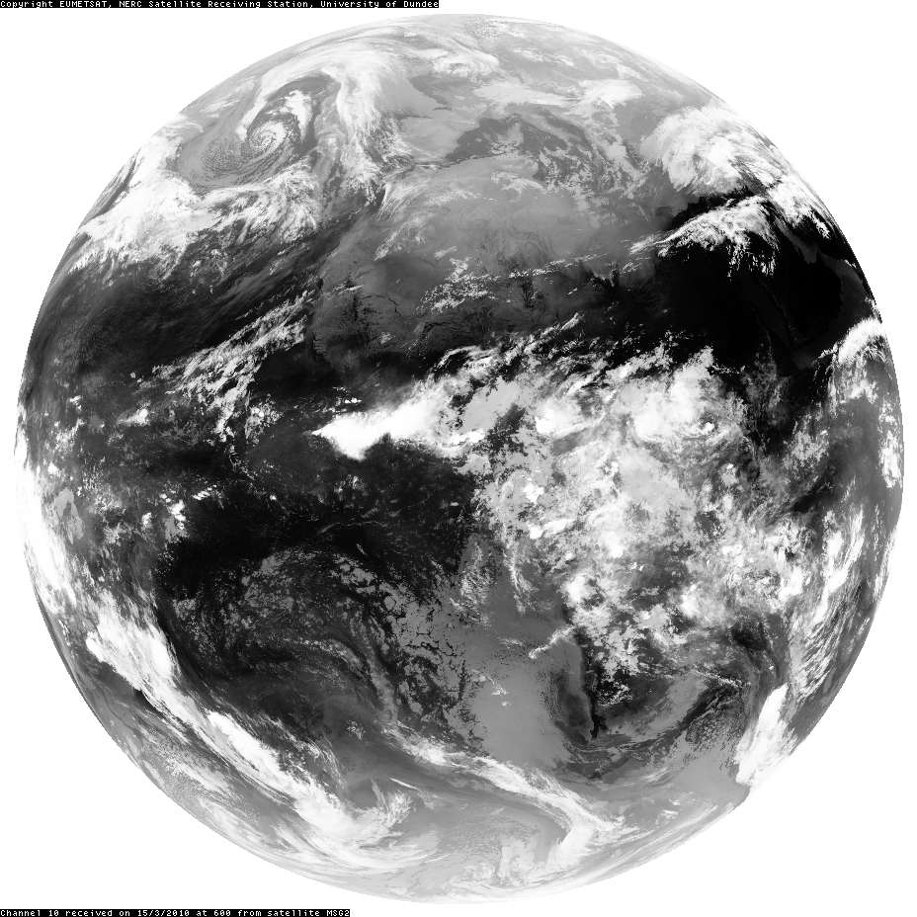
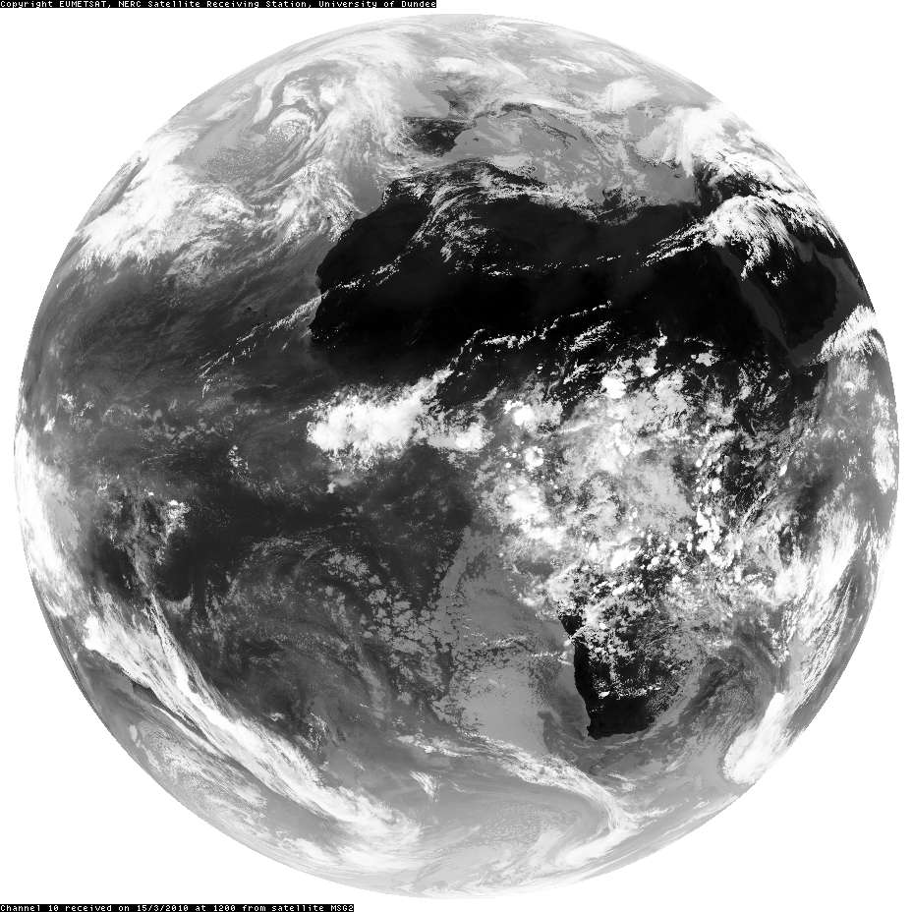
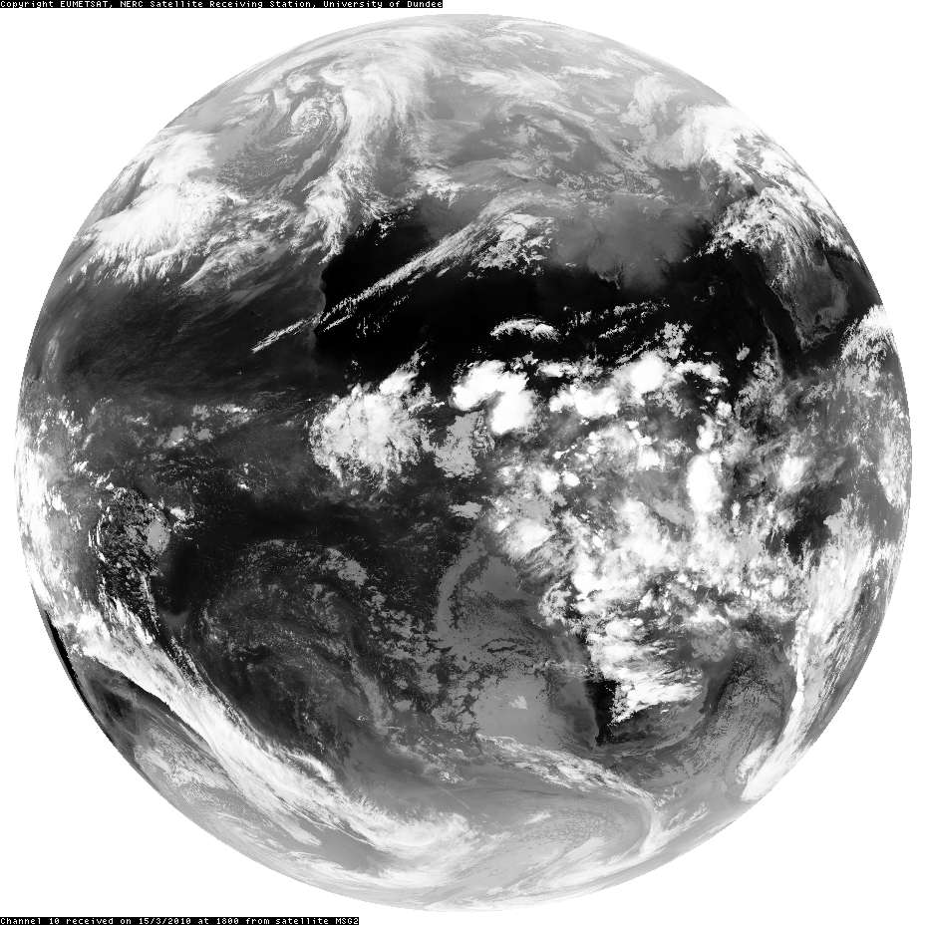
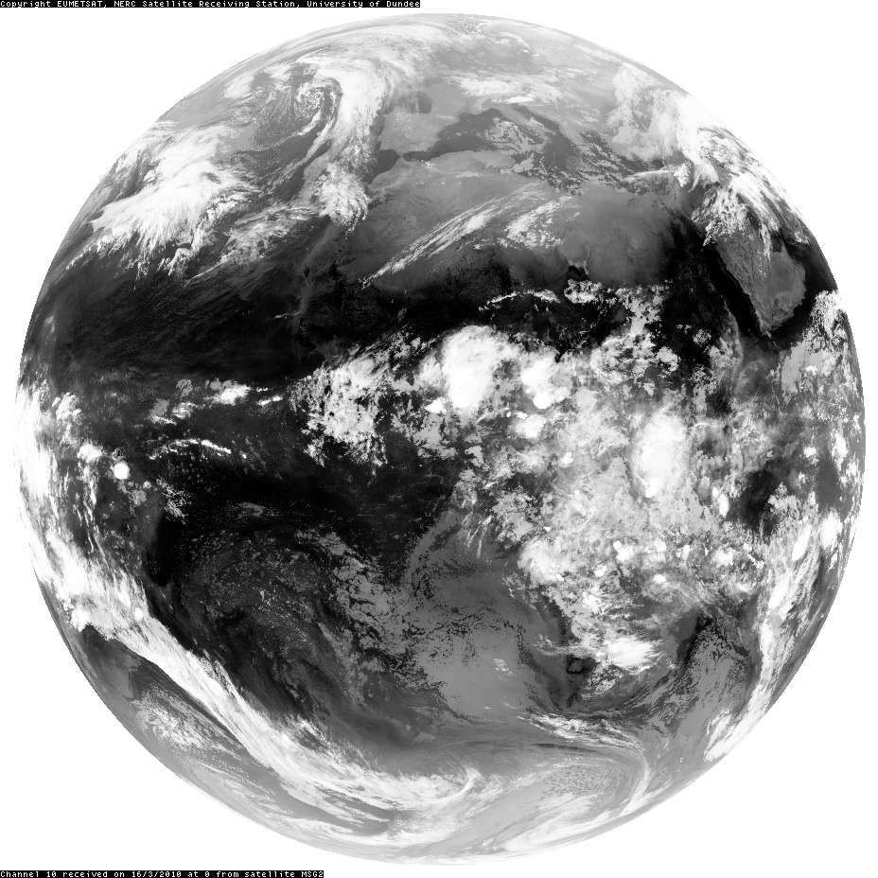
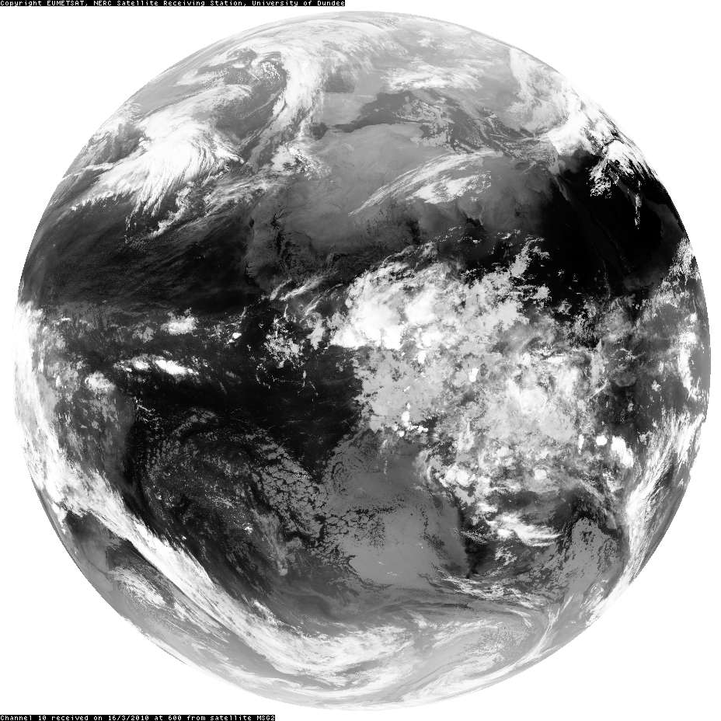
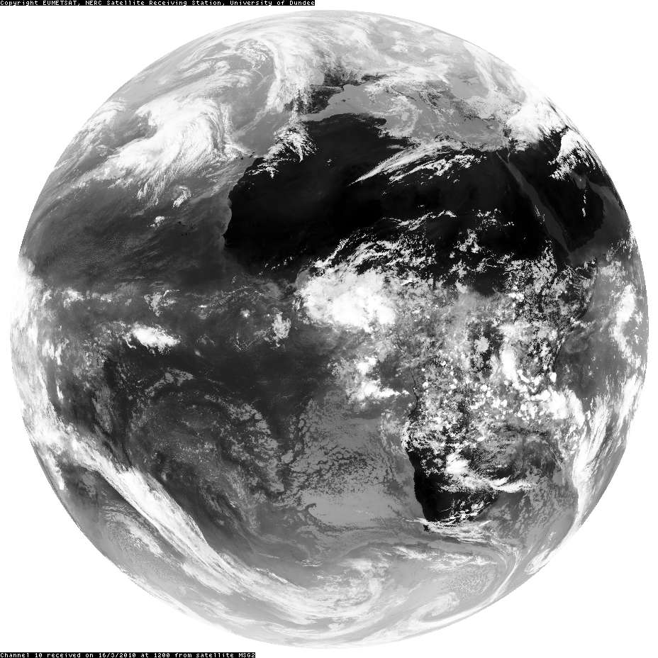
Sequences of satellite images (visible + infrared)
www.sat.dundee.ac.uk
SEVIRI channel 1, 0.56 – 0.71 μm
SEVIRI channel 10, 11 –13 μm
Courtesy NERC Satellite Receiving Station, University of Dundee

Slide 10
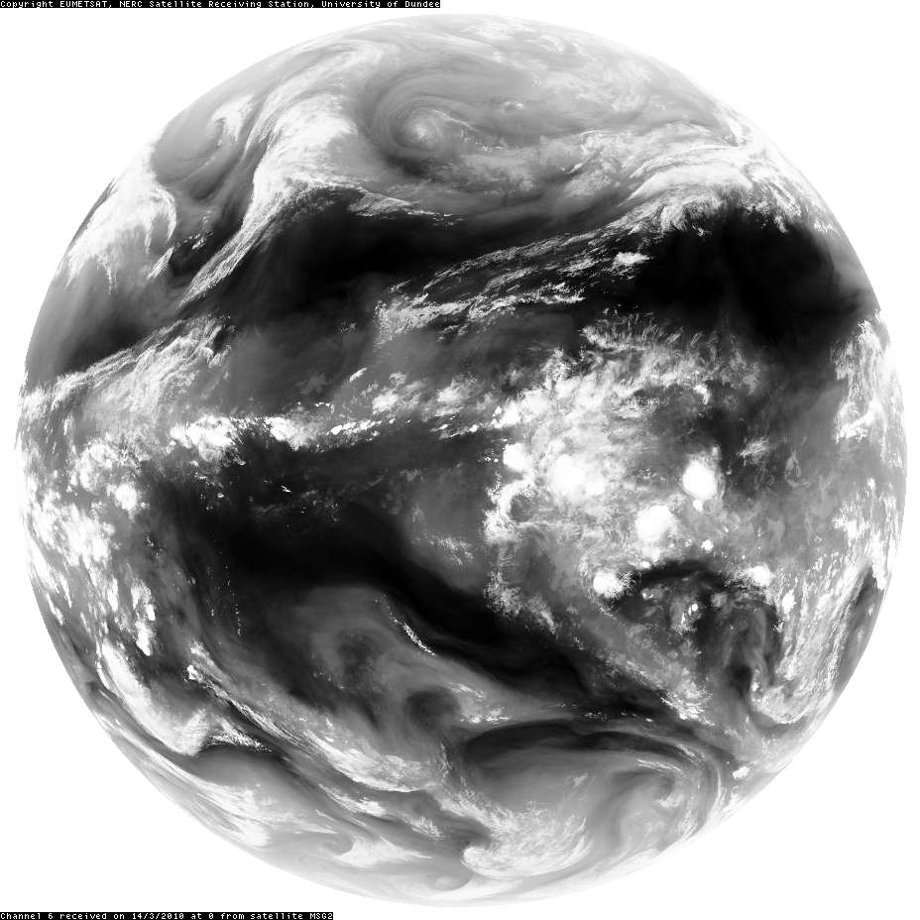
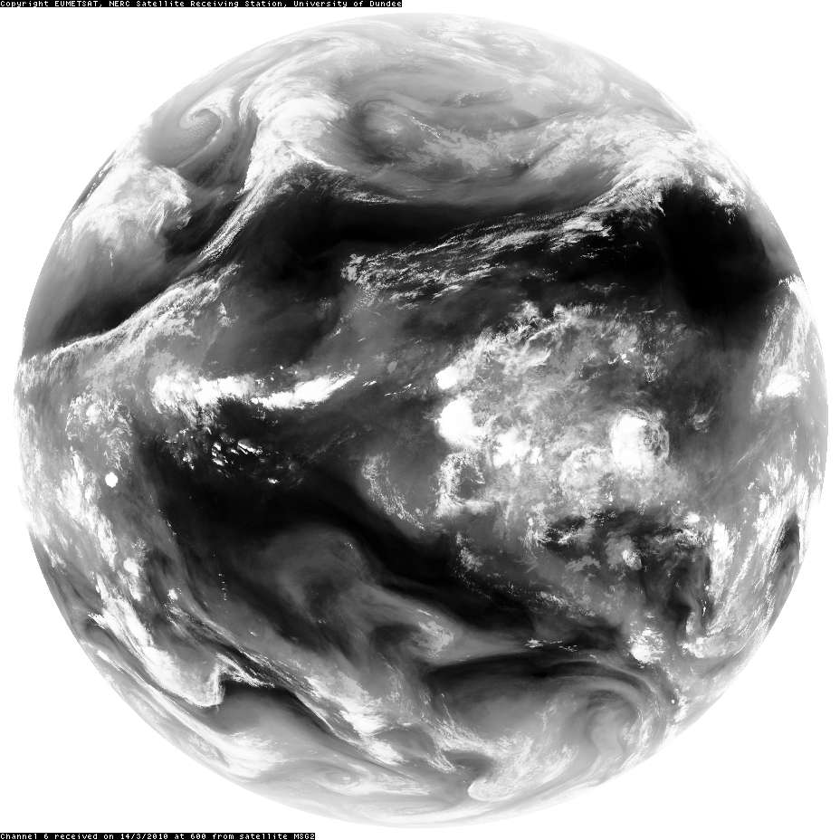
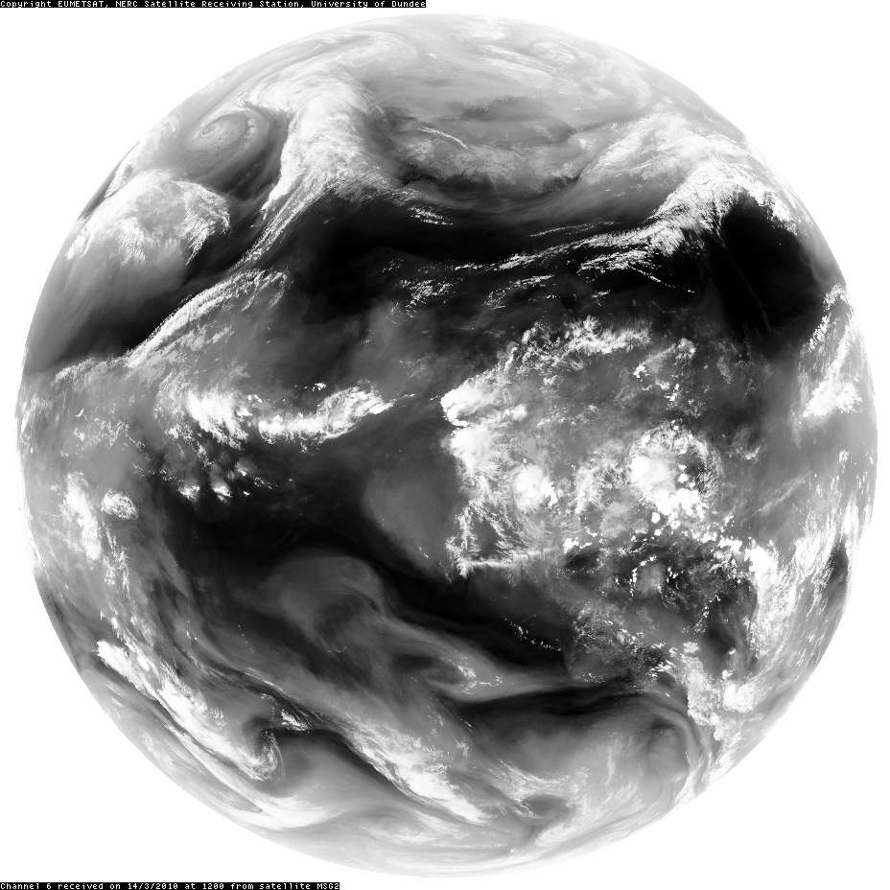
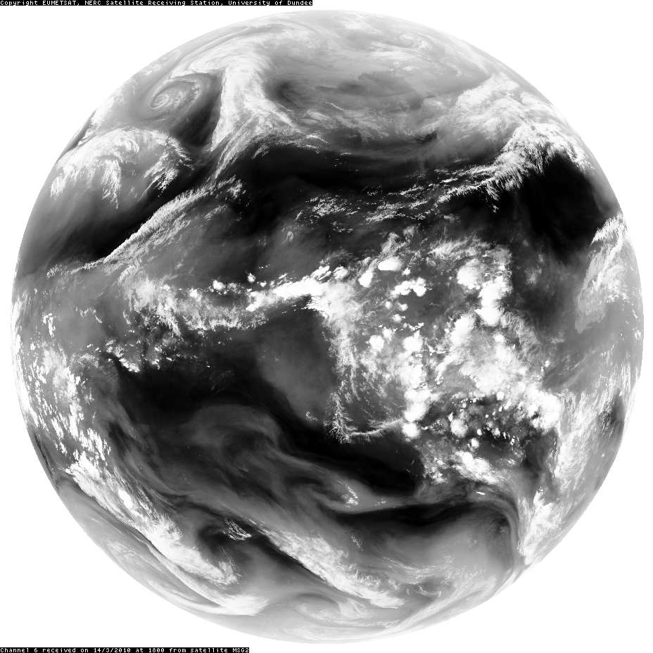
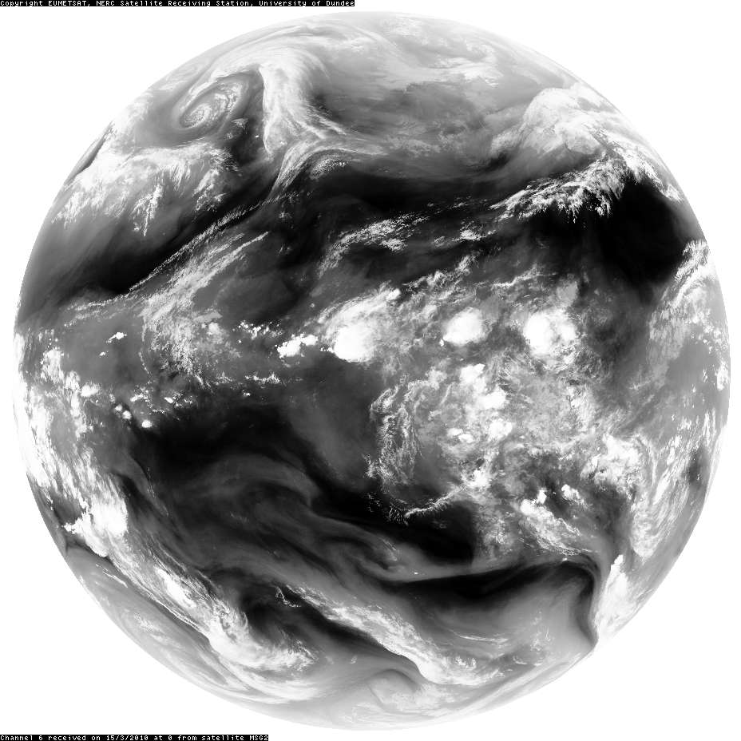
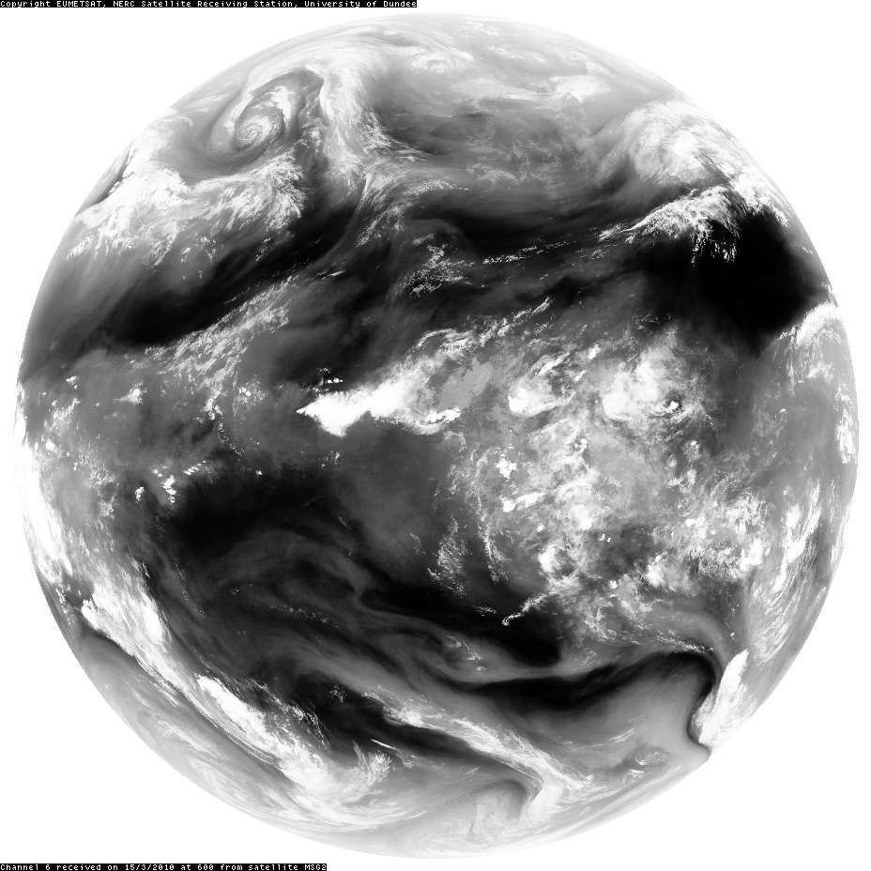
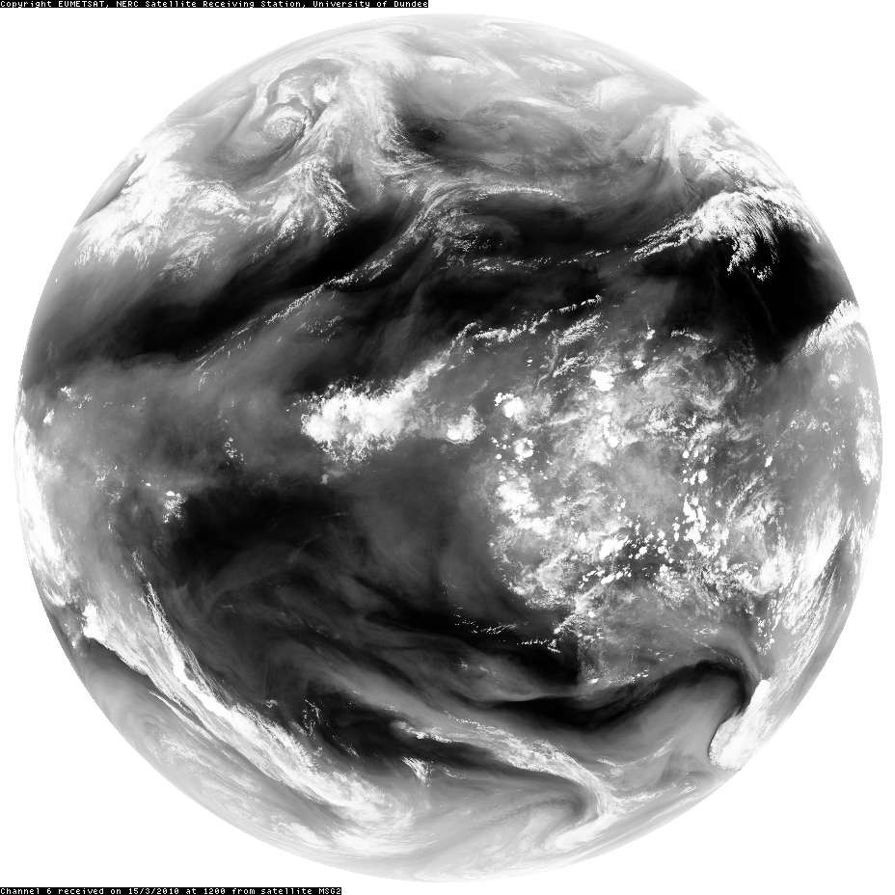
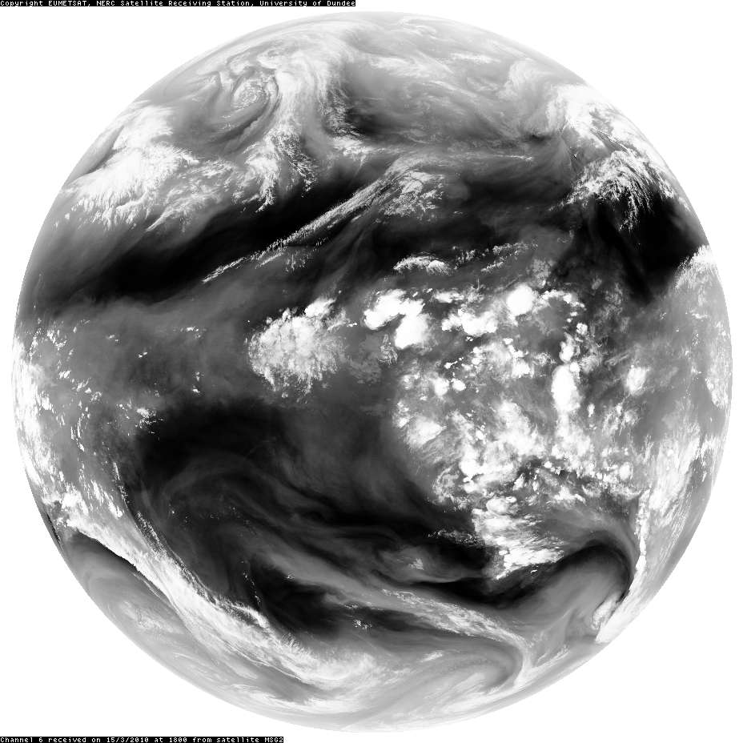
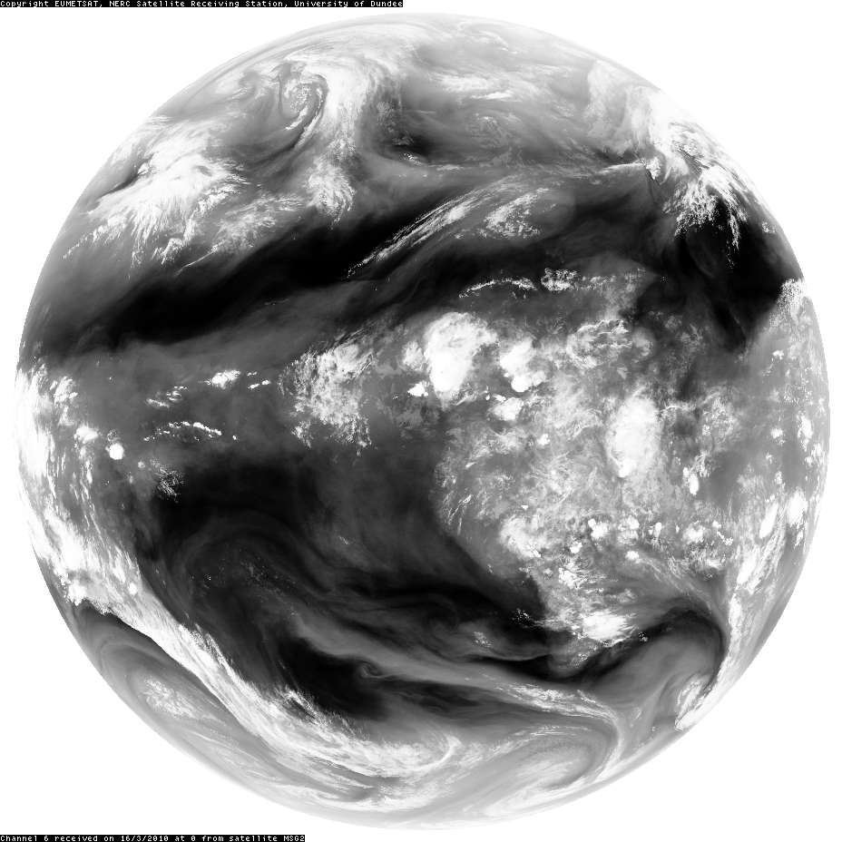
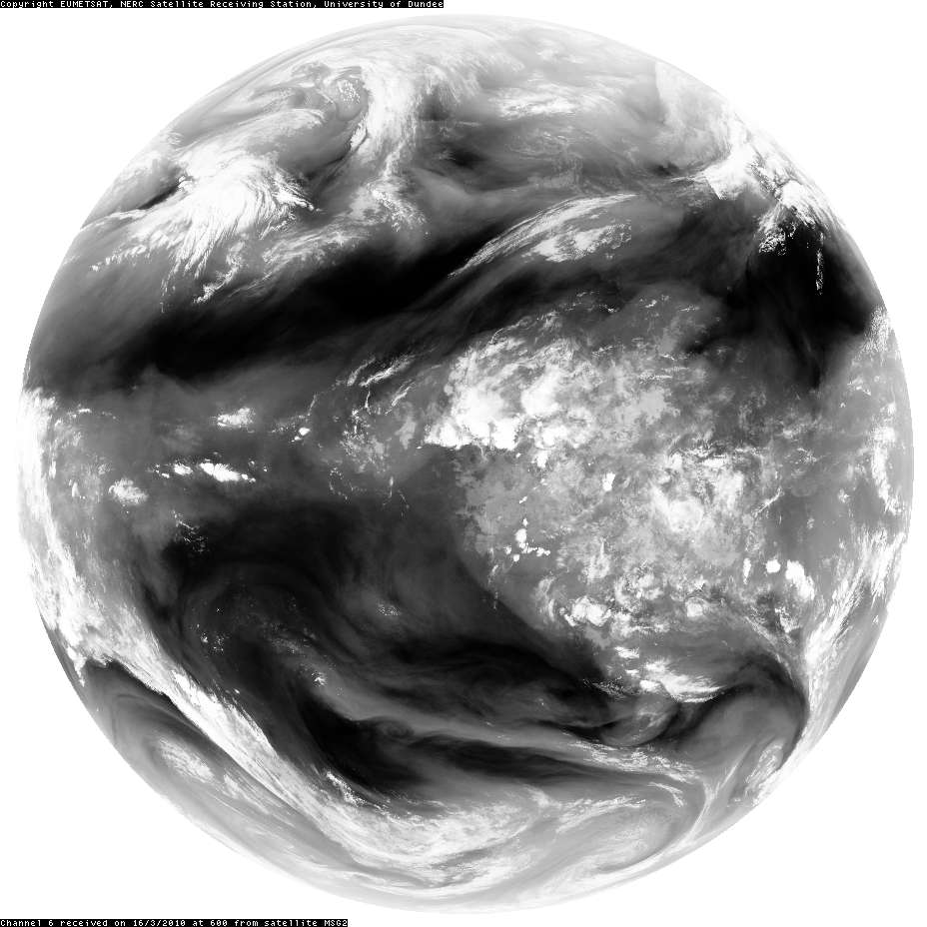
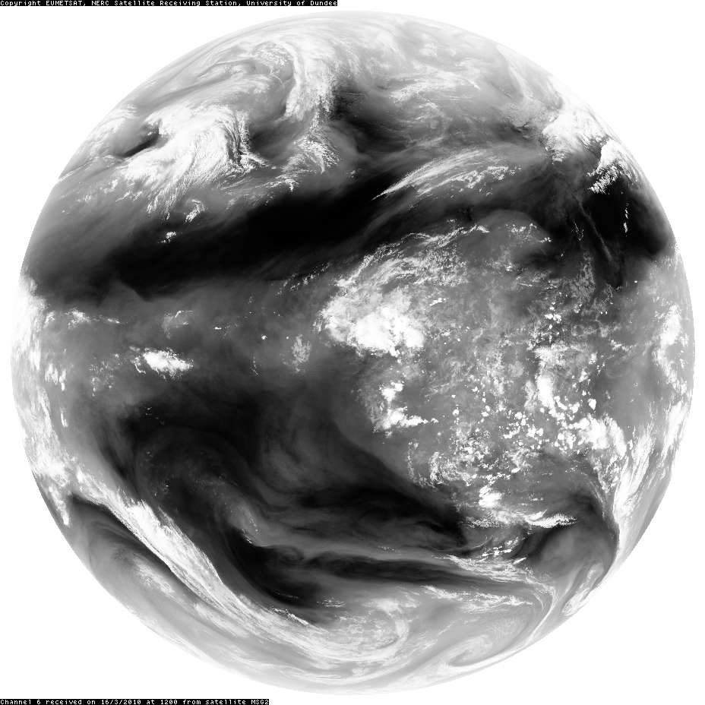
Sequences of satellite images (visible + infrared + water vapour)
www.sat.dundee.ac.uk
SEVIRI channel 1, 0.56 – 0.71 μm
SEVIRI channel 10, 11 –13 μm
SEVIRI channel 6, 6.85 –7.85 μm
Courtesy NERC Satellite Receiving Station, University of Dundee

Slide 11
Flow regimes

Slide 12
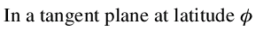
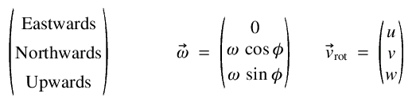











Geostrophic balance
L
Gaspard-Gustave de Coriolis

Slide 13


Orbit configurations
12
Polar orbit
600 - 800 km above sea level typically.
Near-global coverage over time.
Non-continuous sampling of a given location.
Often used for sounders (e.g. on board EnviSat, EOS Aura, etc).
Geostationary orbit
• 35 786 km above sea level, latitude 0.0°.
• View 1/4 of Earth's surface (60S-60N).
• Continuous sampling of a given location.
• Often used for imagers (e.g. on board MeteoSat, etc).
• Horiz. resolution degrades poleward.

Slide 14

Viewing geometries
Limb
• Good vertical resolution possible (~1km).
• Poor horizontal resolution.
• Used mainly in research.
Nadir
• Good horizontal resolution possible.
• Poor vertical resolution (several km).
• Used mainly in operational weather forecasting.

Slide 15
Satellite ‘imagers’ vs ‘sounders’
Imager:
An instrument that measures a signal with spatial resolution.
On board geostationary and polar orbiting satellites.
Nadir viewing only.
Sounder:
An instrument that measures a signal with spectral resolution.
On board mainly polar orbiting satellites.
Nadir or limb viewing.
Can be processed to give quasi-height resolved retrievals of T, q, O₃, etc. (used heavily for numerical weather prediction).

Slide 16

Selection of instruments
not comprehensive!
List of more acronyms at www.met.rdg.ac.uk/~ross/DARC/Acronyms.html

Slide 17


Other types of satellite instrument
Scatterometer Radio occultation

Slide 18


Forecast accuracy
Take the average accuracy of a 1-day forecast in 1980.
How long does a forecast have to be (subsequently) to achieve this accuracy?
How close is forecast to latest analysis?
Northern hemisphere
Southern hemisphere
Courtesy Met Office
Courtesy ECMWF

Slide 19


Example imagery – polar lows
06/04/2007, MODIS 30/03/2013, MODIS
Courtesy NERC Satellite Receiving Station, University of Dundee

Slide 20



Example imagery – frontal systems
31/01/2008, MODIS 08/12/2011, MODIS 22/03/13, AVHRR
Courtesy NERC Satellite Receiving Station, University of Dundee

Slide 21


Example imagery - thunderstorms
30/10/2008, AVHRR 24/04/2008, MODIS
Courtesy NERC Satellite Receiving Station, University of Dundee

Slide 22


Example imagery - hurricanes
29/08/2005, GOES-E 29/10/2012, GOES-E
Courtesy NERC Satellite Receiving Station, University of Dundee

Slide 23


Example imagery - anticyclones
09/12/2001, MODIS 21/09/2006, MODIS
Courtesy NERC Satellite Receiving Station, University of Dundee

Slide 24




Example imagery – other features of interest
03/04/2011, MODIS 07/05/2010, MODIS 20/03/2009, AVHRR
27/03/13, AVHRR
Courtesy NERC Satellite Receiving Station, University of Dundee

Slide 25


Deriving useful information from satellite data
compare simulated with measured spectra
Simulated brightness
temperature (K)
Measured brightness
temperature (K)
wavenumber (cm⁻¹)
wavenumber (cm⁻¹)
simulate spectrum
adjust atmospheric profiles for greater agreement
(retrieval / assimilation theory)
Estimation of atmospheric state refined with information from measured spectrum
Temperature water vapour O₃

Slide 26
Courtesy NERC Satellite Receiving Station, University of Dundee
SEVIRI channel 6, 6.85 –7.85 μm
Ref: From Sputnik to EnviSat, and beyond: The use of satellite measurements in weather forecasting and research
Brugge & Stuttard, Weather 58 (March 2003), 107-112; Weather 58 (April 2003), 140-143.

