Slide 1
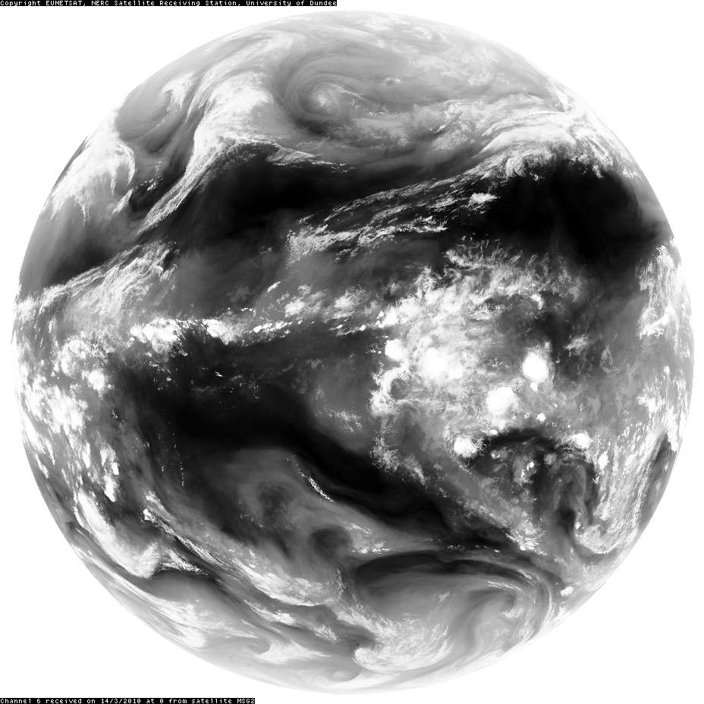
Courtesy NERC Satellite Receiving Station, University of Dundee
SEVIRI channel 6, 6.85 –7.85 μm
Ref: From Sputnik to EnviSat, and beyond: The use of satellite measurements in weather forecasting and research
Brugge & Stuttard, Weather 58 (March 2003), 107-112; Weather 58 (April 2003), 140-143.

Slide 2
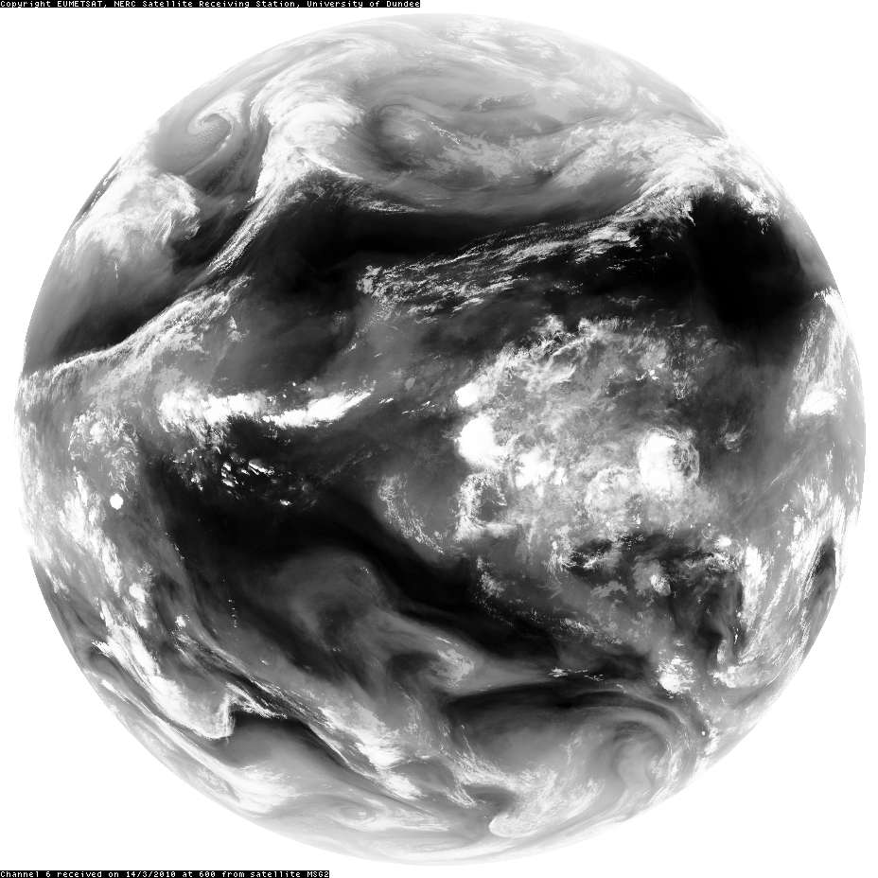
Courtesy NERC Satellite Receiving Station, University of Dundee
SEVIRI channel 6, 6.85 –7.85 μm
Ref: From Sputnik to EnviSat, and beyond: The use of satellite measurements in weather forecasting and research
Brugge & Stuttard, Weather 58 (March 2003), 107-112; Weather 58 (April 2003), 140-143.

Slide 3
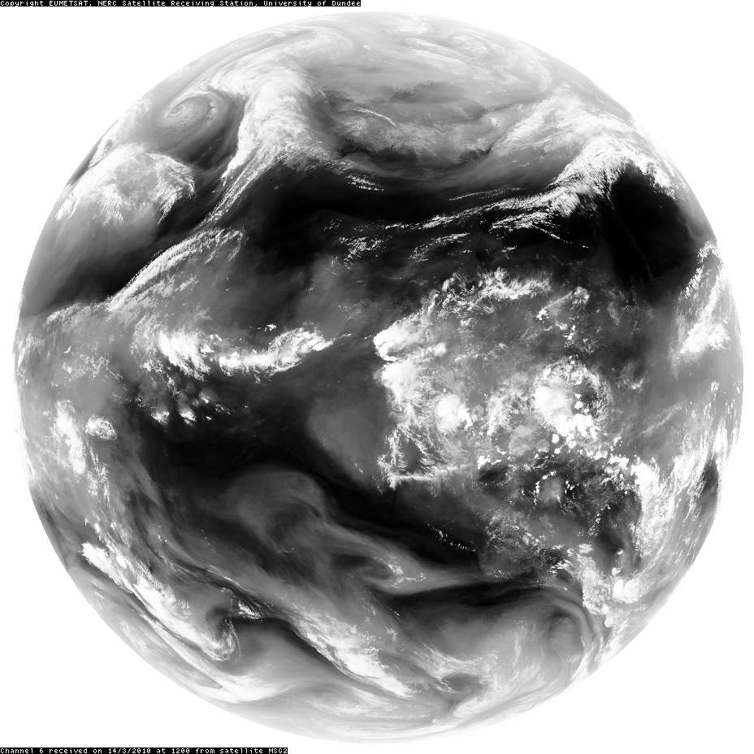
Courtesy NERC Satellite Receiving Station, University of Dundee
SEVIRI channel 6, 6.85 –7.85 μm
Ref: From Sputnik to EnviSat, and beyond: The use of satellite measurements in weather forecasting and research
Brugge & Stuttard, Weather 58 (March 2003), 107-112; Weather 58 (April 2003), 140-143.

Slide 4
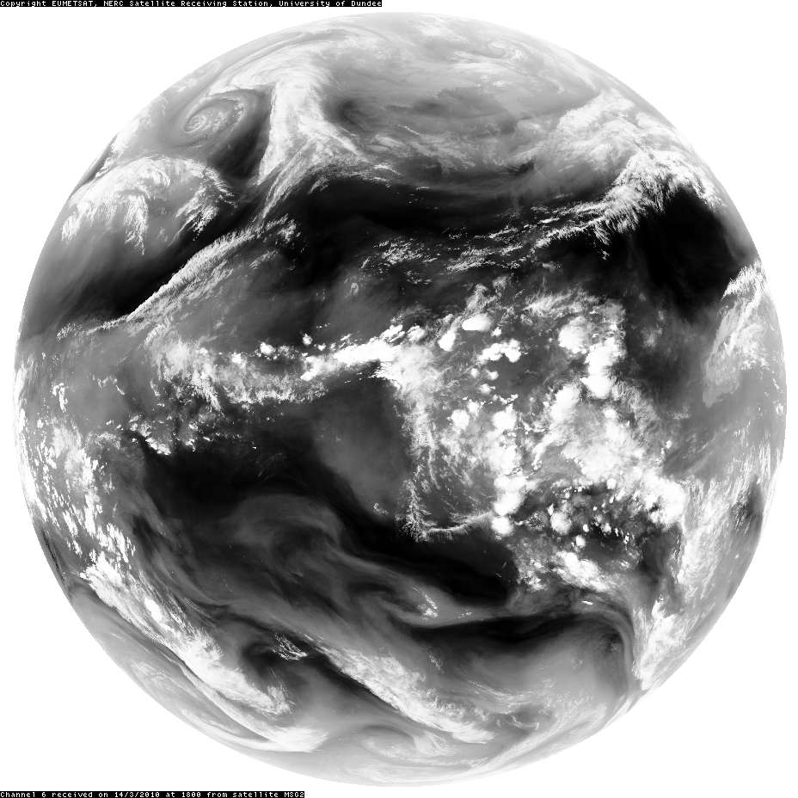
Courtesy NERC Satellite Receiving Station, University of Dundee
SEVIRI channel 6, 6.85 –7.85 μm
Ref: From Sputnik to EnviSat, and beyond: The use of satellite measurements in weather forecasting and research
Brugge & Stuttard, Weather 58 (March 2003), 107-112; Weather 58 (April 2003), 140-143.

Slide 5
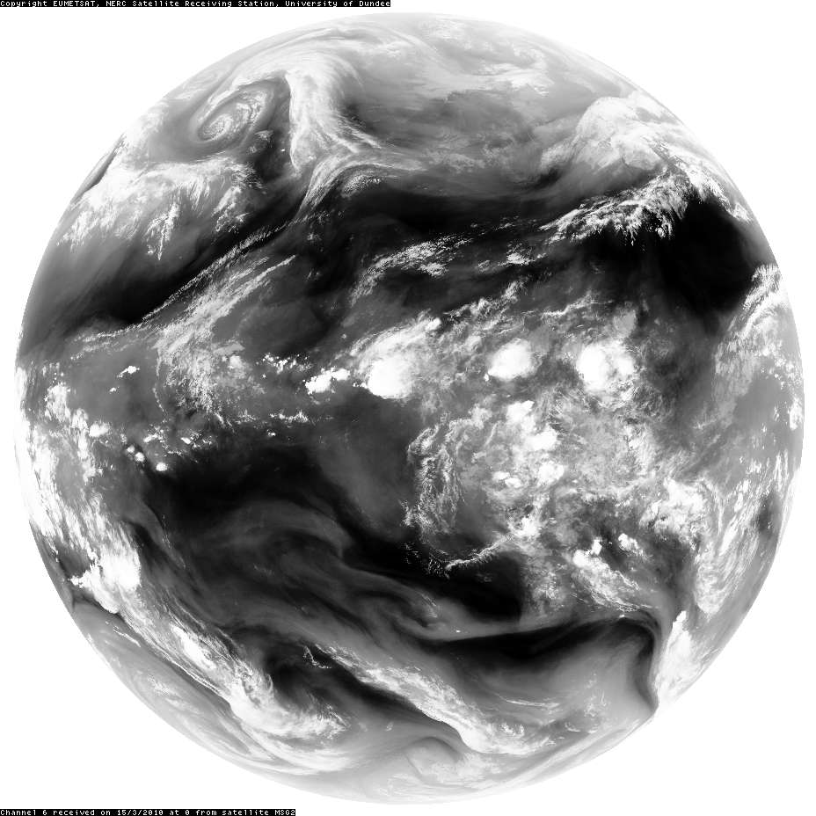
Courtesy NERC Satellite Receiving Station, University of Dundee
SEVIRI channel 6, 6.85 –7.85 μm
Ref: From Sputnik to EnviSat, and beyond: The use of satellite measurements in weather forecasting and research
Brugge & Stuttard, Weather 58 (March 2003), 107-112; Weather 58 (April 2003), 140-143.

Slide 6
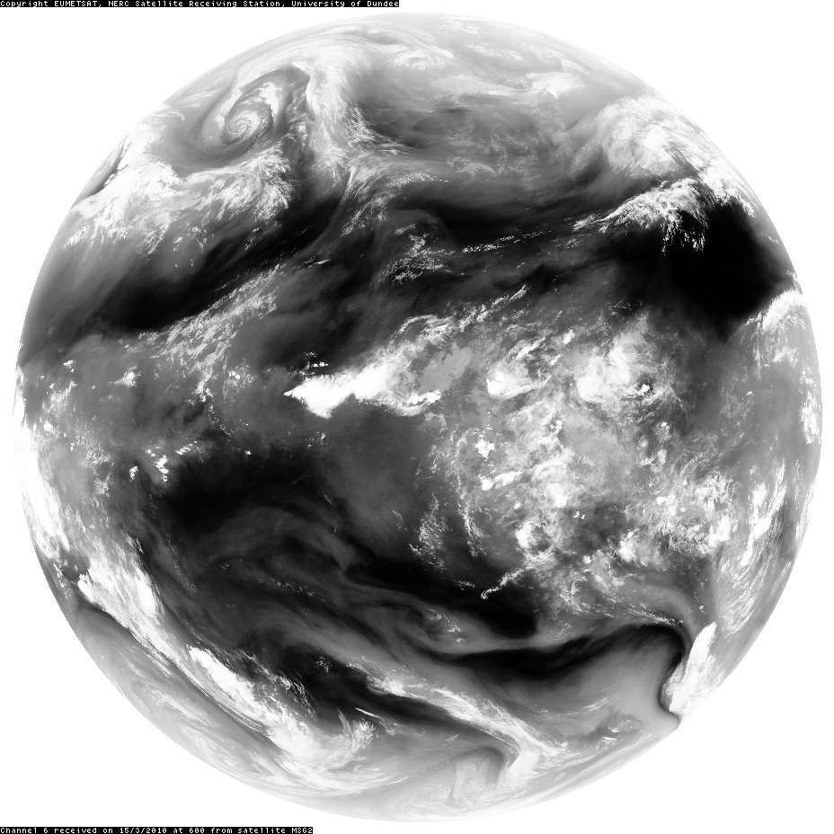
Courtesy NERC Satellite Receiving Station, University of Dundee
SEVIRI channel 6, 6.85 –7.85 μm
Ref: From Sputnik to EnviSat, and beyond: The use of satellite measurements in weather forecasting and research
Brugge & Stuttard, Weather 58 (March 2003), 107-112; Weather 58 (April 2003), 140-143.

Slide 7
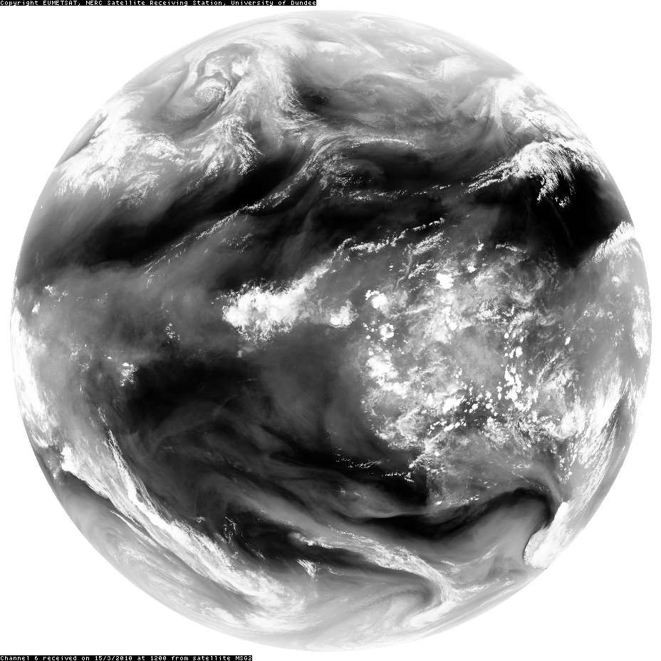
Courtesy NERC Satellite Receiving Station, University of Dundee
SEVIRI channel 6, 6.85 –7.85 μm
Ref: From Sputnik to EnviSat, and beyond: The use of satellite measurements in weather forecasting and research
Brugge & Stuttard, Weather 58 (March 2003), 107-112; Weather 58 (April 2003), 140-143.

Slide 8
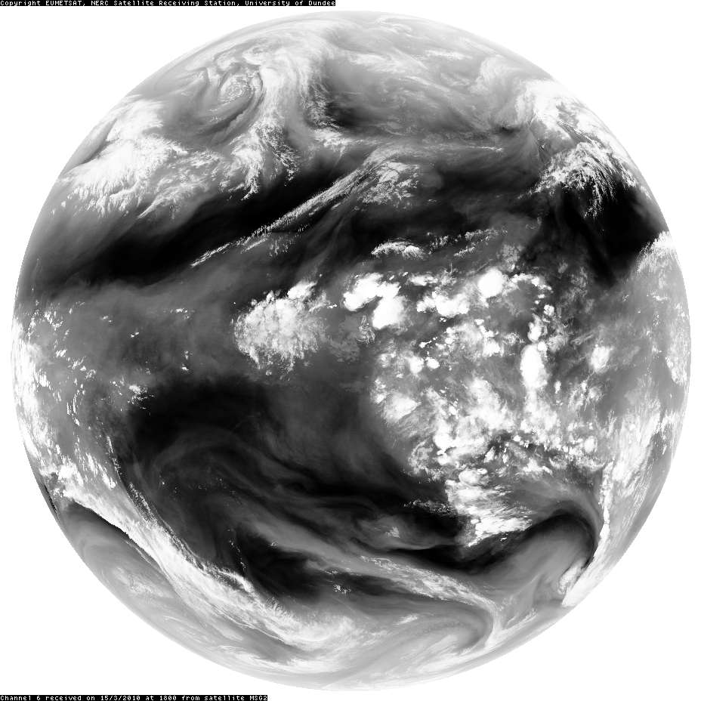
Courtesy NERC Satellite Receiving Station, University of Dundee
SEVIRI channel 6, 6.85 –7.85 μm
Ref: From Sputnik to EnviSat, and beyond: The use of satellite measurements in weather forecasting and research
Brugge & Stuttard, Weather 58 (March 2003), 107-112; Weather 58 (April 2003), 140-143.

Slide 9
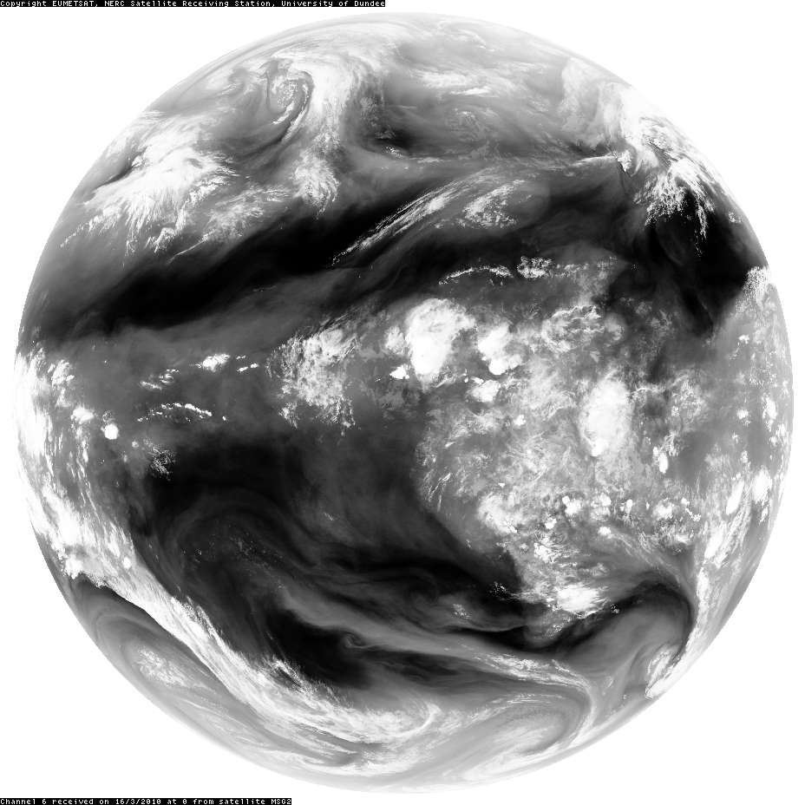
Courtesy NERC Satellite Receiving Station, University of Dundee
SEVIRI channel 6, 6.85 –7.85 μm
Ref: From Sputnik to EnviSat, and beyond: The use of satellite measurements in weather forecasting and research
Brugge & Stuttard, Weather 58 (March 2003), 107-112; Weather 58 (April 2003), 140-143.

Slide 10
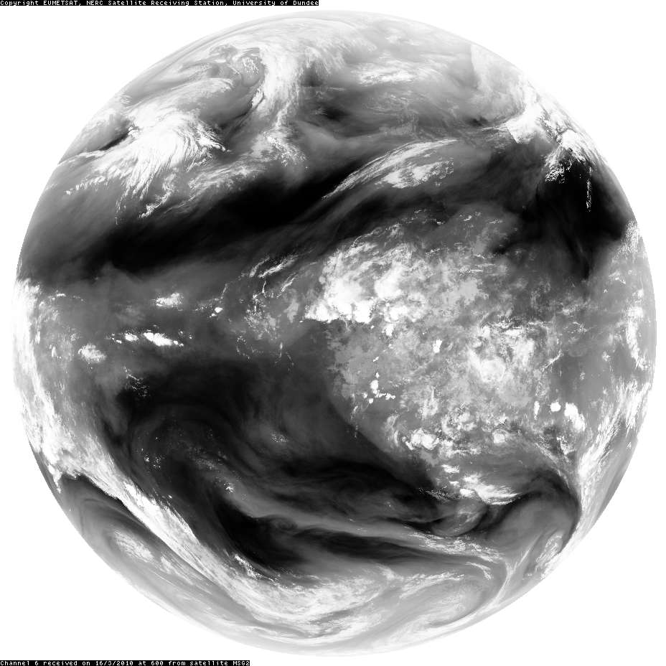
Courtesy NERC Satellite Receiving Station, University of Dundee
SEVIRI channel 6, 6.85 –7.85 μm
Ref: From Sputnik to EnviSat, and beyond: The use of satellite measurements in weather forecasting and research
Brugge & Stuttard, Weather 58 (March 2003), 107-112; Weather 58 (April 2003), 140-143.

Slide 11
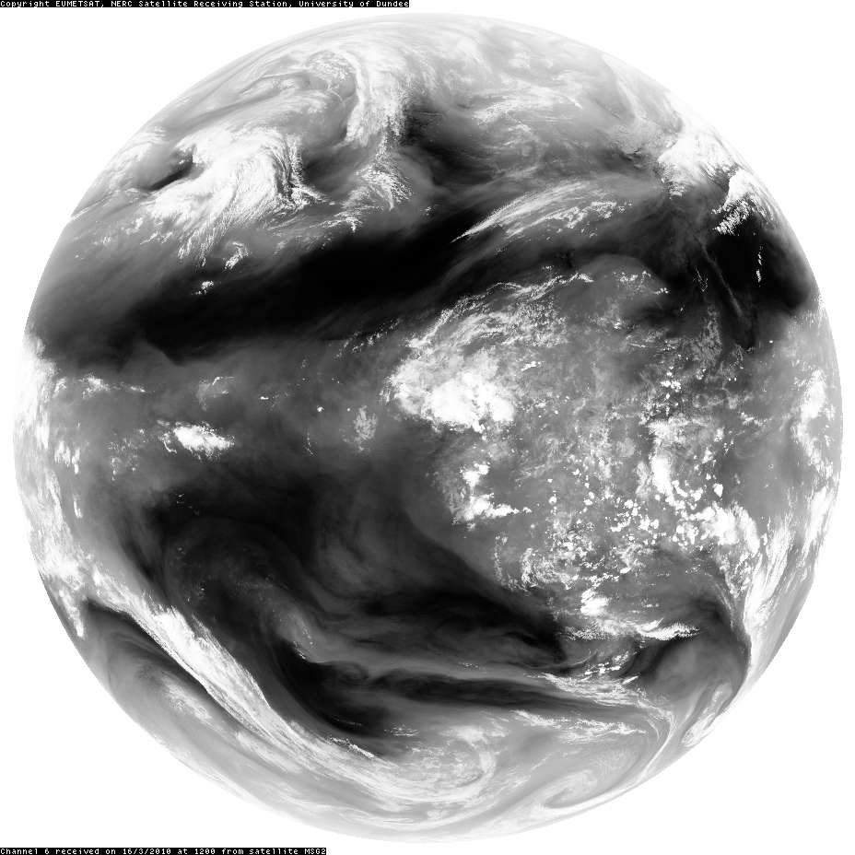
Courtesy NERC Satellite Receiving Station, University of Dundee
SEVIRI channel 6, 6.85 –7.85 μm
Ref: From Sputnik to EnviSat, and beyond: The use of satellite measurements in weather forecasting and research
Brugge & Stuttard, Weather 58 (March 2003), 107-112; Weather 58 (April 2003), 140-143.

