Slide 1
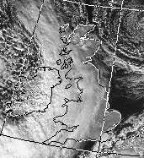
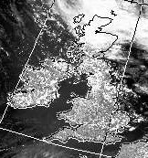



High-resolution assimilation and weather forecasting
Ross Bannister and Stefano Migliorini (NCEO, Reading)
Mark Dixon (ex MetO, JCMM, Reading)
NCEO Annual Conference, September 2010, Leicester
Oct 29 2008 Jul 7 2007
‘Large scale’ precip ‘Convective’ precip
Thanks to: Roger Brugge (NCEO), Sue Ballard (MetO), Jean-Francois Caron (MetO)

Slide 2
What’s new about the high resolution assimilation problem?
 | Global/synoptic/mesoscale | Convective scale
Error growth timescale | ~ 3 days | ~ Few hours
Features | Cyclones, fronts | Convective storms
Diagnostic relationships | Hydrostatic balance, near geostrophic balance (except in tropics) | Near hydrostatic balance for non-convecting regions, non geostrophic on smaller scales
Important quantities | Vorticity, pressure, temperature, divergence, humidity | + vertical velocity, cloud water and ice, surface quantities ...
Observations | Aircraft, sonde, buoys, IR sounders, scatterometer, etc. | + radar, cloud affected satellite data
Other Complications |  | Simultaneous ‘large’ and ‘small’ scale features Limited area model Lateral boundary conditions Inadequate representation of large-scale

Slide 3
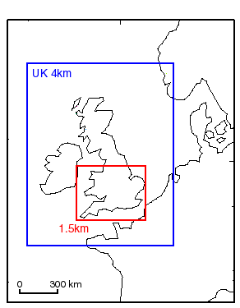
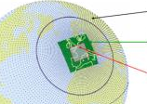
Resolution of atmospheric models
SUK-1.5
Met Office
/ 1.5km
convective scale
1-10 km
meso-scale
100 km
synoptic scale
1000 km
1.5 km
4 km
12km
20 km (N640)
25 km (N512)
40km (N320)
60 km (N216)
90 km (N144)
120 km (N108)
135 km (N96)
270 km (N48)
(c) MeteoFrance

Slide 4
Aims
To develop a system to
deal appropriately with convective dynamics in a variational data assimilation system,
use available high-resolution observations,
make probabilistic forecasts.
Background
A variational data assimilation system should respect the dynamics of the problem, even for 3d-Var. Why?
Background error PDF
observations
model observations
observation operator
‹x_{B}›
‘model space’ ‘observation space’

Slide 5
What is the measured ‘shape’ of the background error PDF at high-resolution?
Use the MOGREPS* ensemble system, adapted to 1.5 km resolution over the Southern UK
1 hour
1 hour
1 hour
control forecast (preliminary 3D-VAR + nudging)
23 perturbations (updated with ETKF†)
time
Calculate covariance and correlation diagnostics with no attempt to overcome rank deficiency
P^{f} = <(x_{i} - ‹x_{i}›) (x_{i} - ‹x_{i}›)^{T}>
‹ › = ensemble mean
* MOGREPS: Met Office Global and Regional Ensemble Prediction System
† ETKF: Ensemble Transform Kalman Filter

Slide 6
Forecast error covariance diagnostics
Can 24 states (control forecast + 23 perturbations) give meaningful statistics?
At what scales can geostrophic effects be ignored?
When does hydrostatic balance break-down?
The answers to these questions will help to develop a new error covariance model for convective scales.

Slide 7
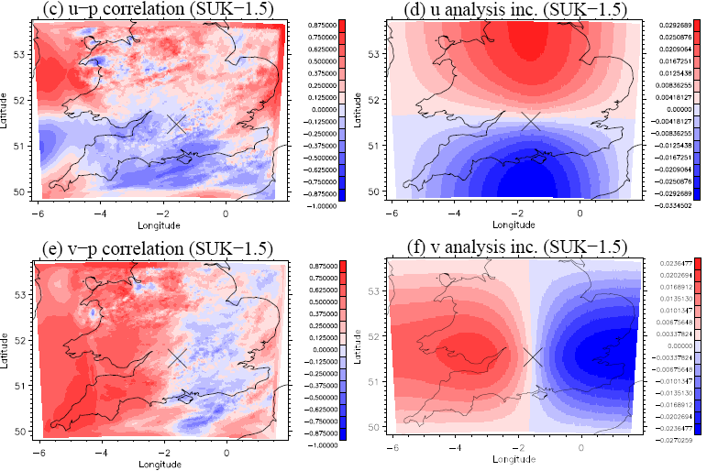
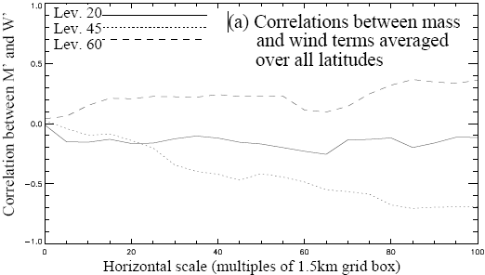
(I) Relevance of geostrophic balance
FORECASET ENSEMBLE DIAGNOSTICS PERFECT GEOSTROPHIC BALANCE
u correlation with p at ×
geostrophic u response
v correlation with p at ×
geostrophic v response
geostrophically
unbalanced
geostrophically
balanced
tropopause
near ground
mid-troposphere

Slide 8
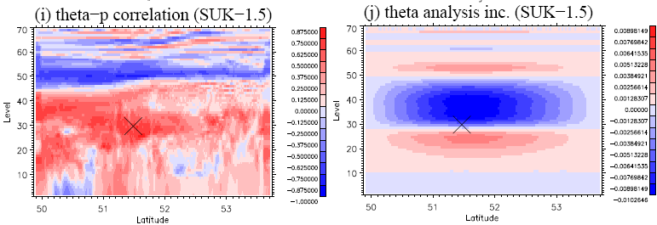
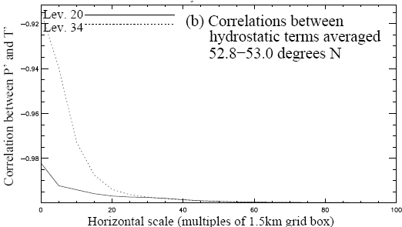
(II) Relevance of hydrostatic balance
FORECASET ENSEMBLE DIAGNOSTICS PERFECT HYDROSTATIC BALANCE
T correlation with p at ×
Hydrostatic T response
hydrostatically
unbalanced
?
hydrostatically
balanced

Slide 9
Summary
Data assimilation needs information about the forecast error statistics.
  The variational assimilation approach needs a model of how components of forecast error are correlated (need to reflect the right physics of the system).
Have adapted the Met Office MOGREPS system to work at high-resolution.
  Useful for probabilistic forecasting.
  Useful to investigate forecast error covariances.
Have found that:
  geostrophic balance diminishes at horizontal scales smaller than about 75 km;
  hydrostatic balance diminishes at horizontal scales smaller than about 20 km, especially within convection (Vetra-Carvalho et al.).
Next stage.
  Improve representation by including other sources of forecast error
  Propose a model of convective-scale forecast error covariances.

