Slide 1
Evaluation of Boundary-Layer Type in Weather Forecast Models Using Long-Term Doppler Lidar Observations
Natalie Harvey
Supervisors: Helen Dacre & Robin Hogan

Slide 2
Questions
Why study the boundary layer?
How is the boundary layer modelled?
Observational diagnosis of boundary-layer type?
How does the Met Office 4km model boundary-layer type compare to the observed?
What next?

Slide 3



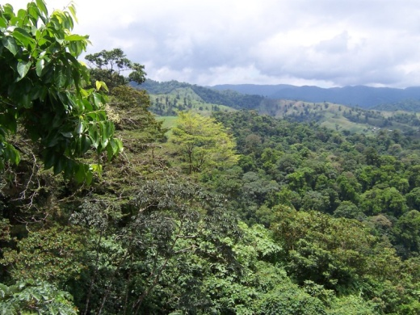
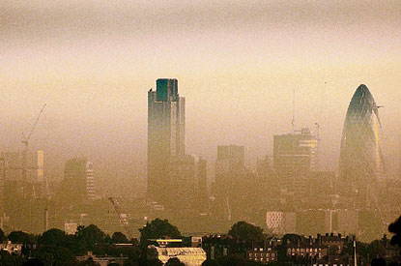

Why study the boundary layer?

Slide 4
How is the boundary layer modelled?
Boundary layer processes are turbulent
They are difficult and expensive to model explicitly so are parameterised
In the Met Office Unified Model the “Lock” Boundary Layer Scheme is used
7 different types diagnosed using stability and cloud type
Diagnosed type affects forecasts of
  Surface temperature
  Cloud cover
  Choice of mixing scheme/s
Not tested over land before

Slide 5
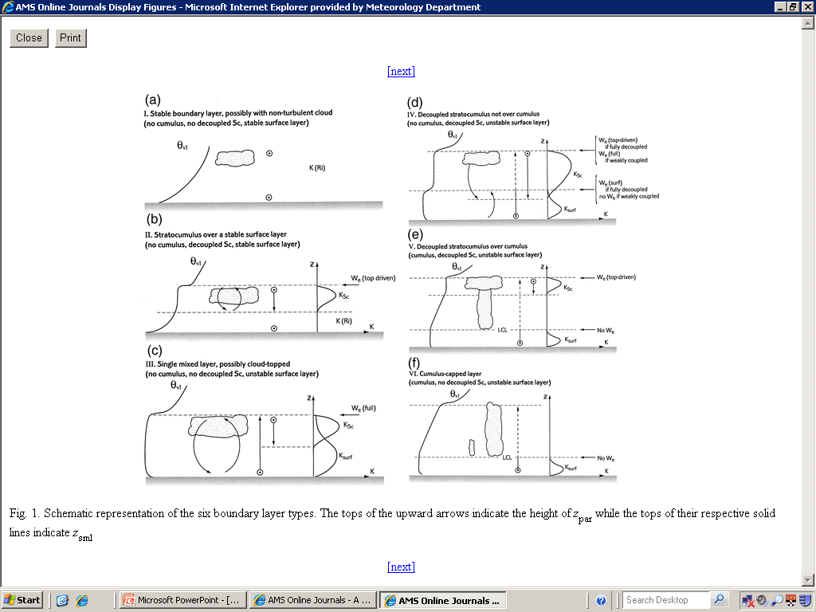
How is the boundary layer modelled?
Lock et al. (2000)
+ Type 7: unstable shear dominated

Slide 6
Stability
Lock et al. (2000)
+ Type 7: unstable shear dominated

Slide 7
Cloud type - stratocumulus
Lock et al. (2000)
+ Type 7: unstable shear dominated

Slide 8
Cloud type - cumulus
Lock et al. (2000)
+ Type 7: unstable shear dominated

Slide 9
Decoupled layer
Lock et al. (2000)
+ Type 7: unstable shear dominated

Slide 10
2 layers of cloud
Lock et al. (2000)
+ Type 7: unstable shear dominated

Slide 11
Model Boundary Layer Diagnosis
stable?
Y
N
cumulus?
cumulus?
Y
N
Y
N
decoupled stratocumulus?
decoupled stratocumulus?
decoupled stratocumulus?
Y
N
Y
N
Y
N
Type 1
Type 2
Type 5
Type 6
Type 4
Type 3

Slide 12
What about observations?
Unstable?
Cloud type?
Decoupled cloud layer?
2 cloud layers?
Sonic anemometer
Doppler lidar – w skewness and variance
Doppler lidar – w variance
Doppler lidar backscatter

Slide 13
Boundary layer?
Really the aerosol layer – first height where 80% of the lidar profiles have no backscatter
Been in contact with the surface within the last 24 hours
Time (UTC)
Aerosol height – all cloud below this height is included in the type diagnosis

Slide 14
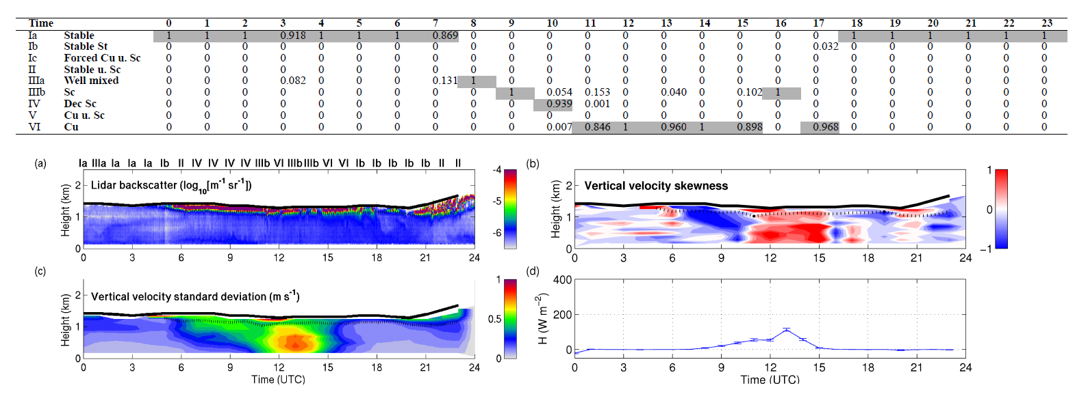
Cloud present?
5% of hour must have cloud
Binary decision
Time (UTC)
No cloud
Cloud for whole hour
Cloud for ~half the hour

Slide 15
Stability
Given by surface sensible heat flux from sonic anemometer
Hour mean value (20 Hz)
Error calculated using the number of independent samples
stable
unstable
stable
Time (UTC)

Slide 16

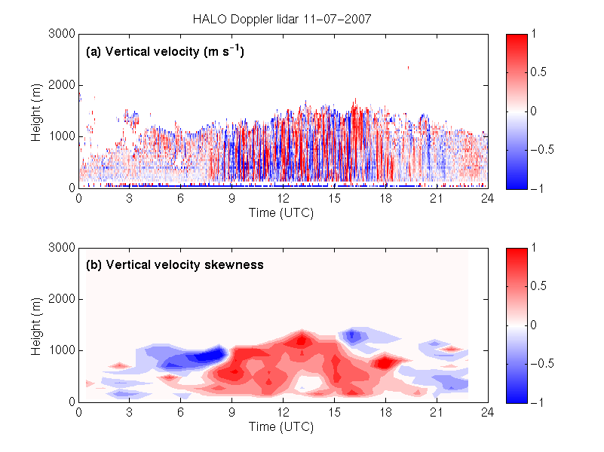
Cloud type?
Turbulence driven from?
Skewness defined as
  Positive in convective daytime boundary layers due to strong, narrow updrafts and weak, wide downdrafts

Slide 17
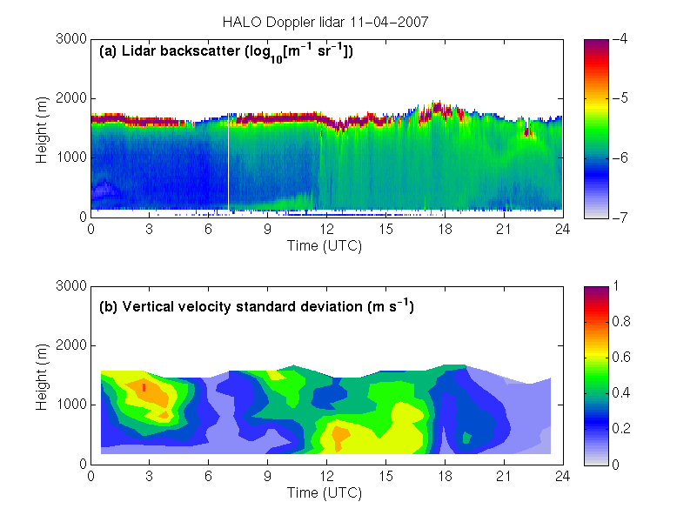
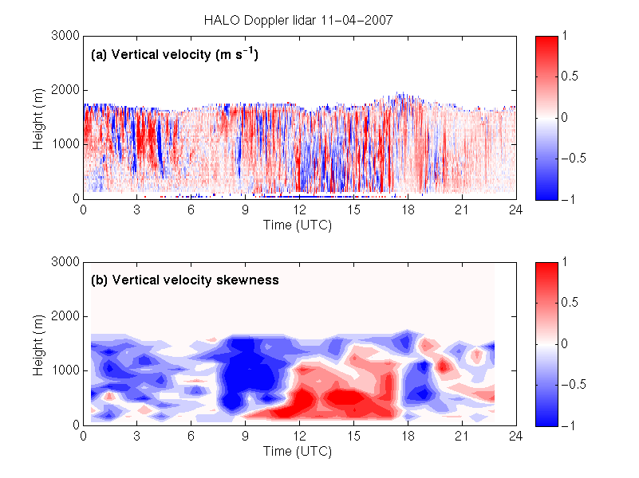
Cloud type?
Turbulence driven from?
Skewness defined as
  Stratocumulus cloud can generate “upside down” convection through long wave cooling.

Slide 18
Cloud type?
Turbulent?
Used to determine the difference between stratocumulus and stratus cloud
Is the vertical velocity variance greater than 0.1m²s⁻² in top 1/3 of the boundary layer?
2 hour mean centred on the hour being diagnosed

Slide 19
Decoupled?
Difficult!
What does it look like?
z
Negative skewness
Minimum in variance
Positive skewness
θ_{vl}

Slide 20
Decoupled?
Based on curvature of a quartic fit to the hour mean vertical velocity variance profile
X Observations
- - - Quartic fit
Cloud base height
0.5 aerosol depth
Height (m)
Height (m)
decoupled curvature increases with height
coupled curvature decreases with height
w variance (m²s⁻²)
w variance (m²s⁻²)

Slide 21
2 or more layers?
PDF of cloud base height for each lidar profile in hour and look for the number of peaks
1
2

Slide 22
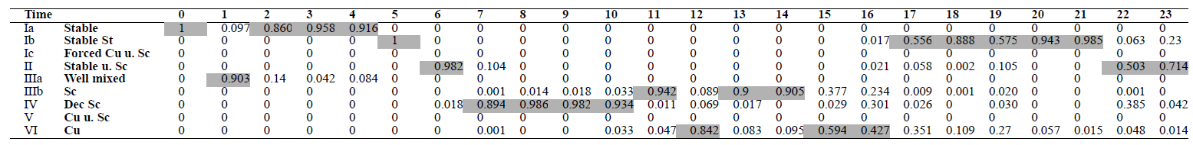
Example day – 18/10/2009
most probable boundary layer type
IV: decoupled stratocumulus
IIIb: well mixed stratocumulus topped
II: decoupled stratocumulus over a stable layer
Usually the most probable type has a probability greater than 0.9
Harvey, Hogan and Dacre (2012, in revision)

Slide 23
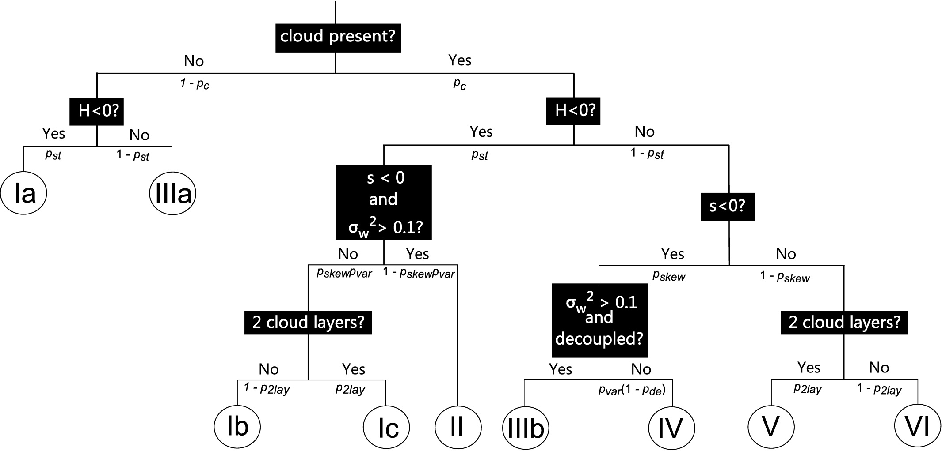
Observational decision tree
stable?
stable?
stratocumulus & decoupled?
stratocumulus?
stable, well mixed
unstable, well mixed
decoupled?
stable, well mixed and cloudy
unstable, well mixed & cloudy
stratocumulus over cumulus
cumulus capped
stratocumulus over stable
decoupled stratocumulus

Slide 24
Most probable transitions
Time of day |  |  |  |  | Occurence
03:00 | 09:00 | 12:00 | 15:00 | 21:00 | percentage of time | number of days
Stable | Well mixed | Well mixed | Well mixed | Stable | 6.0 | 40
Stable St | Sc | Sc | Sc | Stable St | 2.4 | 16
Stable | Stable | Well mixed | Stable | Stable | 1.2 | 8
Stable | Well mixed | Cu | Cu | Stable | 1.2 | 8
Stable | Well mixed | Well mixed | Well mixed | Well mixed | 1.2 | 8
12% of the time
“Textbook” boundary layer evolution

Slide 25
Model comparison: data
Description | 4km Met Office Model | Observations
Data availability | 9 closest model grid points to Chilbolton | 1 point location
Do types need combining? | Unstable shear dominated boundary layers (type VII) combined with well mixed (type III) | Ia, Ib and Ic combined into type I (stable) IIIa and IIIb combined into type III (well mixed)
Meteorological conditions | Raining hours removed | Raining hours removed
Cumulus depth constraint | Cumulus types (V and VI) treated as well mixed (type III) if less than 400m deep. | To apply the same constraint cloud depth was found using the Cloudnet (Illingworth et al., 2007) classification product

Slide 26
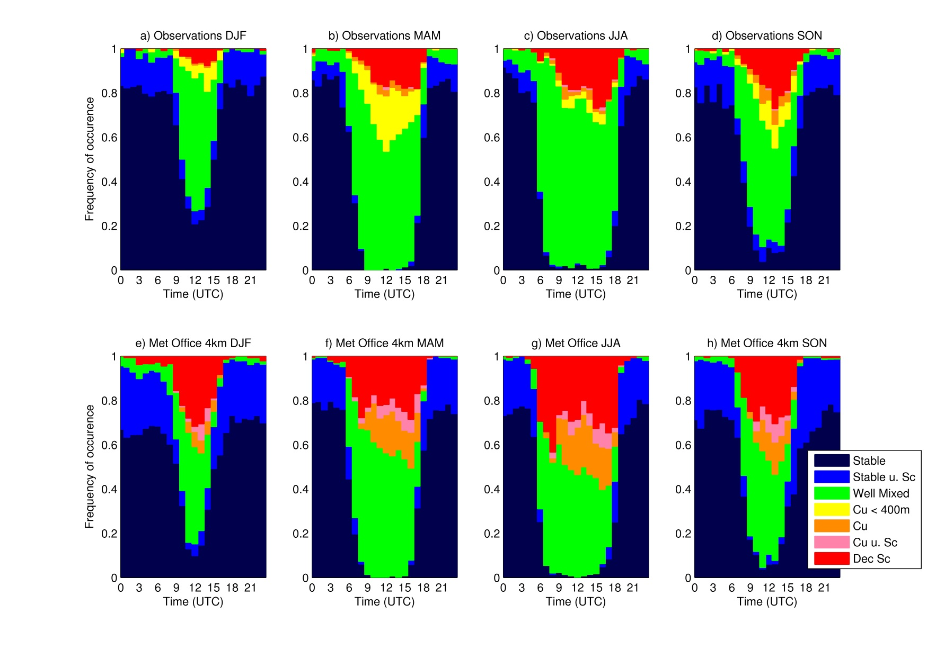
Diurnal comparison:
01/09/2009 – 31/08/2011

Slide 27
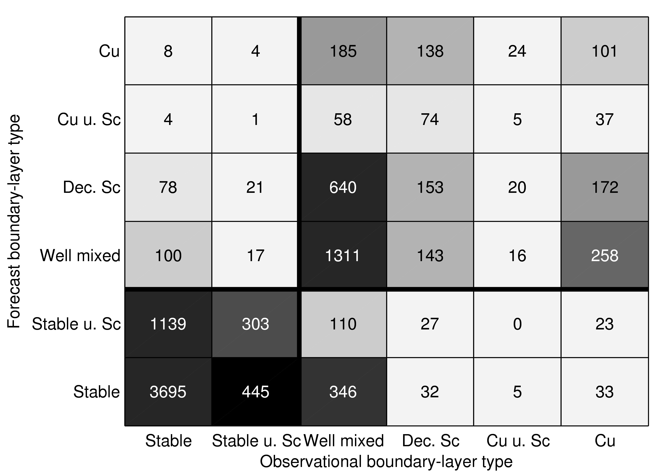
Temporal comparison
01/09/2009 – 31/08/2011
Perfect match would have all numbers along diagonal.
Stable/unstable distinction is well matched in model and observations

Slide 28
Forecast skill
Event forecast | Event observed
 | Yes | No
Yes | a | b
No | c | d
Many different measures that could be used
A SEDI value of 1 indicates perfect forecasting skill.
Robust for rare events
Equitable
Difficult to hedge.
where and
Symmetric extremal dependence index
(Ferro & Stephenson, 2011)

Slide 29
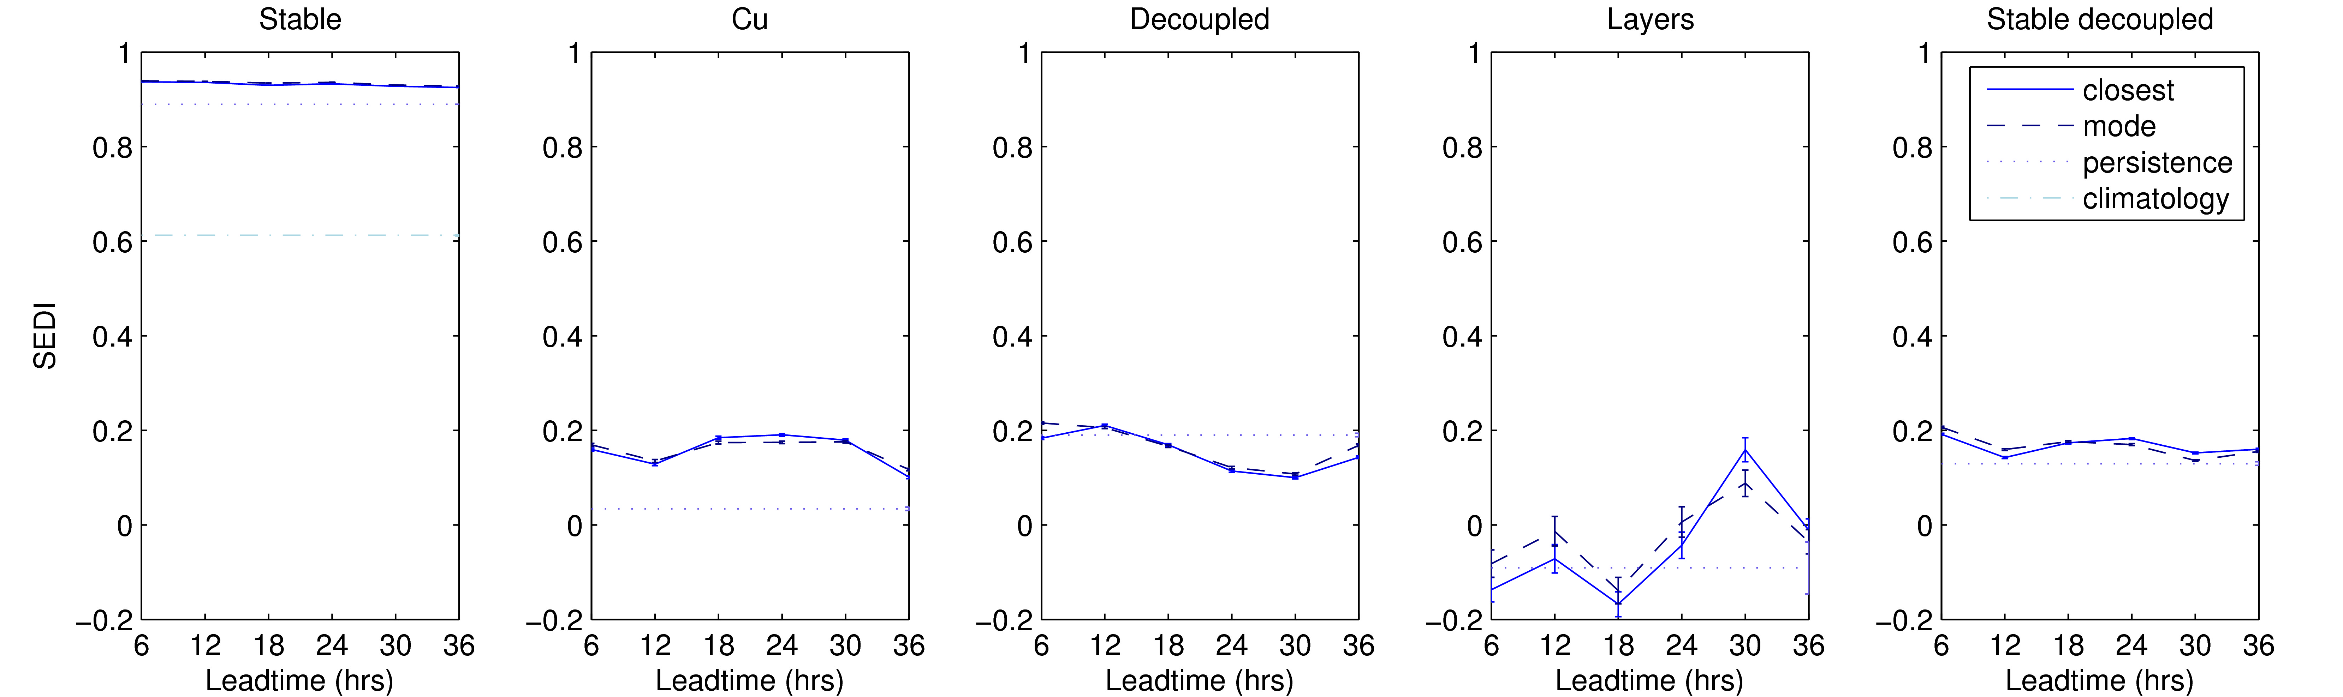
Forecast skill
random

Slide 30
Forecast skill
Stable?
b
a
Model very skilful at predicting stability (day or night!)
d
c
random

Slide 31
Forecast skill
Cumulus present?
a
b
Not as skilful as stability but better than persistance
d
c
random

Slide 32
Forecast skill
Decoupled?
b
a
Not significantly better than persistence
d
c
random

Slide 33
Forecast skill
More than 1 cloud layer?
b
a
d
c
Not significantly more skilful than a random forecast
random

Slide 34
Forecast skill decoupled stratocu over a stable surface?
slightly more skilful than a persistence forecast
b
a
d
c
random

Slide 35
Summary
Boundary layer processes are turbulent and are parameterised in weather forecast models.
A new method using Doppler lidar and sonic anemometer data diagnose observational boundary-layer type has been presented.
Clear seasonal and diurnal cycle is present in the Met Office 4km model and observations with similar distributions.
The model has the greatest skill at forecasting the correct stability, the other decisions are much less skilful.

Slide 36
What next?
Extend to other models without explicit types (e.g. ECMWF)
Do same analysis over another site, possibly London
Does misdiagnosis of the boundary-layer type affect the vertical distribution of pollutants and if so how long does this difference in pollutant distribution last?
Can the Met Office model be tuned to give the same boundary layer type distribution as the observations?

