Slide 1
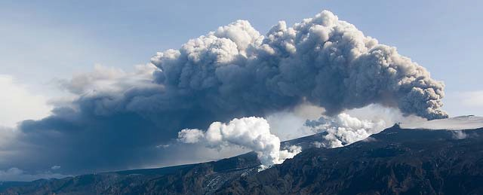
Quantifying uncertainty in volcanic ash forecasts
Natalie Harvey, Helen Dacre (Reading)
Helen Webster, David Thomson, Mike Cooke (Met Office) Nathan Huntley (Durham)

Slide 2
Improving confidence in volcanic ash forecasts
Natalie Harvey, Helen Dacre (Reading)
Helen Webster, David Thomson, Mike Cooke (Met Office) Nathan Huntley (Durham)

Slide 3
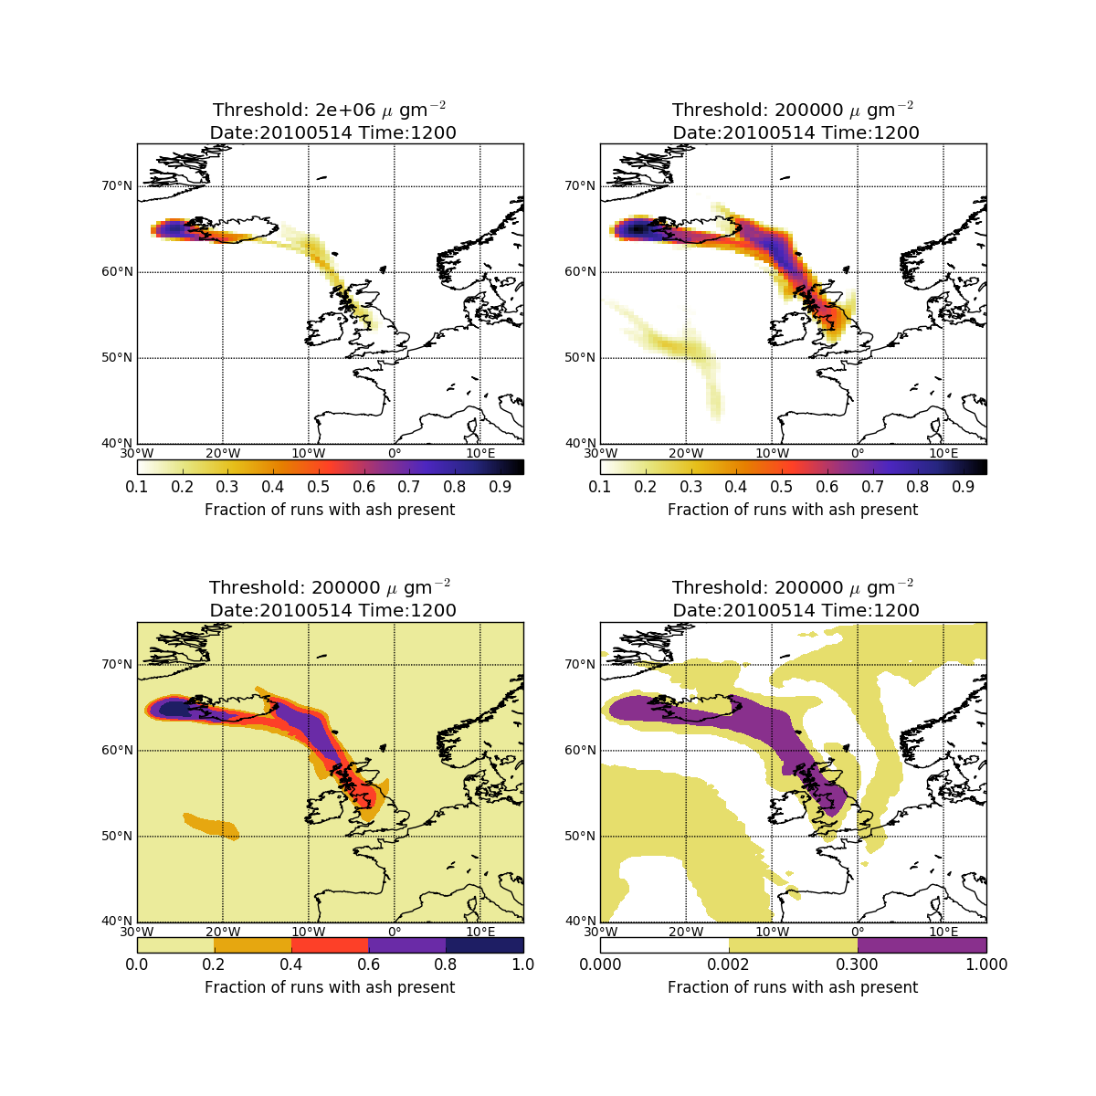
Probabilistic Forecast
Example: 1200 14 May 2010
Medium contamination
(2x10⁻³ g/m³)

Slide 4

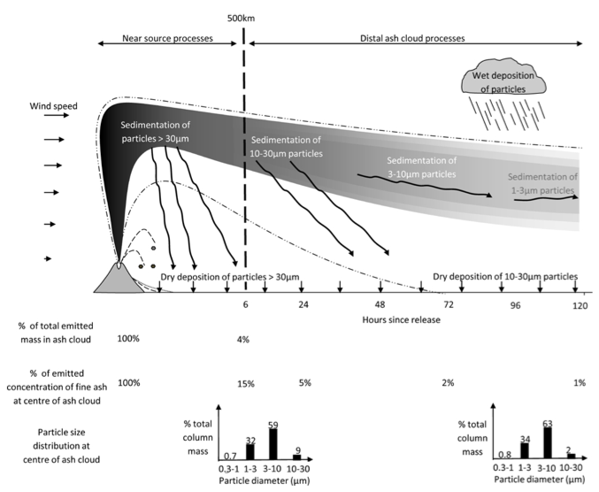


Sources of uncertainty
Missing processes
Imperfect model
Notes:
During volcanic eruptions, volcanic ash transport and dispersion models (VATDs) are used to forecast the location and movement of ash clouds. VATD models use time varying wind fields (from NWP models, typically every 3 hrs) to calculate the trajectories of particles.
Those models use input parameters, called 'eruption source parameters', such as plume height H, mass eruption rate dM/dt, duration
D, and the mass fraction of erupted debris finer than 63 μm, which can remain in the cloud for many hours or days. Estimation of these parameters is by no means a trivial task and is specific to each eruption.
VATD models include Hysplit, NAME, Flexpart, Puff, MLDP0
The accuracy of VATD model forecasts is largely dependent on the accuracy of the input parameters, known as eruption source parameters (ESP’s)
These include
The height of the volcanic ash plume above the volcano vent, H
The mass eruption rate, dM/dt
The duration of the eruption
The vertical distribution of ash in the plume
The mass fraction of erupted debris finer than 63 μm, which can remain in the cloud for many hours or days.
Much of the ash in the eruption plume falls out close to the volcano and to estimate concentrations of ash at long ranges an estimate of the fraction of the ash that survives early fall out is needed (distal fine ash fraction).
The processes controlling the evolution of the concentration in the distal ash cloud include sedimentation and deposition of particles, horizontal and vertical mixing processes and wind shear.

Slide 5

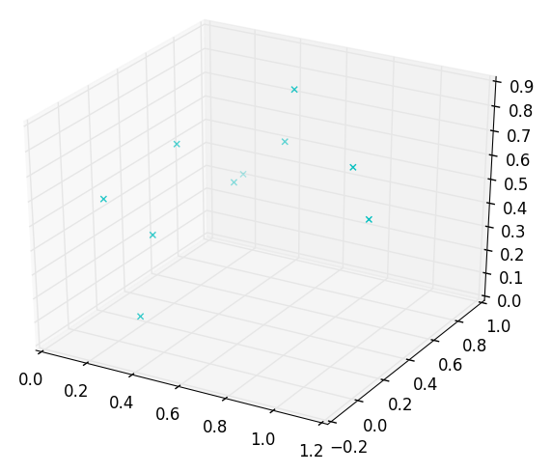
Quantifying uncertainty
Emulation
With this emulator, we can explore the parameter space much faster, and furthermore identify plausible and implausible regions (for instance through history matching). Early investigations suggest that the average concentration over a particular region and time can be used to build useful emulators.
1 variable
2 variables
3 variables

Slide 6
Quantifying uncertainty
Emulation
With this emulator, we can explore the parameter space much faster, and furthermore identify plausible and implausible regions (for instance through history matching). Early investigations suggest that the average concentration over a particular region and time can be used to build useful emulators.
More than 3 variables?
1 variable
2 variables
3 variables

Slide 7
Quantifying uncertainty
Emulation
With this emulator, we can explore the parameter space much faster, and furthermore identify plausible and implausible regions (for instance through history matching). Early investigations suggest that the average concentration over a particular region and time can be used to build useful emulators.
Dispersion model
Complex – over 25 different parameters
Runs slowly
Can’t easily understand interactions
Emulator
Simple approximation of complex model
Quickly evaluated over large range of parameter space
Identify parameters that contribute most to the uncertainty in the output and interactions between them
Statistics happens here!
1. Variable 3
2. Variable 7
3. Variable 1
4. Variable 22
…..
Statistics happens here!

Slide 8
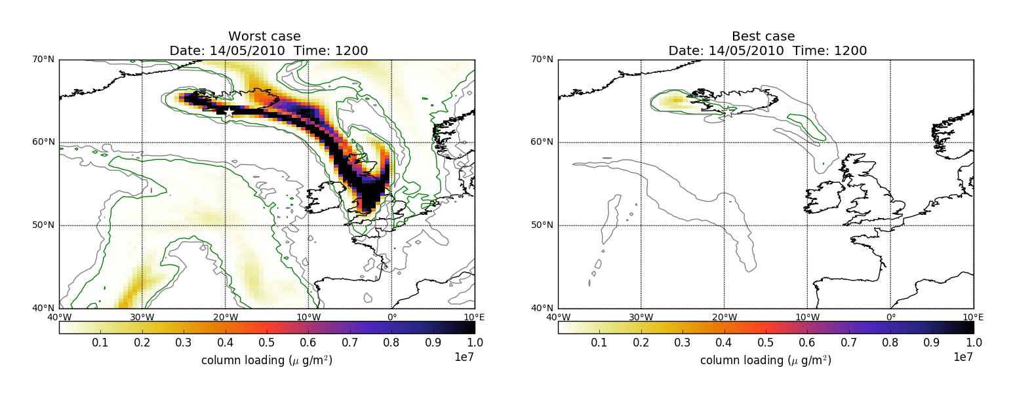
Quantifying uncertainty
Example: 14 May 2010
500 NAME runs
15 parameters varied (all at the same time)
Parameter ranges determined by experts in the field

Slide 9
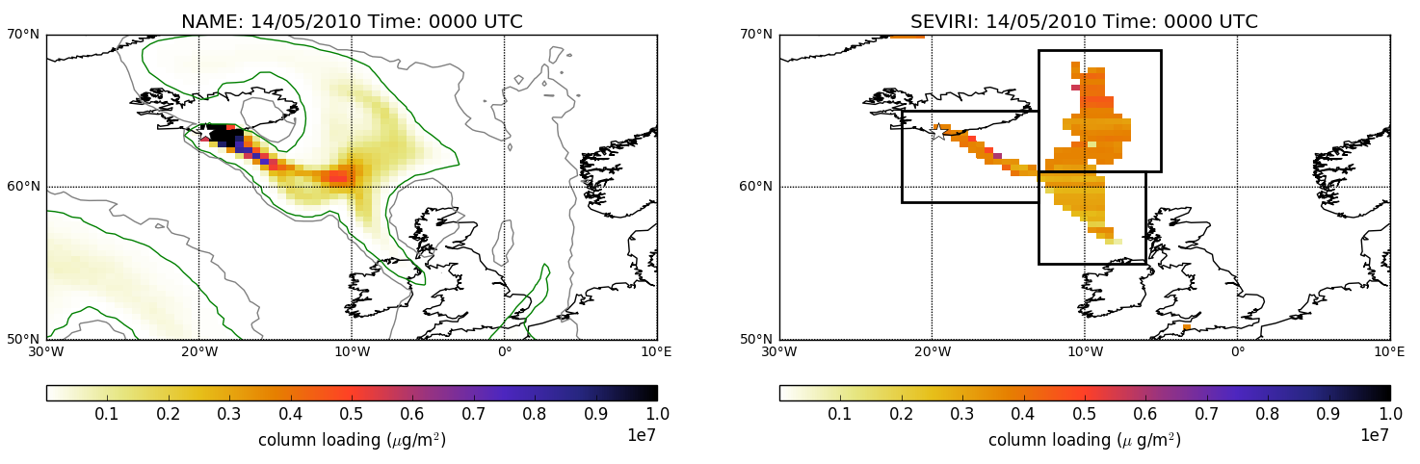
Quantifying uncertainty
Example: 14 May 2010
Emulate average ash column loading in 81 pre-determined regions (2/3 per hour)
“Best guess” model
Satellite

Slide 10
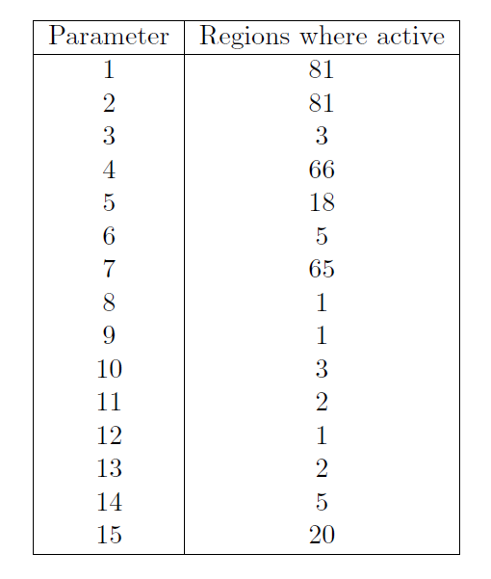
Quantifying uncertainty
Most important parameters
This information can be used to inform future research and measurement campaigns.
  Prioritise variables (and their ranges) to perturb for a small operational ensemble
plume height and mass eruption rate
Free tropospheric turbulence
Precipitation level required for wet deposition
Particle size
distribution

Slide 11
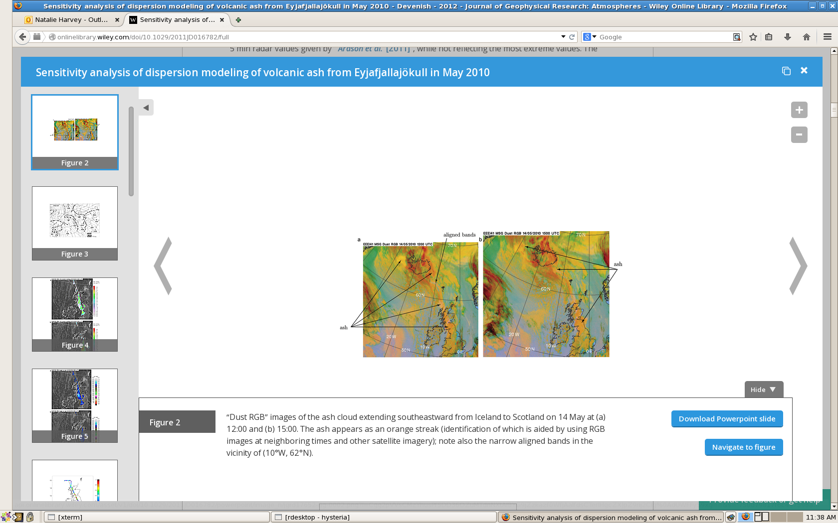
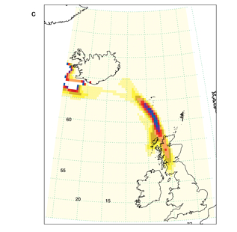
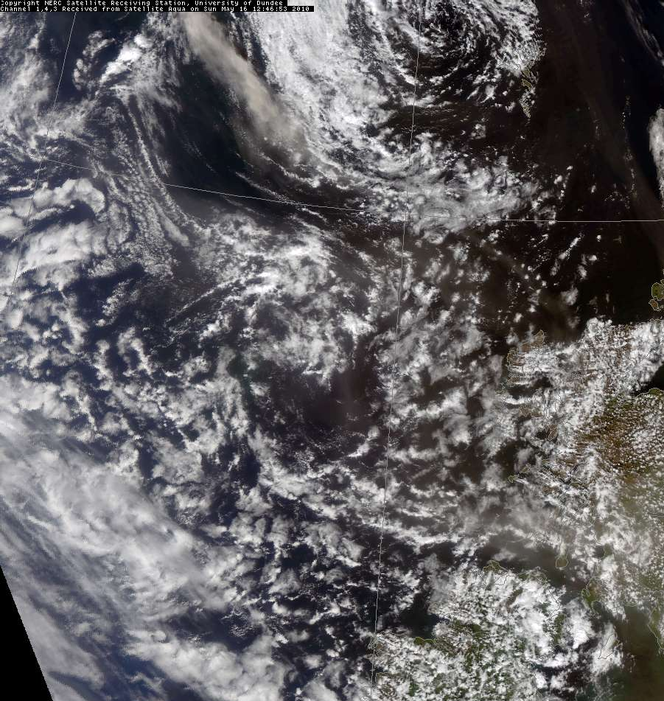
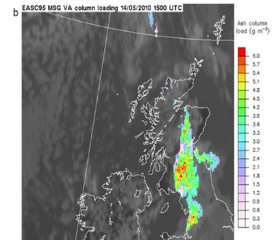
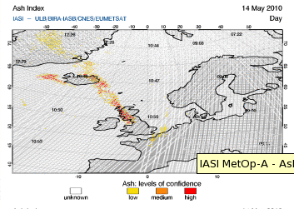
What is a good spatial forecast?
Example: 14 May 2010
RGB satellite
Visible satellite
Model
Ash loadings
IASI ash index

Slide 12
What is a good spatial forecast?
Spatial comparison
Problem: Model output is more spatially coherent with a wide range of concentration values compared to the satellite. This is due to the satellite having a detection limit.
Answer: Match the number of model pixels to the number of satellite pixels before performing comparison.
Choose pixels with highest levels of ash
Column loading (µg/m²)

Slide 13




What is a good spatial forecast?
Spatial comparison
Look in the neighbouring grid boxes and compares the fraction containing ash
Increase neighbourhood size to get measure of “useful” skill or scale at which we “trust” the forecast
Model
Obs
Model
Obs
$$\frac{1}{1}$$
$$\frac{0}{1}$$
$$\frac{3}{9}$$
$$\frac{3}{9}$$

Slide 14
What is a good spatial forecast?
Spatial comparison
Satellite
Model
Scale
200 km
5 times grid scale
40 km
grid scale
Harvey & Dacre (2015)

Slide 15
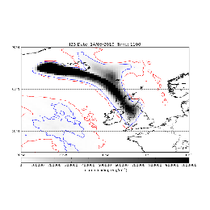
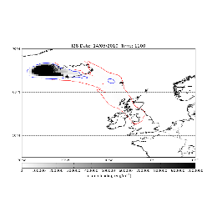
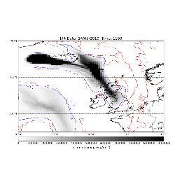
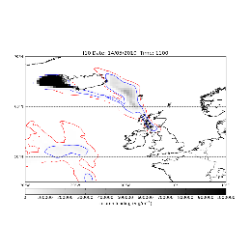
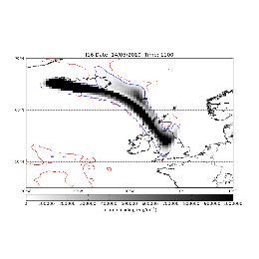
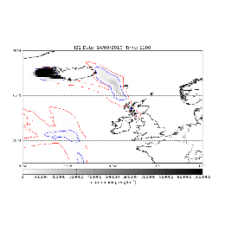
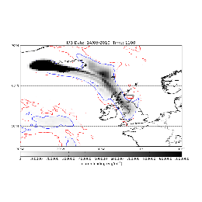
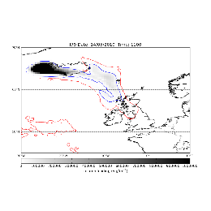
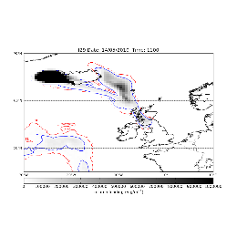
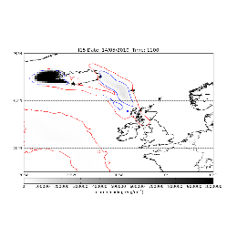
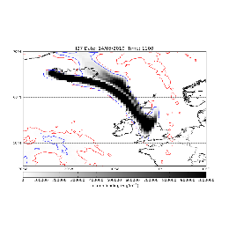
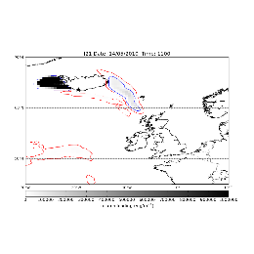
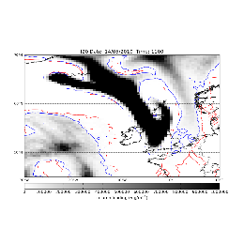
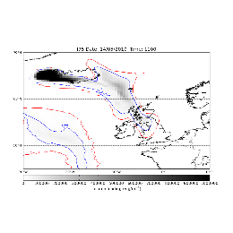
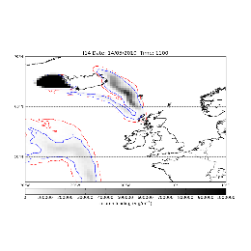
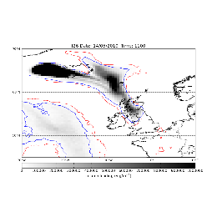
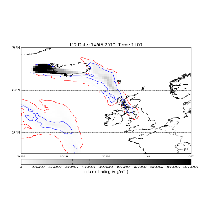
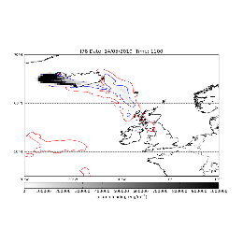
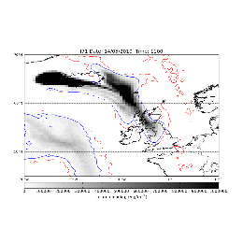
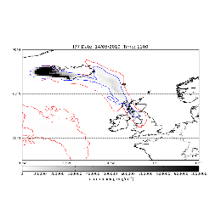
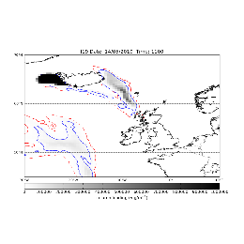
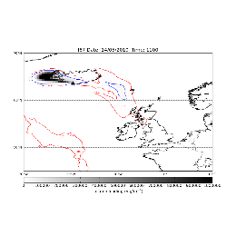
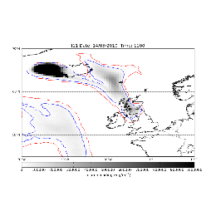
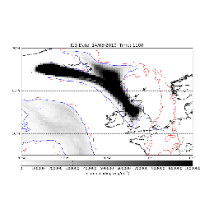
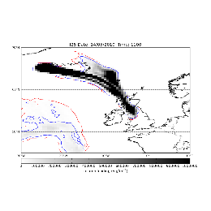
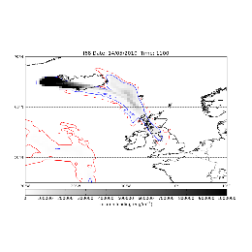
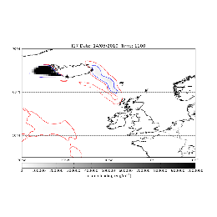
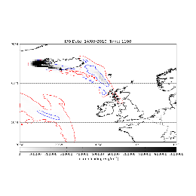
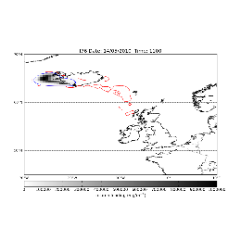
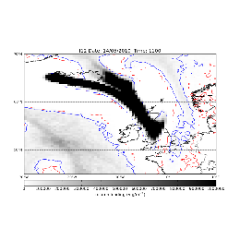
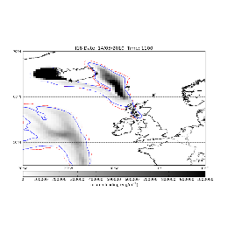
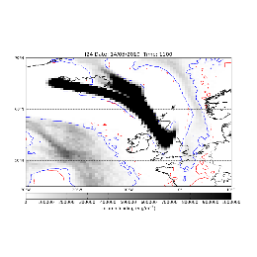
Probabilistic Forecast?
Many realisations
Different information about the volcano
Different input meteorology
Different model parameters
Different models

Slide 16
Probabilistic Forecast?
Ash concentration threshold
Low contamination
(2x10⁻⁴ g/m³)
Medium contamination
(2x10⁻³ g/m³)

Slide 17
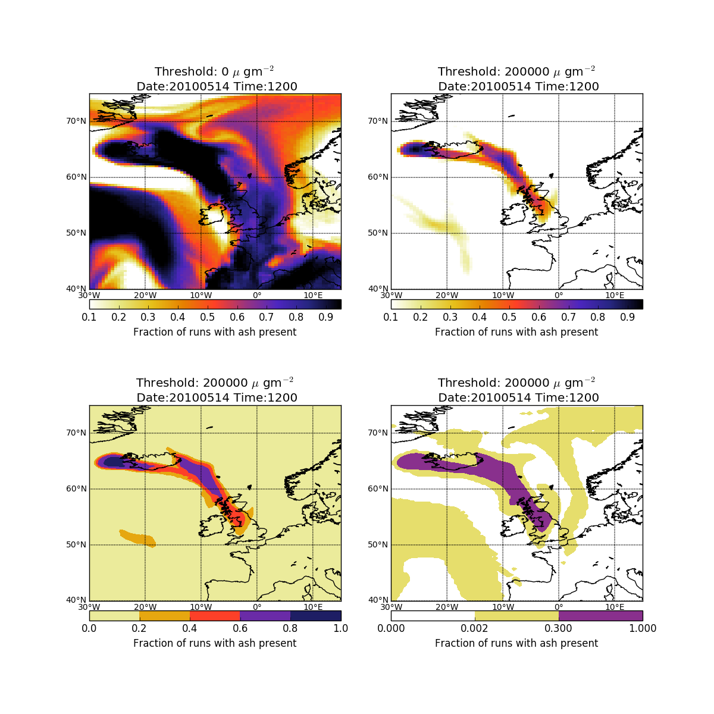
Probabilistic Forecast?
Probability threshold
Low contamination
(2x10⁻⁴ g/m³)
One model run

Slide 18
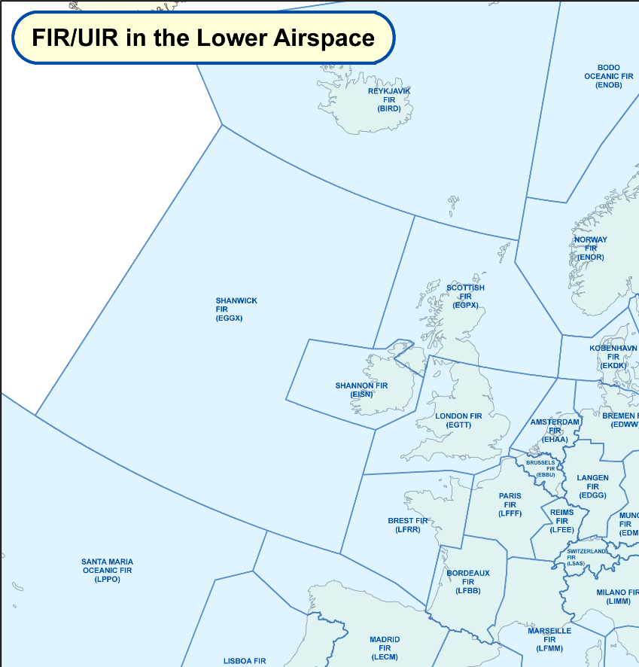
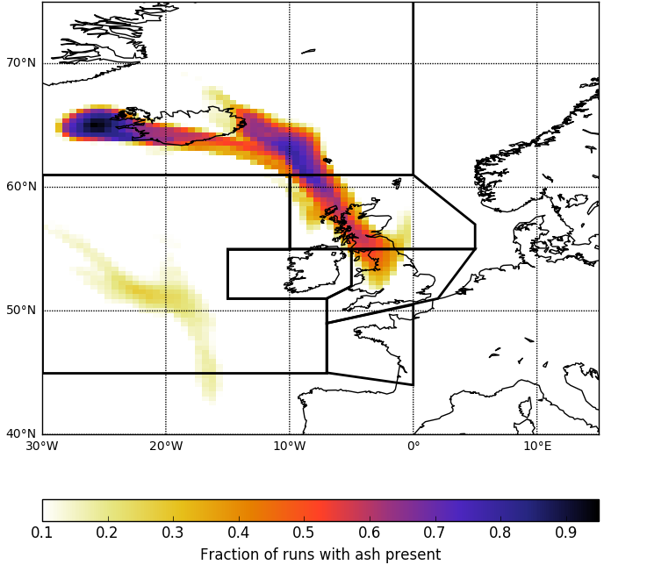
Probabilistic Forecast?
Region of interest
Source: EUROCONTROL

Slide 19
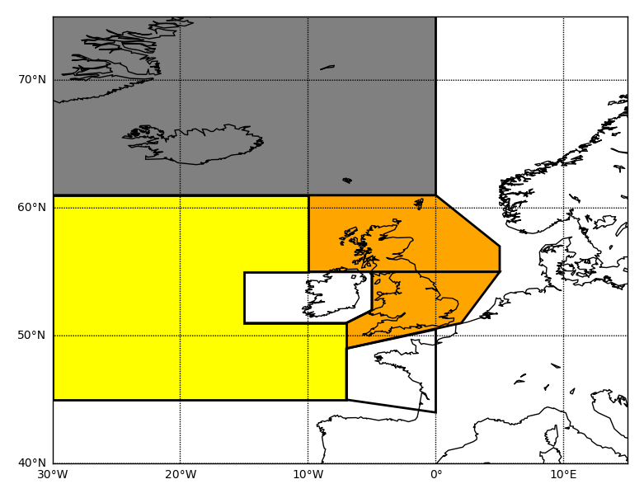
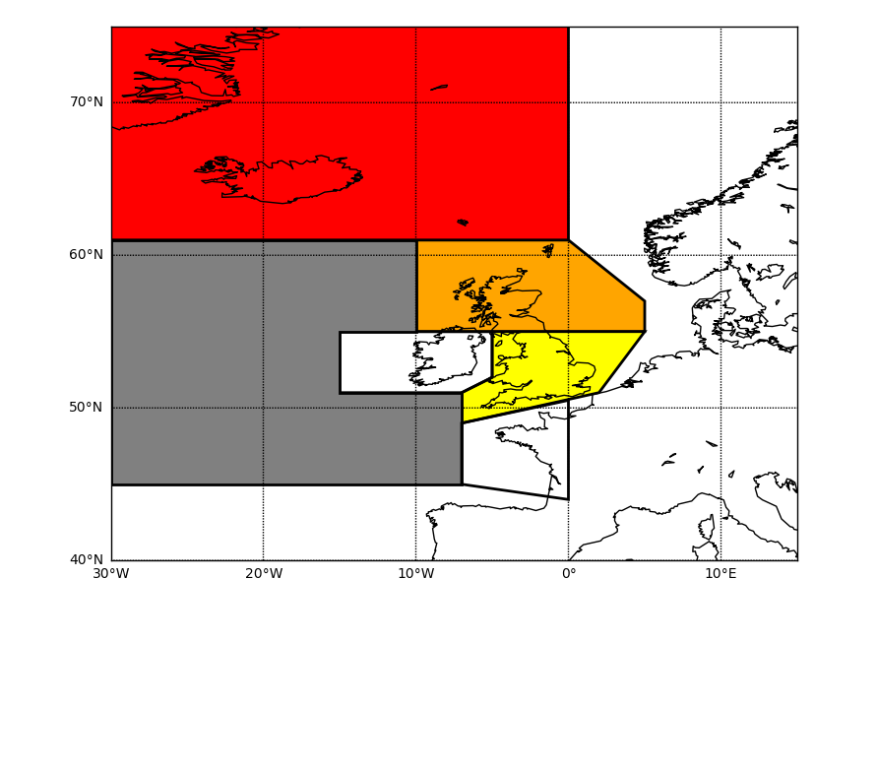
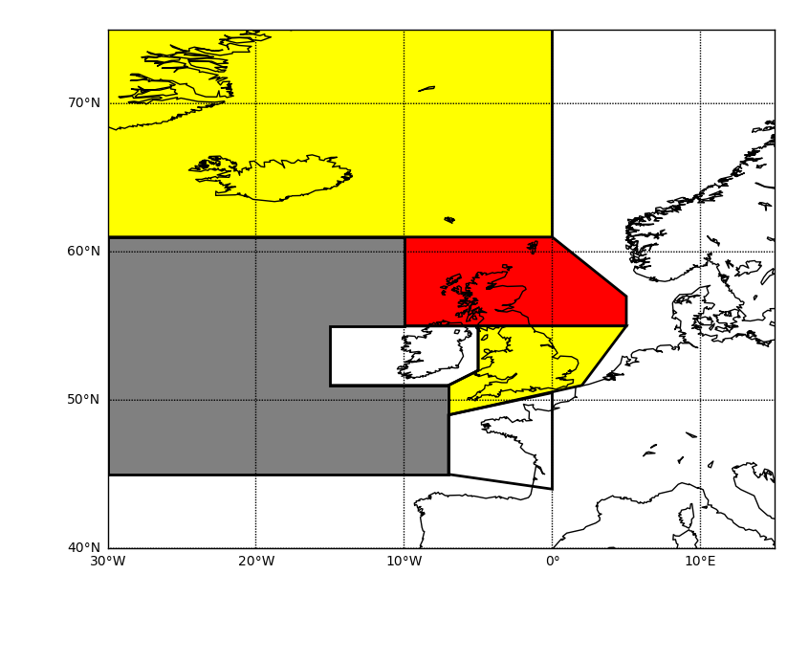
Probabilistic Forecast?
Region of interest
Fraction of FIR with ash
Maximum fraction in FIR
Mean fraction in FIR

Slide 20
Probabilistic Forecast?
Along flight path
High contamination
One model realisation
Medium contamination
Low contamination
Ten model realisations

Slide 21













Probabilistic Forecast?
Impact models?
Impact model

Slide 22
Improving confidence in volcanic ash forecasts
  Emulation can be used to find the parameters that contribute most to the uncertainty in model output
  Inform research priorities
  Prioritise variables to perturb for a small operational ensemble
  Now have a metric which can be used to determine the scale over which a model can be trusted and can be applied to probabilistic forecasts
  What is the most useful way to convey probabilistic information to decision makers?

Slide 23

Questions?

