Slide 1

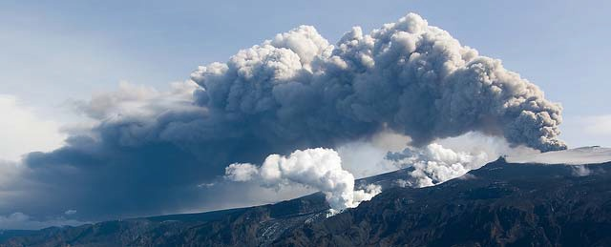
Reducing the risk of volcanic ash to aviation
Natalie Harvey, Helen Dacre (Reading)
Helen Webster, David Thomson, Mike Cooke (Met Office)
Nathan Huntley (Durham)

Slide 2
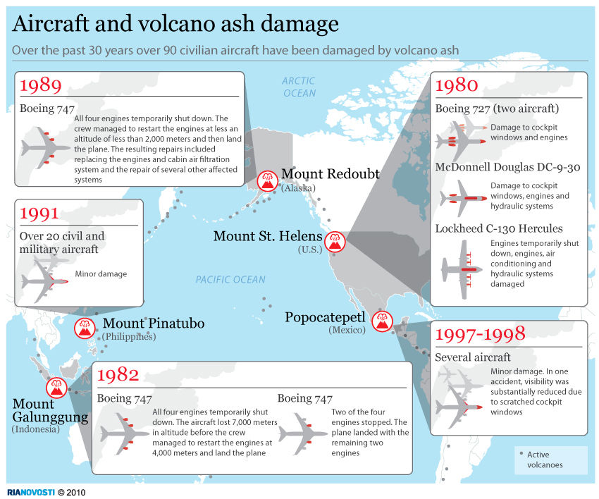
Impact on aircraft
Volcanic ash is hard and abrasive
Volcanic ash can cause engine failure
> 126 incidents of encounters with ash clouds since 1935
Ash-encounter (AE) severity index ranging from 0 (no notable damage) to 5 (engine failure leading to crash)
Difficult to predict what a safe level of ash concentration is for aircraft to fly through

Slide 3
Impact on aircraft
Volcanic ash is hard and abrasive
Volcanic ash can cause engine failure
> 126 incidents of encounters with ash clouds since 1935
Ash-encounter (AE) severity index ranging from 0 (no notable damage) to 5 (engine failure leading to crash)
Difficult to predict what a safe level of ash concentration is for aircraft to fly through

Slide 4
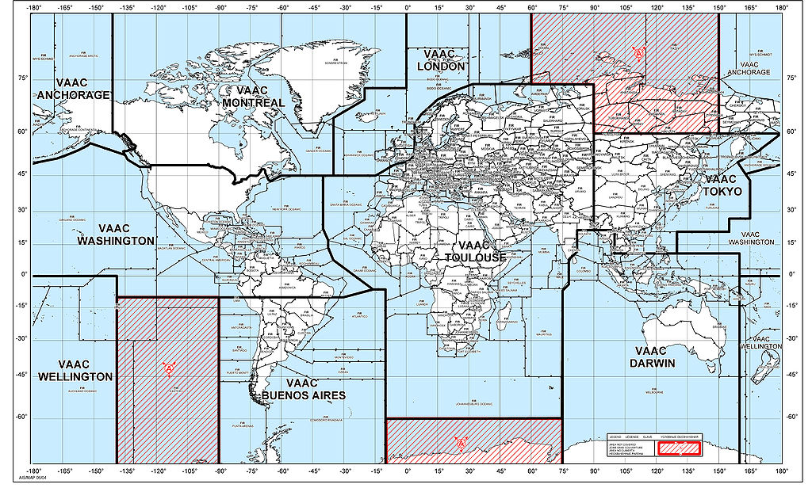
Volcanic Ash Advisory Centres
(VAACs)

Slide 5
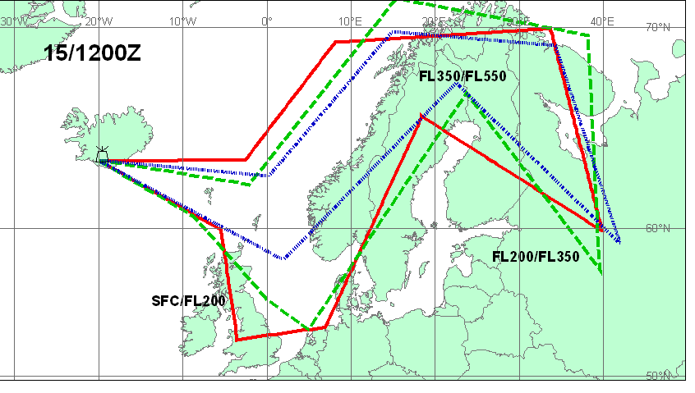
Volcanic ash graphics

Slide 6
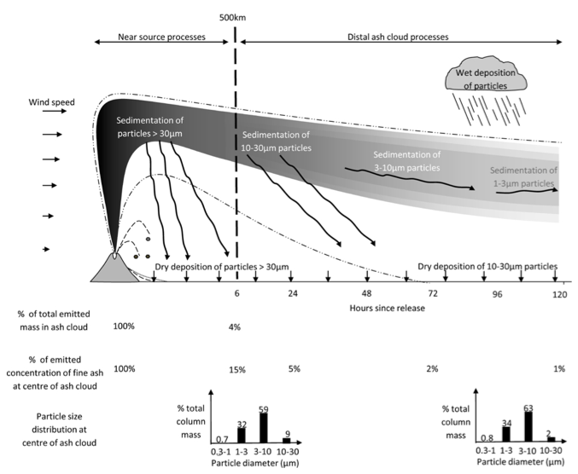
Volcanic Ash Transport and Dispersion (VATD) Models
Notes:
During volcanic eruptions, volcanic ash transport and dispersion models (VATDs) are used to forecast the location and movement of ash clouds. VATD models use time varying wind fields (from NWP models, typically every 3 hrs) to calculate the trajectories of particles.
Those models use input parameters, called 'eruption source parameters', such as plume height H, mass eruption rate dM/dt, duration
D, and the mass fraction of erupted debris finer than 63 μm, which can remain in the cloud for many hours or days. Estimation of these parameters is by no means a trivial task and is specific to each eruption.
VATD models include Hysplit, NAME, Flexpart, Puff, MLDP0
The accuracy of VATD model forecasts is largely dependent on the accuracy of the input parameters, known as eruption source parameters (ESP’s)
These include
The height of the volcanic ash plume above the volcano vent, H
The mass eruption rate, dM/dt
The duration of the eruption
The vertical distribution of ash in the plume
The mass fraction of erupted debris finer than 63 μm, which can remain in the cloud for many hours or days.
Much of the ash in the eruption plume falls out close to the volcano and to estimate concentrations of ash at long ranges an estimate of the fraction of the ash that survives early fall out is needed (distal fine ash fraction).
The processes controlling the evolution of the concentration in the distal ash cloud include sedimentation and deposition of particles, horizontal and vertical mixing processes and wind shear.

Slide 7
RACER: Robust Assessment and
Communication of Environmental Risk
Volcanic ash strand aims:
1. Develop a methodology for assessing source, parameter and structural uncertainty in dispersion models
2. Quantify the relative importance of different sources of uncertainty and hence identification of measurements needed to constrain uncertainty.
3. Combine multiple uncertainties into a single probabilistic volcanic ash forecast.

Slide 8
Framework for quantifying uncertainty
Expert Elicitation:
choose parameters and their ranges
Experimental Design:
choose parameters and their ranges
Run perturbed parameter ensemble
Build emulator for each grid box and output variable
Test emulator against simulator
Full variance based sensitivity analysis using emulator
Following Lee et al. (2011)

Slide 9



Expert Elicitation
Spread over 3 sessions
2 experts from Met Office (plus input from other members of the dispersion group), Nathan Huntley (Durham)
Facilitator : Andy Hart
Target output: column integrated mass loading
Considered over 20 different parameters

Slide 10
Experimental design
Case study 14 May 2010 – lots of observations
Maximum information in fewest runs
  Latin hypercube sampling (other sampling methods are available!)
    Good marginal coverage and space filling properties
Normalised parameter value
Parameter

Slide 11

Emulation
This is part of the process is being performed at Durham
The 100 training runs are being used to build the emulator
A further 200 runs are being completed as I speak!
Initial findings:
  It is relatively easy to emulate simple summaries (e.g. total ash predicted in a particular region at a particular time).
  The parameters that have the most influence are:
    plume height
    emission rate
    fraction of large particles
    Ppt_crit - parameter governing when the precipitation rate is large enough to contribute to wet deposition

Slide 12
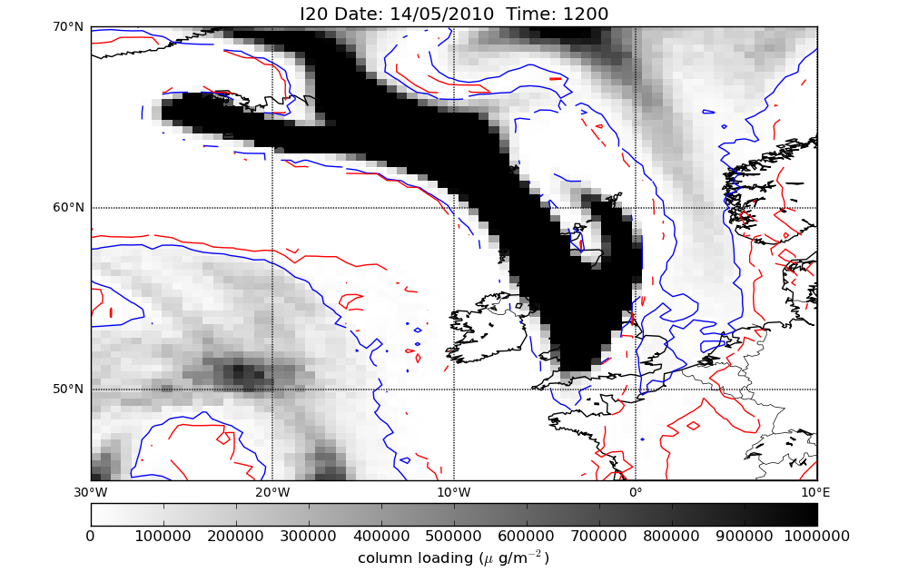
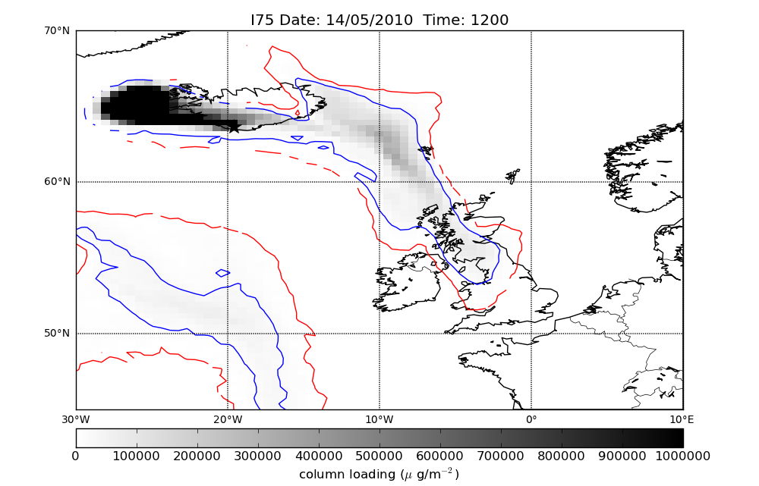
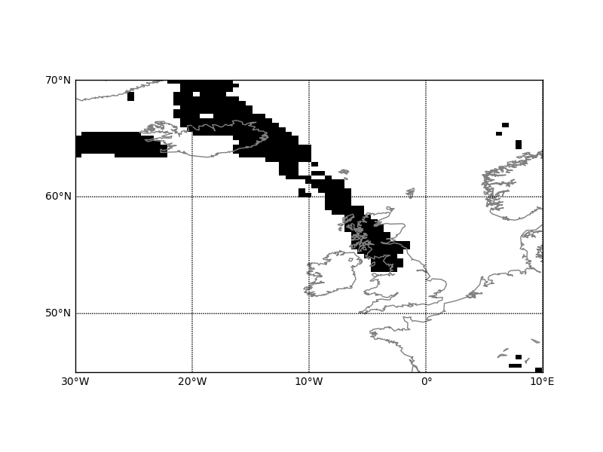
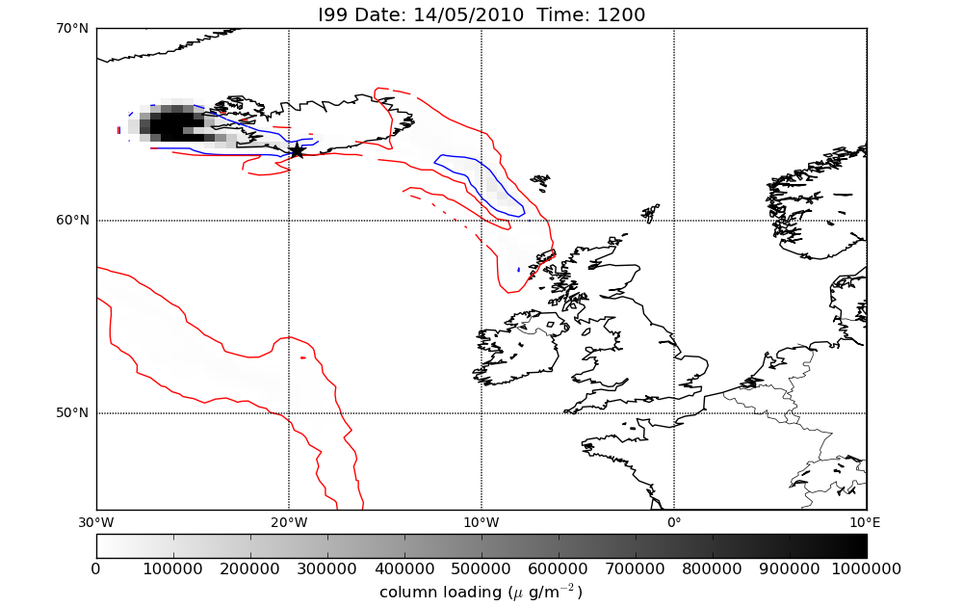
Case study: 14 May 2010
L
“New” ash
“Older” ash
H
SEVIRI Satellite Retrieval

Slide 13
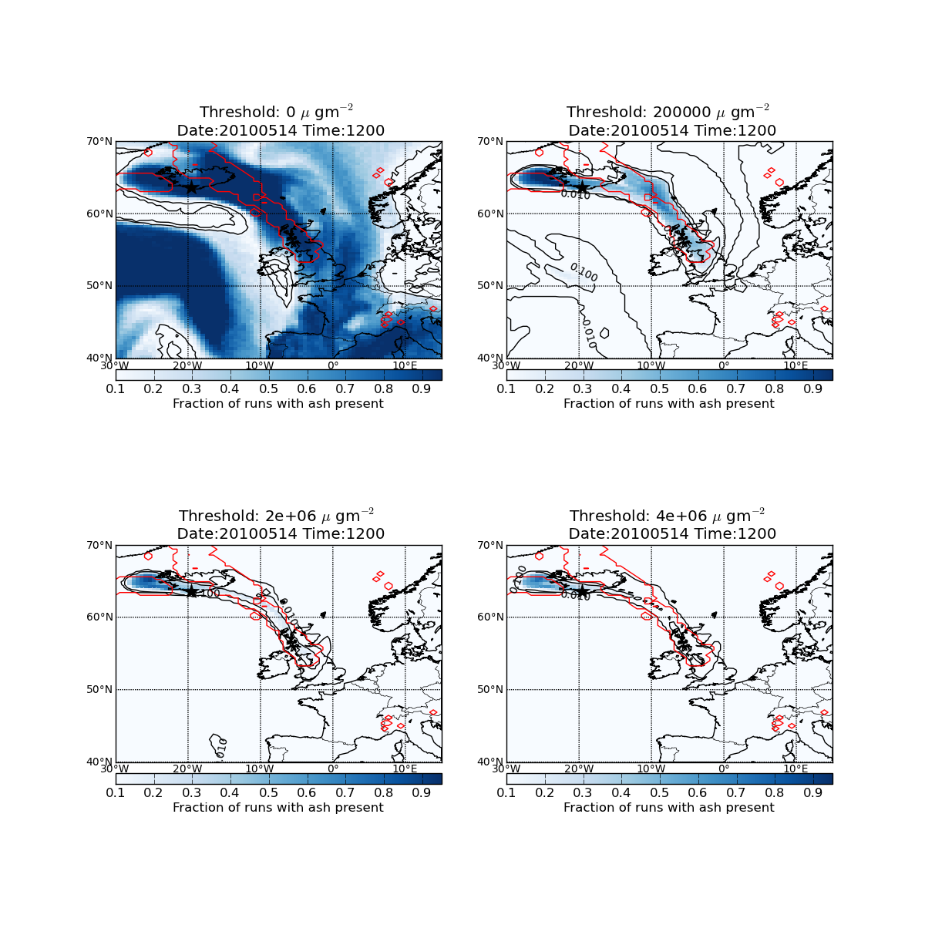
Probabilistic Forecast?

Slide 14
Probabilistic Forecast?
Threshold: 2mg/m³
Ash layer depth: 100m
Threshold: 2mg/m³
Ash layer depth: 1000m
Is there a way to evaluate these probabilistic forecasts?

Slide 15
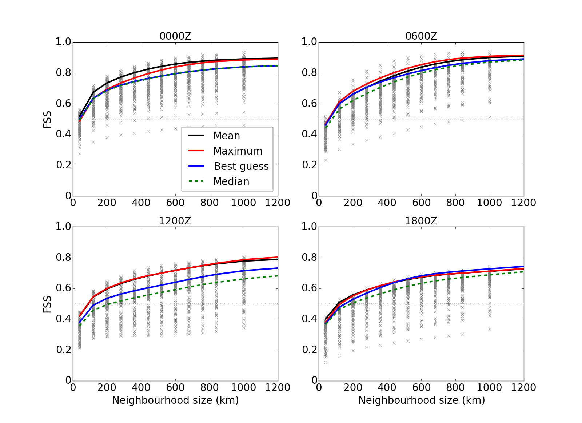
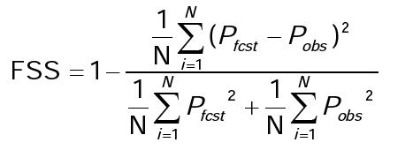
Does the ensemble perform better than the best guess simulation?
Fractions Skill Score (FSS)
Compares fractional coverage in forecast with fractional coverage in observations over different neighbourhoods

Slide 16
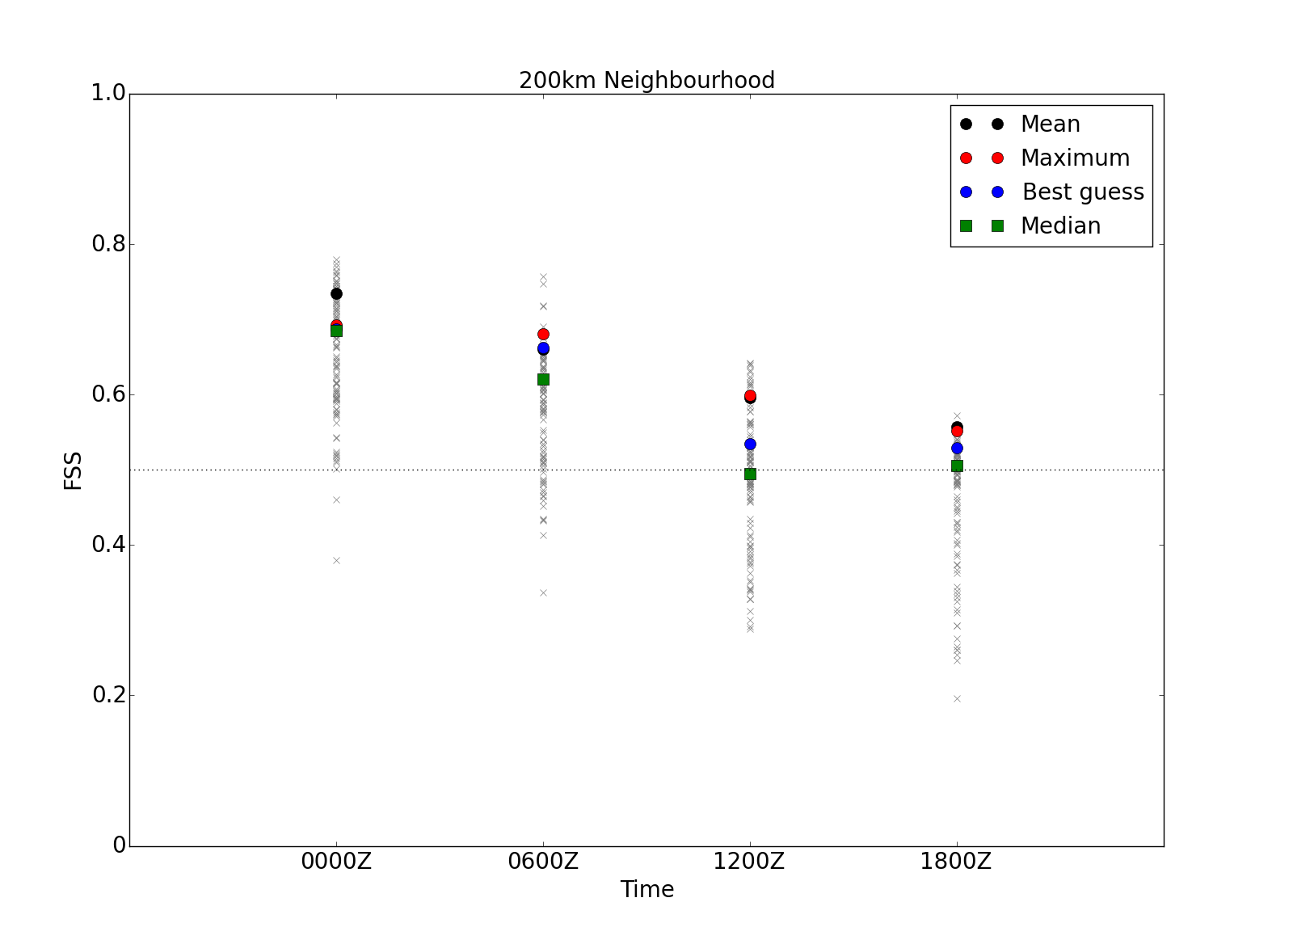
Does the ensemble perform better than the best guess simulation?
200km Neighbourhood
FSS
Time

Slide 17
Future Work
Further develop emulator to enable the quantification of relative importance of different sources of uncertainty within the model
Develop a framework to assess the structural uncertainty in the NAME model
Quantify the uncertainty associated with the meteorological forecasts
Develop methods of evaluating probabilistic forecasts
Design of ensembles for emergency response?

