Slide 1

WP2.1a,b: High resolution simulations of convection
GOAL: To inform parametrization development and in particular improve the temporal evolution of convection (“convective memory”)
METHOD: Analysing the diurnal cycle of deep convection using MONC
Chimene Daleu, Natalie Harvey
Steve Woolnough, Bob Plant
Alison Stirling

Slide 2
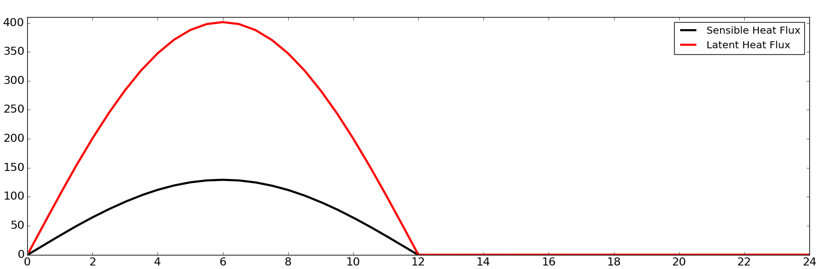
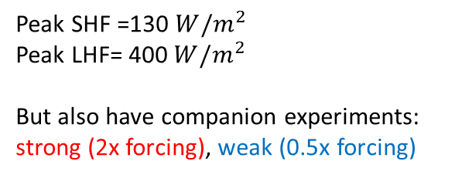

Experimental setup – based on EUROCS
Idealised prescribed surface forcing based on EUROCS (Guichard et al., 2004), balanced by a specified large scale cooling of -2.2K/day. Initial profiles also based on EUROCS.
3D setup: 100km x 100km domain with 200m horizontal and 99 vertical levels (stretched grid and 20 km top).
Run for 10 diurnal cycles
$${W/m}^{2}$$
Peak SHF =130 ${W/m}^{2}$
Peak LHF= 400${ W/m}^{2}$
But also have companion experiments: strong (2x forcing), weak (0.5x forcing)
Time (hr)

Slide 3
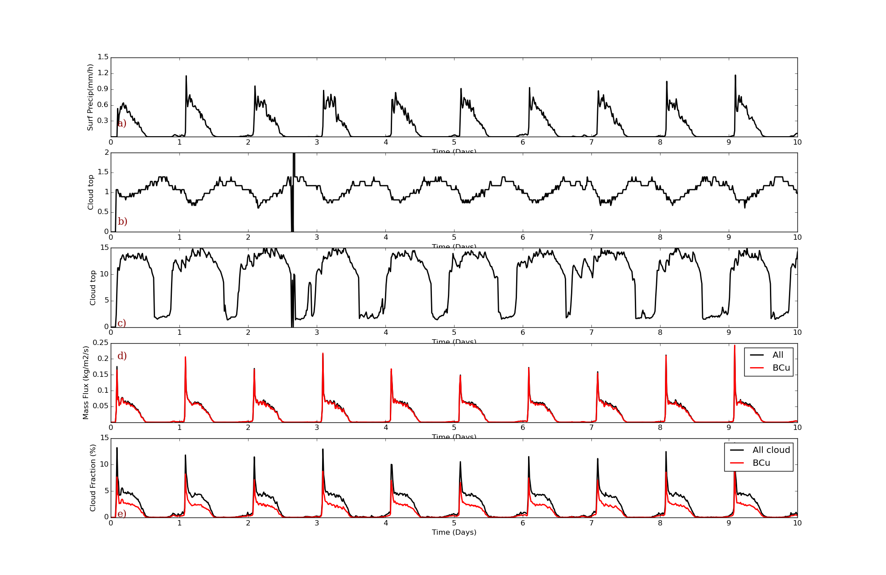

Development of convection
Precipitation (mm/h)
Cloud Top (km)
Mass Flux (${kg/m}^{2}/s$)
Cloud fraction (%)
Time (days)
The characteristics of the convective response are not consistent day-to-day.
Initial response of convection seen as a strong “spike”.
There is always cloud at night time in the domain (sometimes deep) .
Maximum precipitation is not always associated with the maximum in mass flux.

Slide 4
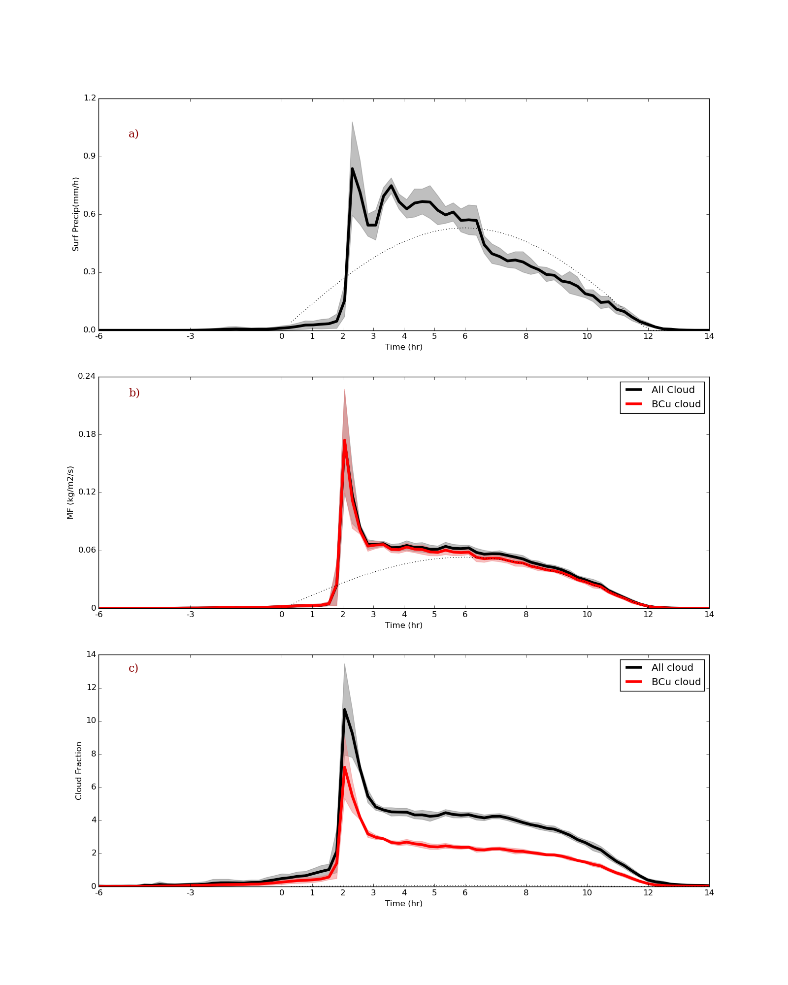


Development of convection
Convection triggered ~2hours after surface forcing starts.
Away from triggering mass flux follows surface forcing.
Larger variability in precipitation than mass flux.
Peak in surface precipitation is before the maximum in surface forcing.
Mass flux (${kg/m}^{2}s$)
Mass flux (${kg/m}^{2}/s$)
Precipitation (mm/h)
Precipitation (mm/h)
Hours
Time (hours)

Slide 5
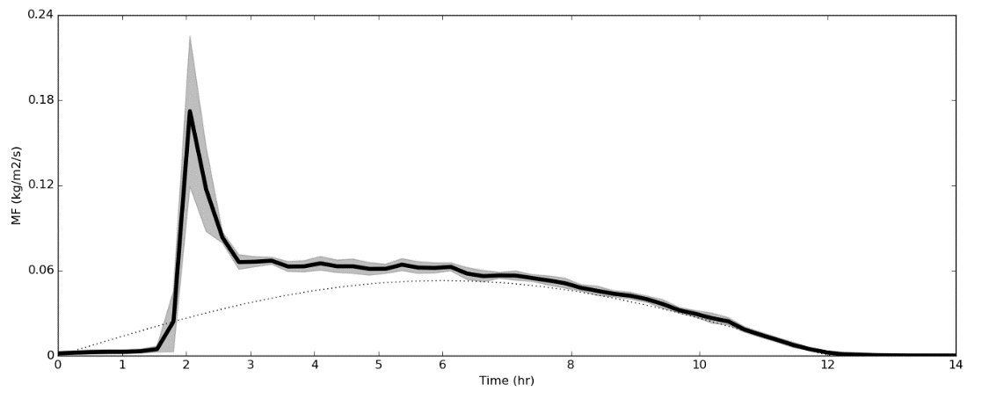
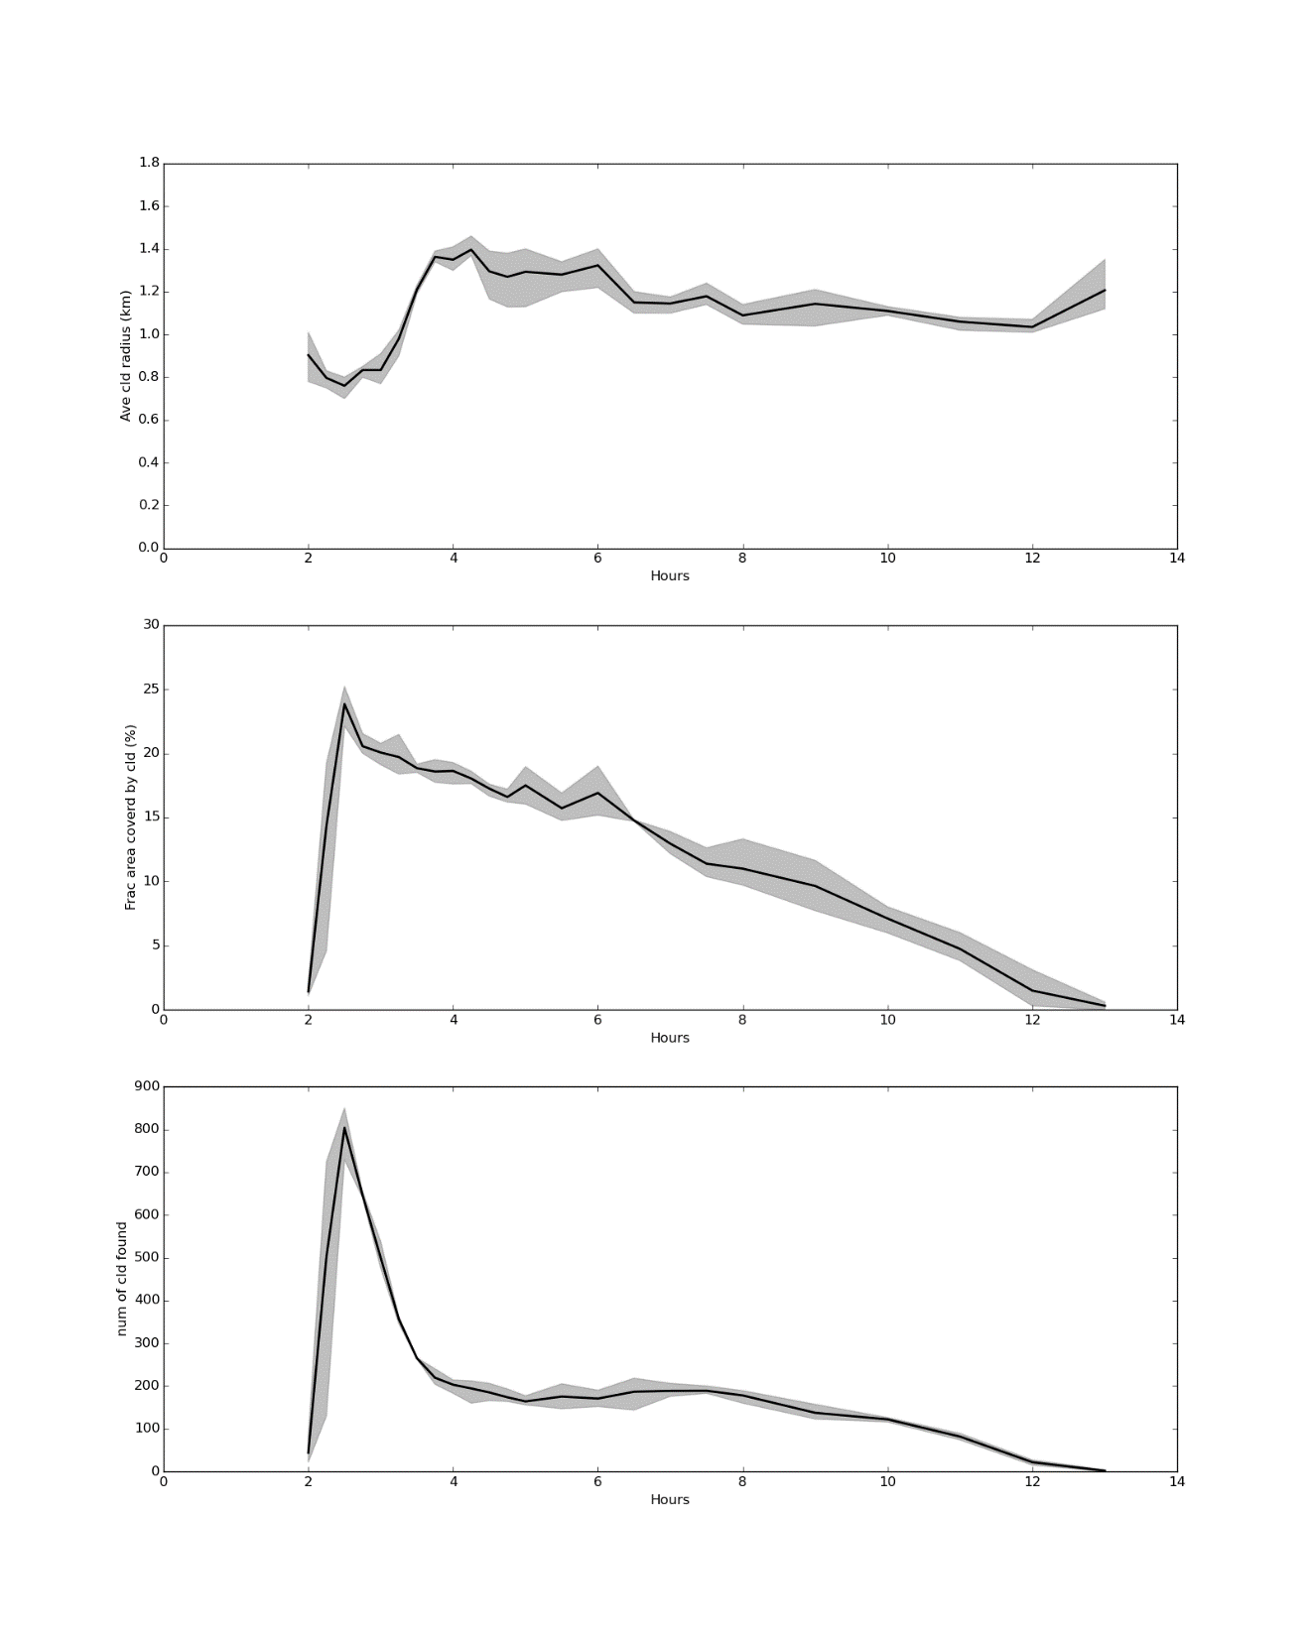
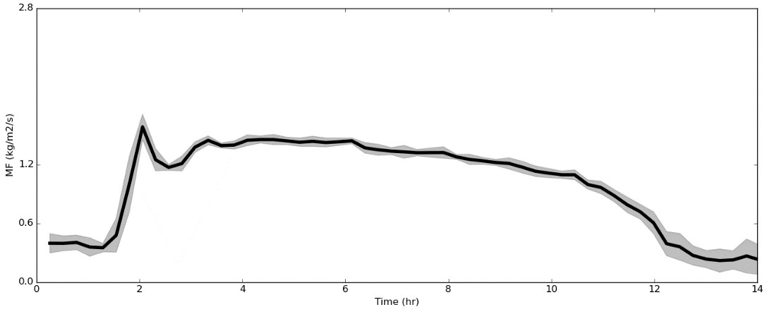


Cloud statistics
What is responsible for the initial mass flux spike?
Mass flux (${kg/m}^{2}/s$)
Mean cloud radius (km)
Mean cloud radius (km)
Mean mass flux per cloud (${kg/m}^{2}/s$)
Number of clouds
Time (hours)
Time (hours)
Spike in triggering mass flux is due to the number of (relatively small) clouds.
After triggering mean cloud radius approximately constant.

Slide 6
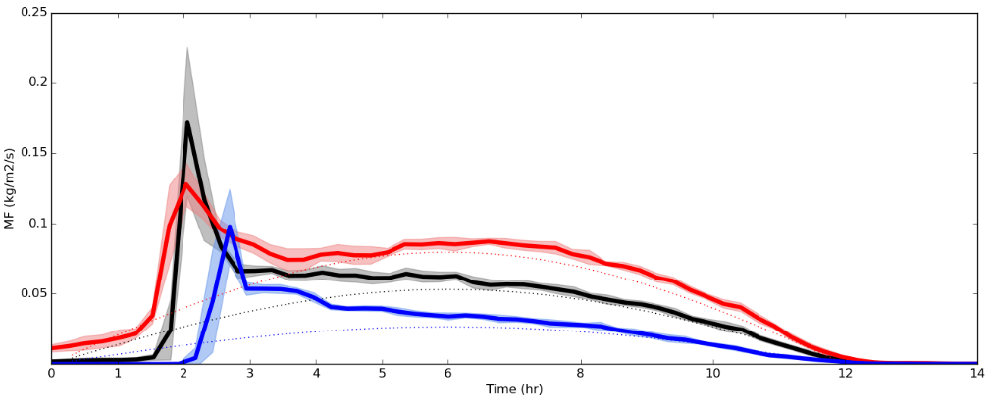
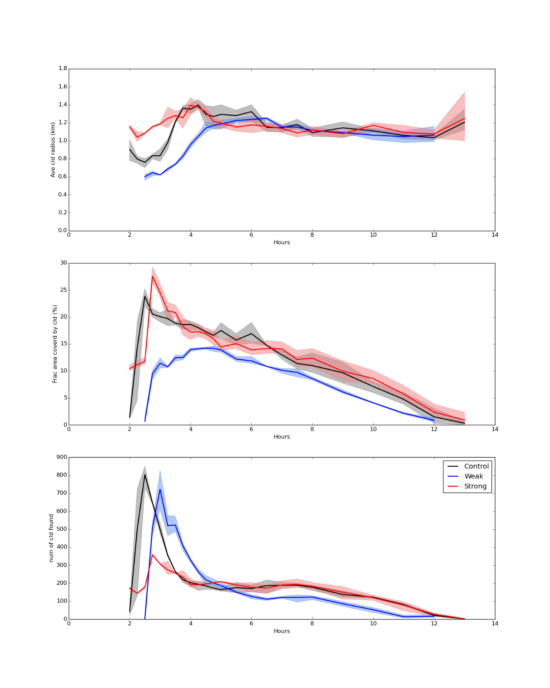
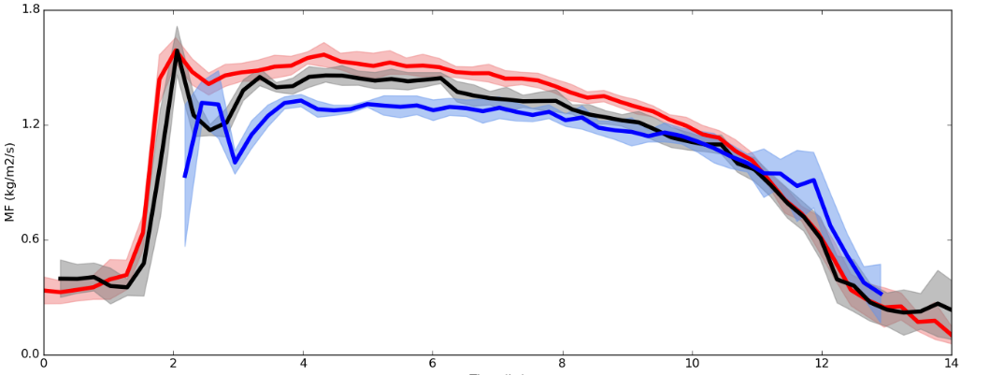

Cloud statistics
What is responsible for the initial mass flux spike?
Mass flux (${kg/m}^{2}/s$)
Mean cloud radius (km)
Mean mass flux per cloud (${kg/m}^{2}/s$)
Number of clouds
Time (hours)
Time (hours)
Changing the surface forcing has little effect on these results (apart from the initial triggering time).

Slide 7
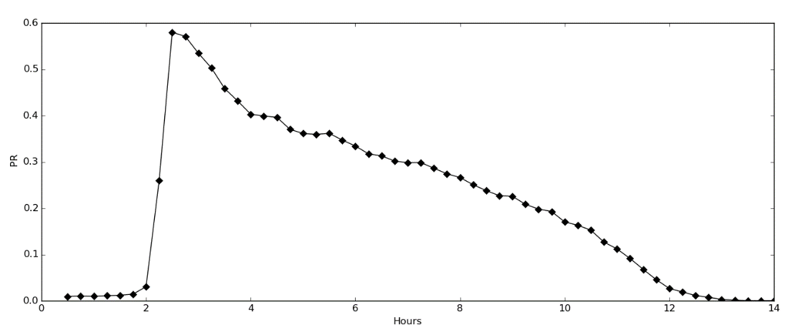
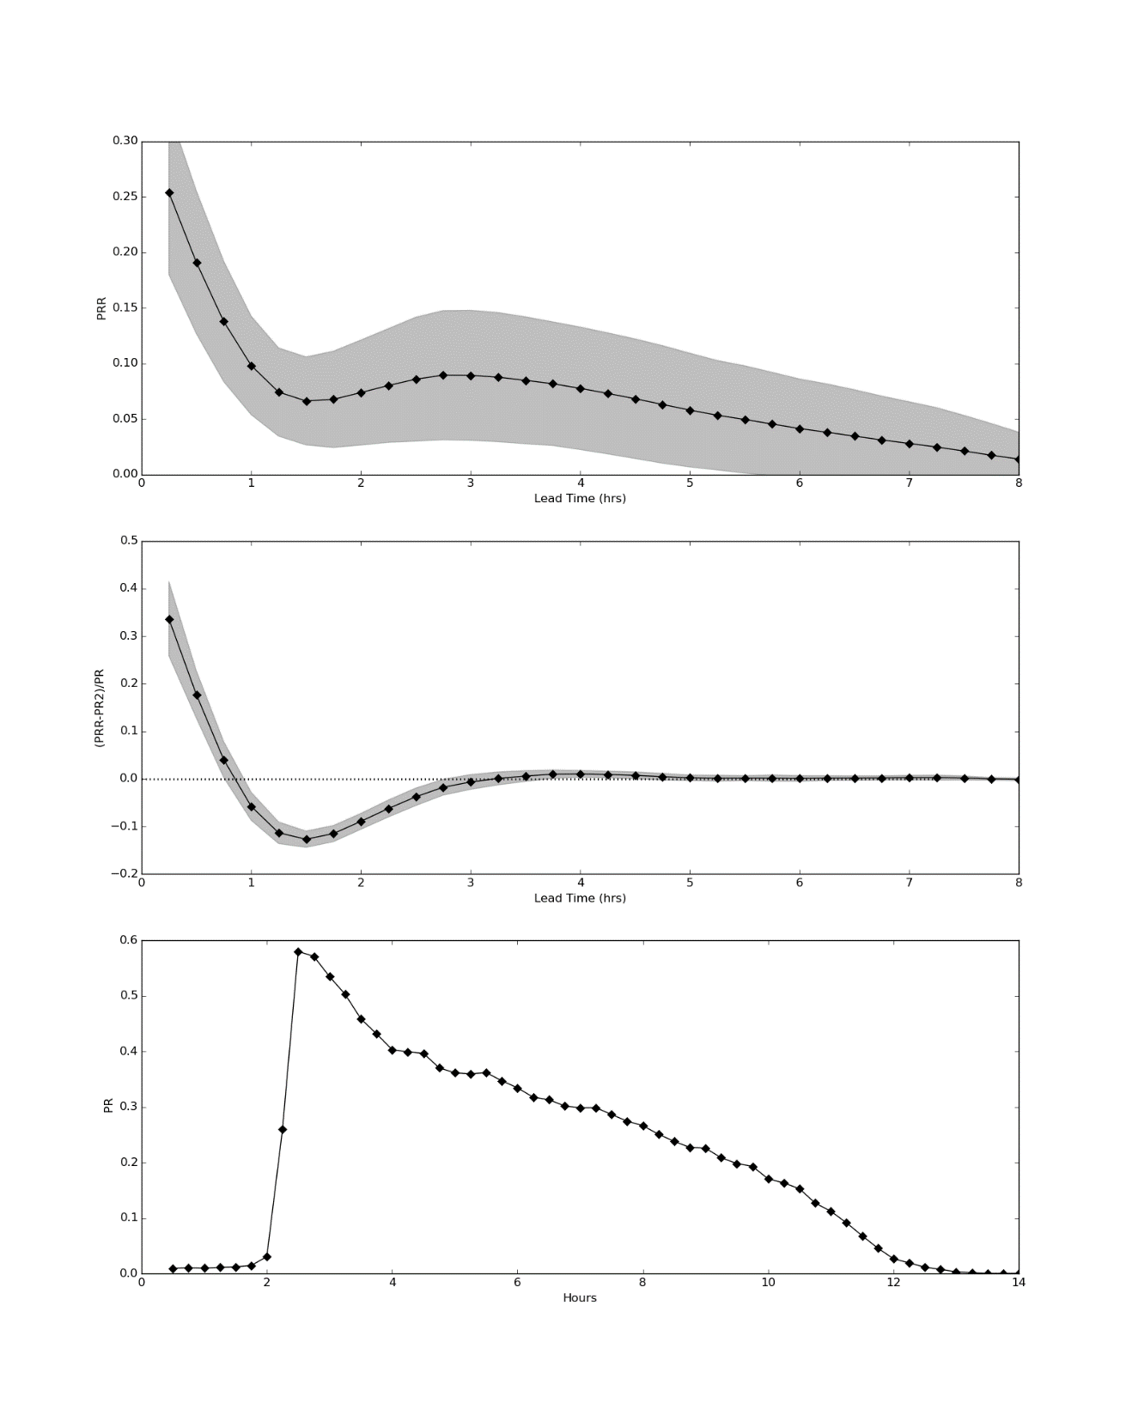


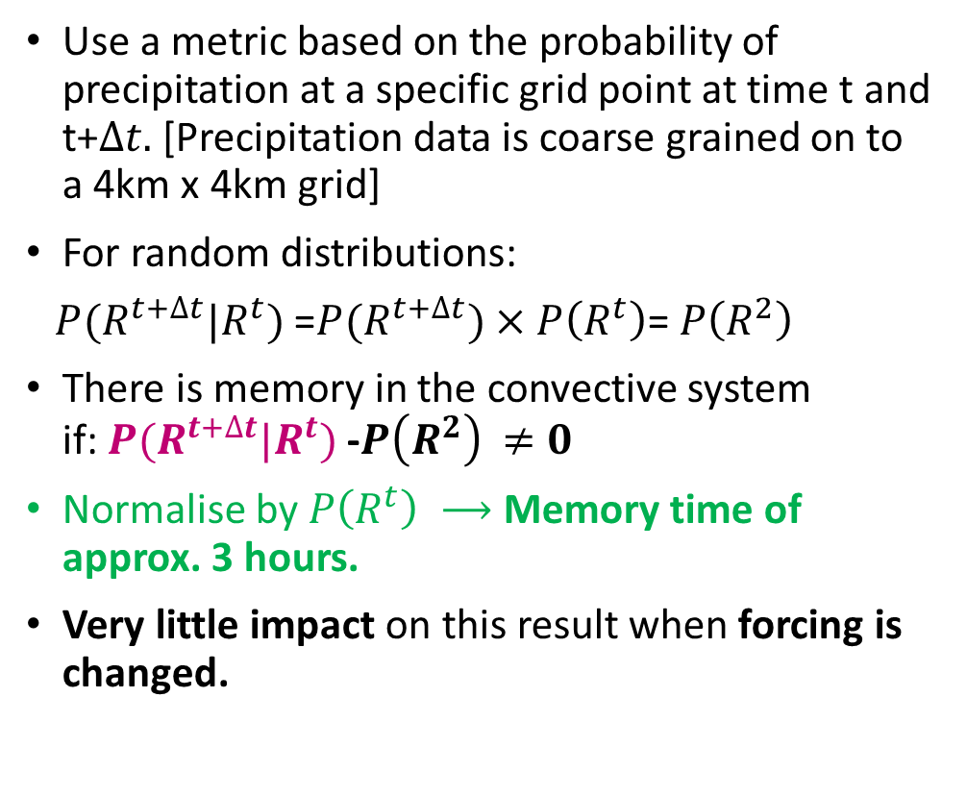


Convective Memory
Use a metric based on the probability of precipitation at a specific grid point at time t and t+$∆t.$[Precipitation data is coarse grained on to a 4km x 4km grid]
For random distributions:
$P(R^{t+∆t}|R^{t})$ =$P(R^{t+∆t})×P\left(R^{t}\right)$=$P\left(R^{2}\right)$
There is memory in the convective system if:$P(R^{t+∆t}|R^{t})$ -$P\left(R^{2}\right)$ $≠0$
Normalise by$P\left(R^{t}\right) ⟶$ Memory time of approx. 3 hours.
Very little impact on this result when forcing is changed.
$$P\left(R^{t}\right)$$
Time (hours)
$$P(R^{t+∆t}/R^{t})$$
$$\text{[}P(R^{t+∆t}|R^{t})\text{ −}P(R^{2})\text{]}\text{/}P\left(R^{t}\right)$$
$∆t$ (hours))

Slide 8
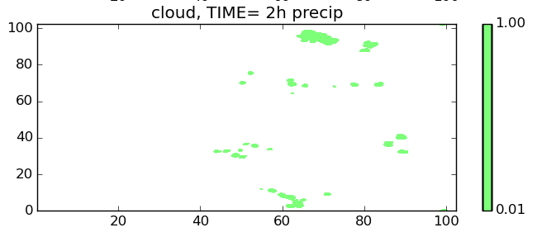
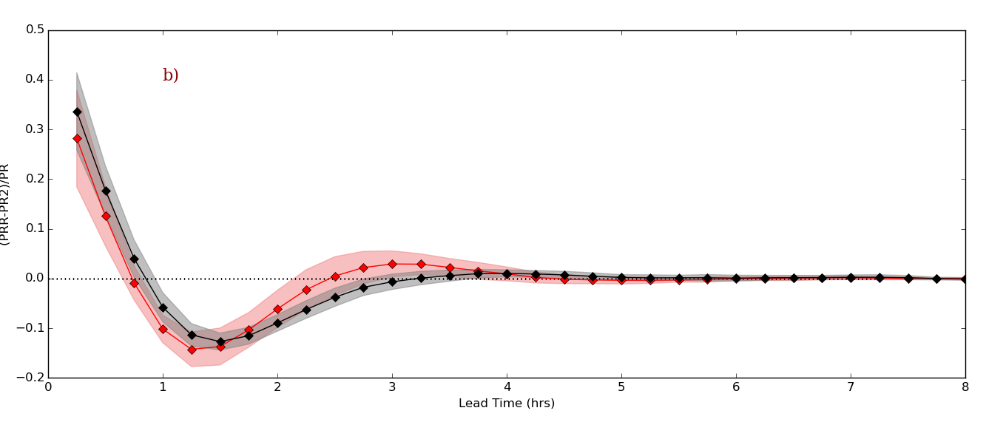
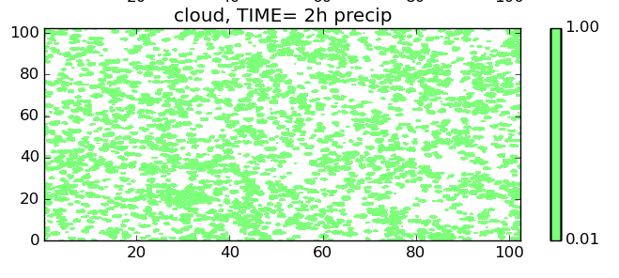



Impact on memory of thermodynamic variability at the start of forcing cycle?
Repeat experiment but remove the variability in $θ$ and $q_{v}$ overnight.
Control
At triggering there is a larger number of smaller clouds.
Memory timescale is a slightly shorter (order 30 minutes).
y (km)
Variability removed
x (km)
$$\text{\{}P(R^{t+∆t}/R^{t})\text{ −}P(R^{2})\text{\}/}P\left(R^{t}\right)$$
y (km)
$∆t$ (hrs)
x (km)

Slide 9
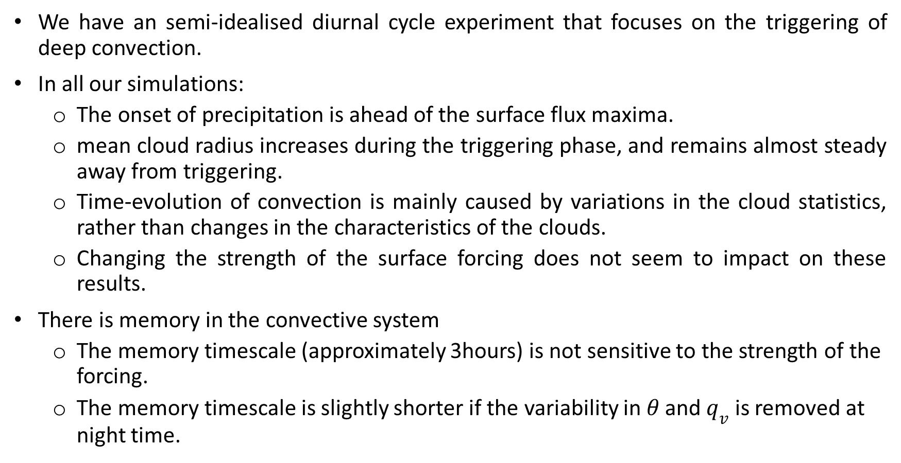
Headlines….
We have an semi-idealised diurnal cycle experiment that focuses on the triggering of deep convection.
In all our simulations:
  The onset of precipitation is ahead of the surface flux maxima.
  mean cloud radius increases during the triggering phase, and remains almost steady away from triggering.
  Time-evolution of convection is mainly caused by variations in the cloud statistics, rather than changes in the characteristics of the clouds.
  Changing the strength of the surface forcing does not seem to impact on these results.
There is memory in the convective system
  The memory timescale (approximately 3hours) is not sensitive to the strength of the forcing.
  The memory timescale is slightly shorter if the variability in $θ$ and $q_{v}$ is removed at night time.

Slide 10
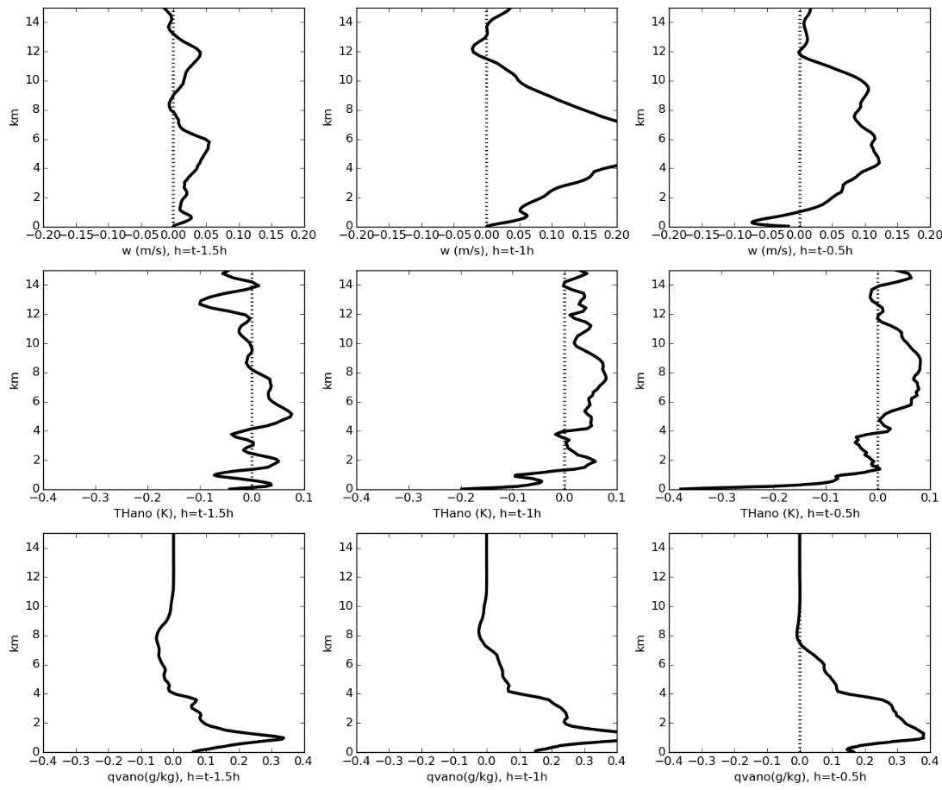
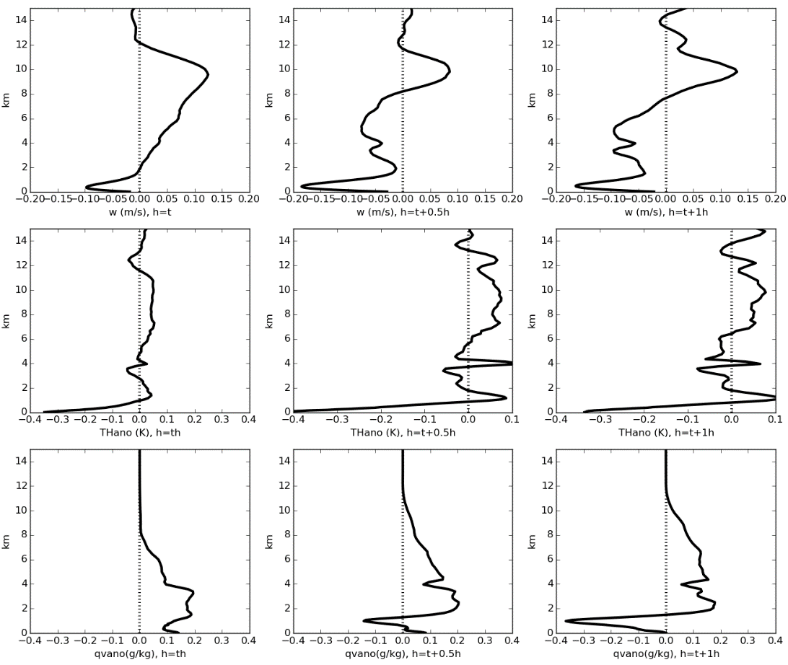
What next?
How do thermodynamic and dynamic profiles change before and after rainfall?
w (m/s)
Θ’ (K)
q_{v}’ (K)
t-1.5 hours
t-1.0 hour
t-0.5 hours
t
t-0.5 hours
t-1.0 hour

Slide 11
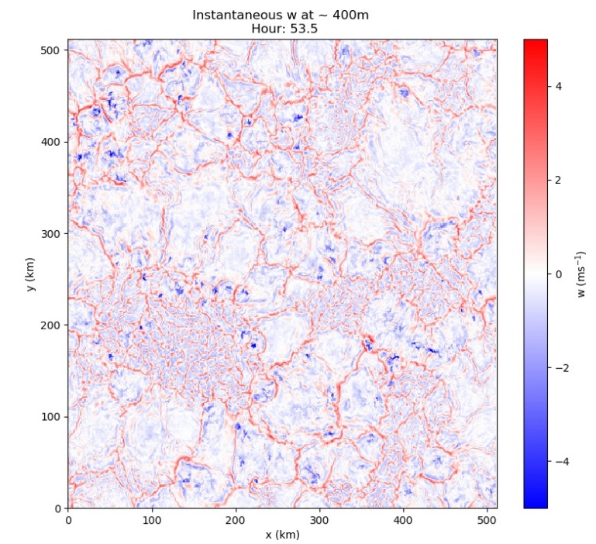
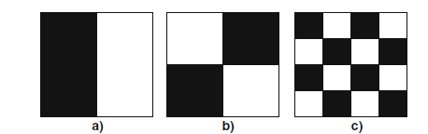
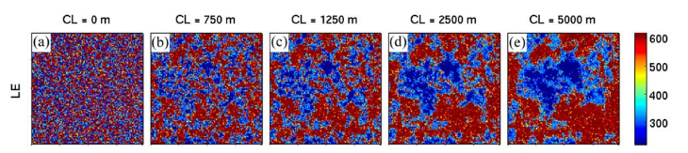
What next?
What is the impact of surface heterogeneity?
    Set up functionality to have spatially varying surface fluxes/temperature (using netcdf files as input)
    Idealised tests of impact of having spatially varying surface fluxes
        Use idealised diurnal cycle setup. Random perturbations? Patches? Sine wave? Correlation length scale?
        Is there an impact on the convection? Are the results significantly different to the homogeneous forcing?
✓
w (m/s)
Increasing correlation length scale

Slide 12
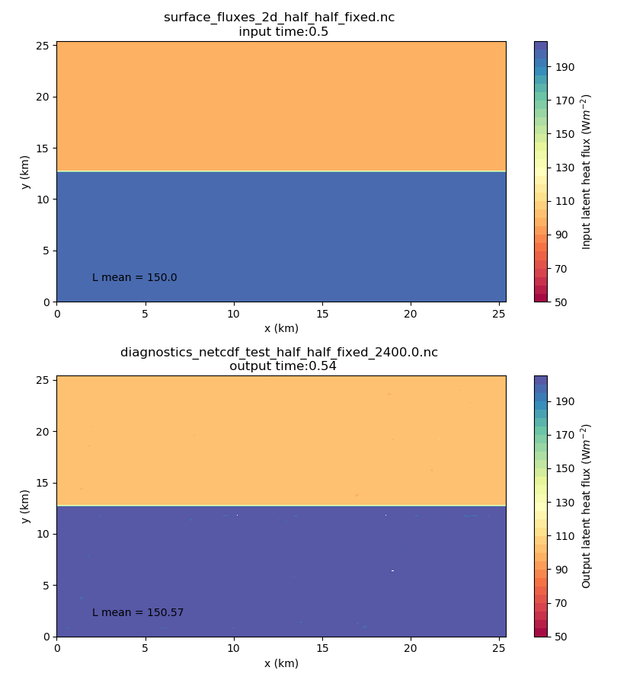
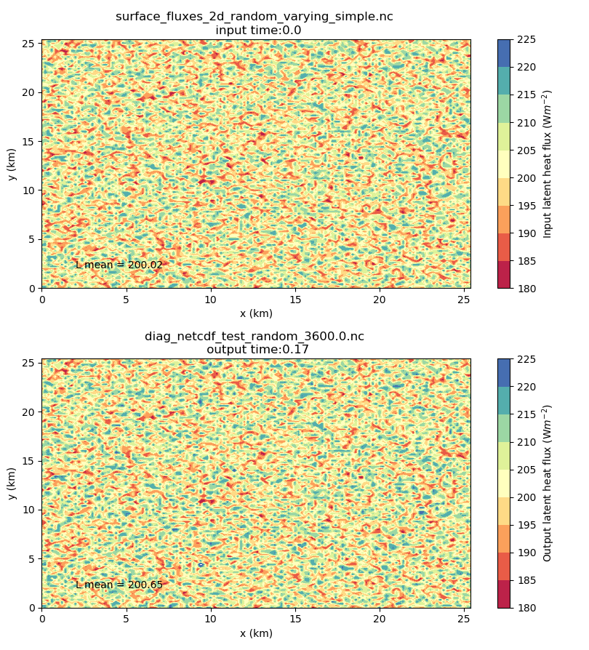
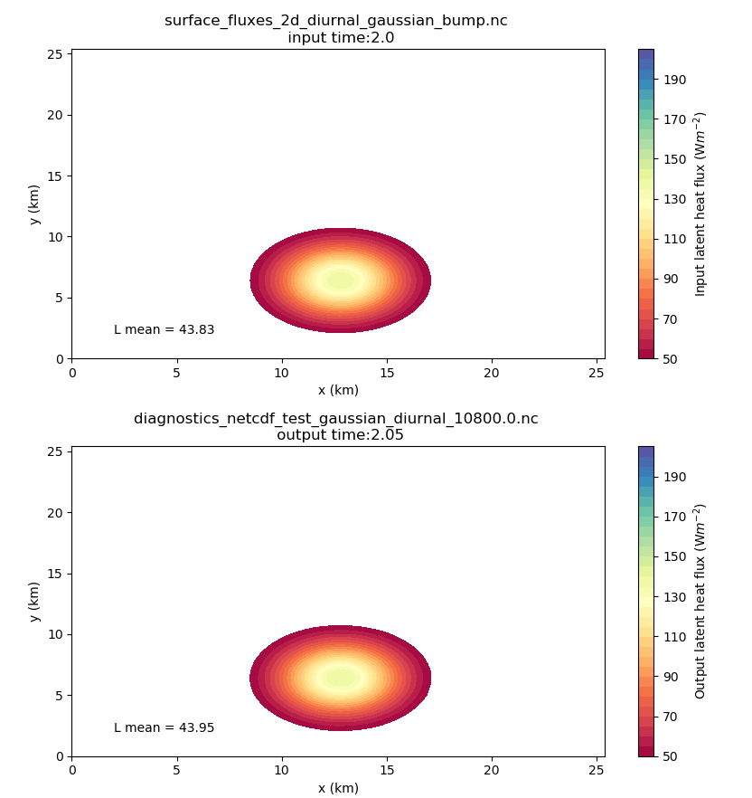
What next?
What is the impact of surface heterogeneity?
Input
Output

Slide 13
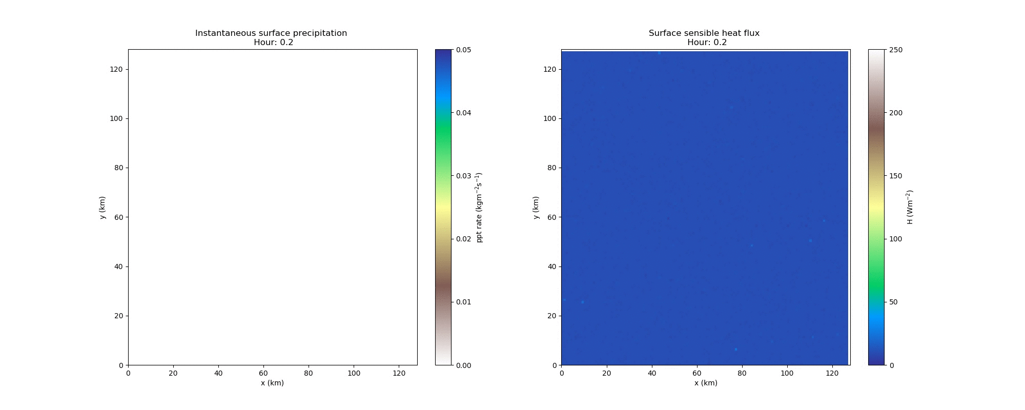
What next?
What is the impact of surface heterogeneity?

Slide 14
Questions?

