Slide 1
WP2.1a,b High Resolution Simulations of Convection
Natalie Harvey, Steve Woolnough, Alision Stirling
GOAL: To inform parametrization development and in particular improve the temporal evolution of convection (“convective memory”)
Notes:
1

Slide 2
Idealised cloud-resolving simulations
“Radiative” Equilibrium Convection
Diurnal cycle over land
Imposed “radiation”
Interactive “radiation”
Homogeneous surface
Heterogenous surface
500km x 500km at ~100m resolution
500km x 500km at ~100m resolution
500km x 500km at ~100m resolution
500km x 500km at ~100m resolution
Also companion simulations at 4km, 12km and ~40km resolution

Slide 3
WP2.1a,b High Resolution Simulations of Convection
Natalie Harvey, Steve Woolnough, Alision Stirling
TODAY: Development of tools to analyse the TKE budget of an idealised diurnal cycle
Notes:
3

Slide 4
Analysis methods and tools
Reynolds averaged budgets: TKE, w’², w’θ’
Whole domain, steady state flow
Which terms control departures from local steady state?
Sub-domains – extra terms
Conditionally-sampled diagnostics
e.g. look at buoyant cloudy updrafts only
Scales for dissipation and production
Spectral diagnostics
Upscale and down scale transports

Slide 5
TKE budget equation
TKE:
Horizontal homogeneity and neglect subsidence
I: Tendency
III: Buoyancy
IV: Shear
V: turbulent transport
VI: pressure correlation
VII: Dissipation

Slide 6
Diurnal cycle
Using LEM
2D
Horizontal grid: 512 x 1km
Vertical grid: 76 levels with 20 km top
Surface forcing based on EUROCS, balanced by large scale cooling
20 days with 10 minute output
Wm⁻²
Time (hours)

Slide 7
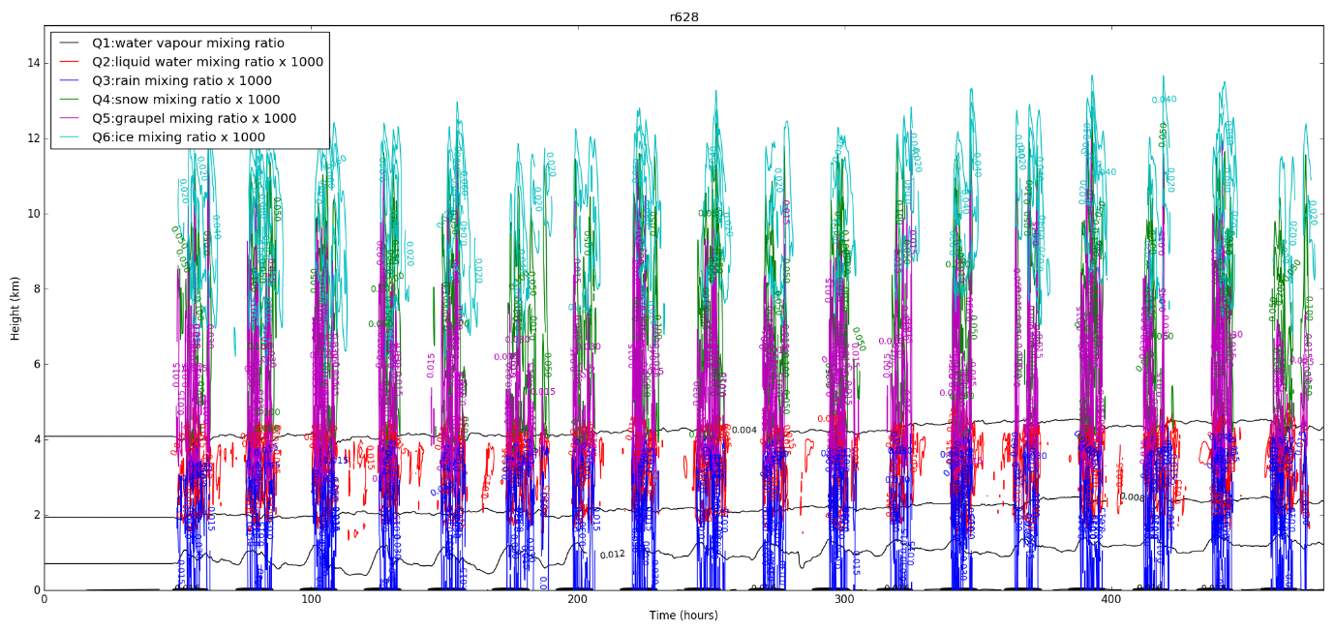
How different?
Height (km)
Time (hours)

Slide 8
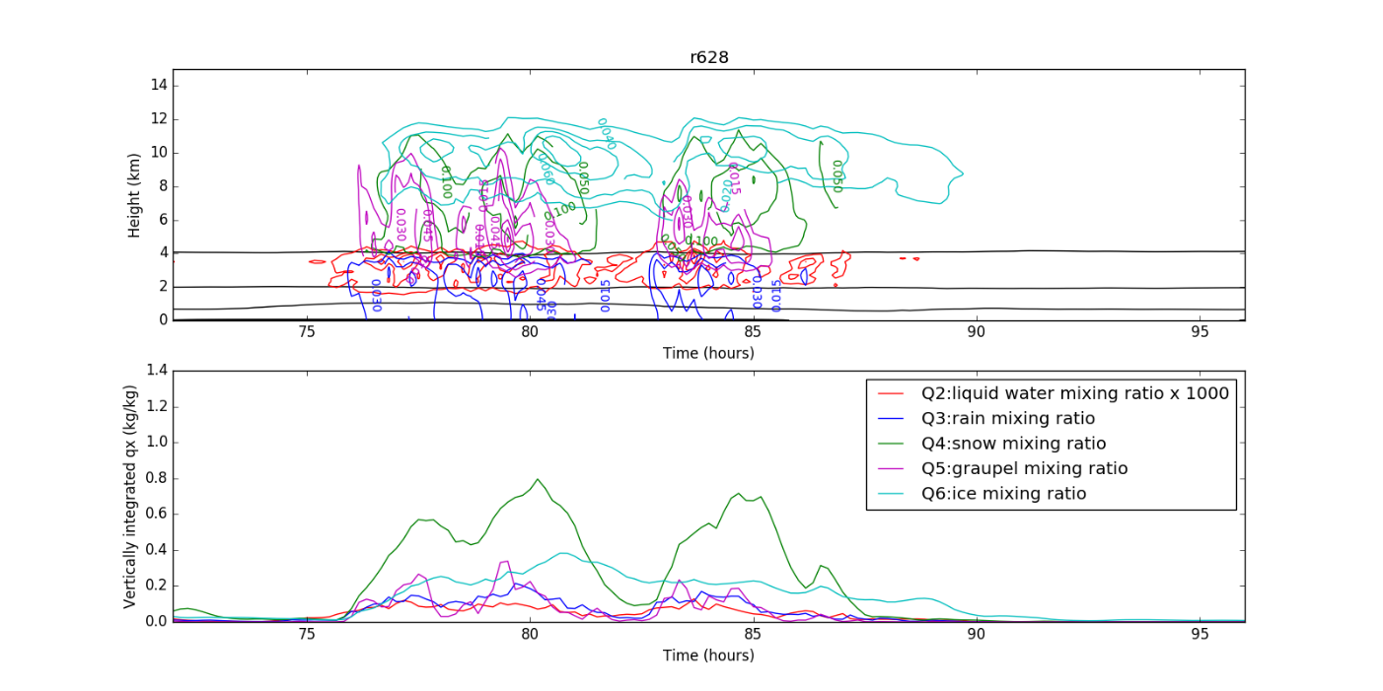
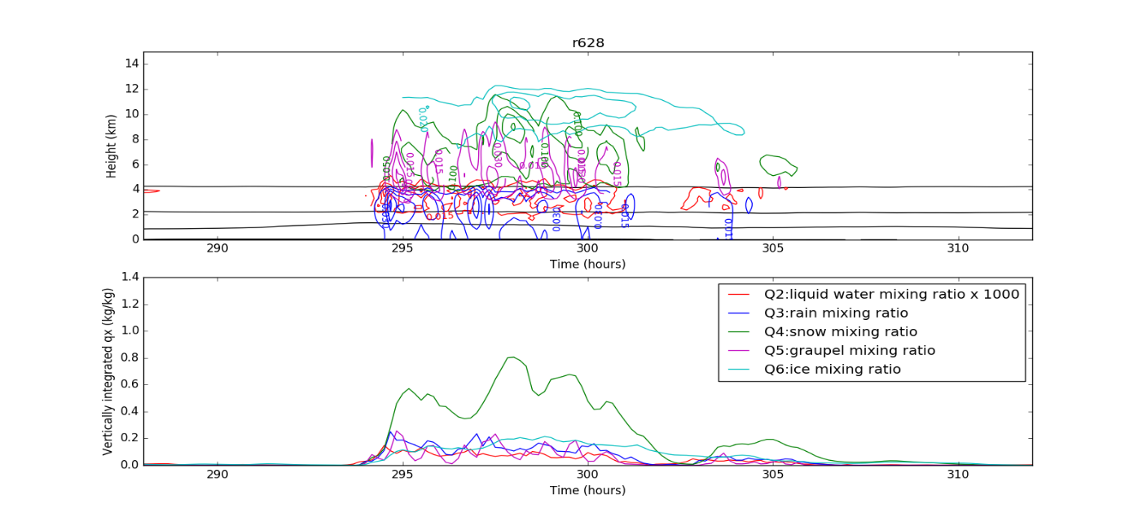
How different?
Height (km)
Cycle 3
Vertically integrated qx
Height (km)
Vertically integrated qx
Cycle 12
Time (hours)

Slide 9
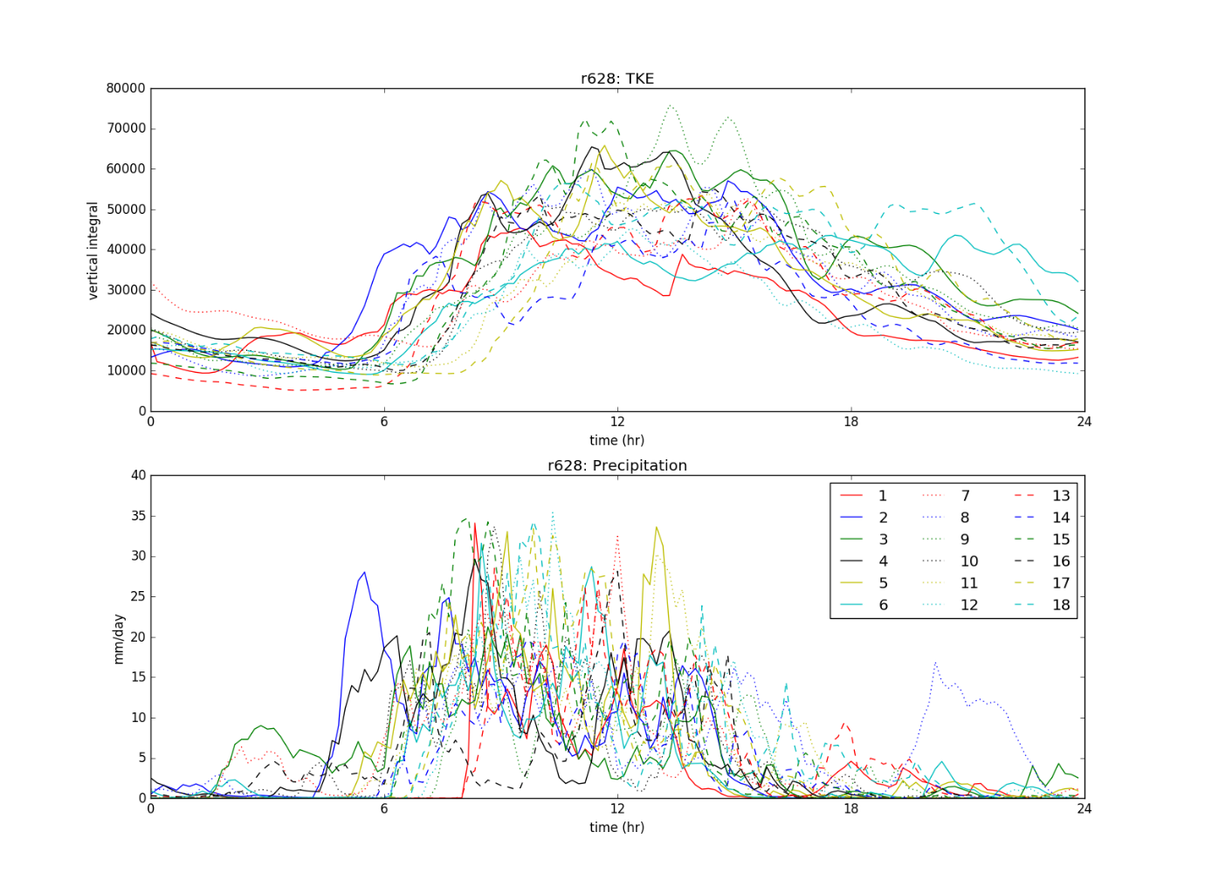
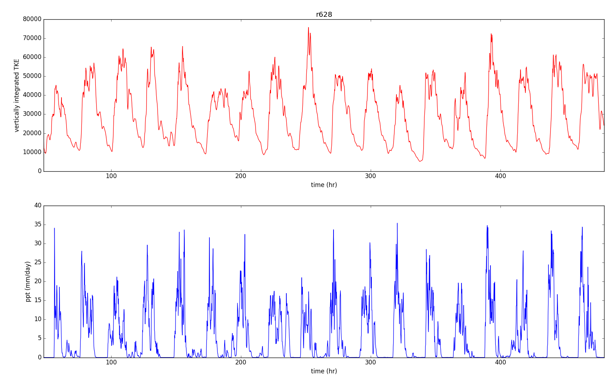
How different?
Vertically integrated TKE
precipitation
Time (hours)

Slide 10
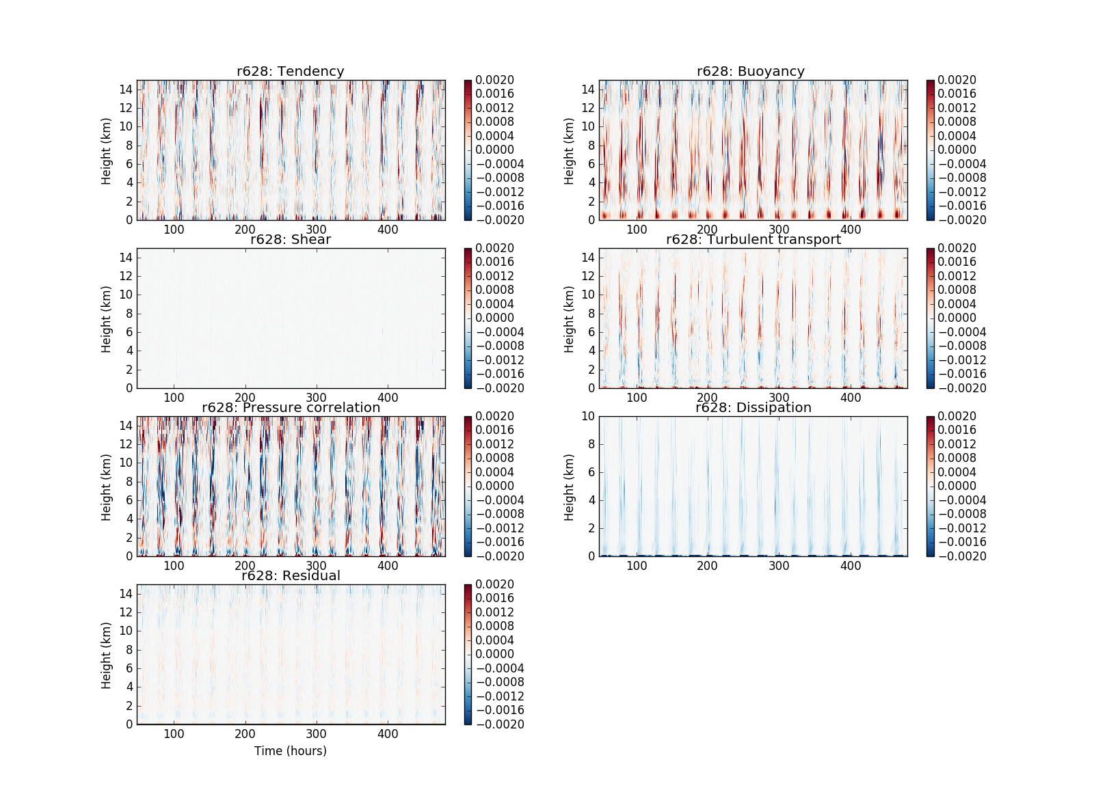
TKE budget terms
Time (hours)
Time (hours)

Slide 11
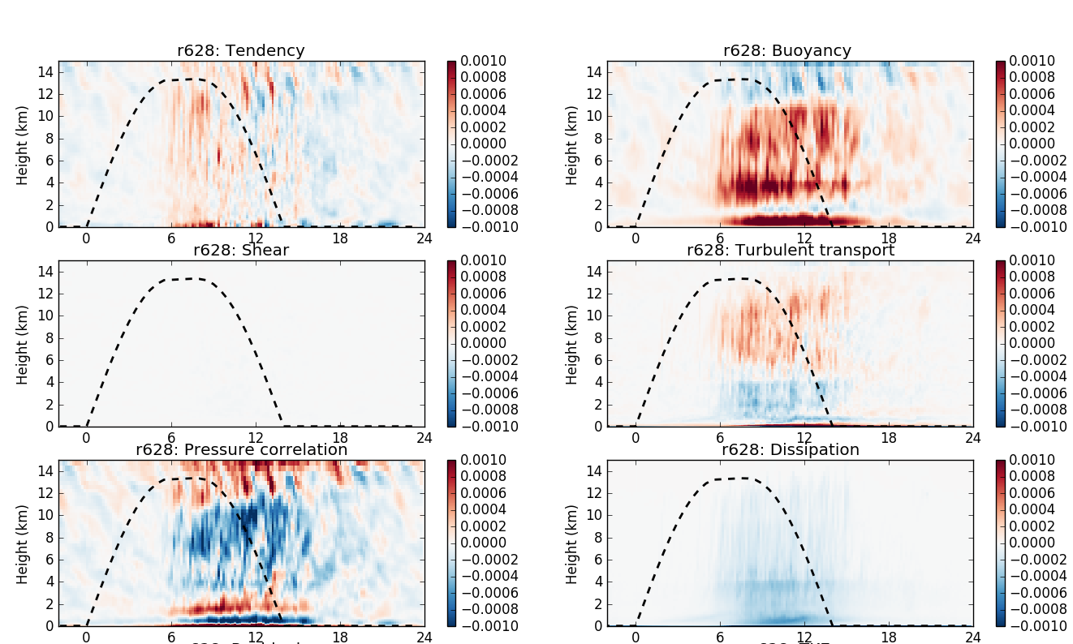
TKE budget terms
Composite of 18 diurnal cycles

Slide 12
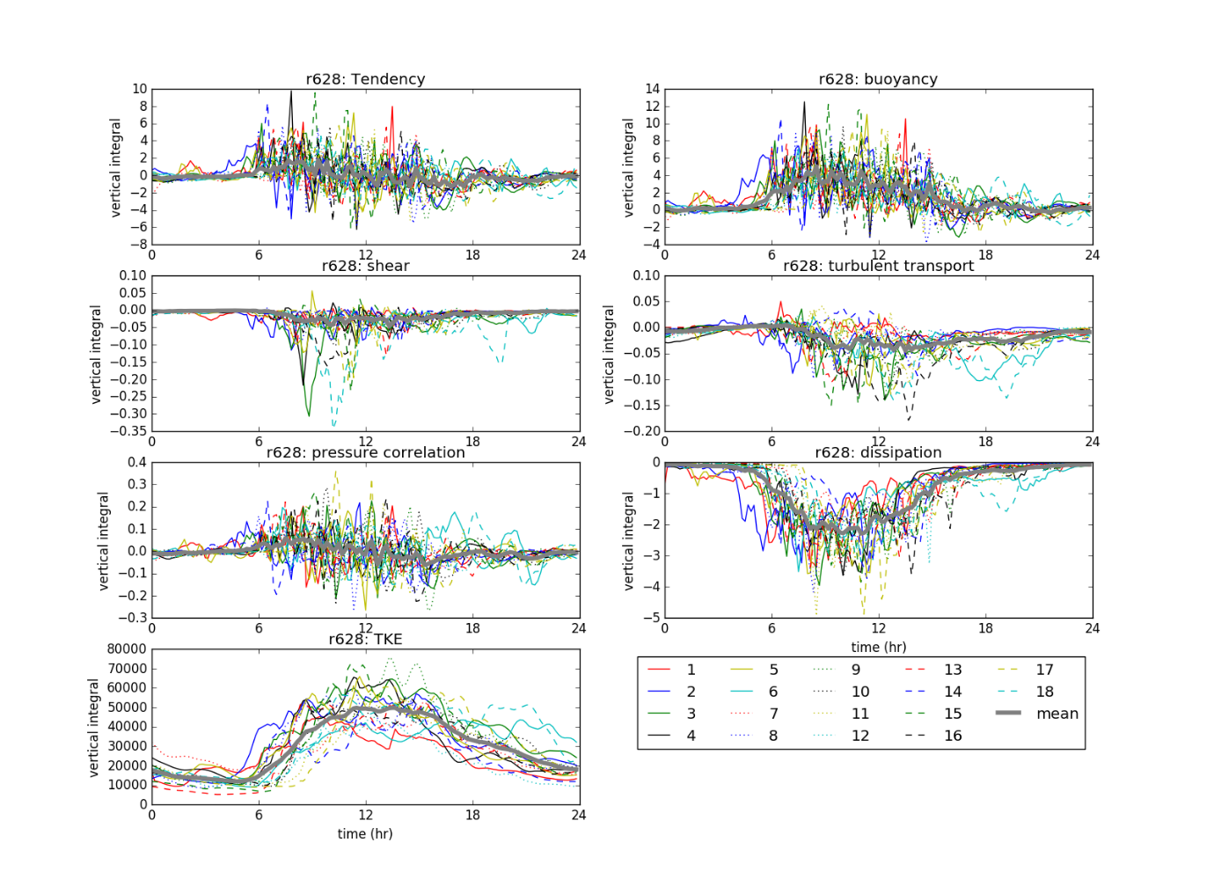
TKE budget terms: vertical integrals

Slide 13
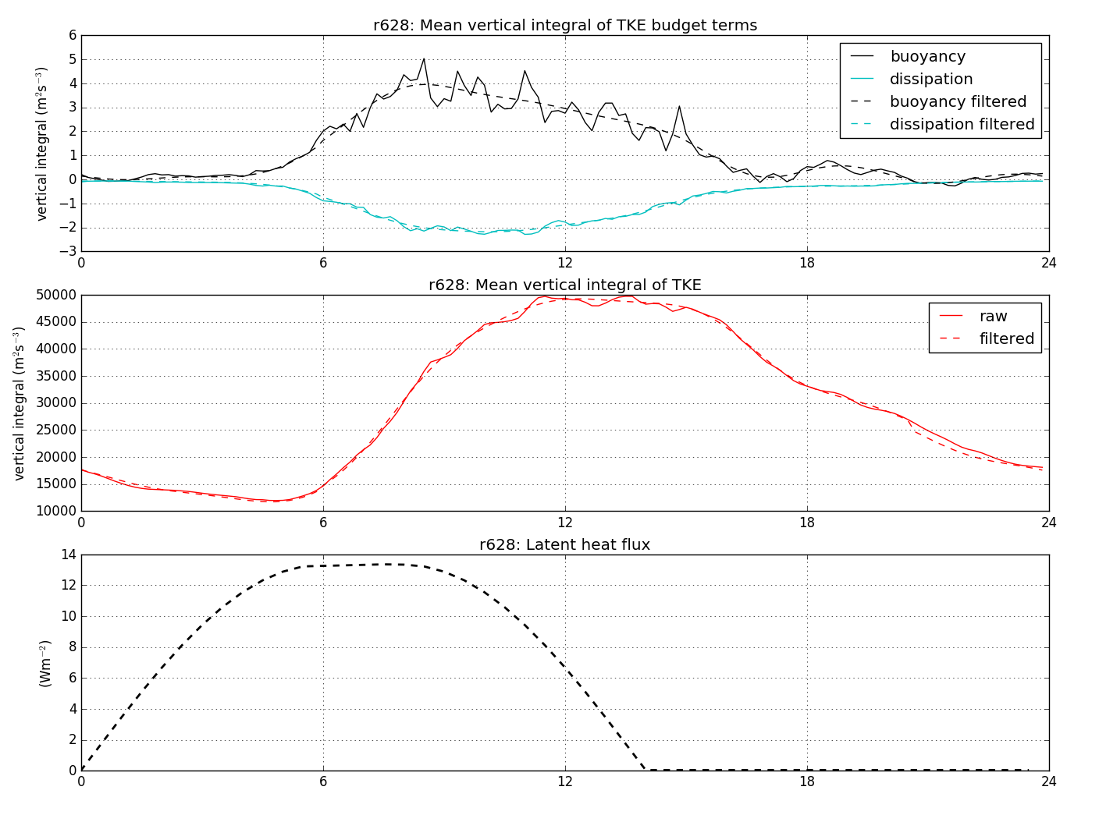
TKE budget terms: vertical integrals
Vertically integrated budget term
Vertically integrated TKE
Wm⁻²
Time (hours)

Slide 14
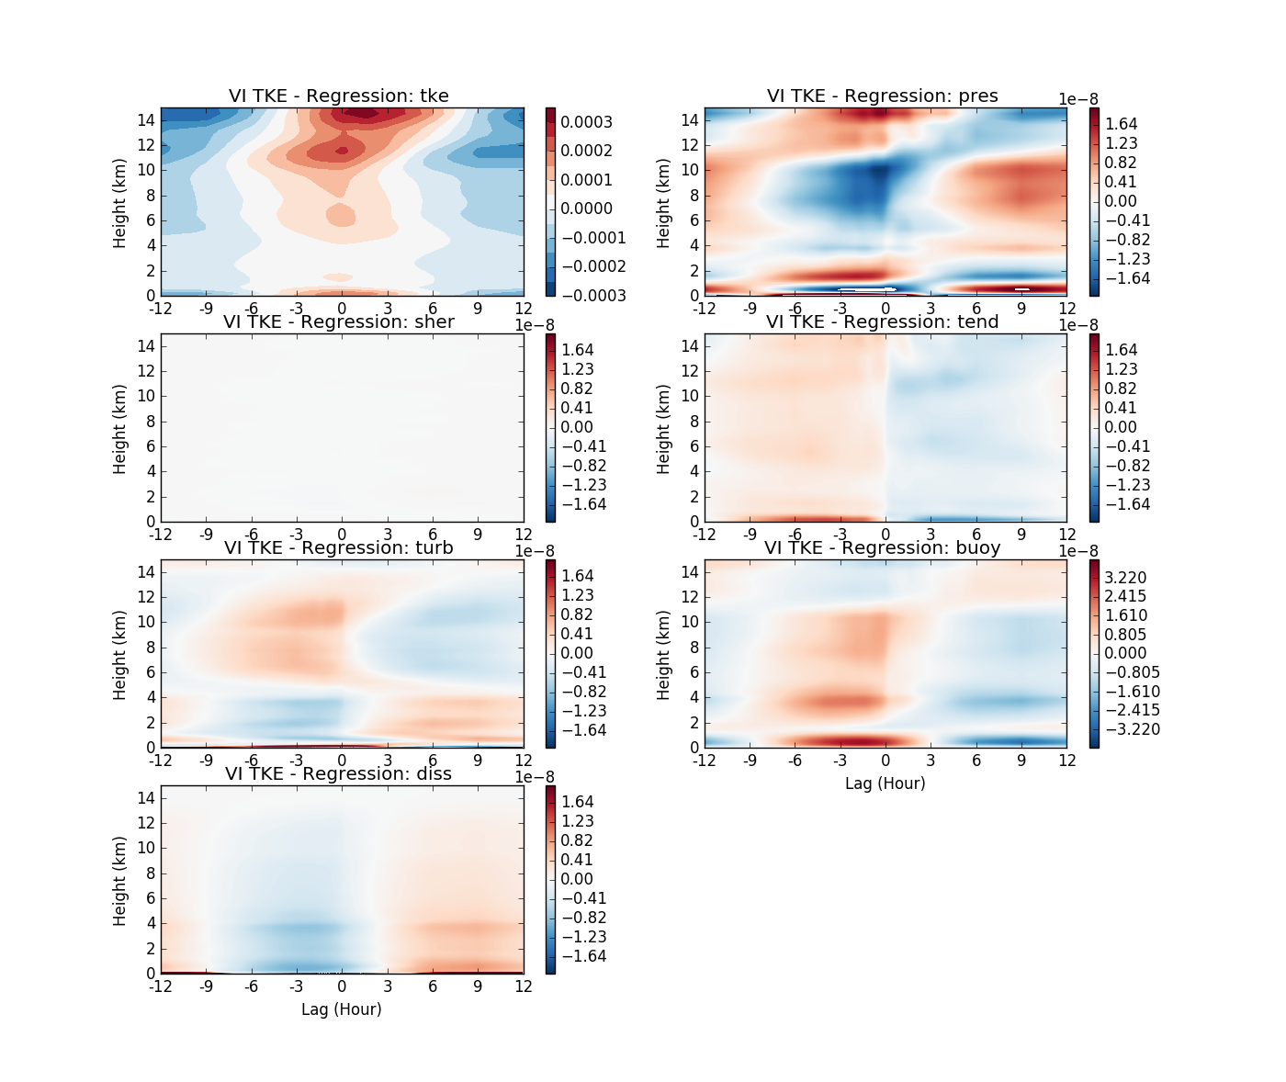
TKE budget terms: regression on to vertically integrated TKE

Slide 15
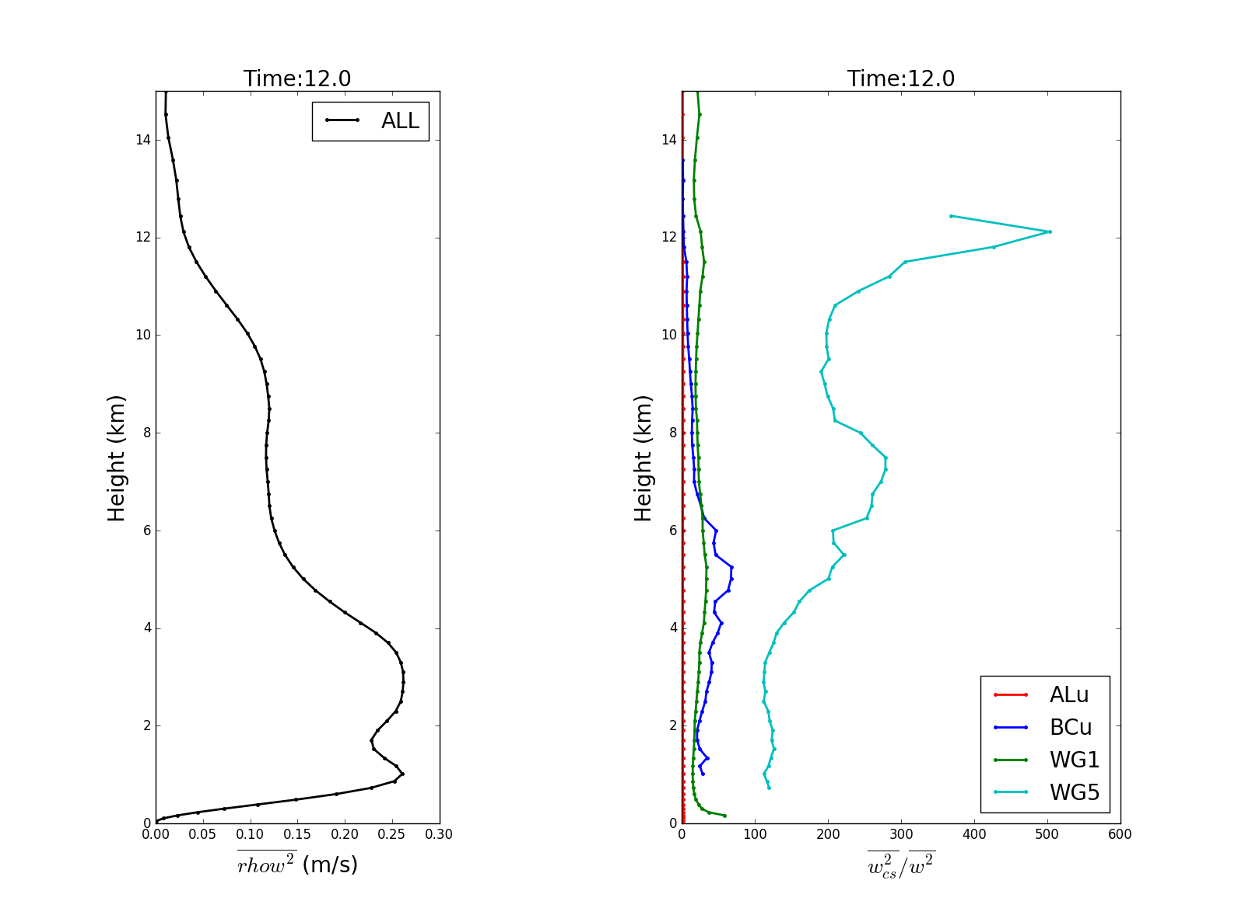
Conditionally sampled diagnostics
Time of vertically integrated TKE maximum
How does TKE relate to conditionally averaged diagnostics?

Slide 16
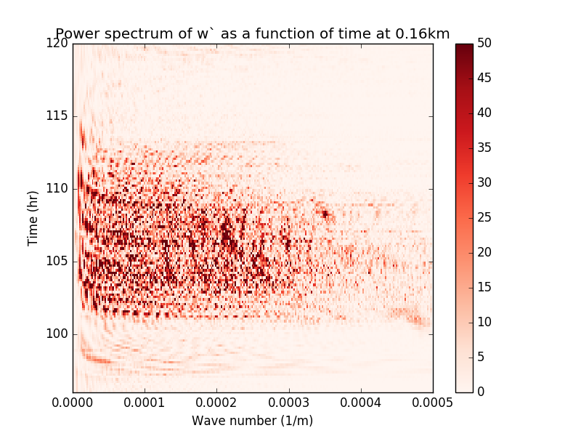
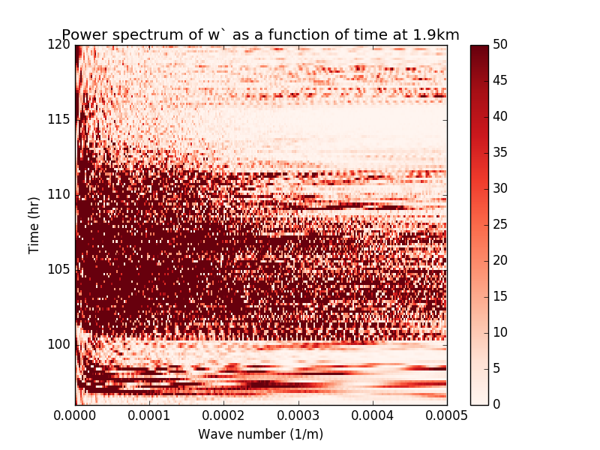
Spectral diagnostics
Spatial spectra
2D vertical velocity - instantaneous every 10 mins
Transports?

Slide 17
Next steps?
Continue the development of tools to analyse the diurnal cycle
Reynolds averaged budgets
Extend to:
Conditional sampling
Spectral diagnostics
Design and perform the high resolution simulations (MONC or idealised UM?)

