Slide 1
CF Standard Names and ontologies
Jonathan Gregory^{1,2}
1 NCAS-Climate, University of Reading
2 Met Office Hadley Centre, Exeter
The branch of metaphysics dealing with the nature of being.
A set of concepts and categories in a subject area or domain that shows their properties and the relations between them.

Slide 2
What are CF standard names?
The conventions define metadata that provide a definitive description of what the data in each variable represents … This enables users of data from different sources to decide which quantities are comparable. … A fundamental requirement for exchange of scientific data is the ability to describe precisely the physical quantities being represented.
They are descriptive phrases, using familiar terminology when clear e.g. wind
They answer the question, What does this variable contain, in physical terms?
acoustic_signal_roundtrip_travel_time_in_sea_water
age_of_sea_ice
air_pressure
sea_water_temperature
tendency_of_atmosphere_mass_content_of_particulate_organic_matter_dry_aerosol_particles_expressed_as_carbon_due_to
_emission_from_residential_and_commercial_combustion
y_wind
zenith_angle
Not the question, What do you call this variable?
lagrangian_tendency_of_air_pressure, not omega

Slide 3
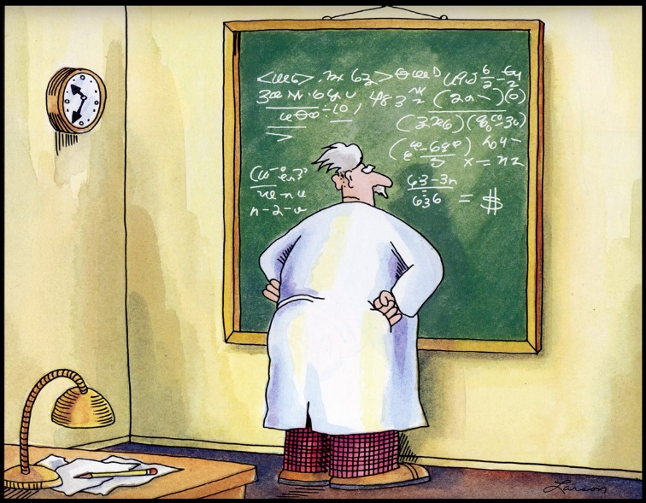
What are CF standard names?
In the standard name table, each standard name has
 a definition, answering, What do you mean by that?
 canonical units.
rainfall_amount is in kg m-2
rainfall_flux is in kg m-2 s-1
rainfall_rate is in m s-1
thickness_of_rainfall_amount is in m
Two quantities with canonical units that are not
equivalent must have different standard names.
$ udunits
You have: kg m-2
You want: kg m-2 s-1
udunits: Units are incompatible
First version of the table, in January 2001, had about 230 names.
Current version, of 12 June 2018, has 4218, thanks to Alison since 2006.
Einstein discovers that time is actually money—but he was mistaken since they have incompatible units

Slide 4
Should standard names be bundled up?
To prevent proliferation of names, standard names don't include numerical metadata (coordinates) or metadata relating to axes (cell methods)
Some other ontologies do e.g. PCMDI names
tasmin = monthly mean of daily-minimum near-surface air temperature
standard_name='air_temperature'
coordinate variable for height=2 m
cell methods of time: minimum within days time: mean over days
Proposals have been made to bundle up standard names and other metadata:
 Common concepts (ticket 29), maybe with opaque names, could be easier for finding variables in files or mapping to other ontologies.
Common concept would be subordinate in case of disagreement, but still redundancy means inconsistency.
 CF string syntax (ticket 94) for naming quantities used in model coupling.

Slide 5
Should standard names be broken down?
In a single attribute, the standard name may combine many different aspects of description of the variable.
 Maybe it would be clearer and simpler to have many separate attributes?
Such factorisation would require smaller controlled vocabularies e.g.
106 mole_fraction_of_X_in_air,
123 mass_concentration_of_X_in_air, where X is methane, etc.
But
 To find a variable, it is more convenient to examine one attribute than many.
surface upwelling shortwave_flux in_air assuming_clear_sky
 Introducing a new attribute would require all existing programs to be revised. e.g. eastward_wind, geostrophic_eastward_wind
Standard names have an order e.g. integral_wrt_depth_of_product
_of_sea_water_density_and_salinity does not mean product_of
_sea_water_density_and_integral_wrt_depth_of_salinity
 More than one instance of an idea may occur within a standard name e.g. product_of_eastward_wind_and_northward_wind
No problem with external translation or mapping onto attributes e.g. SWEET.

Slide 6
Why is it so hard to decide on new standard names?
It isn't always. It’s quite easy if
 Existing vocabulary is combined following existing patterns e.g.
sea_ice_basal_temperature like land_ice_basal_temperature
 New vocabulary is proposed following existing categories and patterns e.g.
solid_precipitation_flux like convective_precipitation_flux
atmosphere_mole_content_of_krypton like many other atmosphere_mole_content names
nudging_increment_in_mass_content_of_water_in_soil like change_over_time_in_mass_content_of_water_in_soil
The work in other cases is to decide what is really needed, and then choose a clear way to describe it e.g. land_ice_mass_not_displacing_sea_water
We make mistakes. Aliases allow us to rectify these to improve consistency, but are not for synonyms.

Slide 7
Could the process be automated?
No, because of green dogs
e.g. tropopause_omnidirectional_photosynthetic_eliassen_palm _flux_in_soil_pores_emerging_from_sea_water
But we could provide tools
 To show phrases and words which occur in existing standard names
 To put existing vocabulary into an order consistent with existing patterns
surface upwelling shortwave_flux in_air assuming_clear_sky
What do you think?

