Slide 1
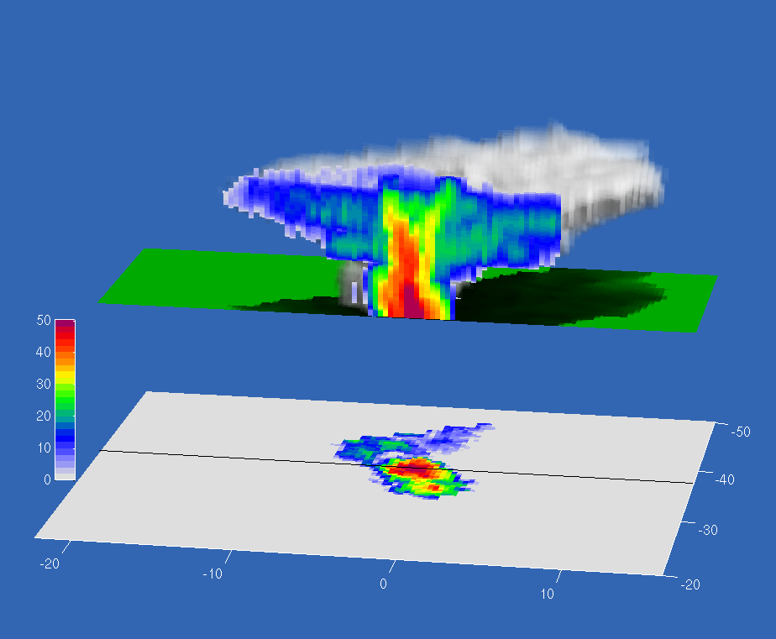

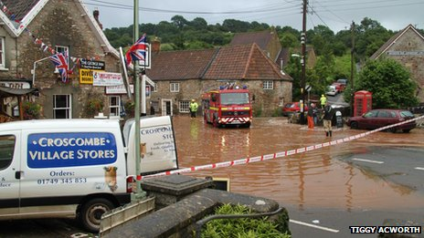
The three-dimensional structure of convective storms
Thorwald Stein (t.h.m.stein@reading.ac.uk)
www.met.reading.ac.uk/~dymecs
Robin Hogan
John Nicol
Robert Plant
Peter Clark
Kirsty Hanley
Carol Halliwell
Humphrey Lean
(UK Met Office)

Slide 2
The three-dimensional structure of convective storms
NWP models run at km-scale: errors in timing, location, structure of convective precipitation.
Storm analysis of 2D fields (surface rainfall rate, OLR) highlights errors, but not underlying processes.
Use high-resolution (300m) radar observations for many storms to evaluate model storm morphology and dynamics.

Slide 3
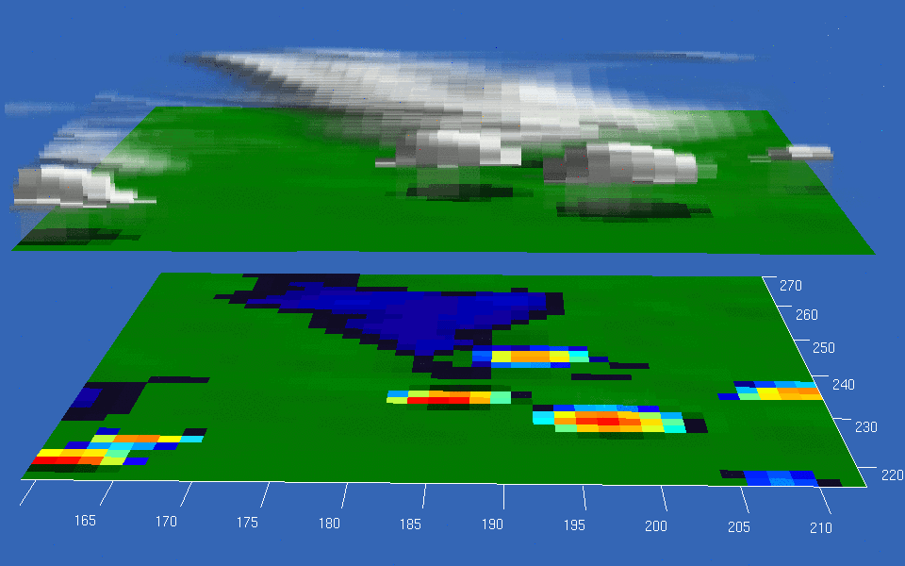
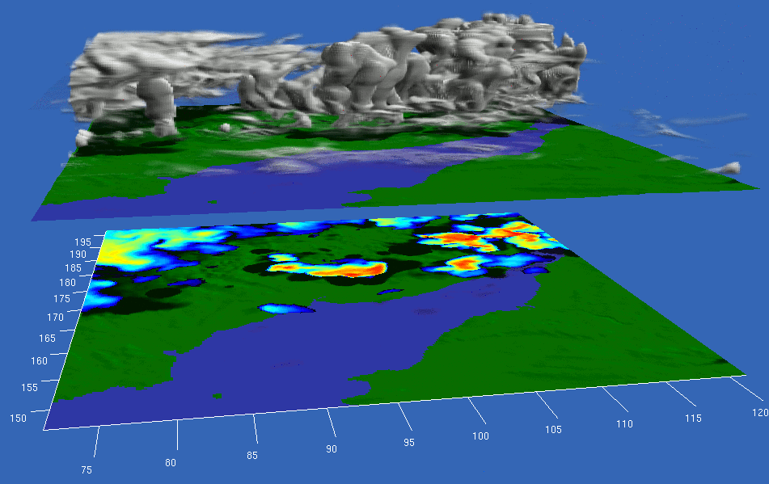


The three-dimensional structure of convective storms
UKV 1500m
200m
Animations by Robin Hogan

Slide 4
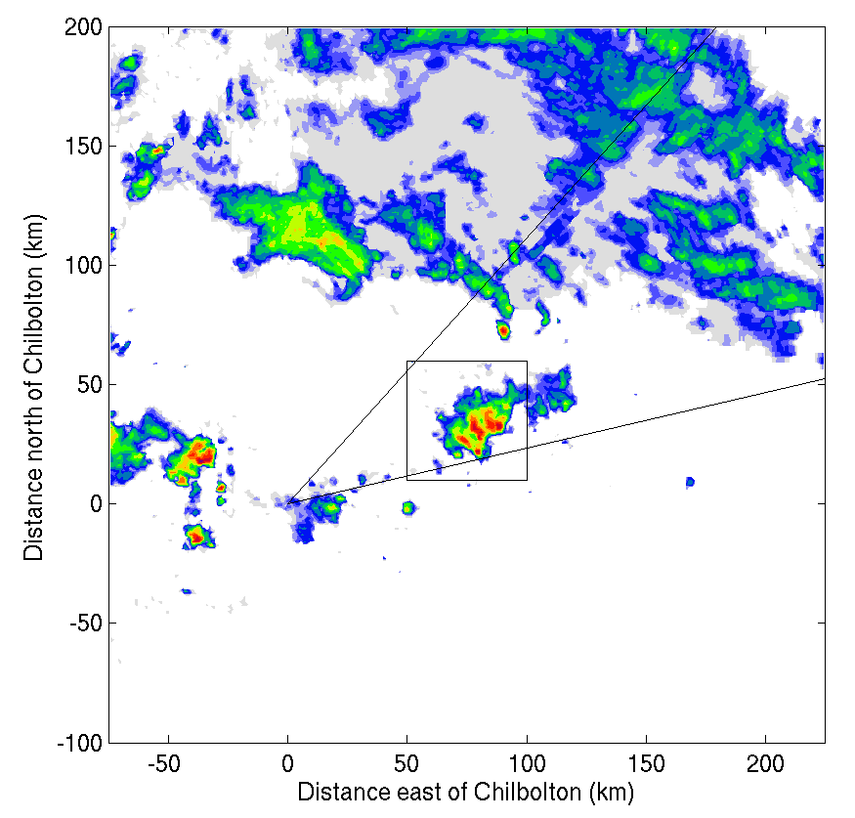
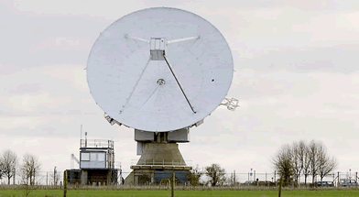

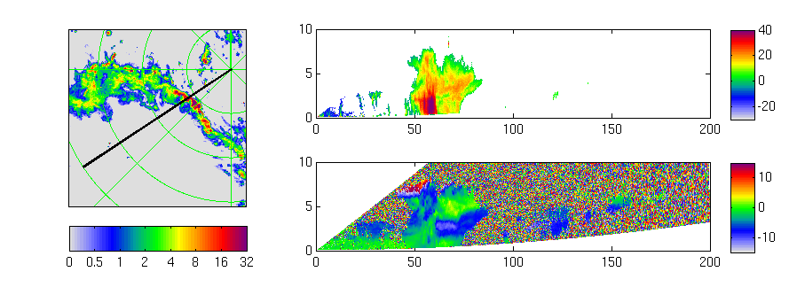
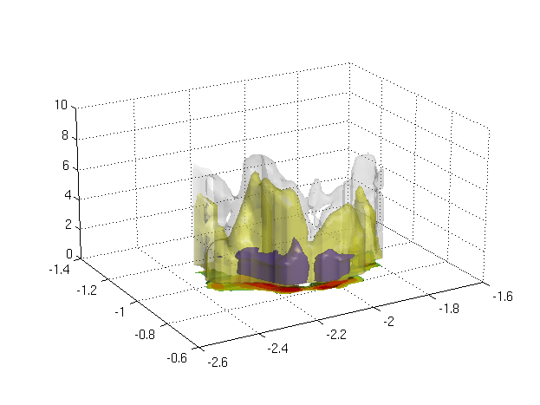
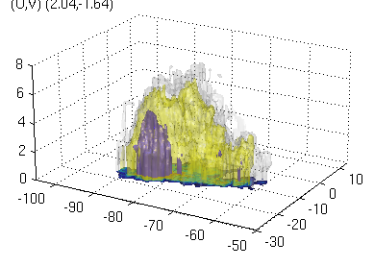
The DYMECS approach: beyond case studies
Track storms in real time and automatically scan Chilbolton radar
Derive properties of hundreds of storms on ~40 days:
Vertical velocity
3D structure
Rain & hail
Ice water content
TKE & dissipation rate
Met Office 1km rainfall composite
25m diameter S-band (3 GHz)
Steerable (2 degrees per second)
0 dBZ out to 150 km
Evaluate these properties in model varying:
Resolution
Microphysics scheme
Sub-grid turbulence parametrization

Slide 5
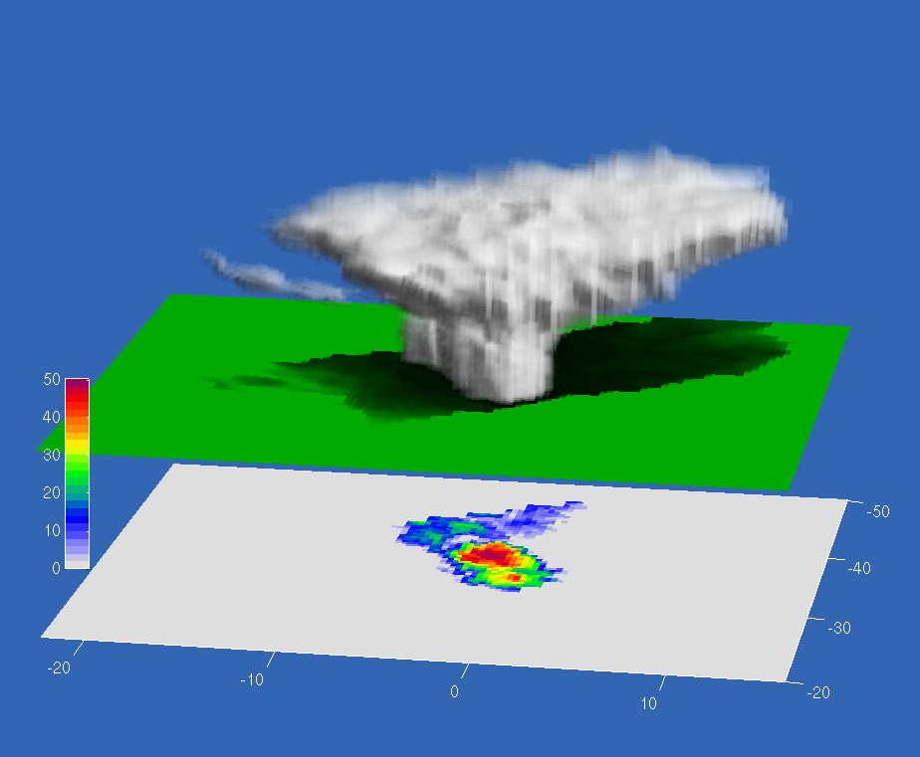
Storm structure from radar
40 dBZ
Radar reflectivity (dBZ)
20 dBZ
0 dBZ
Distance north (km)
Distance east (km)

Slide 6
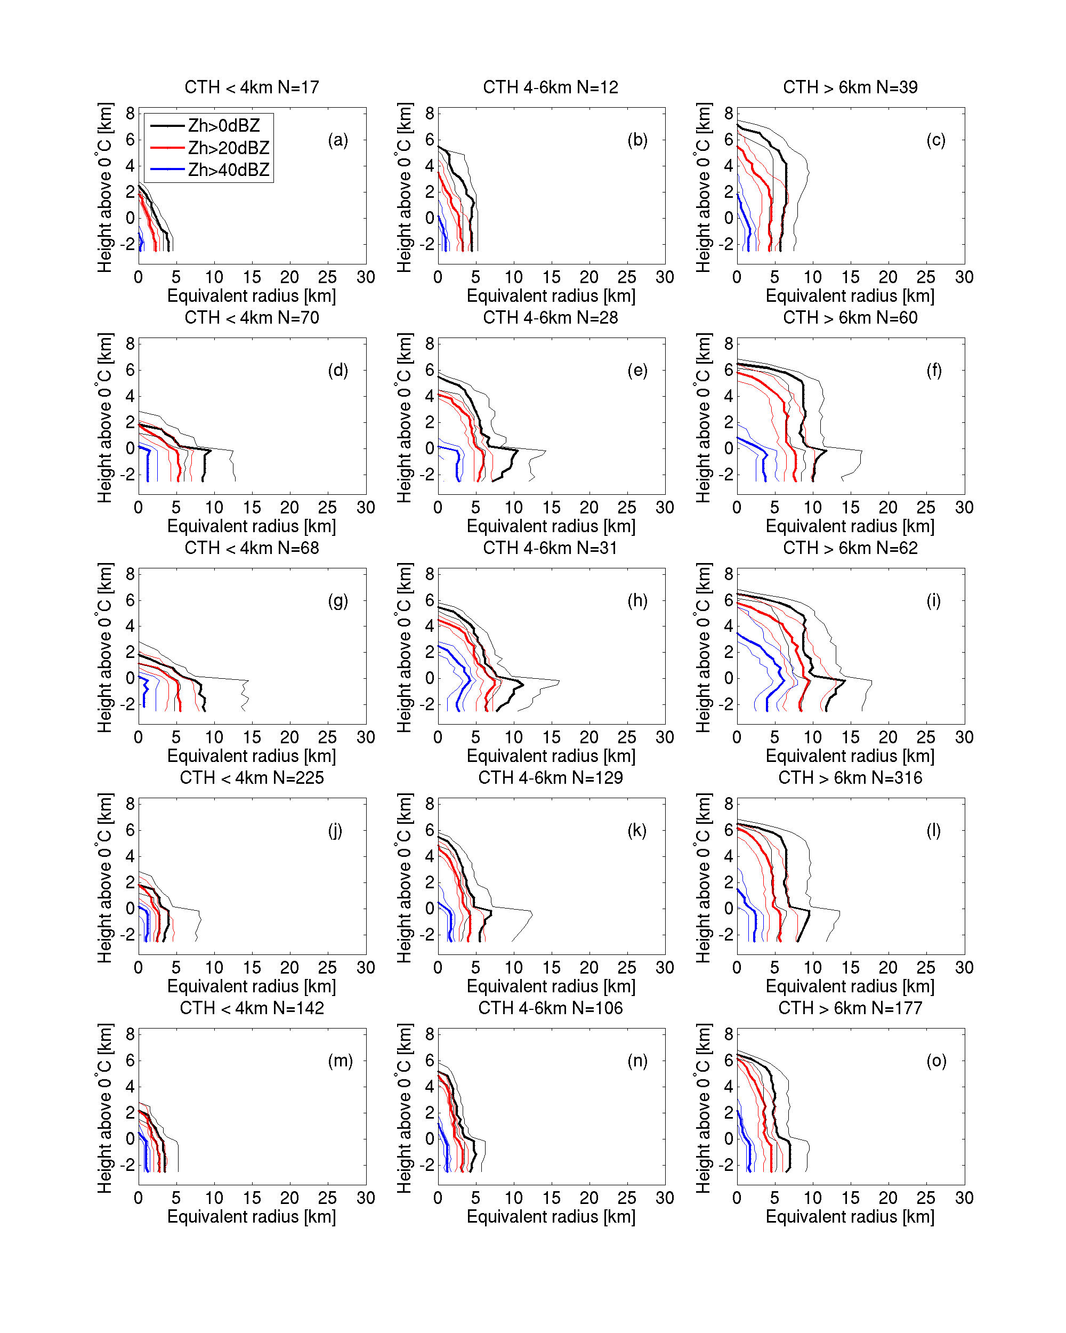
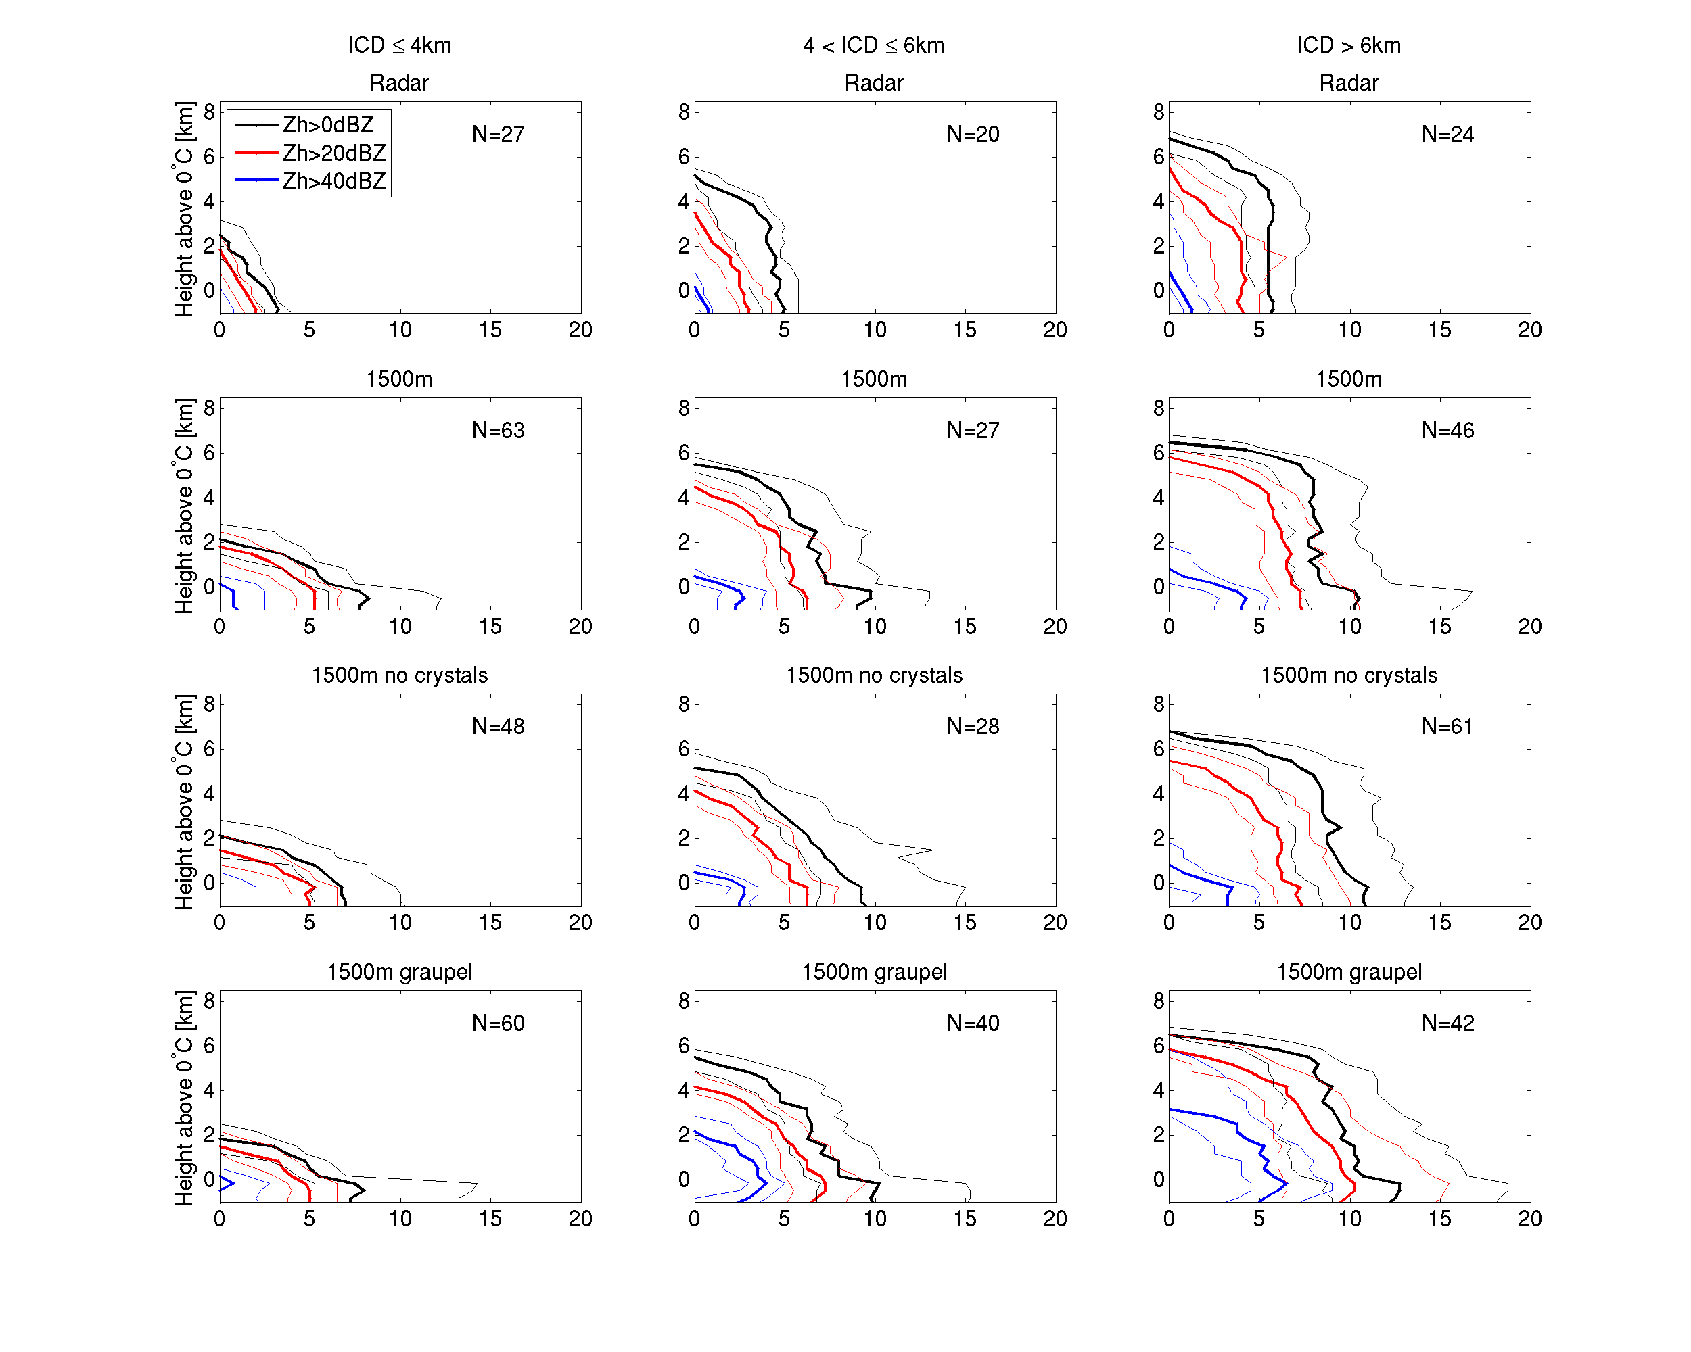
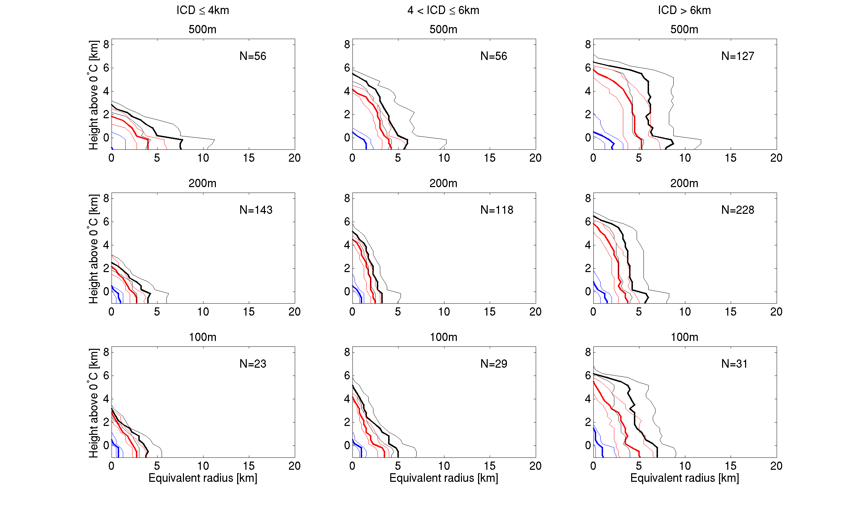
Median storm diameter with height
“Convergence”?
Observations
UKV 1500m
500m
200m
Drizzle from nowhere?
“Shallow”
Lack of anvils?
“Deep”

Slide 7
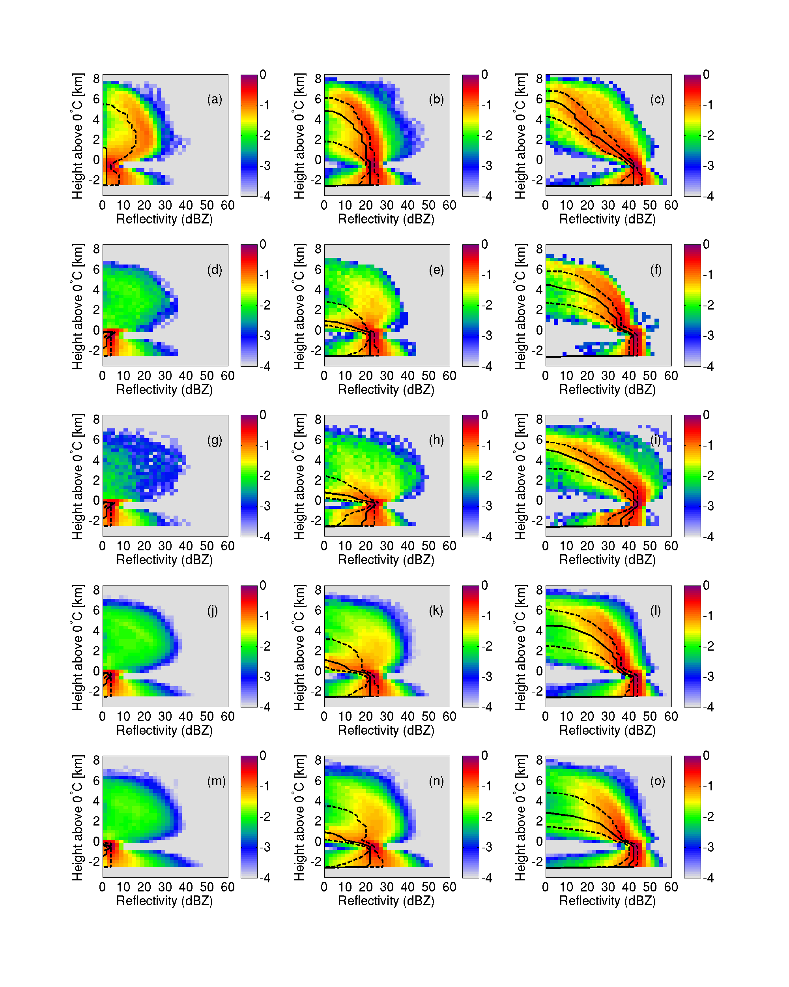
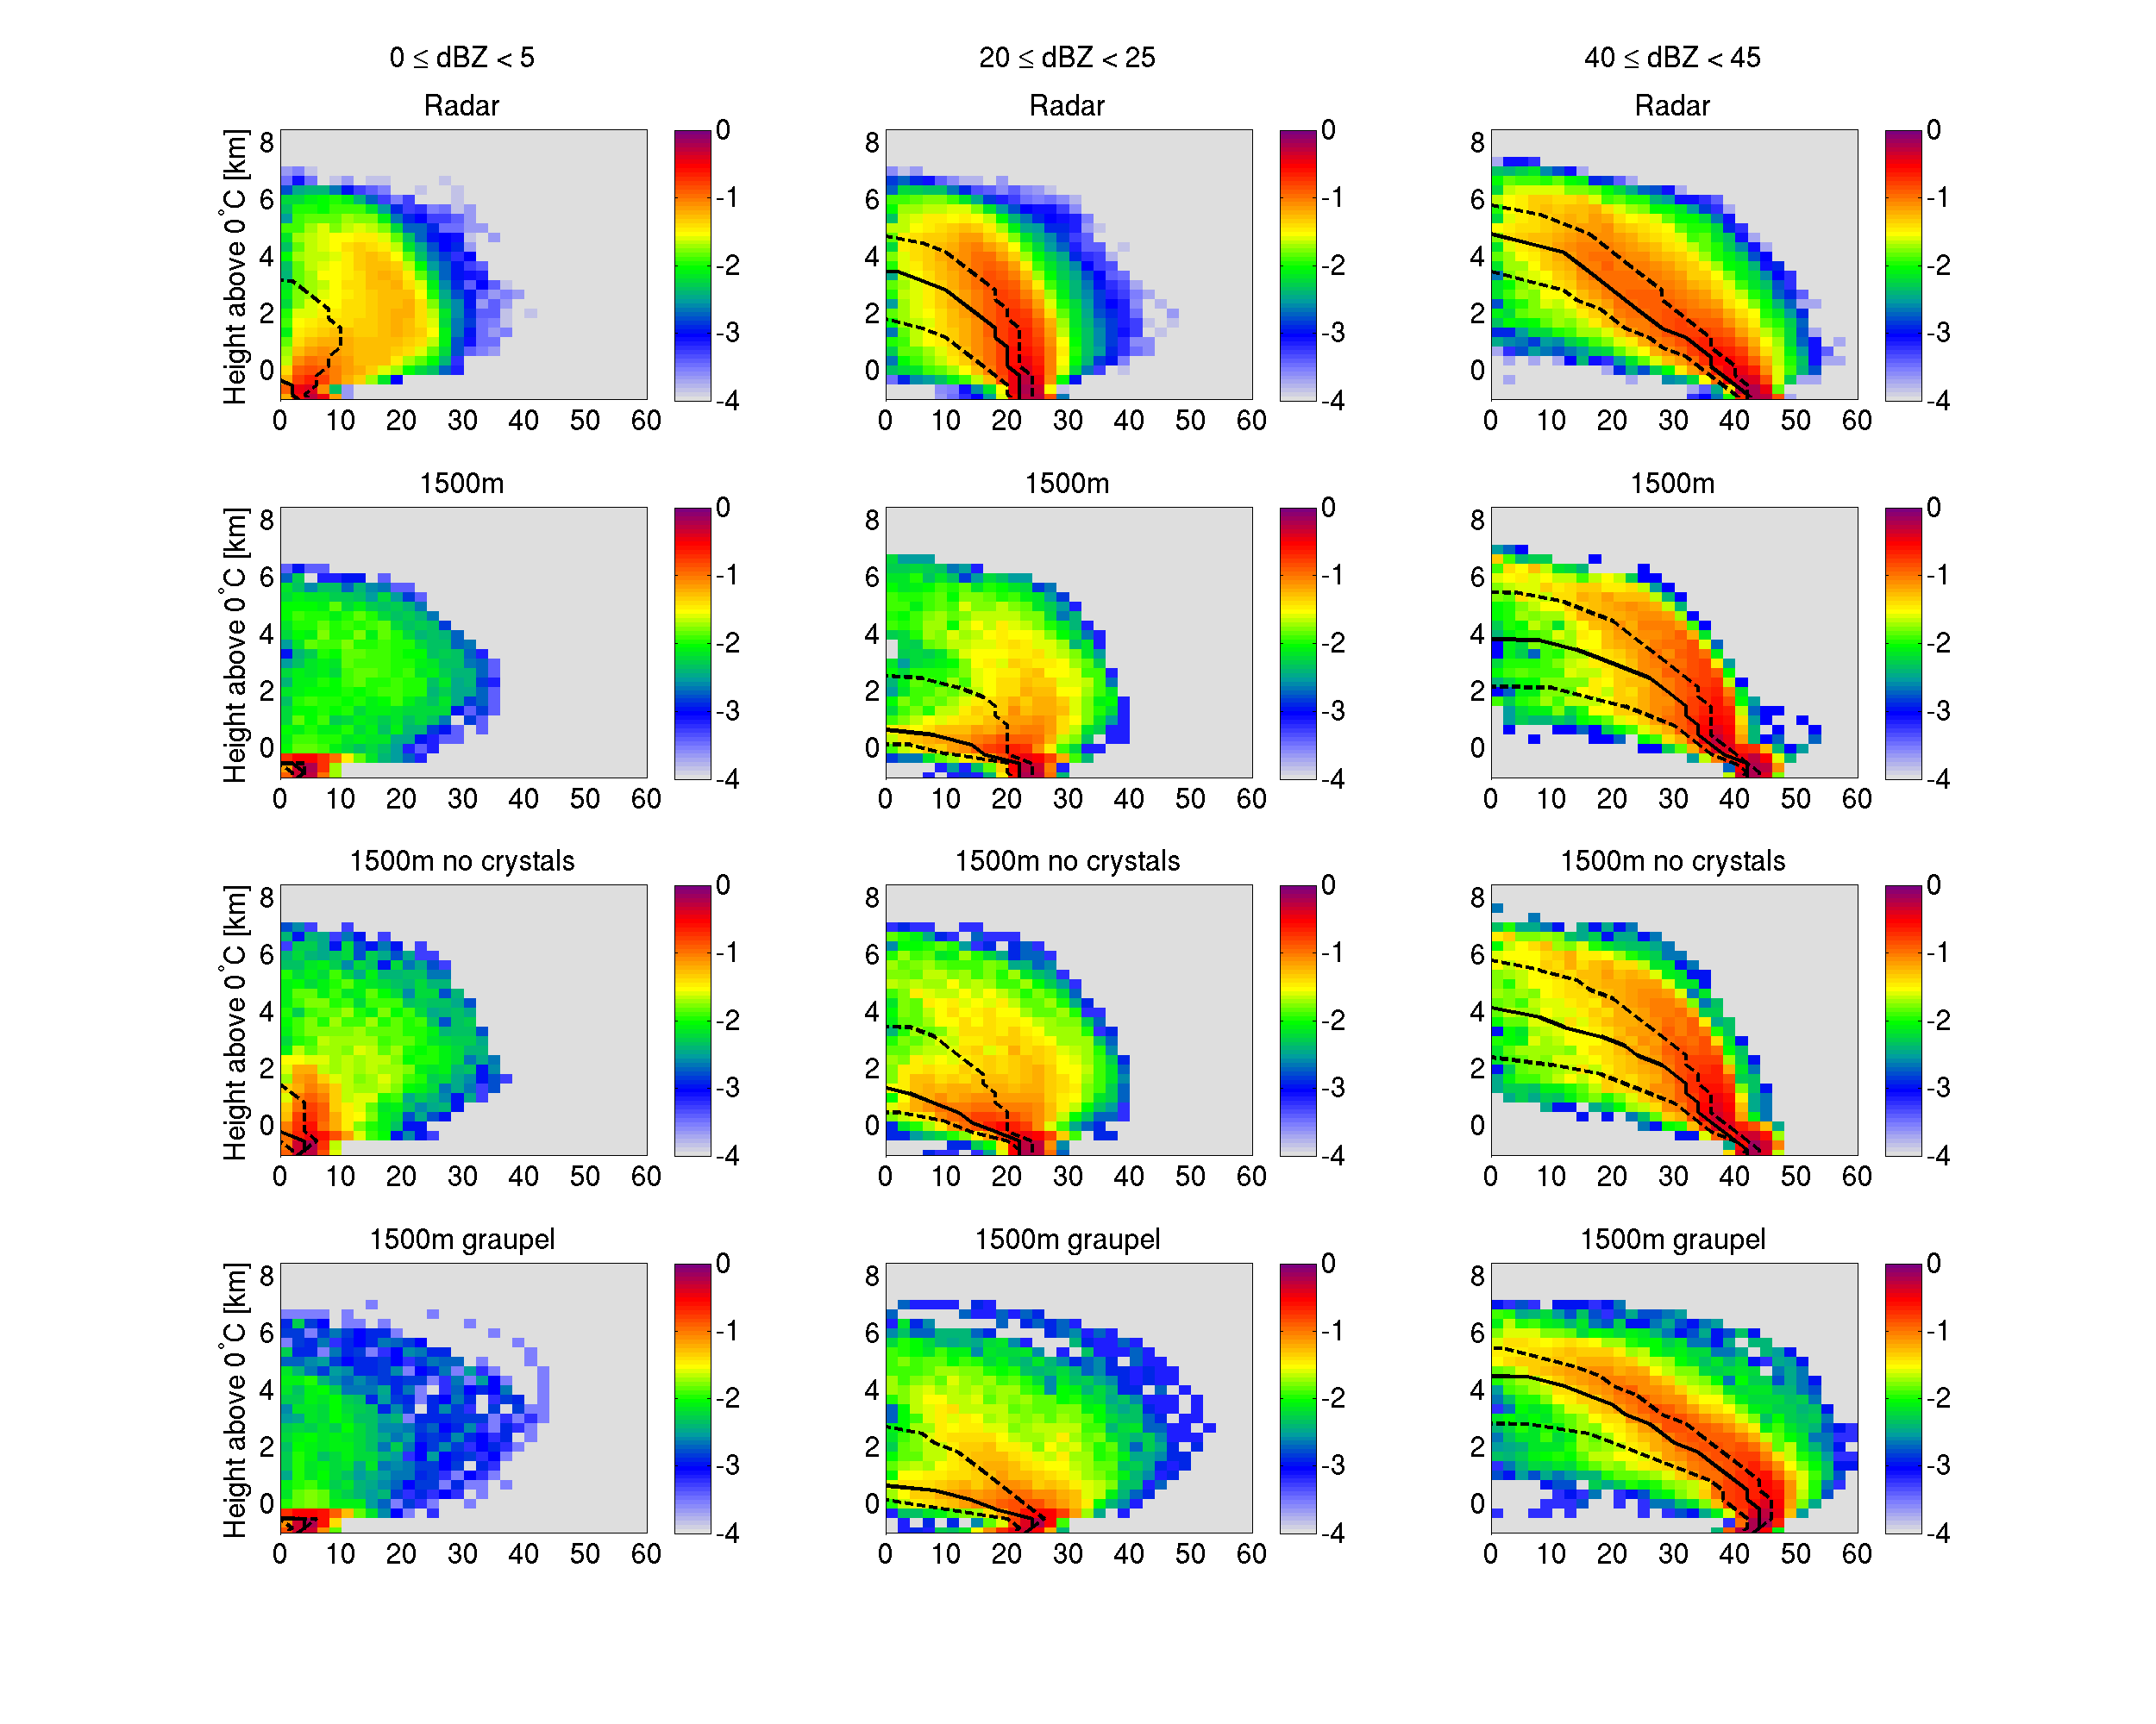
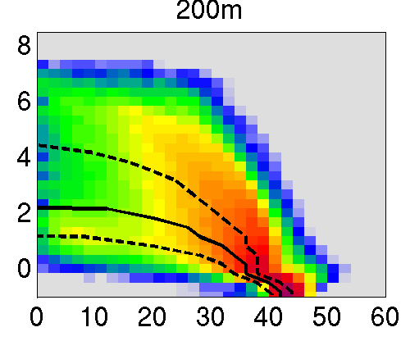
Vertical profiles of reflectivity
Model:
High rainfall rate from storms lacking ice or
have ice cloud dBZ<0
Conditioned on average
reflectivity at 200-1000m
below 0ºC.
Reflectivity distributions for
profiles with this
mean Z 40-45 dBZ are shown.
1.5-km
1.5-km + graupel
200-m
1.5-km no crystals
Observations

Slide 8
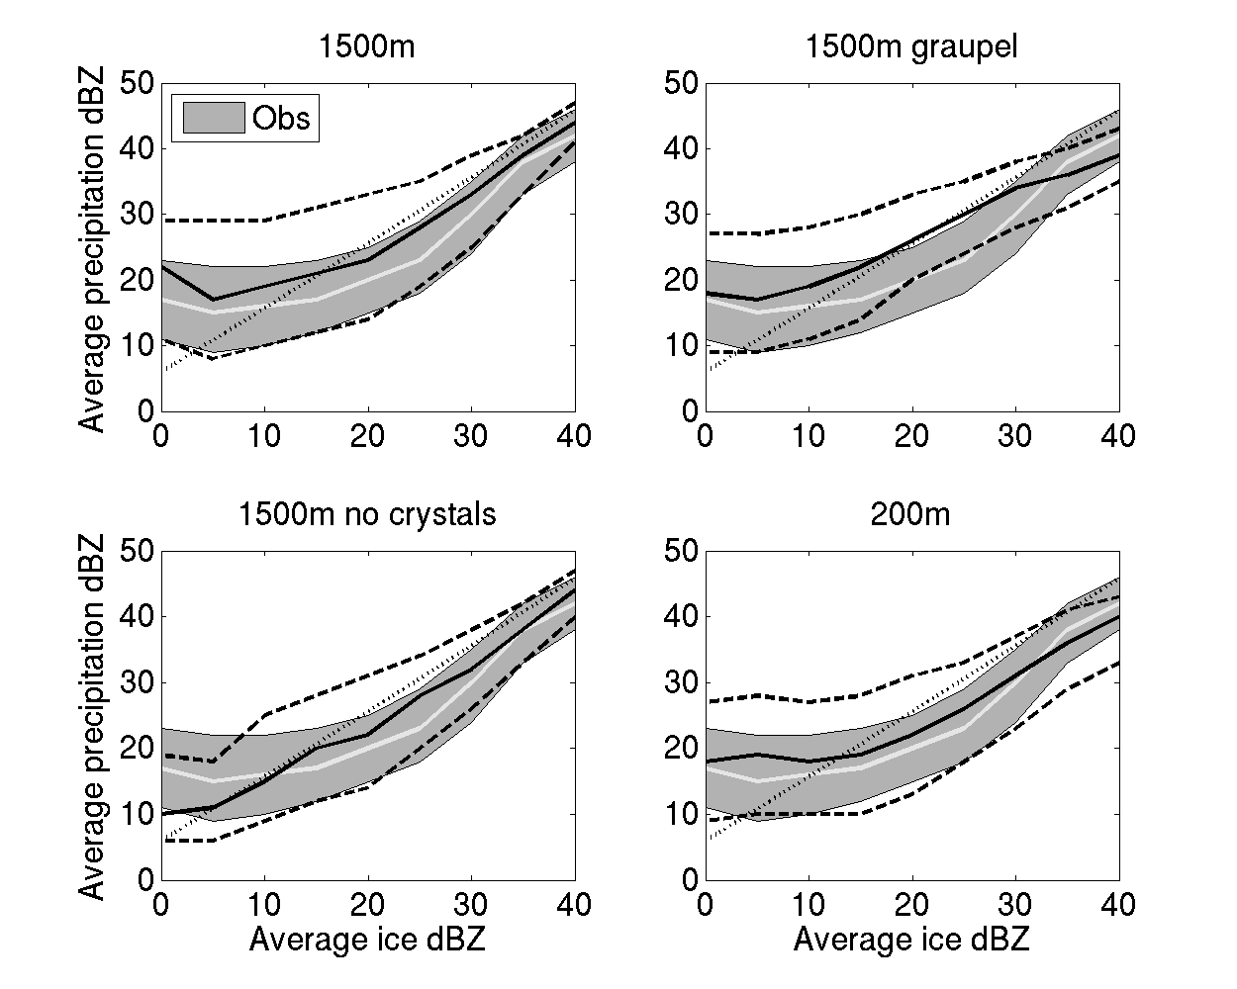
Interquartile range
rain dBZ
conditioned on
ice dBZ
Model:
For ice dBZ < 20
Top 50% of rain dBZ
are 5-10 dB too high
No crystals?
Aggregates-only
rain dBZ 5-10 dB
too low.

Slide 9
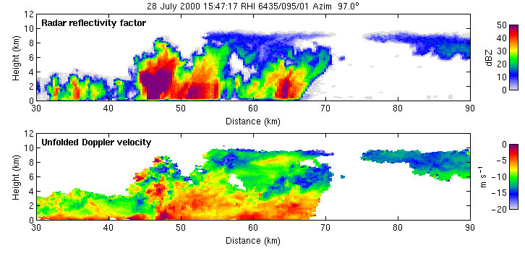
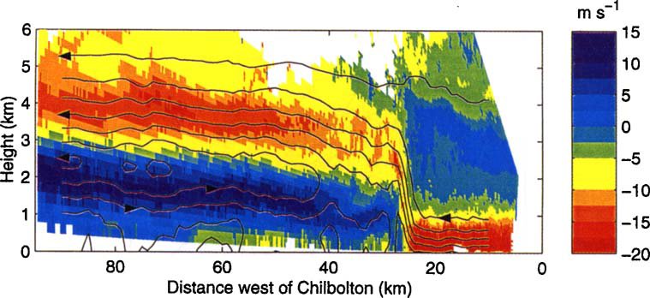
Updrafts?
Hogan et al. (2008)
  Track features in radial velocity from scan to scan
Chapman & Browning (1998)
  In quasi-2D features (e.g. squall lines) can assume continuity to estimate vertical velocity

Slide 10
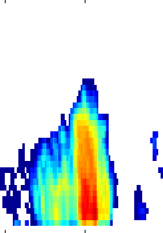
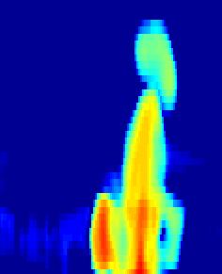
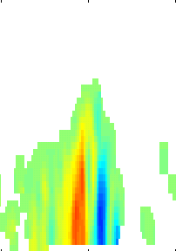
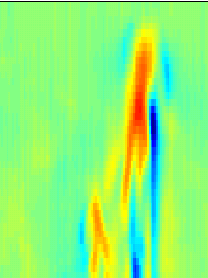
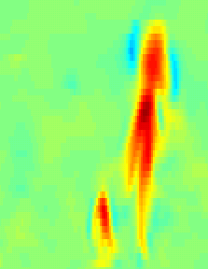
Observations
UKV 1500m
Updraft retrieval
Reflectivity
40 dBZ
Estimated
vertical velocity
+10 m/s
Estimate vertical velocity from vertical profiles of radial velocity, assuming zero divergence across plane.
-10 m/s
10 km height
Actual model
vertical velocity
Quantify errors due to 2D flow assumption
20 km width
(slide courtesy John Nicol)

Slide 11
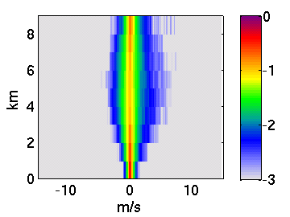
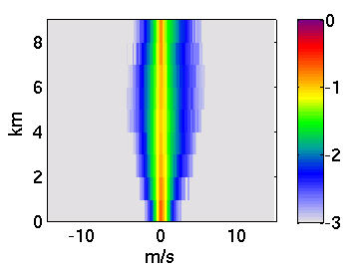
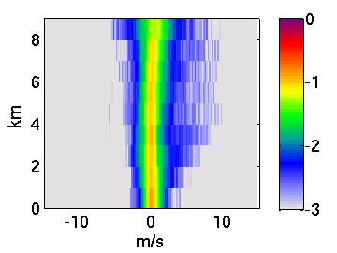
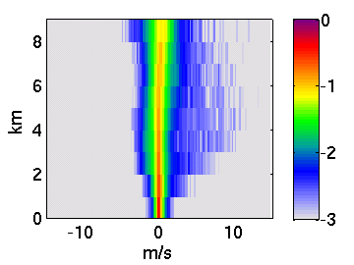
Vertical velocity distributions with height
Observations
500m
Estimated
vertical velocity
down
up
down
up
2. Use map to simulate “true” observed PDF
1. Derive map from PDF of estimates to PDF of true model velocities
True
vertical velocity
down
up
(slide courtesy John Nicol)
Radar data with dBZ>0 within 90 km of the radar

Slide 12
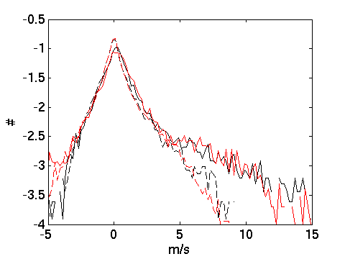
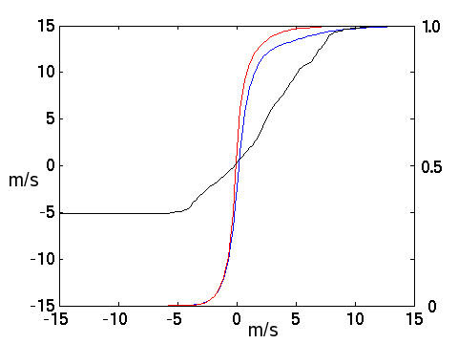
Vertical velocity distribution between 7-8 km
True model velocity
Estimated model velocity
Radar estimated velocity
Radar mapped “true” velocity
500m simulation compares well with radar using 2D flow assumption (dashed lines)
map
(slide courtesy John Nicol)

Slide 13
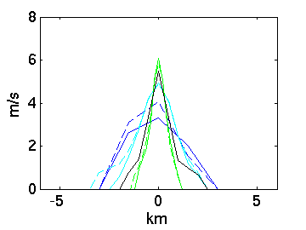
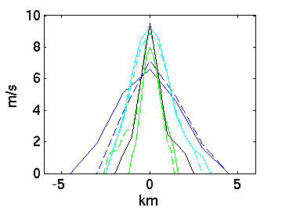
Evaluation of width of updrafts
Retrieval in both observations and model:
wmin=0.5 m/s; wmax>3.0m/s
True model versus mapped observations:
wmin=1.0 m/s; wmax>5.0m/s
Observations
200-m model
500-m model
1.5-km model
Model updrafts shrink with resolution
  200-m model has about the right width
  Does 100-m model shrink further or stay the same?
  How does Smagorinsky mixing length affect model?

Slide 14
The three-dimensional structure of convective storms
Thorwald Stein (t.h.m.stein@reading.ac.uk)
www.met.reading.ac.uk/~dymecs
Models with smaller grid length produce
narrower storms, similar to observations.
Models associate shallow ice cloud
with high rainfall too frequently.
500m grid length model has vertical
velocity distribution comparable to
observations.
Future work: Study the “E” of DYMECS.

Slide 15
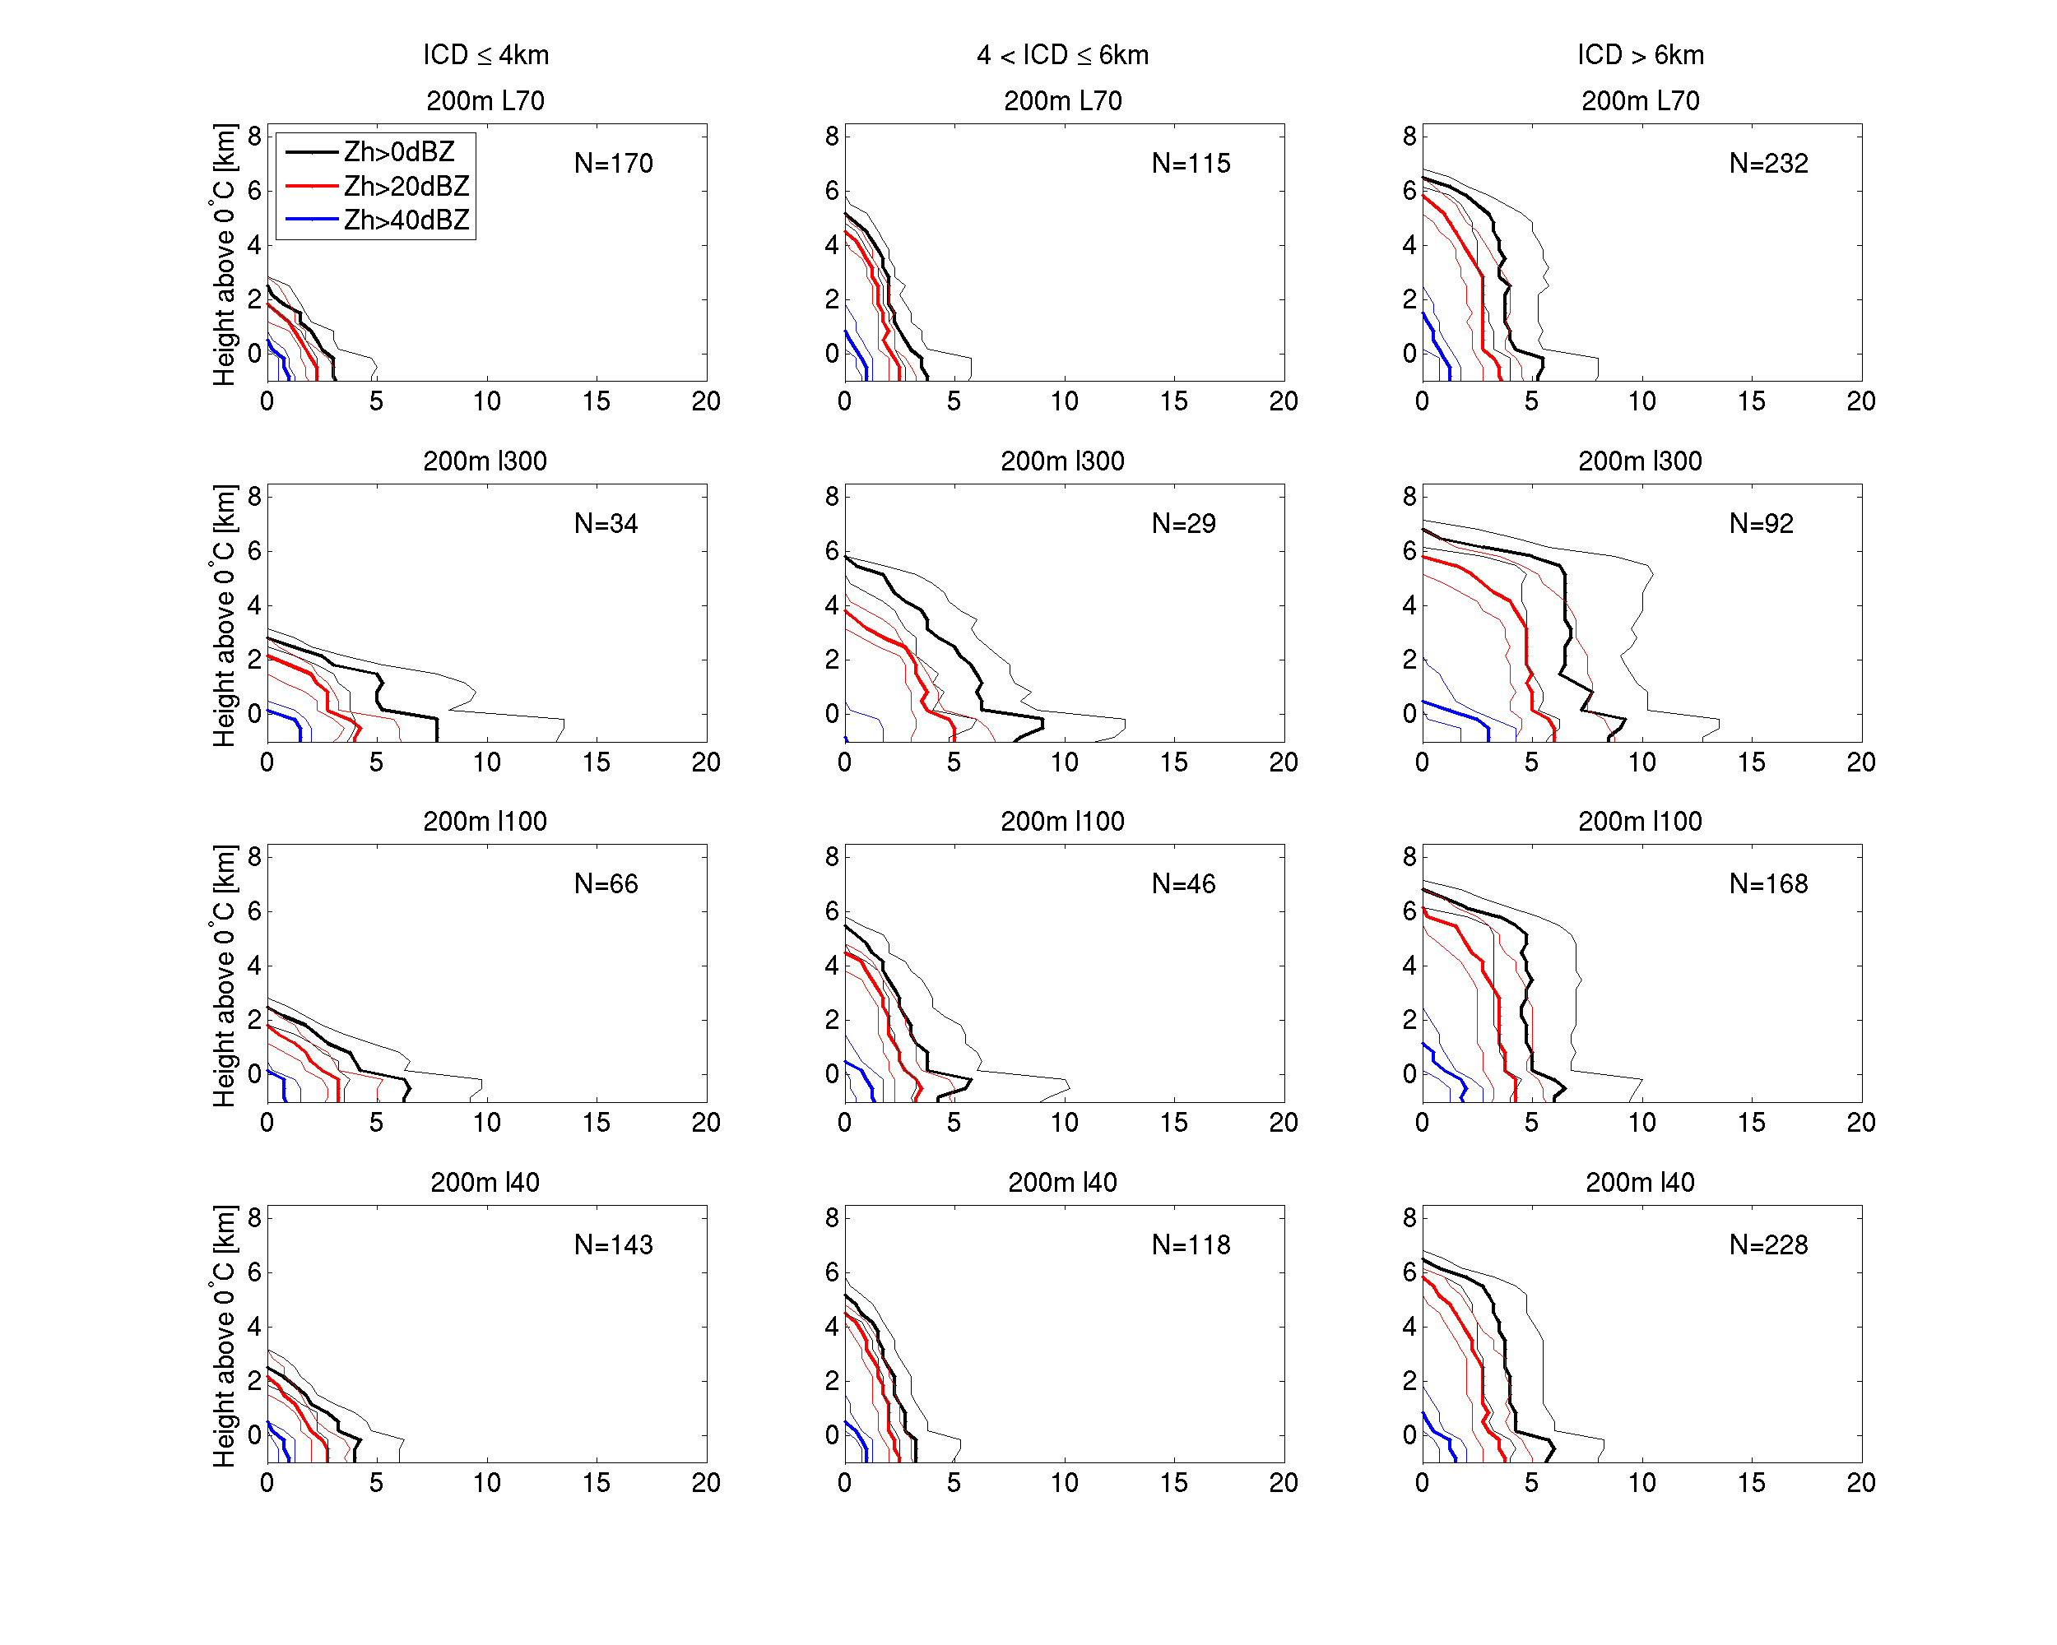
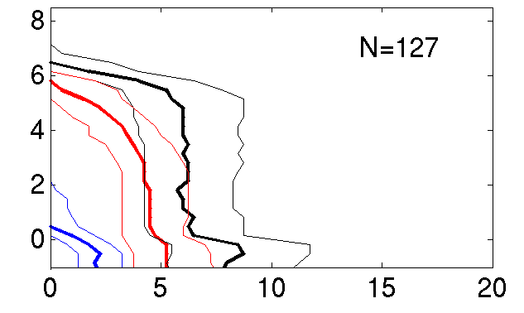
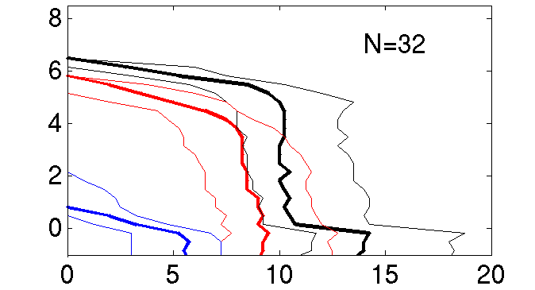
Mixing-length sensitivity
in 200m storm structures
40m mixing length
100m mixing length
300m mixing length
500m model
1500m model
200m simulation can approximate storm structures in coarser grid-length simulations by varying mixing length

