Slide 1
Mixing in Explicit Convection in the UM
Peter Clark

Slide 2
A word on terminology
The literature is full of confusing terms (and possibly confused people) – ‘the model was run with no boundary-layer scheme but using xx turbulence scheme’.
There are really only three classes of model:
Reynolds-averaged, ensemble mean parametrization. Almost invariably assume horizontally homogeneous forcing so technically 1D, though sometimes applied 3D.
‘Proper’ LES; ‘sub-filter’ model with filter scale well into the inertial sub-range and realised flow well resolved. (ISGS in this class but must be done very carefully!)
‘Terra-incognita’ – we want to filter the equations, but we don’t know how. 500 m + explicit models are firmly in this category.

Slide 3
History of ‘Turbulence’ in convective-scale UM
Initial experiments - del-2 and del-4 horizontal diffusion (Humphrey Lean)
Magnitude dictated by rough argument based on Smagorinsky. Hence ‘8-timestep’ diffusion.
Analysis of w-spectra
Very clear need for vertical mixing outside BL, especially at to of cirrus.
Eventually technical limitations overcome and ‘local’ BL scheme extended throughout model.

Slide 4
Constant Diffusion
In 1 D (to illustrate)
nΔx wave damped with e-folding time
‘Smagorinsky’ approach means
Lean et al, 2008

Slide 5
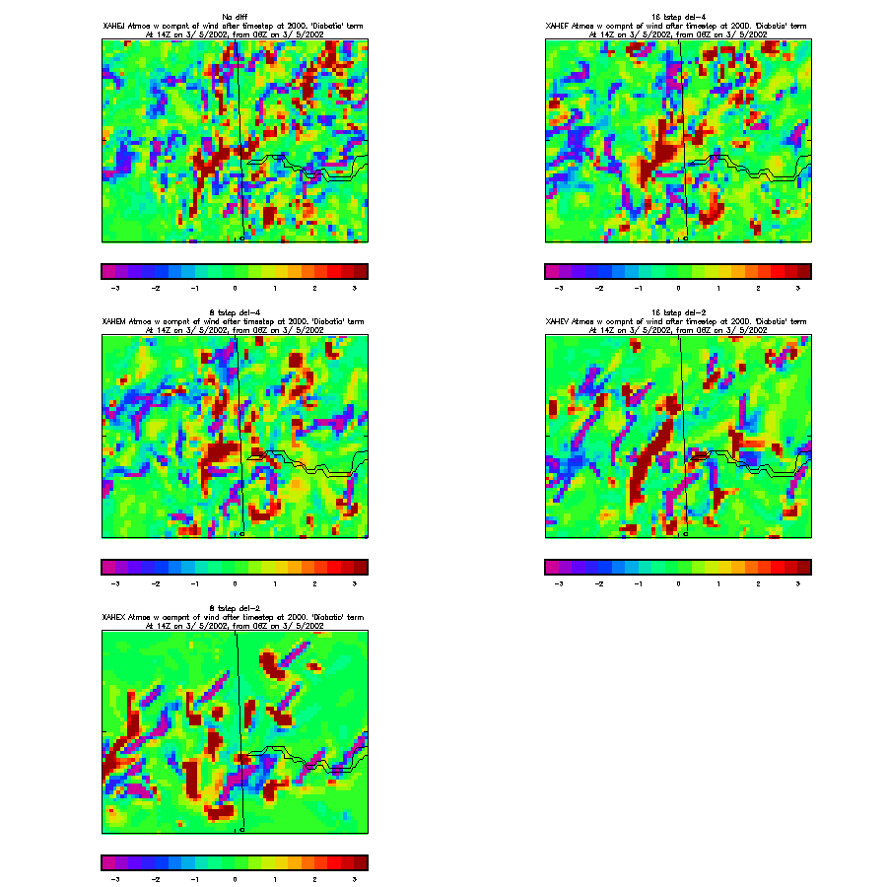
Impact of fixed horizontal diffusion
No Diffusion
16∆t ∇⁴
8∆t ∇²
8∆t ∇⁴
16∆t ∇²
Timescale=
E-folding time for
2∆x waves
(With Humphrey Lean,
UWERN Convection Workshop, Jan 2004?)
W at 2 km

Slide 6
Velocity spectra in scattered convection Limited Area Model
-5/3
No Diffusion
-3
16∆t ∇⁴
8∆t ∇⁴
16∆t ∇²
8∆t ∇²
Wavenumber m⁻¹

Slide 7
History of ‘Turbulence’ in convective-scale UM
2 and 3D Smagorinsky-Lilly implemented (Halliwell)
Desire to have facility to compare with CRM/LEM. (e.g. CBL compares well if the model is intelligently set up.
Heuristic desire to only mix ‘where needed’. Easy to formulate in variable resolution.
A starting point for a 3D turbulence scheme – can we use split solver, implicit vertical, explicit horizontal?

Slide 8
Smagorinsky-Lilly
Note the role of the stability function is often forgotten.
(Note also literature varies on factors of 2!)

Slide 9
What is done in other models?
It is often unclear what has been used – authors often refer to ‘standard (e.g. Mellor-Yamada level 2.5) turbulence closure or ‘standard’ TKE scheme.
This makes about as much sense as using the UM BL scheme.
Rarely clear whether 3D or 1D.
What choices of length scale are being made?
Schemes do exist which attempt to ‘blend’ from – e.g. Bougeault
Is conditional instability included?

Slide 10
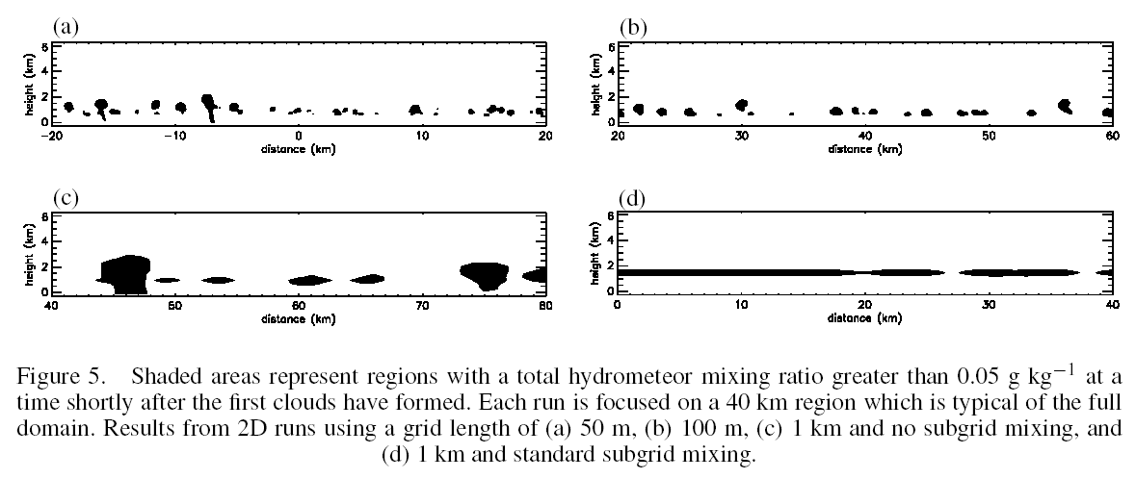
Met Office CRM (2D)
50 m
100 m
1 km, no subgrid
1 km, standard subgrid
Petch, 2006, Q.J.R.M.S 132, 345-358

Slide 11
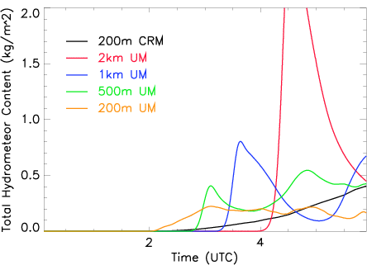
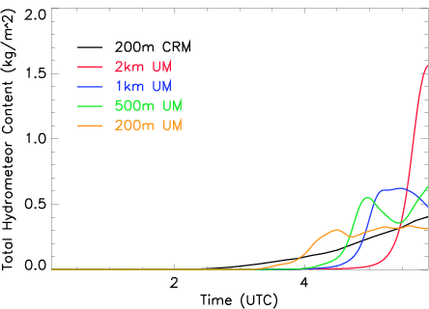
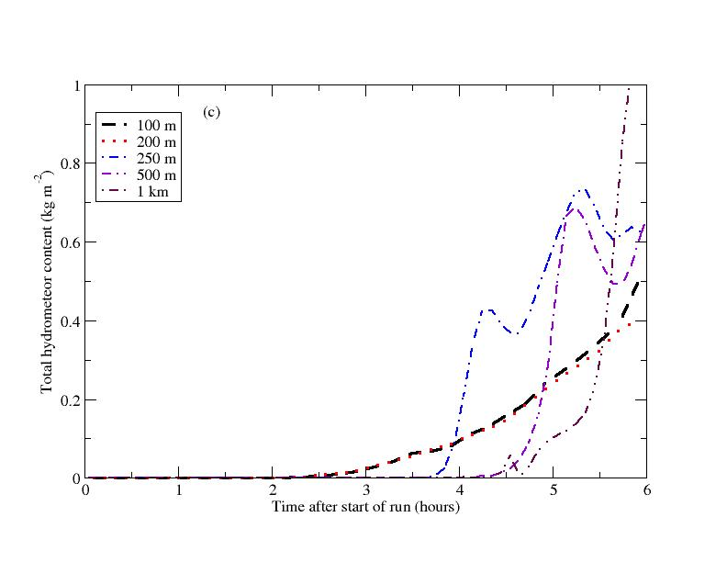
Diurnal Convection: Sensitivity to grid resolution
Standard 1D BL+horiz. diffusion: Increasing delay of first rain and overshoot with decreasing resolution
“3D” Smagorinsky-Lilly scheme reduces overshoot significantly and reduces variation of delay with res.
200m “3D” Smagorinsky-Lilly scheme is close to 200m CRM (within uncertainty)
REFERENCE
Met Office CRM
Petch, 2006,
Q.J.R.M.S 132, 345-358
3DSL Cs=0.23
GCSS LBA Diurnal Cycle, Grabowski et al, 2006

Slide 12
Requirements
We need to do better in ~1 km models.
We need measures of vertical motion both for diabatic heating and microphysics (CCN activation, size sorting etc. etc.)
There may be better schemes out there already but if so it is not obvious they are well tested and validated.
We need good, validated reference solutions.

Slide 13
Testing (and developing) ‘turbulence’
Real cases (CSIP, DYMECS – COPE to come). Essential but uncontrolled. There is always something we haven’t measured!
Idealized
Diurnal cycle/cold air outbreaks
Radiative-convective equilibrium
‘UK convection’ – Halliwell
Weisman and Klemp ‘warm bubble’ thunderstorm/supercell.

Slide 14
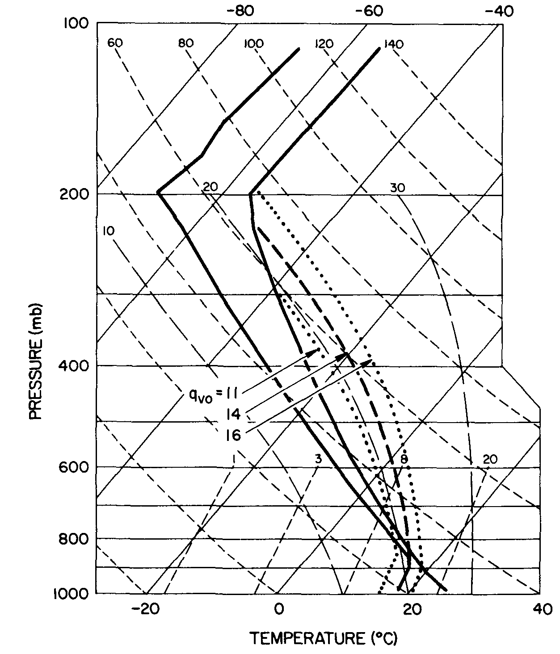
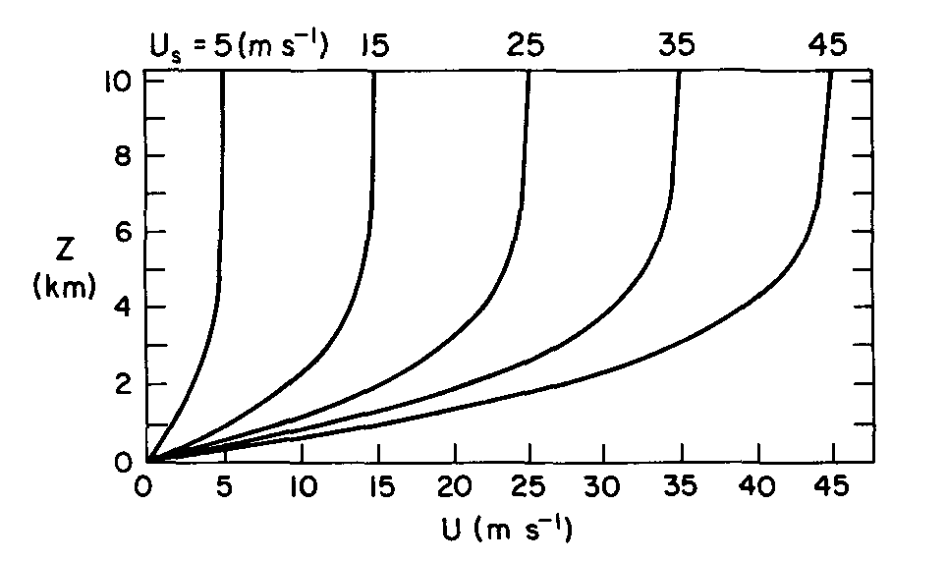
Weisman and Klemp Idealized Profile
Weisman and Klemp MWR 1982
Simple analytic profile
Used by numerous authors
Later modified (Weisman and Rotunno, 2000) to include directional shear.
Standard WRF test case with fixed viscosity)

Slide 15
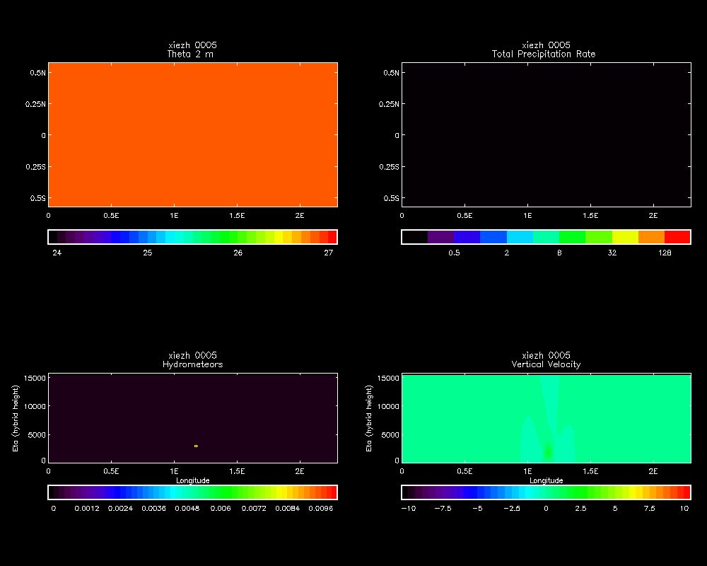
Weisman and Klemp 500 m L140 UM
15 m/s
(plots storm relative)
’10 km’ Gaussian bubble 2 C
14 g/kg q
10 s timestep
Single-ice microphysics

Slide 16
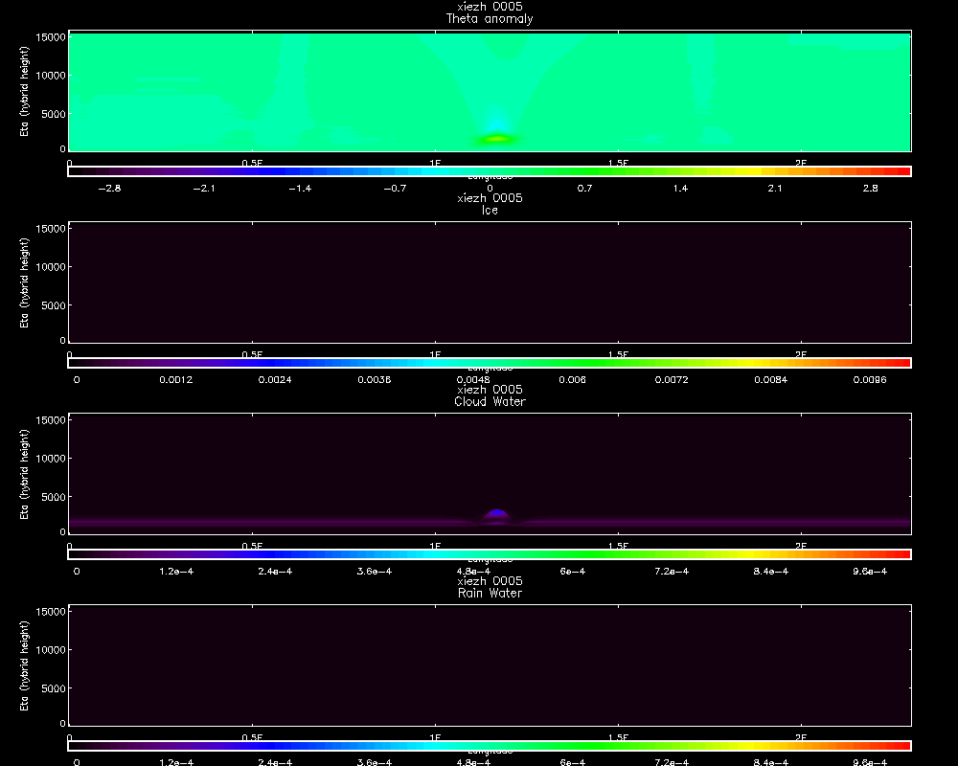
Weisman and Klemp 500 m L140 UM

Slide 17
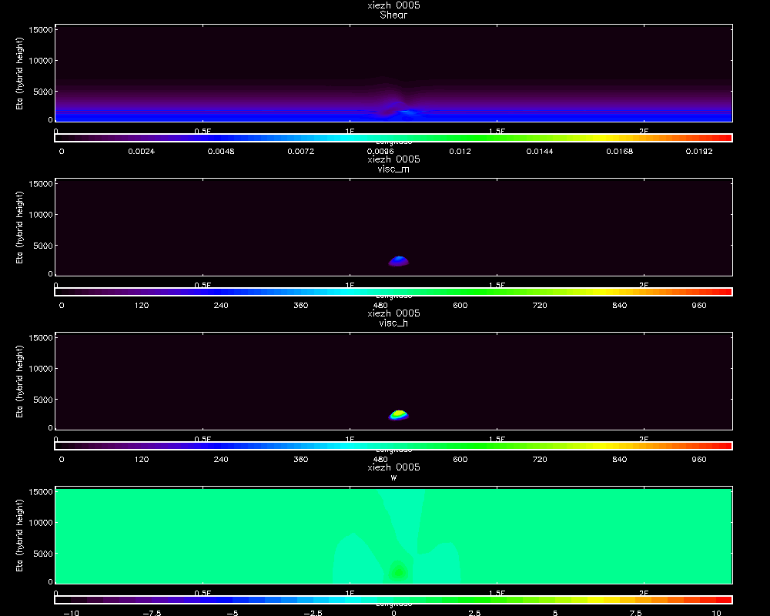
Weisman and Klemp 500 m L140 UM
Shear
Visc-m
Visc-h
w

Slide 18
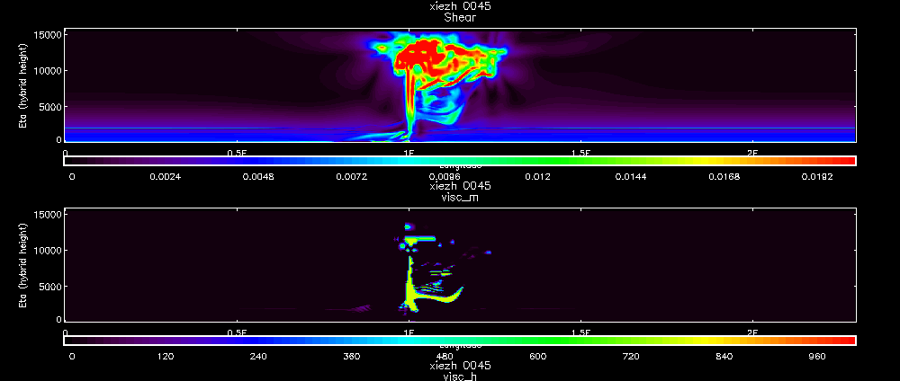
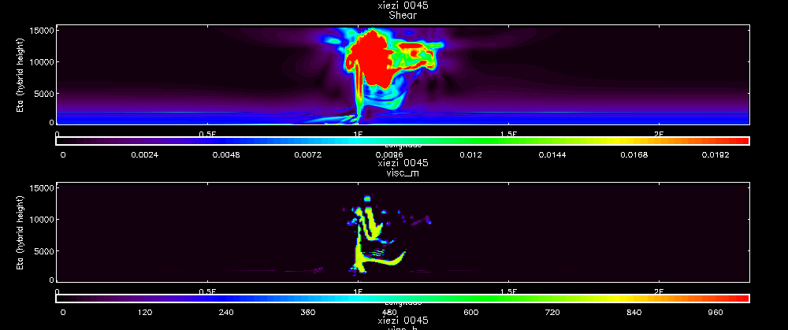
Weisman and Klemp 500 m UM LEM vs UM stability functions
Shear
UM
Sharpest
Visc-m
Shear
LEM
Standard
Visc-m

Slide 19
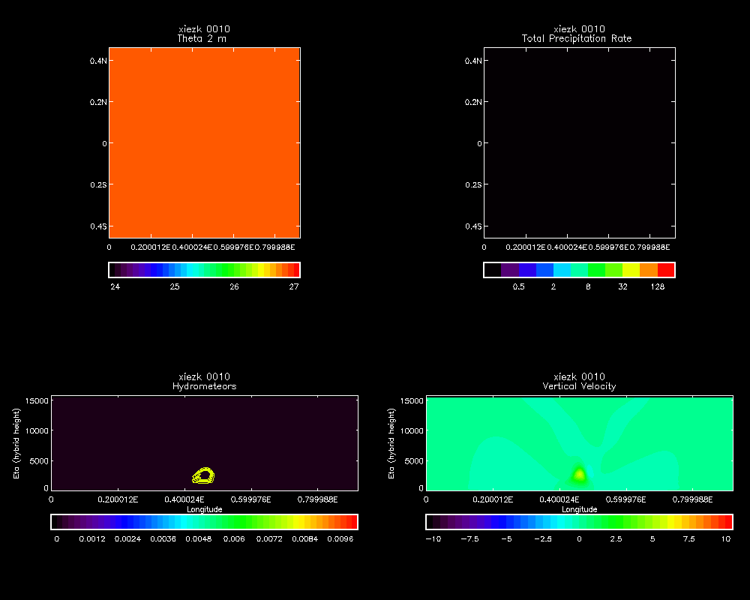
Weisman and Klemp 100 m UM L140
1 s timestep
1024x1024
LEM stability
Dry static adjustment (boo!)

Slide 20
Plans/Aspirations
Are the stability functions appropriate for saturated conditions?
Comparison of different resolutions.
ENDGAME
‘UKV’ microphysics.
Include radiation?
Different wind profiles, soundings etc.
Investigate 100 m model stability.
Alternative schemes (3D tke, Wyngaard (2004) …..)
Compare with other models?

Slide 21
Thank you for your attention. Any questions?

