Slide 1
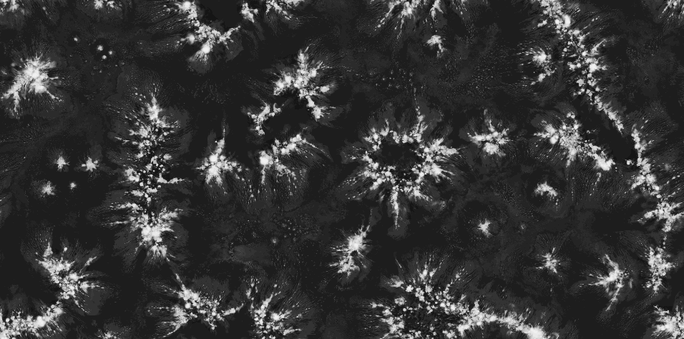
13 June, 2013 Dymecs Meeting, Reading
Tropical convective organisation in the UM
Chris Holloway
NCAS-Climate, Dept. of Meteorology, University of Reading

Slide 2
Cascade
Organized convection and scale interactions in the tropical atmosphere
Cascade is a UK NERC-funded consortium lasting from 2008-2012, with ongoing related research.
Both real case studies and idealized tropical conditions are simulated using cloud-system resolving models over large tropical domains.
Aims
Advance understanding of convective organization and scale interactions
Inform the development of new approaches to convective parameterization
Create a new framework for process modeling
Notes:
2
Cascade is a consortium project funded by the UK Natural Environment Research Council. It involves researchers at the National Centre for Atmospheric Science (NCAS-Climate) and the Walker Institute at the University of Reading, the University of East Anglia, University of Leeds and the Met Office, plus collaborators at NCAR, CSU, GFDL and ECMWF.
Cascade uses simulations by the Met Office atmospheric model (UM, slide 3) at cloud-system resolving resolution, over tropical domains large enough to allow the large-scale circulation and convection to evolve in response to each other. Both continental and oceanic convection will be studied using a small number of real case studies augmented by idealised simulations.
The model will be evaluated in conjunction with new satellite observations of the 3-dimensional evolution of clouds and rain-producing systems. Analysis will focus on specific phenomena and processes (slide 2) with the aim of advancing understanding of the organisation of convection and interactions across time and space scales. This will be used to inform the development of new approaches to the parameterization of convection in weather and climate prediction models.

Slide 3
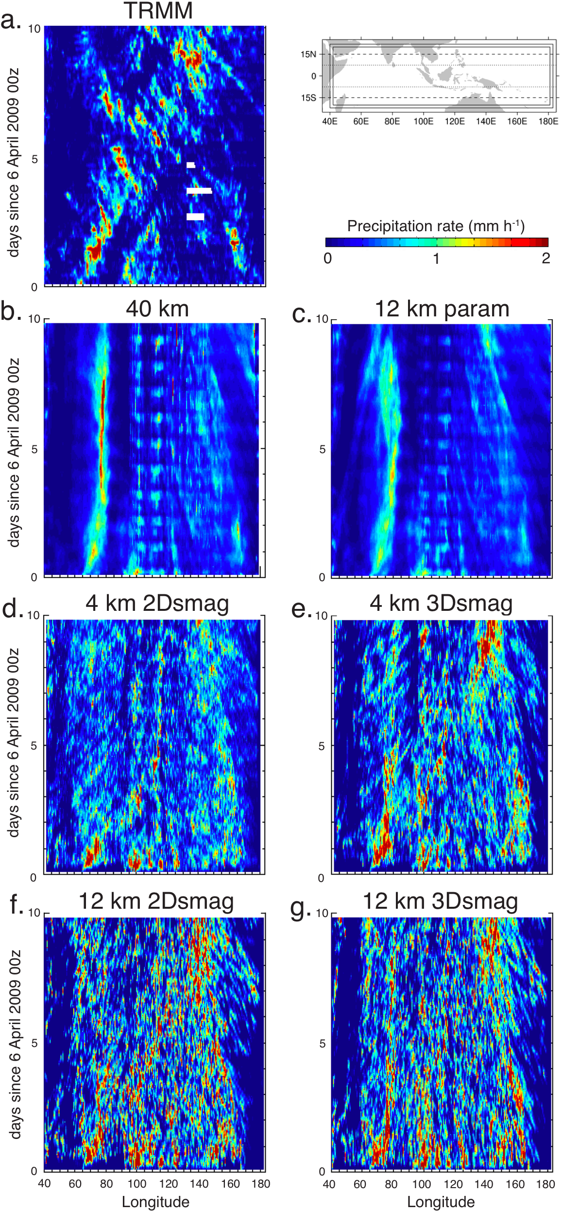
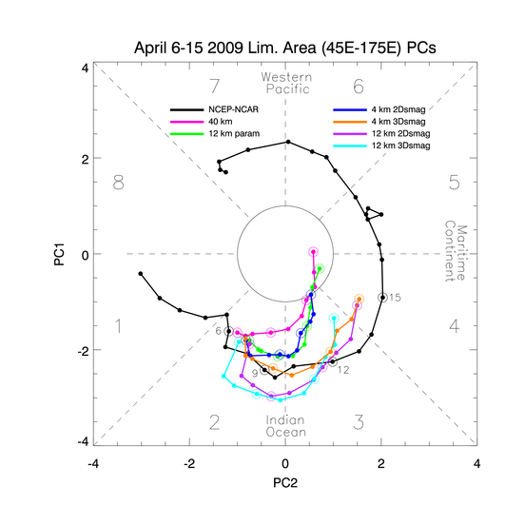
Cascade
MJO performance
25 km avg (except for 40 km) 3-h avg, Hov. 7.5S – 7.5N
4km 2Dsmag (without vertical Smag. Mixing) loses large-scale organization, too much rainfall across whole equatorial region, much too dry in lower troposphere.
4 km with 3D Smagorinsky (horizontal and vertical subgrid mixing) has more realistic MJO in terms of convection and winds.
12 km and 40 km with parameterized convection MJO is too weak, does not propagate convective signal through Maritime Continent, but does capture some features. (MJO improves with explicit convection).
4 km 3D Smag. atmosphere is moister and closer to saturation, particularly at low rain rates, as in ECMWF analyses.
Holloway, Woolnough, and Lister, 2013, J. Atmos. Sci.

Slide 4
Cascade
April 2009: Precipitation distribution
Rainfall distributions (sea points, 1.0 degree, 3-hr)
Probability density for non-zero values
Fraction of total precipitation per rain rate
12 km model has too much light rain, not enough heavy rain,
preferred rate ~10 mm/day
(0.4 mm/h)
Explicit convection gives more realistic (larger) amounts of rain at higher rain rates, particularly for coarser grids and/or Smag. vertical mixing (generally closer to TRMM data, but often too much heavy rain).
Parameterized convection has preferred scale of rain rate (more light rain), unlike observations and explicit convection (potential consequences of resulting heating and moistening for dynamics, MJO).
Holloway, Woolnough, and Lister, 2012, QJRMS

Slide 5
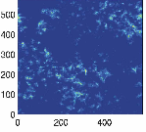
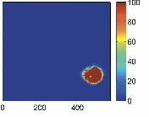
Background: Organized tropical rainfall in idealized high-resolution models
constant SST, no land, no Coriolis force (no rotation)
initially scattered rainfall becomes aggregated into one region
linked to feedbacks between convective rainfall, tropospheric water vapor, radiation, and surface fluxes
SAM model (US)
UK Met Office Unified Model (Met-UM)
Day 10
Day 50
Day 23-25
Precipitation rate (mm/day)
Column Water Vapour (mm)
(Black contours show precipitation rate)
y (km)
y (km)
x (km)
x (km)
x (km)
Bretherton et al. 2005
Steve Woolnough
Notes:
put units down here, explain better what we are looking at in these figures. A bit more general for non-atmospheric science people. Come

Slide 6
Current and Future Work
Current and Future Work
Can we find links between convective self-aggregation in idealized models and organized tropical convection in observations or more realistic simulations?

Slide 7
Aggregation state after 40 days in idealised UM 4 km radiative-convective equilibrium runs
Current and Future Work
No interactive
radiation or interactive
surface fluxes
No interactive
radiation
Control
Precipitation
Column
Water Vapour
Future work: do these processes affect simulations of real case studies of organised tropical convection in a similar way?

Slide 8
Summary of main Cascade results
Conclusions
The Cascade framework provides a means of improving global models by studying interactions between the convective scale and larger scales and how these change with a model’s representation of convection.
We can also improve explicit-convection models by subjecting them to larger-scale observational constraints.
Idealized models showing self-aggregation of convection provide an important possible link to organized convection in nature (but even if the link is spurious, we need to understand why models do this).

Slide 9
Current and Future Work
Future Work: Links with Met Office
High-resolution modelling of Tropical Cyclones (Stu Webster, Jill Chamberlain’s PhD)
EMBRACE high-resolution modelling over Indian Monsoon region
Idealised modelling of convective organisation and cold pools in order to aid in convective parametrisation development (Alison Stirling)
Application of Dymecs-type storm tracking analysis to tropical locations (Thorwald Stein)
Applying metrics and knowledge from Met Office NWP and research in the UK to convective research in the tropics (and vice-versa)
Already happening in Australia, Korea

Slide 10
Current and Future Work
Things I’d like to see:
Mass/tracer conservation
Variable grid resolution (GungHo project) to test two-way interactions between high and low resolution regions
Continuing development of idealised UM, including easier ability to use some idealised settings in real case studies
(so, continue to improve the use of UM to study processes)
Parametrisations that scale automatically with grid size

