Slide 1
Terrain-locked convective rainbands & MOGREPS-UK(V)
Andrew Barrett, Sue Gray (Univ. of Reading)
Dan Kirshbaum (McGill University, Canada)
Nigel Roberts (MetOffice@Reading)
(with thanks to Paul Field, Simon Vosper, Humphrey Lean (Met Office), David Schultz and Jonathan Fairman (Manchester))

Slide 2
Motivation
Convection-permitting models are now common
Much uncertainty over location of convection due to uncertainties on larger scales
Terrain is fixed in space and can help initiate convection
Storms can become terrain-locked ➔ large rain totals
Increased predictability of convection over terrain?

Slide 3
Terrain-locked convective band
An elongated band of rain fixed above orography
Persistent for an hour or more
PRESTO (PREcipitation STructures over Orography) project involving Reading, Manchester and Met Office. Aims:
Determine mechanisms and predictability of rainbands
Create multi-region climatology of banded precipitation
Understand regimes for orographic rainbands

Slide 4
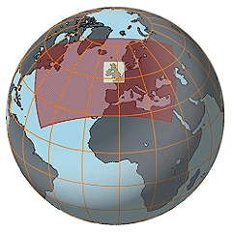
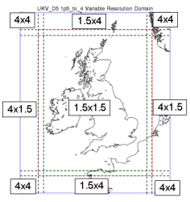
MOGREPS-UK(V): UM setup
Global ensemble (00Z)
control + 23(20) members
NAE domain nested in Global (06Z)
Analysis from NAE model
Initial conditions perturbations interpolated from Global ensemble
No ‘Random Parameters’ scheme
UKV domain nested in NAE (09Z)
Variable resolution - 1.5 km over UK
No convection scheme
Downscaled from NAE domain

Slide 5
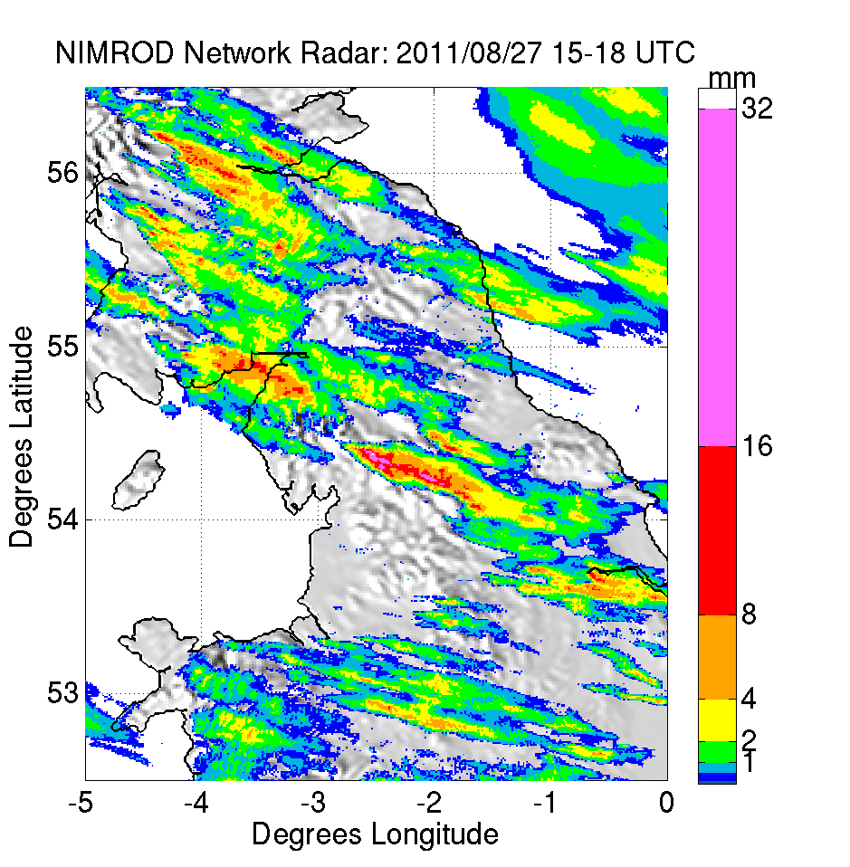
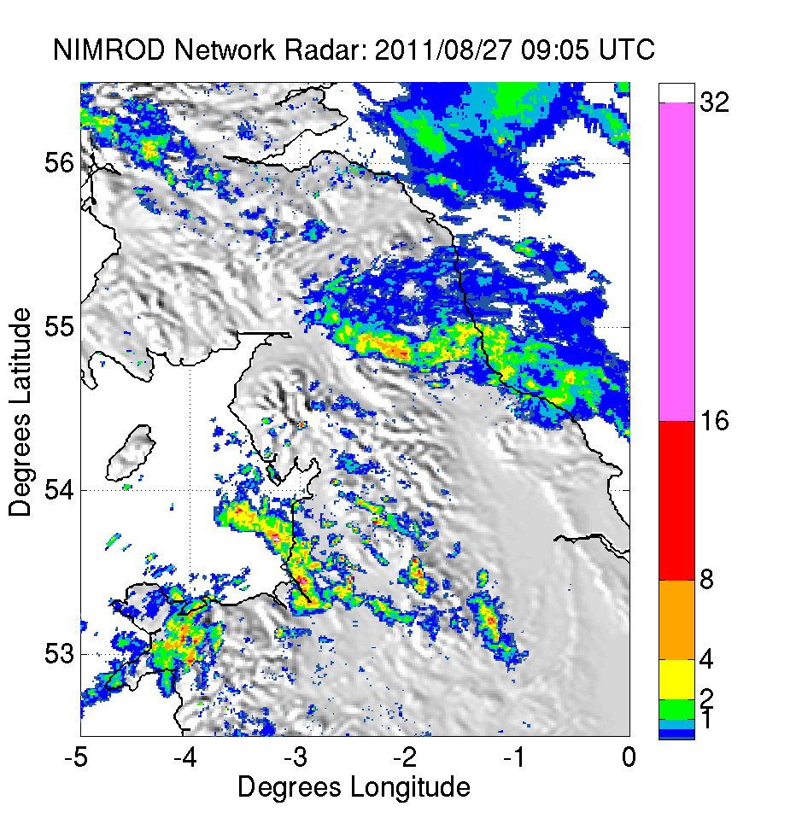
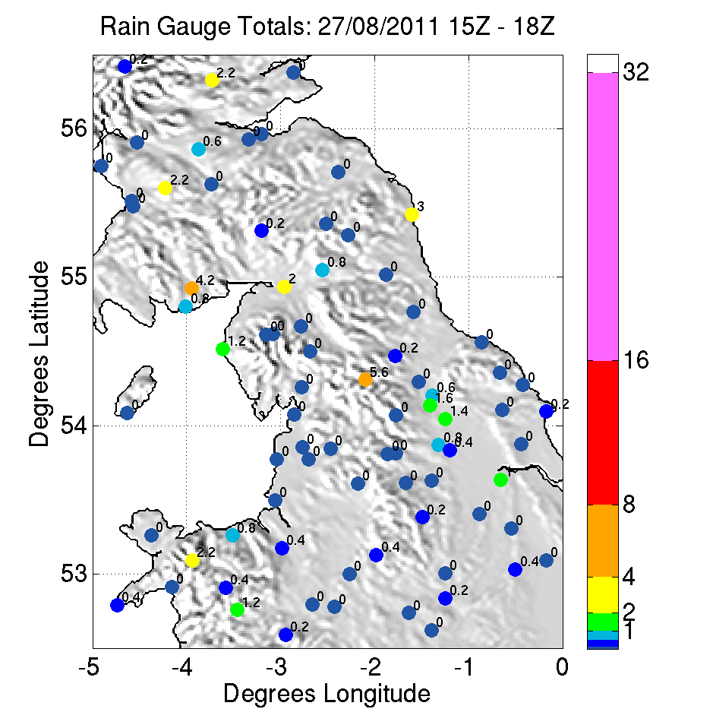
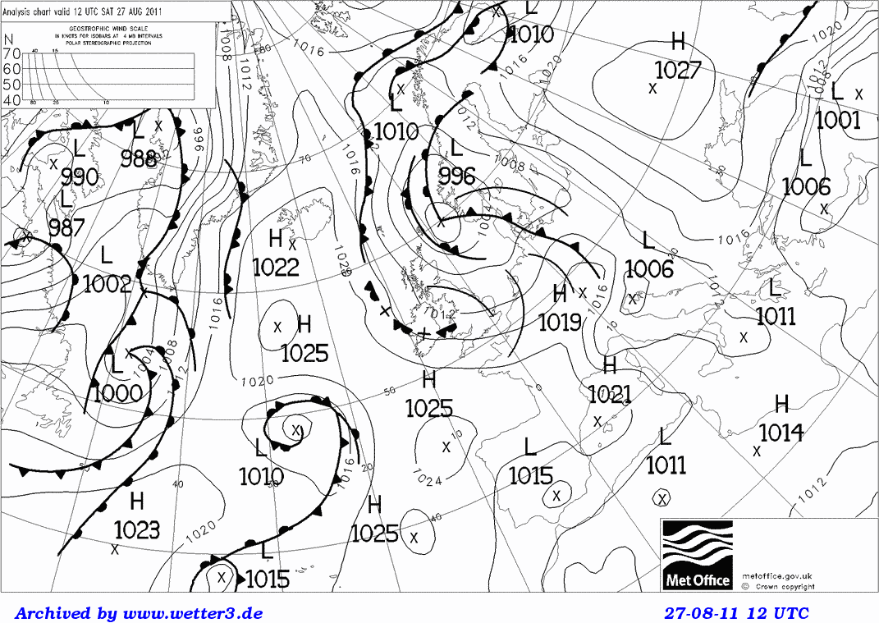
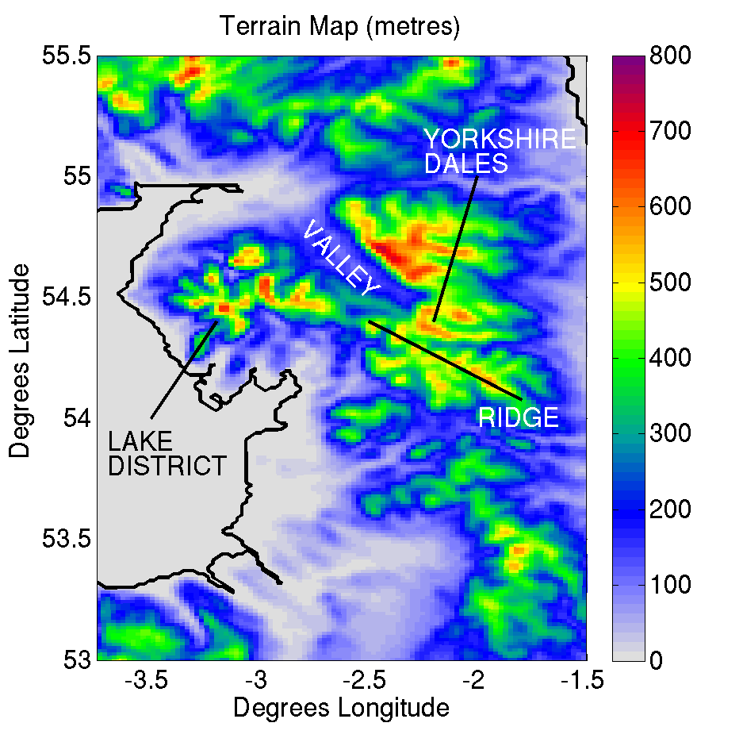
27 August 2011

Slide 6
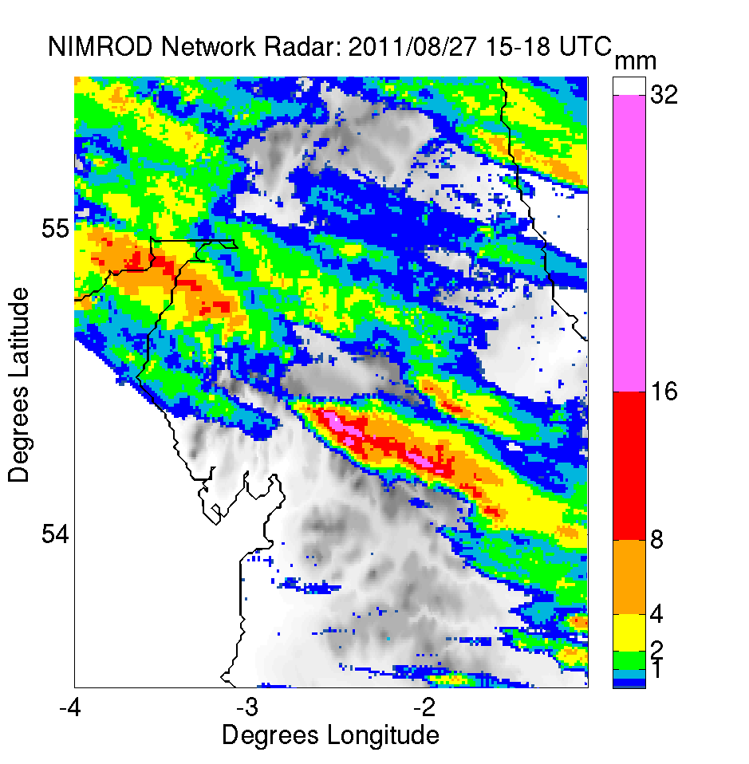
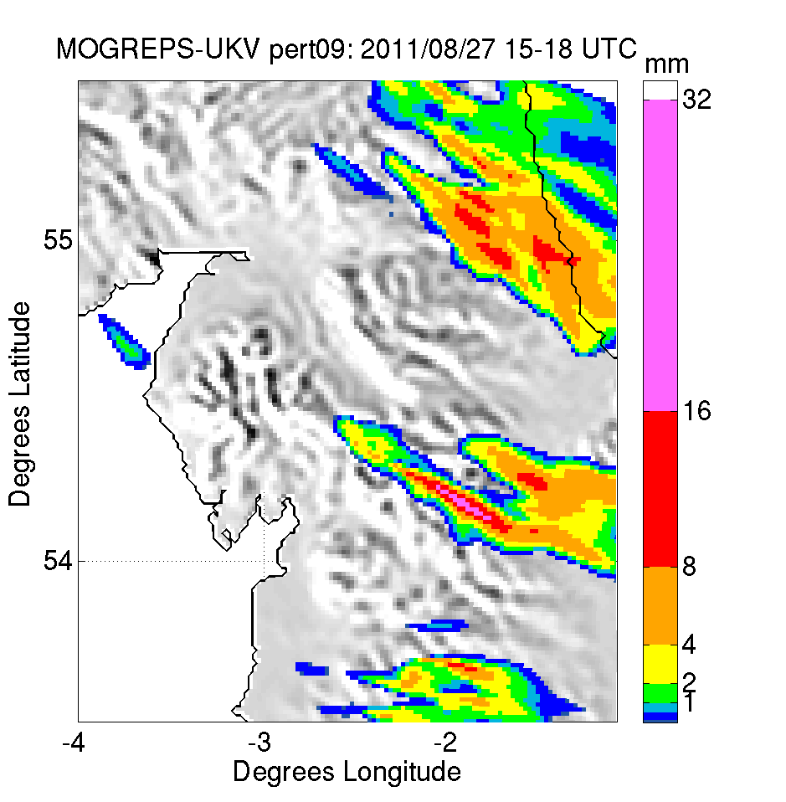
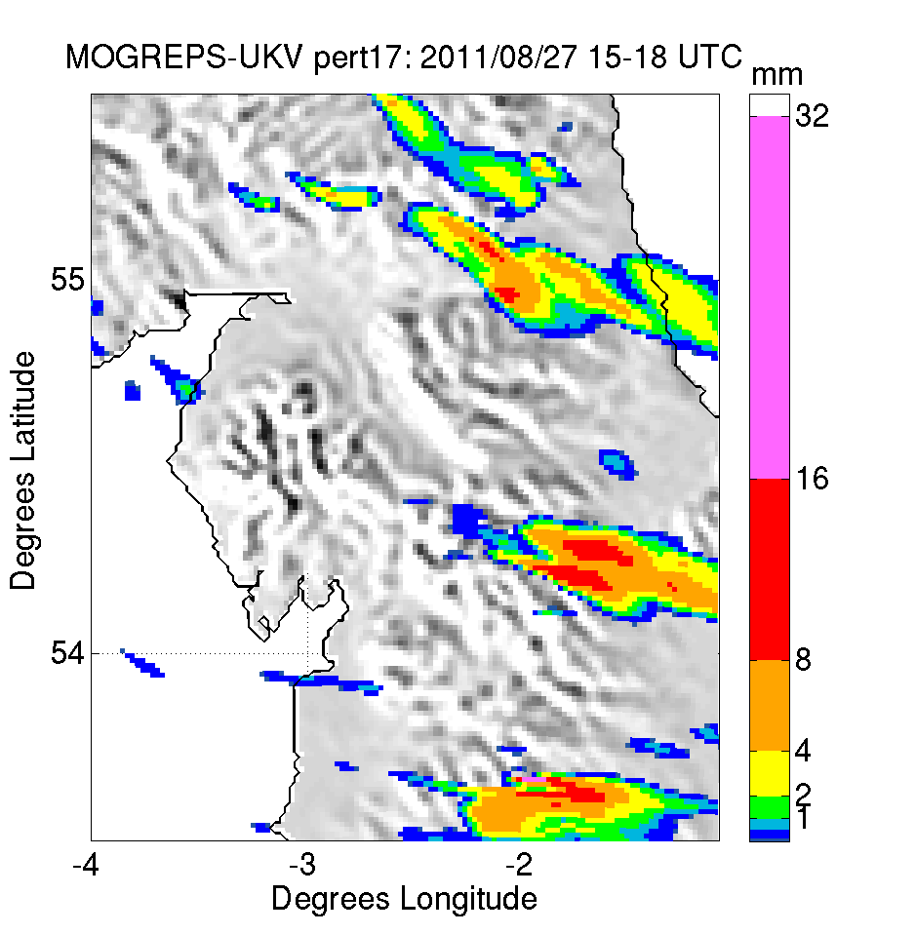
Best ensemble members
Banded convection in observed location
Some degree of stationarity

Slide 7
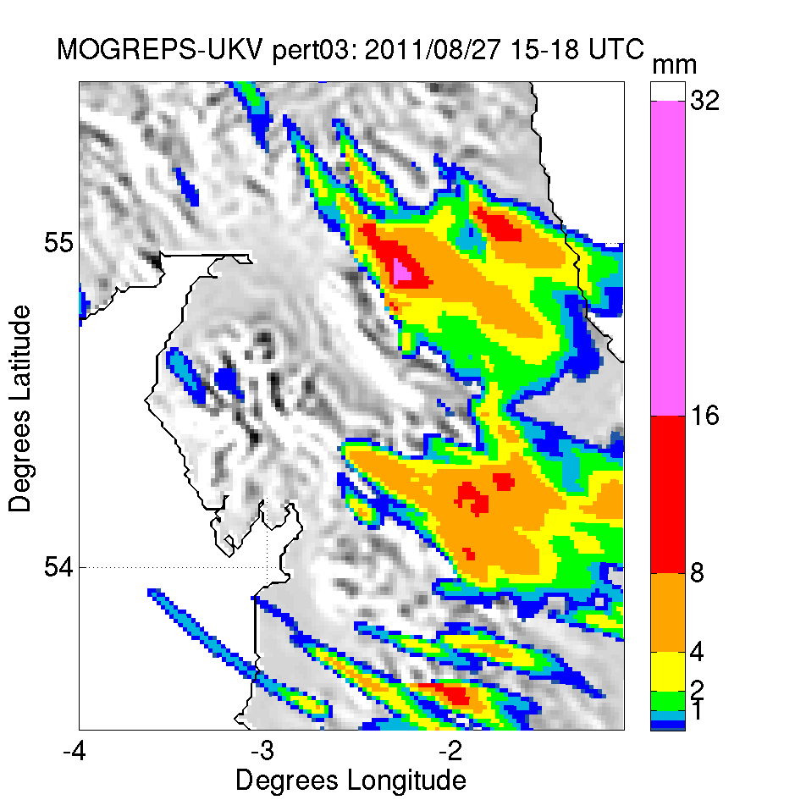
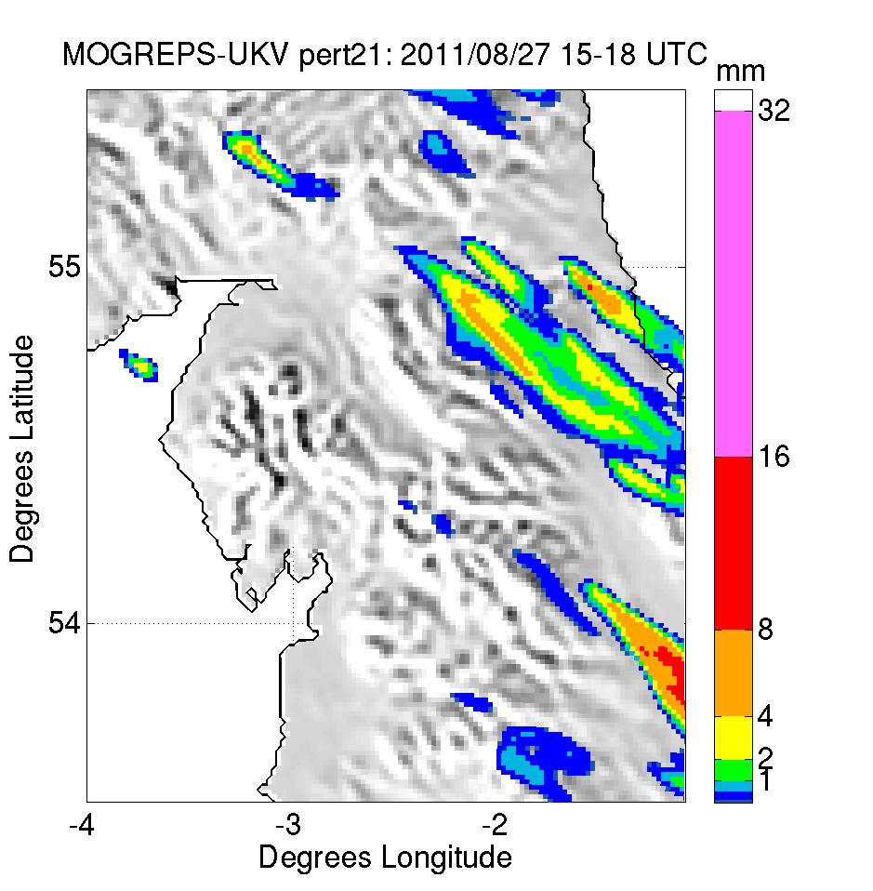
Worst ensemble members
Convective initiation in wrong location or not at all

Slide 8
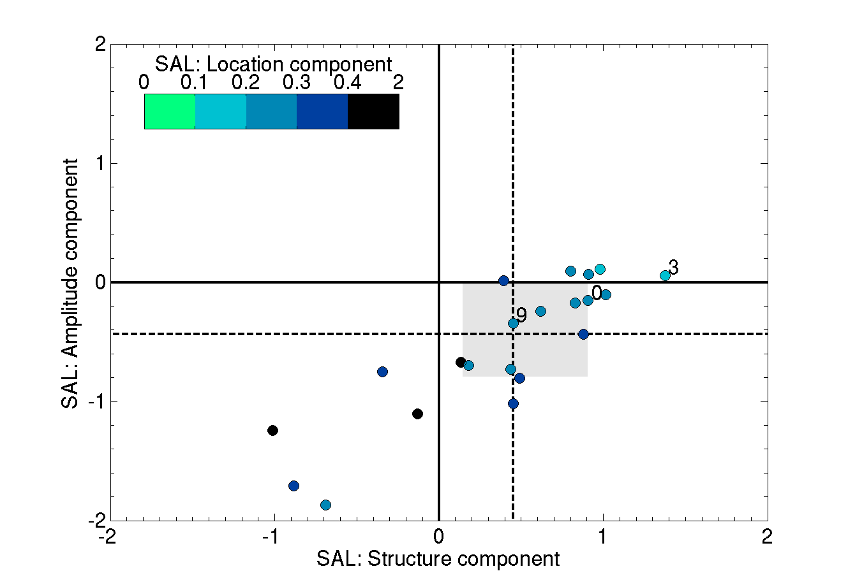
SAL verification: control ensemble
17
21

Slide 9
Ensemble sensitivity analysis
Define a measure of “skill”
Rain accumulation
Duration of continuous rain
Perform point-by-point linear regression
y = mx + c
De-emphasise points with low correlation coefficient
a = r²/0.1 (r²<0.1)
a = 1 (r²≥0.1)
Normalise by σ_{x}
Map of: m.a / σ_{x}

Slide 10
Synoptic role
Black contours: MSLP
Colours: change in band duration for 1 st.dev. increase in MSLP
Favourable conditions:
Deeper low pressure centre
Low centre further east
Lower pressure in Irish Sea

Slide 11
Local-scale role

Slide 12
Changed orography
Lake District
Increase terrain height by 30%
Flatten terrain
Yorkshire Dales
Remove terrain above 400m

Slide 13
Changed terrain: impact on rainfall
Raised terrain produces 17% more rain
Rain shifted 20km upstream & lasts 25 mins longer

Slide 14
Impact of increasing terrain

Slide 15
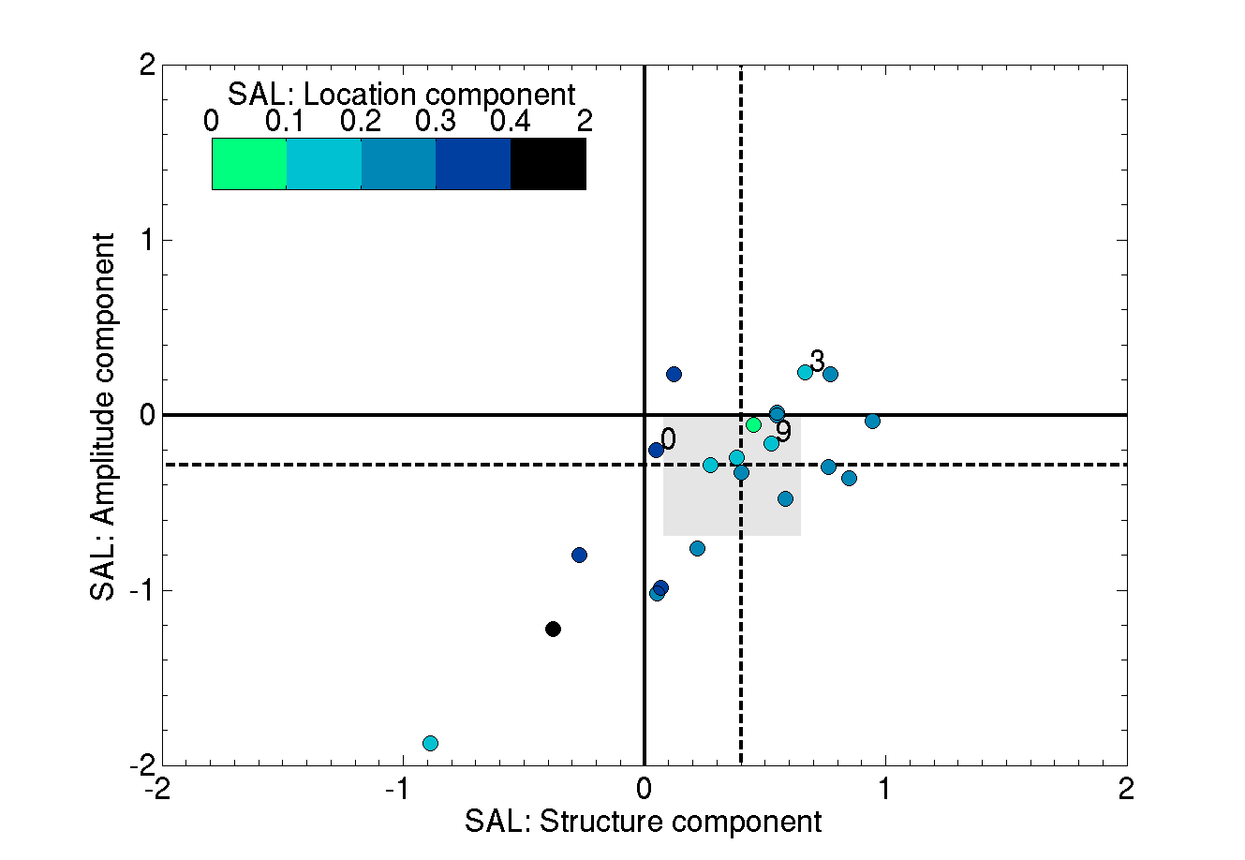
SAL verification: increased terrain
17
21

Slide 16
Predictability of orographic convection
Control ensemble
Rain typically too weak, too far downstream and non-stationary
Raised terrain ensemble
Improved rain amounts, location and increased duration
Still most ensemble members
Orography increases predictability
Can initiate convection (repeatedly) in favourable conditions
1.5km model orography increases predictability
BUT still large sensitivity to synoptic scale flow and uncertainty

Slide 17
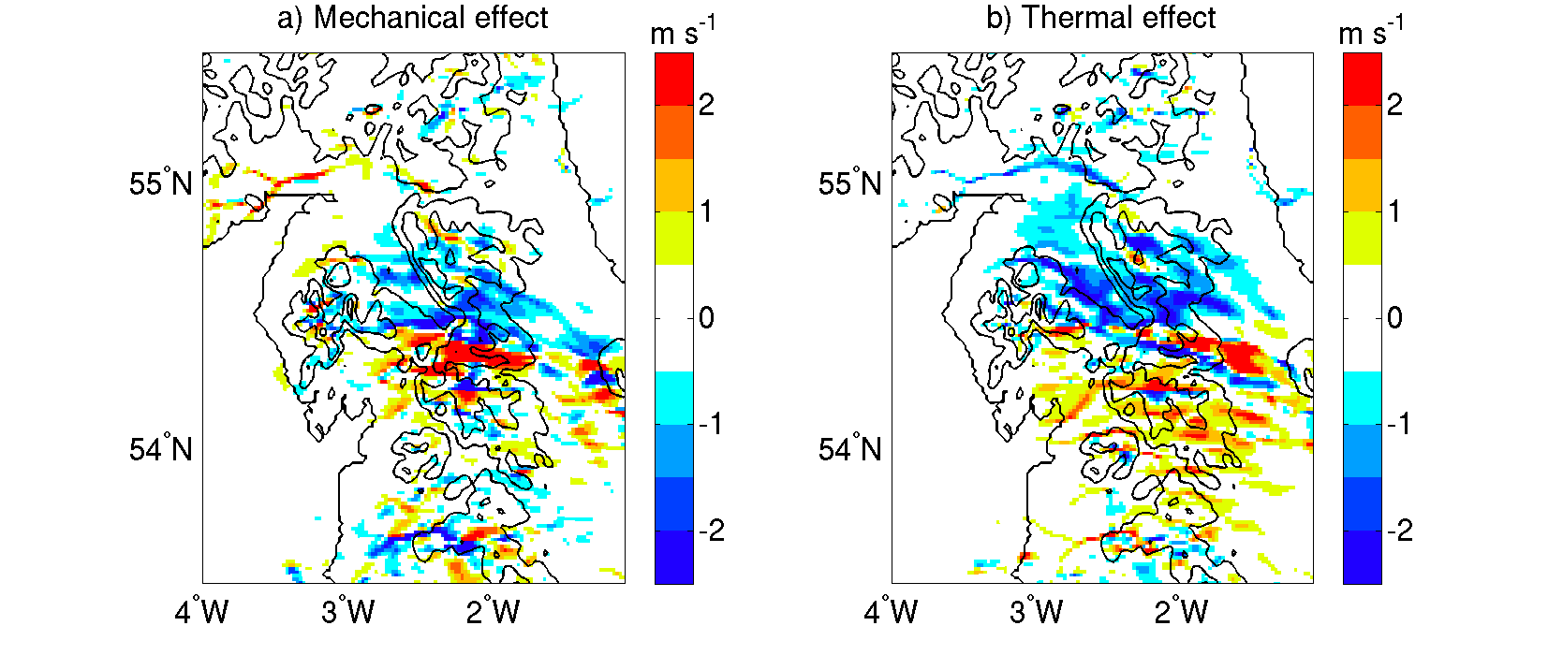
Mechanisms behind bandedness
Physical deflection creates “sharp” lee-side convergence
Elevated heating affects winds further away
Ensemble can reproduce the processes creating the band

Slide 18
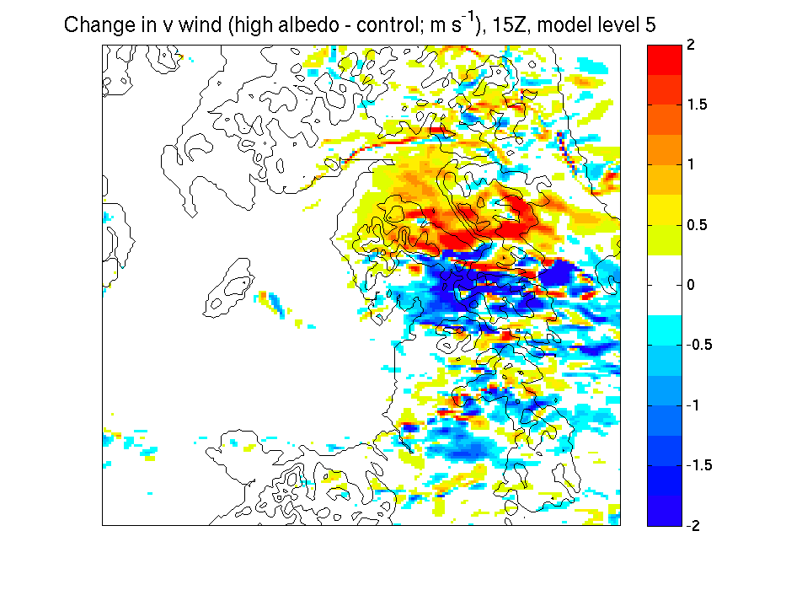
Role of elevated heating
Control
No elevated heating

Slide 19
Elevated heating in ensemble

Slide 20
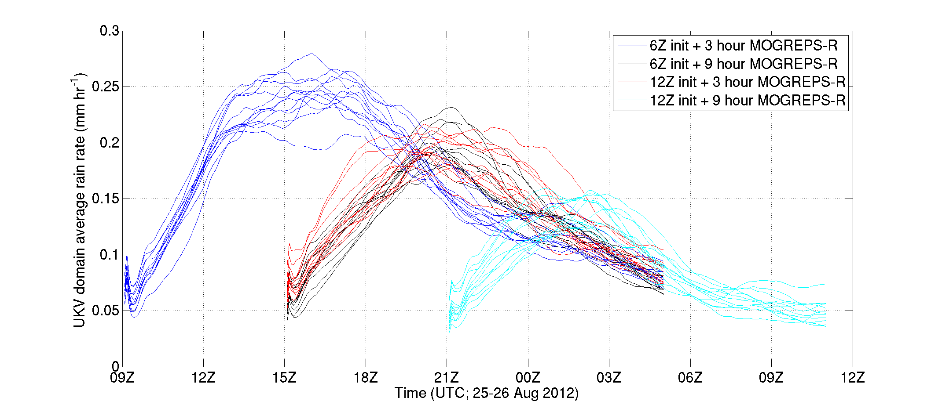
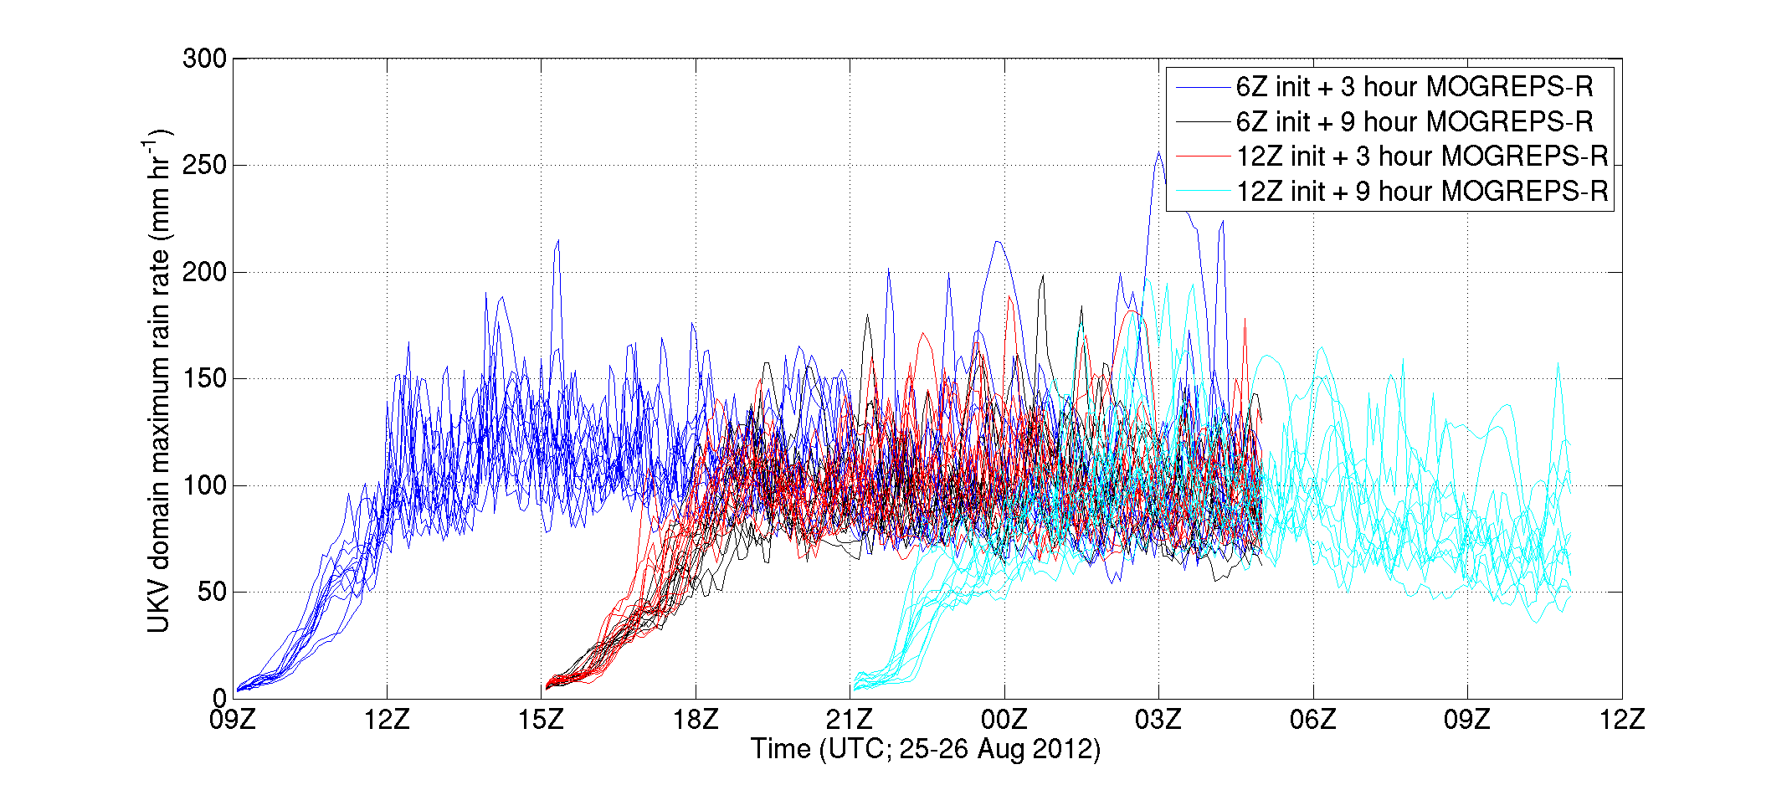
Spin up time

Slide 21
Summary
In phase convergence response to orography:
Physical deflection
Elevated heating
Synoptic scale flow
controlling strength and direction of upstream flow
Predictability
Despite predictable impact of terrain, band dependent on subtle details and overall predictability is low
Ensemble prediction
Greater skill with increased terrain height
Next: study multiple cases over UK
Different mechanisms in different cases?
Compare predictability in different regions and with other storm types

