Slide 1
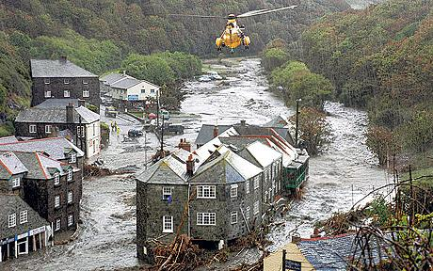
Quasi-stationary Convective Storms in the UK: A Case Study
Robert Warren
Supervised by Bob Plant, Humphrey Lean & Dan Kirshbaum
Notes:
This is the title slide, PowerPoint will automatically format the first slide with the title master, although this can be changed in the design palette.

Slide 2
Background
Quasi-stationary convective storms (QSCSs)
Repeated triggering and training of cells over a confined area for an extended period of time
Potential for significant rain accumulations and flash flooding
Numerous case studies from around the world
Key project questions:
How common are QSCSs in the UK and how does their occurrence vary seasonally, geographically and with synoptic conditions?
What are the typical mechanisms of stationarity in UK QSCSs?
How predictable are QSCSs using a high-resolution NWP model (MetUM, UKV).
Notes:
This is a basic slide based on the slide master. To create a slide just insert a new slide (Ctrl+M) and PowerPoint will automatically format the slide with the slide master. Text will automatically placed in bullets. The bullets have five different levels of nesting, to get the next level down you simply use the tab key.

Slide 3
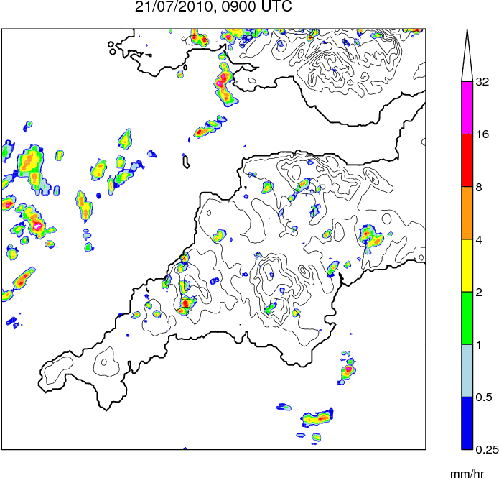
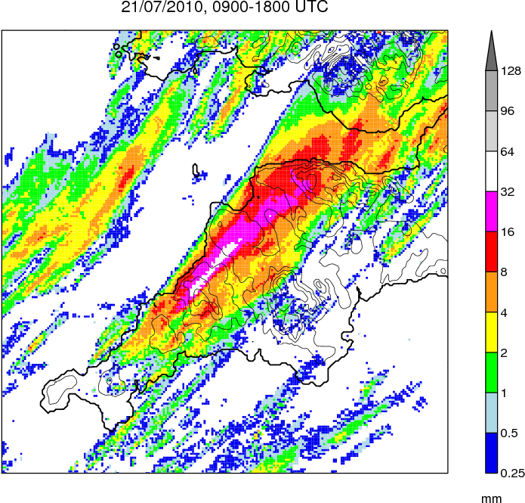
Case Study, 21/07/2010
Rain Rate
Rain Accumulation
Notes:
This is a basic slide based on the slide master. To create a slide just insert a new slide (Ctrl+M) and PowerPoint will automatically format the slide with the slide master. Text will automatically placed in bullets. The bullets have five different levels of nesting, to get the next level down you simply use the tab key.

Slide 4
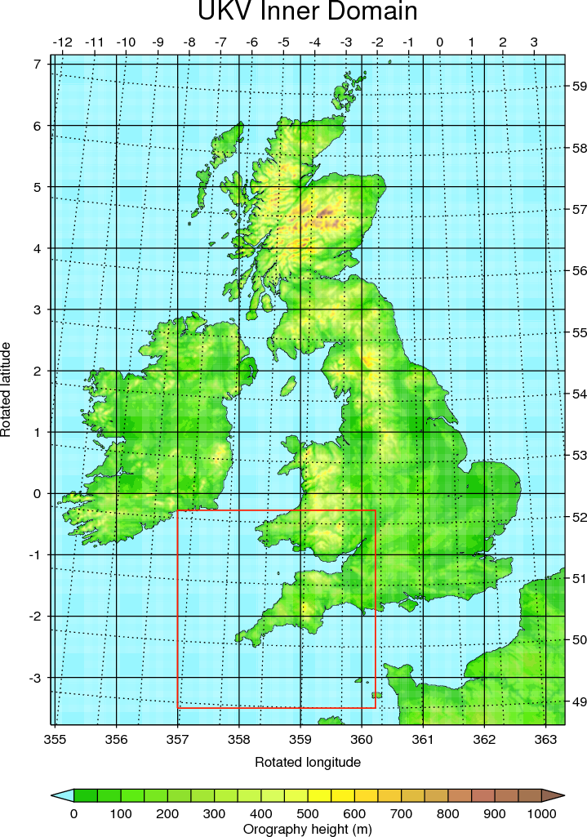
Simulation Strategy
MetUM - UKV model:
Resolution: 1.5-km inner domain, stretching to 4-km outer domain
Explicit convection
70 vertical levels
Initialised from operational 03 UTC UKV analysis; LBCs from operational NAE run
Smaller domain with same resolution nested within UKV to reduce expense
Notes:
This is a basic slide based on the slide master. To create a slide just insert a new slide (Ctrl+M) and PowerPoint will automatically format the slide with the slide master. Text will automatically placed in bullets. The bullets have five different levels of nesting, to get the next level down you simply use the tab key.

Slide 5
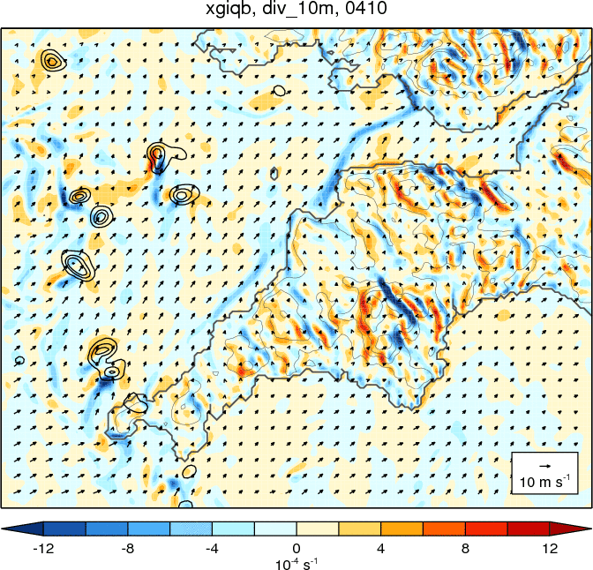
Control Simulation
Divergence at 10m (colours; 10⁻⁴ s⁻¹)
Rain rate (black contours; 1, 5, 10, 20, 40 m s⁻¹)
Wind at 10 m (vectors)
Orography (fine grey contours, 100 m interval)
Notes:
This is a basic slide based on the slide master. To create a slide just insert a new slide (Ctrl+M) and PowerPoint will automatically format the slide with the slide master. Text will automatically placed in bullets. The bullets have five different levels of nesting, to get the next level down you simply use the tab key.

Slide 6
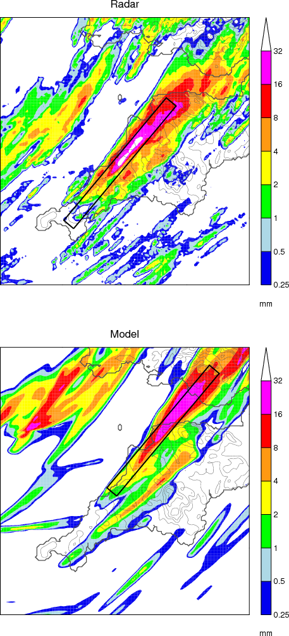
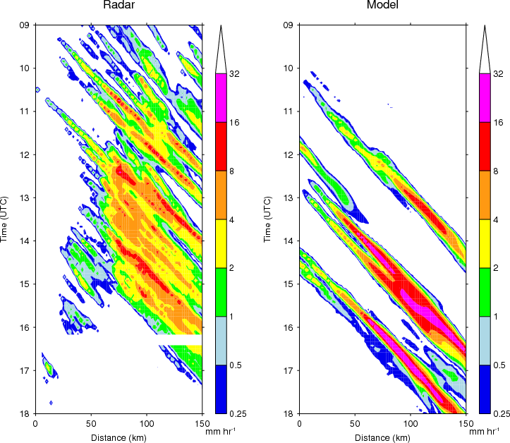
Verification – Hovmöller plots
Notes:
This is a basic slide based on the slide master. To create a slide just insert a new slide (Ctrl+M) and PowerPoint will automatically format the slide with the slide master. Text will automatically placed in bullets. The bullets have five different levels of nesting, to get the next level down you simply use the tab key.

Slide 7
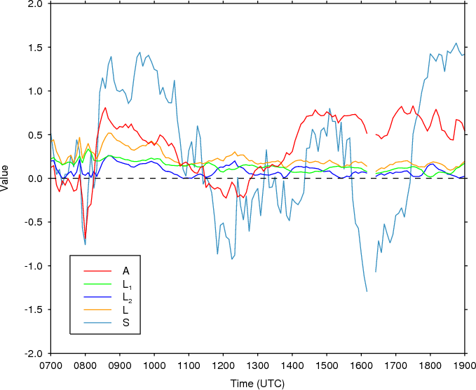
Verification – SAL
Compares two identically-gridded precipitation fields in terms of the relative structure (S), amplitude (A) and location (L) of objects within them (Wernli et al. 2008)
Objects defined as contiguous areas with $R≥1$mm hr⁻¹
Values for accumulated rainfall are $S=−0.097$ $A=−0.030$, $L=0.100$
Notes:
This is a basic slide based on the slide master. To create a slide just insert a new slide (Ctrl+M) and PowerPoint will automatically format the slide with the slide master. Text will automatically placed in bullets. The bullets have five different levels of nesting, to get the next level down you simply use the tab key.

Slide 8
Sensitivity Tests – Methodology
Name | Factor under investigation | Methodology
OROG | Orography | Land height over southwest peninsula set to zero
DZ0 | Differential surface roughness | Roughness length for momentum over land fixed to sea value
DT | Differential surface heating | Solar constant reduced to 400 W m⁻²
CP | Cold pools | Temperature changes associated with evaporation of rain and melting of snow removed
DRY | Convection | Specific humidity and cloud water content variables set to zero in initial conditions and LBC data
Notes:
This is a basic slide based on the slide master. To create a slide just insert a new slide (Ctrl+M) and PowerPoint will automatically format the slide with the slide master. Text will automatically placed in bullets. The bullets have five different levels of nesting, to get the next level down you simply use the tab key.

Slide 9
Sensitivity Tests – Results
Notes:
This is a basic slide based on the slide master. To create a slide just insert a new slide (Ctrl+M) and PowerPoint will automatically format the slide with the slide master. Text will automatically placed in bullets. The bullets have five different levels of nesting, to get the next level down you simply use the tab key.

Slide 10
Sensitivity Tests – Results
Notes:
This is a basic slide based on the slide master. To create a slide just insert a new slide (Ctrl+M) and PowerPoint will automatically format the slide with the slide master. Text will automatically placed in bullets. The bullets have five different levels of nesting, to get the next level down you simply use the tab key.

Slide 11
Simulations – Summary
Verification
Storms repeatedly form in roughly the same area as observed
Cells initiate ~2 hours late and 50 km too far north along coast
Inland propagation of storms after 15 UTC was captured
Cells are too intense during late afternoon
Sensitivity tests
Differential surface heating is primary control on convergence line and storm development – convergence line is a sea breeze front
Frictional backing of wind over land, orography, and storm cold pools all have only minor influence on storm evolution
DRY run needs to be repeated with no/fixed surface latent heat flux
Notes:
This is a basic slide based on the slide master. To create a slide just insert a new slide (Ctrl+M) and PowerPoint will automatically format the slide with the slide master. Text will automatically placed in bullets. The bullets have five different levels of nesting, to get the next level down you simply use the tab key.

Slide 12
Future Work
Case Study
Repeat DRY run with no/fixed surface latent heat flux
Other sensitivity test (e.g. increase forcing / instability / moisture)?
Simulate at higher (500-m) resolution
QSCS climatology
Automatic identification and classification of storms using archived NIMROD data
Idealised modelling
Investigate stationary sea breeze fronts using simple topography and a variety of wind, temperature and humidity profiles
Notes:
This is a basic slide based on the slide master. To create a slide just insert a new slide (Ctrl+M) and PowerPoint will automatically format the slide with the slide master. Text will automatically placed in bullets. The bullets have five different levels of nesting, to get the next level down you simply use the tab key.

