Slide 1
Wind and Wave Variability in Re-analysis Models and Satellite Measurements in the North Atlantic
Ray Bell - 4th year project
Supervisors: Dr. David Cromwell, Dr. Christine Gommenginger and Professor. Meric Srokosz

Slide 2
Wind and Wave Variability
Previous studies
Re-analysis models
Comparison of models with altimeter data
EOF analysis: Variability explained and correlated again climate indices
ENSO’s influence in the North Atlantic - teleconnections
Conclusions and Future work

Slide 3
Project outline
Understand and quantify the variability of the wind speeds, swh and wave period in the North Atlantic in the wave model datasets; ERA-40 and ERA-Interim and compare against the altimeter datasets.
Differences between 10 day and 35 day repeat cycle altimeter datasets.
Notes:
Longterm calibrated gridded satellite altimeter datasets developed here at the NOC

Slide 4
Applications and previous work
Applications
Safety at sea. Engineering projects.
Renewable energy studies (Mackay et al, 2010)
Future wind and wave climate changes due to global warming (Wang et al, 2004; Wang et al, 2009)
Previous studies
Most studies have focused on the North Atlantic Oscillation’s (NAO) influence on significant wave height (swh) in the north east . (Bacon and Carter, 1991; Woolf et al, 2002; Woolf et al, 2003; Dodet et al, 2010)
Few studies on wave period variability (Sykes, 2005)
Recent links with other atmospheric modes such as the EAP and ENSO.
Notes:
Wind speeds and ocean surface gravity waves play a major role in many engineering and environmental issues in the open ocean and in coastal zones.
This study can asses the potential for ocean based renewable energy
Which is where I come in...

Slide 5
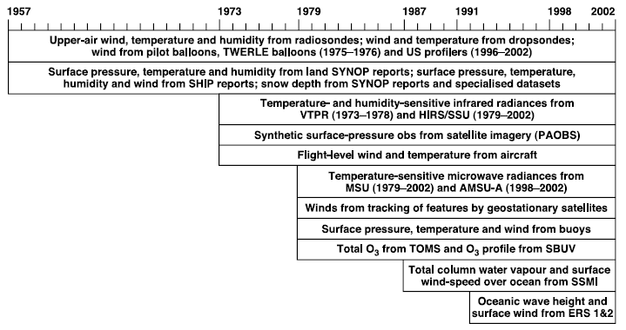
Re-analysis models
Data assimilation of past observations input into a model to create a homogenous spatial dataset. (Greenslade and Young, 2004; Greenslade and Young, 2005)
European Centre for Medium-range Weather Forecasting (ECMWF).
ERA-40 September 1992 – August 2002. 2.5° x 2.5°
ERA-Interim September 1992 – July 2009. 1.5° x 1.5°
Wave parameters from the Wave Assimilation Model (Komen et al, 1994)
(Uppala et al, 2005)
Notes:
Give u and v directional wind = wind speed
WAM – [output of the 2D wave energy spectrum of frequency and direction at each grid point by integrating the wave energy balance equation. From these spectra derived integrated wave parameters can be obtained] – swh, mwp
ERA-40 – 1957 – 2002. 2.5 x 2.5
ERA-Interim 1989 – 2009. – 1.5 x 1.5 higher spatial resolution. Better physics – Meteosat winds. Updated version of WAM, better formulation of ocean wave dissipation
ERS-1 in Dec 1991 – May 1993 -, problem with FDP. caused swh above 3m to be underestimated. Create time inhomogeneties
ERS-2 in June 1996, more accurated FDP
I compare how the re-analysis model maps the satellite data homogenously in time and space in comparison to the actual satellite data.

Slide 6
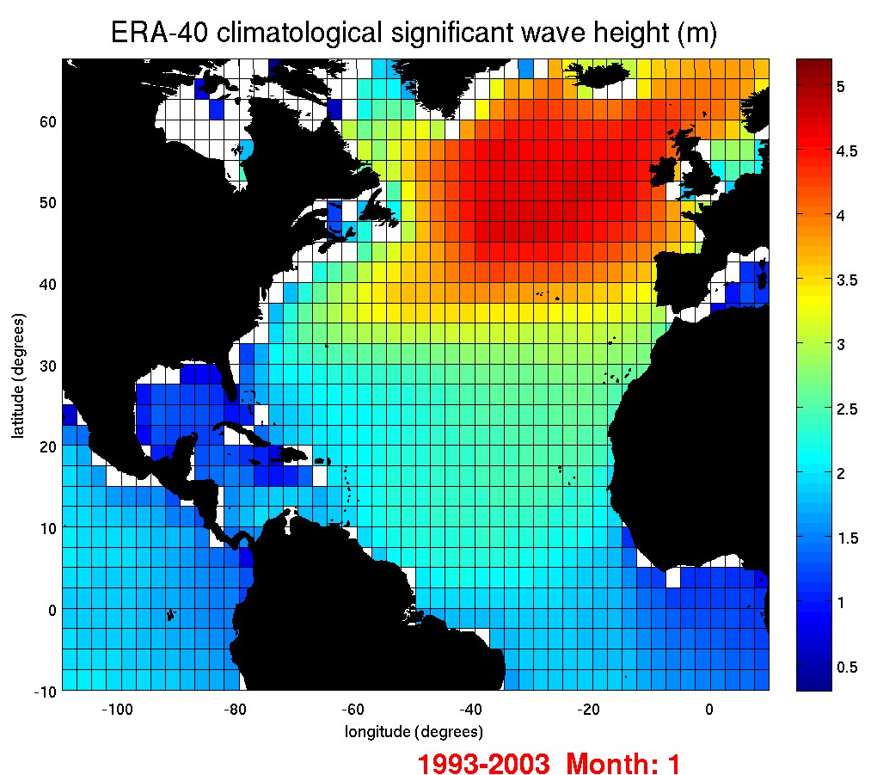
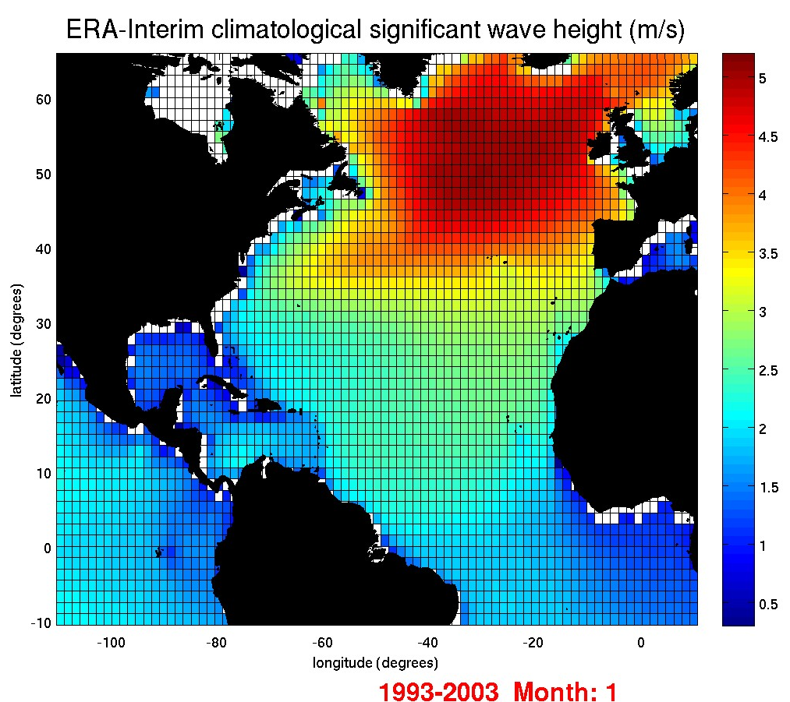
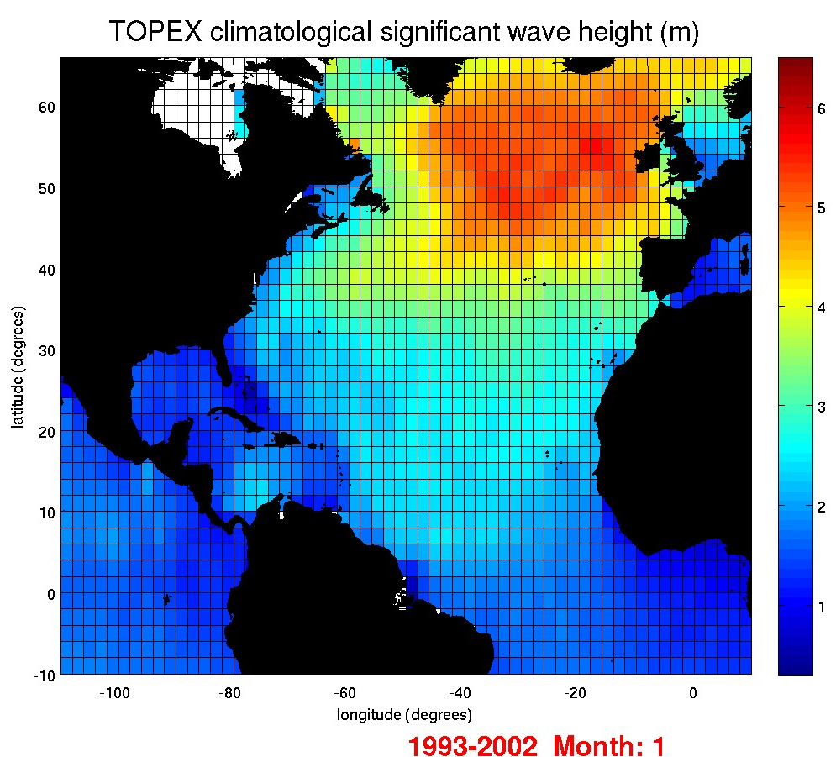
Underestimated ERA-Interim wind speeds are likely to be the cause of lower swh compared to the satellite data
Notes:
Long term calibrated gridded satellite altimeter datasets.
Change in colour scale of TOPEX data.
ERA-Interim is a step in the right direction
ERA-Interim gives larger wind speeds but still less than other altimeter data and other re-analysis produces
Limitations of altimeters – trackiness
Area down to 10S. To observe possible telconnections later on.
January gives the largest results but also the most variability, as the atmospheric modes show the most extreme changes in their such phase, such as NAO + and NAO -.
The zonal winds are strongest during the NAO + and also there is an increase in storminess.
Low around the equator due to the low wind speeds and dispersive nature of the waves.
[in the NW wind speed has more effect on swh than the fetch (Young, 1999).

Slide 7
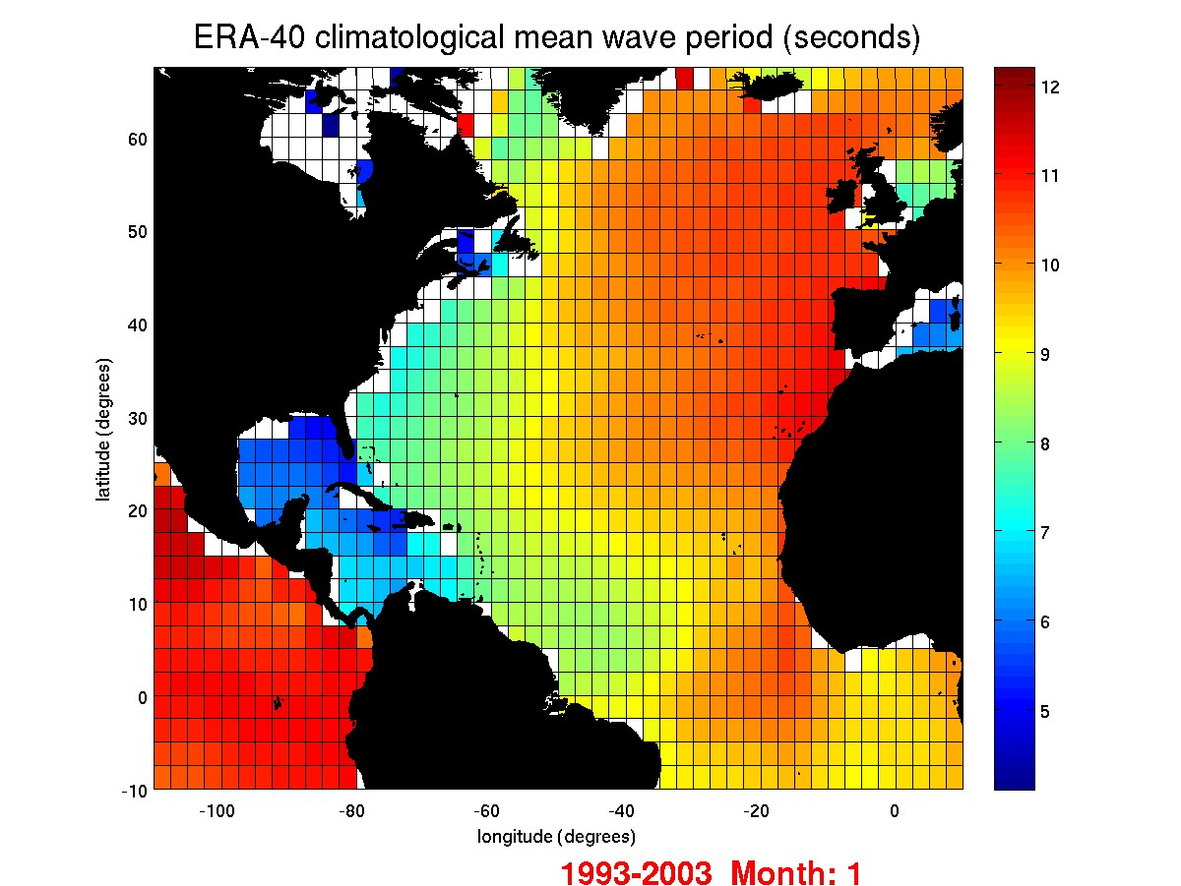
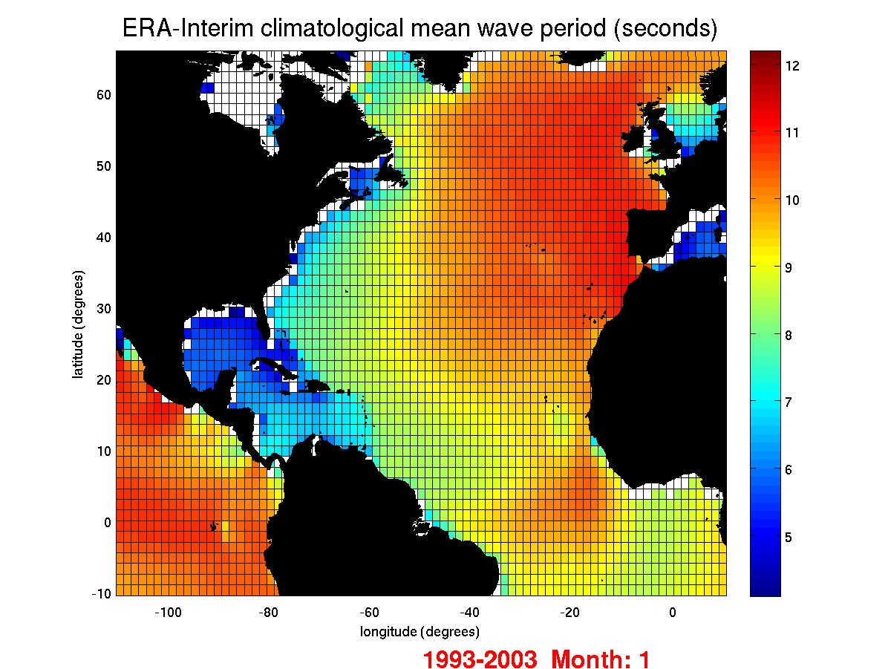
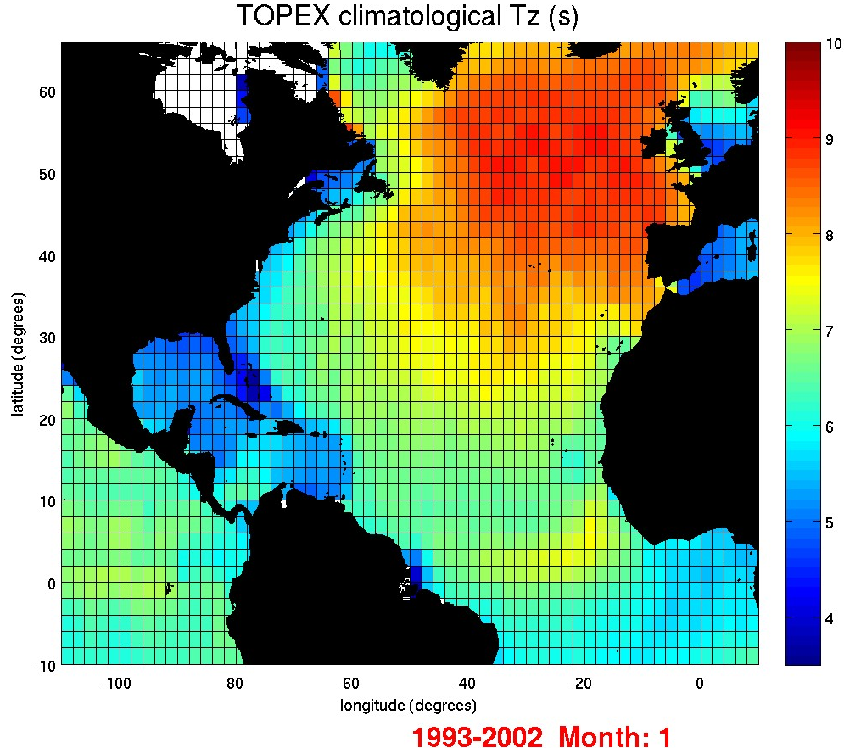
Notes:
TOPEX measures Tz > mpw = Te
ERA-Interim gives lower values off the coast e.g. east coast of America.
Maximum values in the east as the westerlies have had time to build and create longer swell waves up in January.
The Phase of the NAO effects the location of the wind speed and therefore fetch which affects mwp.

Slide 8
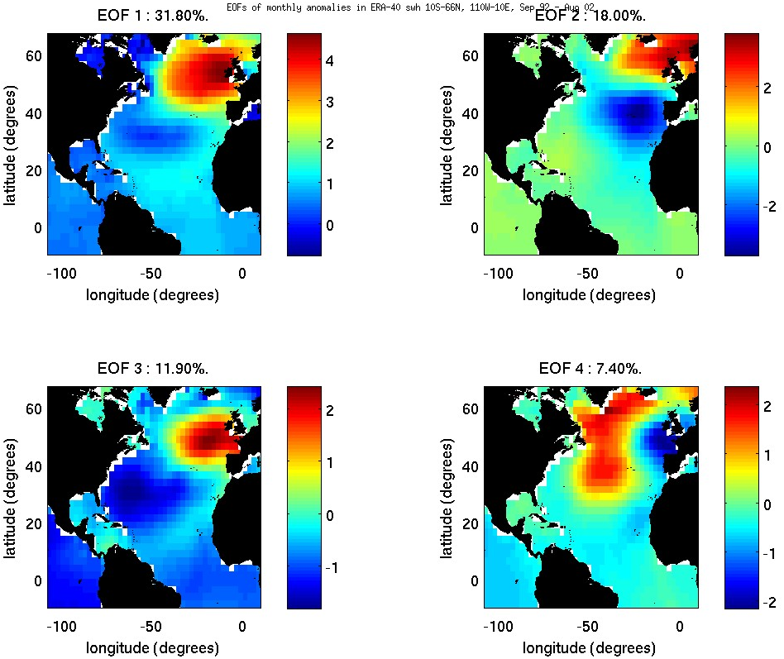
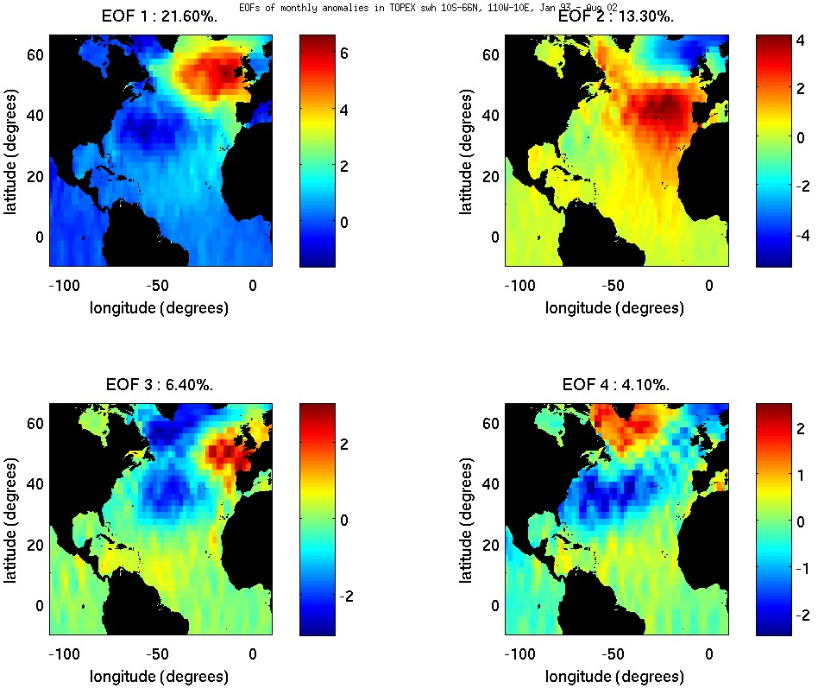
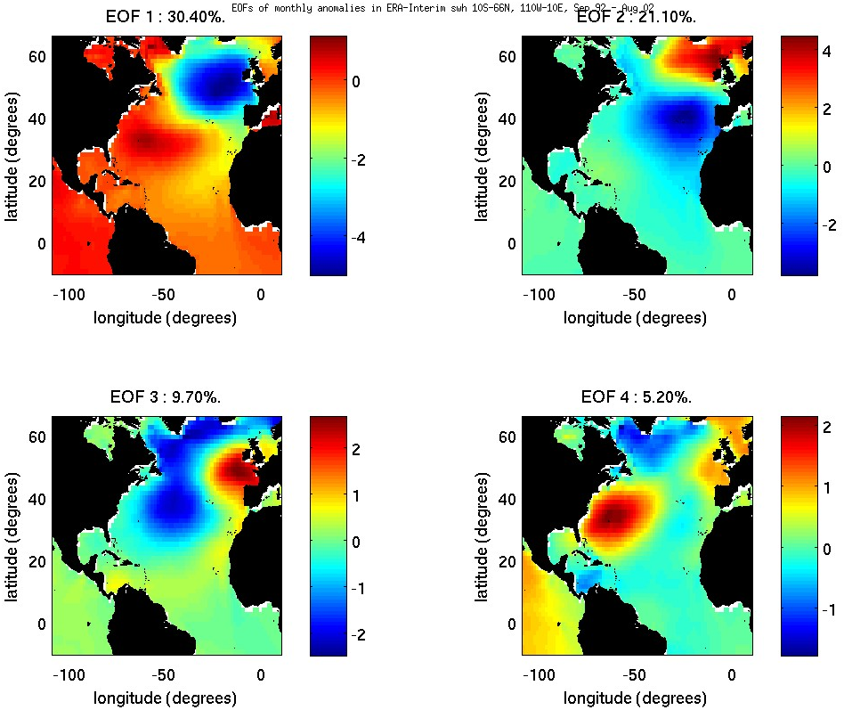
Empirical Orthogonal Functions
swh
ERA-40
TOPEX
ERA-Interim
Notes:
Provide a compact description of the spatial-temporal variability of the data series in terms of orthogonal functions.
The low order (first few) can be related to atmospheric patterns/oscillations calculated from monthly anomalies – calculated from the earlier climatologies.`
Be aware – mathematical construct so there is no guarantee that they represent a physical or dynamic mode in the climate system.
First 4 to compare and they should explain the main atmospheric forcing and a large percentage of the variance.
EOF 1 - the negative values are arbitrary – can be in PC
Difference in the spatial pattern of EOF 3 between the model data
TOPEX – trackiness

Slide 9
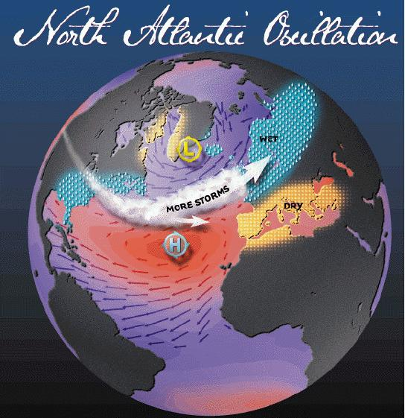
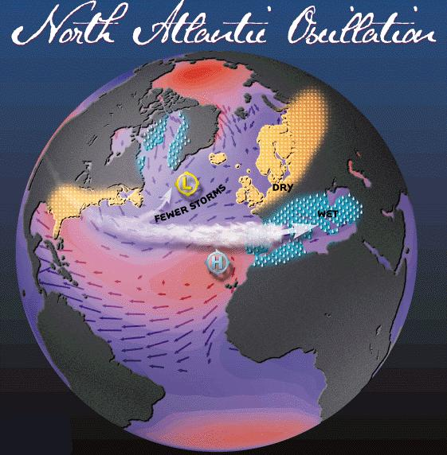
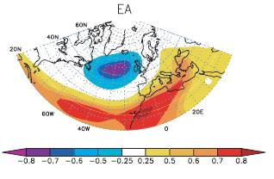
Climate indices
Correlation against the Principal Components from the EOFs.
NAO
Large changes in mean wind speed and direction over the Atlantic.
Influences intensity, number of storms, their paths, and their weather, which can all affect wave parameters (Hurrell and Deser, 2009).
EAP
Structurally similar to the NAO but more central Atlantic (Josey and Marsh, 2005)
Shows strong multi-decadal variability
MEI
Temporal correlation between the monthly standardized height anomalies at each point and the monthly EAP for December-February 1960-2000. Trigo et al (2008).
Indice uses sea level pressure, zonal and meridional surface wind, SST, surface air temperature and cloudiness (Wolter and Timlin, 1993)
+ phase
- phase
Notes:
NAO – redistributions of atmospheric mass between the Icelandic low pressure centre and the Azore high pressure centre.
+ phase gives stronger westerlies across the North Atlantic.
Both are variable in time and space.
EAP - consists of a north-south dipole of anomaly centers spanning the North Atlantic from east to west.
More central Atlantic
Indices downloaded from National Oceanographic and Atmospheric Administration Climate Prediction Centre
MEI - NOAA/OAR/ESRL/PSD

Slide 10
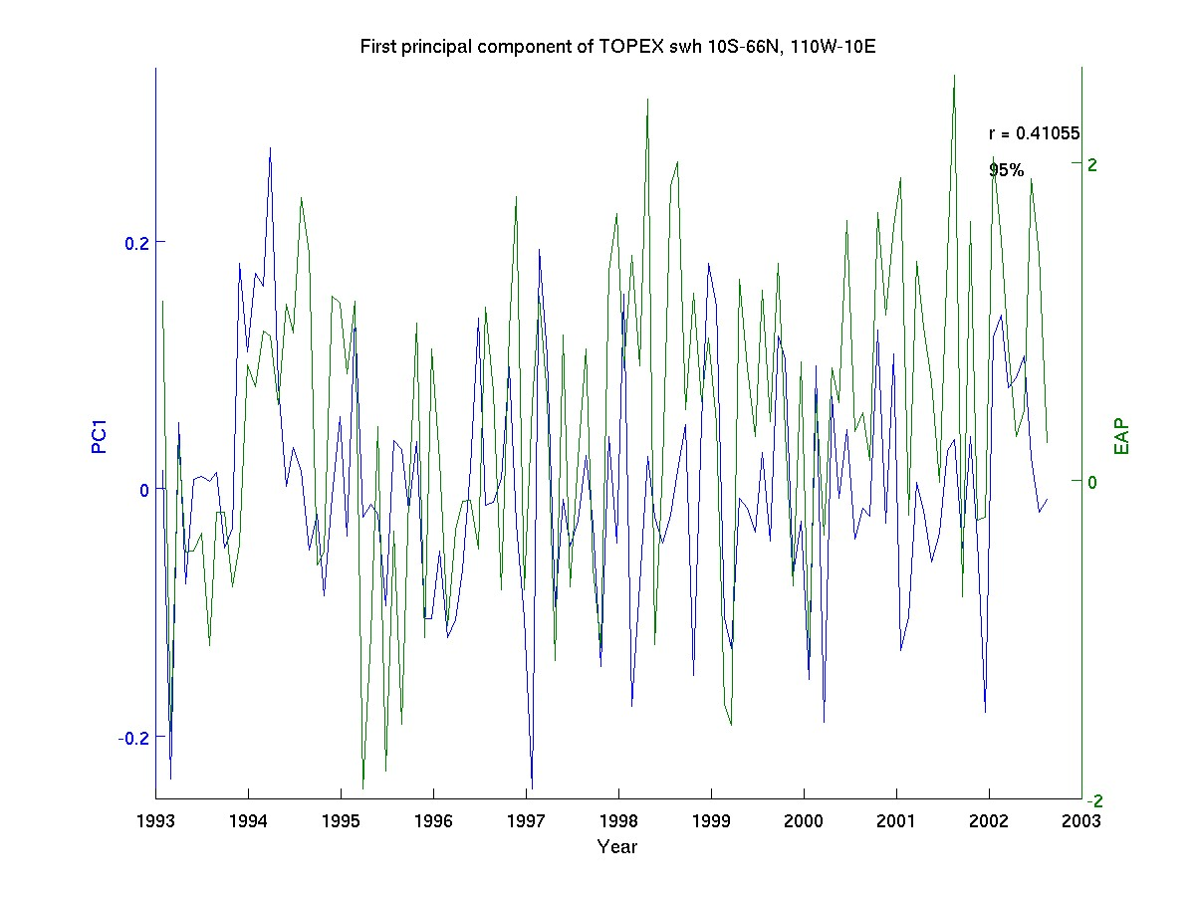
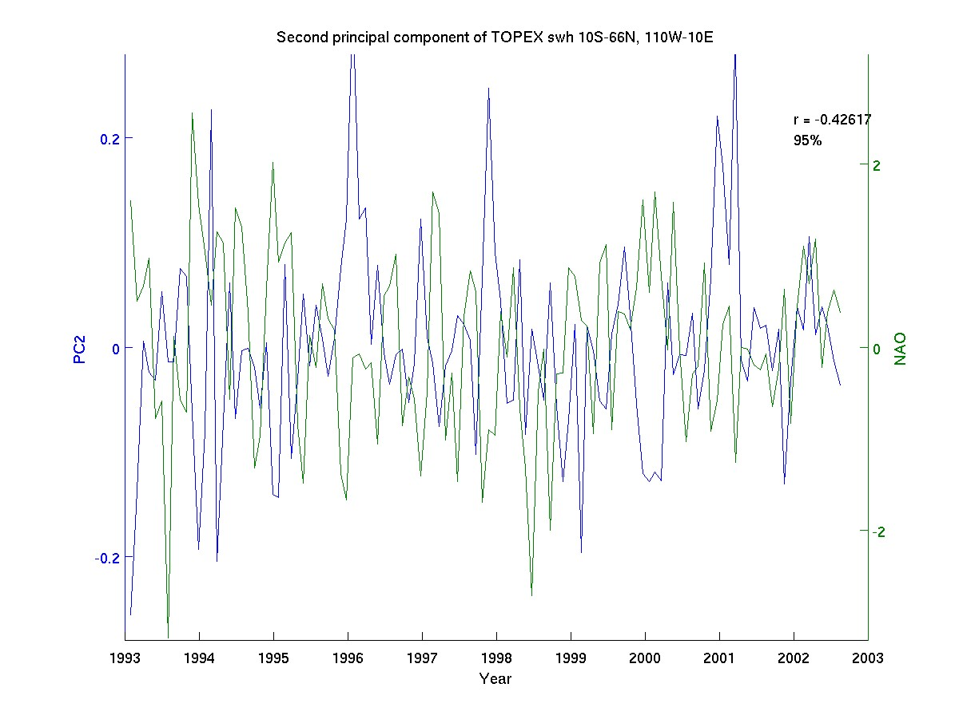
TOPEX swh Jan 93 – Aug 02
Notes:
Just showing the strongest correlations PC1 vs. EAP. PC2 vs. NAO.
95% confidence level – null hypothesis assumes that there is no correlation between each pair of time series. The effective degrees of freedom is calculated for each pair of time series (maximum 360), where the coherence and autocorrelation (on itself) of the data is taken into account when estimating the degrees of freedom
All results were statistically significant at the 95% value.

Slide 11
swh
ERA-40 | NAO | EAP
PC1 | 0.37 | 0.41
PC2 | 0.41 | -0.2
Sep 92 – Aug 02
ERA-Interim | NAO | EAP
PC1 | -0.38 | -0.5
PC2 | 0.55 | -0.11
TOPEX | NAO | EAP
PC1 | 0.35 | 0.41
PC2 | -0.42 | 0.14
Jan 93 – Aug 02
Dominant mode of variability slightly more related to the EAP
Secondary mode of variability more related to the NAO
Correlation of the NAO and EAP = 0.1

Slide 12
swh - longer time span
September 1992 – July 2009
ERA-Interim | NAO | EAP
PC1 | -0.25 | -0.5
PC2 | 0.55 | -0.11
(May 1995 – December 2002) + (January 2003 – December 2008)
TOPEX + Jason-1 | NAO | EAP
PC1 | 0.08 | -0.48
PC2 | -0.58 | 0.08
ERS-2 + Envisat | NAO | EAP
PC1 | 0.001 | -0.48
PC2 | -0.63 | 0.02
Decrease of NAO’s influence in the longer time period and an increase in the EAP’s influence in the dominant mode of variability (Sykes, 2005)
Notes:
tx-j1 repeat cycle of 10 days less spatial resolution.
e2-n1 repeat cycle of 35 days 3 x’s spatial resolution.
Sykes (2005) who studied up to 2004 Found EAP to increase towards the end of his time series of the winter months.

Slide 13
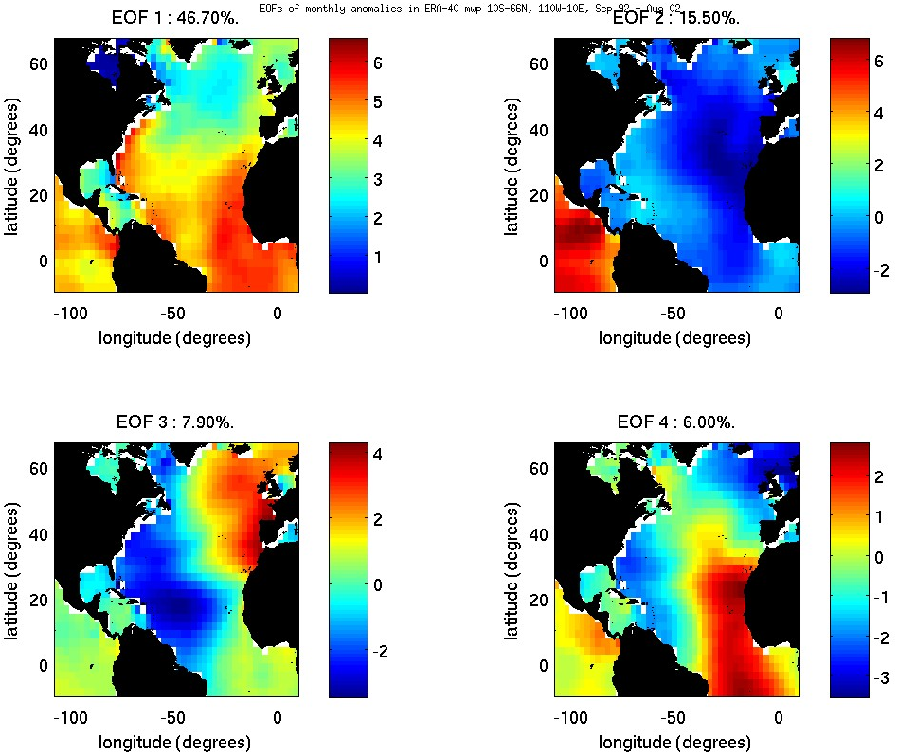
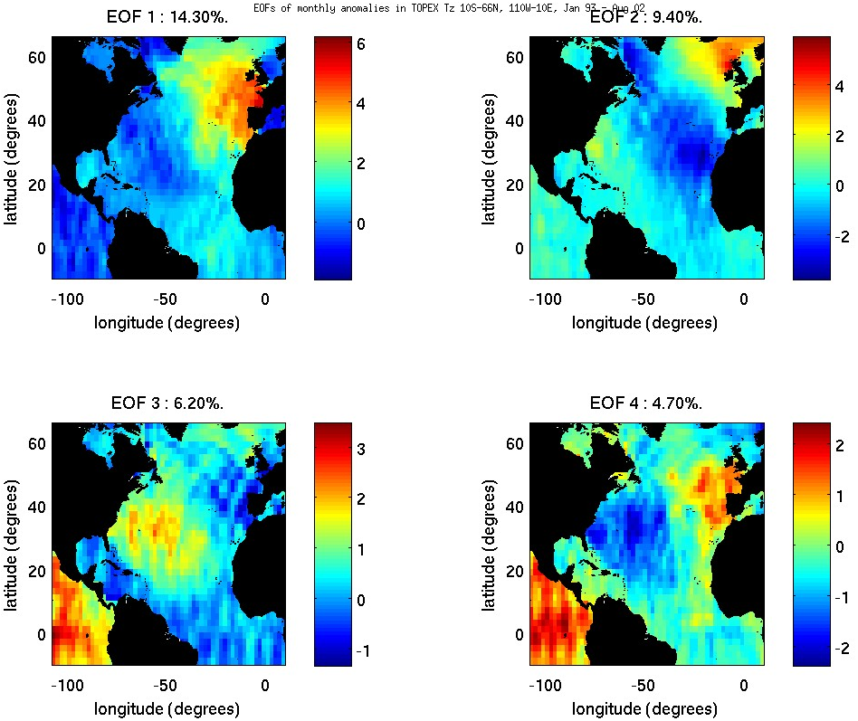
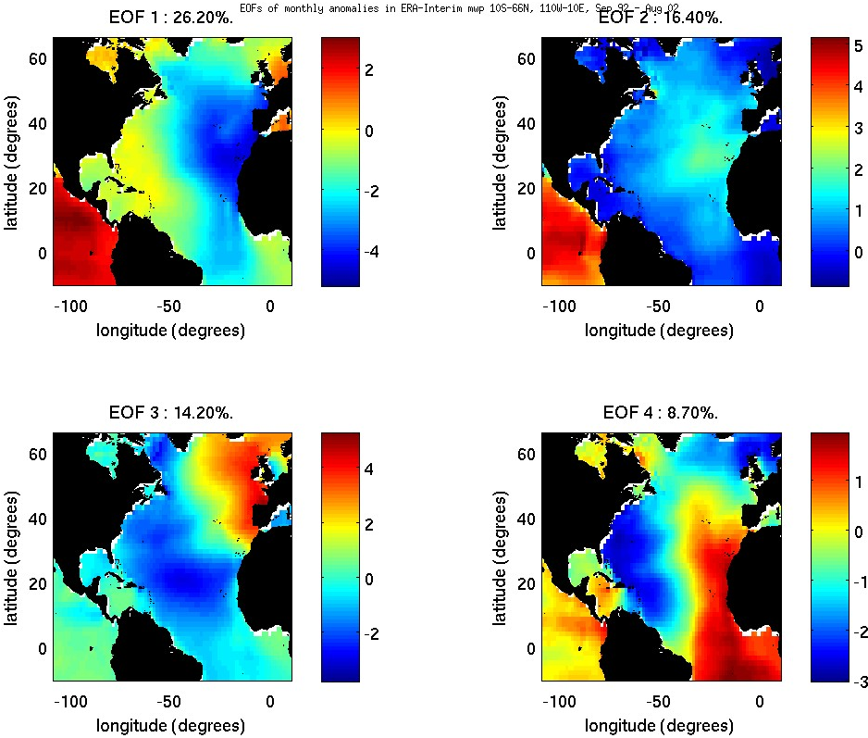
Wave period
TOPEX
ERA-40
ERA-Interim
Notes:
First two modes from the model data show no likely pattern to any atmospheric forcing.
Only EOF 3 which shows something that looks familiar to the NAO
TOPEX’s first 2 modes are similar to swh.

Slide 14
Wave period
ERA-40 | NAO | EAP
PC1 | -0.02 | 0.1
PC2 | -0.02 | -0.08
PC3 | 0.47 | 0.37
ERA-Interim-long | NAO | EAP
PC1 | -0.15 | -0.3
PC2 | 0.2 | -0.32
PC3 | 0.56 | 0.32
ERA-Interim | NAO | EAP
PC1 | -0.02 | -0.25
PC2 | -0.16 | 0.22
PC3 | 0.59 | 0.36
TOPEX + Jason-1 | NAO | EAP
PC1 | -0.07 | 0.47
PC2 | 0.58 | 0.14
PC3 | 0.13 | 0.01
TOPEX | NAO | EAP
PC1 | 0.26 | 0.41
PC2 | 0.52 | 0.01
PC3 | -0.12 | 0.05
ERS-2 + Envisat | NAO | EAP
PC1 | -0.1 | 0.18
PC2 | -0.04 | 0.41
PC3 | 0.6 | 0.12
Notes:
Wouldn’t really trust the model mwp.
More accurate wave period datasets gives correlations with climate indices similar to swh
1st mode of variability linked to the EAP
2nd mode of variability linked to the NAO
EAP has more of an influence and the NAO has less on the dominant mode of variability in the recent time series

Slide 15
Wind speed teleconnections
Lagged MEI anomalies against wind speed anomalies
ERA-Interim September 1992 – July 2009 Wind speed correlations
+ Correlation in west tropical North Atlantic which spreads eastwards with a lag of 4-8 months (Shaw, 2008; lee et al, 2008)
Small positively correlated area in the central North Atlantic which moves north eastwards from 18-25 months (Taylor, 1998)
Notes:
Hyperlink the ‘wind speed teleconenctions’ with model wind speeds.
I lagged up to 3 ½ years as a general periodicy of ENSO.
95%

Slide 16
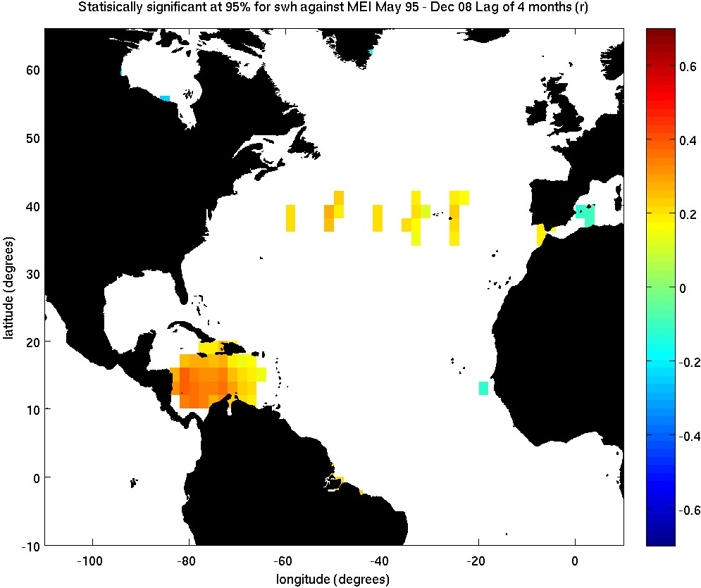
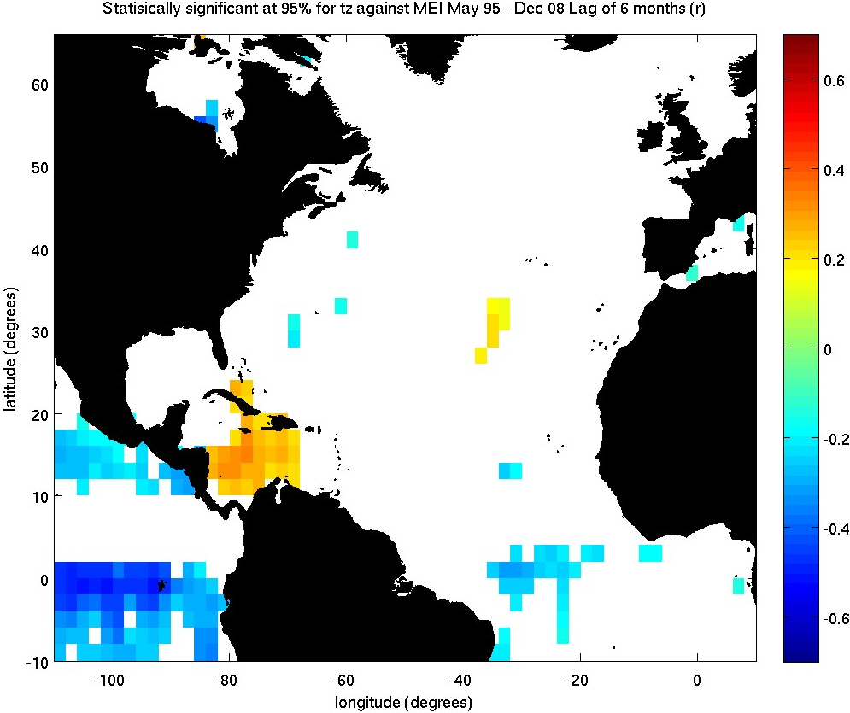
Teleconnections observed in wave parameters
swh - lag of 4 months
T_{z} - lag of 6 months
ERS-2 + Envisat
TOPEX + Jason-1
Significant at the 95% confidence interval
Notes:
Used satellite data to complement the spatial homogenous model data with more accurate data.

Slide 17
Conclusions
ERA-Interim is a step in the right direction for wind speed and swh. Time inhomogeneities have been reduced
The ERA-40 and ERA-Interim wave period are very different from satellite altimeter data. Not consistent with the results of Caires et al (2005). Further analysis required.
Calming of the wave climate in the longer datasets, possibly as the early 1990s had the largest global swh values from ERA-40 (Sterl and Caires, 2005).
Altimeters provide stronger correlations with the atmospheric modes.
The influence of the EAP on wind and wave climate is greater that the NAO when considering longer time series (Seierstad et al, 2007; Lionello and Galati et al, 2008)
Notes:
The time inhomogeneities have been reduced in ERA-Interim, especially in the earlier 1990s.
I found the differences are large in the EOFs of mwp. Further analysis is needed.
ERA-Interim extends up to the end of 2000s now
Model and satellites as each have there respective limitations.

Slide 18
Future work
Assess the wave climate from the 2000s in comparison to the 1990s.
Optimal Interpolation to reduce altimeter trackiness.
This study shows the need for a concurrent use of wave models and satellite measurements.

Slide 19
Any questions ???
References
Bacon, S. and Carter, D. J. T. (1991) Wave climate changes in the North Atlantic and North Sea, International Journal of Climatology, 11, pp. 545 – 558.
Caires, S., Sterl, A. and Gommemginger, C.P. (2005) Global ocean mean wave period data: validation and description, Journal of Geophysical Research., 110, C02003
Dodet, G., Bertin, X. and Taborda, R. (2010) Wave climate variability in the North-East Atlantic Ocean over the last six decades. Ocean Modelling. 31. pp. 120-131.
Greenslade, D.J.M. and Young, I.R. (2004) Background errors in a global wave model determined from altimeter data. Journal of Geophysical Research. 109,C09007.
Greenslade, D.J.M. and Young, I.R. (2005) The Impact of Altimeter Sampling Patterns on Estimates of Background Errors in a Global Wave Model. Journal of Atmospheric and Oceanic Technology. 22. pp. 1895-1917.
Hurrell, J. W., and Deser, C. (2009) North Atlantic climate variability: The role of the North Atlantic Oscillation. Journal of Marine Systems, 78(1), pp. 28-41
Josey, S.A. and Marsh, R. (2005) Surface freshwater flux variability and recent freshening of the North Atlantic in the eastern subpolar gyre, Journal of Geophysical Research, 110, C05008
Komen G.J., Cavaleri, L., Donelan, M., Hasselmann, K., Hasselmann, S., Janssen, P.A.E.M. (1994) Dynamics and Modelling of Ocean Waves, p.532
Lee, S.-K., Enfield, D. B., Wang, C. (2008) Why do some El Niño’s have no impact on tropical North Atlantic SST? Geophysical Research Letters., 35, L16705.
Lionello, P. and Galati, M.B. (2008) Links of the significant wave height distribution in the Mediterranean sea with the North Hemisphere teleconnections patterns. Advances in Geosciences. 17. pp. 13-18.
Mackay, E.B.L., Bahaj, A.S. and Challenor, P.G. (2010) Uncertainty in wave energy resource assessment. Part 2: Variability and predictability. Renewable energy, 35(8). pp. 1809-1819.

Slide 20
References Continued
Seierstad, I.A., Stephenson, D.B. and Kvamstø, N.G. (2007) How useful are teleconnection patterns for explaining variability in extratropical storminess, Tellus, 59A, pp. 170-181.
Shaw, B. (2008) ENSO teleconnections and the North Atlantic Ocean. An exercise in correlation. MPO 672 – ENSO Dynamics, Prediction and Predictability. p. 7.
Sterl, A. and Caires, S. (2005) Climatology, variability and extreme of ocean waves: The web based KNMI/ERA-40 wave atlas. International Journal of Climatology. 25(7). pp. 963-977. Full edition Available online [http://www.knmi.nl/onderzk/oceano/waves/era40/license.cgi] accessed 16th February 2010.
Sykes, N. (2005). Changes in wind and wave climate observed from space. MSc project. University of Southampton. p. 58.
Taylor, A.H., Jordan, M.B. and Strephens, J.A. (1998) Gulf stream shifts following ENSO events. Nature. 393.
Trigo, R.M., Valente, M.A., Trigo, I.F., Miranda, P.M.A., Ramos, A.M., Paredes, D., Garcia-Herrera, R. (2008) The Impact of North Atlantic Wind and Cyclone Trends on European Precipitation and Significant Wave Height in the Atlantic, Annals of the New York Academy of Sciences. Vol. 1146, suppl. 1, pp. 212-234.
Uppala, S.M., et al (2005) The ERA-40 re-analysis. Quarterly Journal of Royal Meteorological Society, 131, pp. 2961-3012.
Wolter, K., and Timlin, M.S. (1993) Monitoring ENSO in COADS with a seasonally adjusted principal component index. Proc. of the 17th Climate Diagnostics Workshop, Norman, OK, NOAA/NMC/CAC, NSSL, Oklahoma Clim. Survey, CIMMS and the School of Meteor., Univ. of Oklahoma, pp. 52-57.
Woolf, D.K., Challenor, P.G., and Cotton, P.D. (2002) Variability and predictability of the North Atlantic wave climate. Journal of Geophysical Research. 107(C10)
Woolf, D.K., Cotton, P.D., and Challenor, P.G., (2003) Measurements of the off shore wave climate around the British Isles by satellite altimeter. Philosophical Transactions of the Royal. Society. London. A., 361, pp. 27-31
Wang, X. L., Zwiers, F.W. and Swail, V.R., (2004). North Atlantic Ocean wave climate change scenarios for the twenty-first century, Journal of Climate, 17, pp. 2368–2383.
Wang, X.L., Swail, V.R., Zwiers, F.W., Zhang, X. and Feng, Y. (2009) Detection of external influence on trends of atmospheric storminess and northern ocean waves heights. Climate Dynamics. 32. pp. 189-203.

Slide 21
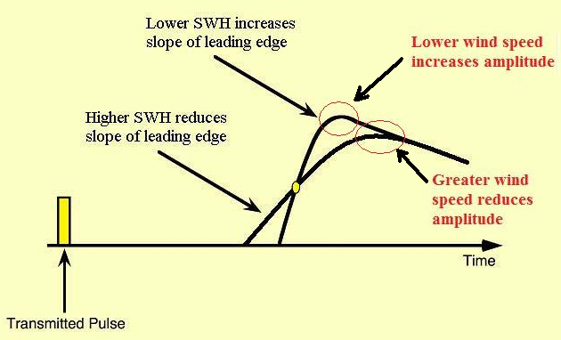
Satellite radar altimeters
Nadir directed pulse of known power, microwave emission and measure backscattered power coefficient (Fu and Cazenave, 2001)
swh – The time delay of the signal.
4 x square root of the sea surface elevation
Wave period – Indirectly, Algorithm based on swh and backscatter power coefficient. (Mackay et al, 2008)
Sykes (2005)

Slide 22
Wave assimilation model
output of the 2D wave energy spectrum of frequency and direction at each grid point by integrating the wave energy balance equation. From these spectra derived integrated wave parameters can be obtained.
Free online data provides: swh, mwp, mwd.
(Paid) ERA-40 provides these every 6 hours of the dataset. used 25 frequencies and 12 directions
ERA-Interim offers a forecast component. uses 30 frequencies and 24 directions

Slide 23
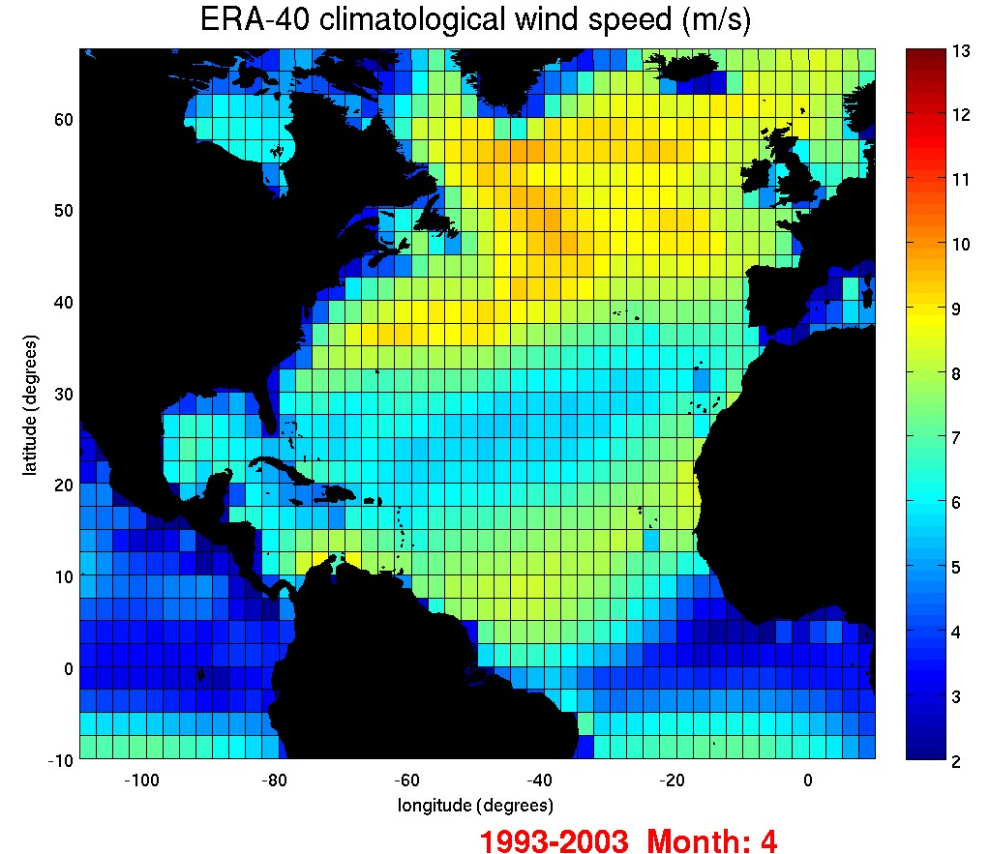
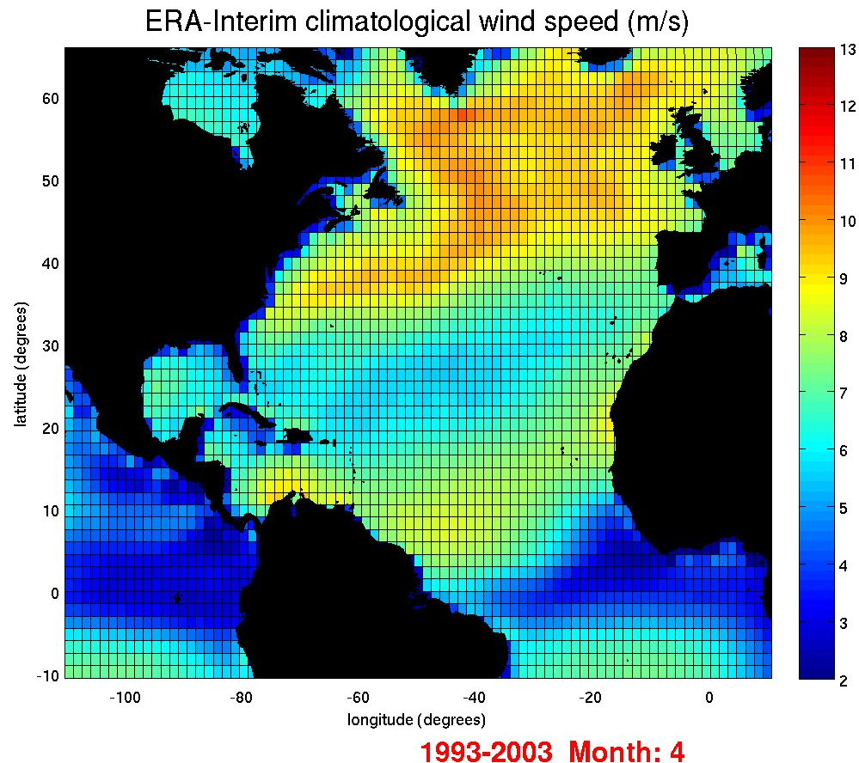
Wind speed - April
ERA-Interim gives an increase in maximum wind speed but still lower in comparison to previous altimeter data and other re-analysis models (Sterl et al, 1998; Young, 1999; Wolf and Woolf, 2006)
Notes:
ERA-Interim increased resolution may be be able to resolve more storms

Slide 24
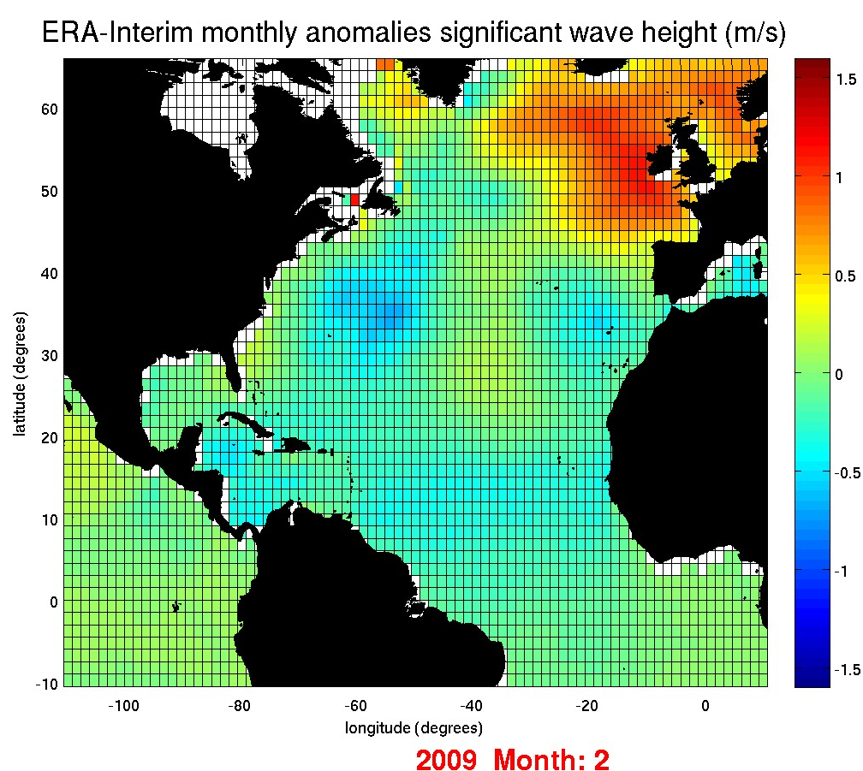
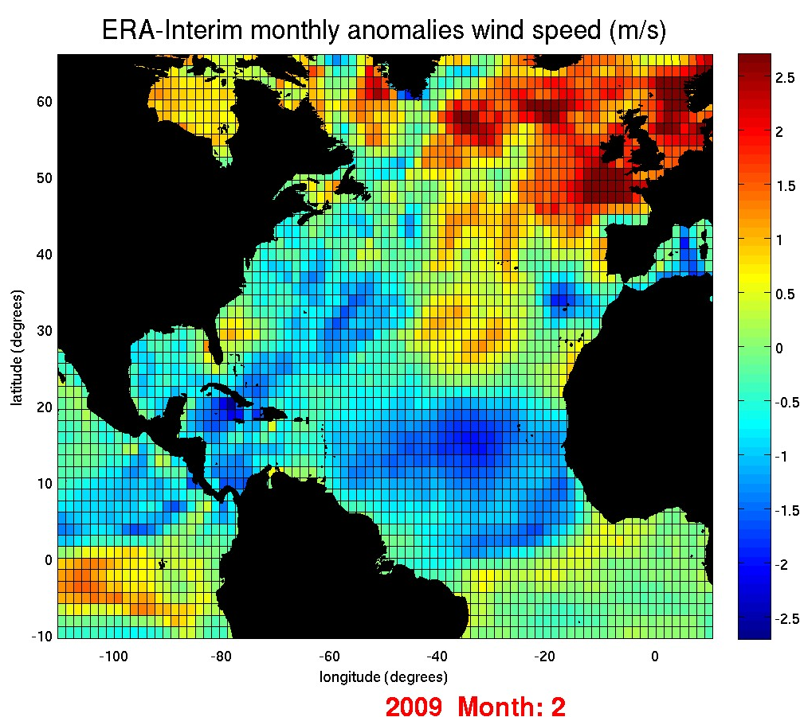
swh climatology
ERA-Interim September 1992 – July 2009
swh forced by local wind speed as well as swell waves from distant storms (Trigo et al, 2008)
Notes:
Before playing the movie, state the size of my area – slightly more west and southwards

Slide 25
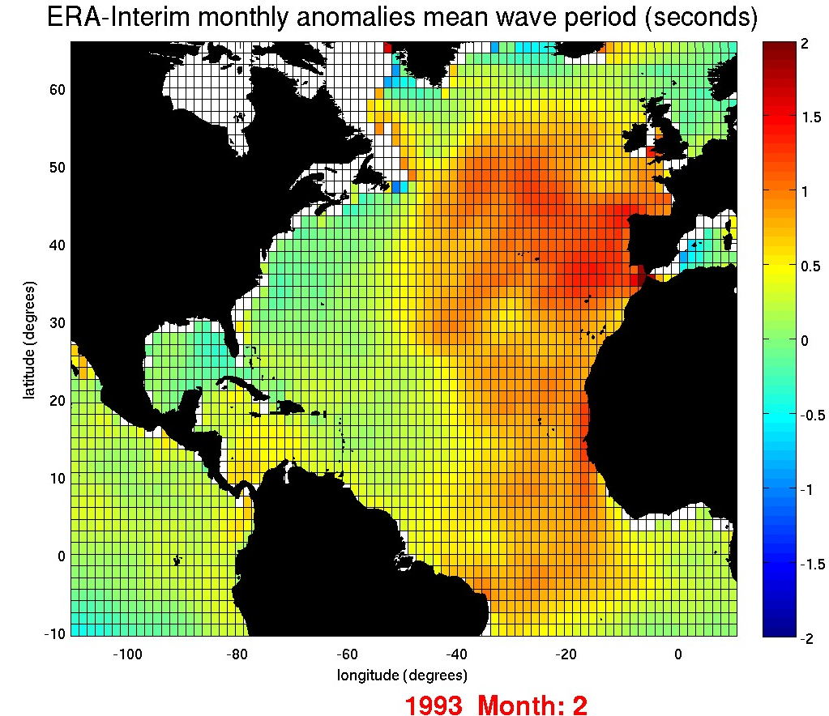
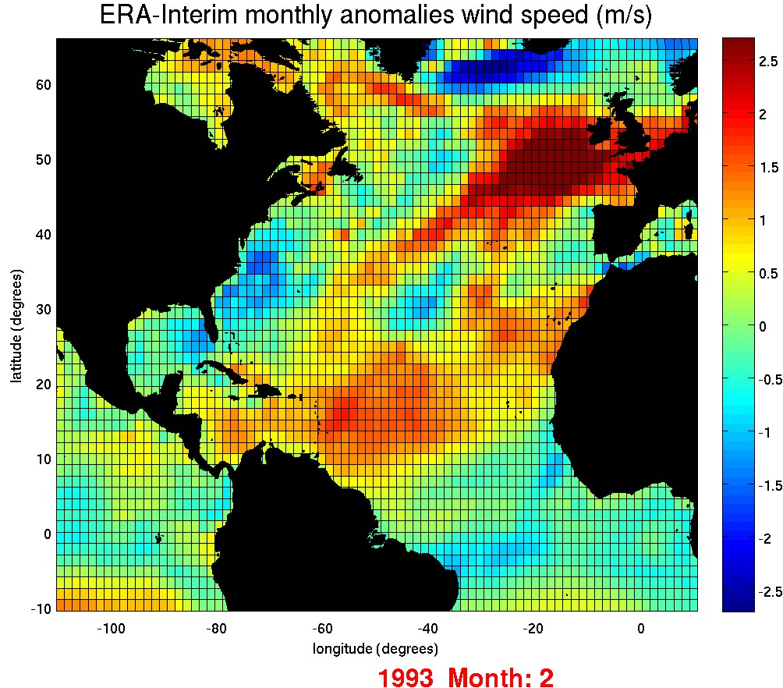
mwp climatology
ERA-Interim September 1992 – July 2009
mwp has complex links with the wind speed

Slide 26
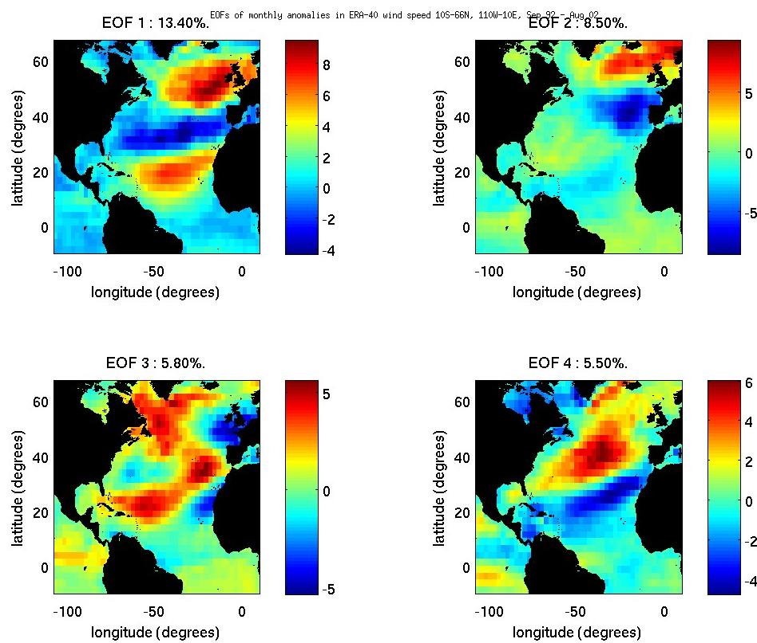
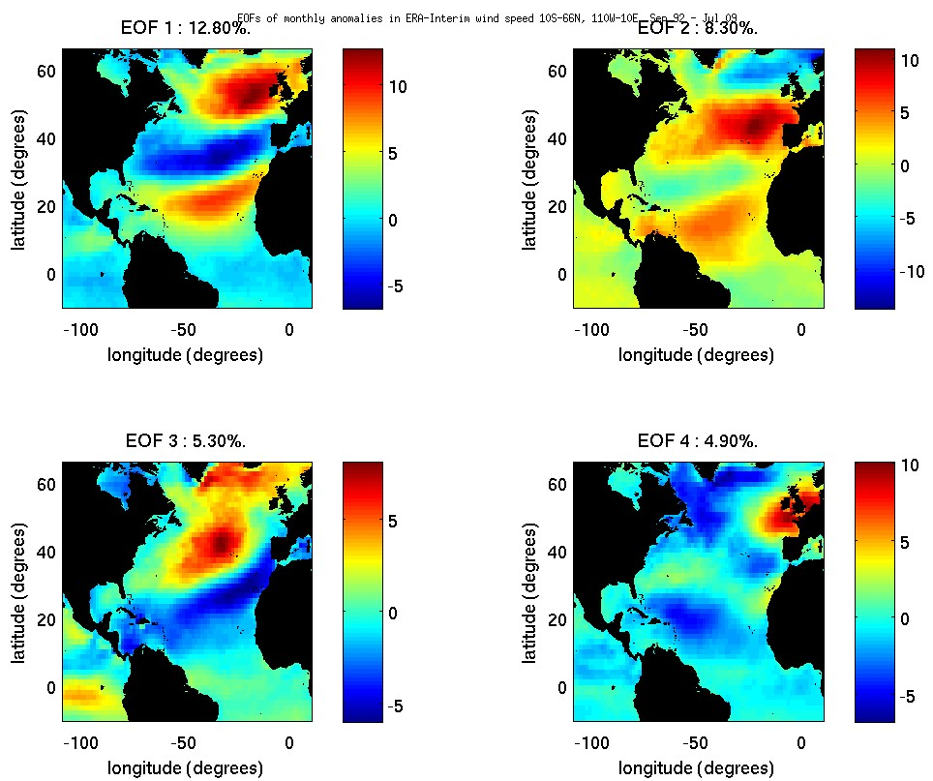
Empirical Orthogonal Functions
Wind speed
ERA-40
ERA-Interim
Similar between models.
1st EOF has a NAO tri-pole type structure

Slide 27
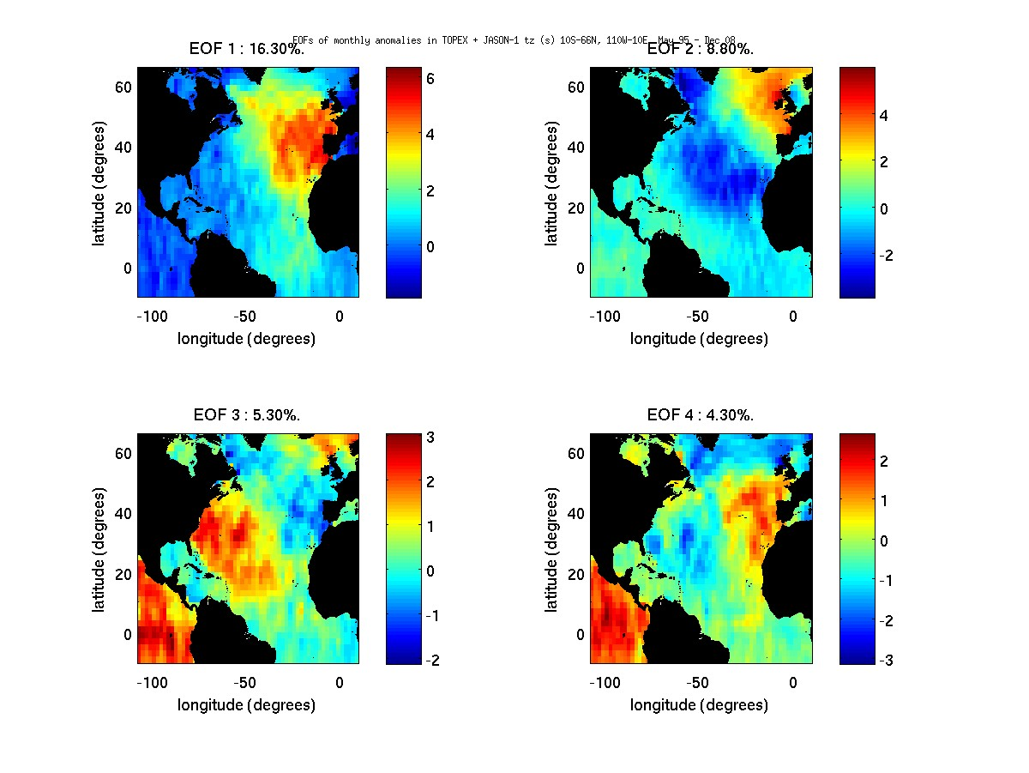
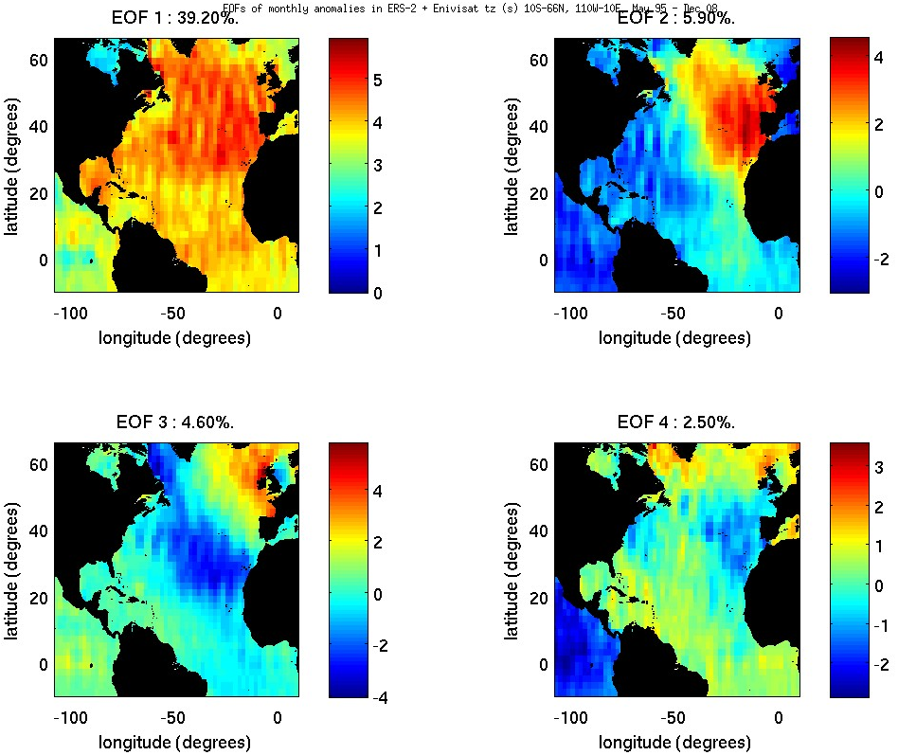
Differences in T_{z} between satellite datasets
TOPEX + Jason-1
ERS-2 + Envisat
TOPEX + Jason-1 may be picking up higher variability pattern.
ERS-2 shown to give –T_{z} in the great lakes. Single frequency altimeter
Further analysis required.
Notes:
Tz is based on a algorithm of swh and backscattered power – wind speed.
ERS-2 gave some erroneous data such as –Tz, these were replaced with NaN’s. Single frequency altimeter.
As much i don’t like to admit it there may be an error in my data processes.
Further analysis required – such as mapping the altimeter wind speed.

Slide 28
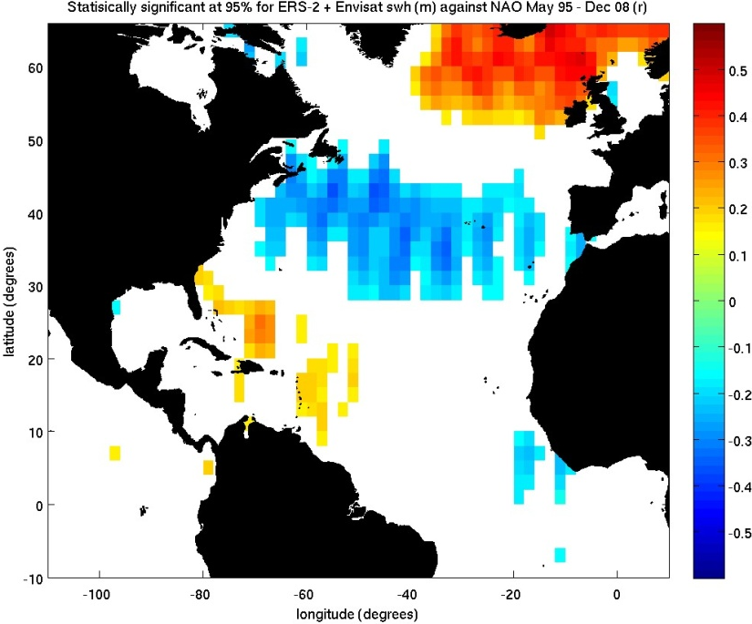
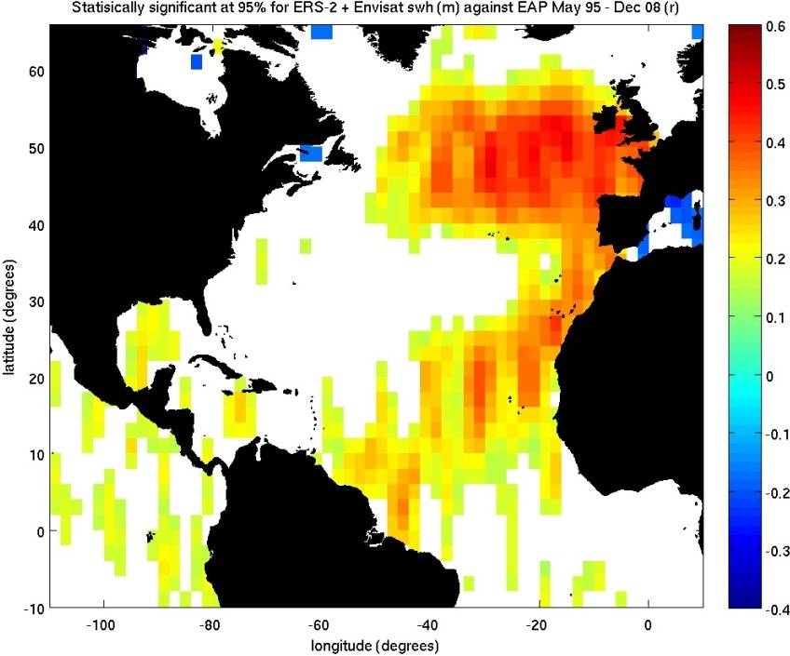
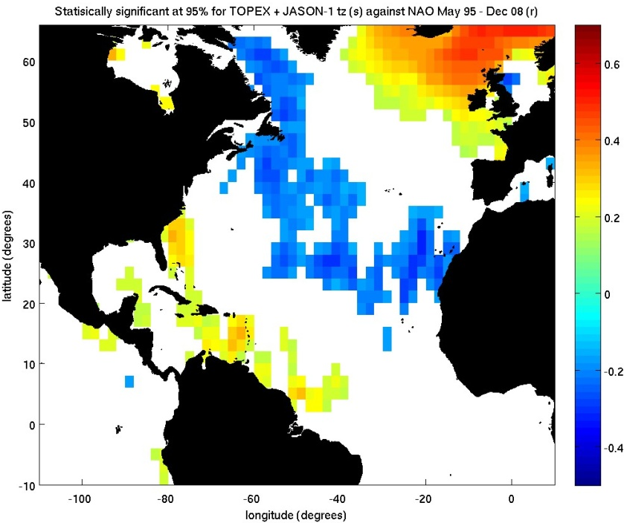
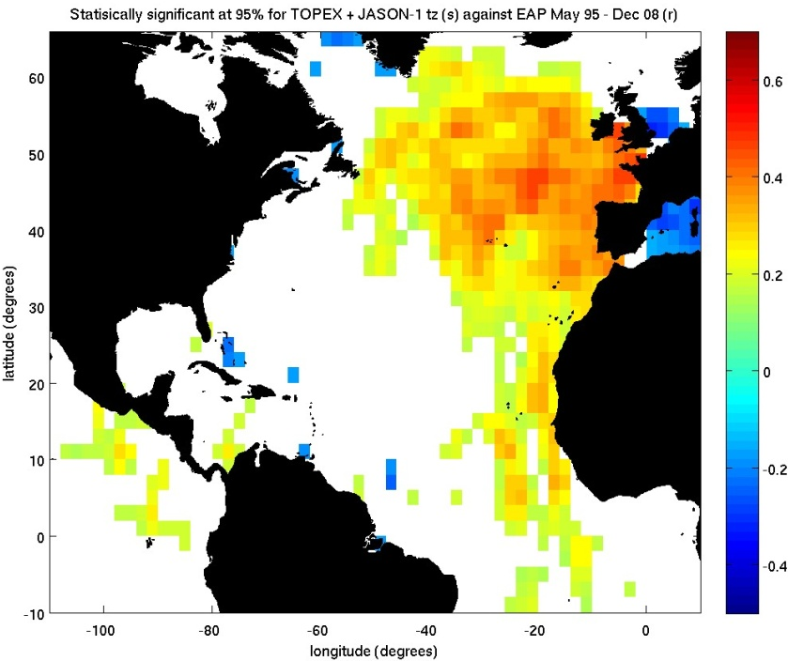
Spatial correlation of climate indices

Slide 29
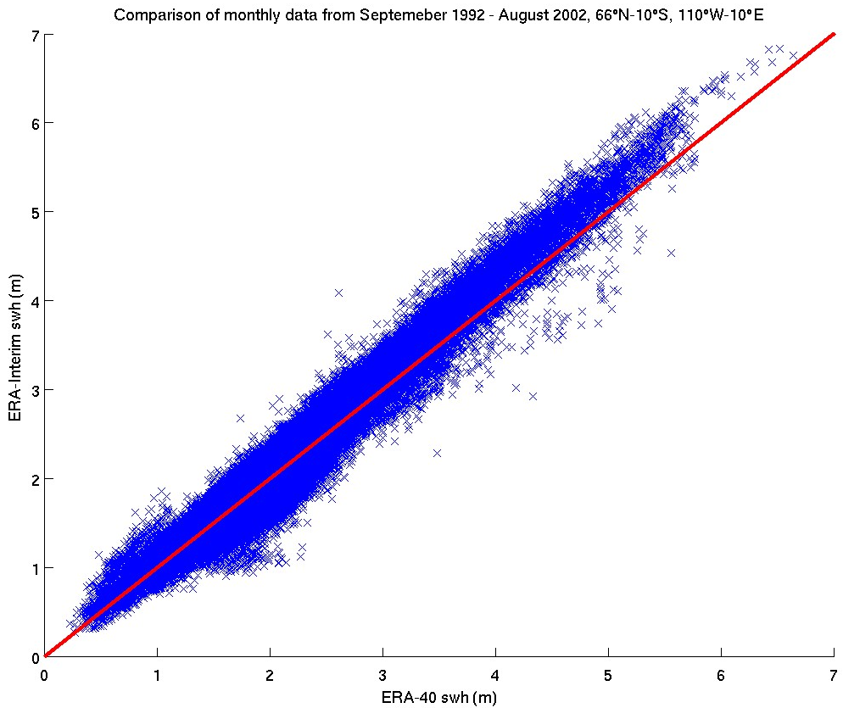
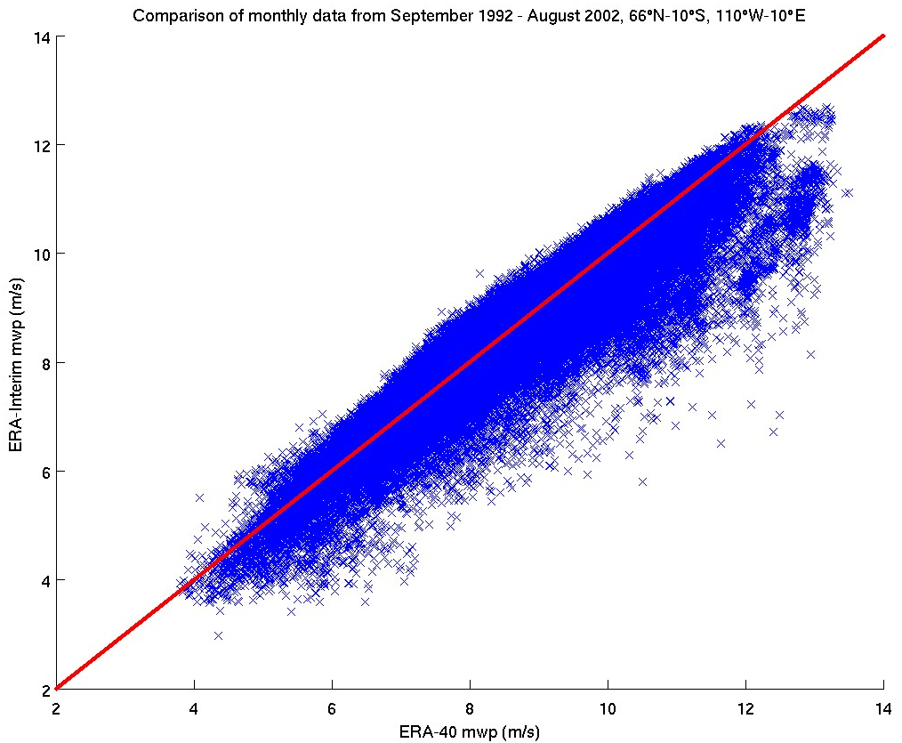
Interpolations

Slide 30
Notation
Significant wave height = swh
Mean wave period = mwp = Te =
Zero upcrossing period = Tz =
nth moment of the wave power spectral density function S(f).
Where is the high-frequency cutoff of the measuring device.

