Slide 1
The Ensemble Kalman filter
Part I: The Big Idea
Alison Fowler
Intensive course on advanced data-assimilation methods. 3-4th March 2016, University of Reading

Slide 2
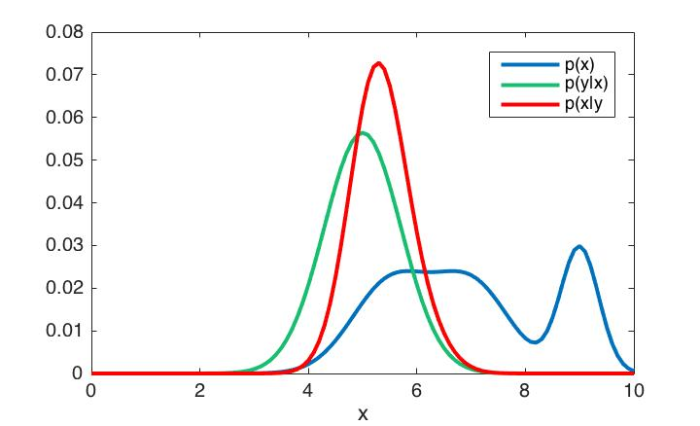

Recap of problem we wish to solve
Given prior knowledge of the state of a system and a set of observations, we wish to estimate the state of the system at a given time.
Figure: 1D example of Bayes’ theorem.
For example this could be rainfall amount in a given grid box.
A-priori we are unsure if there will be moderate or heavy rainfall. The observation only gives probability to the rainfall being moderate.
Applying Bayes’ theorem we can now be certain that the rainfall was moderate and the uncertainty is reduced compared to both the observations and our a-priori estimate.
No rain
Moderate rain
Heavy rain

Slide 3

Recap of 4DVar
*Observations
background uncertainty, characterised by B
observation uncertainty, characterised by R
*
*
x^{b}
*
*
M(xª)
analysis uncertainty.
xª
*
M(x^{b})
t₀
Assimilation window
time
forecast
4DVar aims to find the most likely state at time t₀, given an initial estimate, x_{b}, and a window of observations.
J (the cost function) is derived assuming Gaussian error distributions and a perfect model.

Slide 4
Recap of 4DVar: why do any different?
Advantages
Gaussian and near-linear assumption makes this an efficient algorithm.
Minimisation of the cost function is a well posed problem (the B-matrix is designed to be full rank).
Analysis is consistent with the model (balanced).
Lots of theory and techniques to modify the basic algorithm to make it a pragmatic method for various applications, e.g. incremental 4DVar, preconditioning, control variable transforms, weak constraint 4DVar...
Met Office and ECMWF both use methods based on 4DVar for their atmospheric assimilation.
Disadvantages
Gaussian assumption is not always valid.
Relies on the validity of TL and perfect model assumption. This tends to restrict the length of the assimilation window.
Development of TL model, M, and adjoint, M^{T}, is very time consuming and difficult to update as the non-linear model is developed.
B-matrix is predominately static.
This motivates a different approach…

Slide 5
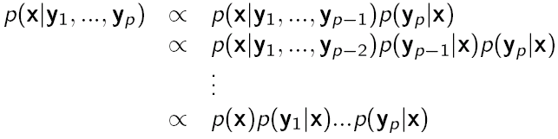
Sequential DA
*Observations
M(x_{b})
M(x_{a})
forecast
a-priori uncertainty, characterised by P_{f}
observation uncertainty, characterised by R
analysis uncertainty.
*
*
x_{b}
*
*
*
Assimilation window
time
Instead of assimilating all observations at one time, assimilate them sequentially in time.
This can be shown to be equivalent to the variational problem, assuming a linear model and all error covariances are treated consistently.

Slide 6
The Kalman filter
Need to be able to evolve the uncertainty in the state from one observation time to the next.
The Kalman filter (Kalman, 1960) assumes a linear model
*Observations
M(x^{b})
M(xª)
forecast
a-priori uncertainty, characterised by P^{f}
observation uncertainty, characterised by R
analysis uncertainty, characterised by Pª.
*
*
x^{b}
*
*
*
Assimilation window
time

Slide 7


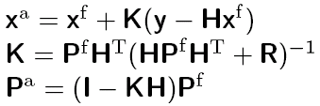
The Kalman filter algorithm
Prediction step
Evolve mean state to time of observation
Evolve covariance to time of observation allowing for model error,
Observation update step
Update mean state given observation
Update error covariance given observation

Slide 8
Motivation for the ensemble Kalman filter (EnKF)
The Kalman filter assumes the evolution model and observation operator is linear.
The Extended Kalman filter (EKF e.g Grewal and Andrews (2008)) was developed to get around this problem by allowing for the mean state to be evolved by the non-linear model.
The EKF still needs the TL and adjoint model to propagate the covariance matrix.
Due to the size of this matrix for most environmental applications, the EKF is not feasible in practice.
An alternative approach to explicitly evolving the full covariance matrix is to instead estimate it using a sample of evolved states (known as the ensemble).

Slide 9
Extended Kalman filter approach
Explicitly evolve the mean and covariances forward in time using M, M and M^{T}.
Time 1
Time 2
Ensemble Kalman filter approach
Sample from the initial time, evolve each state forward in time using M, then estimate the mean and covariance from the evolved sample.

Slide 10
EnKF algorithms
There are many many different flavours of EnKF.
EnKF algorithms can be generalised into two main categories:
  Stochastic algorithms (e.g. the perturbed observation Kalman filter)
  Deterministic algorithms (e.g. the ensemble transform Kalman filter)
All EnKF methods can be represented by the same basic schematic:
*
*
x_{b}
*
*
*
Assimilation window
time

Slide 11

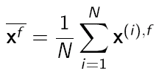
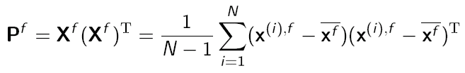



The perturbed observation Kalman Filter
Developed by Evensen (1994)
Prediction step
  Evolve each ensemble member forward using the non-linear model with added noise.
  Reconstruct the mean ensemble
  And its covariance
Filtering step
  Update the ensemble using perturbed observations
.
.
.
.
.
*
Where R_{e} is the covariance reconstructed from the perturbed observations

Slide 12
The perturbed observation Kalman Filter
The advantages of the perturbed observation KF is that it is very simple to implement and understand for toy models. However…
  It is necessary to perturb the observations in order for the variance of the ensemble after the update step to correctly represent the uncertainty in the analysis.
  This introduces additional sampling noise.
  The perturbed ob KF also needs to invert the rank deficient matrix
This motivates the development of square-root or deterministic forms of the EnKF which do not need to perturb the observations.

Slide 13
Ensemble Square Root Filter
The idea of ESRF is to create an updated ensemble with covariance consistent with
Recall that the ensemble covariance matrix is given by
Instead of updating each ensemble member separately, as in the perturbed observation KF, the ESRF generates the new ensemble simultaneously by updating X^{f} instead of x^{(i),f}

Slide 14


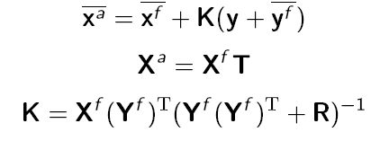
Ensemble Square Root Filter
Prediction step
  This is the same as for the perturbed observation ensemble KF. The rest is different...
Forecast-observation ensemble
  Transform the forecast ensemble to observation space
  from this can compute the mean and perturbation matrix
Update ensemble mean and perturbation matrix
Need to define the matrix T.

Slide 15
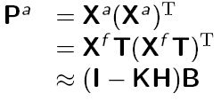

Ensemble Square Root Filter
The T matrix
The matrix T is chosen such that
This does not uniquely define T which is why there are so many different variants of the ESRF, e.g. the Ensemble Adjustment Kalman Filter (Anderson (2001), and the Ensemble Transform Kalman Filter Bishop et al. (2001))
Tippet et al. (2003) review several square root filters and compare their numerical efficiency.

Slide 16


The Ensemble Transform Kalman Filter
First introduced by Bishop et al. (2001), later revised by Wang et al. (2004).
T is computed from the eigenvalue decomposition of
The revision by Wang et al. highlighted that any T which satisfies the estimate of the analysis error covariance does not necessarily lead to an unbiased analysis ensemble, see Livings et al. (2008) for conditions that T must satisfy for the analysis ensemble to be centred on the mean.

Slide 17


Model error
The ensemble Kalman filter allows for an imperfect model by adding noise at each time step of the model evolution.
The matrix Q is not explicitly needed in the algorithm, only the effect of the model error in the evolution of the state.
There have been many different strategies to including model error in the ensemble, based on where you think the source of the error lies. A few examples are
  Multiphysics- different physical models are used in each ensemble member
  Stochastic kinetic energy backscatter- replaces upscale kinetic energy loss due to unresolved processes and numerical integration.
  Stochastically perturbed physical tendencies
  Perturbed parameters
  Or combinations of the above
Can verify the model error representation against independent observations (e.g. Berner et al. 2011 also see next lecture).

Slide 18
Summary of the Ensemble Kalman Filter
Advantages
  The a-priori uncertainty is flow-dependent.
  The code can be developed separately from the dynamical model e.g. NCEO’s EMPIRE system which allows for any model to assimilate observations using ensemble techniques.
  No need to linearise the model, only linear assumption is that statistics remain close to Gaussian.
  Easy to account for model error.
Disadvantages
  Sensitive to ensemble size. Undersampling can lead to filter divergence. Ideas to mitigate this include localisation and inflation (see next EnKF lecture).
  Assumes Gaussian statistics, for highly non-linear models this may not be a valid assumption (see lecture on particle filters)
  The updated ensemble may not be consistent with the model equations.

Slide 19
Summary of the Ensemble Kalman Filter
The different EnKF algorithms
  Many different algorithms exist.
  Stochastic methods update each ensemble member separately and then estimate the first two sample moments to give the ensemble mean and covariance.
  Deterministic methods update the ensemble simultaneously based on linear/Gaussian theory.
EnKF vs 4DVar
  Each method has its own advantages and disadvantages- there is no clear winner.
  Hybrid methods aim to combine the best bits of both (see lecture later today on hybrid methods)

Slide 20
Further reading
Kalman (1960) A new approach to linear filtering and prediction problems. J. Basic Engineering, 82, 32-45.
Grewal and Andrews (2008) Kalman Filtering: Theory and Practice using MATLAB. Wiley, New Jersey.
Evensen (1994) Sequential data assimilation with a nonlinear quasi-geostrophic model using Monte Carlo methods to forecast error statistics. J. Geophys. Res., 99(C5), 10143-10162.
Tippet et al. (2003) Ensemble Square Root Filters. Mon. Wea. Rev., 131, 1485-1490.
Anderson (2001) An ensemble adjustment filter for data assimilation. Mon. Weather Rev., 129, 2884-2903.
Bishop et al. (2001) Adaptive sampling with the ensemble transform Kalman filter. Mon. Wea. Rev., 126, 1719-1724.
Wang et al. (2004) Which Is Better, an Ensemble of Positive–Negative Pairs or a Centered Spherical Simplex Ensemble? Mon. Wea. Rev., 132, 1590-1605.
Livings et al. (2008) Unbiased ensemble square root filters. Physica D. 237, 1021-1028.
Berner et al. (2011) Model uncertainty in a mesoscale ensemble prediction system: Stochastic versus multiphysics representations, Mon. Weather Rev., 139, 1972–1995.

