Slide 1
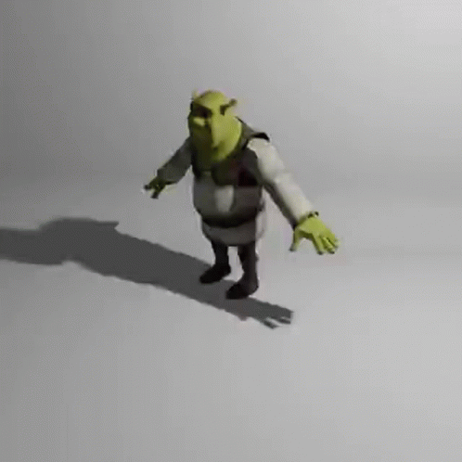

Slide 2
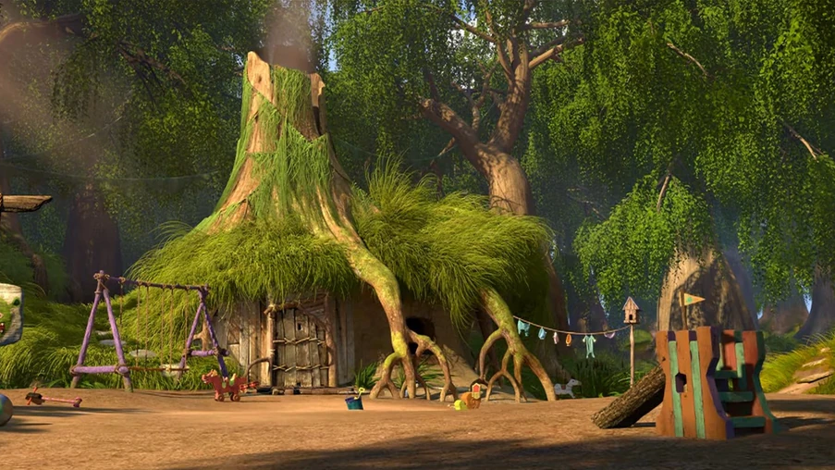
Swamp
Notes:
Scene 1

Slide 3
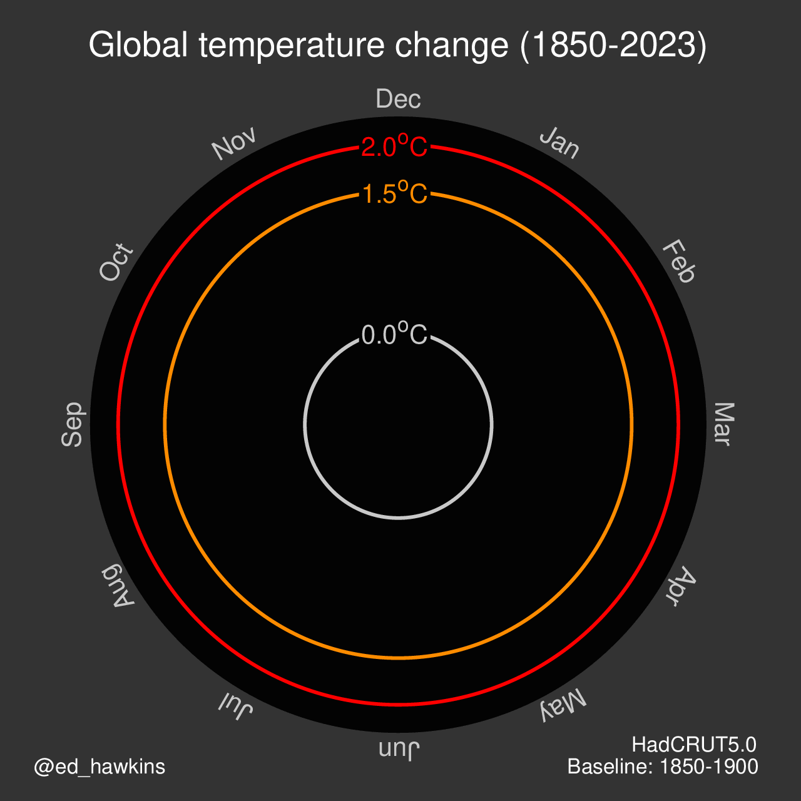
Ed Hawkins once told me the world is gonna warm up,
And climate forecasts show little spread,
The graphs were kinda fun,
Coloured stripes and a spiral,
And the shape of an L for temperature and..

Slide 4
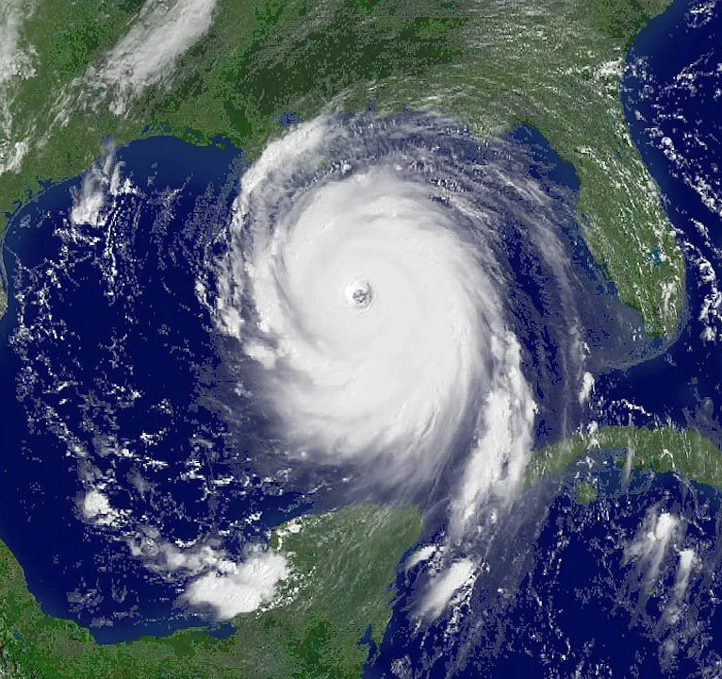
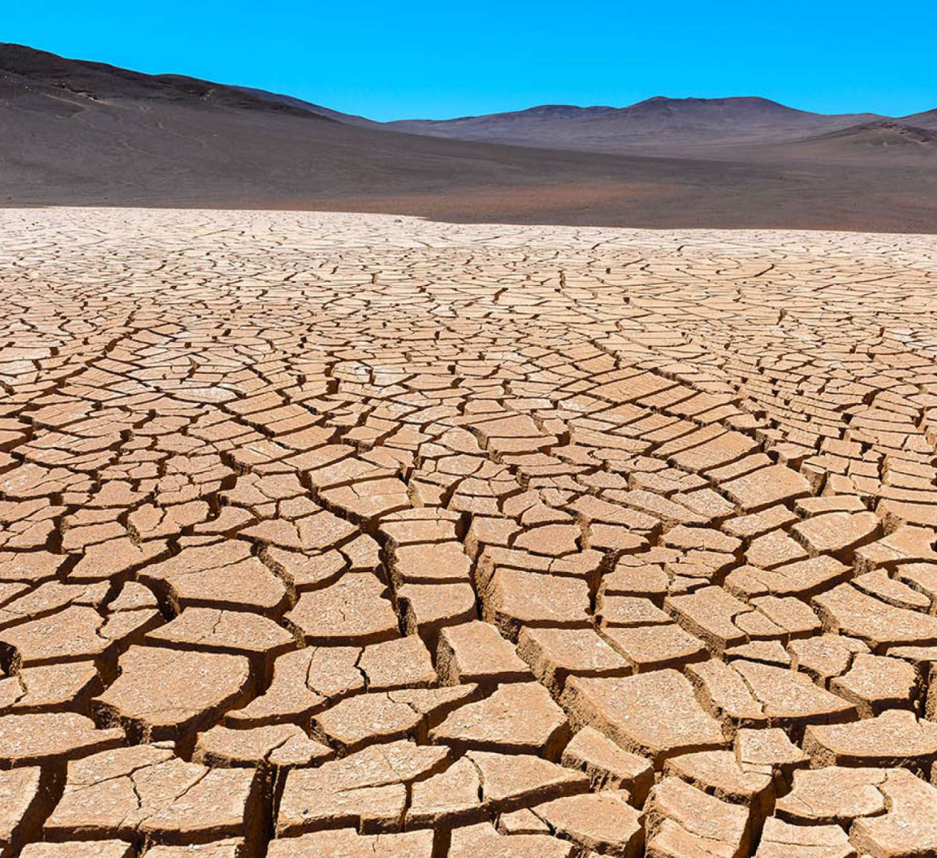
Well, extremes start coming and they don't stop coming,
Hurricanes, heatwaves, droughts, storms and flooding,
Didn’t make sense to ignore the facts,
So I got a degree and I joined NCAS,

Slide 5
So much to do, So much to read,
So much time spent writing the panto,
I never thought Jasmin was slow,
I never thought Wendy would go,

Slide 6
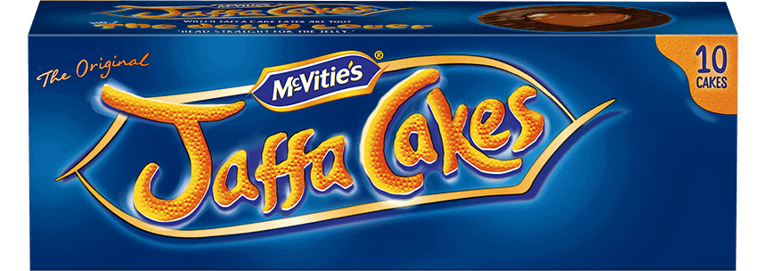
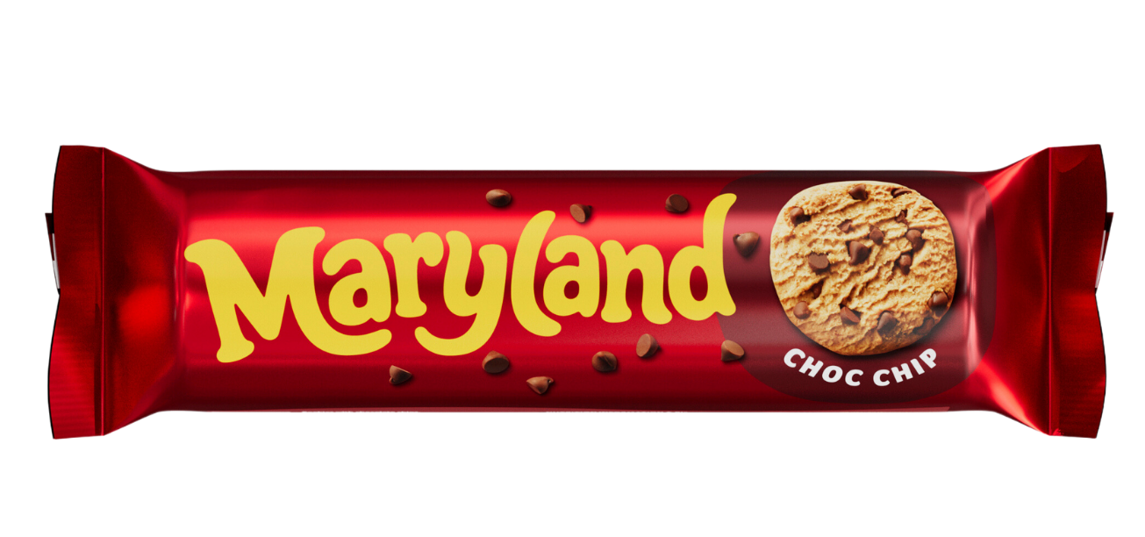
Hey now, I'm a scientist, I need a PC, I'm underpaid,
Hey now, I'm a scientist, I've got my laptop, and plots made,
All this data is gold,
While biscuit brackets are controversial…

Slide 7
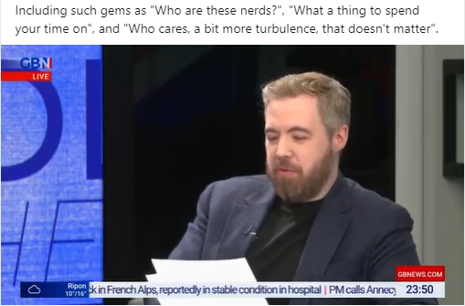
It’s a warm place, and it's gonna get warmer,
Want AC right now wait til you get older,
But the GB news man begs to differ,
Judging from a scroll through his posts on twitter,

Slide 8
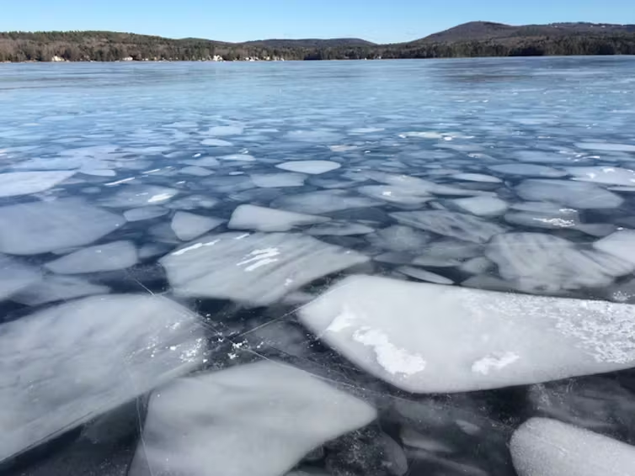
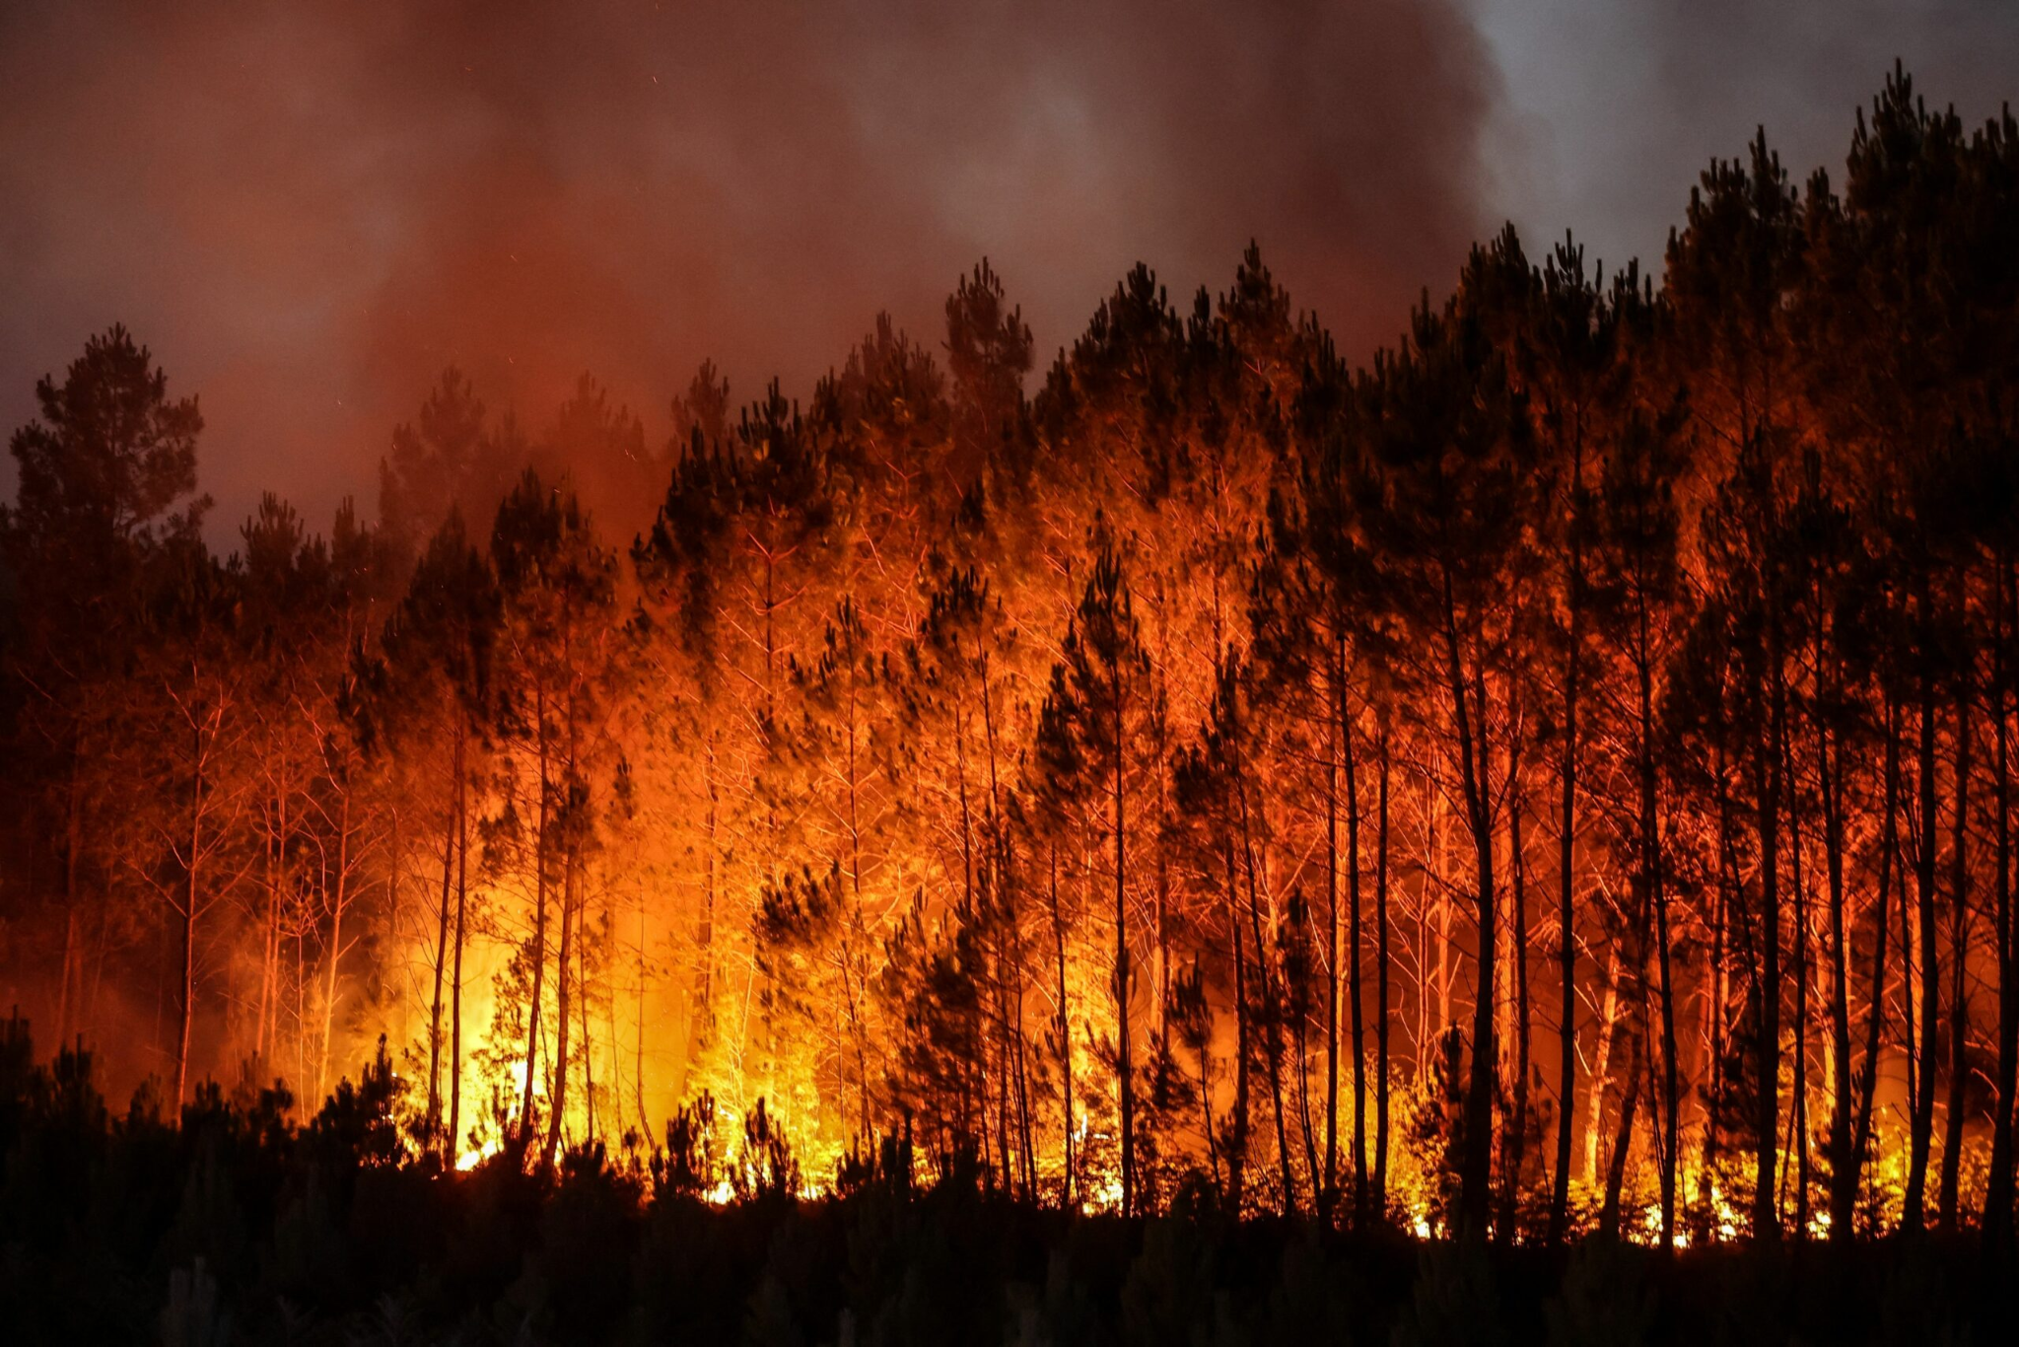
The ice we skate no longer exists,
Your homes underwater so you might as well swim,
Europe’s on fire,
And at war,
That’s the way I have it guess I’ll never get bored,

Slide 9
Hey now, I'm a scientist, I need a holiday, I’m under strain,
Hey now, I'm a scientist, I'm on my holiday, with plots made,
All this data is gold,
While biscuit brackets are controversial…

Slide 10
Hey now, I'm a scientist, I need a holiday, I’m under strain,
Hey now, I'm a scientist, I'm on my holiday, with plots made,
All this data is gold,
While biscuit brackets are controversial…

Slide 11
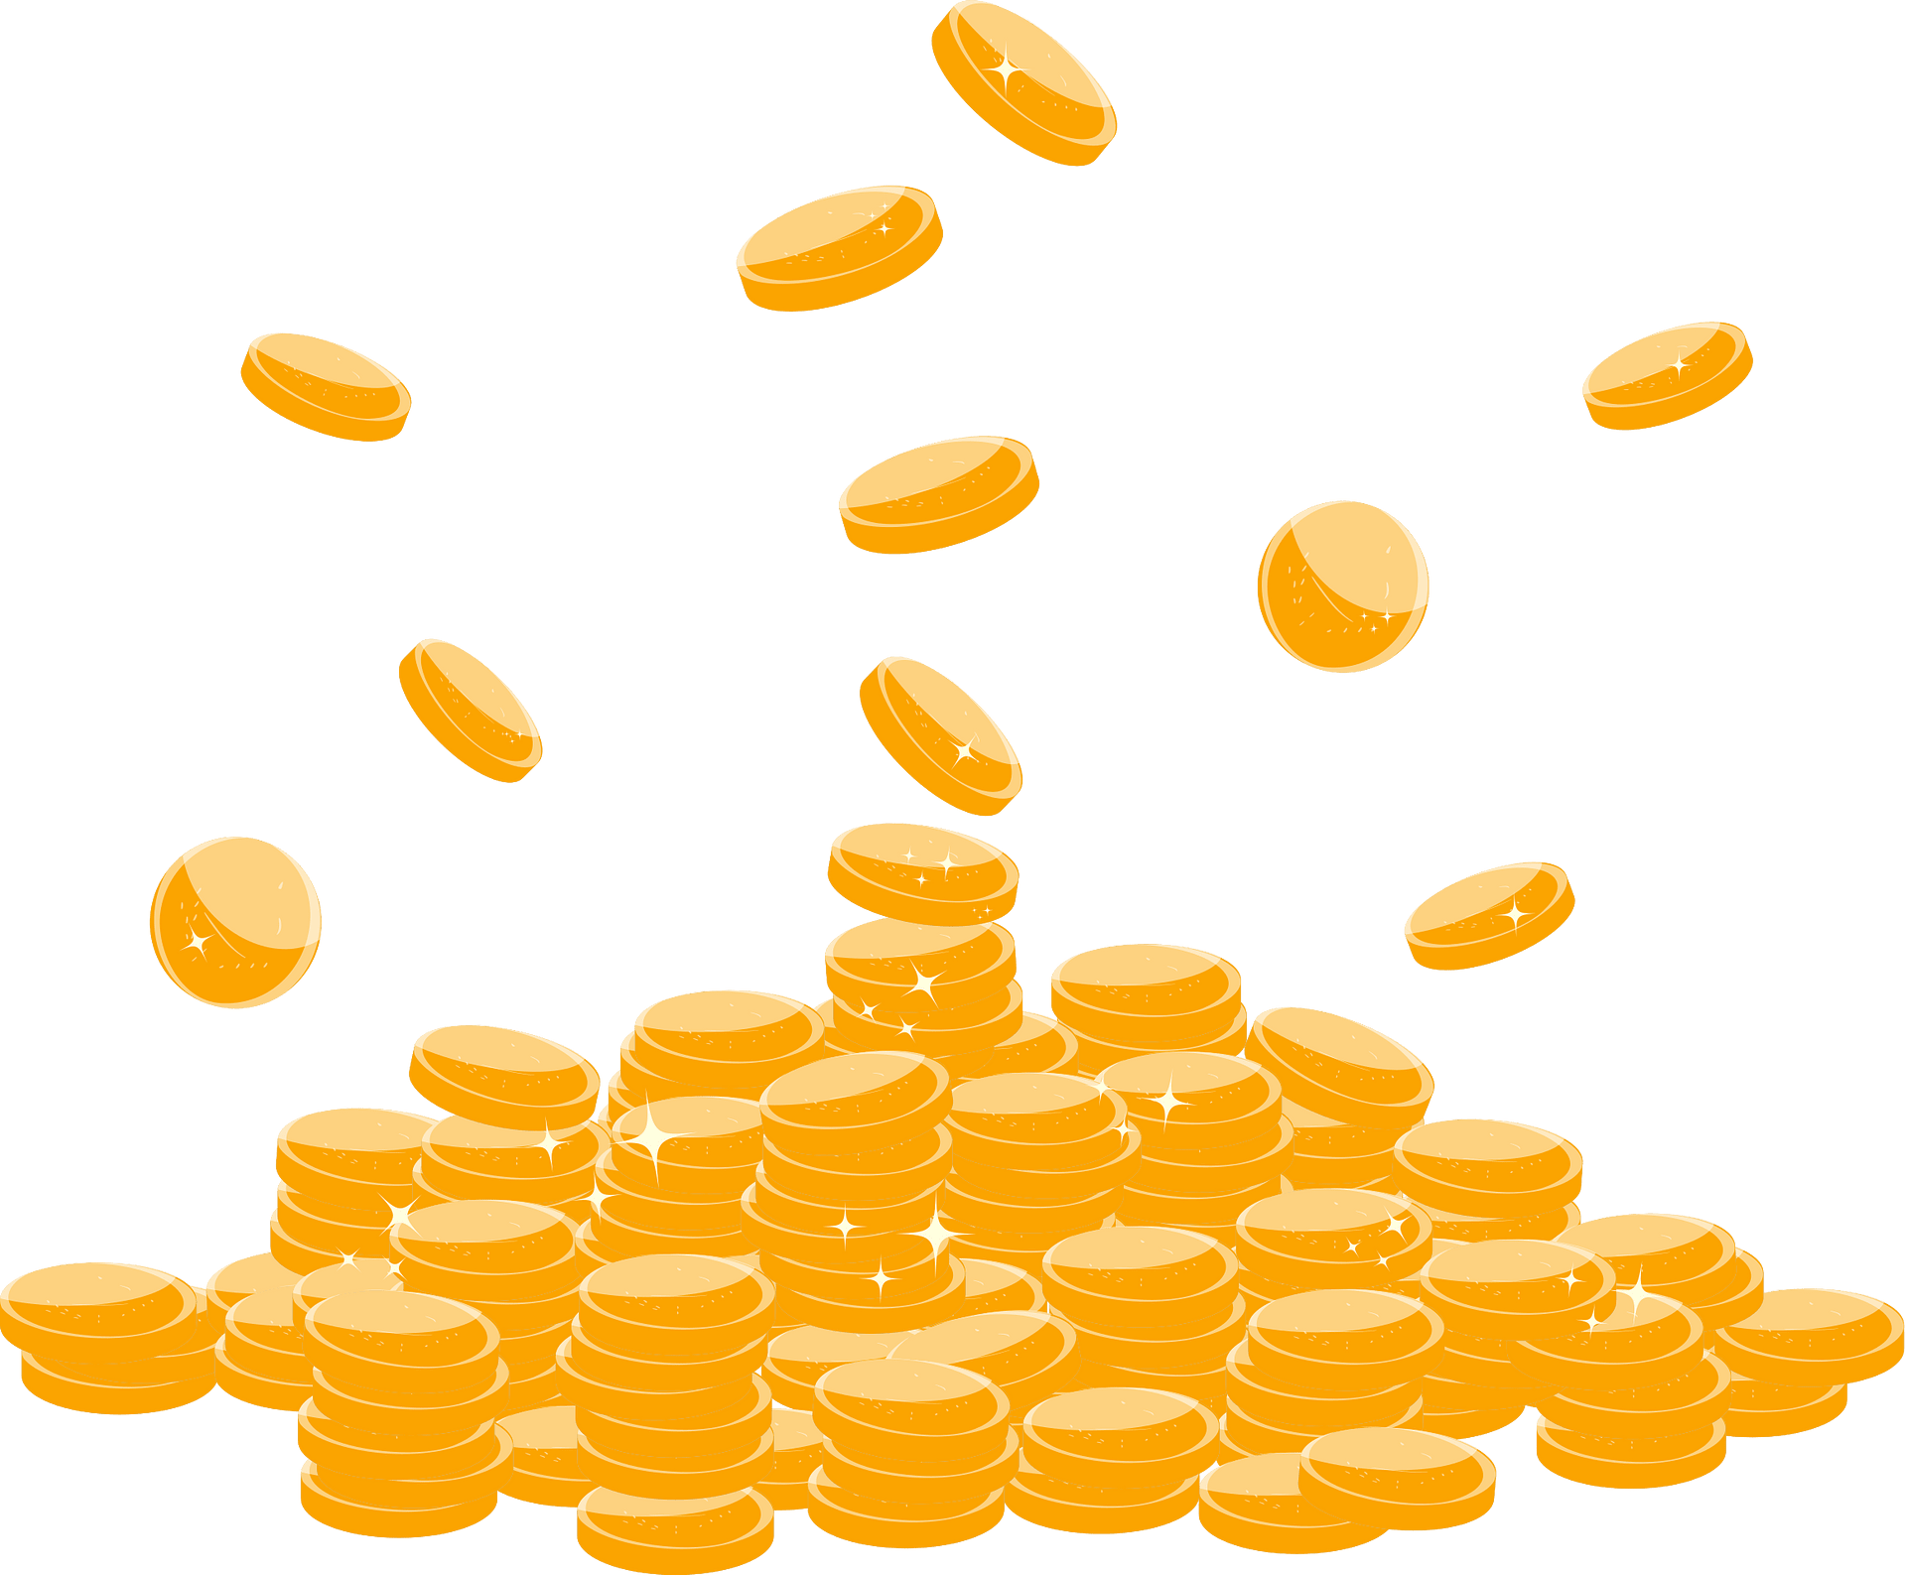
Mark Prosser once asked could I spare some change for coffee,
Need to get my brain to function again,
I said yep,
What a concept,
I could use a hot drink myself,
And we could all use a little change,

Slide 12
Well, the coffee keeps flowin and it don’t stop flowin,
The Tassimo machine - it fuels the met department,
It’s the only way I can get my work done,
With a 10pm finish and a 6am start,

Slide 13
So much to do, without the sleep,
So much time spent writing the panto,
I’ll never know if I don’t stop (STOP!),
Will I ever get a faculty spot?,

Slide 14
Hey now, I'm a scientist, bypass my coffee, to numb the pain,
Hey now, I'm a scientist, but will my project, enact change,
All this data is gold,
THE BISCUIT BRACKETS NOT AT ALL CONTROVERSIAL!,

Slide 15
All this data is gold,
And meanwhile Peter Clarke has mugs under control...

Slide 16
Swamp
Notes:
Scene 1

Slide 17
SCENARIO
Super Cold but Exciting New And Relatively Interesting Opportunities

Slide 18
Swamp
Notes:
Scene 1

Slide 19
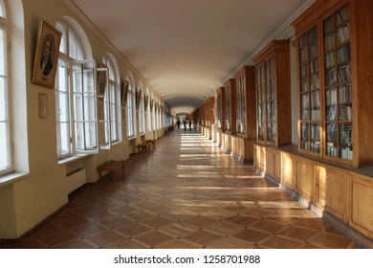

Slide 20
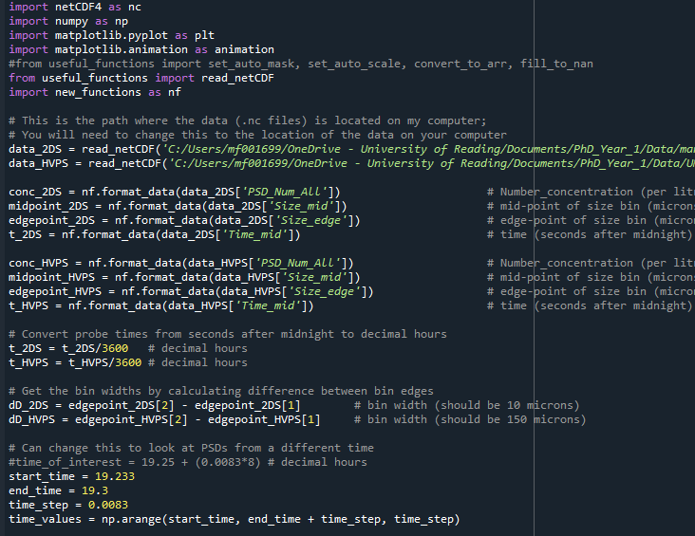
Gotta make a move to the office of LCP
Place to keep me codin’,
keep me workin’ with some energy

Slide 21
Well, I talk about it, talk about it
Talk about it, talk about it
Talk about, talk about
Talk about heating

Slide 22
Wanna get warm
Wanna get warm
Wanna get warm...

Slide 23
A-won't you get me some heating now?
Won't you get me some heating now?
Won't you get me some heating now?
Won't you get me some heating now?

Slide 24
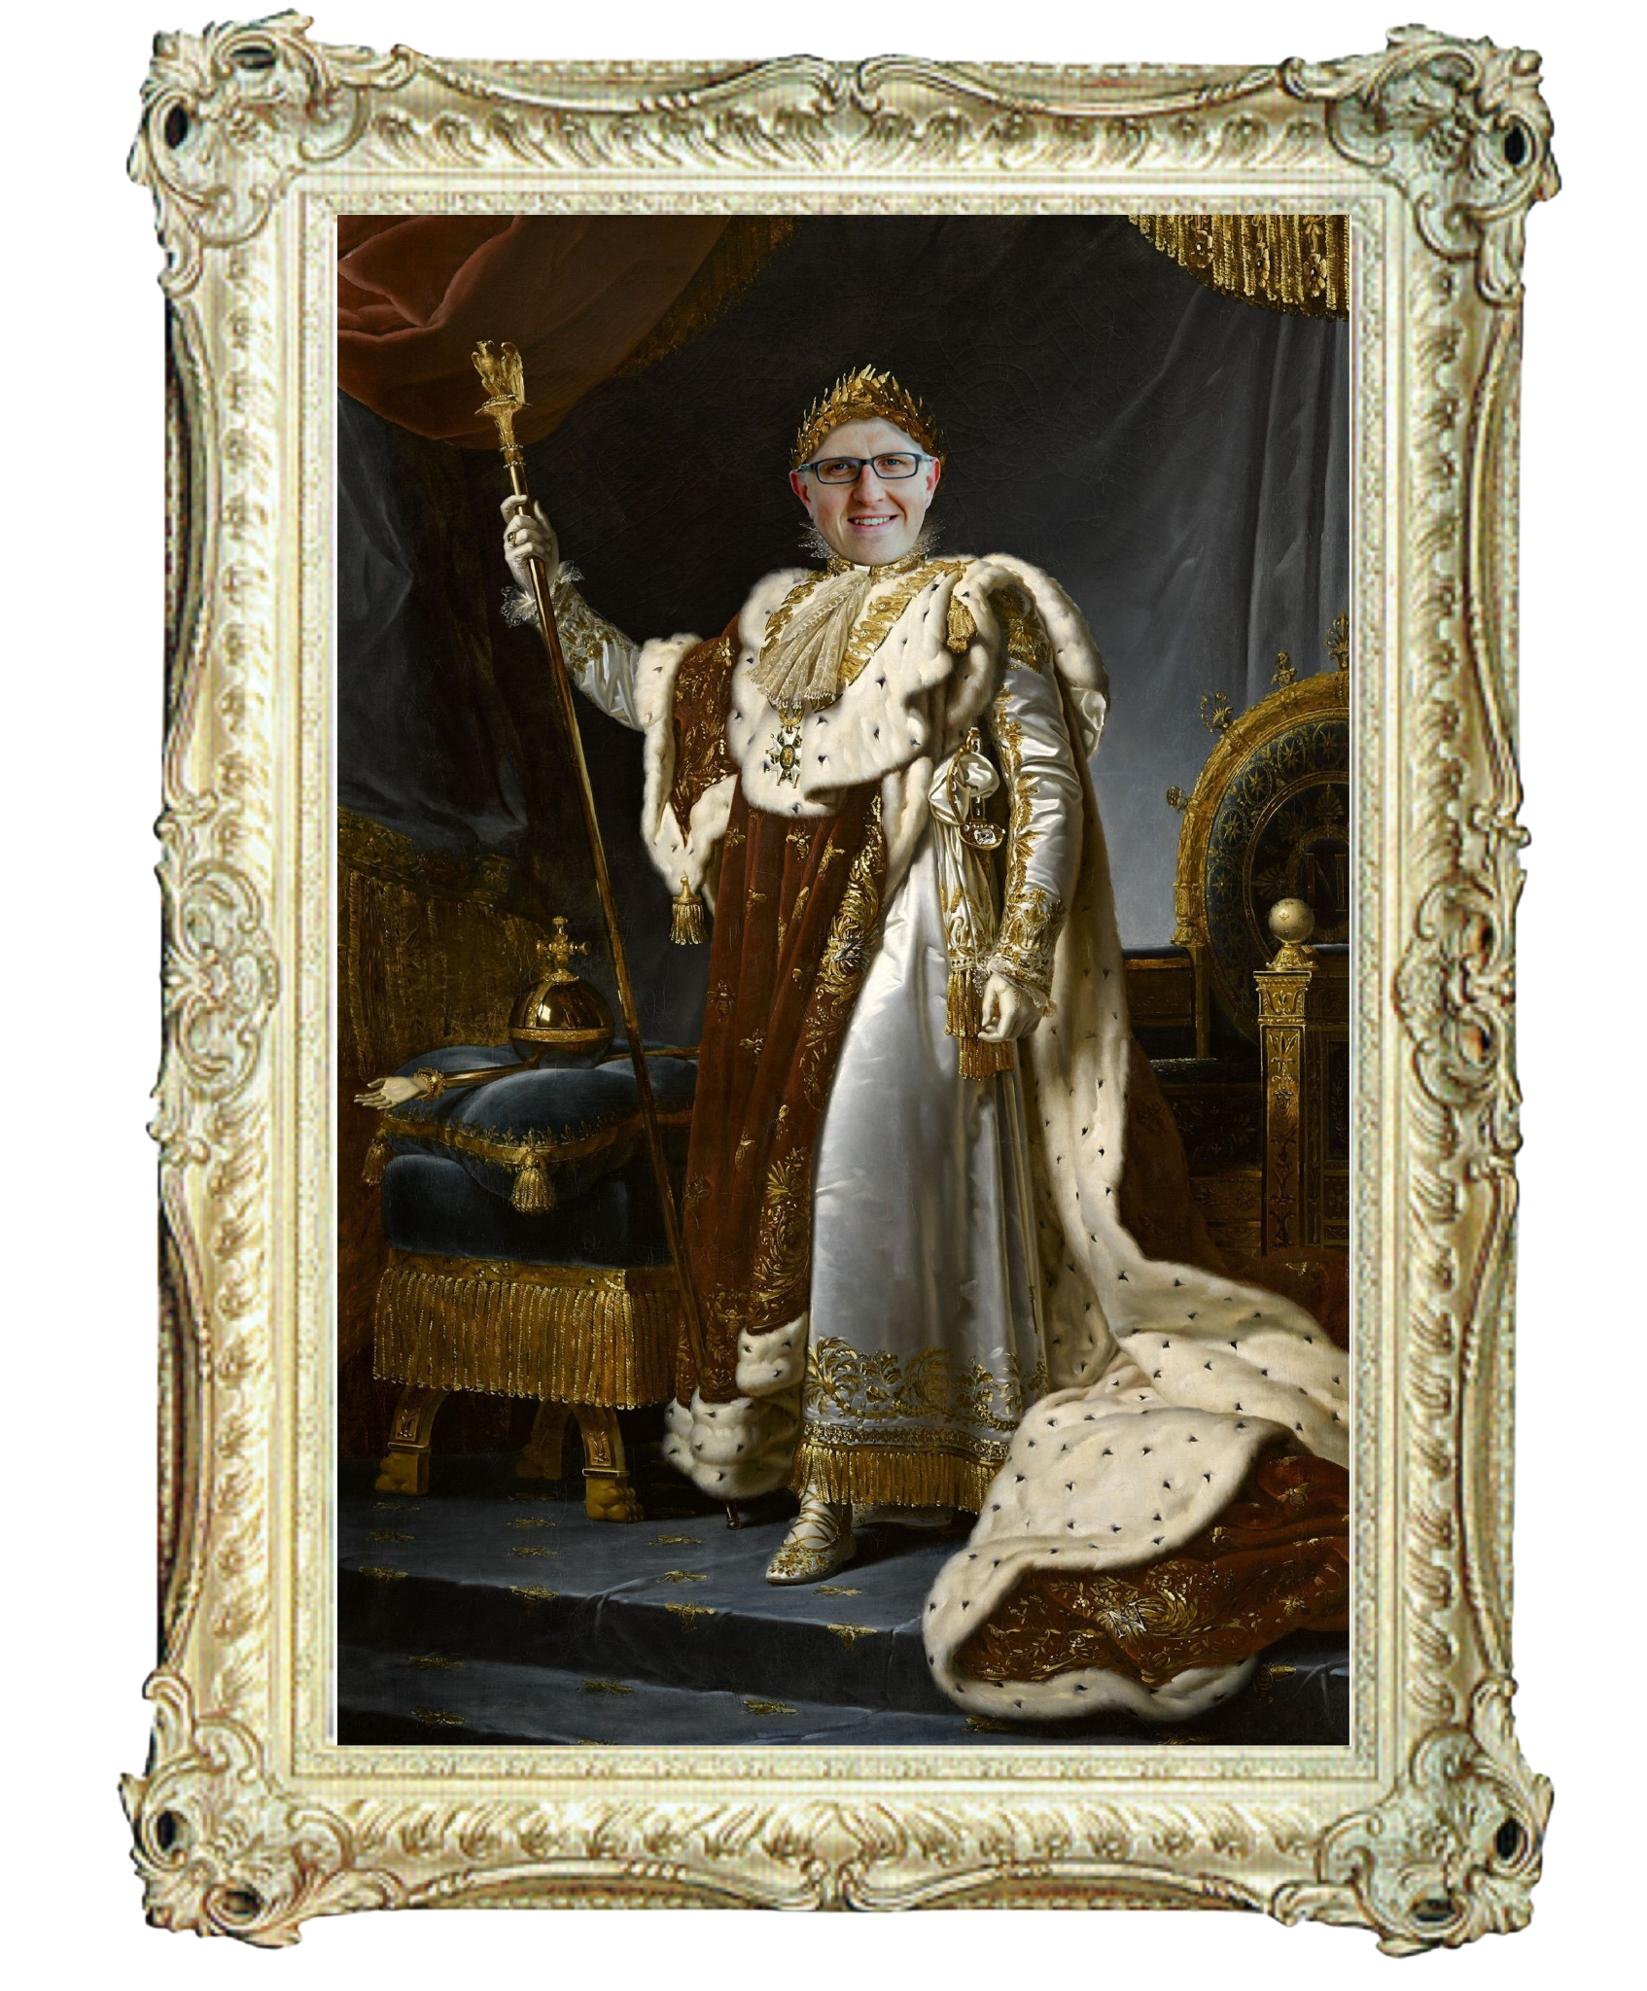

Slide 26
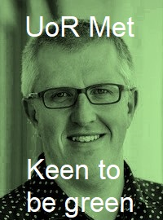

Slide 27
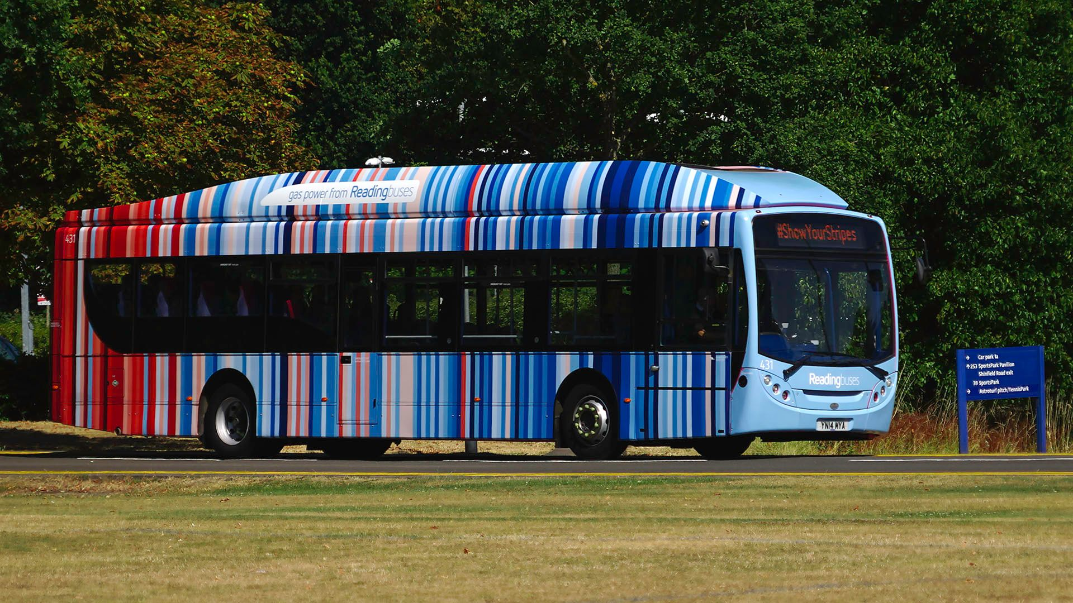

Slide 30
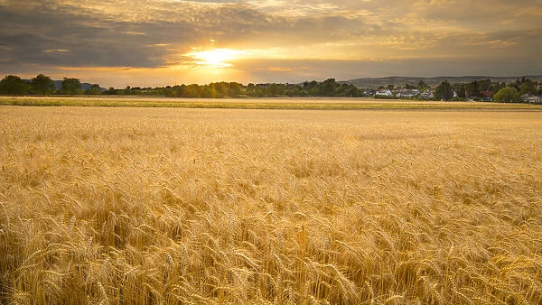
Travelling scene
Notes:
Scene 3

Slide 31
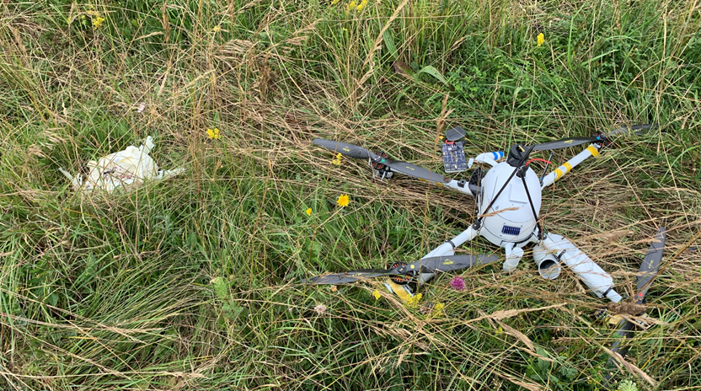

Slide 32
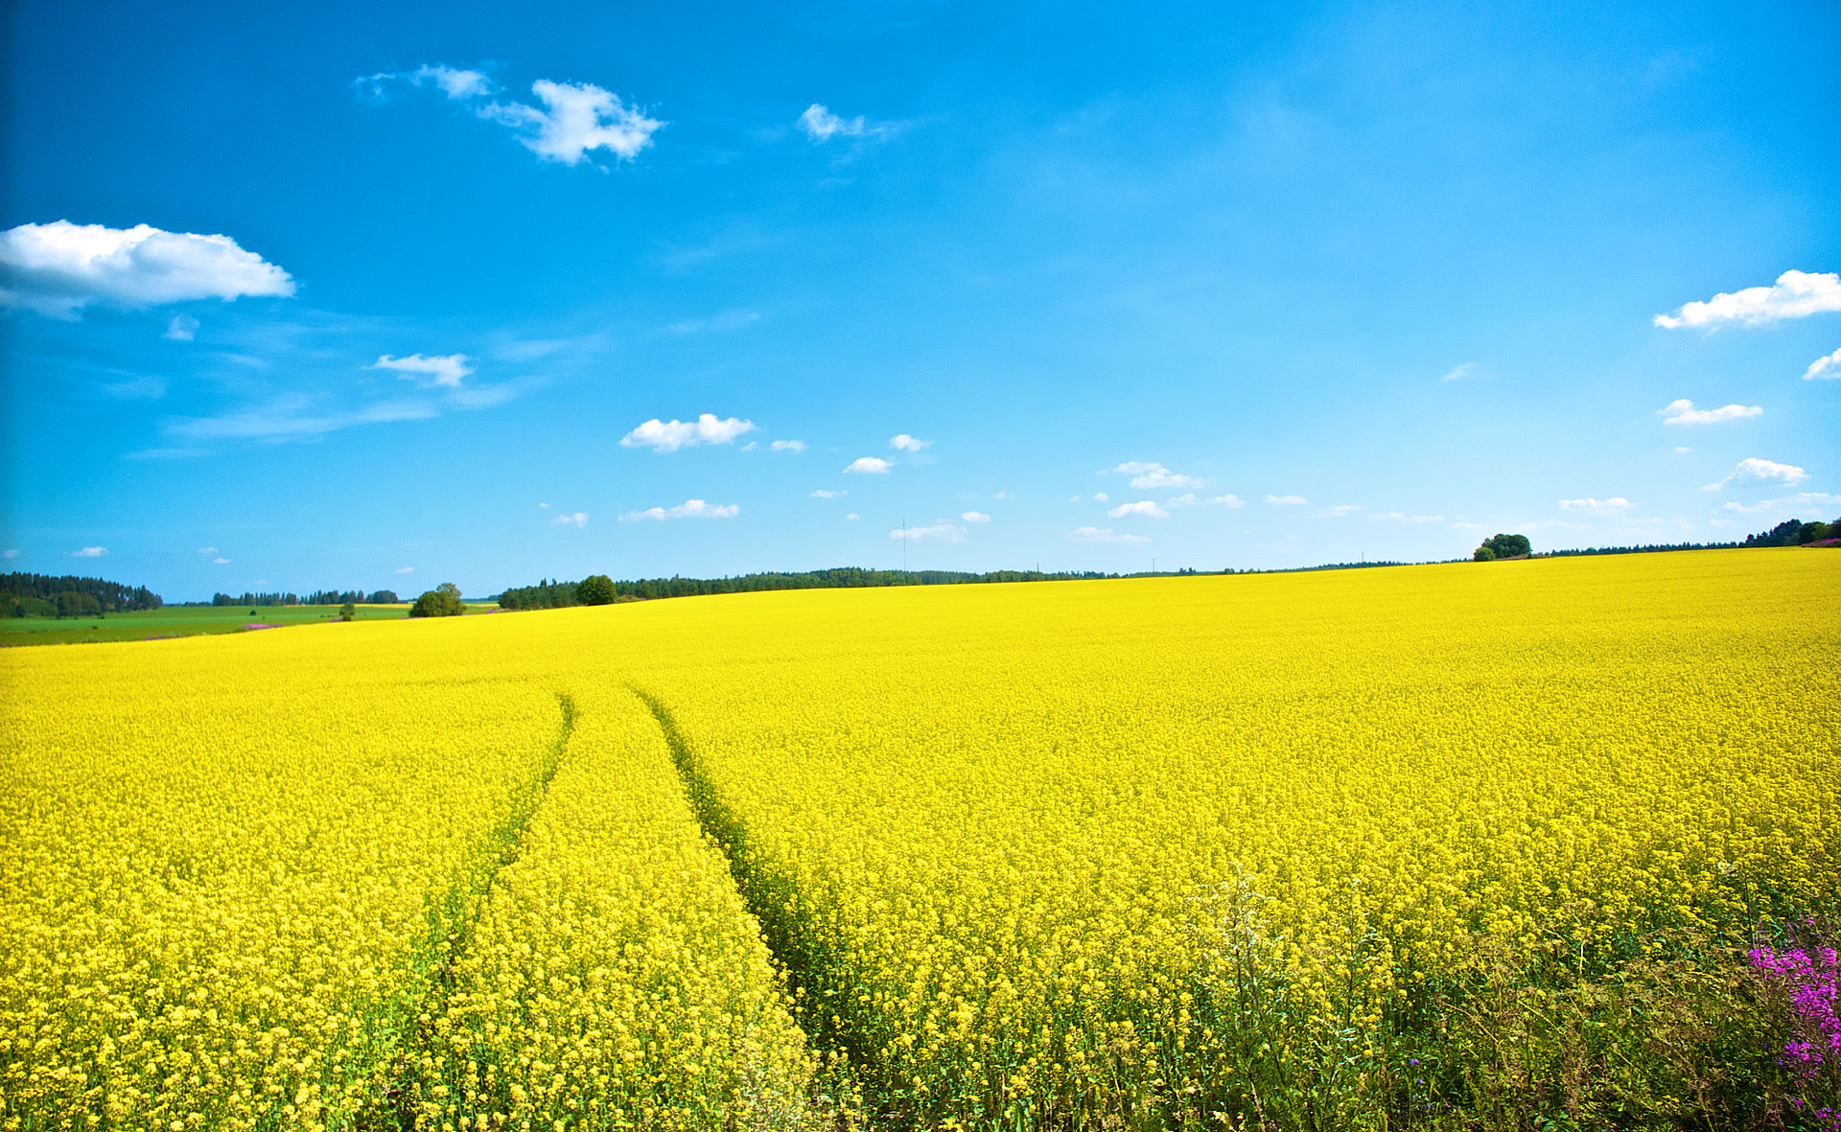
travelling

Slide 33
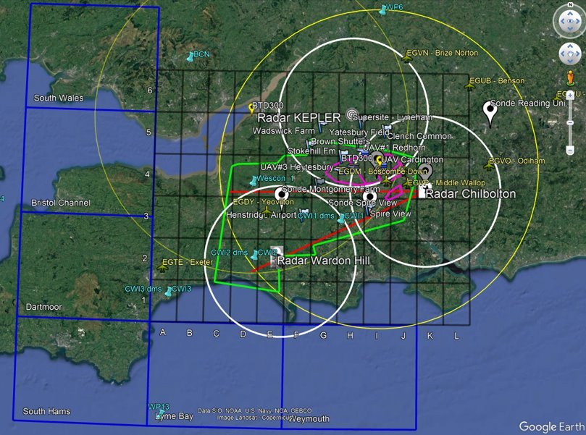

Slide 36
Where have all the ice sheets gone
And where are all the bees?
Where's the Tory government to fight the rising seas?
Isn't there a Dutch Prince who has a physics book?
Flying high, FAAM pitches and rolls
And turbulence has Paul shook

Slide 37
I need a hero
I'm holding out for net zero and the end of the flight
They've gotta be strong
And they've gotta be fast
And they've gotta be fresh from whiteknights

Slide 38
I need a hero
I'm holding out for a hero 'til the morning light
They've gotta be sure
And it's gotta be soon
And they've gotta be larger than life
Larger than life

Slide 39
Somewhere in the Hoskins
Inside one L forty two
Running SCENARIO DTP
There's someone claiming back for you
Bringing in the biscuits and heating up the tea
It's gonna take a Fairy Wendy to get me through my PhD (yeah)

Slide 40
I need you Wendy
I'm holding out for you Wendy 'til the end of the flight
She's gonna be strong
And she's gonna be fast
And she's fresh from the Isle of Wight

Slide 41
I need net zero
I'm holding out for net zero til the carbon is right
We've gotta get green
And it's gotta be soon
And it's gotta be Fairy Wendy, Fairy Wendy

Slide 43
— Interval —

Slide 44
travel

Slide 45
I thought change was only true in COP reports
Meant for governments but not for me.
Carbon’s out to get me
That's the way it seems.
Global warming haunted all my dreams.

Slide 46
Donkey made a case, now I'm a believer
Not a trace, of p-m ten
Now I'm green, I'm a believer!
I couldn't litter if I tried.

Slide 47
I thought change was more or less some fake news thing,
Seems the more I read the less that's true.
I see use in tryin'
There’s a lot to gain.
Just like getting rid of acid rain.

Slide 48
Donkey made me change, now I'm a lot cleaner
I was deranged, no doubt in my mind.
I'm in awe, now I’m much greener!
I couldn't eat beef if I tried.

Slide 49
Pessimism got me
Now, that's the way it seemed
SSPs (Shared Socioeconomic Pathways), haunted all my dreams

Slide 50
Then Donkey made his case, now I'm an achiever
Was in a daze, no doubt in my mind.
I'm in awe, now I’m a dreamer!
Couldn't be bitter if I tried.

Slide 51
travelv

Slide 52
Swamp
Notes:
Scene 1

Slide 53
SUSTAIN
Suspiciously Unachievable Sustainable Transition Assessment INitiatives

Slide 54
Swamp
Notes:
Scene 1

Slide 55
Turning off the Racc to savE Electricity
Friendly ReorganisatiOn of Grants
Providing Less Access to coNferEnces in europe by Train
rECycling bins to One BIN

Slide 56
Swamp
Notes:
Scene 1

Slide 57
He was Thorwald
She was FionEd
Can I make it any more academic?
He loved research
She loved the Earth
What more can I say?

Slide 58
He wanted her
She'd never tell
Secretly she wanted to excel
But all of her peers
Stuck to their norms
They had a problem with his novel forms

Slide 59
He was a radar boy
She said, "See you later, boy"
He wasn't mainstream enough for her
She had a brilliant mind
Her focus was hard to find
She needed to come back to research

Slide 60
Five years from now
She sits at home
Working on papers, she's all alone
She turns on her screen
Guess what she sees
LCP on climate change TV

Slide 61
She calls her colleagues
They already know
And they've all got tickets for his talk show
She tags along
And stands in the crowd
Looks up at the man that she turned down

Slide 62
He was a climate boy
She said, "See you later, boy"
He wasn't mainstream enough for her
Now he's a superstar
Presenting on webinars
Does your great mind see what he's worth?

Slide 63
He was a radar boy
She said, "See you later, boy"
He wasn't mainstream enough for her
Now he's a superstar
Presenting on webinars
Does your great mind see what he's worth?

Slide 64
Sorry, girl, but you missed out
Well, tough luck, that boy’s mine now
We are more than just colleagues
The collaboration ends

Slide 65
Too bad that you couldn't see
See the impact that boy could be
There is more than meets the eye
I see the knowledge that’s inside

Slide 66
He's just a guy
And I'm just a girl
Can I make it any more logical?
We are in sync
Haven't you heard
How we explore each other's words

Slide 67
I'm with the climate boy
I said, "See you later, boy"
I'll be in the lab after the show
I'll be at a conference
Discussing the evidence
About a world we used to know

Slide 68
I'm with the climate boy
I said, "See you later, boy"
I'll be in the lab after the show
I'll be at a conference
Discussing the evidence
About a world we used to know

Slide 69
Swamp
Notes:
Scene 1

Slide 70
The BH Stripes (Charquaad-Perez and Hawkins, 2023)

Slide 71
Swamp
Notes:
Scene 1

Slide 72
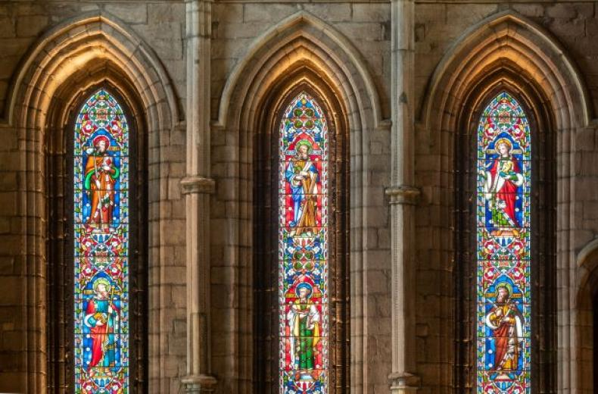
Notes:
Scene 6

Slide 74
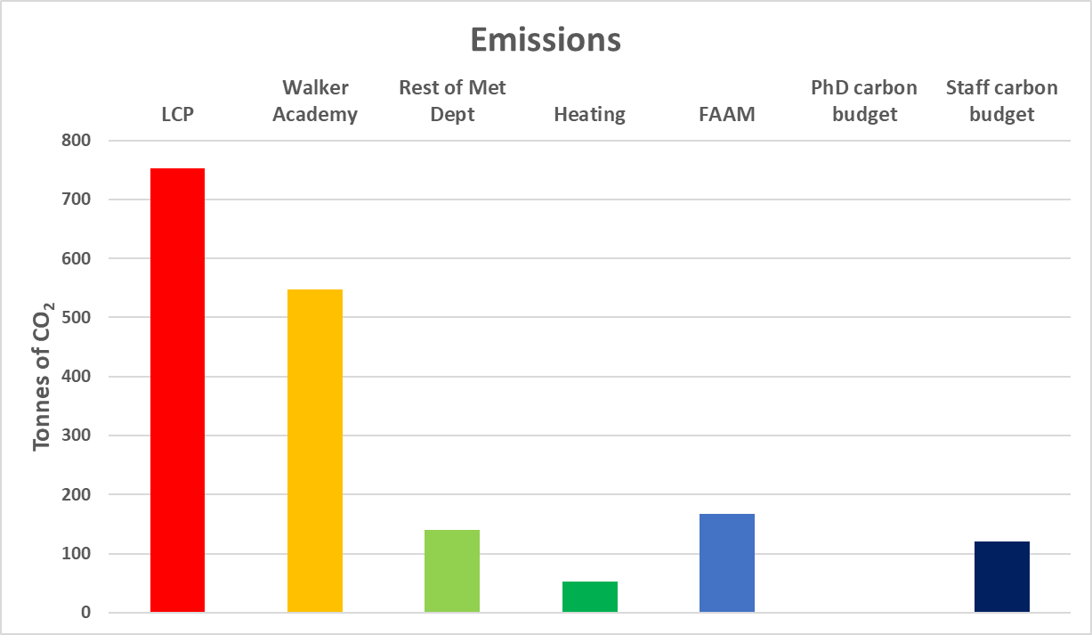

Slide 76
We’re into ecosystems
Recycling and plant-based pork
We feel a premonition
We’ll use a bamboo spork

Slide 77
We’re into green solutions
Solar panels shining bright
We’ve got a new ambition
Net zero is in sight

Slide 78
We’ll make you plant some new trees, then go measuring the rain
We’ll make you live the climate life, wash away the carbon stain
Like a fresh breeze through the vane
Come on!

Slide 79
Carbon, methane out
We’re livin' la vida eco
We’ll write and publish while
Livin' la vida eco

Slide 80
Our papers are well read
And our actions super-eco
We will help Earth out
Livin' la vida eco
Livin' la vida eco
Livin la vida eco

Slide 81
Woke up in the Met Department
It was dark and the lights were out
They turned them off just to save some carbon
It was cold, heating’s off as well

Slide 82
We’ll never use a plastic straw
Only sip from eco cups
And once you've joined our cause, you'll know
The world can level up
Yeah, we’ll make you go all in
Come on!

Slide 83
Private jets are out
We’re livin' la vida eco
We'll thrive and live longer
Livin' la vida eco

Slide 84
PM (Particulate Matter) two point five
Is significantly lower
We will help you out
Livin' la vida eco
Livin' la vida eco
Livin la vida eco

Slide 85
Swamp
Notes:
Scene 1

Slide 86
FIN

Slide 87
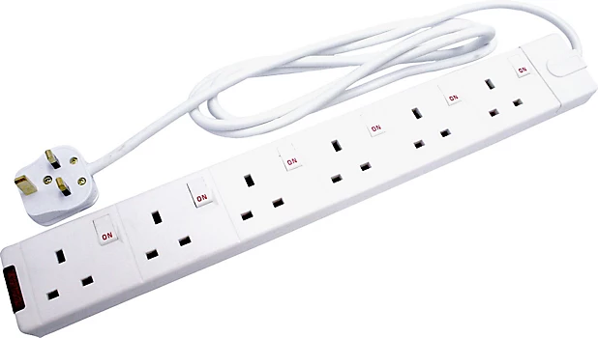
BIG THANKS TO
For powering the department, leading us through difficulties, and allowing us to believe that nothing is out of reach…
Beth’s extension lead

Slide 88
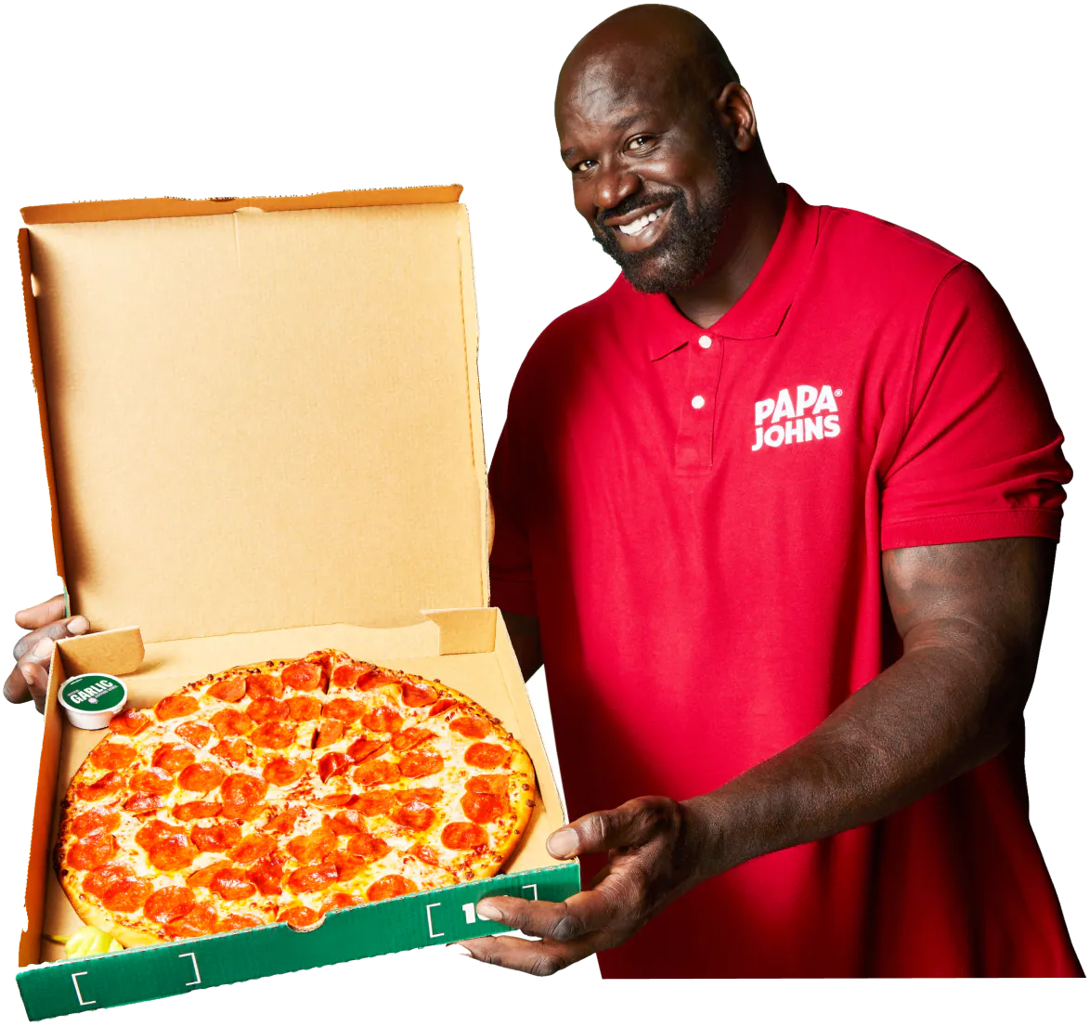
BIG THANKS TO
For fuelling the prop making and singing sessions
Shaquille “Shaq” Rashaun O’Neal x Papa John’s: Shaq-a-Roni pizza

Slide 89
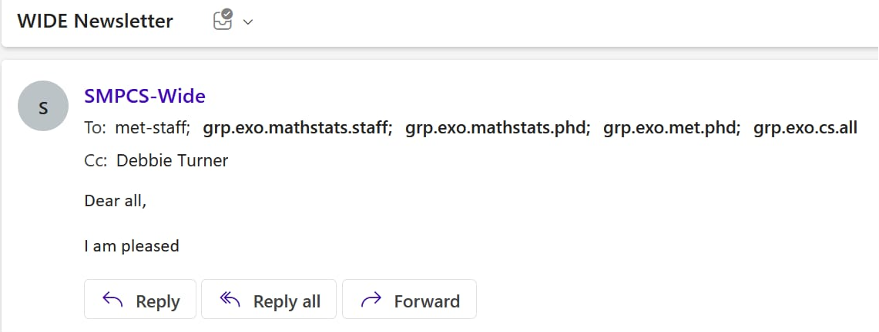
BIG THANKS TO
All of the staff for unknowingly providing us with content for the last year!

Slide 90
Wendy
BIG THANKS TO

