Slide 1

10

Slide 3


Slide 4
THE ADVENTURES OF
THE MR METS

Slide 5
Episode 11:
DR INNESS’S
LONG-AWAITED
MR METS DEBUT

Slide 7
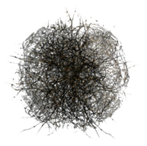
Meteorology

Slide 9
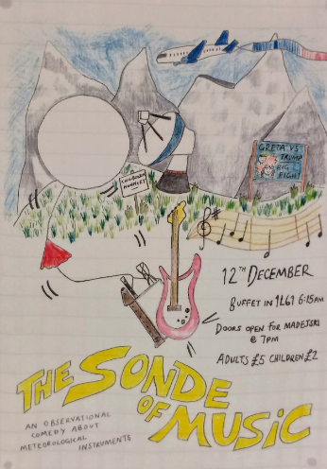

IT can help to upgrade to Windows 10...
DO IT NOW OR SUFFER THE CONSEQUENCES
-- Mr Blanchonnet

Slide 12
NO ENTRY Use One-Way System

Slide 14
3L corridor

Slide 15
Access to roof only
THROUGH
THIS DOOR

Slide 18
Where is everyone?

Slide 19
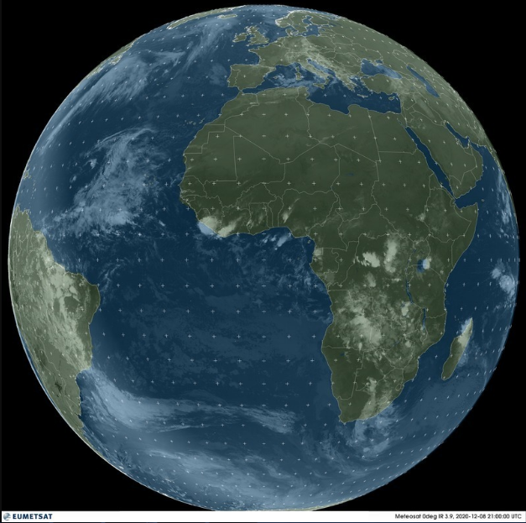
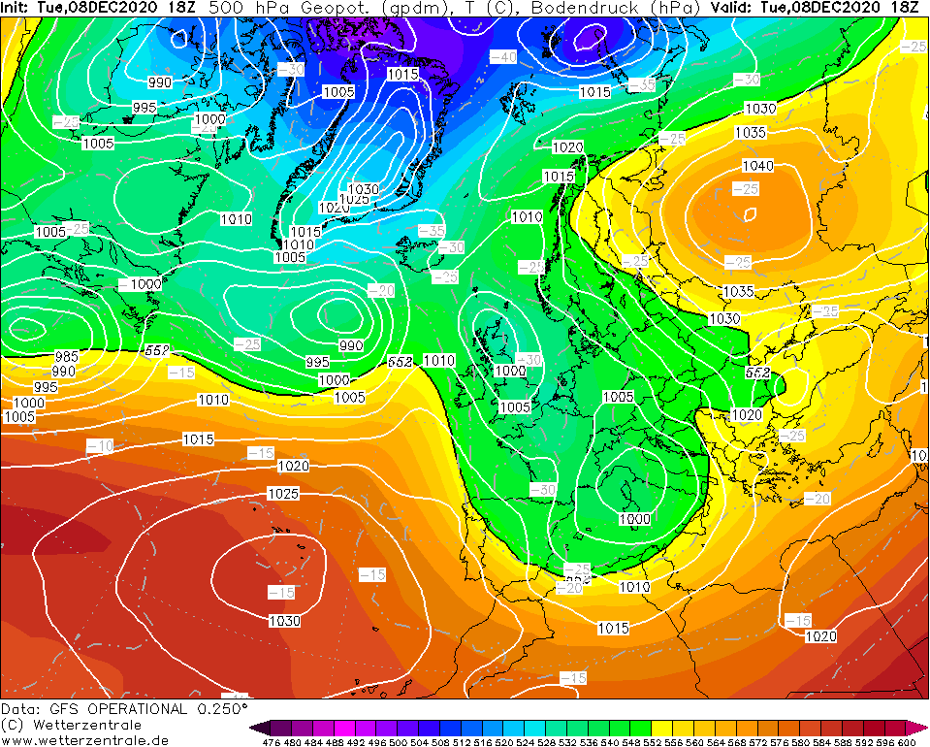
EXTERMINATE

Slide 20
Where is everyone?

Slide 21
EXTERMINATE

Slide 22
Where is everyone?

Slide 23
EXTERMINATE
EXTERMINATE

Slide 24
Where is everyone?

Slide 25
EXTERMINATE

Slide 26
Where is everyone?

Slide 27
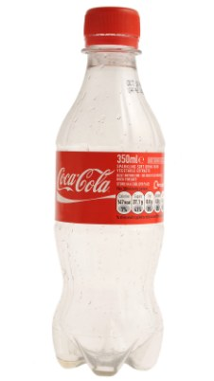
EXTERMINATE

Slide 28
Where is everyone?

Slide 29
EXTERMINATE

Slide 30
Where is everyone?

Slide 31
EXTERMINATE

Slide 32
EXTERMINATE

Slide 33
EXTERMINATE

Slide 34
Where is everyone?

Slide 35
EXTERMINATE

Slide 36
Where is everyone?

Slide 37
EXTERMINATE

Slide 38
Where is everyone?

Slide 39
FOOD
MILK
ONLY
OTHER FRIDGE

Slide 40
MILK
ONLY

Slide 42
Where is everyone?
EXTERMINATE

Slide 44
Mic
Sound
Video
Participants
Share
Smile
Chat
Leave

Slide 45
Prof Charlton-Perez
Mic
Sound
Video
Participants
Share
Smile
Chat
Leave

Slide 46
Prof Harrison
Mic
Sound
Video
Participants
Share
Smile
Chat
Leave

Slide 47

Prof Ambaum
Mic
Sound
Video
Participants
Share
Smile
Chat
Leave

Slide 48

Dr Shonk
Mic
Sound
Video
Participants
Share
Smile
Chat
Leave

Slide 49
Prof Ambaum
Mic
Sound
Video
Participants
Share
Smile
Chat
Leave

Slide 50
Prof Charlton-Perez
Mic
Sound
Video
Participants
Share
Smile
Chat
Leave

Slide 51
Prof Methven
Mic
Sound
Video
Participants
Share
Smile
Chat
Leave

Slide 52
Prof Charlton-Perez
Mic
Sound
Video
Participants
Share
Smile
Chat
Leave

Slide 53

Dr Tailleux
Mic
Sound
Video
Participants
Share
Smile
Chat
Leave

Slide 54
Prof Clark
Mic
Sound
Video
Participants
Share
Smile
Chat
Leave

Slide 55
Prof Ambaum
Mic
Sound
Video
Participants
Share
Smile
Chat
Leave

Slide 56
Prof Charlton-Perez
Mic
Sound
Video
Participants
Share
Smile
Chat
Leave

Slide 58
NO ENTRY Use One-Way System

Slide 60
3L corridor

Slide 64
MOO
MILK

Slide 65


Slide 66
MOO
MILK

Slide 68
MOO
MILK

Slide 70
MOO
MILK

Slide 71
MOO
MILK

Slide 74
THE END

