Slide 1
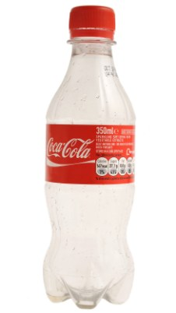

Slide 2
THE ADVENTURES OF
THE MR METS

Slide 3
Episode 10:
PROF HARRISON’S
FIRST SYMPHONY

Slide 6
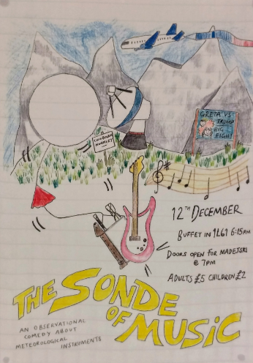
IT can help to upgrade to Windows 10...
DO IT NOW OR SUFFER THE CONSEQUENCES
-- Mr Blanchonnet

Slide 7
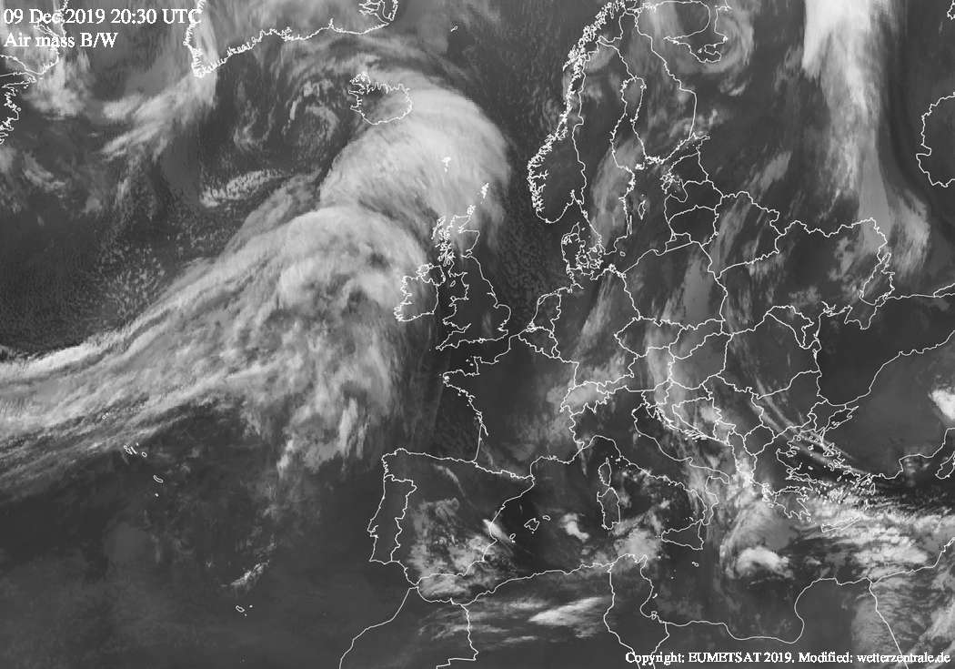
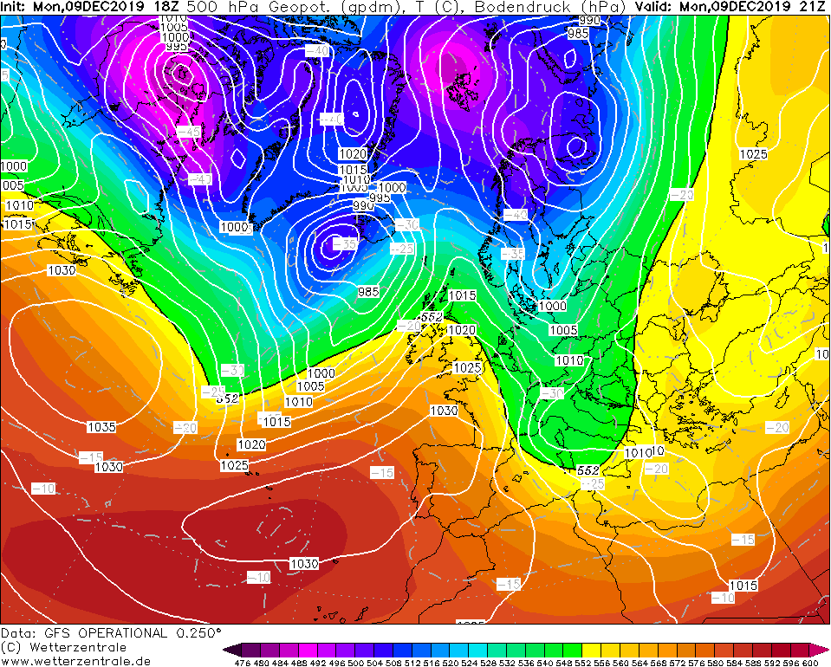
Ted
Ted

Slide 8
IT can help to upgrade to Windows 10...
DO IT NOW OR SUFFER THE CONSEQUENCES
-- Mr Blanchonnet

Slide 9
Ted
Ted

Slide 10
IT can help to upgrade to Windows 10...
DO IT NOW OR SUFFER THE CONSEQUENCES
-- Mr Blanchonnet

Slide 12
IT can help to upgrade to Windows 10...
DO IT NOW OR SUFFER THE CONSEQUENCES
-- Mr Blanchonnet

Slide 13
Ted
Ted

Slide 14
IT can help to upgrade to Windows 10...
DO IT NOW OR SUFFER THE CONSEQUENCES
-- Mr Blanchonnet

Slide 16
IT can help to upgrade to Windows 10...
DO IT NOW OR SUFFER THE CONSEQUENCES
-- Mr Blanchonnet

Slide 23
Take CAT to the vet for worming.
Take WIFE to the hairdresser.

Slide 28
1U14
Prof Clark

Slide 35
Notes:
“That sounds a bit stupid to me,” said Prof Ambaum, suspiciously.

Slide 41
JAM
JAM

Slide 43
JAM
JAM

Slide 45
JAM
JAM

Slide 47
Tweetmaster General

Slide 48
Tweetmaster General

Slide 49
Tweetmaster General
Tweety Pie

Slide 50
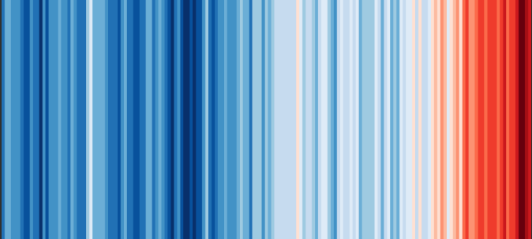
Tweetmaster General
Professor of the Stratosphere

Slide 51
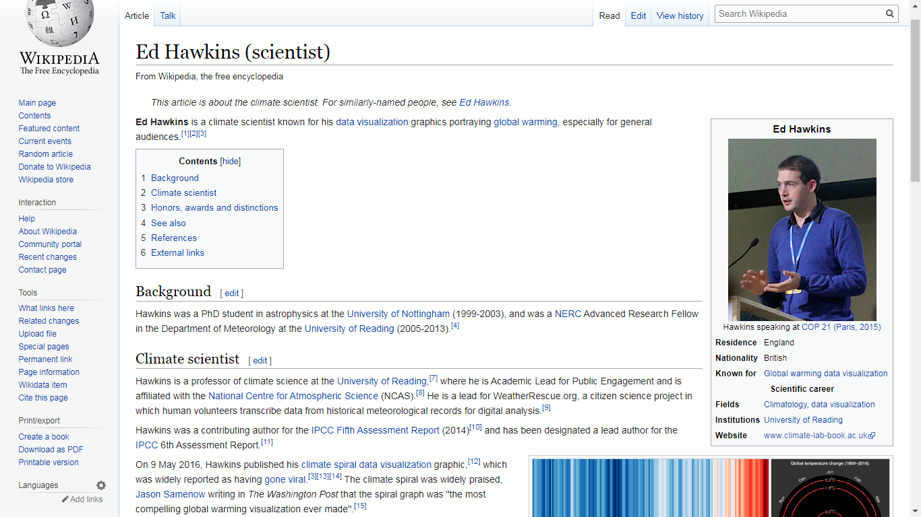
Tweetmaster General
Wikipedia Page
Professor of the Stratosphere
The Day Prof Hawkins Invented Climate Stripes

Slide 53
JAM

Slide 54
YAMAHAHA

Slide 55
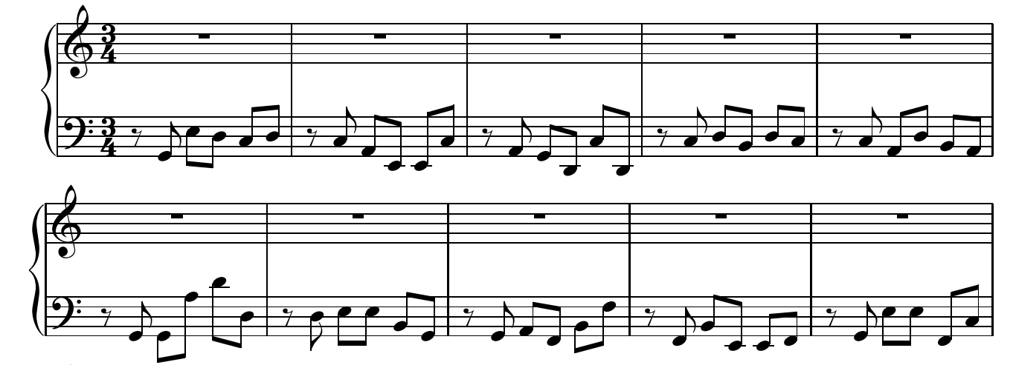
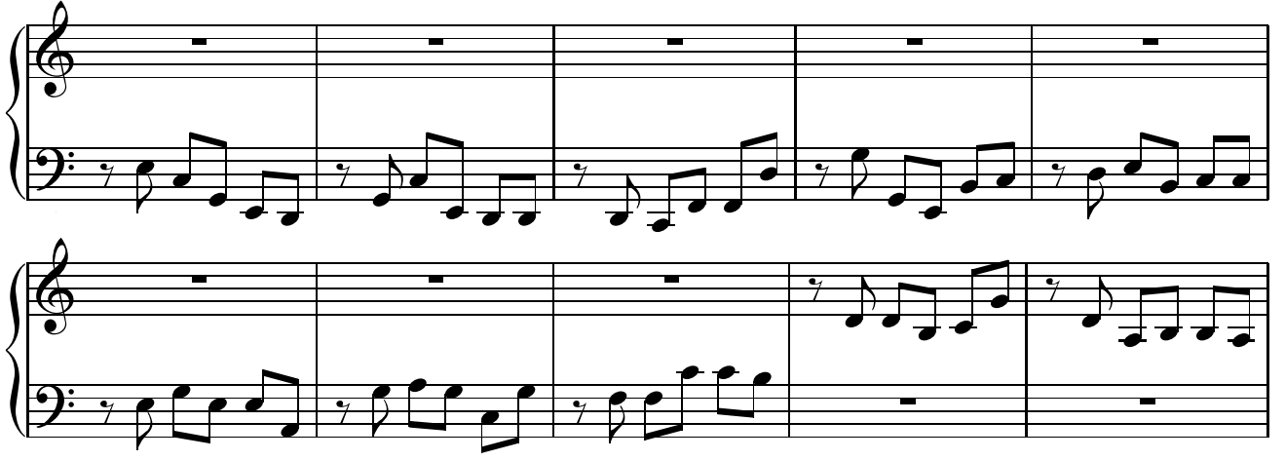
The Climate Notes
1850
1855
1860
1865
1870
1875
1880
1885
1890
1895
1900
1905
1910
1915
1920

Slide 56
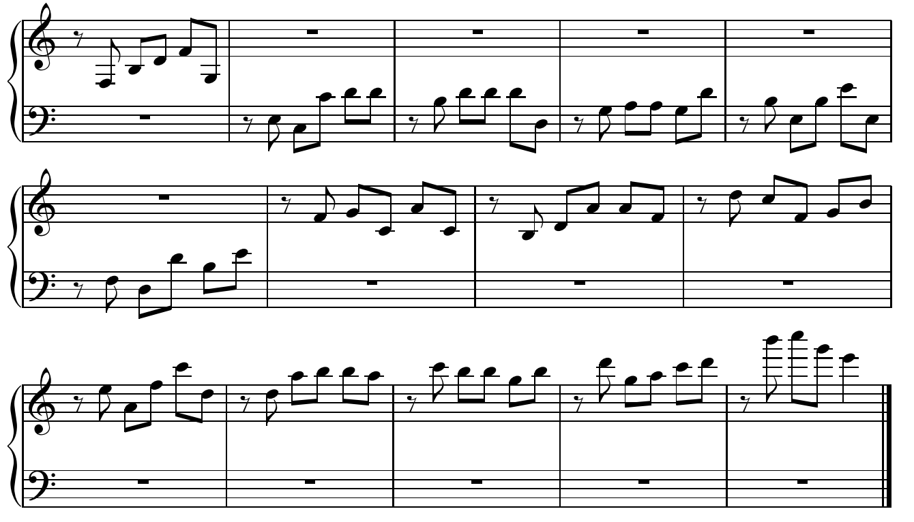
1925
1930
1935
1940
1945
1955
1960
1965
1970
1950
1975
1980
1985
1990
1995
2000
2005
2010
2015

Slide 57
THE END
#ShowYourStripes
#PlayYourNotes

