Slide 1
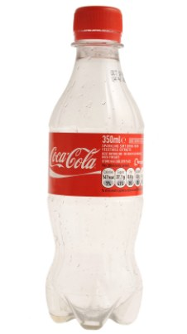

1. Mr Reynolds Saves the Day
2. The Rescue of Prof Illingworth
3. Dr Methven’s Secret Assignment
4. Prof Lockwood’s Unfortunate Incident
5. Dr Ambaum’s Impactful Solution
6. Mr Gill’s Strange Challenge
7. Dr Dacre’s Delivery
8. Prof Clark’s Miracle Panto Cure
6. Mr Gill’s Strange Challenge
7. Dr Dacre’s Delivery
8. Prof Clark’s Miracle Panto Cure

Slide 2
THE ADVENTURES OF
THE MR METS

Slide 3
Episode 9:
#PROF_HAWKINS AND THE COMPUTER TROUBLE

Slide 4

Cafe
Harri-son

Slide 5
Cafe
Harri-son

Slide 6
FROM: Mr Blanchonnet
TO: Happy Met Landers
THE E-MAIL SYSTEM IS DOWN.
MANY OTHER PROGRAMS ARE NOT WORKING PROPERLY.
WE ARE TAKING REMEDIAL ACTION IMMEDIATELY.
WE AIM TO HAVE EVERYTHING BACK UP AND RUNNING IN THREE DAYS.
P.T.O.

Slide 7
Cafe
Harri-son

Slide 15
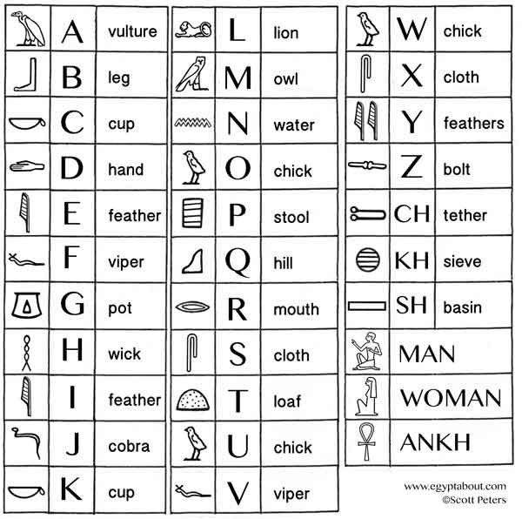

20 °C

Slide 17
ERROR!

Slide 18
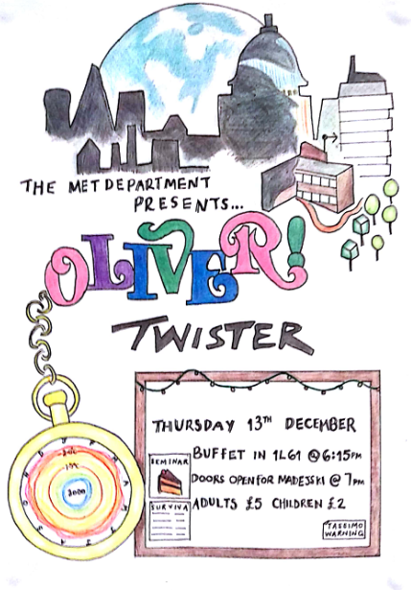

Slide 19
3L49
Prof J. Methven

Slide 21
3L49
Prof J. Methven

Slide 23
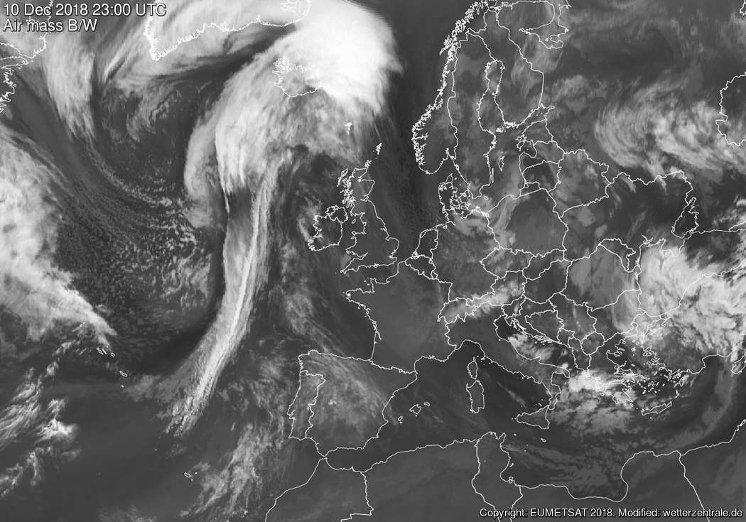
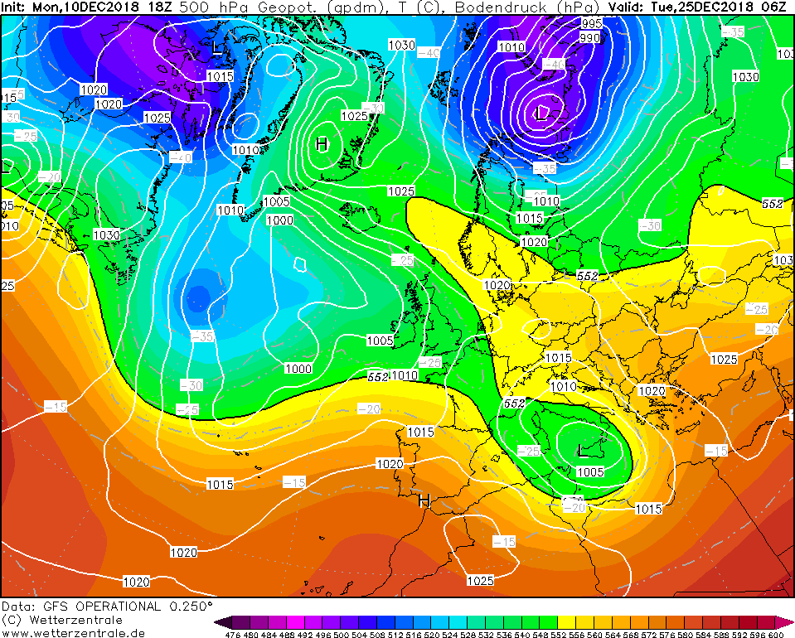


Slide 24
BIG DAVE’S WEATHER OBSERVATION
MET RUNNERS
THIS WEEK’S CHALLENGE

Slide 26
BIG DAVE’S WEATHER OBSERVATION
MET RUNNERS
THIS WEEK’S CHALLENGE

Slide 28
PSYCHO WORLD
HAPPY MET LAND

Slide 29
YE OLDE
MAPPE
HERE BE PSYCHOANALYSIS ROOMS
ENTER YE NOT, LEST YE BE ANALYSED
NCAS
WORLD
HERE BE PSYCHO QUAD
HERE BE
NEW CARPETS
ABANDON YE ALL HOPE
HERE BE SITTING UNDERGRADUATES
HERE BE THE MRI SCANNER
FALL YE NOT OVER THEM
FALL YE NOT INTO IT, LEST YE BE SCANNED

Slide 30
BERKSHIRE TEMPERATURES

Slide 31


Slide 32
BERKSHIRE TEMPERATURES

Slide 34
BERKSHIRE TEMPERATURES

Slide 36
BERKSHIRE TEMPERATURES

Slide 38
118
Mr A. Heaps

Slide 39
SPARE COMPUTER PARTS
SCREW-DRIVERS
LOCAL JASMIN

Slide 41
SPARE COMPUTER PARTS
SCREW-DRIVERS
LOCAL JASMIN

Slide 43
SPARE COMPUTER PARTS
SCREW-DRIVERS
LOCAL JASMIN

Slide 49
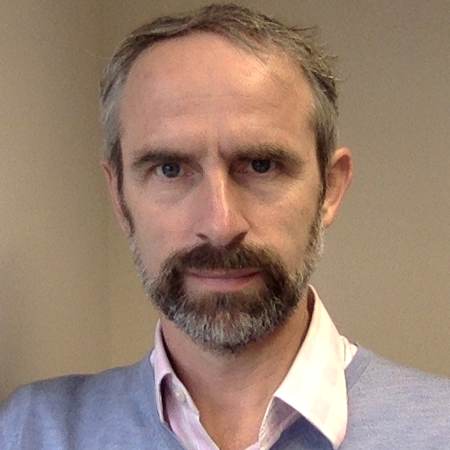
THE END

