Slide 1
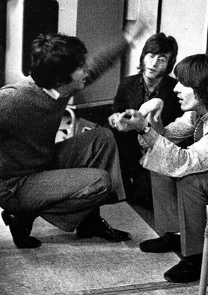
Back in the SCR
Back in the what?

Slide 2
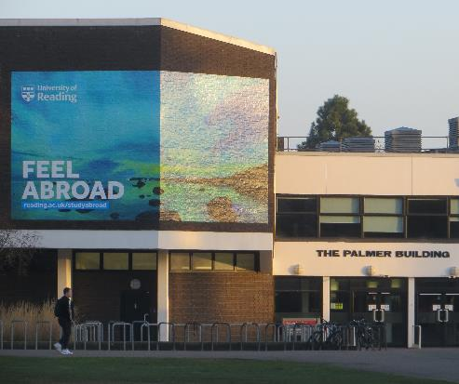

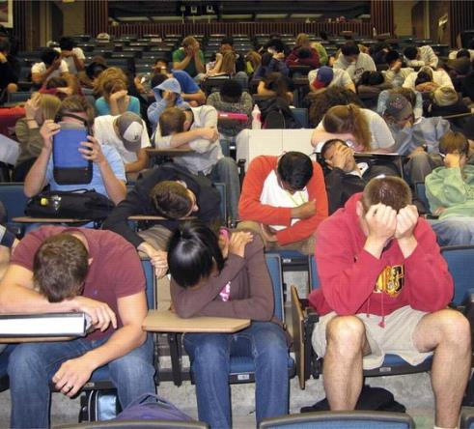
Biked in from the Palmer, where I had to teach
That lecture didn’t go quite right
All the students seemed to be beyond my reach
But then I did go on all night

Slide 3
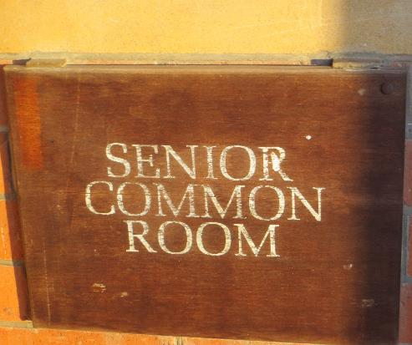
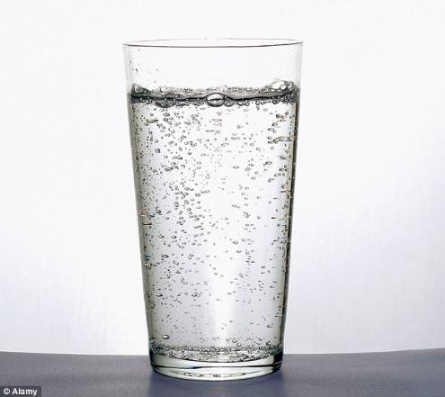
We’re back in the S-CR
You don’t know how thirsty we are, doc
Back in the S-CR

Slide 4
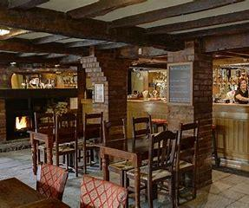
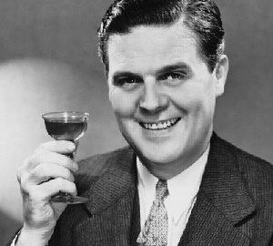
Students never used to be let in the place
Somewhere staff could drink alone
Now we just can’t find a seat, it’s such a disgrace
We stand and sip our sherries and moan

Slide 5

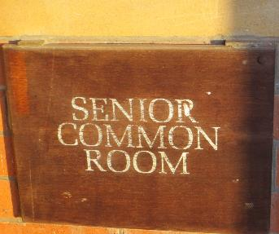
We’re back in the S-CR
You don’t know how hungry we are, doc
Back in the S-CR

Slide 6
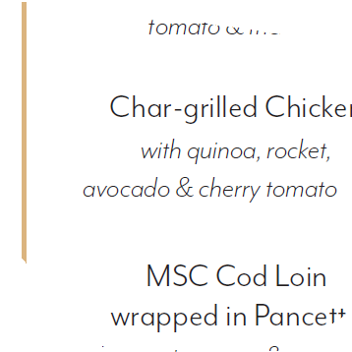

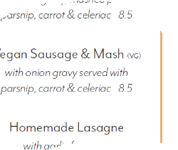
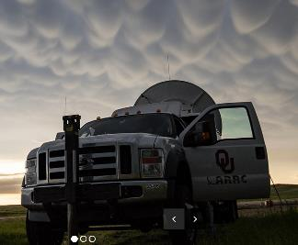
Well, the chargrilled chicken really knocks us out
But we leave the veg behind
And the ve-gan sausage makes us sing and shout
And Oklahoma’s always on our mi-mi-mi-mi-mi-mi-mind

Slide 7
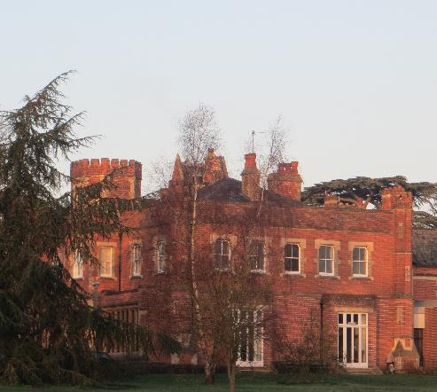
Instrumental break
(without instruments, because they broke ☹)

Slide 8
We’re back in the S-CR
You don’t know how grumpy we are, doc
Back in the S-CR

Slide 9
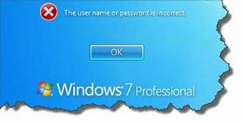
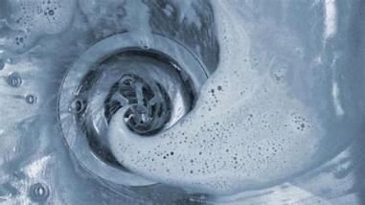

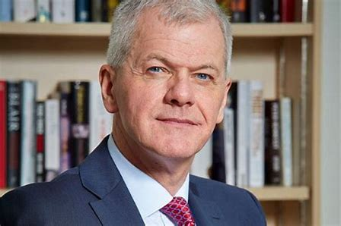
Well the IT system often locks us out
Our passwords can’t be right
Our M-drives go on a walkabout
But David Bell’s no longer on our mi-mi-mi-mi-mi-mi-mind

Slide 10
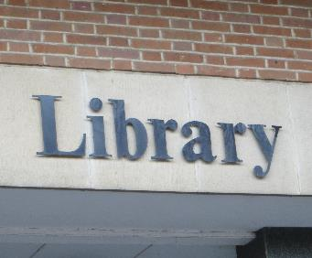
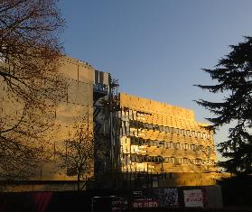

Show us your refurbished library just outside
Yes, we’ll bring our Campus Cards
Forty-million pounds, did we hear you right?
At least it’s got a gold façade

Slide 11
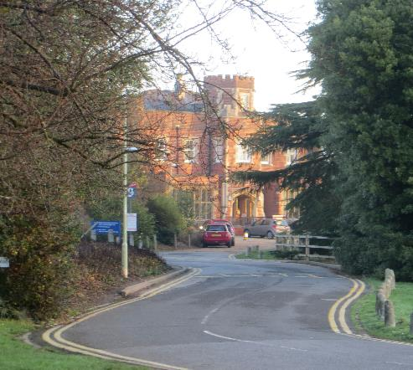
We’re back in the S-CR
You don’t know how lucky we are, doc
Back in the S-CR

Slide 12
Back in the SCR
Imagine … there’s no SCR. That gives me an idea

