Slide 1
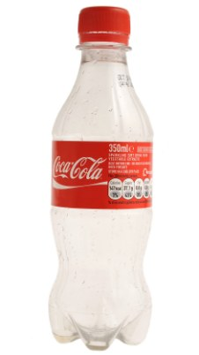

Slide 2
THE ADVENTURES OF
THE MR METS

Slide 3
Episode 7:
DR DACRE’S DELIVERY

Slide 4
WRITE PANTO AFTER PARTY SONG REQUESTS HERE!
I’m too sexy –Right Said Fred
Cotton eye joe macarena
Agadoo doo doo
Something by Taylor Swift
Weather With You – Crowded House
Blame it on the Weatherman – B*witched

Slide 5
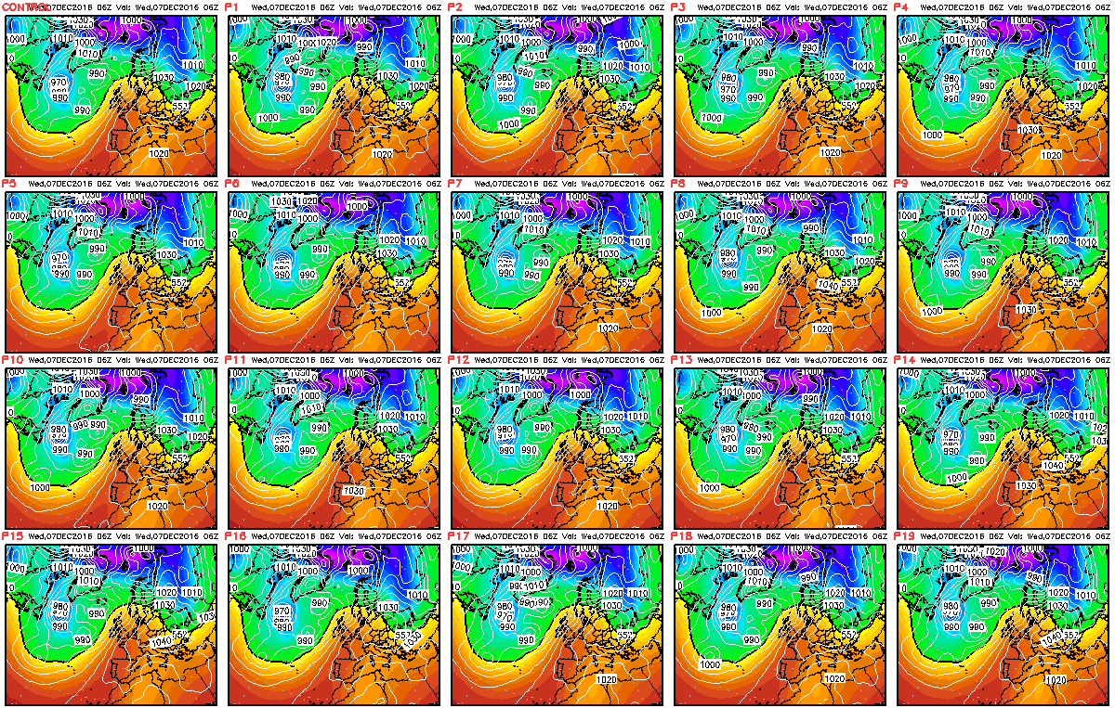
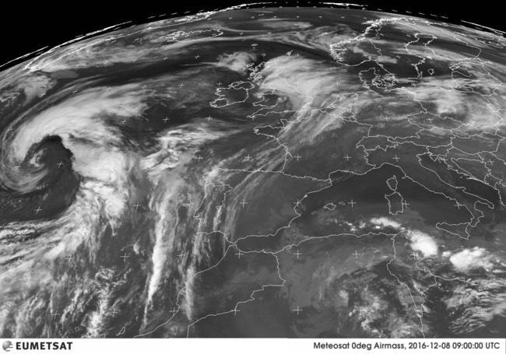

Slide 6
WRITE PANTO AFTER PARTY SONG REQUESTS HERE!
I’m too sexy –Right Said Fred
Cotton eye joe macarena
Agadoo doo doo
Something by Taylor Swift
Weather With You – Crowded House
Blame it on the Weatherman – B*witched

Slide 10
TO:
Dr Dacre
Happy Met Land
DELIVERED BY
YODEL

Slide 16
Mete

Slide 17
Mete

Slide 21
Mete

Slide 24
Mete

Slide 30
Meteorology

Slide 32
Meteorology

Slide 37
Mete

Slide 38
THE END

