Slide 1
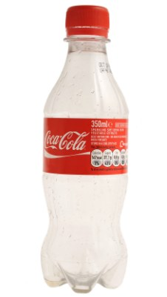

Slide 2
THE ADVENTURES OF
THE MR METS

Slide 3
Episode 6:
MR GILL’S
STRANGE CHALLENGE

Slide 4
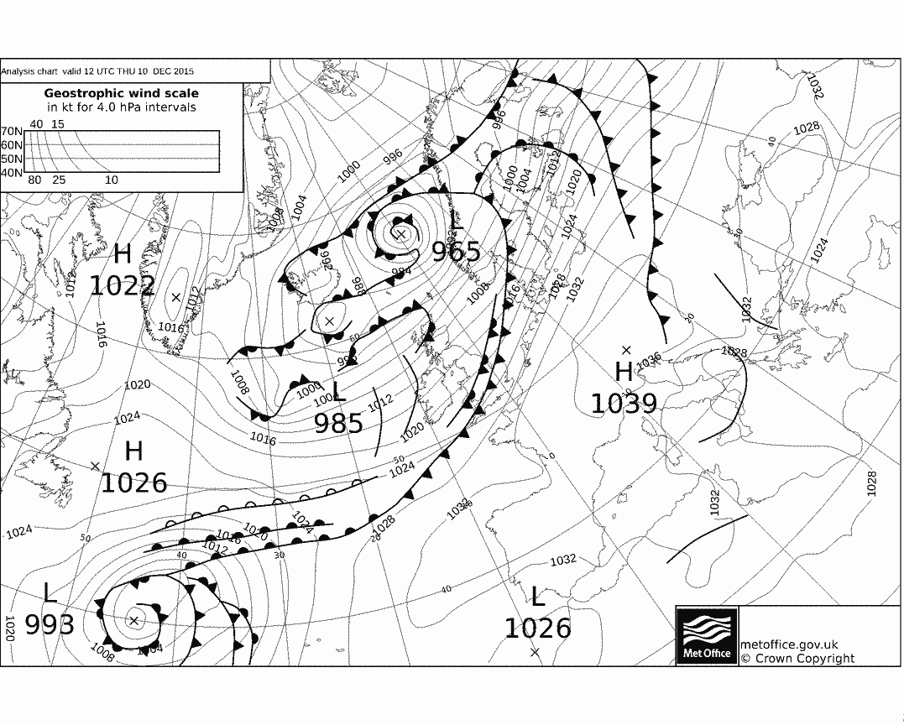
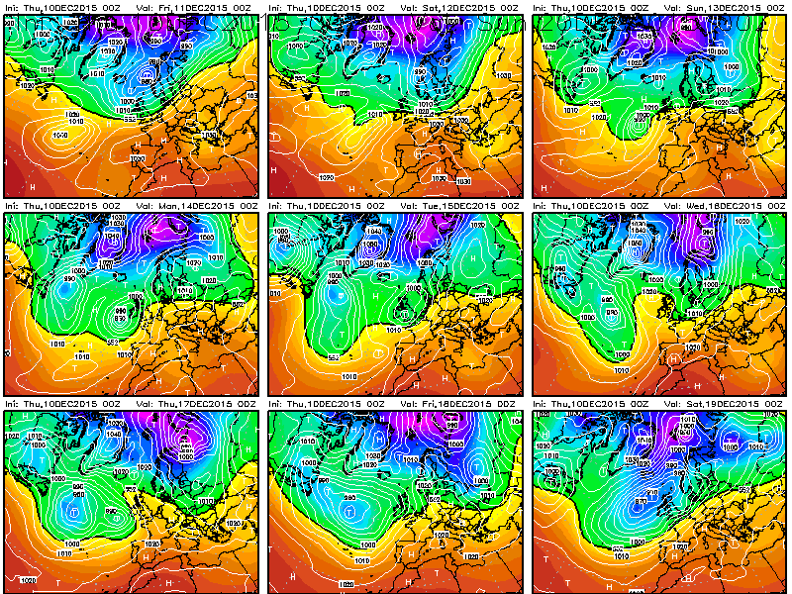

Slide 5
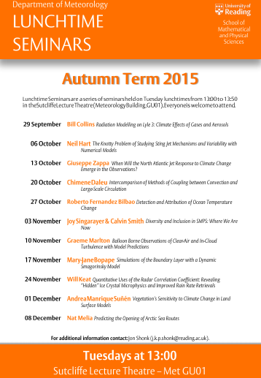
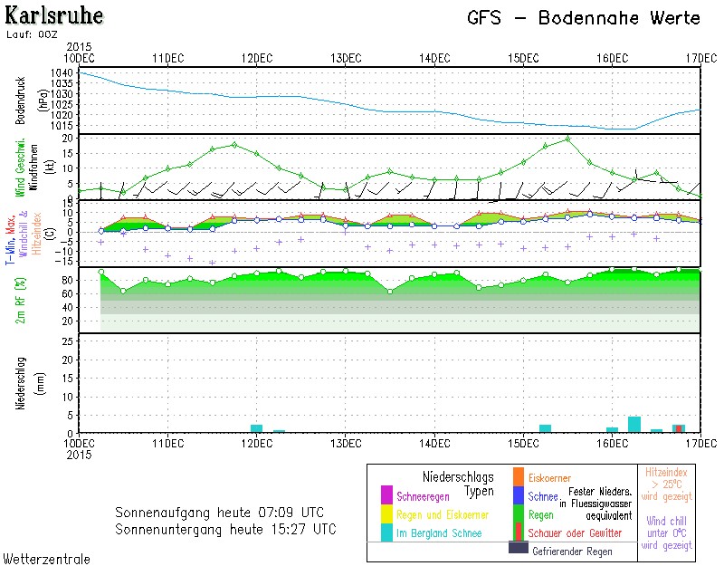

Slide 6
Join READING UNIVERSITY
METEOROLOGY SOCIETY!!!
I love entropy!
MScs: buy Dr Ambaum’s book!

Slide 8
Join READING UNIVERSITY
METEOROLOGY SOCIETY!!!
I love entropy!
MScs: buy Dr Ambaum’s book!

Slide 10
Join READING UNIVERSITY
METEOROLOGY SOCIETY!!!
I love entropy!
MScs: buy Dr Ambaum’s book!

Slide 11
Health and Safety Form
................ __
............. __
___
Signed_____
Date_____

Slide 16
Z
Z
Z
Z
Z

Slide 19
Join READING UNIVERSITY
METEOROLOGY SOCIETY!!!
I love entropy!
MScs: buy Dr Ambaum’s book!

Slide 23
Join READING UNIVERSITY
METEOROLOGY SOCIETY!!!
I love entropy!
MScs: buy Dr Ambaum’s book!

Slide 26
Join READING UNIVERSITY
METEOROLOGY SOCIETY!!!
I love entropy!
MScs: buy Dr Ambaum’s book!

Slide 28
Join READING UNIVERSITY
METEOROLOGY SOCIETY!!!
I love entropy!
MScs: buy Dr Ambaum’s book!

Slide 31
Health and Safety Form
................ __
............. __
___
Signed_____
Date_____

Slide 33
Health and Safety Form
................ __
............. __
___
Signed_____
Date_____

Slide 34
................ __
............. __
................ __
............. __

Slide 39
................ __
............. __
................ __
............. __

Slide 41
................ __
............. __
................ __
............. __
................ __
............. __
................ __
............. __

Slide 43
THE END

