Slide 1
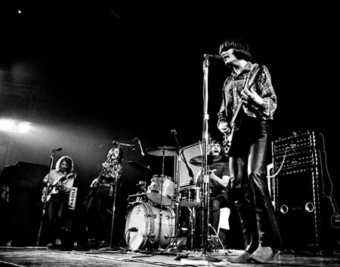
With apologies to John Fogerty and Creedence Clearwater Revival

Slide 2
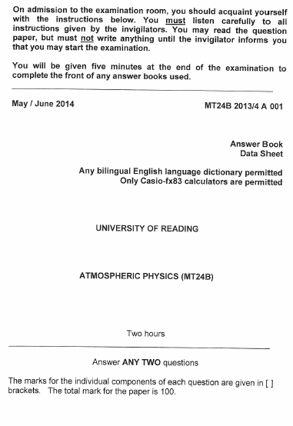
I see bad marks arising
I see questions you’ll avoid
I see equations (that) need deriving
I feel my red pen getting annoyed

Slide 3
Don’t use Fahrenheit
Your answer won’t be right
Now’s a good time to revise
Be it geopotential height
Or ultraviolet light
It’s about time you revised

Slide 4
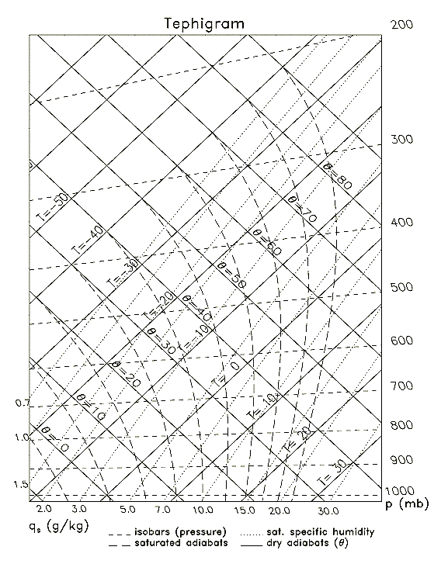
Hope you can get your head together
There’s fronts you’ll have to classify
It won’t be just about the weather
You’ll need that stuff on entrop-i

Slide 5
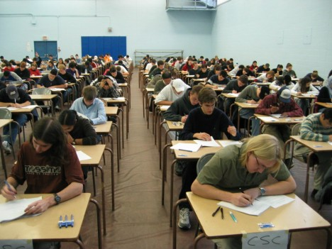
Don’t go out tonight
You won’t know what to write
It’s about time you revised
Have you been up all night?
You look a sorry sight
The exam room’s on the right

Slide 6
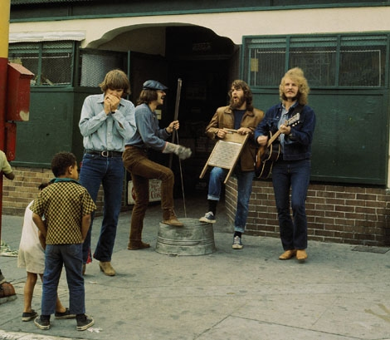
Instrumental bit …

Slide 7
I can’t see where your answer’s going
I can’t see what you’re trying to prove
I can’t see what your equat’ns showing
Or why those terms have been removed

Slide 8
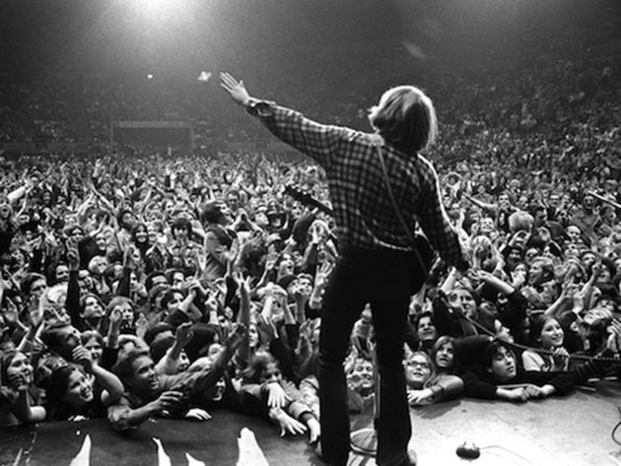
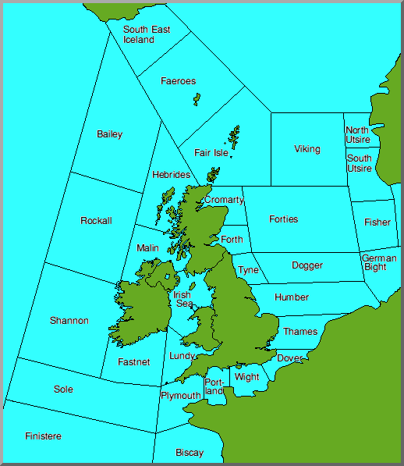
In Sole or German Bight
Your forecast won’t be right
It’s a bit late to revise
Wind won’t turn to the right
If the sign’s not right
It’s a bit late to revise
It’s a good time to revise
It’s about time you revised

