Slide 1
THE ADVENTURES OF
THE MR METS

Slide 2
Episode 4:
PROF LOCKWOOD’S UNFORTUNATE INCIDENT

Slide 3
LAST TIME
ON THE MR METS...

Slide 4
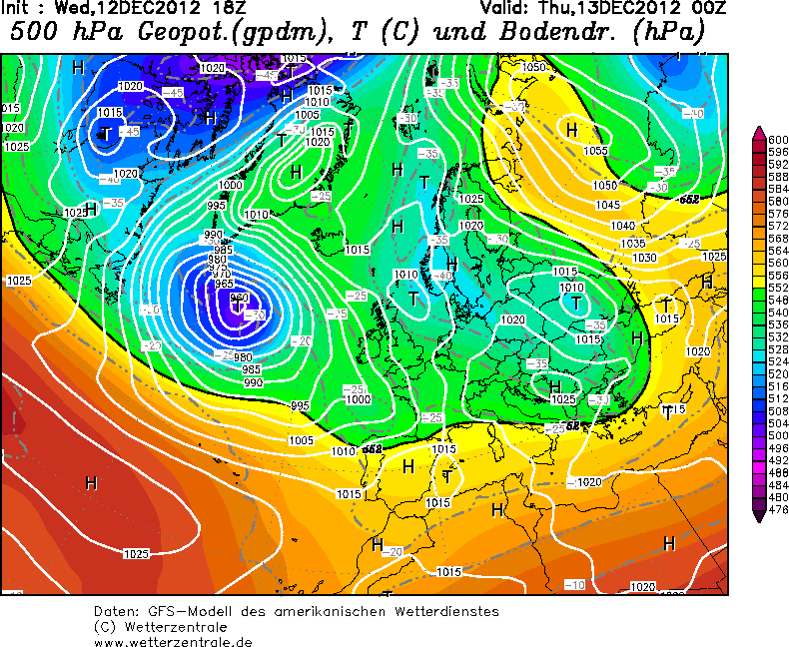
LAST TIME...

Slide 5
LAST TIME...

Slide 6
FAAM
Meteorology

Slide 10
FAAM
FAAM
Meteorology

Slide 11
Meteorology

Slide 13
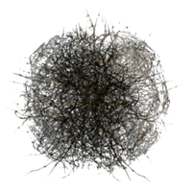

Slide 14
YOU ARE NOW LEAVING
HAPPY MET LAND
POPULATION: 500

Slide 15
YOU ARE NOW LEAVING
HAPPY MET LAND
POPULATION: 500
POPULATION: 495

Slide 16
MIGHTY SWAMP

Slide 17
BRIDGE OF BROKEN FACES
LAKE OF BOTULISM

Slide 18
HERE BE DRAGONS

Slide 19
WELCOME TO
SUGAR-
LAND
POPULATION: 0
POPULATION: 5

Slide 20
SUGARLAND

Slide 21
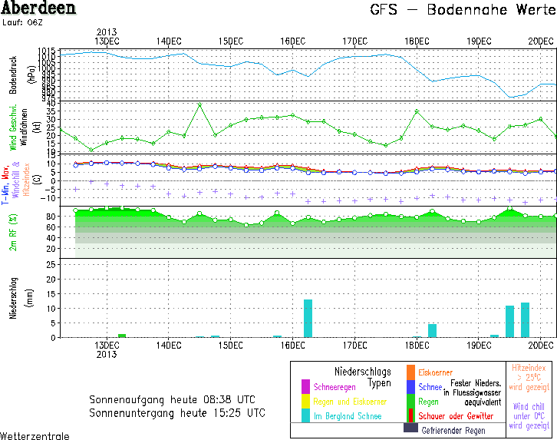
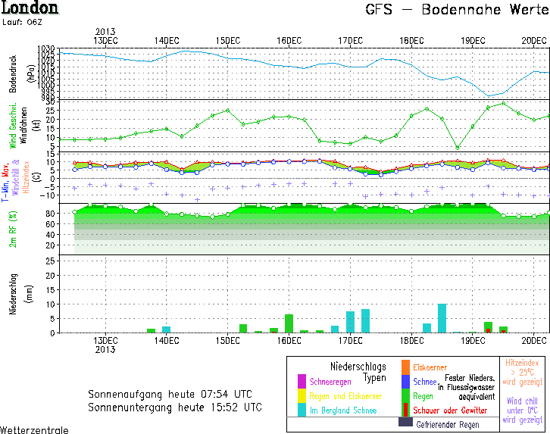

Slide 22
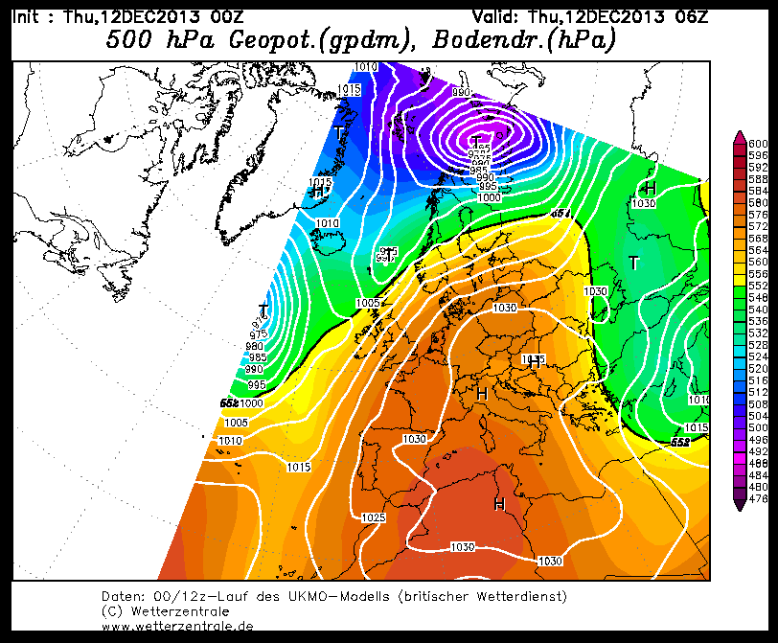

Slide 24
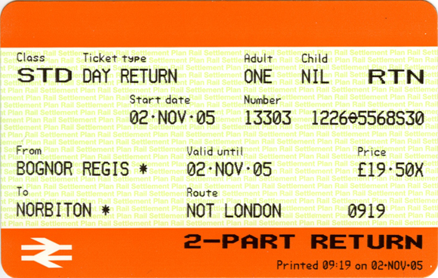
FIFTH
SINGLE
ONE
NIL
OUTWARD
12-DEC-13
3.14159265358979323...
HAPPY MET LAND
12-DEC-13
BASINGSTOKE
FGW

Slide 30
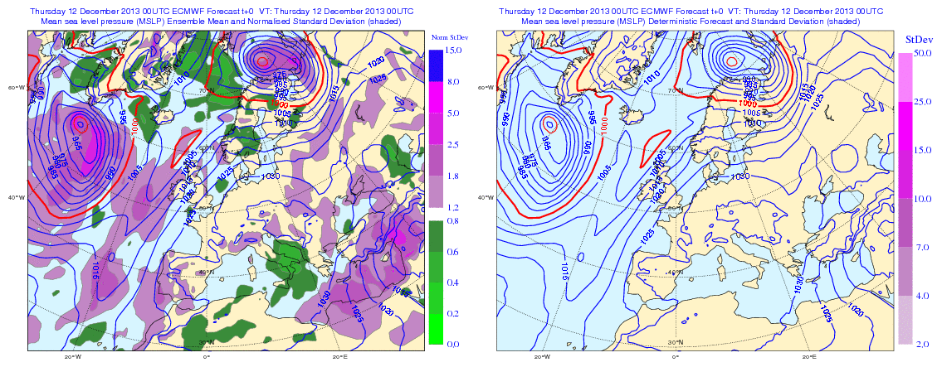

Slide 32
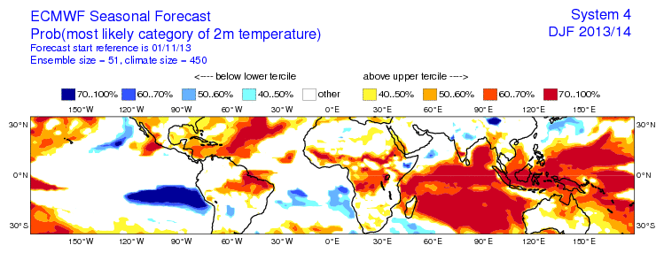
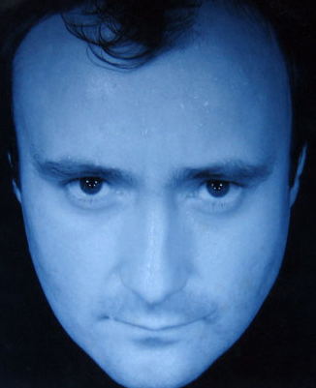

Slide 41
TO BE CONTINUED...

Slide 49
BBC Acorn Microcomputer (c) 1981
BASIC 1.0
Ready
>
_

Slide 51
BBC Acorn Microcomputer (c) 1981
BASIC 1.0
Ready
10 CLS
20 PRINT "Hello World"
30 GOTO 20
run
Hello World
Hello World
Hello World
Hello World
Hello World
Hello World
Hello World
Hello World
Hello World
Hello World
Hello World
Hello World
_

Slide 53
YE OLDE MAPPE
SUGARLAND
LA
HERE BE
DRAGONS
HERE BE
DRAGONS
LAKE OF BOTULISM
BRIDGE OF BROKEN FACES
MIGHTY
SWAMP
HAPPY MET LAND
NOT-SO-HAPPY AG LAND

