Slide 1
Reading sUPERVISOR DEVELOPMENt Programme
With apologies to
Benny and Björn

Slide 2
(I’m your) Supervisor having to remind you
Your thesis is almost due
You’re still on Chapter 2
We really must see something new

Slide 3
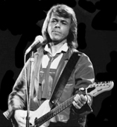
Instrumental bit … please be patient

Slide 4
I am sikk and tyred of your spellink
And I’m only reeding the intro
At least I’ll have something to sing
About – at the Department Panto
So I imagine I can see the end is coming
Suddenly I feel all right
And its gonna be so different
At the S-C-R tonight!

Slide 5
(Yes, I’m your )
Supervisor, please don’t say “who are you?”
You can’t fool anyone
If your program just won’t run
And your writing’s only just begun
(Yes, I’m your)
Supervisor , coming to remind you
Your thesis is now due
I’m reading Chapter 2
We really must see something new

Slide 6
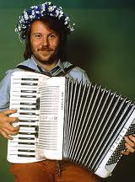
En annan avgörande bit. Ha tålamod igen

Slide 7
Twenty thousand of your words
And not even a single reference (not even Hoskins et al. (1985))
Your, punctuation; is - absurd
No clue how to end a sentence,
There are moments when the meaning seems so hazy
And it surely can’t be right
Everything will be so different
When you re-write it tonight!

Slide 8
(Yes, I’m your )
Supervisor, please don’t say “who are you?”
You can’t fool anyone
If your program just won’t run
And your writing’s only just begun
(Yes, I’m your)
Supervisor, coming to remind you
Your thesis is overdue
I’m reading Chapter 2
We really must see something new

Slide 9
(Yes, I’m your )
Supervisor, please don’t say “who are you?”
You can’t fool anyone
If your program just won’t run
And your writing’s only just begun
(Yes, I’m your)
Supervisor, coming to remind you
Your thesis is overdue
I’m reading Chapter 2
We really must see something new

