Slide 1
THE ADVENTURES OF
THE MR METS

Slide 2
Episode 3:
DR METHVEN’S
SECRET ASSIGNMENT

Slide 4
DALE: 4 NEIL: 7
DALE: 5 NEIL: 7

Slide 5
ROSS

Slide 6
ROSS REYNOLDS
Happy Met Land
Award for Awesomeness

Slide 7
ROSS REYNOLDS
Happy Met Land
Award for Awesomeness

Slide 8
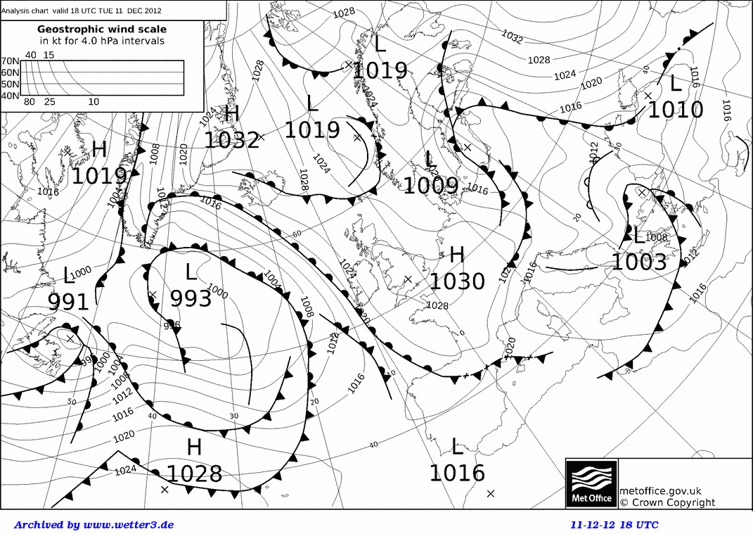
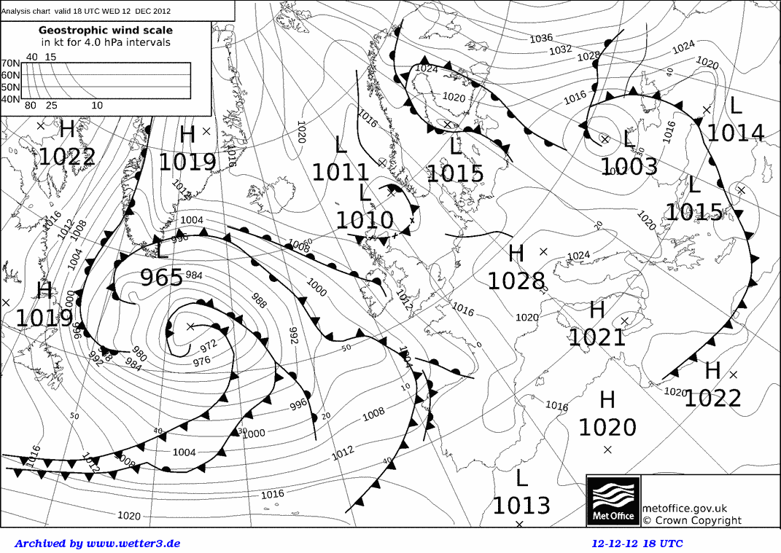

Slide 12
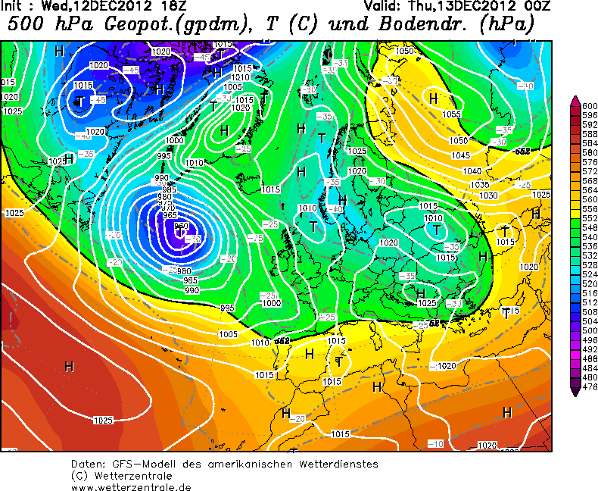

Slide 25
THINGS THAT REQUIRE A FULL HEALTH AND SAFETY RISK ASSESSMENT:
Opening a door.
Opening a window.
Making a cup of tea (kettles can be hot).
Putting on a shoe.
Health and Safety Form
................ __
............. __
___
Signed_____
Date_____
Health and Safety Form
................ __
............. __
___
Signed_____
Date_____

Slide 27
THINGS THAT REQUIRE A FULL HEALTH AND SAFETY RISK ASSESSMENT:
Opening a door.
Opening a window.
Making a cup of tea (kettles can be hot).
Putting on a shoe.
Health and Safety Form
................ __
............. __
___
Signed_____
Date_____

Slide 28
YE OLDE MAPPE
SUGARLAND
LA
HERE BE
DRAGONS
HERE BE
DRAGONS
LAKE OF BOTULISM
BRIDGE OF BROKEN FACES
MIGHTY
SWAMP
HAPPY MET LAND
NOT-SO-HAPPY AG LAND

Slide 30
THINGS THAT REQUIRE A FULL HEALTH AND SAFETY RISK ASSESSMENT:
Opening a door.
Opening a window.
Making a cup of tea (kettles can be hot).
Putting on a shoe.
Health and Safety Form
................ __
............. __
___
Signed_____
Date_____
Health and Safety Form
................ __
............. __
___
Signed_____
Date_____

Slide 31
Health and Safety Form
................ __
............. __
___
Signed_____
Date_____
Health and Safety Form
................ __
............. __
___
Signed_____
Date_____

Slide 33
Health and Safety Form
................ __
............. __
___
Signed_____
Date_____
Health and Safety Form
................ __
............. __
___
Signed_____
Date_____

Slide 37
THINGS THAT REQUIRE A FULL HEALTH AND SAFETY RISK ASSESSMENT:
Opening a door.
Opening a window.
Making a cup of tea (kettles can be hot).
Putting on a shoe.
Health and Safety Form
................ __
............. __
___
Signed_____
Date_____

Slide 38
FAAM
Meteorology

Slide 40
TO BE CONTINUED...

