Slide 1
It’s singa-longa-staff time!

Slide 2
How many hours can a post-doc survive, before needing boosts of caffeine?
Yes ‘n how many times can they fill their mugs, before they break the new machine?
Yes ‘n how many lunch breaks can one postdoc have, down on the croquet green?

Slide 3
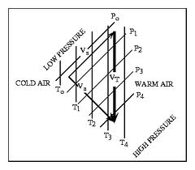
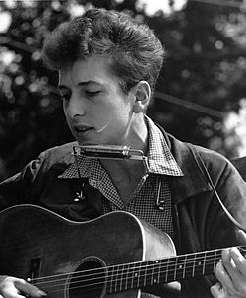
The answer my friend is in the thermal wind, the answer is in the thermal wind

Slide 4
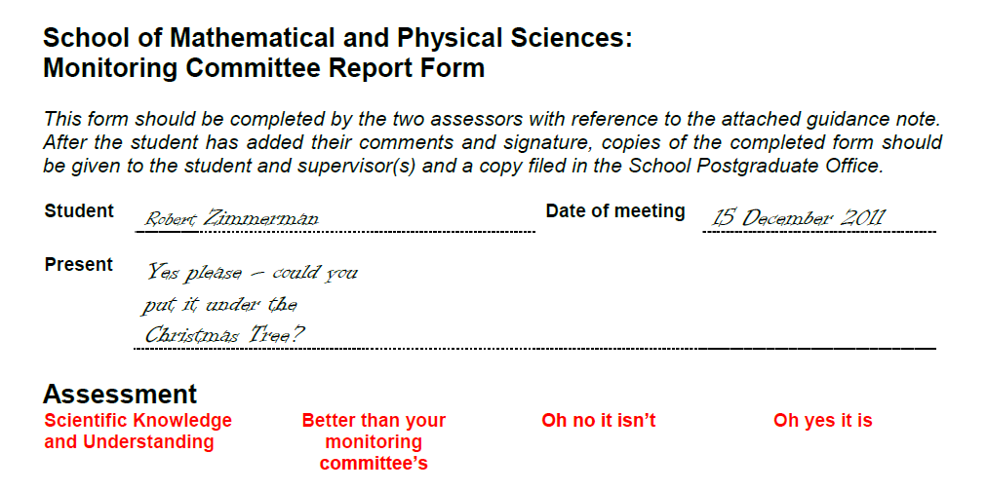
How many years can a student waste, before they have a thesis plan?
Yes ‘n how many hours can they mess with their code, before a postdoc lends a hand?
Yes ‘n how many times can they go to the Tuns, before they are forever banned?

Slide 5
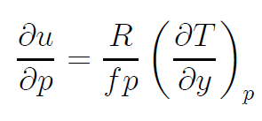
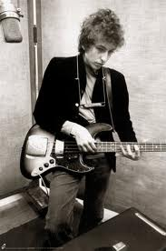
The answer my friend is in the thermal wind, the answer is in the thermal wind

Slide 6
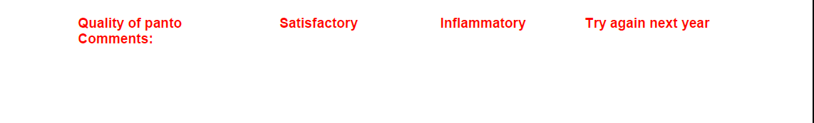
How many typos can a chapter have, before it is really confused?
Yes ‘n how few papers can a student read, and believe that the literature’s reviewed?
Yes ‘n how many theories can one thesis have, that are hard to imagine are true?

Slide 7
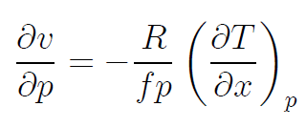
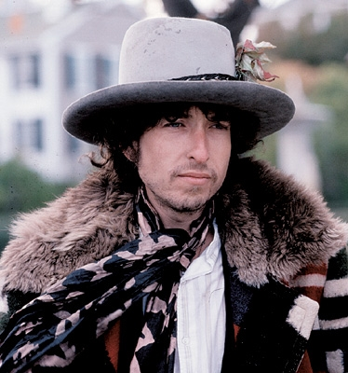
The answer my friend is in the thermal wind, the answer is in the thermal wind

Slide 8
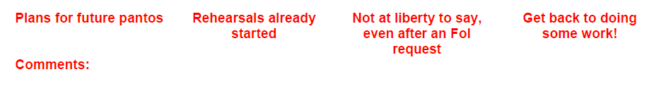
How many years can a thesis consume, before it is worth a PhD?
Yes ‘n how many hours can a viva take, before a student is free?
Yes ‘n how many songs can a panto have, that don’t even mention PV?

Slide 9

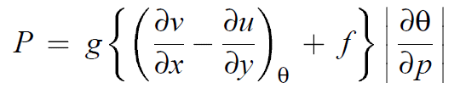
The answer is none, not a single one, the answer is not a single one

Slide 10
The answer is in the thermal wind!

