Slide 1
THE ADVENTURES OF
THE MR METS

Slide 2
Episode 1:
MR REYNOLDS SAVES THE DAY

Slide 3
ROSS

Slide 4
“Numerical Integration of the Barotropic Vorticity Equation”

Slide 5
“Numerical Integration of the Barotropic Vorticity Equation”

Slide 6
“Numerical Integration of the Barotropic Vorticity Equation”

Slide 7
Z
Z
Z
Z
Z
Z
Z
Z

Slide 8
“Numerical Integration of the Barotropic Vorticity Equation”

Slide 9
“Numerical Integration of the Barotropic Vorticity Equation”

Slide 10
WONG
PERRY
QUATRO
BANSHEE
METOPRIME

Slide 12
WONG
PERRY
QUATRO
BANSHEE
METOPRIME

Slide 13
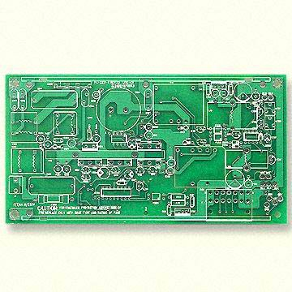
WONG
PERRY
QUATRO
BANSHEE
METOPRIME

Slide 14
He
He

Slide 15
He
He

Slide 16
He
He

Slide 17
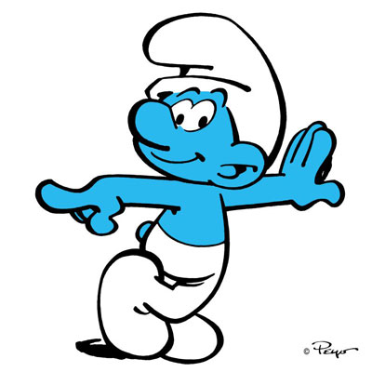
?

Slide 18
He
He

Slide 19
ROSS

Slide 21
ROSS

Slide 22
PANTO
CUPBOARD

Slide 23
PANTO

Slide 24
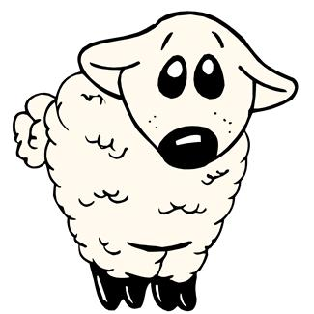
PANTO
IT’S BEHIND YOU !!

Slide 25
PANTO

Slide 27
CUPBOARD
The Spy Who Loved Meteorology
1U07

Slide 28
CUPBOARD
The Spy Who Loved Meteorology
1U07
The Spy Who Loved Meteorology
1U07

Slide 30
THE END

