Slide 1
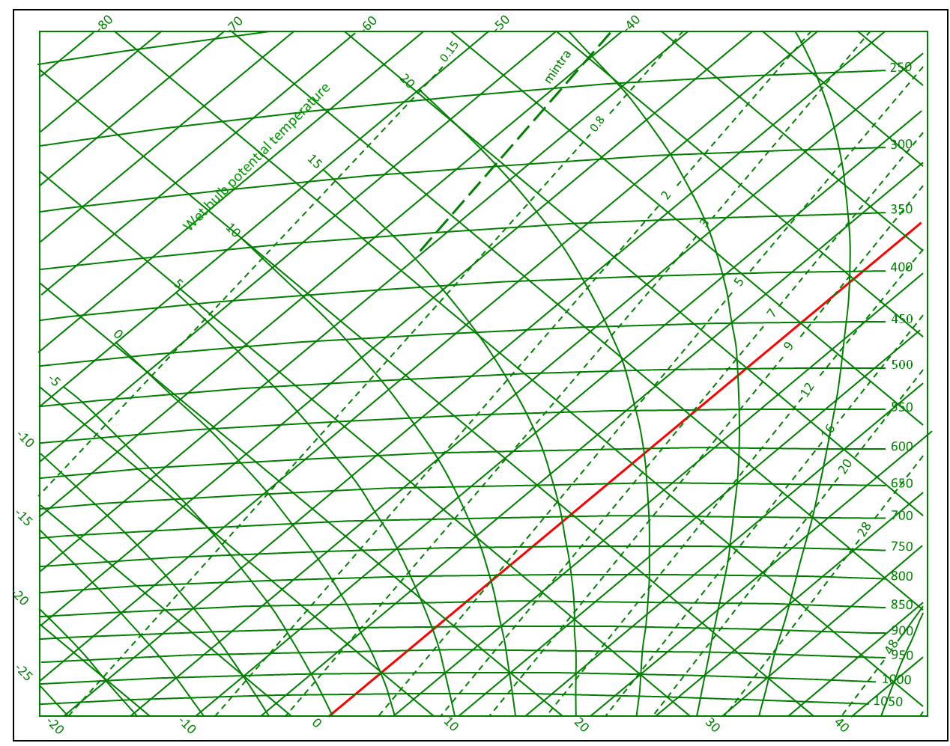
The student cometh
(with apologies to Flanders and Swan)
‘Twas on a Monday morning, my postgrad student called.
He’d tried to plot a tephigram - not getting it at all.
He said, ”Like, just explain it, man or I’s not comin’ back”
So I said, ”We’ll launch a radiosonde and then you’ll get the knack!”

Slide 2
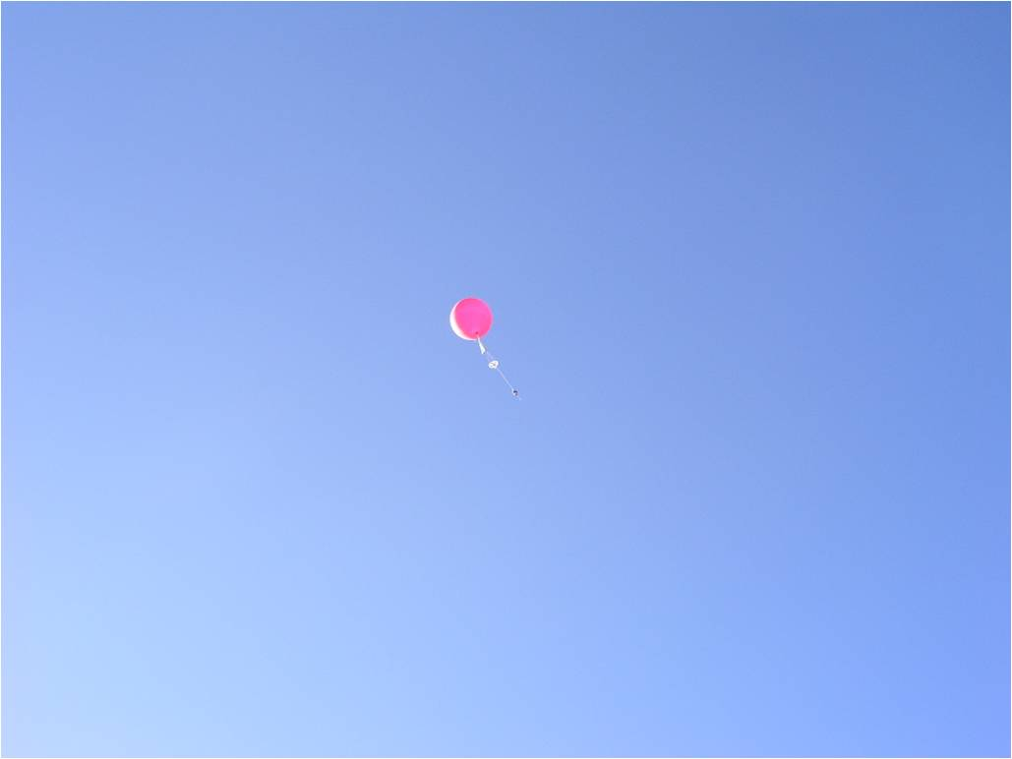
Oh, it all makes work for the lecturer to do.

Slide 3
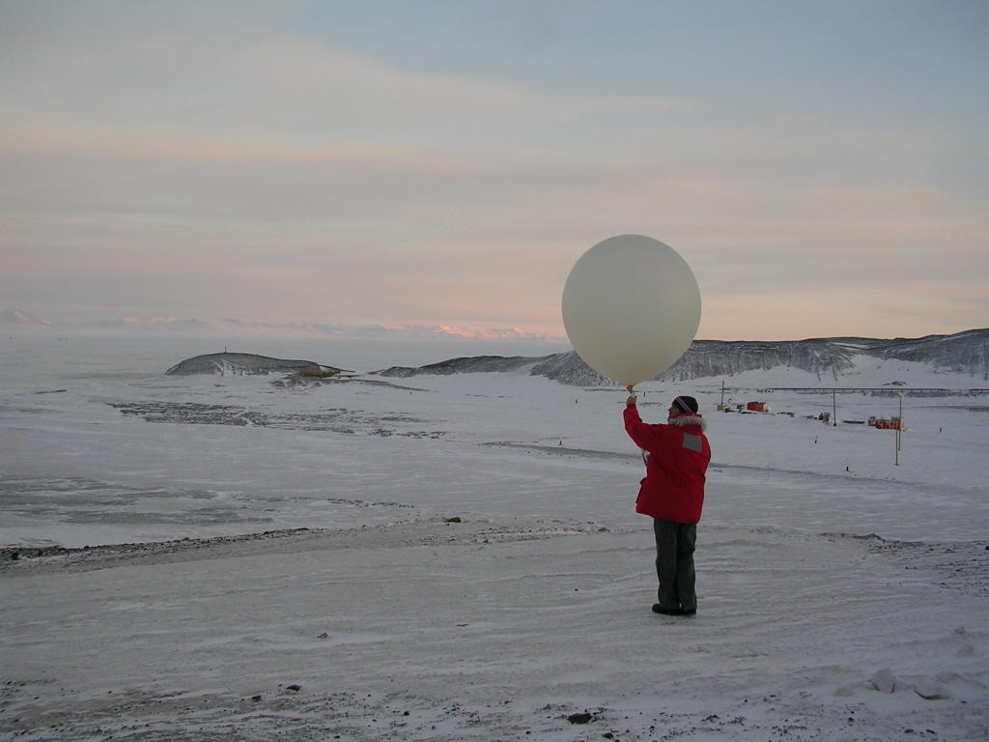
‘Twas on a Tuesday morning, we went up to the field,
A balloon we filled with helium and then its end we sealed.
We watched it rising through the air, it really looked quite grand.
Then he said, “What is this little box I’m holding in my hand?”

Slide 4
Oh, it all makes work for the lecturer to do.

Slide 5
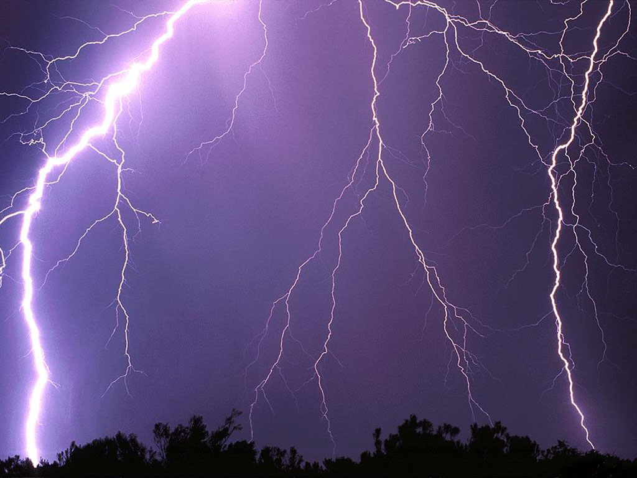

Twas on a Wednesday morning he said he’d try again
This time he did it on his own despite persistent rain
But, worse, he filled it to the brim with copious H₂
Which ignited in a lightning strike and now he’s bound to sue!

Slide 6
Oh, it all makes work for the lecturer to do.

Slide 7
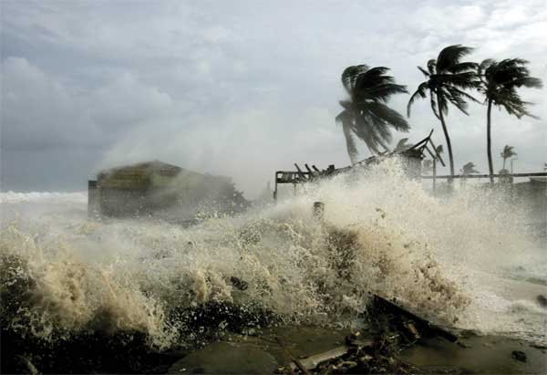
‘Twas on a Thursday morning we tried to launch again.
The forecast was for gale force winds - maybe a hurricane.
I said, “Hold tight the string, my lad, I’ll tune the ra-dee-o!”
But the next gust swept him off his feet - he landed at Heathrow!

Slide 8
Oh, it all makes work for the lecturer to do.

Slide 9
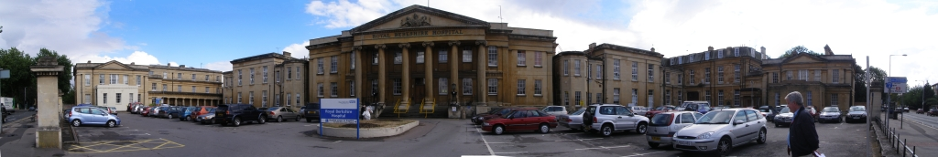
'Twas on a Friday morning, he was in a Royal Berks bed.
He'd managed to survive the fall by landing on his head.
But still had all the data safe as any student should.
So I said, “You plot a tephigram to check it’s any good”

Slide 10
Oh, it all makes work for the lecturer to do.

Slide 11
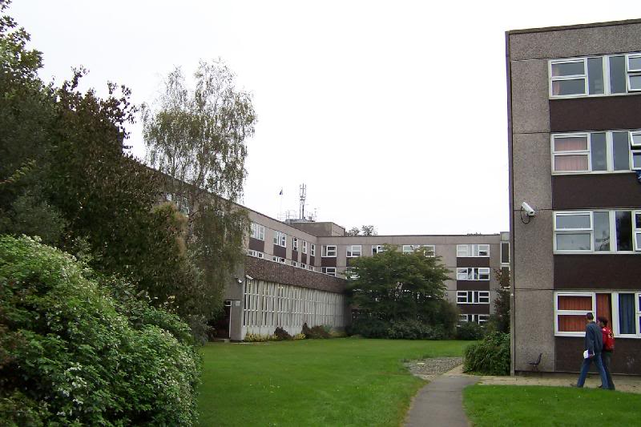
-80
-70
-60
-50
-40
0.15
250
20
mintra
0.8
Wet bulb potential temperature
300
15
2
350
10
3
On Saturday and Sunday, I’m a warden at the Hall...
So, ‘twas on a Monday morning that my postgrad student called
400
5
5
7
450
0
9
500
-5
12
550
-10
16
600
20
650
-15
700
28
750
800
-20
850
900
48
950
-25
1000
1050
-20
-10
0
10
20
30
40

