Slide 1
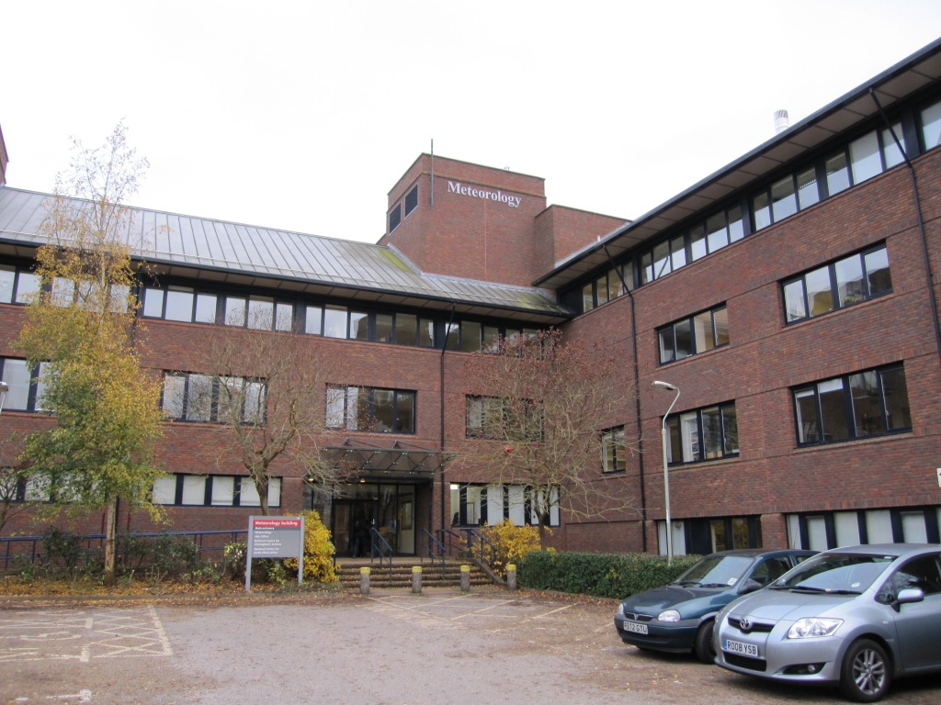
The Department of Meteorology Welcomes You to ...

Slide 2
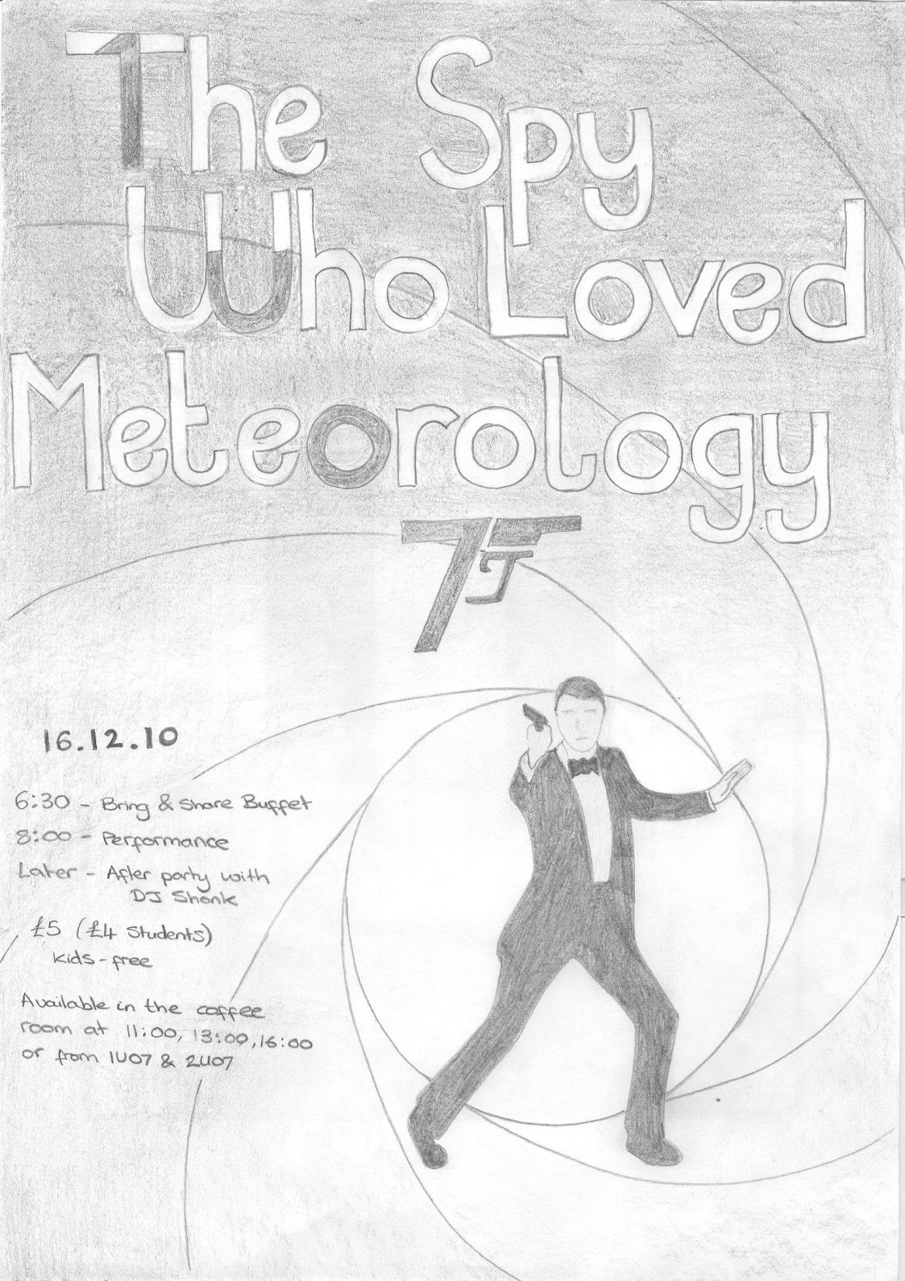

Slide 3
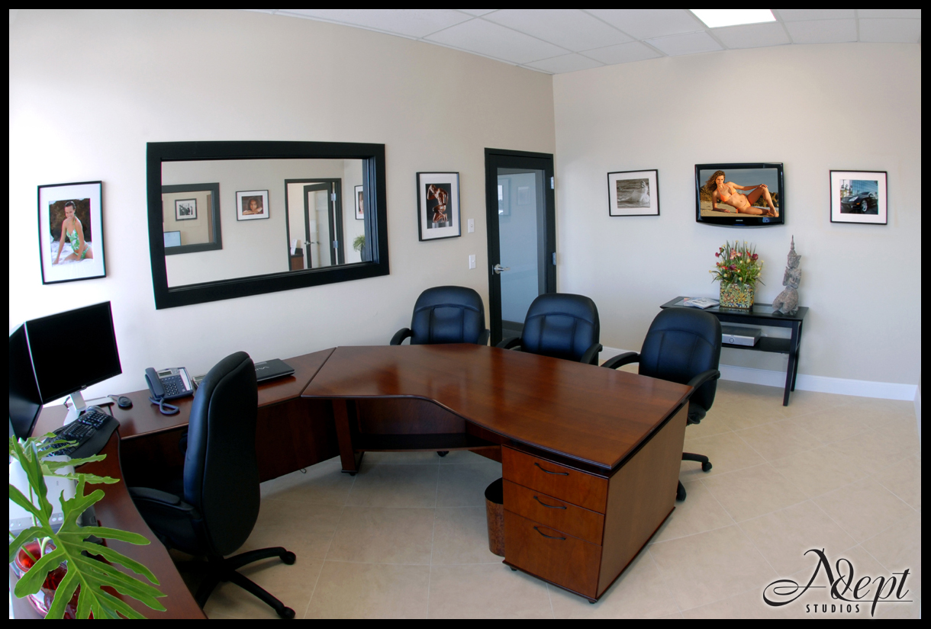

Slide 4








Slide 5
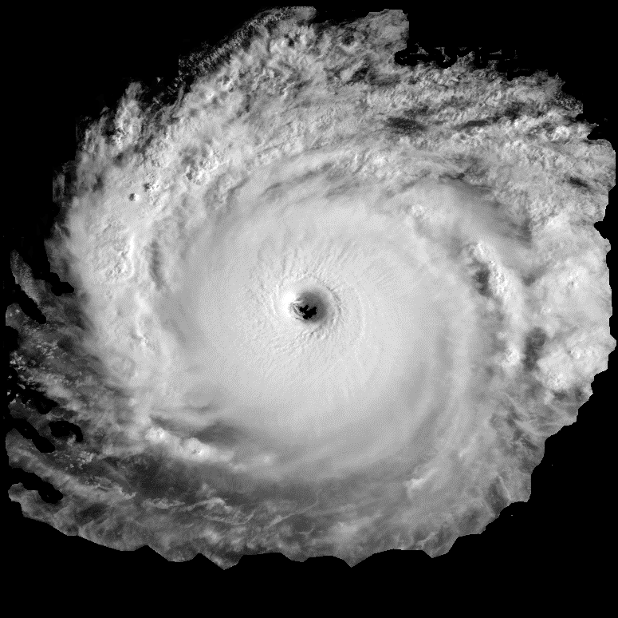

Xynthia

Slide 6
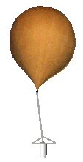


Slide 7
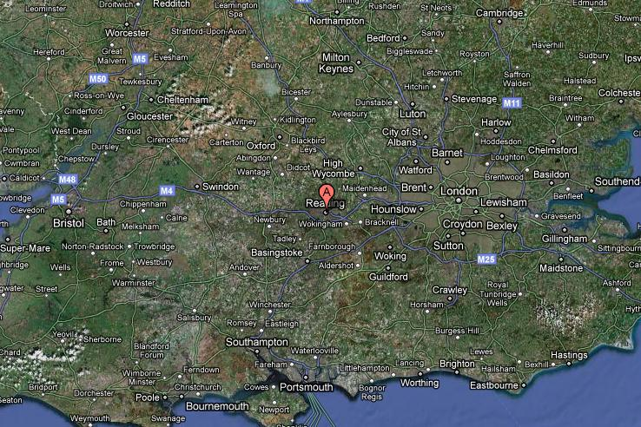

Slide 9
Notes:
Click to advance slide after the Da-Da, bong, Da-Da, bong, Da-Da, Da Da Da bit

Slide 11
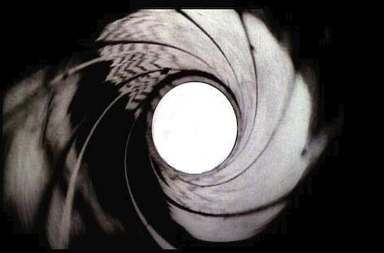
James Sonde 1U07
In
The Spy Who Loved Meteorology
Notes:
Crucial – Click when ending bit of bond theme comes on

Slide 12
James Sonde 1U07
In
The Spy Who Loved Meteorology

Slide 13

PROGRAM Nobody_Does_it_Better()
James Sonde, James Sonde,
yeah he’s the best
Nobody does it better
Not Reynolds or Charlton-Perez
Better than Ambaum, Shine and Barlow too
James Sonde, he’s the best
If you’re ever looking
For an accurate forecast
And someone to tell you cloud type
He’s geeky but dreamy
The spy who loved me-teorology
Is keeping the department safe tonight
And nobody codes it better
He’s second to IMPLICIT NONE
His Boundary Conditions are all well defined
And all his variables are LONG
He knows how to couple
With any model
He’ll perturb the physics inside you
He’ll stir up your PV
And increase your entropy
And help you pass MTMG02
(Atmospheric Physics, duh)
And nobody does it better
Not Hogan, Gray or Inness
Better than Dacre, Plant and Illingworth
James Sonde, he’s the best
James Sonde, he’s the best
Oh, oh, oh
James Sonde, he’s the best
END PROGRAM

Slide 14
Notes:
Change of scene -> Scene 1

Slide 15
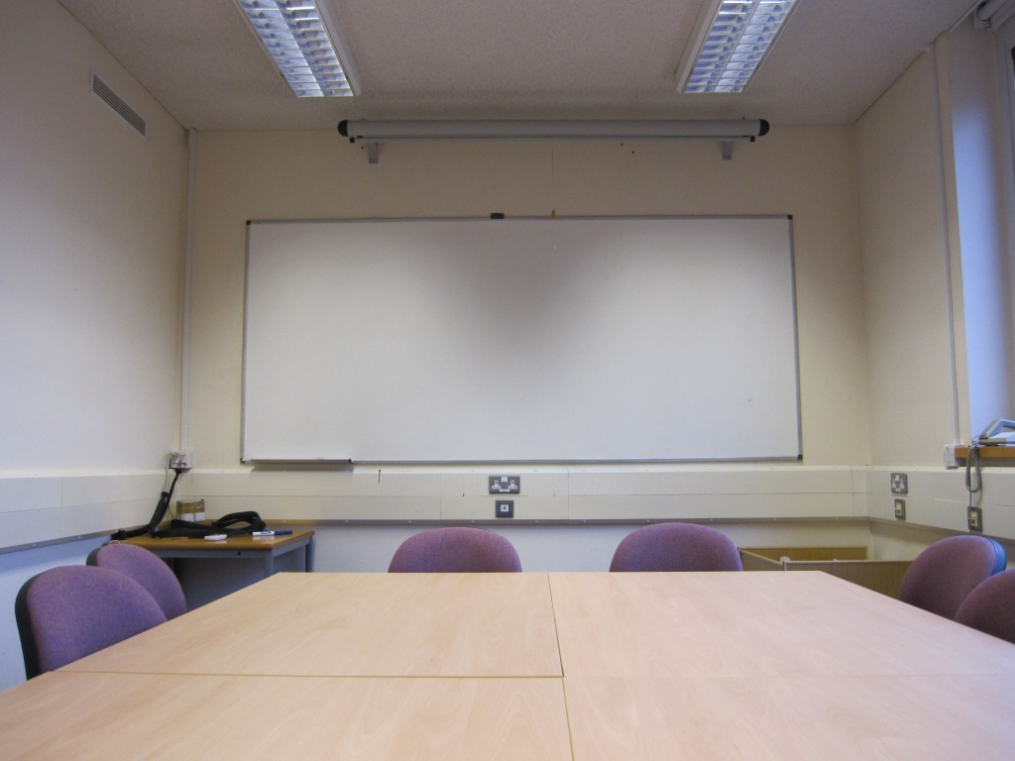

Slide 16
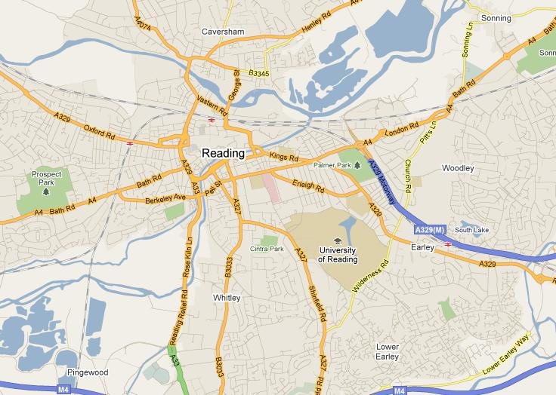
Notes:
Click once to stop flashing light, click again to change slide

Slide 17
Notes:
Change of scene to Gile’s lab

Slide 18
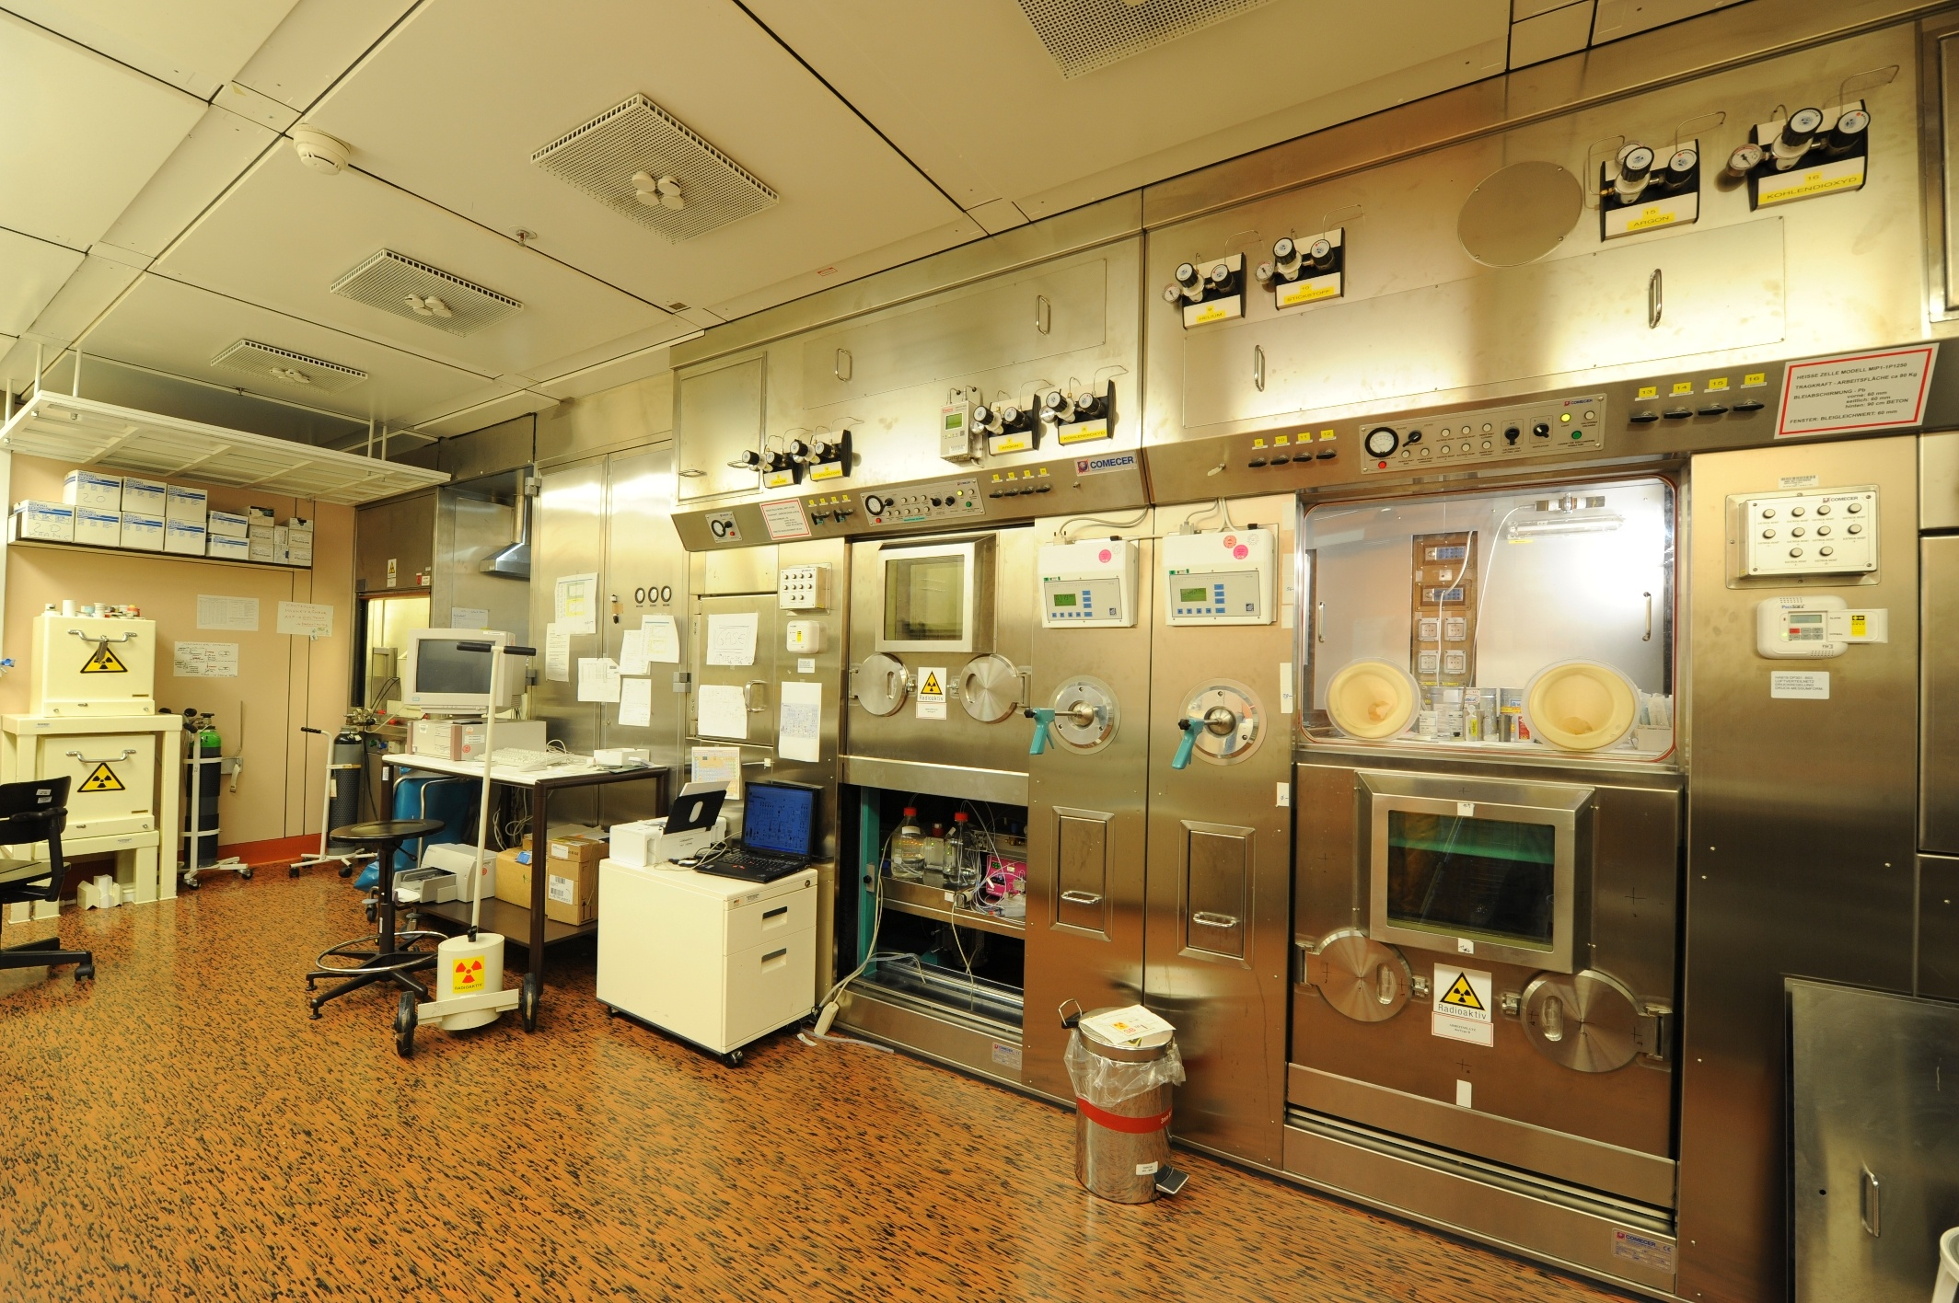

Slide 19
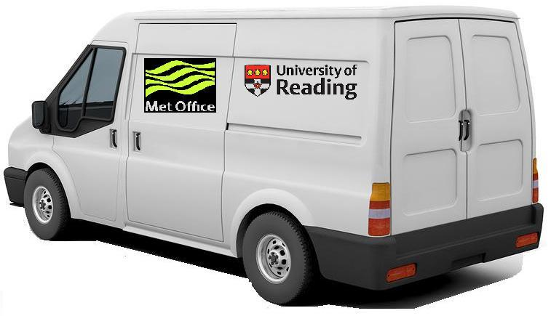
Notes:
Click again to go back to Gile’s lab briefly

Slide 21


Slide 22
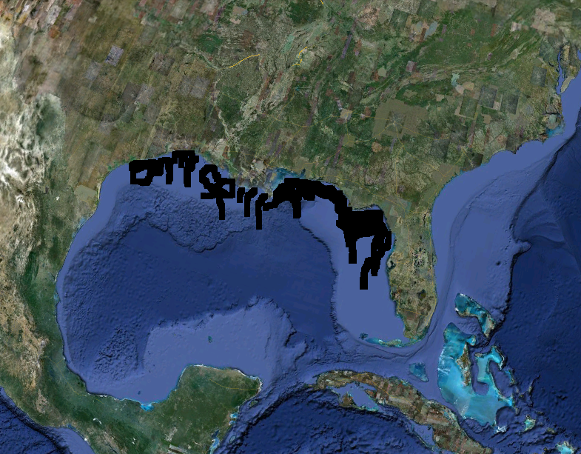
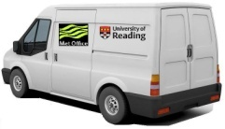

Slide 23
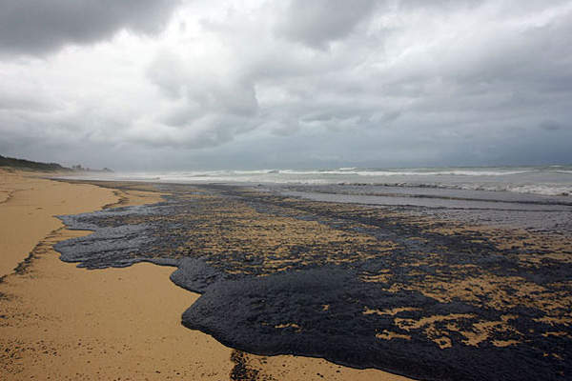
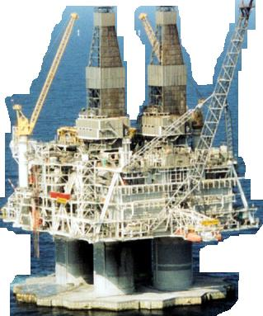

Slide 24
Notes:
Change of scene -> Scene 2

Slide 25
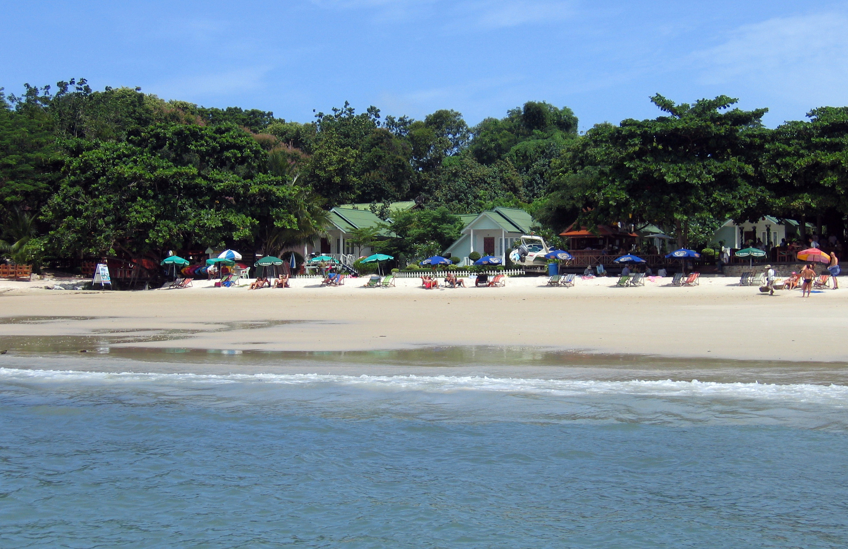
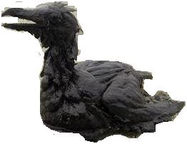
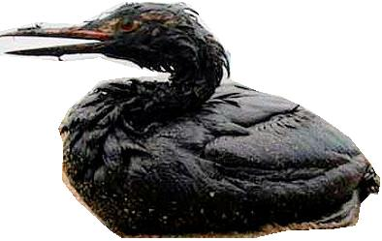
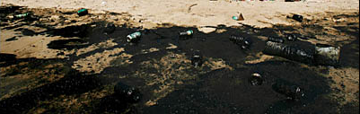
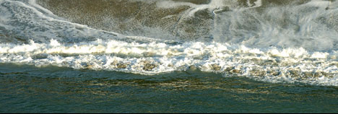
Notes:
Click for phone ring for DG

Slide 26
Notes:
Change of scene -> Scene 3

Slide 27
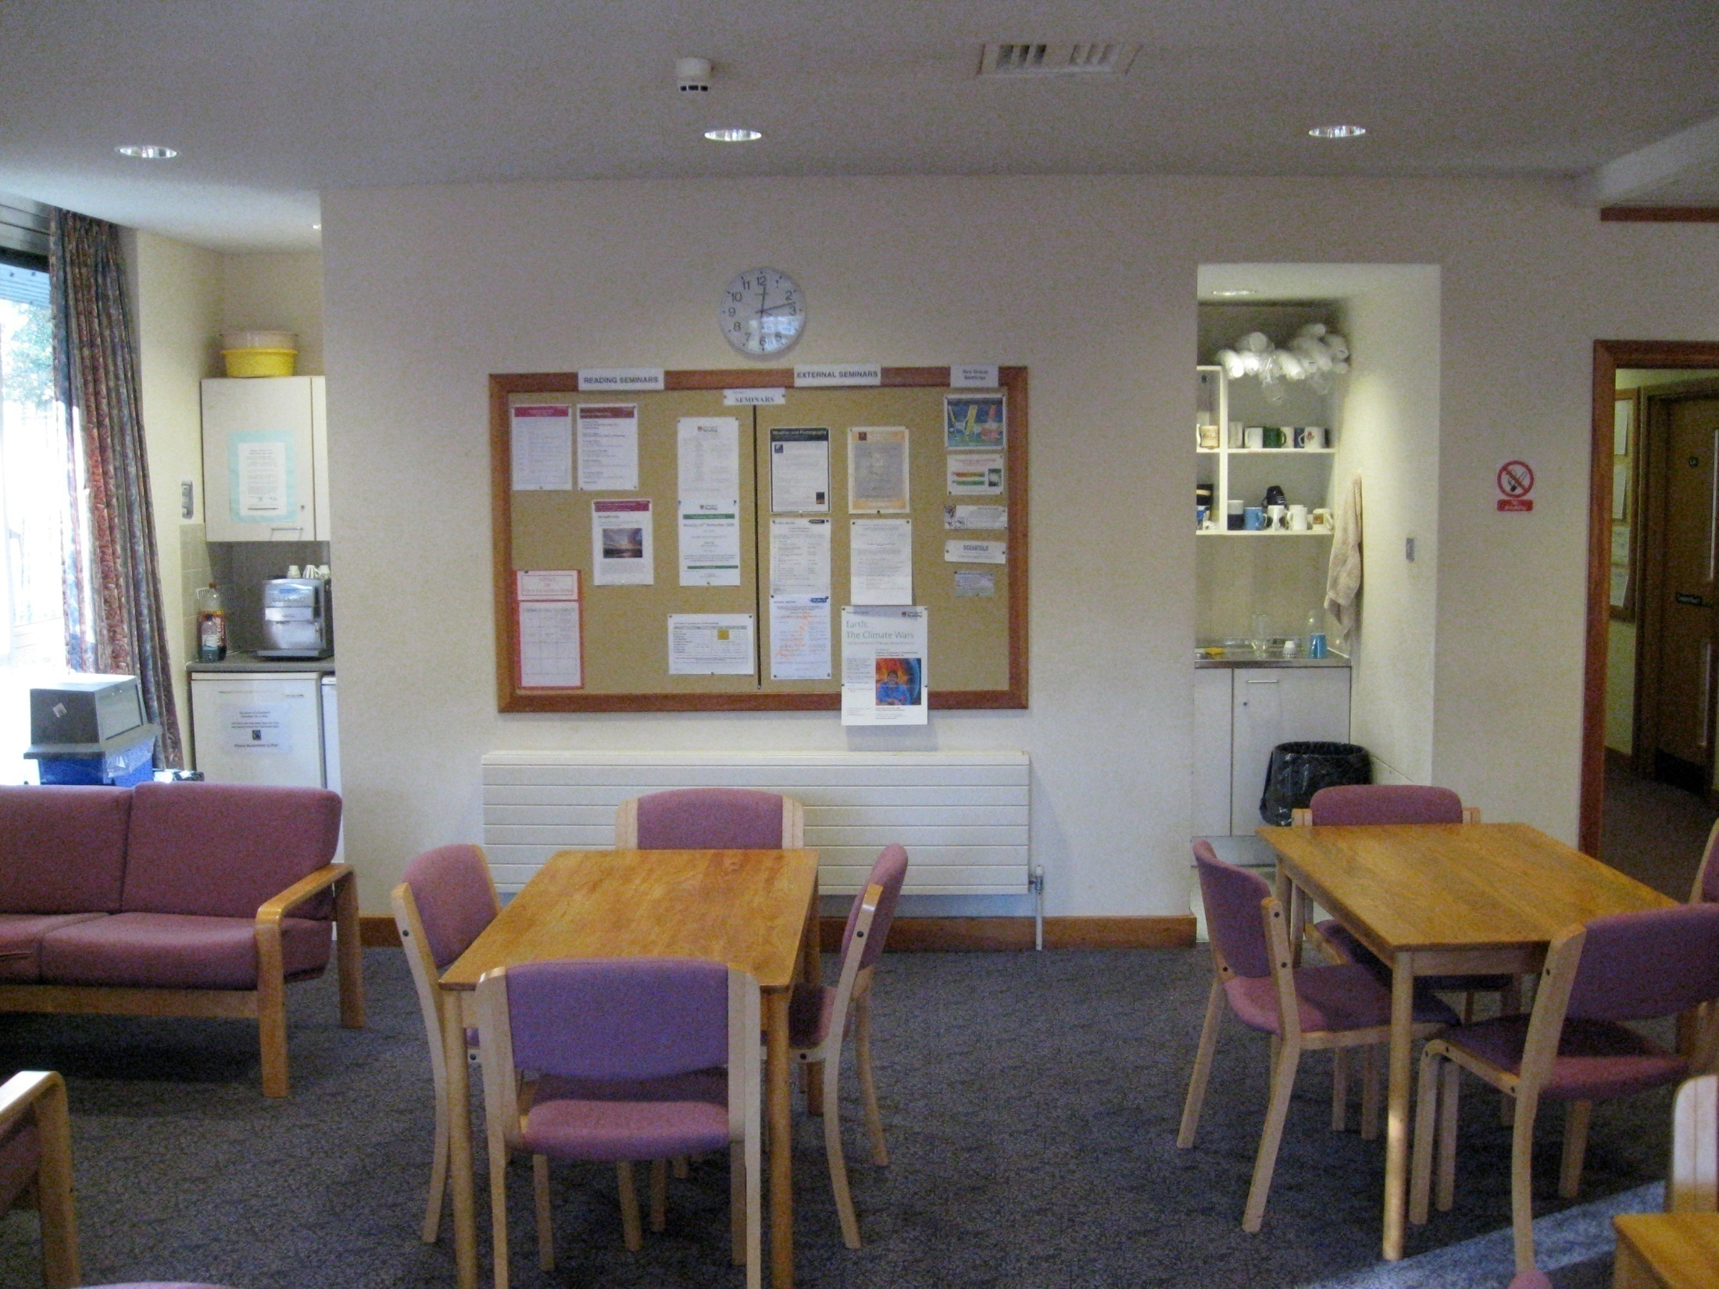

limate
lobal
addies
Notes:
Click once to show KGB, then once again to hide it

Slide 28
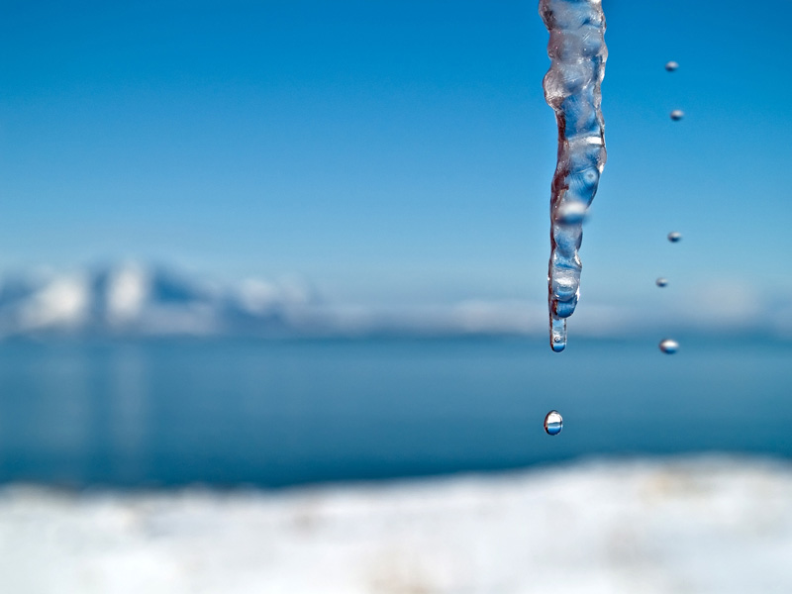
COLD
Sonde’s threat is like a high prison wall
So we can rule the world, we can rule the world
(Instrumental)
But I’ve thought it through, yes I’ve thought it through
Sonde’s threat is like a high prison wall
I have the power to turn
Climate to what it was
I’m indestructible
Coldfinger freezing!
I’m indestructible
Coldfinger freezing!
(i’m) sorry that the planet has warmed
Stuck under that cut off low
Always be freezing
Thank you for your concern
Slowly being melted away
The level of the seas must now fall
Cold
There’s bound to be a little more ice
Don’t worry about sea level rise
Now that we’re on Blofeld’s team
Cold
I have the power to turn
Climate to what it was
Climate to what it was
I’m indestructible
Coldfinger freezing!
Stuck under that cut off low
My finger’s going to freeze them all
It’s only a freeze away
We can build a weather machine
But I will leave him standing so small
Always be freezing oh, it is
It’s indestructible
Making you freezing, we’ll be
I like the ice and the snow
Cold
After the floods have gone
I love the ice and the snow
It’s indestructible
But I can leave him standing so small
Cold
I have the power to turn
Something to cool down your soul
Making potential temp low
Cold
Cold
Sea level rise makes me forlorn
It’s indestructible
Glaciers are here today,
Just another meter today

Slide 30
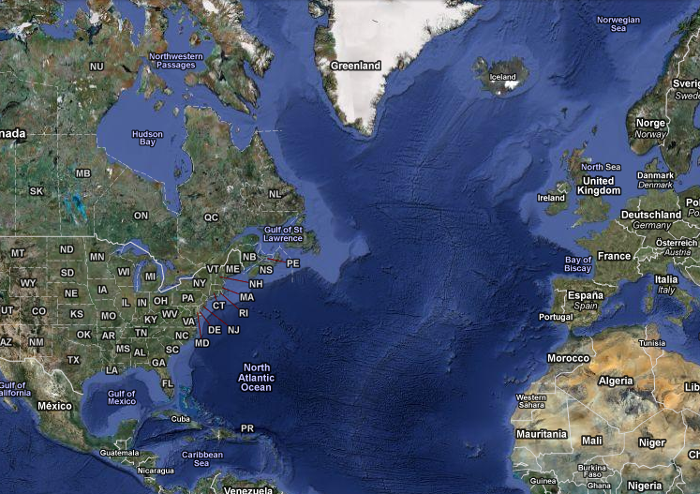

Slide 31
Notes:
Change of scene -> Scene 4

Slide 32
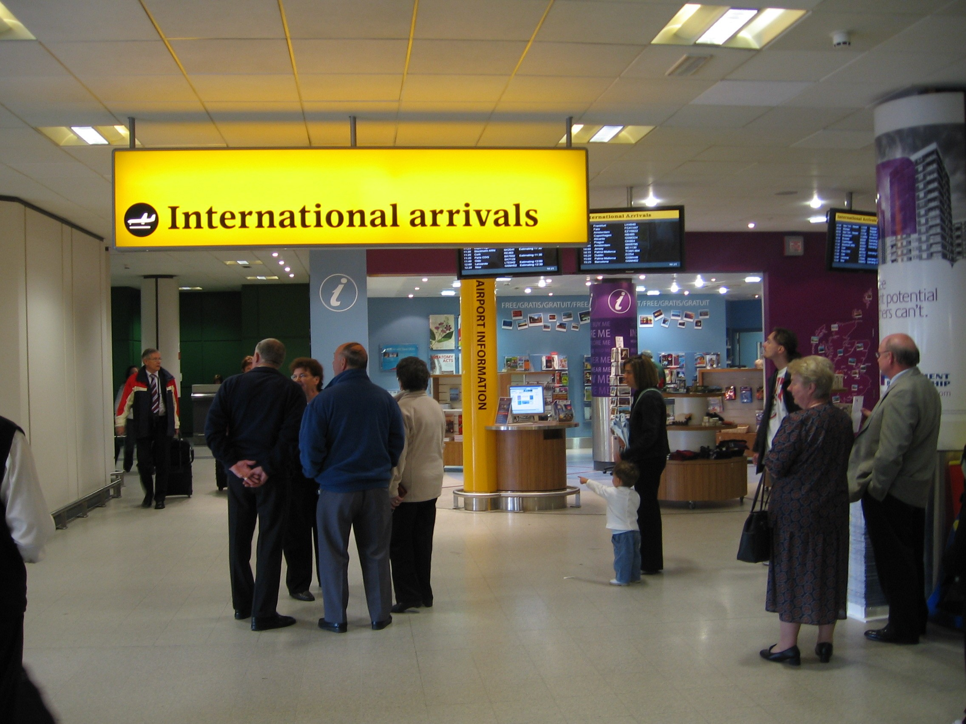
Notes:
Click/space once to start lightning strike

Slide 33
INTERVAL

Slide 34
Notes:
Change of scene -> Scene 5. Click to reveal outside Chilbolton briefly while narrating

Slide 35
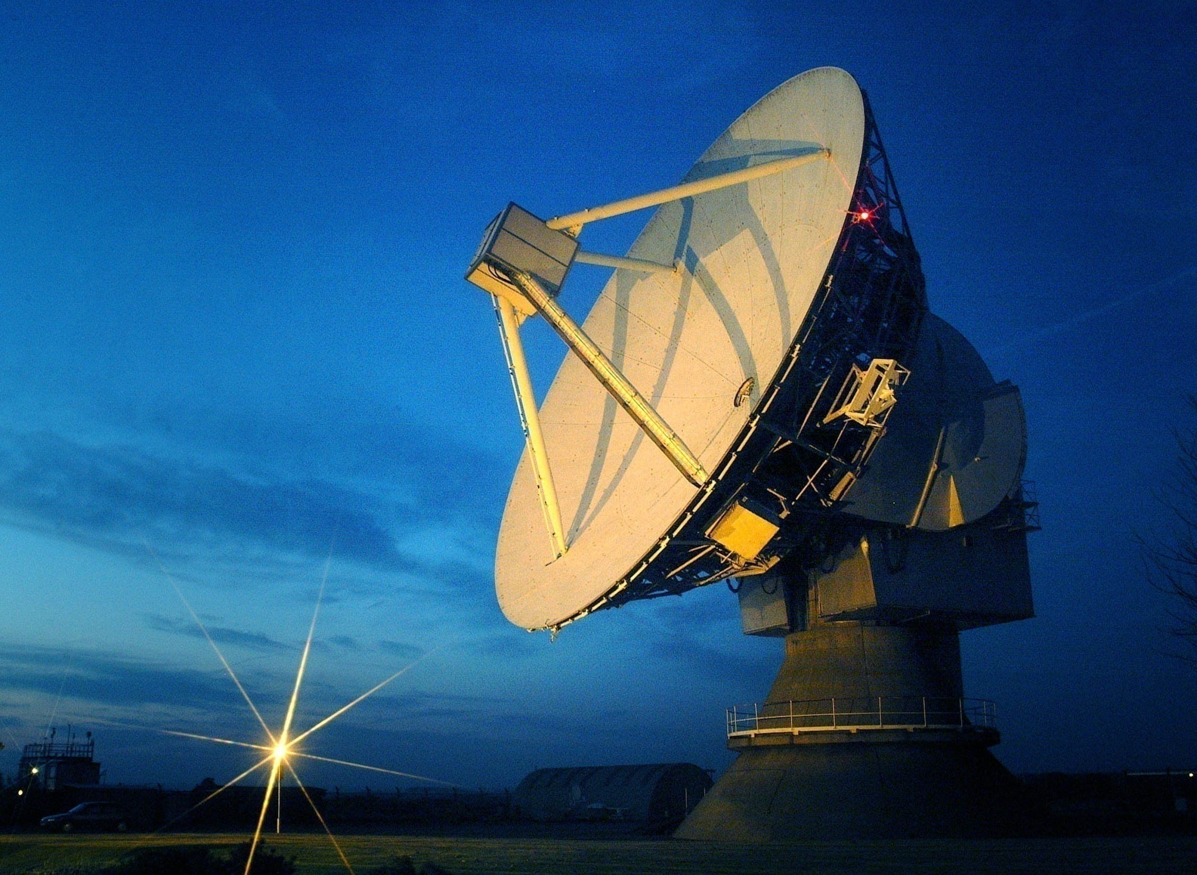

Slide 36
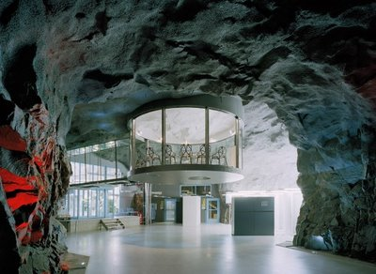

Slide 37
From the day that I could talk
I said I’d one day be
An evil doctor of
Meteorology
Taking measurements with radar, and with LIDAR too
Though I’m really still not sure what the latter one can do!
I’d measure cloud
Reflectivity
At the Chilbolton Facility
Use ZDR and phi-dp
To distinguish rain and hail
My retrieval algorithms would surely never fail
But I was sad
Kind of lonely
Stuck here every day
Just me and Anthony
Being evil, is only really fun
When your wicked schemes can be shared with someone
So I thought, let’s see
Who could it be?
A friend, an evil genius, just like me
Then it clicked: a clone is what I need
I call him Mini-Rob, cause he’s only 3 foot 3!
Notes:
After rap click to get rid of banner

Slide 39
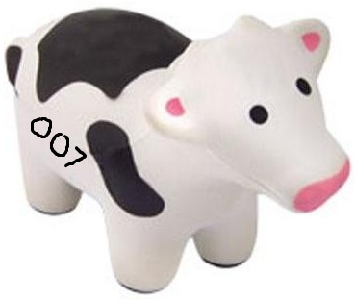

Slide 40
Notes:
Change of scene -> Scene 6. Show outside of Casino Royale Met Soc briefly before clicking to go inside again

Slide 41
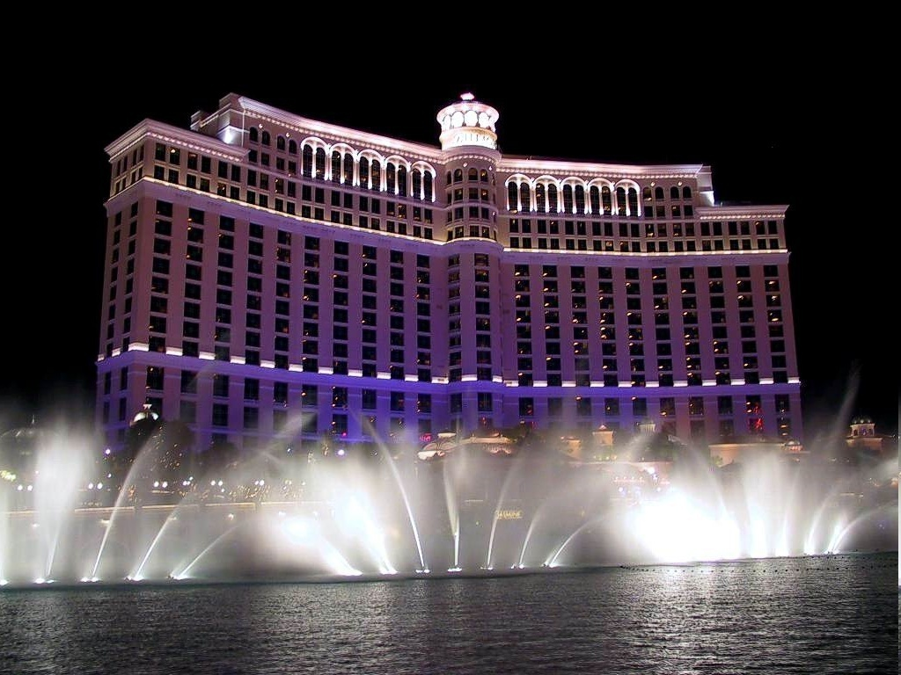


Slide 42
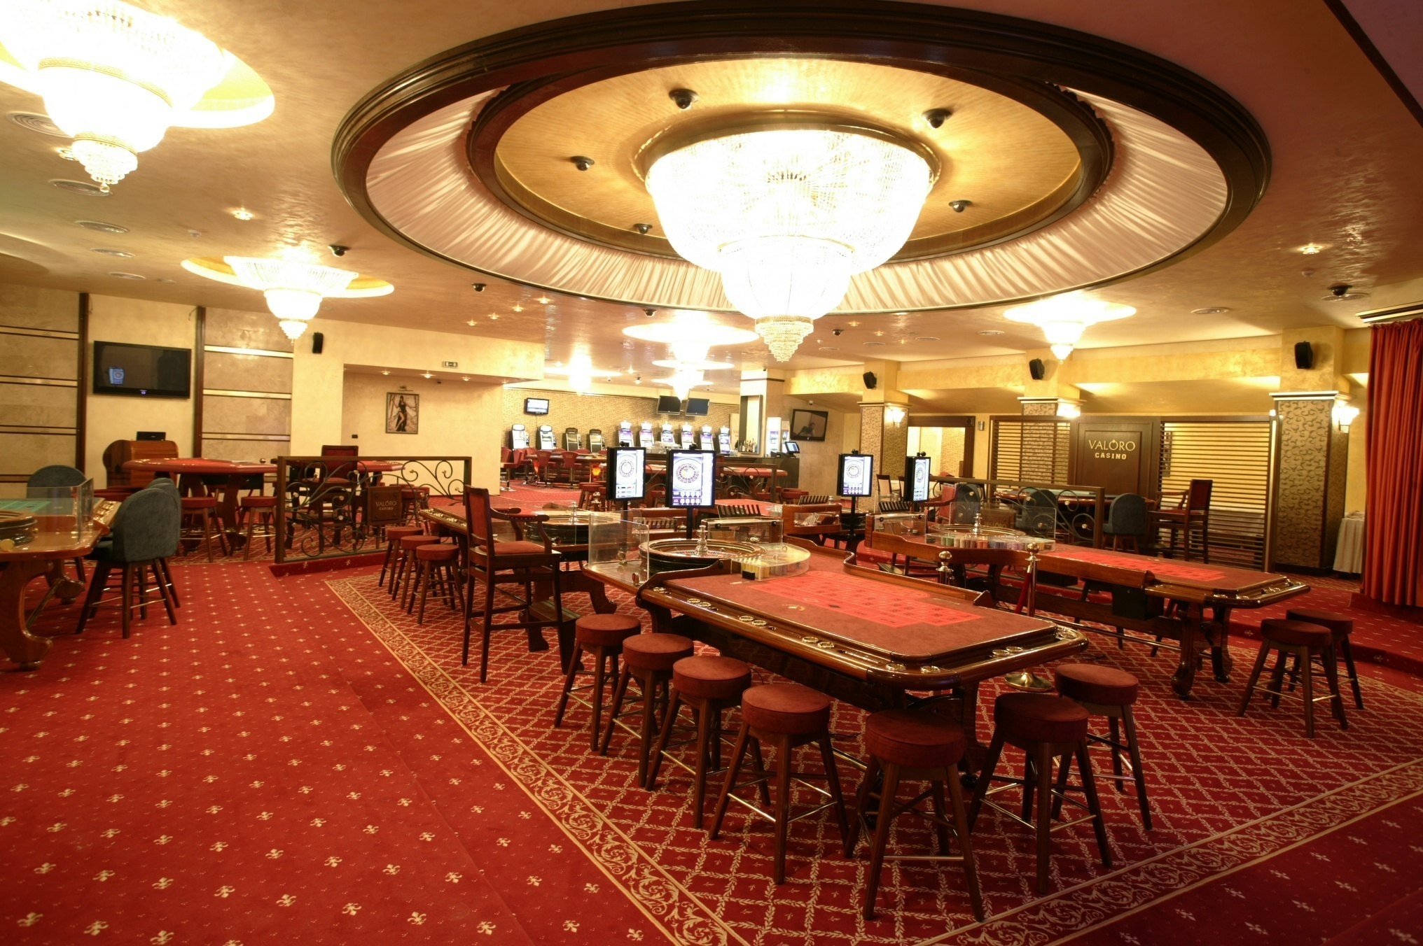

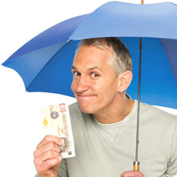

Slide 43
Notes:
Snowing – click to go back to inside casino

Slide 45
Notes:
Change of setting to M’s office

Slide 47
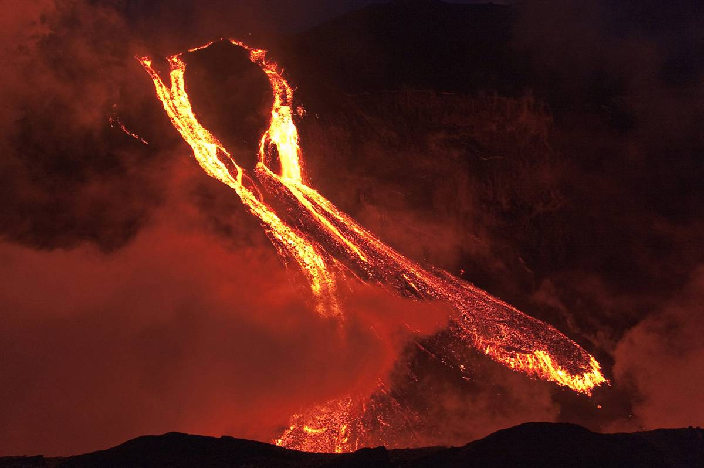
E vil
pro J ect
A iming
F or
ma J or
A tmospheric
contro L
L ocated
A t
e J ecting
v Ö lcano
ma K ing
U ltimate
ice L andic
L air

Slide 49
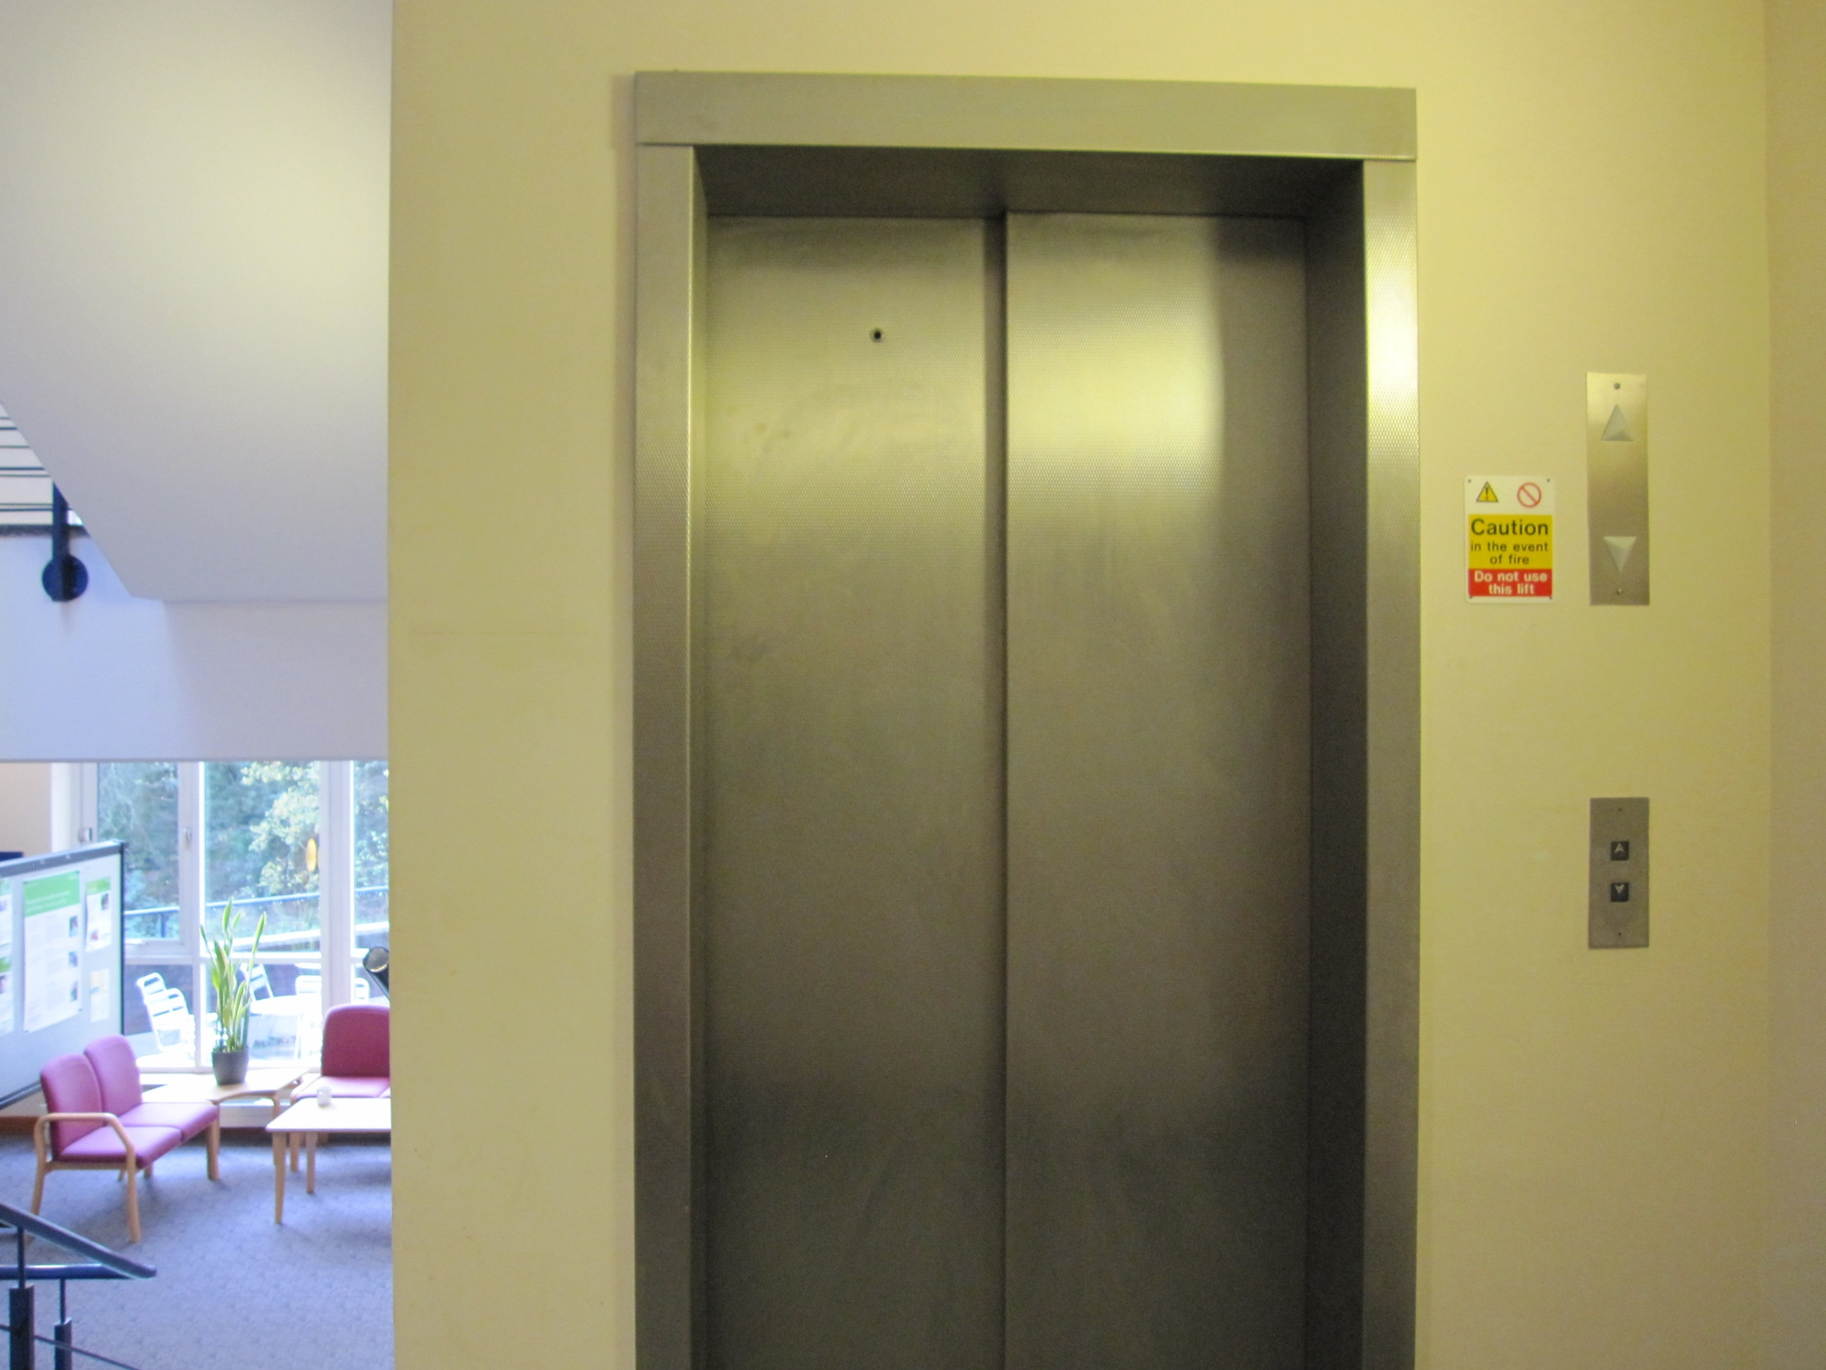
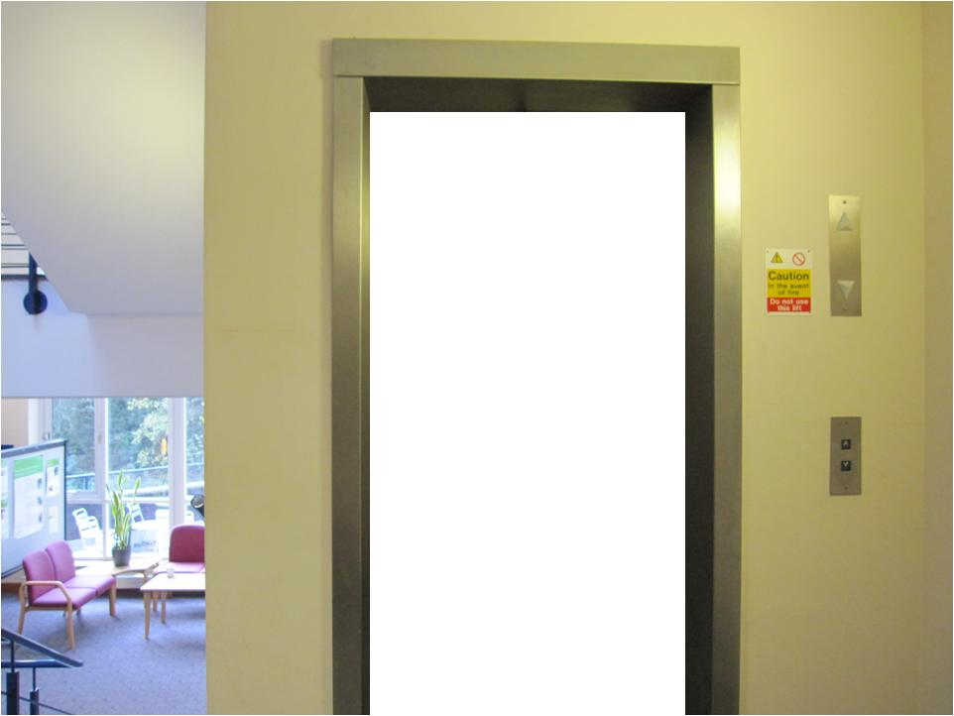
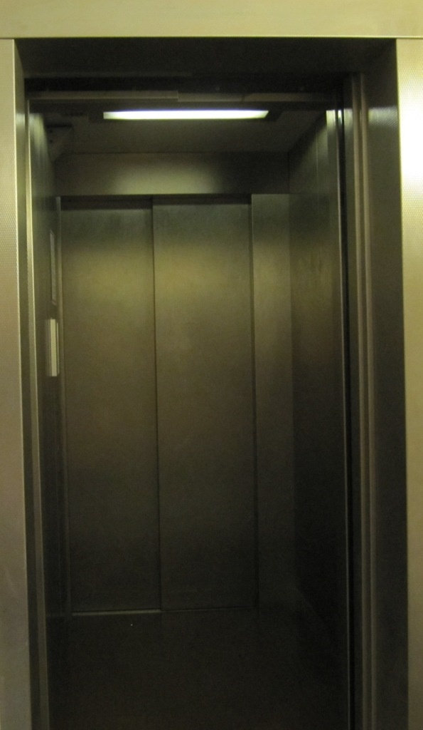
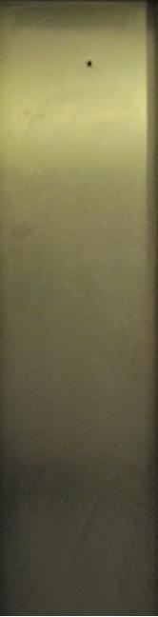


Slide 50
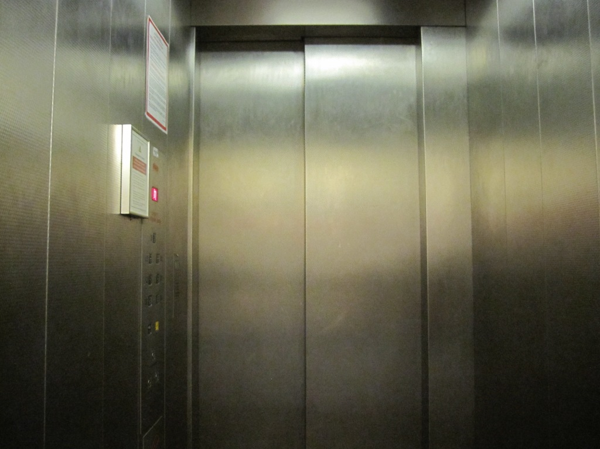

Slide 51
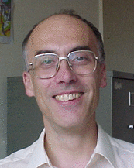

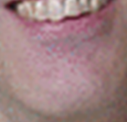

Slide 53
Well the lift doors they are frozen so tight
Let’s have a sing-song then we’ll put up a fight
It’s so cold I might just lose all my hair
While we’re wondering how we’ll get down the stairs
Sonde to the left of me,
Agent C to the right, here I am,
Stuck in the Met Lift with you
And I’m wondering what it is we should do
It’s so hard to wipe a smile from my face
Though it’s scary in this small confined space
Sonde to the left of me,
Agent C to the right, here I am
Stuck in the Met Lift with you
We’ll you started out not knowing
But you found out all of Blofeld’s plans
Dr Snow he came a callin’
Pointed his finger and said
Freeze... Freeze...
The results of my team Reading FC
I’m Ross Reynolds usually free of cares,
Still we’re wondering how we’ll get down the stairs
Sonde to the left of me,
Agent C to the right, here I am
Stuck in the Met Lift with you
Yes I’m stuck in the Met Lift with you
Stuck in the Met Lift with you
Yes I’m stuck in the Met Lift with you
Stuck in the Met Lift with you
Yes I’m stuck in the Met Lift with you
Yes I’m stuck here in the Met Lift with you
There’s no radio or TV to see

Slide 54
Notes:
Breakout of lift – click when they break out of lift and again on next slide to open the doors

Slide 55
Notes:
Click to open the doors

Slide 56
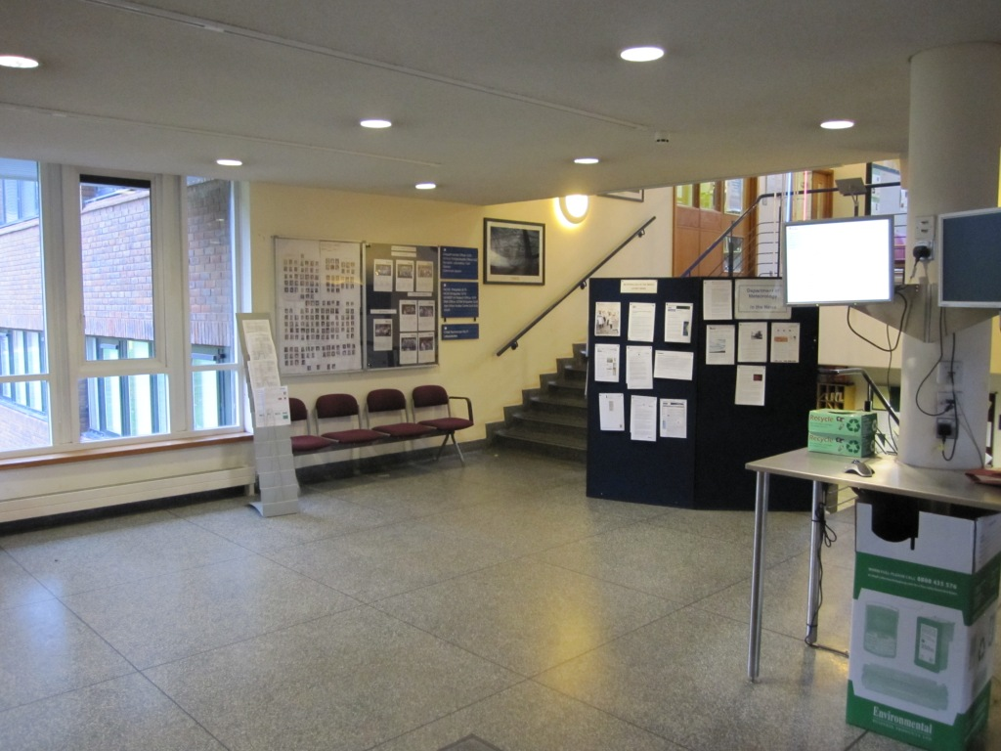
Notes:
Foyer – Met Mums. Then move onto sign-in area

Slide 57
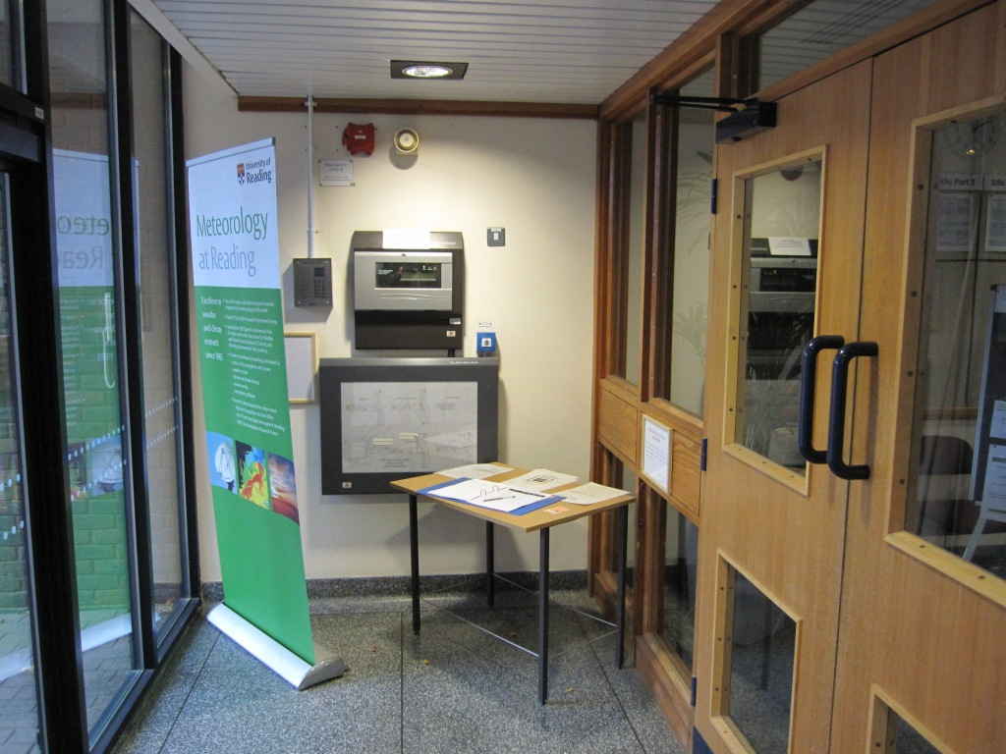
Notes:
Sign in area

Slide 58
Notes:
Click to move onto animation of department van

Slide 59
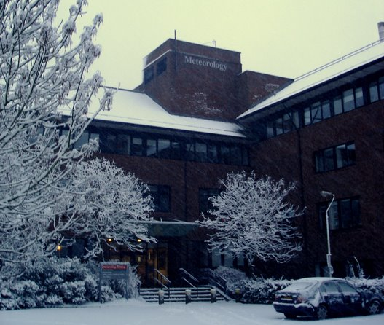

Slide 60
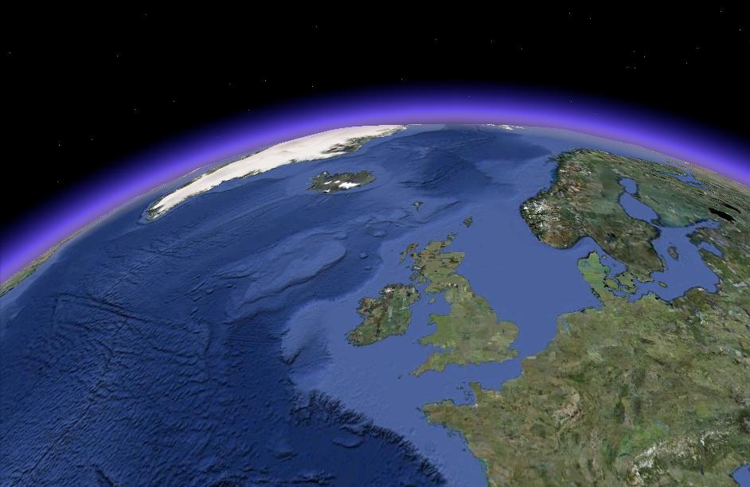


Slide 61
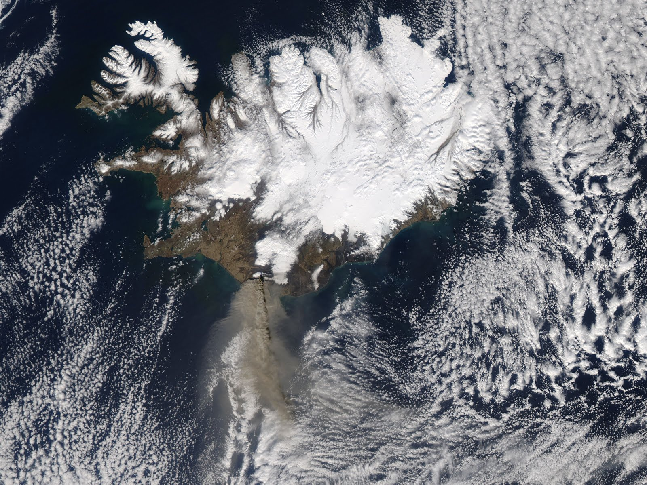

Slide 62
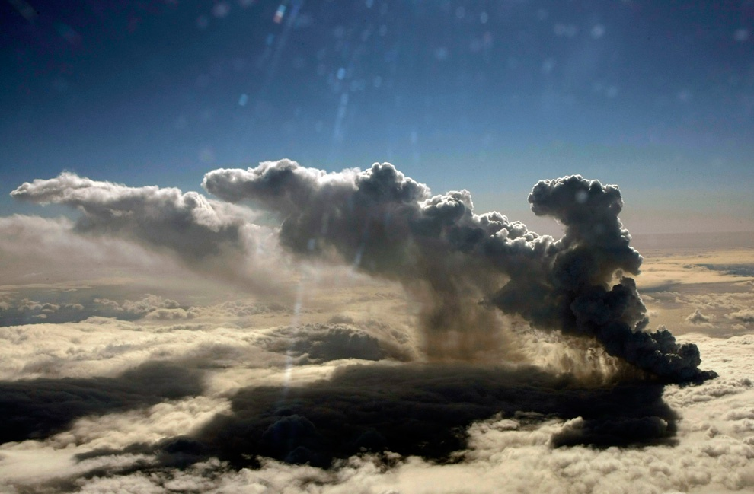


Slide 63
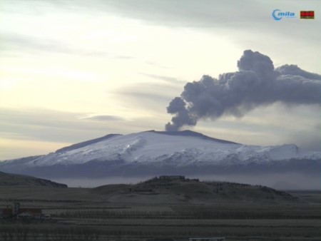


Slide 64
Notes:
Change of scene -> Scene 7

Slide 65
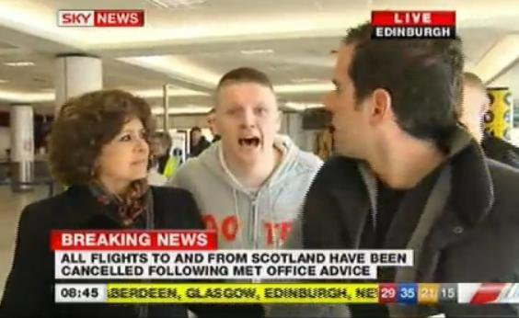
Notes:
Rude interruption – will automatically go back to a blank screen after 5 seconds

Slide 66
Notes:
Scene 7

Slide 67

Notes:
Animation of sonde and agent c waking into volcano

Slide 68
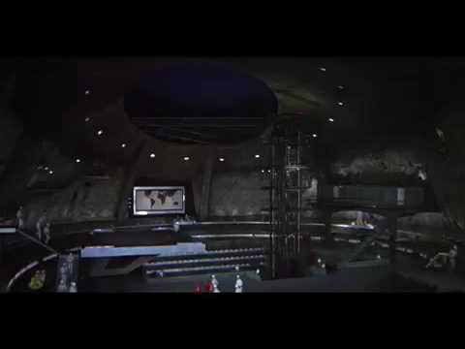
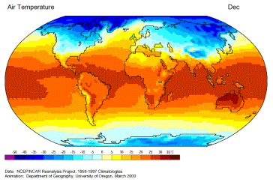
Notes:
Evil lair inside volcano

Slide 69
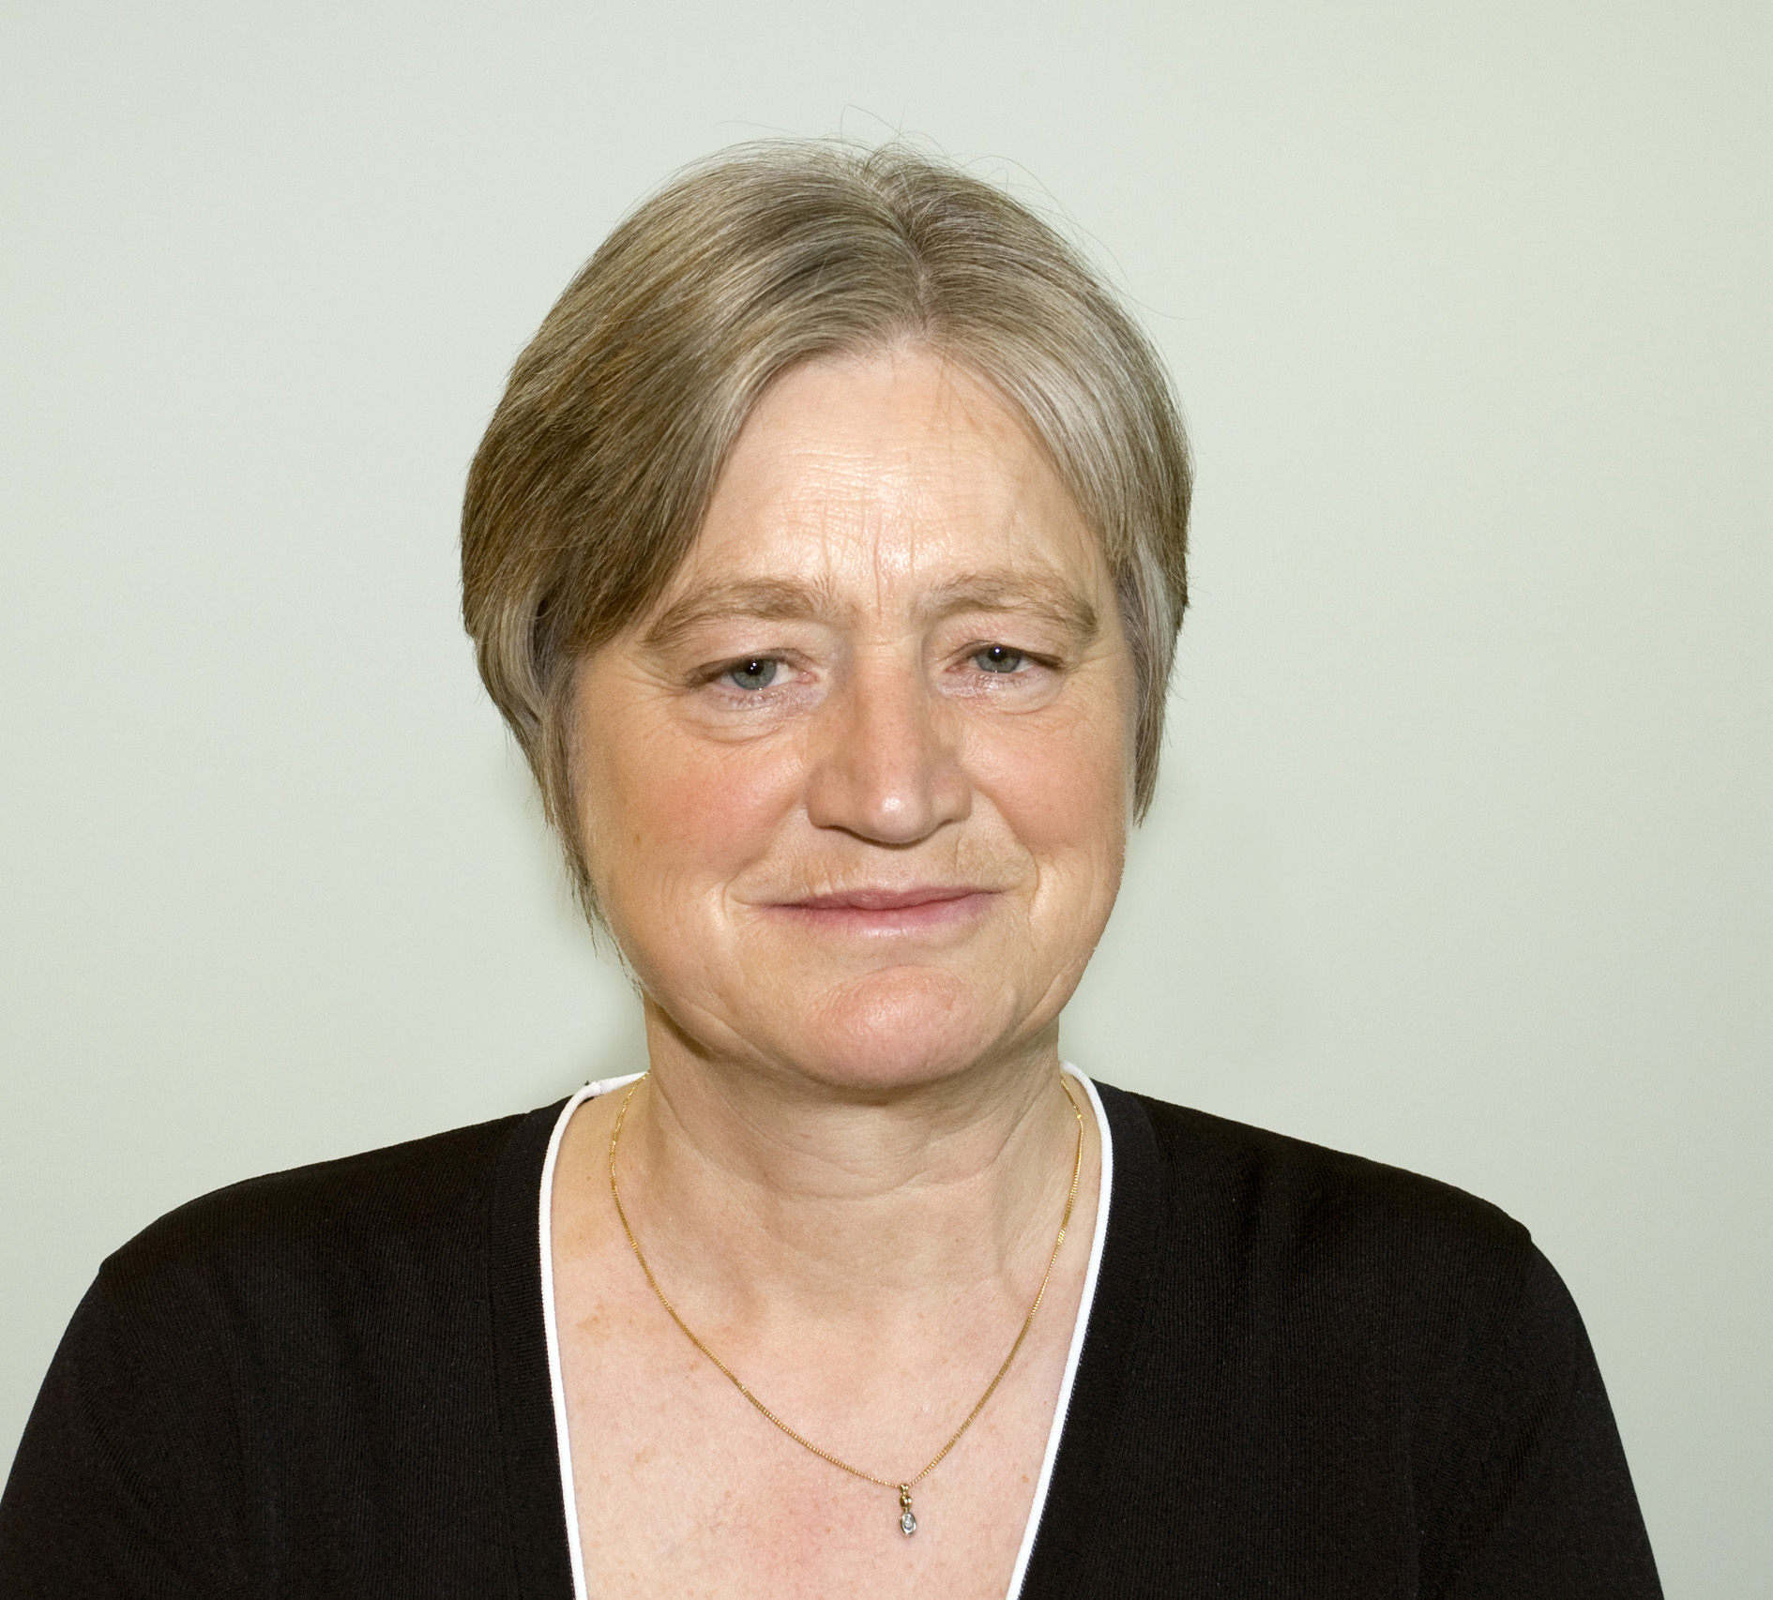
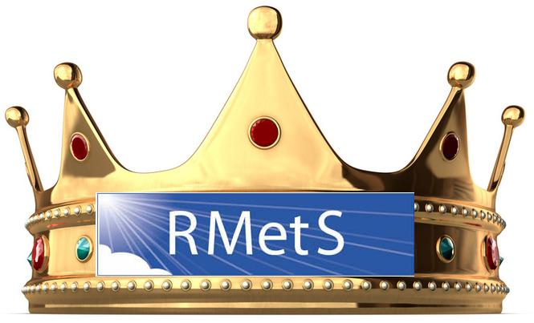




Notes:
Click to start phone ring. Click again to start the mouth movement

Slide 72
Notes:
Click to start animation of van going back to uk

Slide 74


Slide 76


Slide 77
Notes:
Met dept with No Snow

Slide 78
Notes:
Change of scene -> Scene 8

Slide 79
Notes:
M’s office. Click for bungee animation

Slide 80



Slide 81
Notes:
M’s office. Next slide is lift with open doors.

Slide 82
Notes:
Click to close doors and sound

Slide 84








James Sonde, found a licence to spill
Upon departmental paper
And then, Robin, tried to show them who’s boss
There were no clues, bar the fact that it was
This was, just a clever smokescreen
Stephen Gill, that man really cares
Jeffrey Chagnon, was his partner and more
To let, Bob Plant, build a weather machine
But he, tripped on, Stephen Gill’s safety tape
And he fell in red hot magma
We’ve all been saved by the Health and Safety
We owe our lives to the Health and Safety
We owe our lives to the Health and Safety
Yellow tape around everything
Janet, tried to foil him with moths
And then, Jonathan, trapped them in lift with Ross
But James Sonde outwitted them all...
Giles, he had, gadgets galore
Health and Safety is our saviour
We’ve all been saved by the Health and Safety
We owe our lives to Health and Safety
Stephen Gill, that man really cares
Health and Safety
From the snow on the trees, to the falling buildings
It gave, BP, the permission to drill
We don’t get R.S.I., we don’t slip on the stairs
Health and Safety
From the snow on the trees, to the falling buildings
But there’s, one thing, we must bring to the fore,
We don’t get R.S.I., we don’t slip on the stairs
We owe our lives to Health and Safety
Yellow tape around everything
Notes:
Final Song

Slide 85

it was ice knowing y’all

