Slide 1
Guide for operational procedure
Spatial Data
Version 2
By Simone Kotthaus
Reviewed and updated by Duick Young 11th July 2010
Version 1 created 02/06/2009 – located in instrument archive

Slide 2
Web
OTAGO
I:\YYYY\London\ALL\
Meteorological Observations in Greater London
SpatialGetA[half hourly task: hh:17, hh:47]
AGeneral.m:
Grab 30min A-data, appends to daily file
Check for missing values
Extract one specified parameter, interpolates to 15 min resolution (+ standard deviation and quality flag)
Write to an external file including all stations
\spatial_V2\A\A#code\codeYYYYDOY.txt
\spatial_V2\parameter\A\ave\AYYYYDOY_15.txt
\spatial_V2\parameter\A\std\AYYYYDOY_15.txt
\spatial_V2\parameter\A\flag\AYYYYDOY_15.txt
A
http://weather.noaa.gov/index.html
B
http://www.wunderground.com
C
http://weather.lgfl.org.uk
D
http://www.londonair.org.uk
dailyplotspatial.m:
Temporal QCQA
Temporal daily plot
Spatial plots for each 15 min period
Yesterday’s data from sources A, B, C
Data from today-14 from all sources
\spatial_V2\Diagnostics\QCQAinfoYYYYDOY_a.txt
\spatial_V2\Diagnostics\QCQAinfoYYYYDOY_b.txt
\spatial_V2\parameter\plots\SpatailYYYYDOY_a.jpg
\spatial_V2\parameter\plots\SpatailYYYYDOY_b.jpg
\spatial_V2\parameter\plots\MM\SpatailYYYYDOYHH_a.jpg
\spatial_V2\parameter\plots\MM\SpatailYYYYDOYHH_b.jpg
SplatialGetBC [daily task: 00:40]
BGeneral.m, CGeneral.m, DGeneral.m:
Save raw data for source B and D
Write formatted daily files for sources B, C, D
Check data from source C for missing values
Extract one specified parameter, interpolates/averages to 15 min resolution (+ standard deviation and quality flag)
\spatial_V2\source\source#\codeYYYYDOY.txt
\spatial_V2\source\source#\codeYYYDOY_raw.txt
\spatial_V2\parameter\source\ave\sourceYYYYDOY_15.txt
\spatial_V2\parameter\source\std\sourceYYYYDOY_15.txt
\spatial_V2\parameter\source\flag\sourceYYYYDOY_15.txt

Slide 3
back
Collected Parameters
Wind Direction [ °]
Wind Speed [m/s]
Air Temperature [°C]
Dew Point [°C]
Relative Humidity [%]
Barometric Pressure [hPa]
Precipitation [mm/h]
Incoming Solar Radiation [W/m^2]

Slide 4
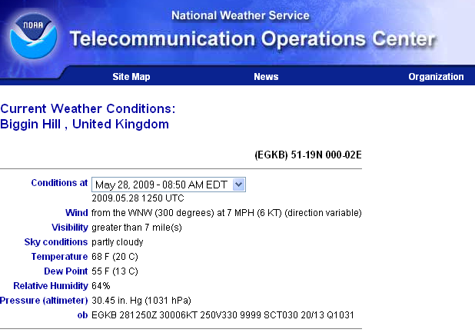
WMO – certified weather stations, gathered on NOAA website
back
data
7 stations
Webpage updated every 30min
One page per station including all available parameters

Slide 5
Private weather stations provide data to “Weather Underground”
back
Important information
64 stations
Webpage with daily data of all parameters in CSV-format

Slide 6
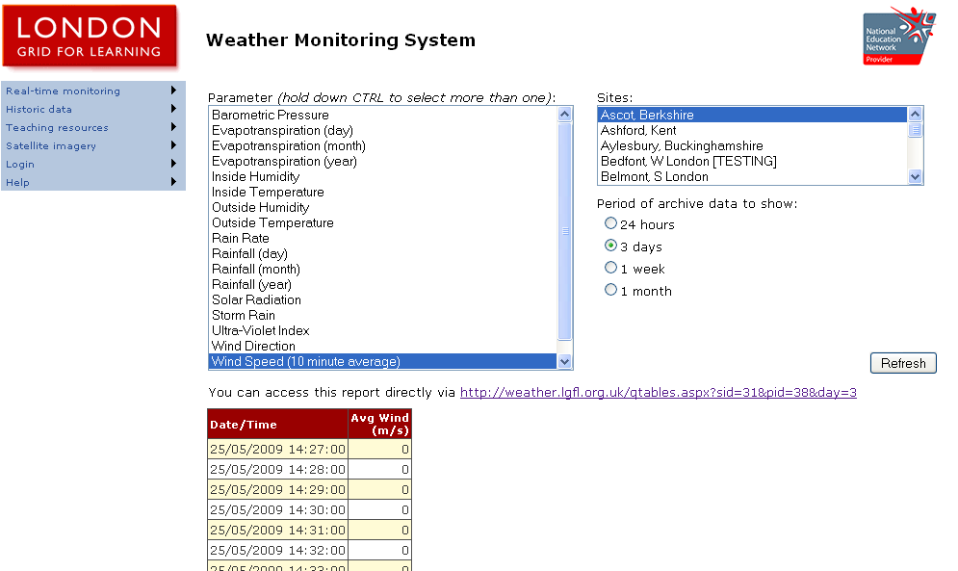
Private weather stations provide data to “London Grid for Learning”
back
Select “3 days” and read second day
data
25 stations
Webpage updated every min

Slide 7
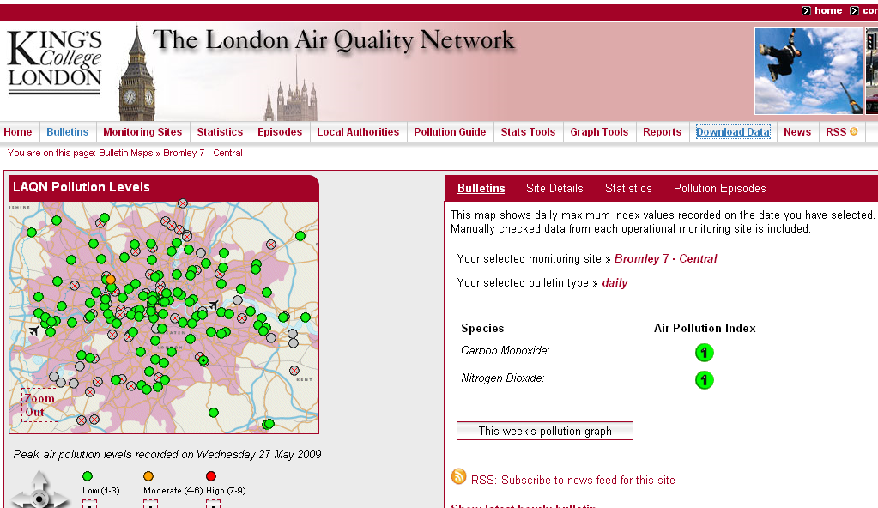
Quality controlled automatic weather stations, operated by The London Air Quality Network
51 stations
Daily file including all parameters of one station can be downloaded directly (‘wget’)
Due to quality control performed by LAQN, data are available with delay of 14 days
back

Slide 8
File convention for data files stored in
I:\YYYY\London\ALL\spatial_V2\$source\$source$sitenumber\
File name structure$CODEYYYYDDD.txt
Missing Value: -99
Three header lines:
%sitenameFile Created: $time
%Created by programnameSource: webpage
%yr|mo|d|hr|min|DOY|dectime|dir(°)|U(m/s)|U10(m/s)|Tair(°C)|Tdew(°C)|RH(%)|p(hPa)|precip(mm/h)|Kdn(W/m^2)
Column Variable Units
1 Year
2 Month
3 Day
4 Hour
5 Minute
6 DOY
7 Decimal Time
8 Wind Direction °
9 Wind Speed m s⁻¹
10 Wind Speed 10min average m s⁻¹
11 Air Temperature °C
12 Dew Point Temperature °C
13 Relative Humidity %
14 Air Pressure hPa
15 Precipitation mm/h
16 Incoming Solar Radiatioon W/m^2
back

Slide 9
File convention for data files stored in
I:\YYYY\London\ALL\spatial_V2\$parameter\$source\ave\$sourceYYYYDDD_15.txt
I:\YYYY\London\ALL\spatial_V2\$parameter\$source\std\$sourceYYYYDDD_std.txt
I:\YYYY\London\ALL\spatial_V2\$parameter\$source\flag\$sourceYYYYDDD_flag.txt
File name structure
Missing Value: -99
Temporal resolution: 15 min
Three header lines:
%$parameter for $number-of-stations stations (for station-info see siteDetails)
%File Created:$time by $programname
%yr|mo|d|hr|min|dectime|
Column Variable
1 Year
2 Month
3 Day
4 Hour
5 Minute
6 Decimal Time
7 $parameter
… …
$number-of-stations
Flag
1 100 % data availability for 15 min average
2 >= 50 % data availability for 15 min average
3 <50 % data availability for 15 min average
4 0% data availability for 15 min average
5 Inactive site
back

Slide 10
Quality Control / Quality Assurance (temporal)
Physically reasonable? Fixed barriers specified for each parameter in parameterDetails.m
Calculate average and standard deviation of all stations for each time step, value is neglected if it exceeds 2.4 x std
Comparison of values of consecutive time steps to delete constant values or too sharply in-/decreasing values (physically reasonable gradient is given in parameterDetails.m)
Interpolation for data gaps of single 15min period
Calculate mean daily value of all stations and standard deviation between stations averaged over all time steps as well as absolute minimum and maximum values
Quality Control / Quality Assurance (spatial)
Identify areas with scarce coverage
Evaluate importance of individual stations
…
back

