Slide 1
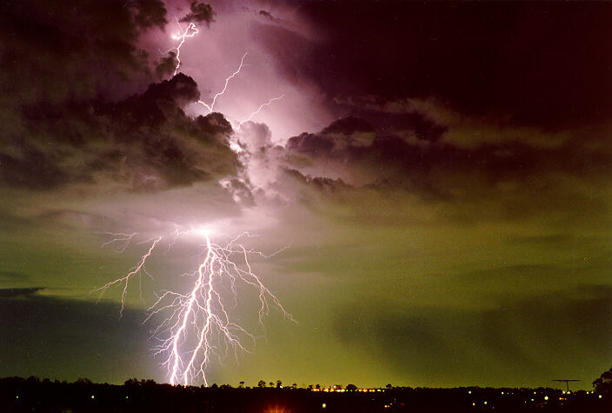
How do thunderstorms work?
Robin Hogan
Department of Meteorology
University of Reading

Slide 2
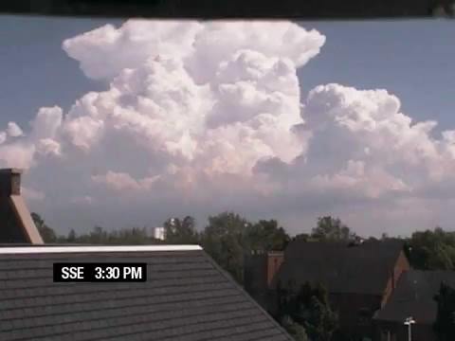

Slide 3
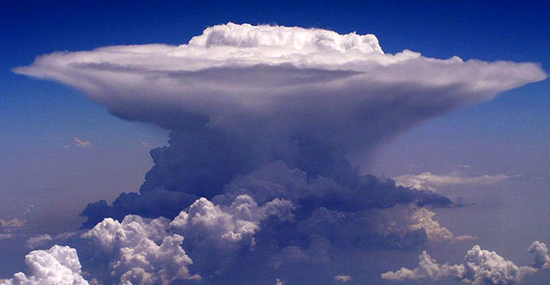
Cumulonimbus cloud
Updraft of 20-50 miles per hour
What’s a cloud made of?
What makes the air rise?
Notes:
Remove bits; what’s a cloud made of

Slide 4
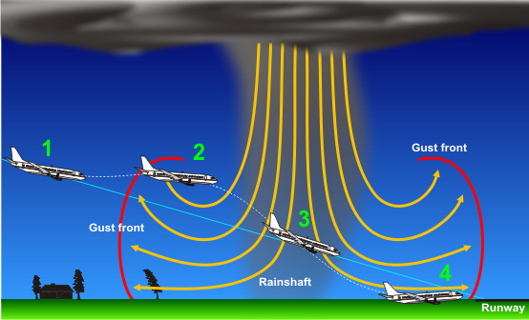
Downbursts
Falling rain drags the air down with it

Slide 5
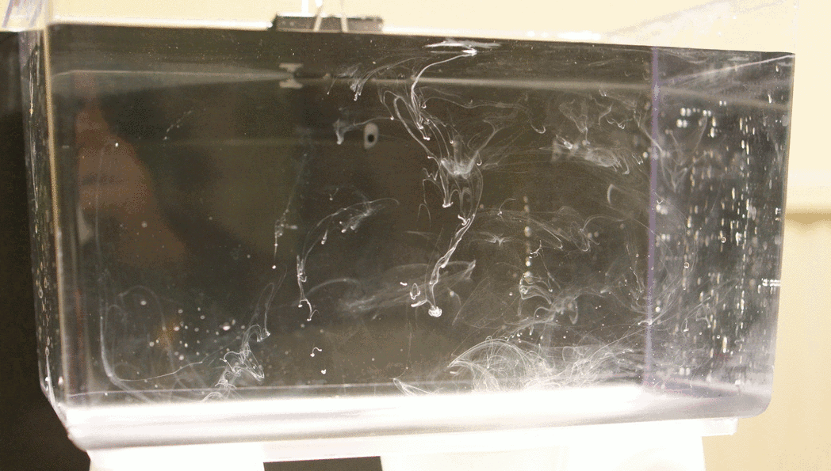
Experiment 1:
A thunderstorm made of cream

Slide 6
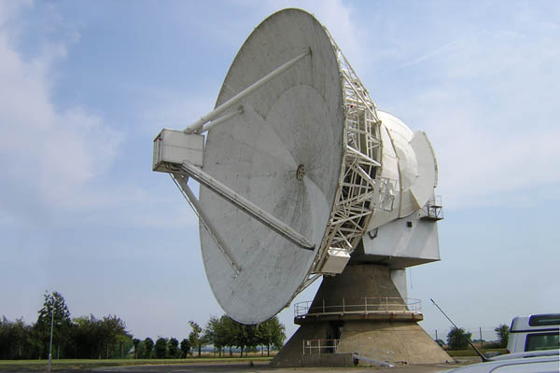
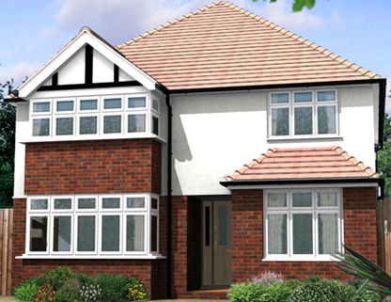
Observing thunderstorms with the Chilbolton radar
25 m

Slide 7
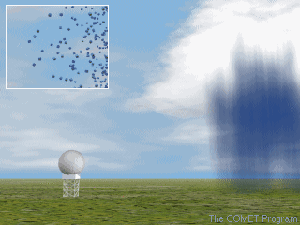

How does a radar work?

Slide 8
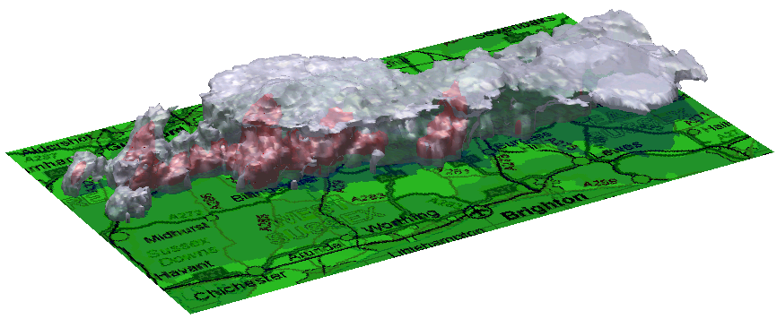
A line of storms observed by the radar
Middle-aged storm
Old storm
Young storm
70 km
28 July 2000

Slide 9
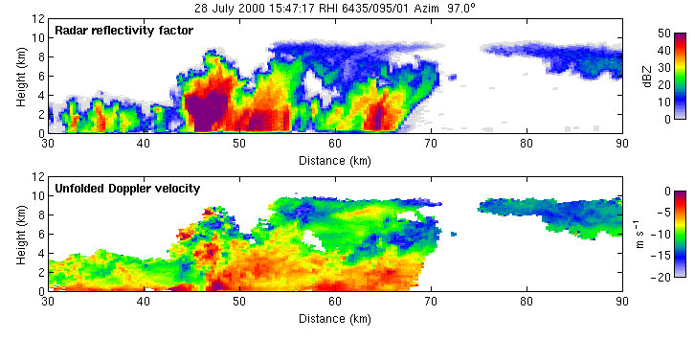
Watching storms grow
Red: Heavy rain
Blue: Cloud

Slide 10
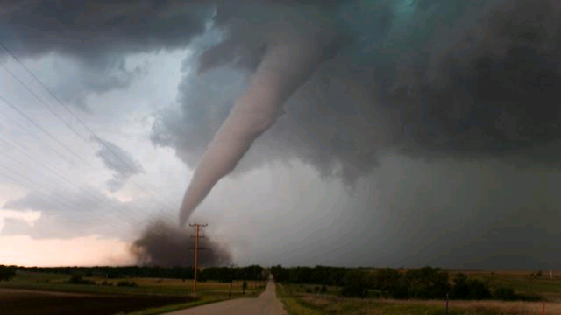
Tornado!
UK has around 33 tornados per year
For its land area, this is highest in the world!
Don’t worry: almost all are F2 or lower

Slide 11
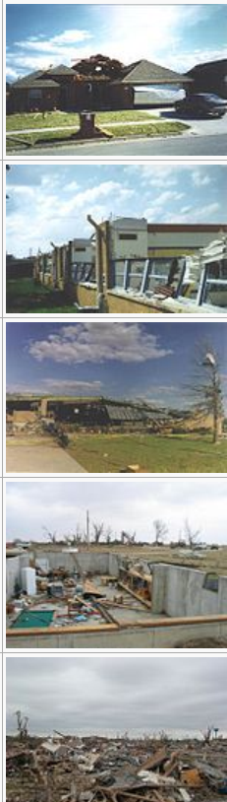
Fujita scale for tornado intensity
F1: 86-110 mph
F2: 111-135 mph
F3: 136-165 mph
F4: 166-200 mph
F5: more than 200 mph

Slide 12
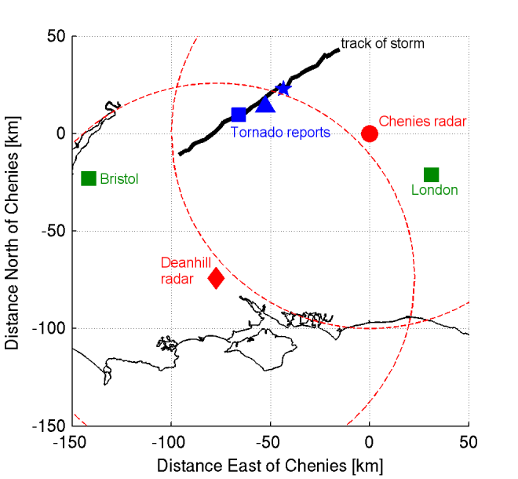
Tornado in England, 7 May 2012

Slide 13
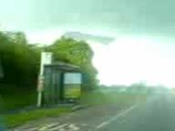

Slide 14
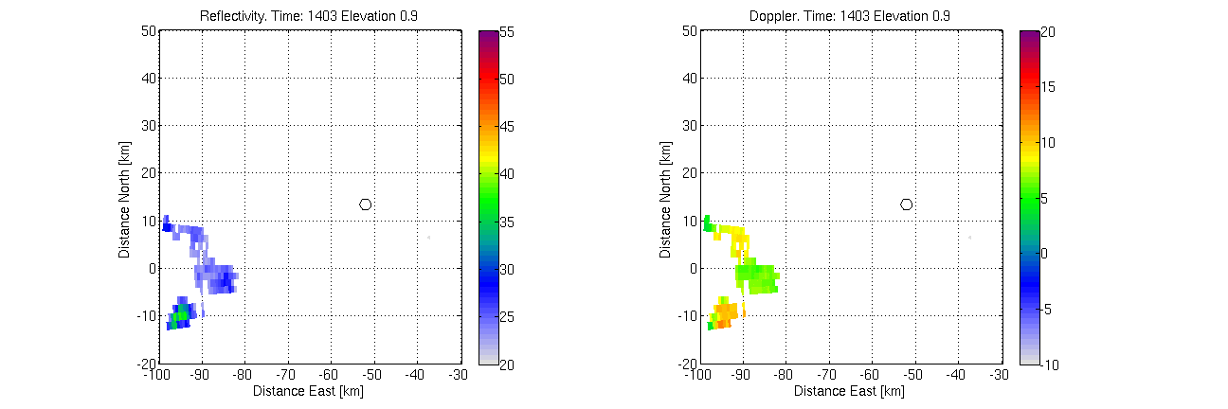
Radar observations of the storm
Using radar at “Chenies”: 10 miles from St Albans
Kidlington
Experiment 2: Speed gun
Witney

Slide 15
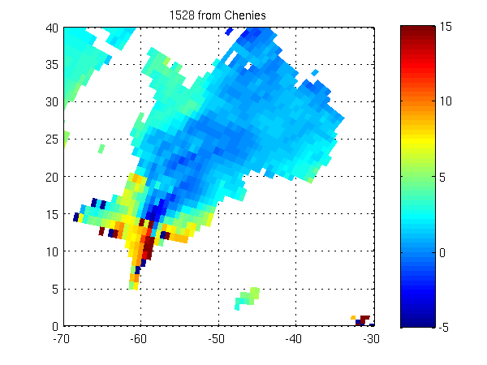
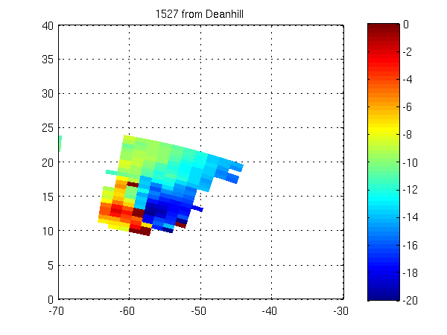
Wind speed from two radars
(max range of radar)
Looking from Chenies
Looking from Deanhill

Slide 16
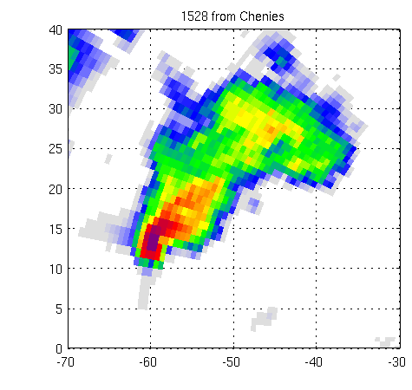
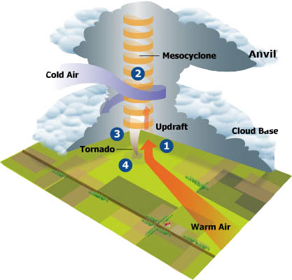
Strong rotation near the heavy rain: a tornado!

Slide 17
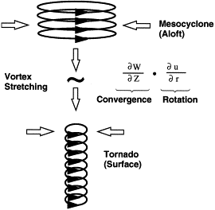
Why does a tornado form?
Stretching and squeezing a rotating column of air makes it speed up
Can you think of any other examples of this idea?
Strong updraft in thunderstorm stretches the column of air
Slow rotation
Rapid rotation (tornado)
Experiment 3: Tornado in a bottle

Slide 18
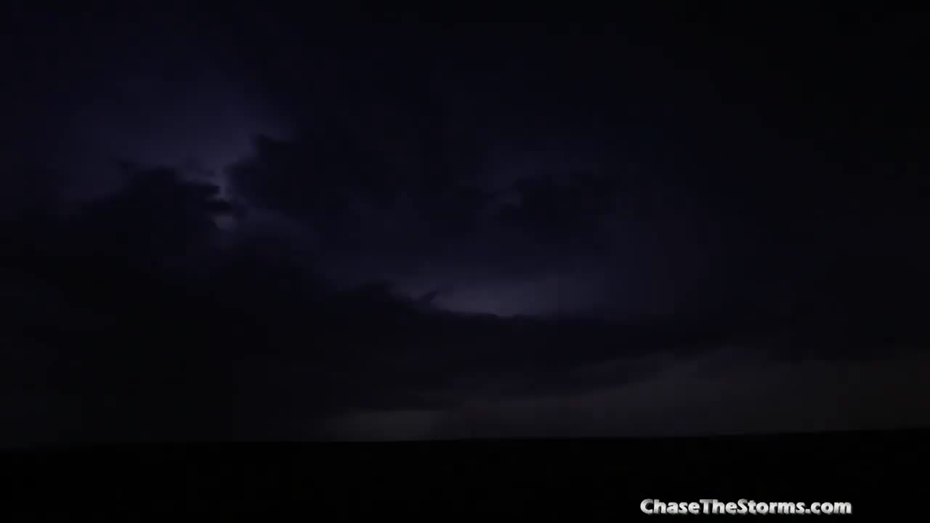
Lightning!

Slide 19
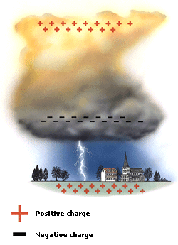
How does lightning form?
+
+
-
-
Hail hits ice crystals
Electrons move on to hail
Electrons go to ground in a lightning flash
Experiment 4:
Make lightning at home

Slide 20
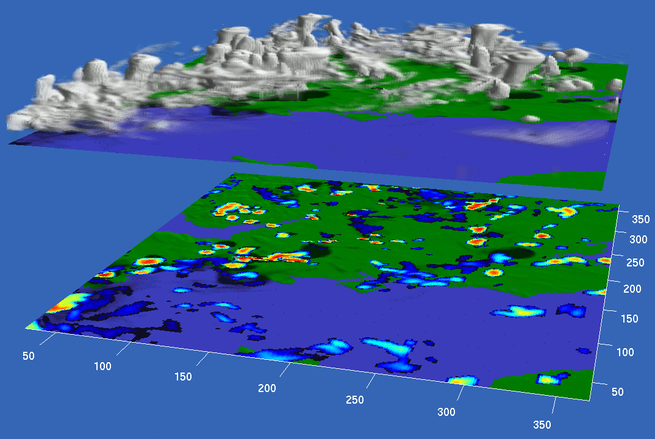
Computer simulation of thunderstorms

Slide 21


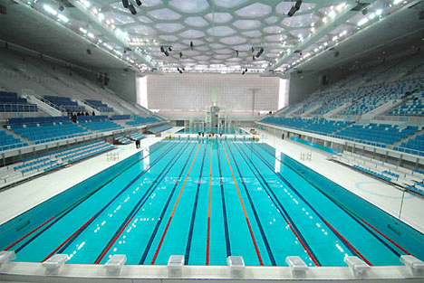
How much does a thunderstorm weigh?
Ice crystals: 800 swimming pools
Cloud droplets: 80 swimming pools
Rain: 200 swimming pools
Total: 1080 swimming pools
Ice crystals: 2,000,000,000 kg
Cloud droplets: 200,000,000 kg
Rain: 500,000,000 kg
Total: 2,700,000,000 kg
.
.
.
.
.
.
.
.
.
.
An Olympic-sized swimming pool
Notes:
Symbols, images simplify

Slide 22
Being a scientist is:
Exciting: discover things no-one knew before
Fun: doing experiments is fun!
Useful: better forecasts can save people’s lives
Employable: lots of well-paid jobs for scientists
Work hard at maths, science and computing
Read interesting science books
But you should:

