Slide 1

Can operator-overloading ever have a speed approaching source-code transformation for reverse-mode automatic differentiation?
Robin Hogan
Department of Meteorology
School of Mathematical and Physical Sciences
University of Reading

Slide 2
Source-code transformation versus operator overloading
Source-code transformation
  Generates quite efficient code (3-4 times original algorithm?)
  Most/all good tools are non-free (?)
  Limited or no support for modern language features (e.g. classes and C++ templates)
Operator overloading
  In principle can work with any language features
  Free C++ tools (e.g. ADOL-C, CppAD, Sacado)
  Not much available for Fortran for reverse mode
  Typically 10-35 times slower than the original algorithm!
This talk is about how to speed-up operator overloading in C++

Slide 3
Free C++ operator overloading tools
ADOL-C and CppAD for reverse-mode
  In the forward pass they store the whole algorithm symbolically
  Every operator and function needs to be stored symbolically (e.g. 0 for plus, 1 for minus, 42 for atan etc)
  Adjoint function (and higher-order derivatives) can then be generated
  Flexibility comes at the cost of speed
Sacado::Rad for reverse-mode
  Differential statements (only) are stored as a tree of elemental operations linked by pointers
Sacado::ELRFad for forward-mode
  (ELR = Expression-level reverse mode, Fad = Forward-mode auto. diff.)
  Use expression templates to optimize the processing of each expression
  But only works in forward-mode automatic differentiation (for n independent variables x, each intermediate variable q is replaced by an object containing the vector

Slide 4
Overview
Optimizing reverse-mode operator-overloading implementations
  Efficient tape structure to store the differential statements
  Efficient adjoint calculation from the tape
  Using expression templates to efficiently build the tape
  Other optimizations
Benchmark of a new, free tool “Adept” (Automatic Differentiation using Expression Templates) against ADOL-C, CppAD and Sacado
  Optimizing the computation of full Jacobian matrices
Remaining challenges

Slide 5
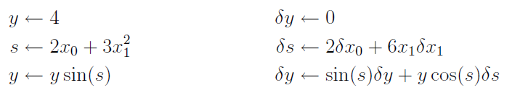
Simple example
Consider simple algorithm y(x₀, x₁) contrived for didactic purposes:
We want the automatic differentiation code to look like this:
double algorithm(const double x[2]) {
  double y = 4.0;
  double s = 2.0*x[0] + 3.0*x[1]*x[1];
  y *= sin(s);
  return y;
}
adouble algorithm(const adouble x[2]) {
  adouble y = 4.0;
  adouble s = 2.0*x[0] + 3.0*x[1]*x[1];
  y *= sin(s);
  return y;
}
// Main code
Stack stack; // Object where info will be stored
adouble x[2] = {…, …} // Set algorithm inputs
adouble y = algorithm(x); // Run algorithm and store info in stack
y.set_gradient(y_AD); // Set dJ/dy
stack.reverse(); // Run adjoint code from stored info
x_AD[0] = x[0].get_gradient(); // Save resulting values of dJ/dx0
x_AD[1] = x[1].get_gradient(); // ... and dJ/dx1
function algorithm(x) result(y)
implicit none
real, intent(in) :: x(2)
real :: y
real :: s
y = 4.0
s = 2.0*x(1) + 3.0*x(2)*x(2)
y = y * sin(s)
return
endfunction
Simple change: label “active” variables as a new type

Slide 6
Minimum necessary storage
What is minimum necessary storage for the equivalent differential statements?
If each gradient is labelled by a unique integer (since they’re unknown in forward pass) then we need to build two stacks:
Total of 120 bytes in this case
Can then run backwards through stack to compute adjoints
2
3
0
1
2
2
3
Statement stack
Operation stack
Index to LHS gradient (unsigned int) | Index to first operation (unsigned int)
2 (δy) | 0
3 (δs) | 0
2 (δy) | 2
… | …
# | Multiplier (double) | Index to RHS gradient (unsigned int)
0 | 2.0 | 0 (δx₀)
1 | 6.0x₁ | 1 (δx₁)
2 | sin(s) | 2 (δy)
3 | y cos(s) | 3 (δs)
4 | … | …

Slide 7
Adjoint algorithm is simple
Need to cope with three different types of differential statement:
  Reverse mode:
  Forward mode:
  General differential statement:
  Equivalent adjoint statements:
for i = 0 to n:

Slide 8
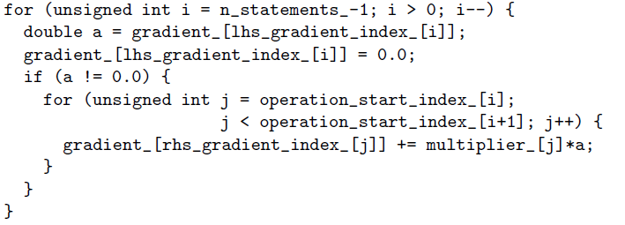
…which can be coded as follows
1. Loop over differential statements in reverse order
2. Save gradient
3. Skip if gradient equals 0 (big optimization)
4. Loop over operations
5. Update a gradient
This does the right thing in our three cases:
  Zero on RHS
  One or more gradients on RHS
  Same gradient on LHS and RHS

Slide 9
Computational graphs
Standard operator overloading can only pass information from the most nested operation outwards:
Differentiation involves passing information in opposite sense:
A node f(x) takes real number w and passes wdf/dx down the chain
operator*
  Pass y sin(s) to be new y
  Pass sin(s)
  Pass y
operator*
y
sin
  Pass value of sin(s)
y
sin
  Pass y cos(s)
  Add sin(s)δy to stack
s
s
  Add y cos(s)δs to stack

Slide 10
Solution using expression templates
C++ supports class templates
  A class template is a generic recipe for a class that works with an arbitrary type
  Veldhuizen (1995) used this feature to introduce Expression Templates to optimize array operations and make C++ as fast as Fortran-90 for array-wise operations
We use it as a way to pass information in both directions through the expression tree:
  sin(A) for an argument of arbitrary type A is overloaded to return an object of type Sin<A>
  operator*(A,B) for arguments of arbitrary type A and B is overloaded to return an object of type Multiply<A,B>

Slide 11
Expression templates continued
The following types are passed up the chain at compile time:
Now when we compile the statement “y=y*sin(x)”:
  The right-hand-side resolves to an object “RHS” of type Multiply<adouble,Sin<adouble> >
  The overloaded assignment operator first calls RHS.value() to get y
  It then calls RHS.calc_gradient(), to add entries to operation stack
  Multiply and Sin are defined with calc_gradient() member functions so that they can correctly pass information up and down the expression tree
  Multiply<adouble,Sin<adouble> >
operator*
  adouble
  Sin<adouble>
y
sin
  adouble
s

Slide 12
Implementation of Sin<A>
// Definition of Sin class
template <class A>
class Sin : public Expression<Sin<A> > {
public:
// Member functions
// Constructor: store reference to a and its numerical value
Sin(const Expression<A>& a)
: a_(a), a_value_(a.value()) { }
// Return the value
double value() const
{ return sin(a_value_); }
// Compute derivative and pass to a
void calc_gradient(Stack& stack, double multiplier) const
{ a_.calc_gradient(stack, cos(a_value_)*multiplier); }
private:
// Data members
const A& a_; // A reference to the object
double a_value_; // The numerical value of object
};
// Overload the sin function: it returns a Sin<A> object
template <class A>
inline
Sin<A> sin(const Expression<A>& a)
{ return Sin<A>(a); }
…Adept library has done this for all operators and functions

Slide 13
Optimizations
Why are expression templates fast?
  Compound types representing complex expressions are known at compile time
  C++ automatically inlines function calls between objects in an expression, leaving little more than the operations you would put in a hand-coded application of the chain rule
Further optimizations:
  Stack object keeps memory allocated between calls to avoid time spent allocating incrementally more memory
  The current stack is accessed by a global but thread-local variable, rather than storing a link to the stack in every adouble object (as in CppAD and ADOL-C)

Slide 14
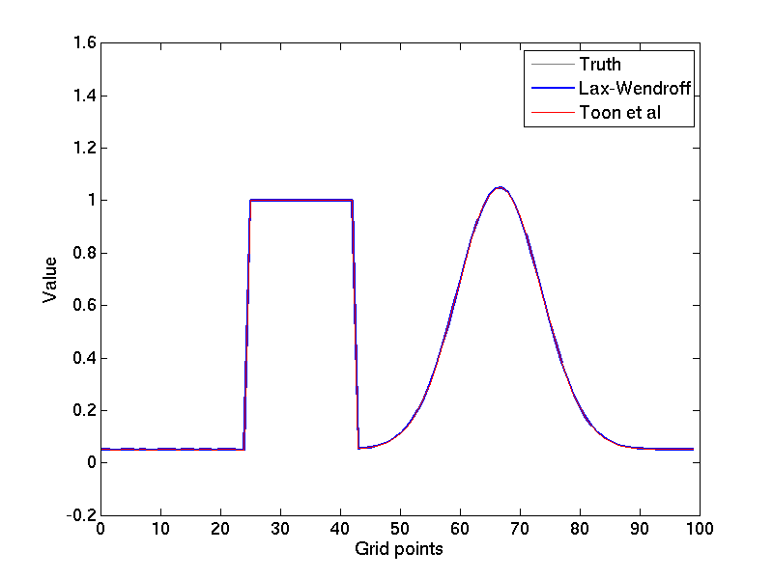
Algorithms 1 & 2: linear advection
One simple PDE (the speed c is a constant):

Slide 15
Algorithm 1: Lax-Wendroff
Lax and Wendroff (Comm. Pure Appl. Math. 1950):
#define NX 100
void lax_wendroff(int nt, double c, const adouble q_init[NX], adouble q[NX]) {
adouble flux[NX-1]; // Fluxes between boxes
for (int i=0; i<NX; i++) q[i] = q_init[i]; // Initialize q
for (int j=0; j<nt; j++) { // Main loop in time
for (int i=0; i<NX-1; i++) flux[i] = 0.5*c*(q[i]+q[i+1]
+ c*(q[i]-q[i+1]));
for (int i=1; i<NX-1; i++) q[i] += flux[i-1]-flux[i];
q[0] = q[NX-2]; q[NX-1] = q[1]; // Treat boundary conditions
}
}
This algorithm is linear and uses no mathematical functions
This algorithm has 100 inputs (independent variables) corresponding to the initial distribution of q, and 100 outputs (dependent variables) corresponding to the final distribution of q

Slide 16
Algorithm 2: Toon et al.
Toon et al. (J. Atmospheric Sci. 1988):
#define NX 100
void toon_et_al (int nt, double c, const adouble q_init[NX], adouble q[NX]) {
adouble flux[NX-1]; // Fluxes between boxes
for (int i=0; i<NX; i++) q[i] = q_init[i]; // Initialize q
for (int j=0; j<nt; j++) { // Main loop in time
for (int i=0; i<NX-1; i++) flux[i] = (exp(c*log(q[i]/q[i+1]))-1.0)
* q[i]*q[i+1] / (q[i]-q[i+1]);
for (int i=1; i<NX-1; i++) q[i] += flux[i-1]-flux[i];
q[0] = q[NX-2]; q[NX-1] = q[1]; // Treat boundary conditions
}
}
This algorithm assumes exponential variation of q between gridpoints (appropriate for certain types of tracer transport)
It is non-linear and calls the mathematical functions exp and log from within the main loop
Same number of independents and dependents as Algorithm 1

Slide 17
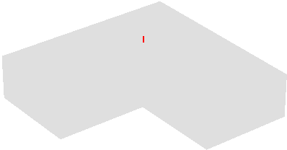
Real-world algorithms
How does a lidar/radar pulse spread through a cloud?
Algorithm 3: Photon Variance-Covariance method (PVC)
Algorithm 4: Time-dependent two-stream method (TDTS)
Hogan (J. Atmos. Sci. 2008)
  Treats small-angle scattering
  Solve four coupled ODEs
  Efficiency O(N ) where N is the number of points in the vertical
  5N independent variables
  N dependent variables
  We use N = 50
Hogan & Battaglia (J. Atmos. Sci. 2008)
  Treats wide-angle scattering
  Solve four coupled PDEs
  Efficiency O(N ²)
  4N independent variables
  N dependent variables
  We use N = 50

Slide 18
Computational cost: 1 & 2
Algorithm 1: Lax-Wendroff
Algorithm 2: Toon et al.
1.0
1.0
2.2
2.3
32
2.7
106
9.2
214
16
238
15
Time relative to original code for Linux, gcc-4.4, O3 optimization, Pentium 2.5 GHz, 2 MB cache
Lax-Wendroff: all AD tools are much slower than hand-coding!
  Because there are no mathematical functions, the compiler can aggressively optimize the loops in the original algorithm
Toon et al.: Adept is only a little slower than hand-coding, and significantly faster than ADOL-C, CppAD and Sacado::Rad

Slide 19
Computational cost: 3 & 4
Algorithm 3: PVC
Algorithm 4: TDTS
1.0
1.0
3.0
3.5
3.7
3.8
25
20
29
34
10
30
Similar results for the real-world algorithms as for Toon et al., since their loops also contain mathematical functions
Note that ADOL-C and CppAD can reuse the same tape but with different inputs (reverse pass only), while Adept and Sacado::Rad cannot
  Adept is typically still faster than the reverse-pass-only for ADOL-C and CppAD
  Note that tapes cannot be reused for any algorithm containing “if” statements or look-up tables

Slide 20
Memory usage per operation
For each mathematical operation (+, *, sin etc.), Adept stores the equivalent of around 1.75 double-precision numbers
Hand-coded adjoint can be much more efficient, and for linear algorithms like Lax-Wendroff, no data need to be stored!
ADOL-C and CppAD store the entire algorithm so require a bit more
Like Adept, Sacado::Rad stores only the differential information, but stores the equivalent of 10-15 double-precision numbers

Slide 21
Jacobian matrices
For n independent and m dependent variables, Jacobian is m×n
If m<n:
  Run the algorithm once to create the tape, followed by m reverse accumulations, one for each row of the matrix
  Optimization: if a strip of rows are accumulated together, compiler can optimize to take advantage of vectorization (SSE2) and loop unrolling
  Further optimization: parallelize the reverse accumulations
If m>n with a tape:
  Run the algorithm once to create the tape, followed by n forward accumulations, one for each column of the matrix
  The same optimizations are possible
If m>n without a tape (e.g. Sacado::ELRFad):
  Each intermediate variable q replaced by vector containing
  Jacobian matrix generated in a single pass

Slide 22
Benchmark using Toon et al.
Consider Toon et al. algorithm: 100x100 Jacobian matrix
Adept and Sacado::ELRFad are fastest overall
CppAD and Sacado::Rad treat one strip of the matrix at a time
  Their reverse accumulations are 100 times the cost of one adjoint
Adept and ADOL-C treat multiple strips at once
  They achieve a 3-5 times speed-up compared to the naive approach
Sacado::ELRFad is a very fast tapeless implementation
  Although Adept is faster for m < n
21
18
52
34
402
244
715 (Sacado::Rad)
20 (Sacado::ELRFad)

Slide 23
Summary and outlook
Can operator overloading compete with source-code transformation?
Yes, for loops containing mathematical functions
  An optimized operator-overloading implementation found to be 2.7-3.8 times slower than original algorithm (hand-coding was 2.3-3.5)
Not yet, for loops free of mathematical functions
  32 times slower (at best); one tool 240 times slower
Adept: free at http://www.met.reading.ac.uk/clouds/adept
  Significantly faster than other free operator-overloading tools tested
  No knowledge of templates required to use it!
Future work
  Merge Adept with matrix library using expression templates: potentially overcome slowness with loops containing mathematical functions?
  Complex numbers, higher-order derivatives
  Will Fortran have templates one day?
Hogan, R. J., 2014: Fast reverse-mode automatic differentiation using expression templates in C++. ACM Trans. Math. Softw., in review

Slide 25
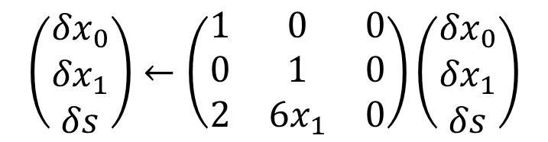
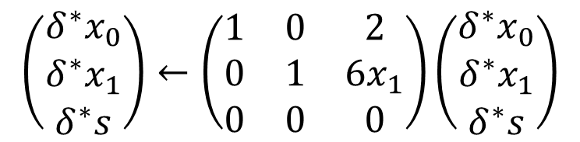
Creating the adjoint code 1
Differentiate the algorithm:
Write each statement in matrix form:
Transpose the matrix to get equivalent adjoint statement:
  Consider δy as the derivative of y with respect to something
  Consider δ∗y as dJ/dy

Slide 26
What is a template?
Templates are a key ingredient to generic programming in C++
Imagine we have a function like this:
We want it to work with any numerical type (single precision, complex numbers etc) but don’t want to laboriously define a new overloaded function for each possible type
Can use a function template:
double cube(const double x) {
  double y = x*x*x;
  return y;
}
template <typename Type>
Type cube(Type x) {
  Type y = x*x*x;
  return y;
}
double a = 1.0;
b = cube(a); // compiler creates function cube<double>
complex<double> c(1.0, 2.0); // c = 1 + 2i
d = cube(c); // compiler creates function cube<complex<double> >

Slide 27

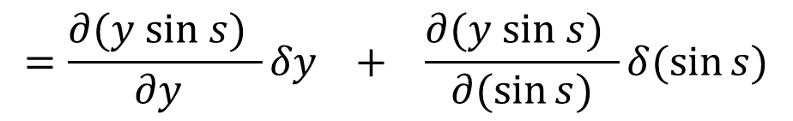
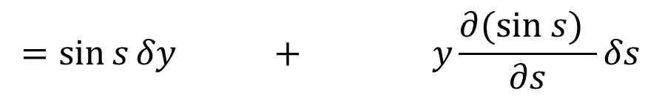

Implementing the chain rule
  Differentiate multiply operator
  Differentiate sine function

Slide 28
Computational graph
Differentiation most naturally involves passing information in the opposite sense
  Each node representing arbitrary function or operator y(a) needs to be able to take a real number w and pass wdy/da down the chain
  Binary function or operator y(a,b) would pass wdy/da to one argument and wdy/db to other
  At the end of the chain, store the result on the stack
  But how do we implement this?
operator*
  Pass sin(s)
  Pass y
y
sin
  Pass y cos(s)
  Add sin(s)δy to stack
s
  Add y cos(s)δs to stack

